Slide 1
ONLINE SYSTEM FOR DBU CONTINUING AND DISTANCE EDUCATION

Slide 2
FULL NAME…………………………………. ID NUMBER
TEKLAY TEKLU……………………………………………..Compr/137/03
ALEMU ENDALE…………………………………………..Compr/104/03
TESFA ADAMU…………………………………………….Compr/091/03
YARED DINKU……………………………………………..Compr/097/03
DIRB WORKU………………………………………………Compr/067/03
BRTUKAN MOGES……………………………………….Compr/062/03
Industrial project I
IT 4th Year Group-12

Slide 3
Presentation outline
Project title
Introduction
Motive to develop the system
Statement of the problem
Objective of the project
A) General objectives
B)Specific objective
Scope of the project
Methodology
Role player of the existing system

Slide 4
Work flow of existing system
Use-case diagram
Conceptual class diagram
Sequence diagrams
Activity diagram
Design of class diagram
Database design

Slide 5
Introduction
What is online distance education?
The ability of teaching and learning process without going to university, college and so on
Teachers and administrators want the teaching learning process to be easy, exciting and effective.
Allow educational institutions to utilize databases applications such as online registration, online uploading reading materials and post updated information thus making the accessing of records centralized.

Slide 6
Motivation
The reasons that motivated us to develop web-based system for Continuing and distance education
The system operated its task manually; because of this manual the office is suffered a lot of problems
To improve our knowledge regards to how to develop systems related to teaching and learning process
To provide alternative solutions with some prototype to the office.

Slide 7
Background
Debre Berhan University Continuing and Distance Education program established in 1999 e.c.
The office has paper-based or manually operated system.

Slide 8
Statement of the problem
Lack of security because there is no centralized database
Time consuming because of it is manually operated
Lack of consistency of data
Data redundancy
Loss of data because it is a paper based system or manually system

Slide 9
Objective of the project
I)General objective
The general objective of this study is to assess the possibility of developing a prototype for continuing and distance education system so as to solve the existing problems.
To understand how the Continuing and Distance Education working and acquiring knowledge on how to solve those current problems

Slide 10
II)Specific objective
Understanding the existing continuing and distance education system
Find out the requirement required to design the prototype
Design the proposed prototype for the existing system, based on the business rule
Implementing the desired system
Testing and validating the developed system
Organize the document so as to submit for evaluation purpose

Slide 11
Scope of the project
Though CDE office performs numerous activities, taking the time allotted to this project in to account only selected activities are going to be automated and implemented in this proposed system. Specifically the activities that are supposed to be automated are:
Online registration based on payment status
Distributing module online based on payment status
Distributing assignments for distance learners

Slide 12
Methodology
Data collection method
Development tools and languages
I)Data collection method
A) Interviewing
B)Document analysis

Slide 13
II) Development tools and languages
Front-end: PHP and Dreamweaver.
Back-end: MySQL database, Zamp server to configure a MySQL database
Server-side scripting: we will use PHP
Client-side scripting: java script, HTML
Power point and MS-word for presentation
Static webpage: CSS for page layout

Slide 14
Role players of the existing system
Student
Continuing and distance education office
Finance department
Registrar office

Slide 15
Role player description
1)Student
Applying to be registered
Collecting modules or reading materials
Collecting assignments
Take tutorial
Submit assignments
View grade
Receive degree certificate

Slide 16
Continuing and distance education
Assign instructors together with course coordinator
Preparing reading materials or modules
Distribute modules
Post Updated information
Post registration date
Receive registered students from registrar office
Duplicating modules
Assign instructors for a particular course
Controlling the overall teaching and learning process in all fields of studies.

Slide 17
Finance department
Process the payment
Checking the payment
Give receipts for those applicants

Slide 18
Office of registrar
Checking the receipts weather the applicant committed the expected payment.
Checking the applicants profile and perform registration.
Prepares report about registered students and submit to CDE office.
Registering student.
Preparing and giving student’s grade report.
Process withdrawal and give withdrawal form.
Preparing and giving degree certificate for students

Slide 19
Work flow of the existing system

Slide 20
Functional Requirements
Login the system: authorized user can login the system
The administrator manages user account including creating, updating and deleting user account.
Administrator upload module and assignment questions
download assignment answers submitted by students.
Students download module and assignment questions upload assignment answers.
Administrator Post updated information

Slide 21
Non-functional requirements
Non-functional requirements are requirement that specify criteria that can be used to judge the operation of a system rather than specific behaviors.
Security
User name and password
Session
Handling Exceptions
More user friendly
Performance

Slide 23
Conceptual class diagram

Slide 24
Sequence diagrams for upload module

Slide 25
Sequence diagram for login use-case
User
Main
Login link
Login form
Login controller
Database
Window (UI)
1: User activates UI ()
2. Select the login link ()
3: Display the login form ()
4. Fill user name and password ()
5. Submit ()
6. Validate ()
7. Try again ()
8. Step 5 continue ()
9. Check ()
10. Response ()

Slide 26
Activity diagram for upload assignment

Slide 27
Design of class diagram

Slide 28
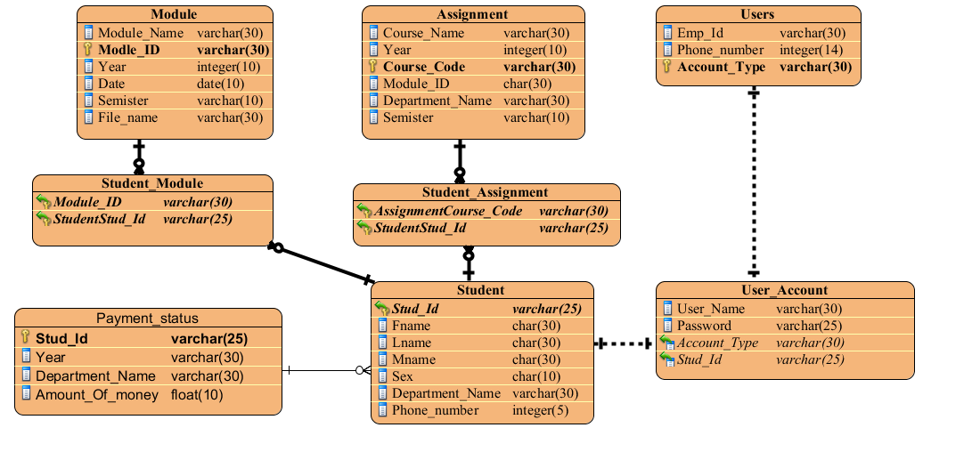
Database design

Slide 29
The End
Thank you !!

