Slide 1
ONLINE SYSTEM FOR DBU CONTINUING AND DISTANCE EDUCATION

Slide 2
FULL NAME…………………………………. ID NUMBER
TEKLAY TEKLU……………………………………………..Compr/137/03
ALEMU ENDALE…………………………………………..Compr/104/03
TESFA ADAMU…………………………………………….Compr/091/03
YARED DINKU……………………………………………..Compr/097/03
DIRB WORKU………………………………………………Compr/067/03
Final Industrial project
IT 4th Year Group-12

Slide 3
Presentation outline
Introduction
Objective of the project
I) General objectives
II)Specific objective
Scope of the project
Functional requirement
Use-case diagram
Class diagram
Database design
Component diagram
Deployment diagram

Slide 4
Introduction
What is online distance education?
The ability of teaching and learning process without going to university, college and so on
Teachers and administrators want the teaching learning process to be easy, exciting and effective.
Allow educational institutions to utilize databases applications such as online registration, online uploading reading materials and post updated information thus making the accessing of records centralized.

Slide 5
Objectives
I) General objective
The general objective of this project is to develop interactive web-based system in order to overcome the problems some subsystems with the existing system.

Slide 6
II) Specific objectives
To minimize work complexity of the existing system
To minimize cost of copying or duplicating materials
To reduce wastage of time to submit assignments
To enable new applicants online applying

Slide 7
Scope of the project
Online application
Distributing modules through internet
Submission of assignment via the internet
Distributing assignments for distance learners

Slide 8
Objective of the project
I)General objective
The general objective of this study is to assess the possibility of developing a prototype for continuing and distance education system so as to solve the existing problems.
To understand how the Continuing and Distance Education working and acquiring knowledge on how to solve those current problems

Slide 9
II)Specific objective
Understanding the existing continuing and distance education system
Find out the requirement required to design the prototype
Design the proposed prototype for the existing system, based on the business rule
Implementing the desired system
Testing and validating the developed system
Organize the document so as to submit for evaluation purpose

Slide 10
Functional Requirement
Login into the system; authorized user can login the system
Manage user’s account including creating and updating
Uploading modules and assignments; enable an administrator upload module and assignment questions as well as download assignment answers submitted by students.
Downloading modules and assignments; enable student to download module and download assignment questions.
Post updated information; for students such information is, registration date, changed policies in the distance education etc.
Online application to be registered

Slide 11
Use-case diagram design

Slide 12
Definition of class diagram
Class diagram is a graphical representation of the static view of the system and represents different aspects of the application. So a collection of class diagrams represent the whole system.
Has 3 parts
Class name
Attributes
And methods

Slide 13
Class diagram design

Slide 14
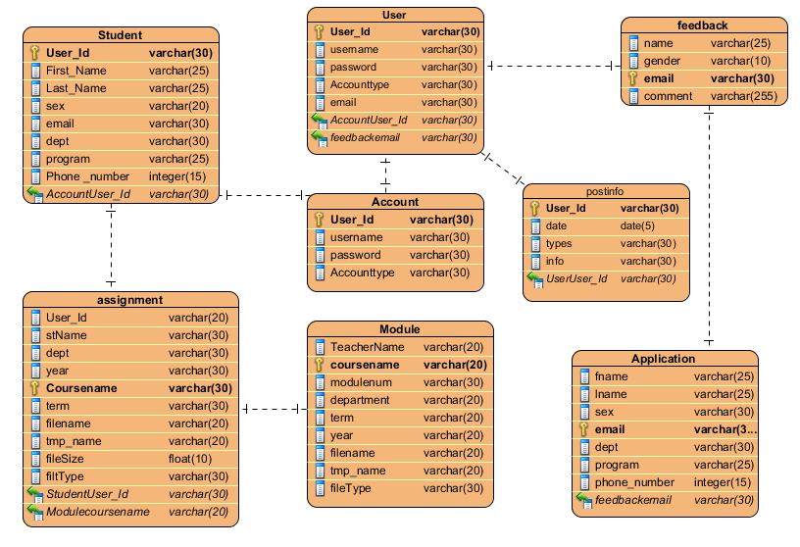
Database design

Slide 15
Definition Component diagram
A component is a container of logical elements and represents things that participate in the execution of a system. Components also use the services of other components through one of its interfaces.

Slide 16
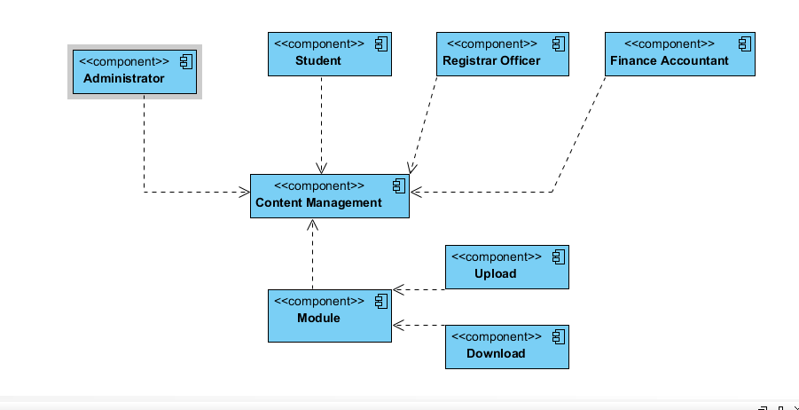
Component diagram design

Slide 17
Definition of Deployment
Deployment diagrams are used to visualize the topology of the physical components of a system where the software components are deployed.
Deployment diagrams are used for describing the hardware components where software components are deployed.

Slide 18
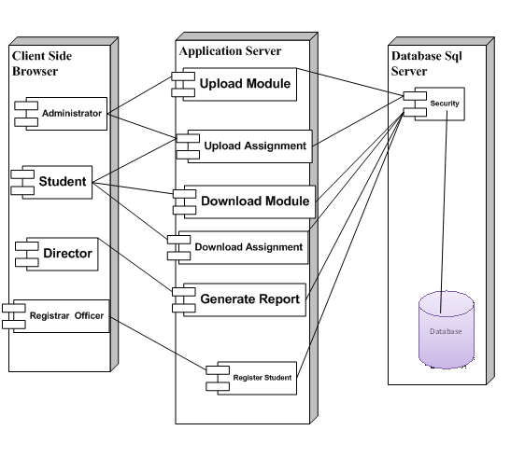
Deployment diagram design

Slide 19
The End
Thank you !!

