Slide 1


JustFind
(“Your only City Guide”)

Slide 2

Problem Statement:
Cities and urban areas witness a massive wave of people coming from every corner in search of jobs, education, and even a better lifestyle. In the initial days after the move, people don’t know the main facilities, attractions, and services offered in the city.

Slide 3
Abstract
The website should be able to provide visitors, students, and job
seekers information like hotels, renting facilities, transportation
services, healthcare services, airport info, shopping landmarks,
emergency helpline, and basically every information that one
needs when trying to settle in a new city.

Slide 4

Overview
Users can access site via Internet and browse web pages to
get the details they need. Users can see the entire overview of a
city along with the important landmarks. This will make their
movement across the city much more comfortable.

Slide 5
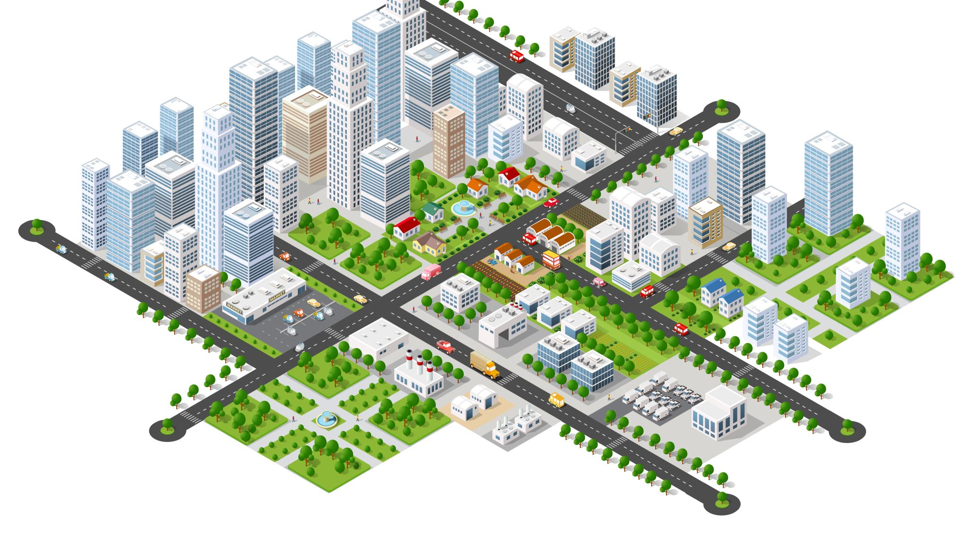
Objective & Scope
The primary motive of this project is to help tourists, visitors as well as local-residents of a city by providing information about hotels, transportation facilities, education facilities, shopping accessibility etc. & keep them updated with the same.

Slide 6
Existing v/s Proposed System
Existing System: In Existing system the person who are visiting a particular city need to gather information from the person who is staying in the city or take the help of the guide in the city. Gather of all these information you need to visit the city. This posses a lot of time and pre-planning. In order to get each piece of information we need to go for help desk.
Proposed System: The Proposed System provides an online information about the particular city going to visit. It also provides additional services to the registered user. The development of this new system contains the following activities, which try to automate the entire process keeping in the view of database integration approach.

Slide 7

Project Timeline
This Project will take 6 months to complete.
Timeline breakdown:
Nov-Dec 2021 - Resource Gathering, Planning and Research, Logical Design, Initial prototype.
Jan-Feb 2022 - Final Prototype. Feb-April 2022 - Development, Testing, Deployment
May-June 2022 - End user testing

Slide 8
Users of the System
As of now, the system only has two main users using it:
Admin: Managing website resources.
End User: consisting of local-residents, students, travelers, businessman, home-makers, etc.

Slide 9

Screenshots

Slide 10
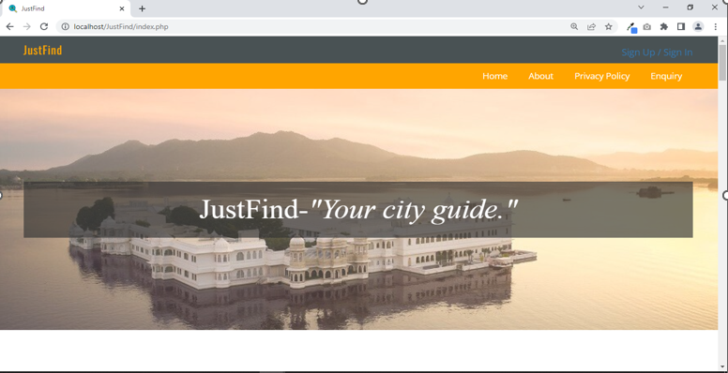
Home Page

Slide 11
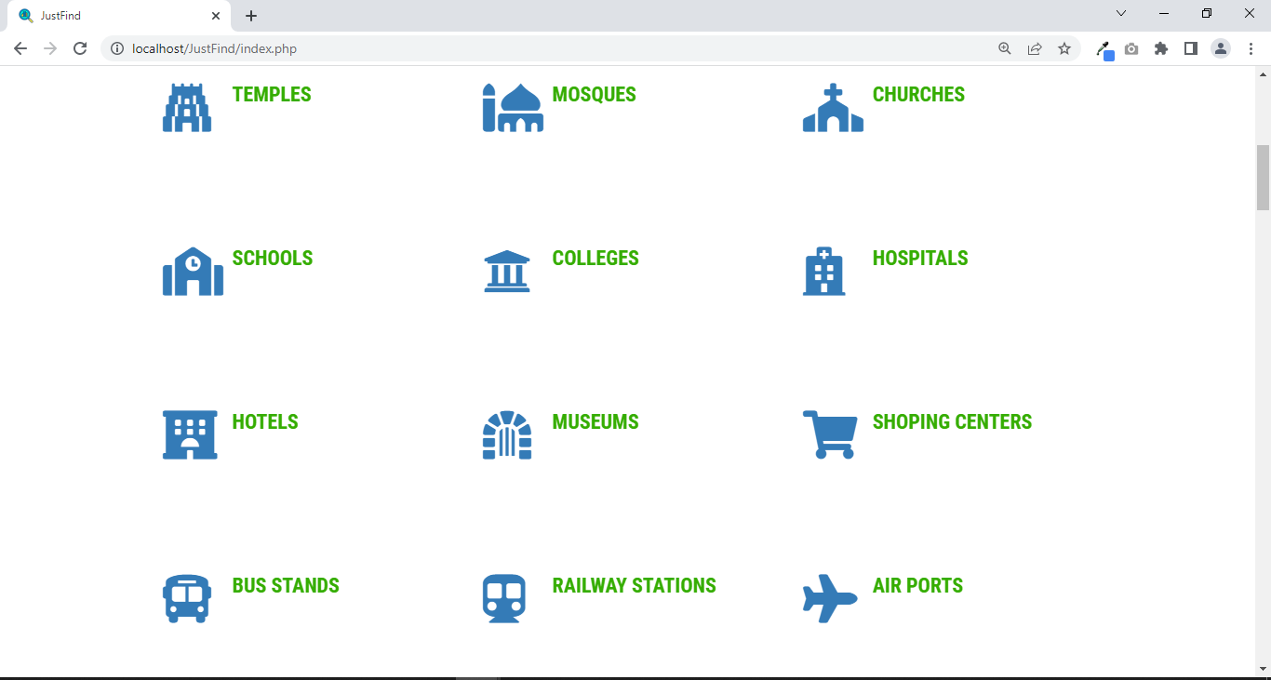
Places added & available to view:

Slide 12
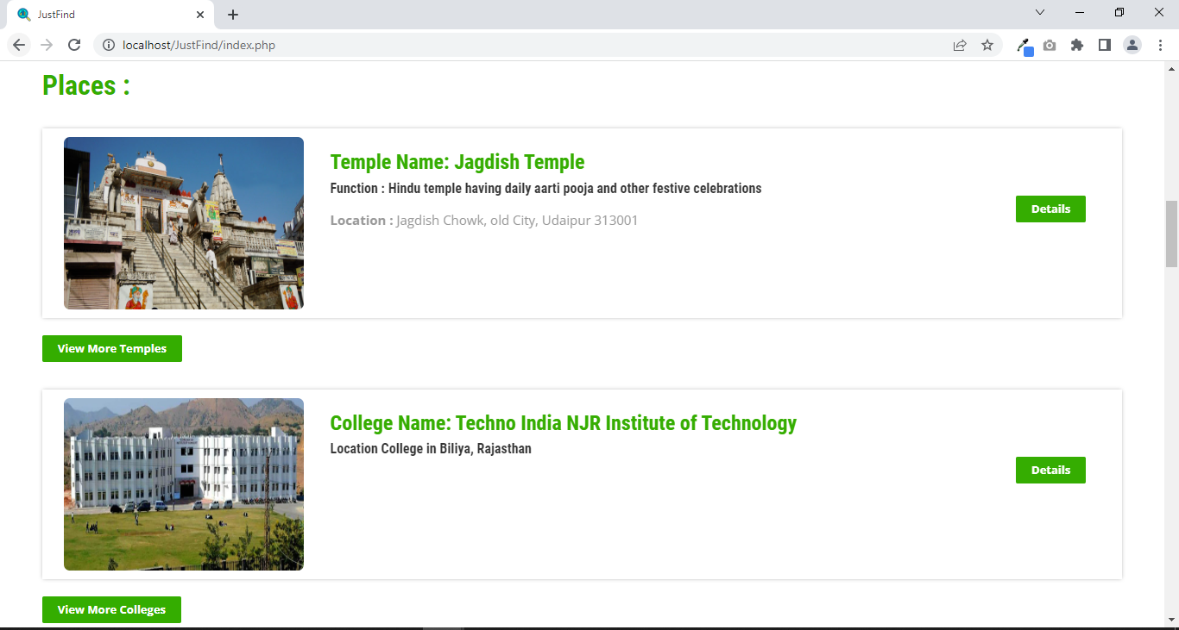
Landing page’ look n feel cont.

Slide 13
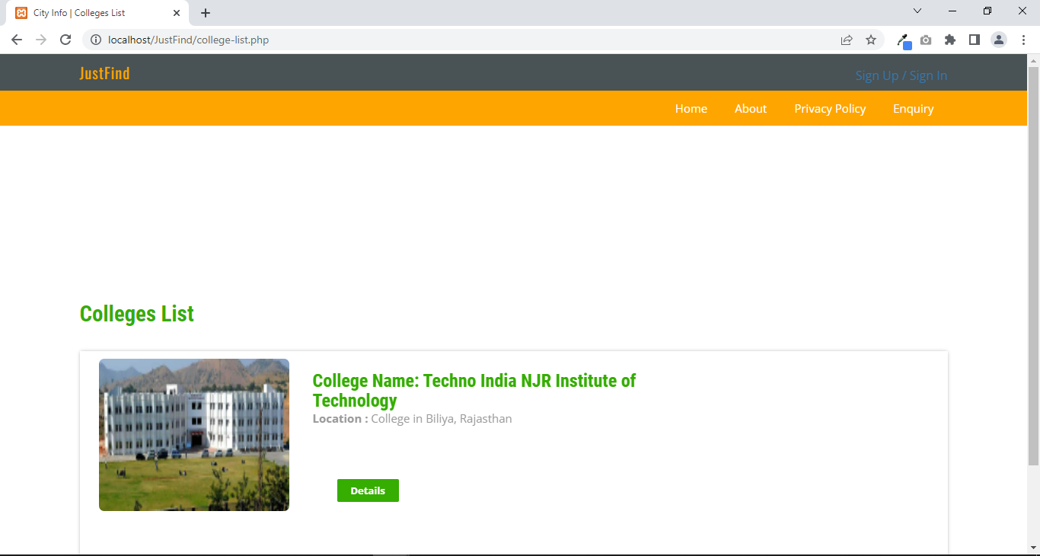
Exploring individual sections:

Slide 14
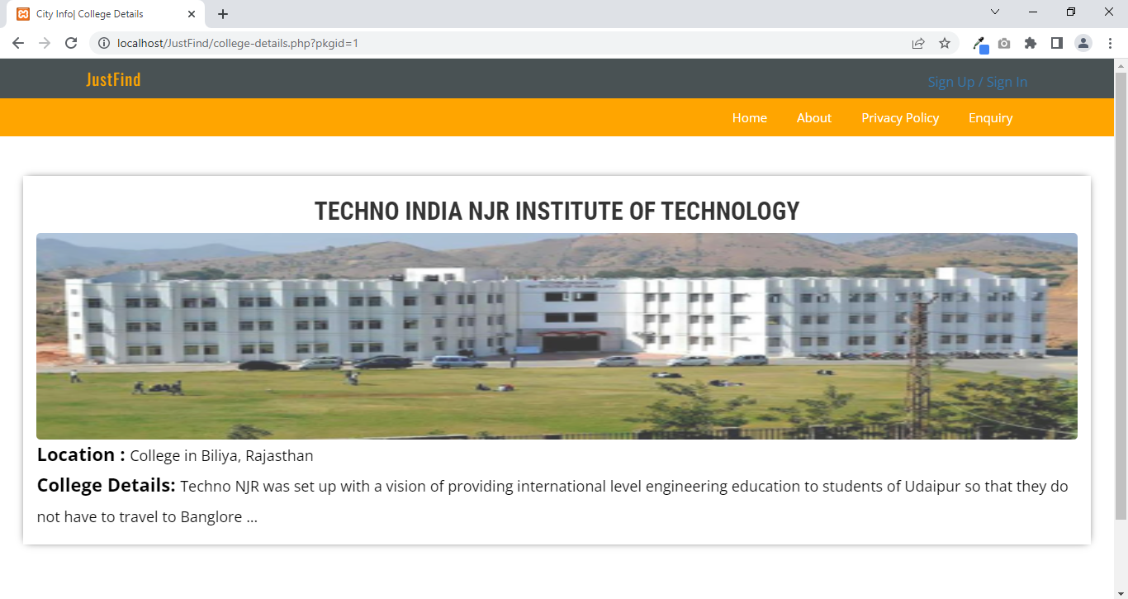
Cont.

Slide 15
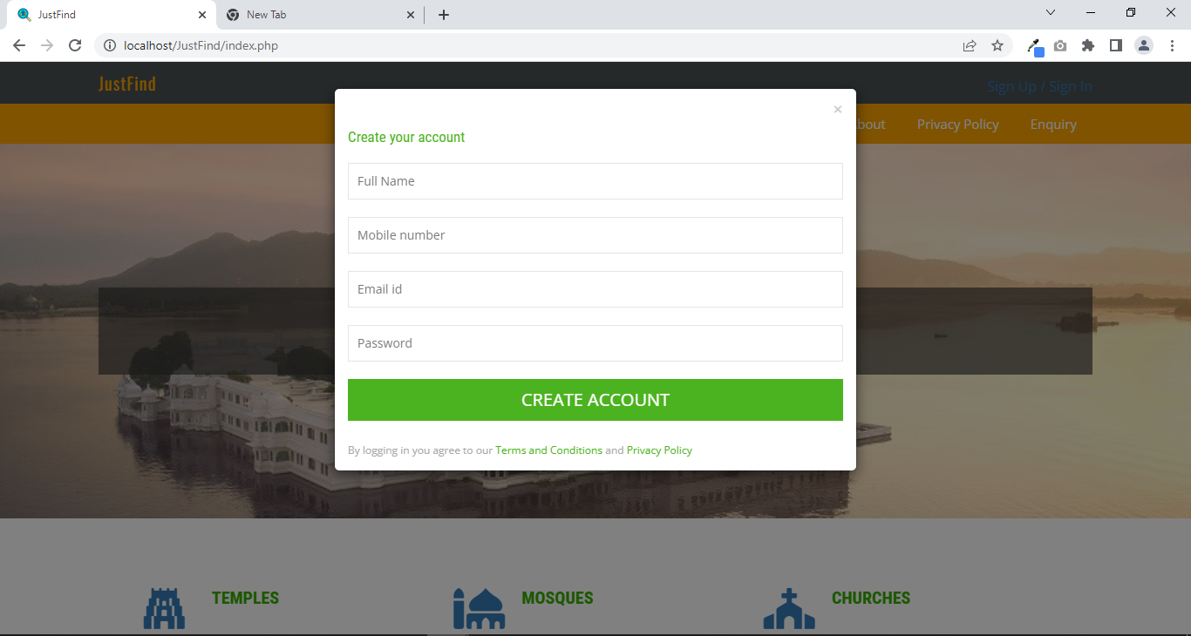
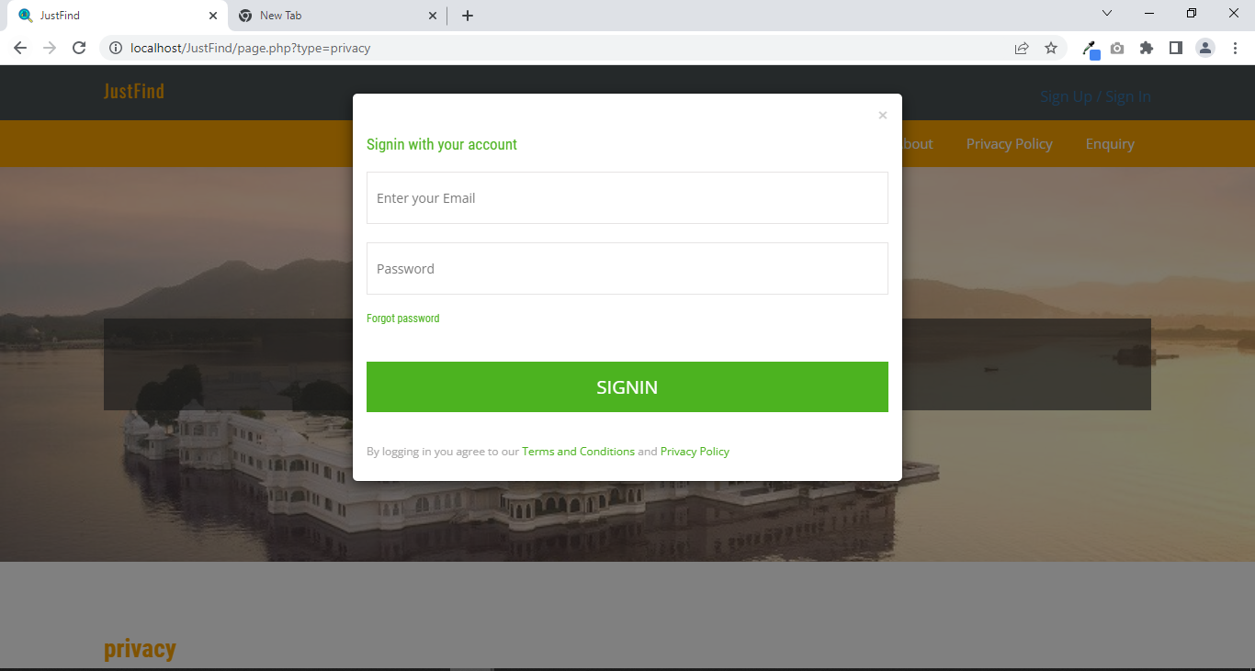
Sign up/ Sign in

Slide 16
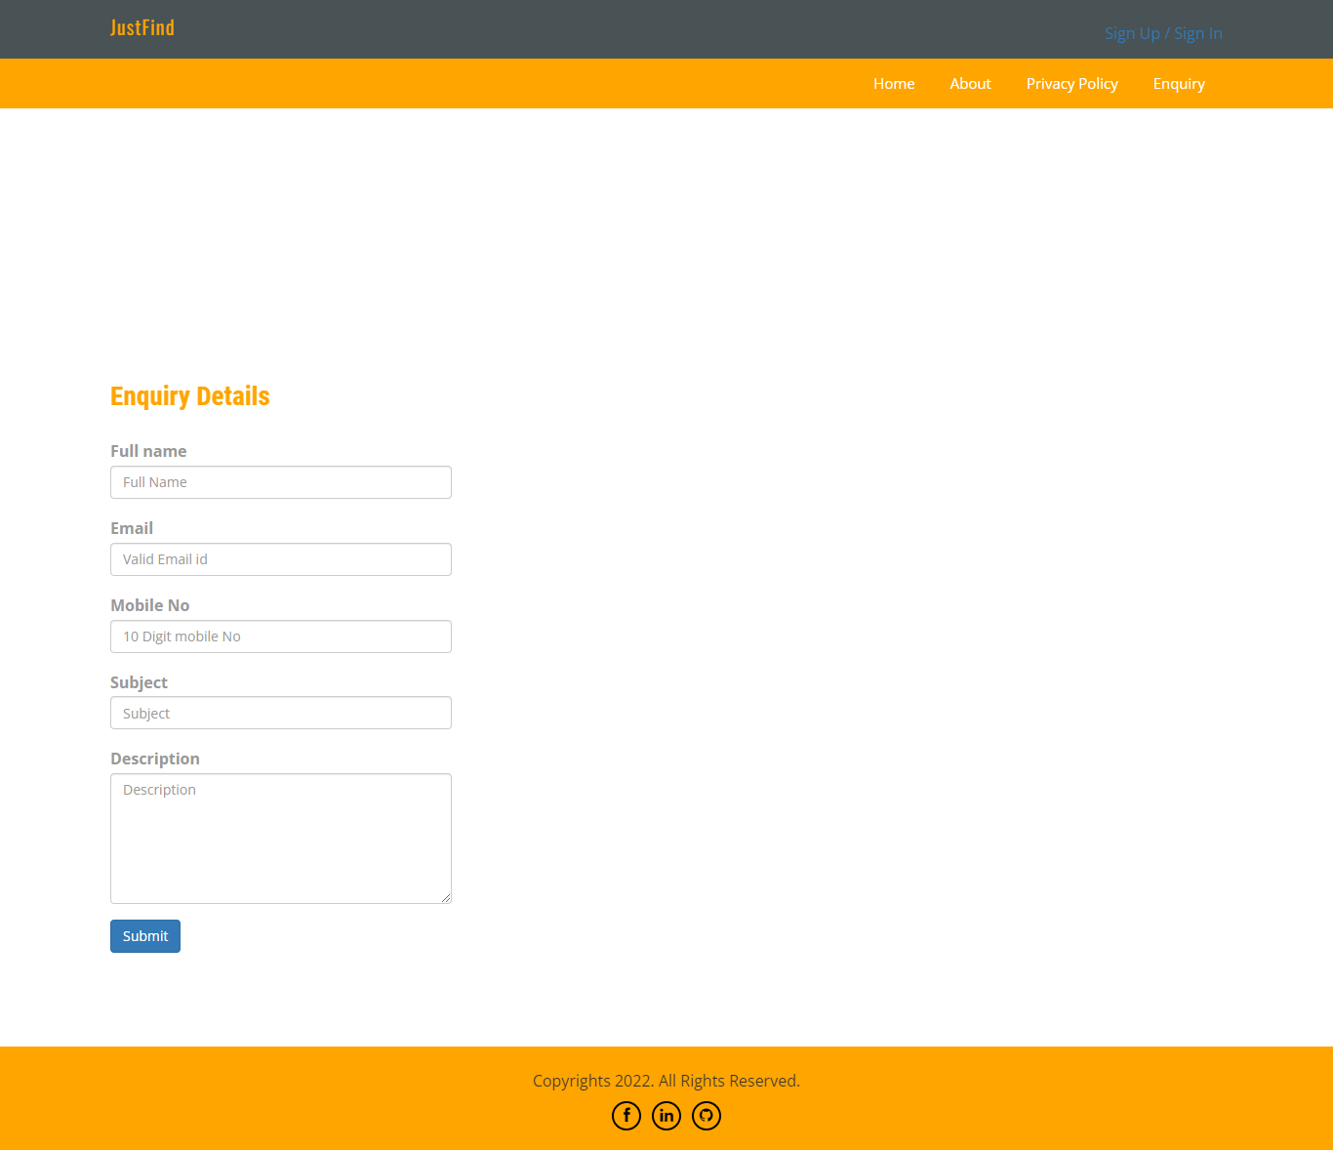
Enquiry/request to admin

Slide 17
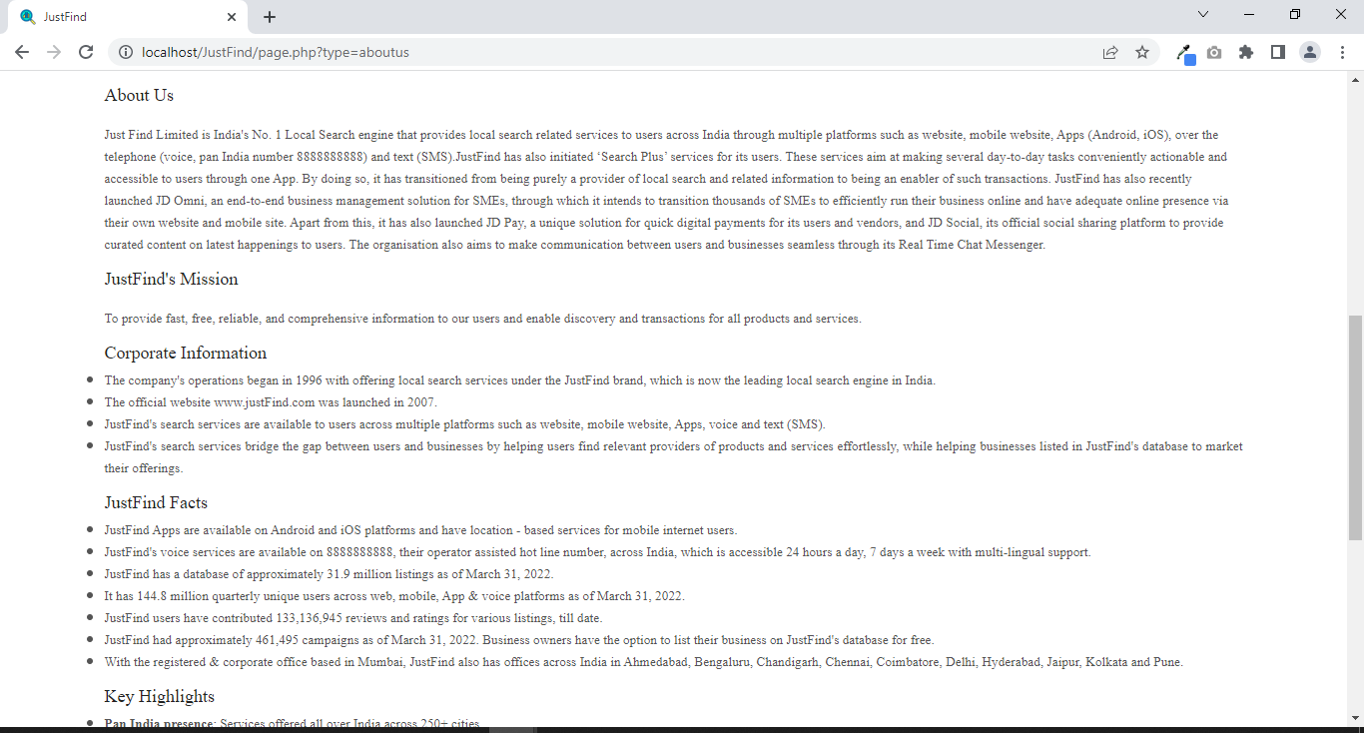
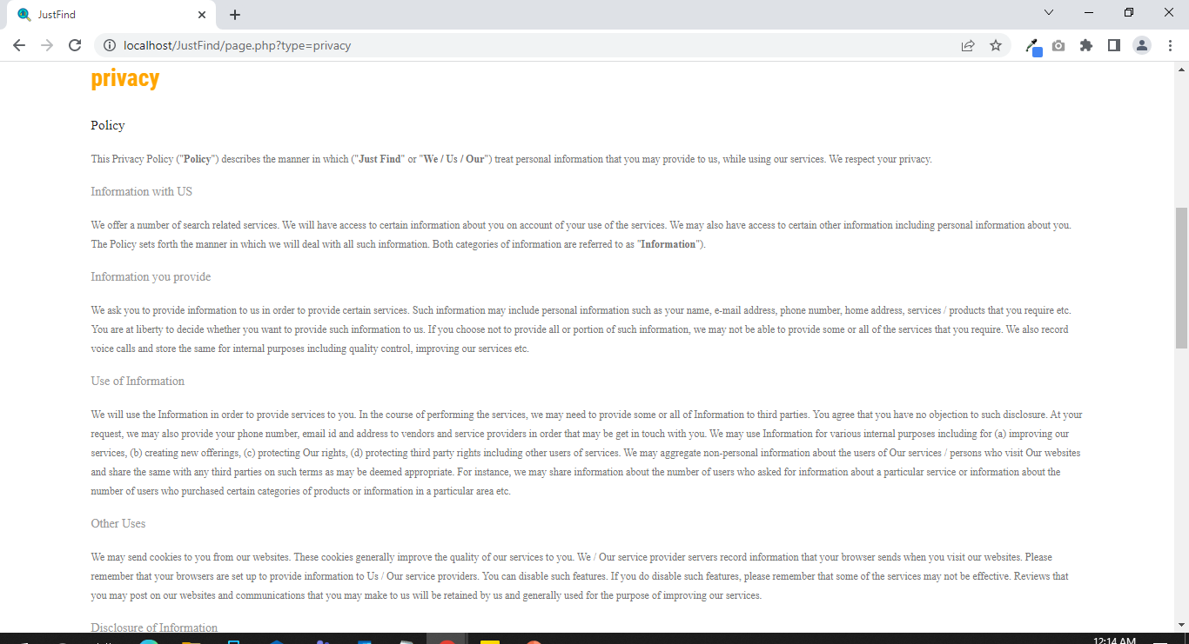
About Us & Privacy

Slide 18
Admin Functionalities

Slide 19
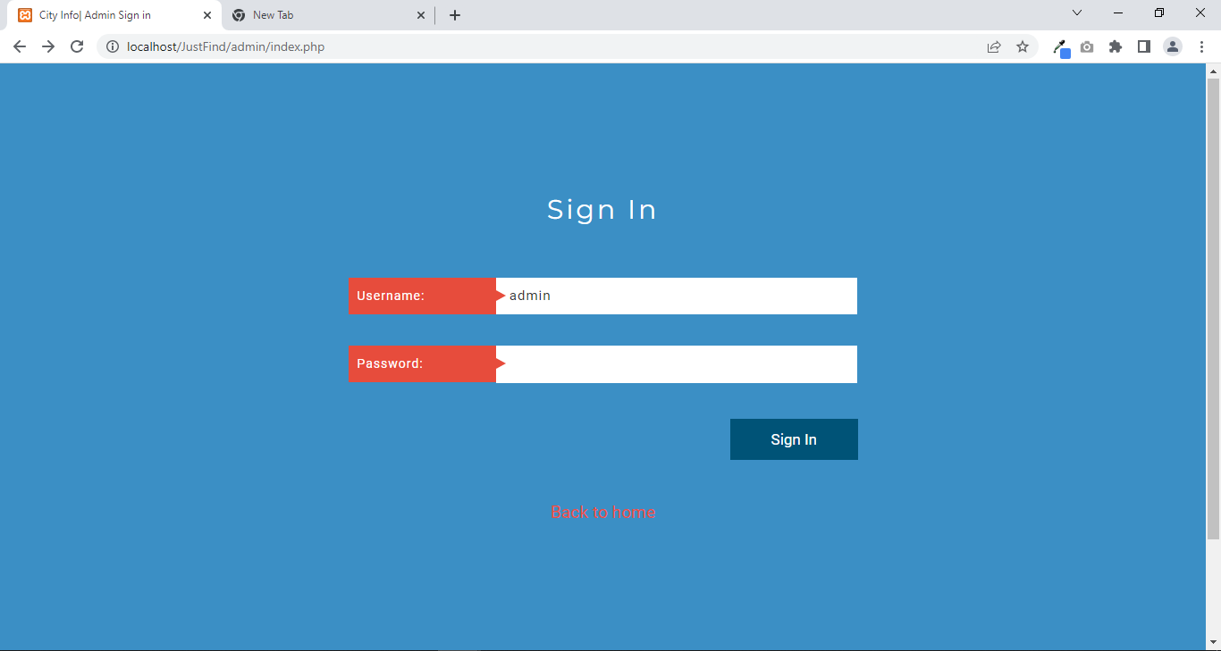
Admin Sign in

Slide 20
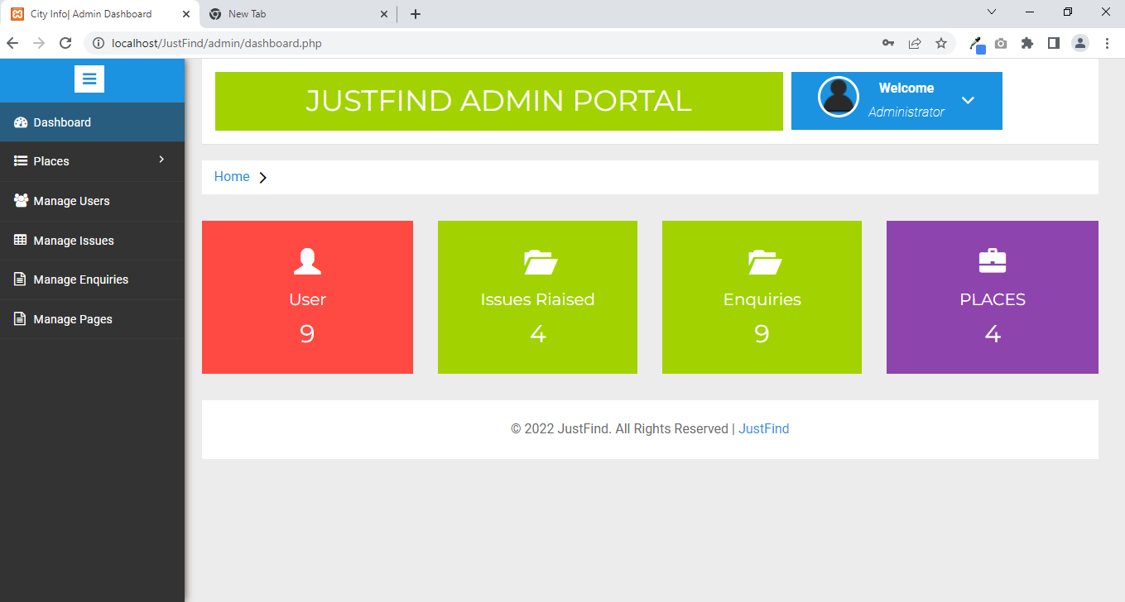
Admin Dashboard

Slide 21
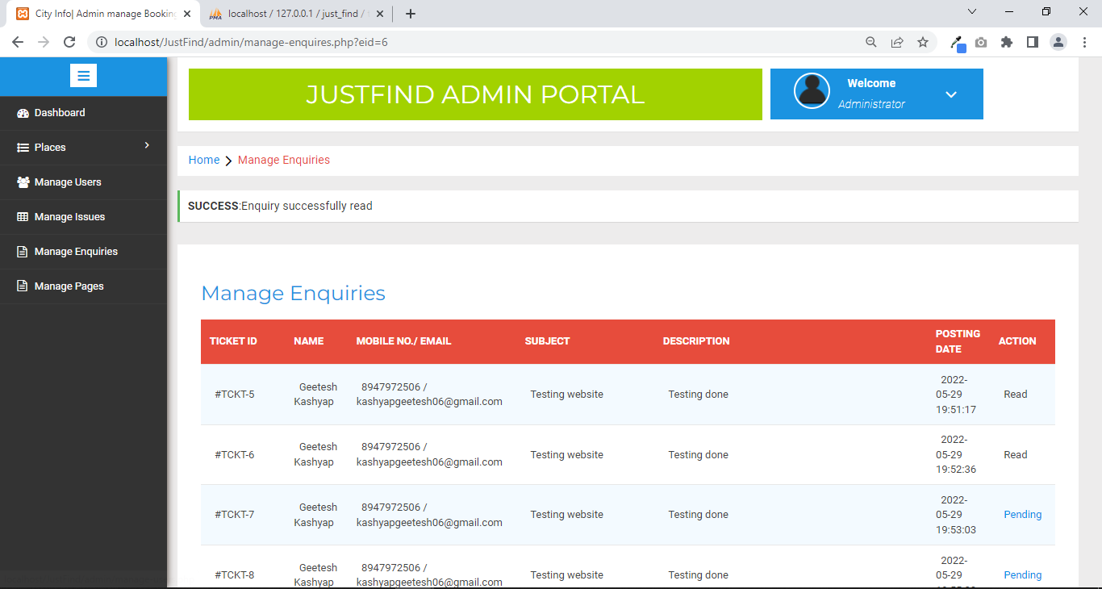
Manage Enquiries

Slide 22
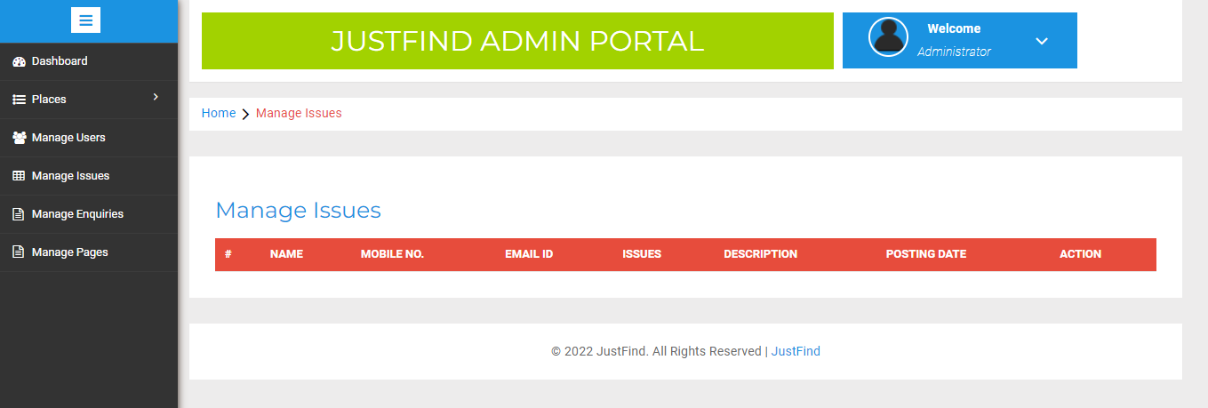
Manage Issues

Slide 23
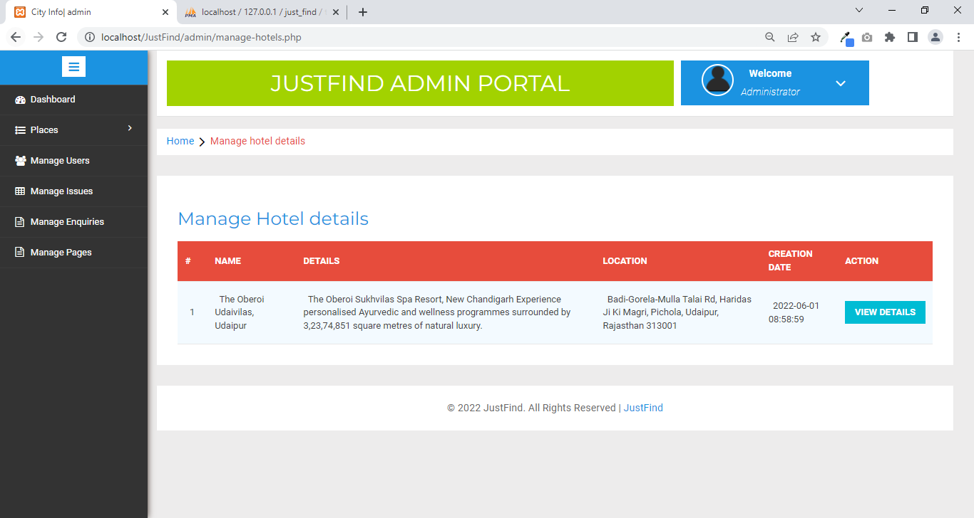
Manage/ update Places:

Slide 24
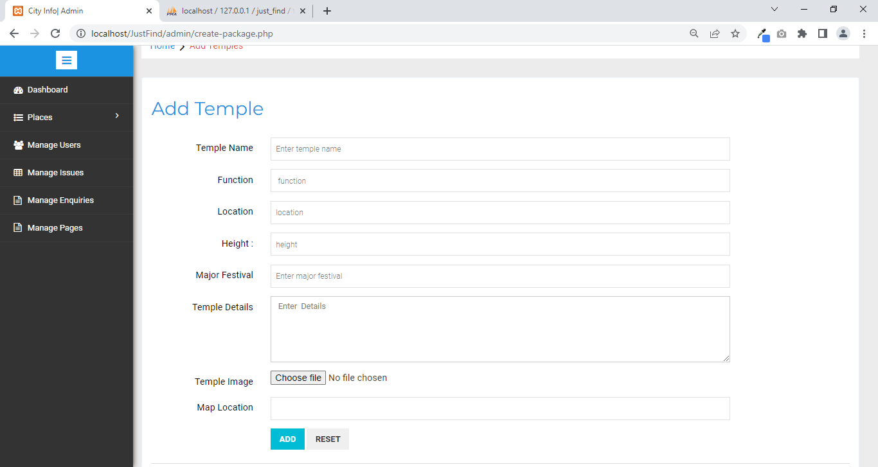
Add new Destinations/ Places

Slide 25
Features to be added soon:
Map and live direction navigation for each destination..

Slide 26

Any Suggestions?

Slide 27

Thank You

