Slide 1
Workflow
Generate Your Schedule With Us
Ememobong Umoh, 200412622
Sophia Pasha, 200471640
Seonyu Park, 200330151

Slide 2
Agenda
Introduction
Problem Definition
Design Requirements
Solutions
Project Management
Conclusion and Future Work

Slide 3
Introduction
Employers have a big responsibility to manage employees’ schedules in order to fulfill all roles.
Schedules constantly change, making it difficult to keep everyone updated in real-time.
Our web-based software application is a scheduling application in which employees can manage their own schedules more efficiently and employers no longer need to manually schedule every task.
There are many different scheduling applications, however most of them are $20-60 per month for only a limited number of users.

Slide 4
Problem Definition
Managers needing to manually schedule each shift
Employees needing to choose their shifts by asking the manager
Most scheduling applications are costly

Slide 5
Design Requirements
Functions:
Web-based software application
Our scheduling application is completely free to use, and is open source
Low threshold application
Objectives:
Employees can choose and view their shifts for the week
Managers can add or drop employees from a shift
Managers can view the entire schedule and share it with all employees

Slide 6
Design Requirements
Constraints:
Economic Factors – the application is completely free to use, saving on manual supplies
Regulatory Compliance – authentication, salting and hashing, and authorization
Ethics – copyright of photos and logos
Sustainability and Environmental Factors – save paper and supplies
Societal Impacts – reduces workload and stress

Slide 7
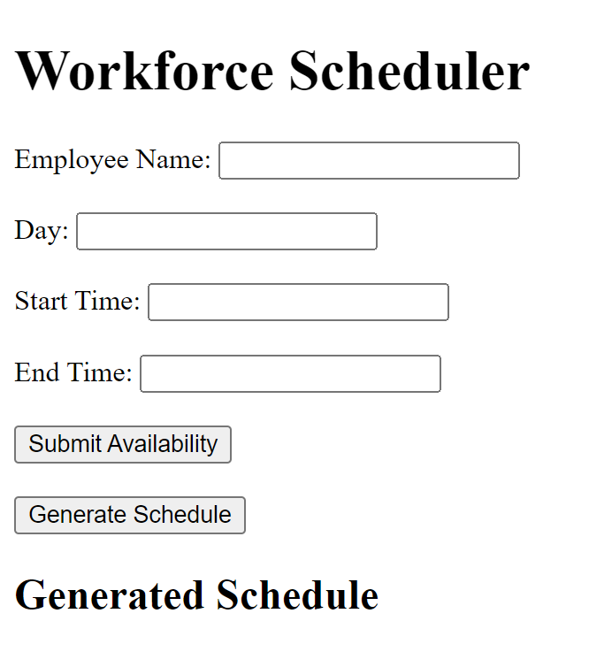
Solution 1

Slide 8
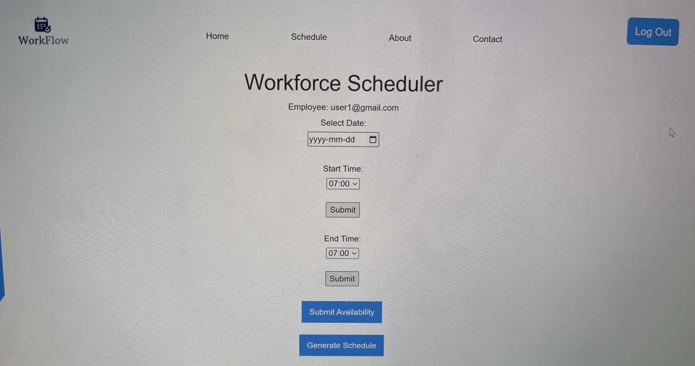
Solution 2

Slide 9
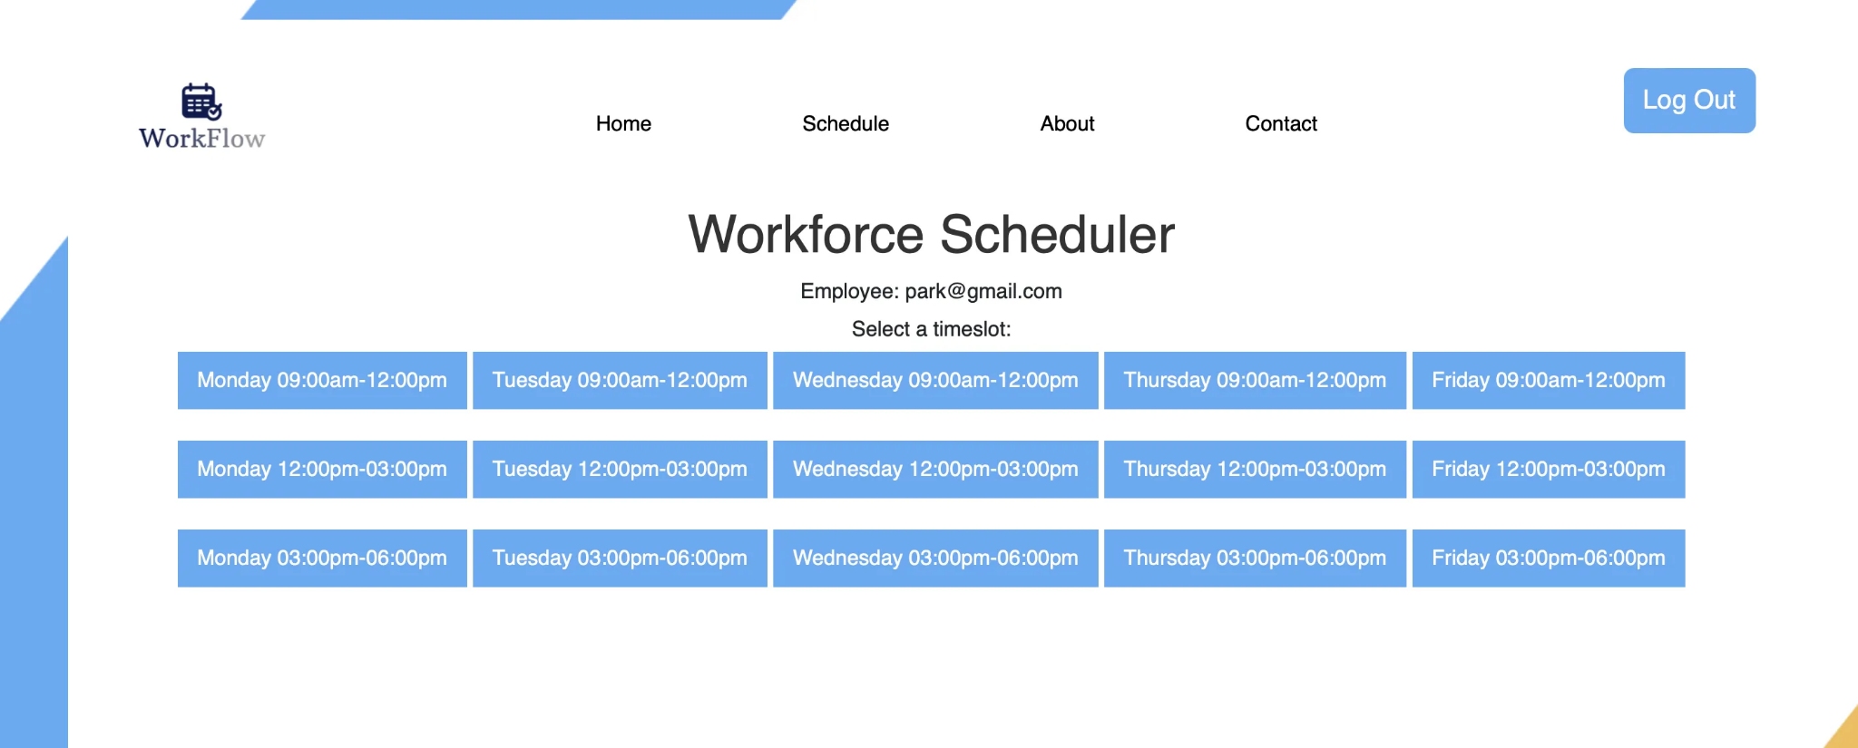
Solution 3

Slide 10
Solution 1 | Solution 2 | Solution 3
Employees are able to enter their own timings for shifts Does not meet the design requirements of having the manager in control of the shifts | This solution is better than solution 1, because it gives the employees a limited amount of options that the manager chooses to display However, it still gives the employees the ability to choose the length of their own shifts | This solution is better than solution 2 because it has a set number of shifts for each day, and the manager can choose the length of each shift

Slide 11
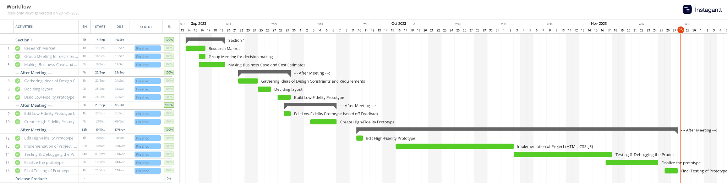
Project Management

Slide 12
Conclusion And Future Work
WorkFlow is a free, open source scheduling app
Employees are given the choice to manage their own schedules
Managers no longer need to manually schedule each shift
For future upgrades, we can improve the security of our users by using salting rounds.
We can also add a payroll system for more convenience
Add customizable designs

