Slide 1
Hardware security; intelectual property piracy; obfuscation
Bisultanov U Volyanuk M

Slide 2
List
Contents
Introduction
Hardware security
Intellectual property piracy
Obfuscation
Problem
Obfuscation methods
Conclusion

Slide 3

Introduction
Hardware Secrity is vulnerability protection that comes in the form of a physical device rather than software that`s installed on the hardware of a computer system
Эта фотография, автор: неизвестен, лицензия: CC BY-NC-ND.

Slide 4

Introduction
Intellectual property piracy occurs when someone copies, reproduces,oruses these protected works without the permission of the rightful owner, often with the intent to profit or benefit from the original creator’s ideas or artistic expressions.

Slide 5
Obfuscation
is the obscuring of the intended meaning of communication by making the message difficult to understand, usually with confusing and ambiguous language.

Slide 6
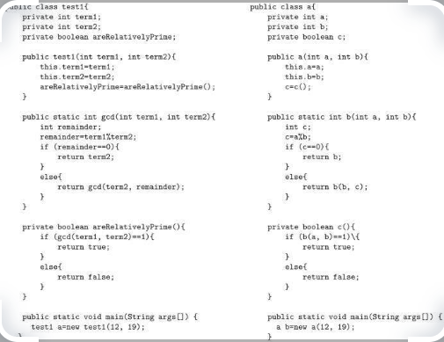
Problem
Code after most obfuscation methods becomes more dependent on the platform or compiler,; Insufficient security of
obfuscation.
So there are better methods...
Example of that code

Slide 7
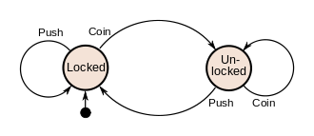
Obfuscation methods
Reverse engineering method – converting machine code into the programming language and examining the latter for vulnerabilities.
Byte level monipulation
Cryptography
Finite State Machine Method, which are studied in universities
Finite state machine

Slide 8
Conclusion
Insufficient security of obfuscation is the main identified drawback, which can be prevented by combining various obfuscation techniques and the encryption method

Slide 9
Thanks for your attention

