Slide 1

Slide 1
DATA DRIVEN:
Olympics Data Analysis
Getrude Gikera

Slide 2
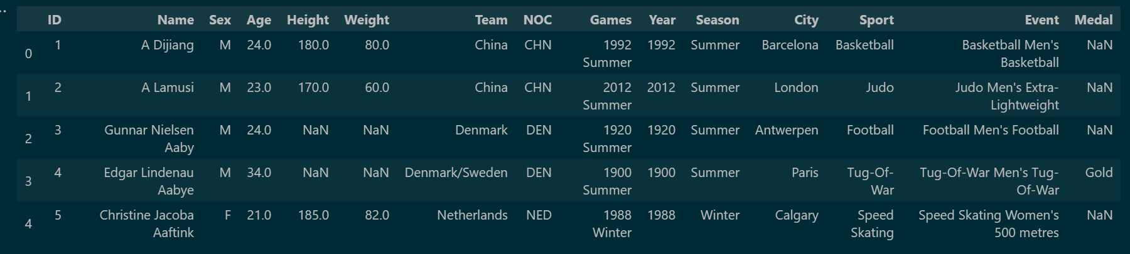
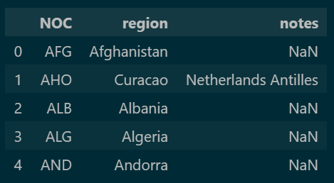
Slide 2
Olympics Data Analysis
The dataset comprises of two excel files, one showing the Athletes demographics and the other showing the regions or countries. This data is combined together in order to work on one file.
This is the Olympics Data Analysis from Kaggle:https://www.kaggle.com/heesoo37/120-years-of-olympic-history-athletes-and-results
It shows a brief History of the olpympic games.
The main libraries used are:
Pandas
Numpy
Matplotlib
Seaborn
2

Slide 3
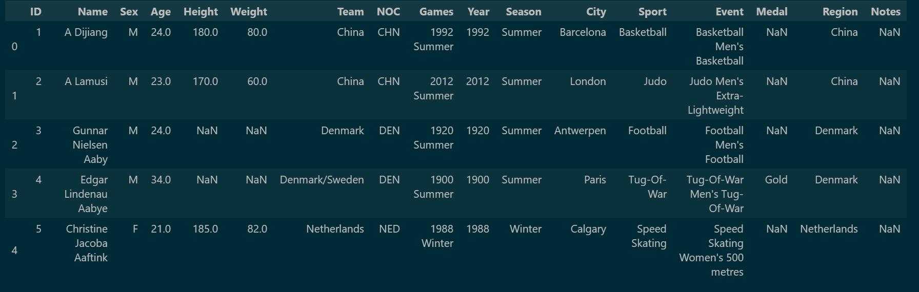
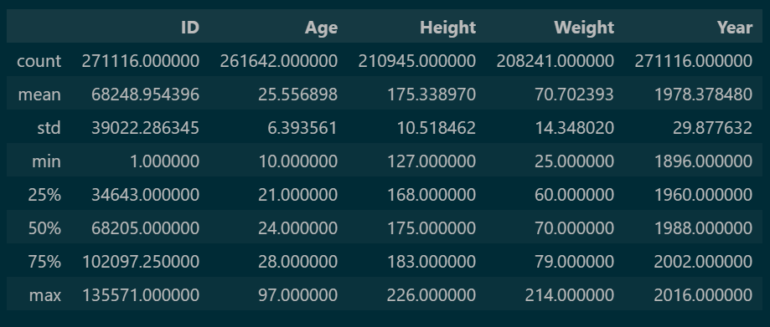
Slide 2
Olympics Data Analysis
Combined Datasets
The data on the left side shows the description of the numerical values represented in the dataset. For instance the 25th percentile of Age is 21.00, while the 25 Percentile of Height is 168.00. The mean for Weight is 70.702393.
3

Slide 4
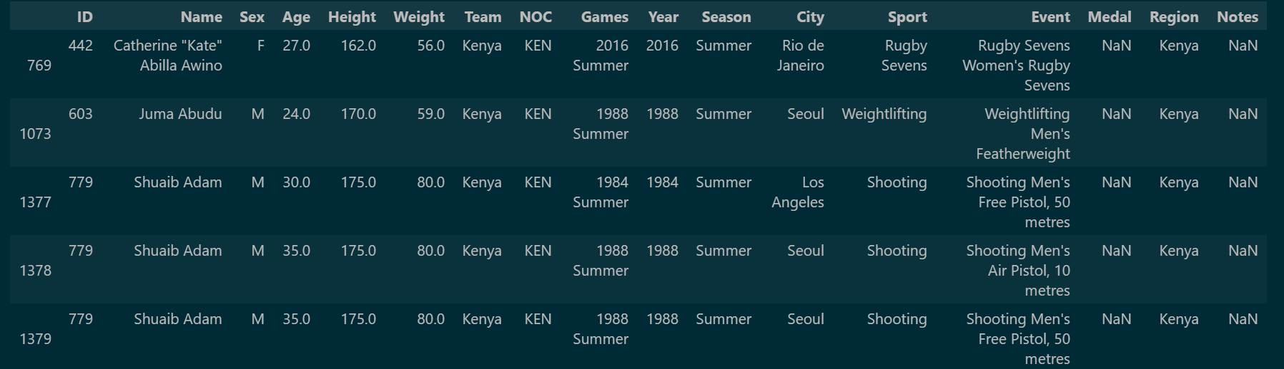
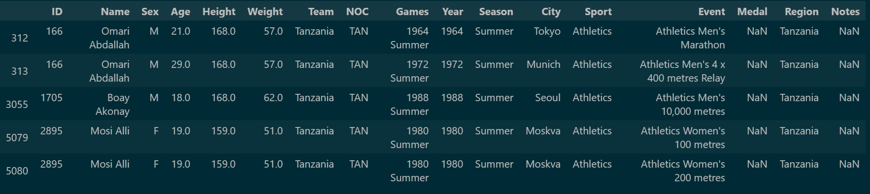
Slide 2
Olympics Data Analysis
Kenyan Participants
Tanzanian Participants
4

Slide 5
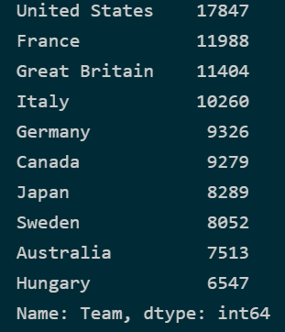
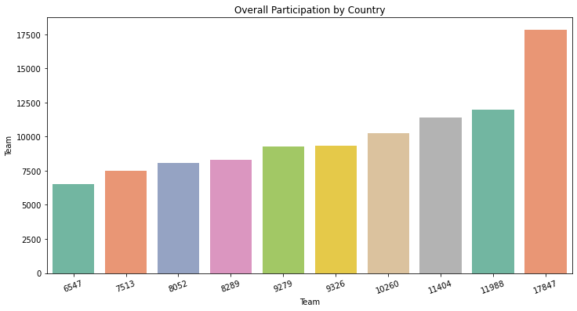
Slide 3
Olympics Data Analysis
Top 10 Countries
e
The top 10 countries that have been participating since the beginning of the Olympics is represented below in the data. The one that has always participated is United States. The representation of a graph is using a bar plot.
5

Slide 6
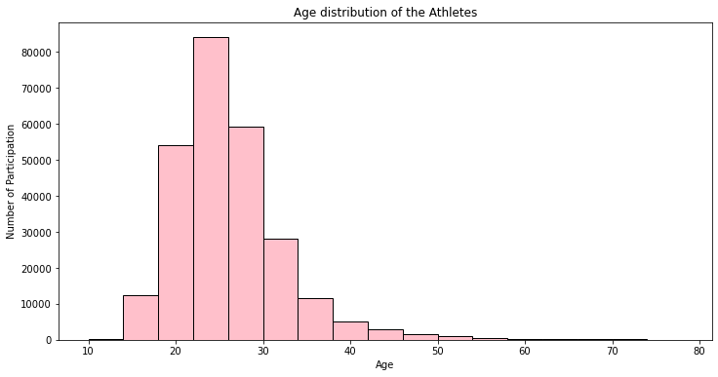
Slide 3
Olympics Data Analysis
The Age Distribution of the Athletes varies from 10 years of age all through 74 years of Age.
e
6

Slide 7
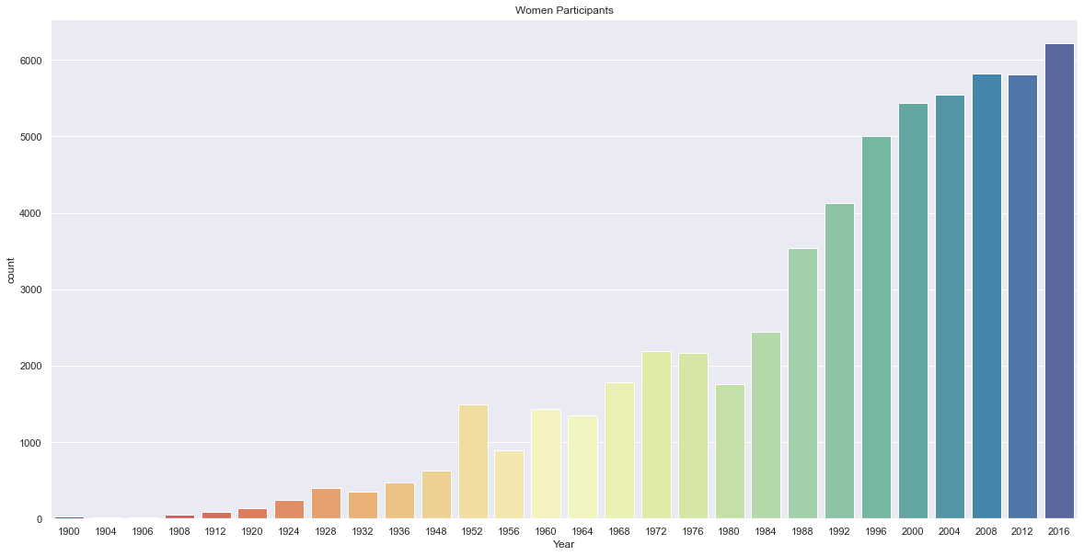
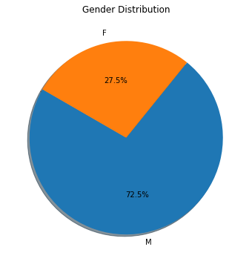
Slide 4
Olympics Data Analysis
Women Distribution
Gender Distribution
From the figure below it shows that in the Olympics years, Men are seen to be the ones who are participating as compared to women
7

Slide 8
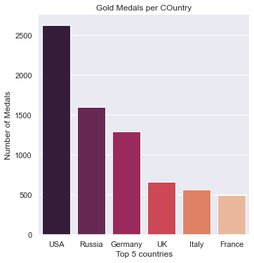
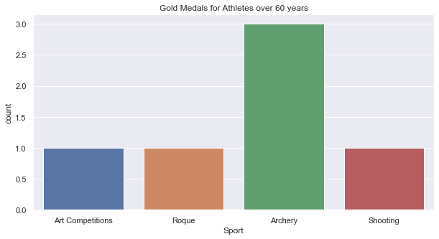
Slide 4
Olympics Data Analysis
Gold Medals for Athletes over 60 Years
Gold Medals per Country
8

Slide 9
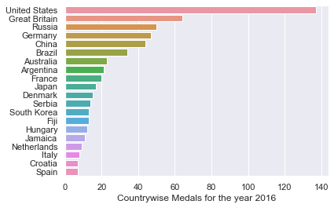
Slide 4
Olympics Data Analysis
Country wise Medals for the Year 2016
9

Slide 10

Slide 10
Olympics Data Analysis
The Olympics Data Analysis helps us understand the brief history of the Olympic games.
The data shows that males are the most dominant when it comes to participating in the Olympic games. And over the years most countries started taking part as compared to the previous years.
The data also shows that Gold medals are won depending on the type of Games played.
10

Slide 11

Slide 11
THANK YOU

