Slide 1

Looking For A Date
A Poisson Experiment, By Robert Morris

Slide 2

Philbert
Philbert is a young 26 year old recent DSU graduate of computer science.
Who is looking to meet a nice young woman and hopefully find himself a date.
The most popular night life in the town is Dave & Filibusters, A popular adult video arcade and sports bar.

Slide 3
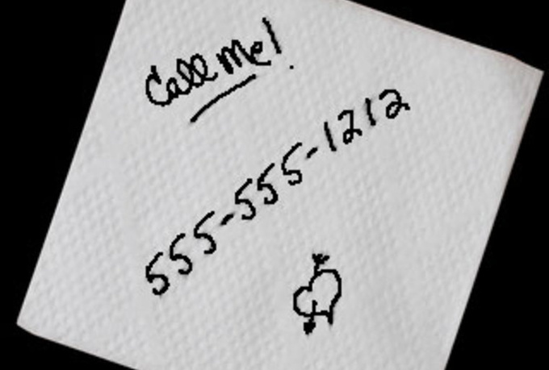
Philbert’s “Numbers”
Philbert’s looks/personality has him of landing 1 follow up date out of 8 girls from whom he receives phone number.
Philbert’s Success of a date depends on the success rate of phone numbers he receives on each night out.
On average, Philbert receives 1 phone number a night.

Slide 4
Model Distribution
This model has to main factors.
  Phone number success rate: lambda
  Follow up Date probability: 1/8 or .125 %
The phone number success rate is a Poisson distribution.
Dating success could be represented as a geometric distribution if we choose to stop the trial once Philbert find a date. ( ie. the kth trial resulting in a success)
      Trials: Lambda(1/8)-1st, Lambda(1/8)-2nd, Lambda(1/8)-(k-1)…...Lambda(1/8)-(kth trial)
The rate of dating success is directly dependent upon the rate of success of phone numbers received.

Slide 5


Modeling Expectations
Model Parameters:
      Nights outs
      Period of Time in question
      Rate of phone numbers received
      Odds of dating success
Factors to influence our experiment:
      Busier/slower Nights Out
        .20 increase on busier nights
        .15 decrease on slower nights
      Filbert Improves his attractiveness
        Increasing the rate of phone numbers

Slide 6

Experiment Questions
How quickly can Philbert expect to land a date?
How often does Philbert receive more or less than 1 number?
What factors have the greatest increase or decrease in Philbert’s odds of success?

Slide 7

Philbert’s Success
Hopefully this model well help to improve Philberts understanding of poisson’s influence on his dating odds and can help him choose the better nights to meet his love.
Any Questions???

