Slide 1
Android Final Project Radio Station App Jerome Demers Philippe Geukers Marco Caballero

Slide 2




Project analysis slide 2
Project Requirements
Analytics
News
Radio App
Media Player
Sign up, Login
Shopping Cart

Slide 3



Project analysis slide 3
What we did
LOGIN
SIGN UP
PLAYLIST MANAGEMENT
NEWS
SONG LIST
Register and Login
System. Unique username validation.
Each user have a different playlist with the song they choose the add to their playlist.
News about the station are display there.
List all the song available on the app, possibility to add them to your playlist. Possibility to view the details of the song.

Slide 4
Project analysis slide 4
Implementation
Login /
Sign Up
Jerome
Phil
Git Hub
News
Marco
Meetings
Implementation
Plan
Song List
Jerome
Phil
Phil
Jerome
Marco
Playlist

Slide 5
Demonstration
By Marco

Slide 6
Functions
Add song to the application
Add song from the application to the playlist of each user
View the songs that were added to the playlist of each user

Slide 7
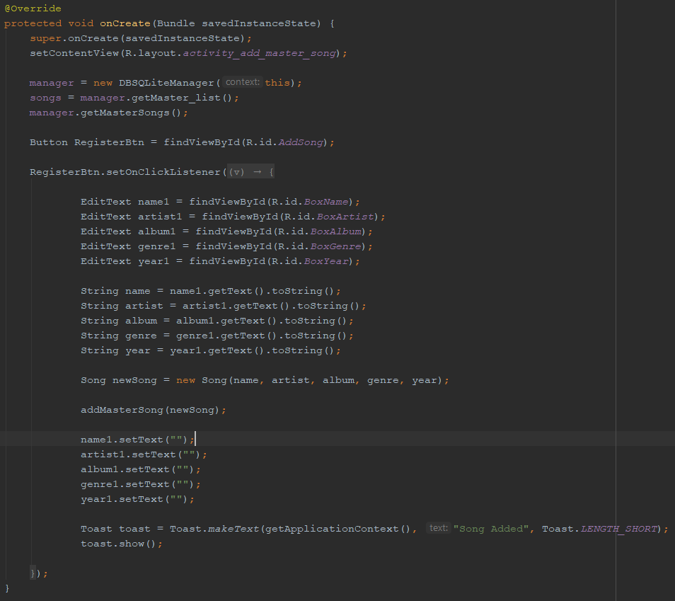
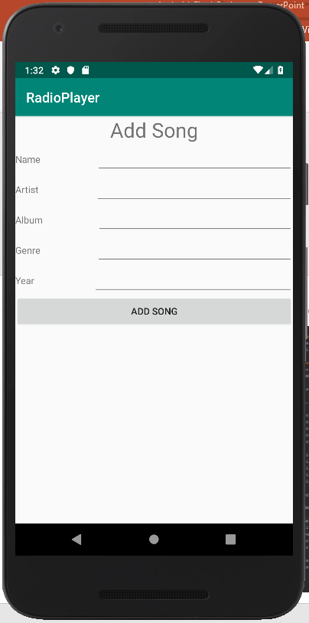
Function 1 – Add song to the application

Slide 8
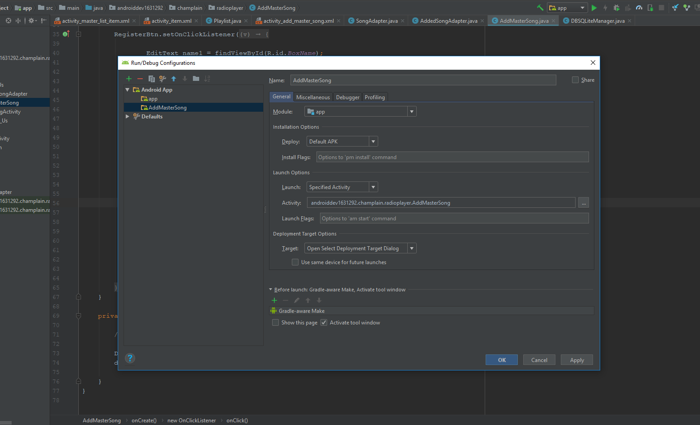
Add an activity seperately

Slide 9
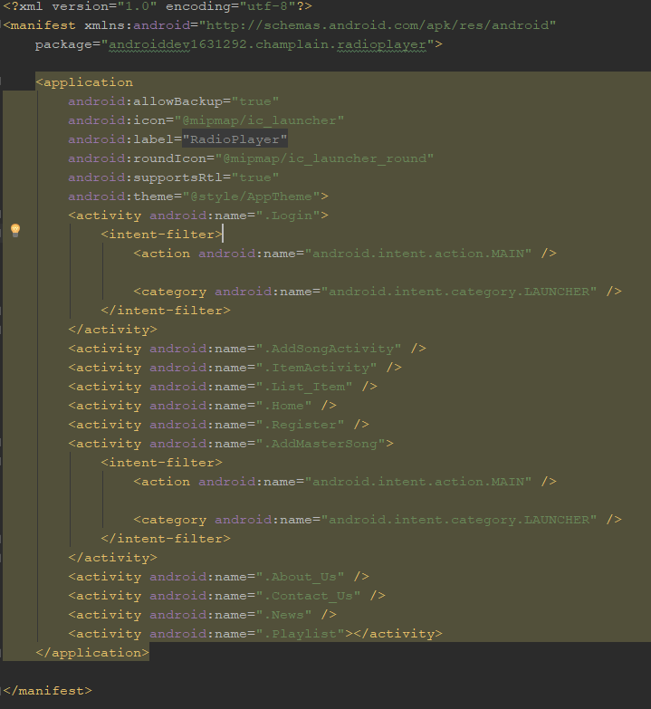
Add an intent Activity

Slide 10
Function 2 – Add a song to the playlist
The second most difficult thing we had to do
Problem: Add a song from the master song table to the playlist of the user.
Solution…

Slide 11
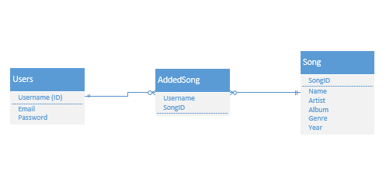
Classes / Tables

Slide 12
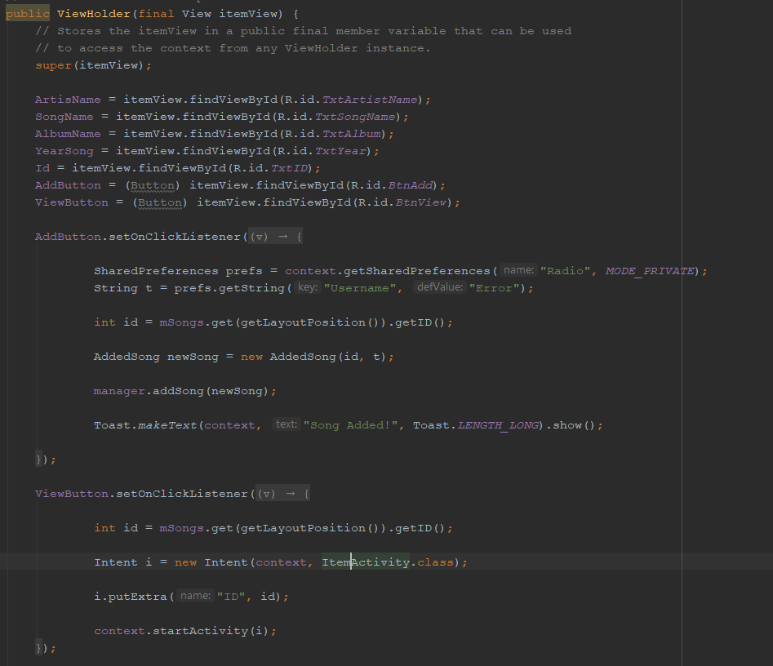
Solution
Added a SharedPreference to hold the username when a user logs in,
Retrieved it in the adapter
Retrieved the ID from the song using the layout position
Add the song using these two variables to the added song table

Slide 13
Function 3 – Retrieve song from the addedSong table
The most difficult thing we had to do
Problem: Add a song from the master song table to the playlist of the user.
Solution…

Slide 14
Classes / Tables

Slide 15
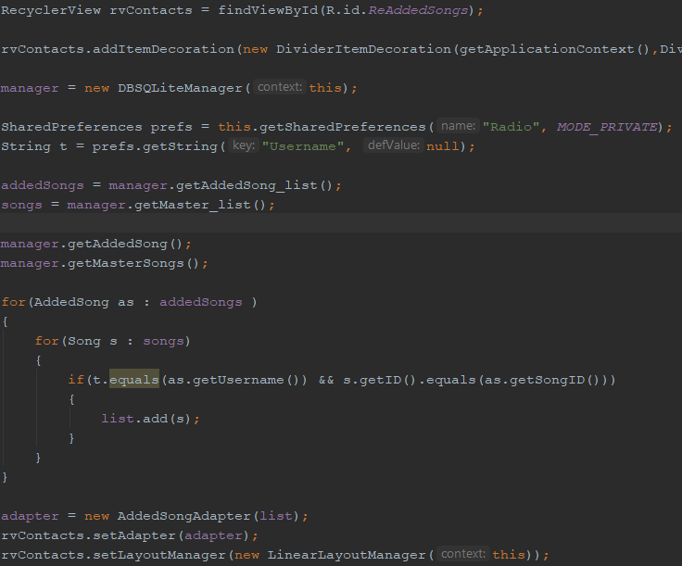
Solution
Retrieve the username from the shared preference
Retrieve the addedsong list and the song list
Compare the usernames and songID
If they are the same, they are added to a third list called list
Send the list to the adapter to be displayed

Slide 16
Thank You

