Slide 1
New York’s Airbnb List Price Drivers
Carolina Carrillo
Denise Person
Gan Jin
Geuntae Jang

Slide 2
Outliers

Slide 3
Data Analysis: Steps to Analyze Data
Identified expected independent variables (price drivers): location, type of rental, number of bedrooms, number of bathrooms, and review scores.
Created pie charts, bar charts, scatter plot, box plot heat maps comparing price to independent variables
Created correlation matrix of independent variables

Slide 4
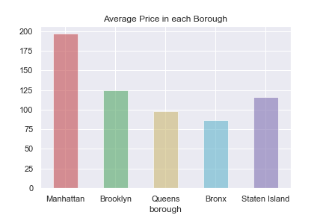
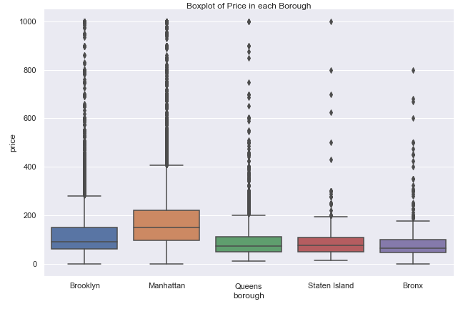
Variable: Location

Slide 5
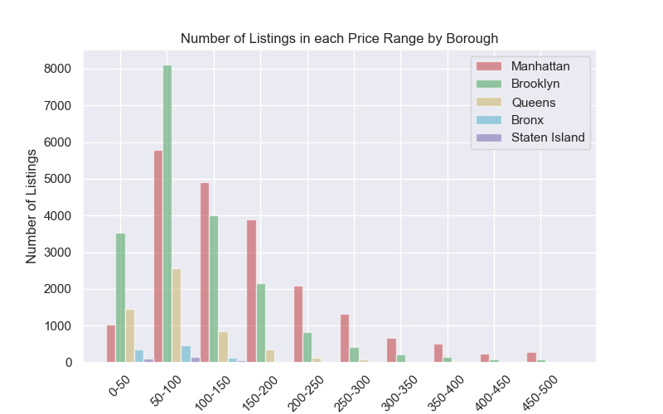
Variable: Location

Slide 6
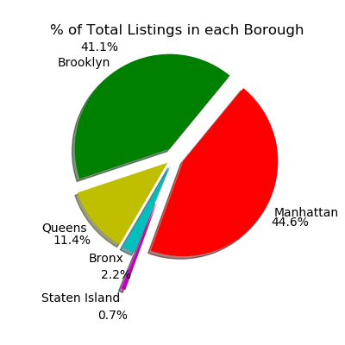
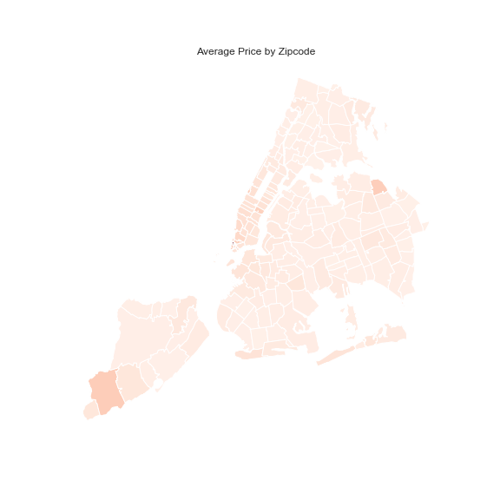
Variable: Location

Slide 7
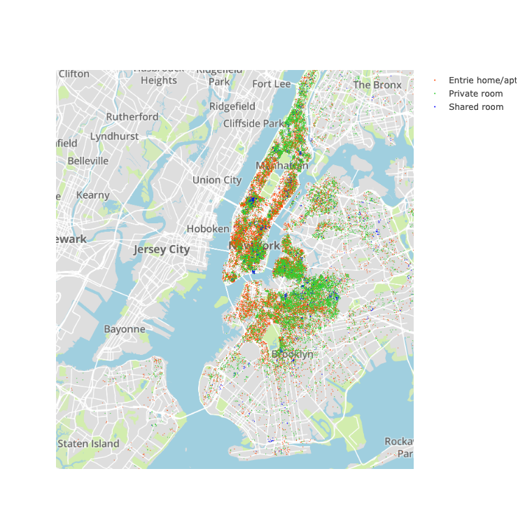
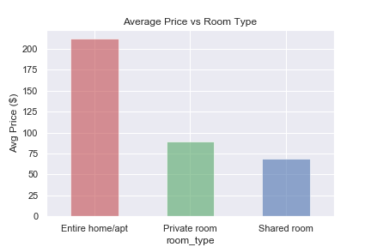
Variable: Room Type

Slide 8
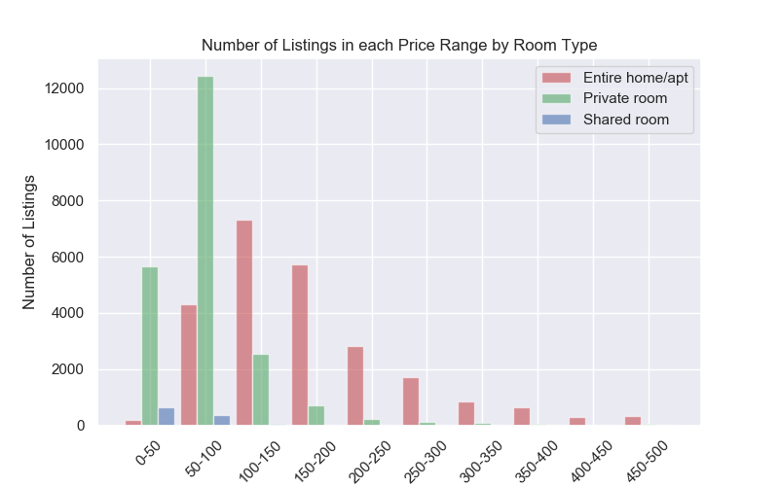
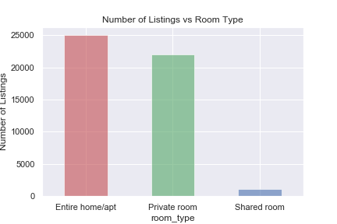
Variable: Room Type

Slide 9
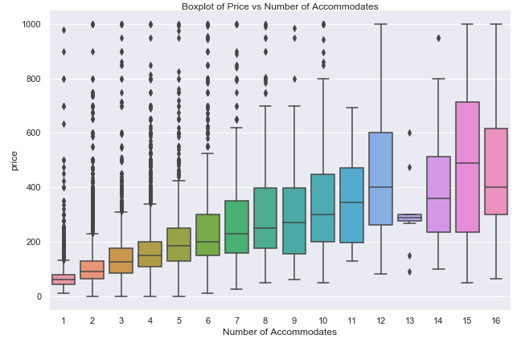
Variable: Number of Guests Accommodated

Slide 10
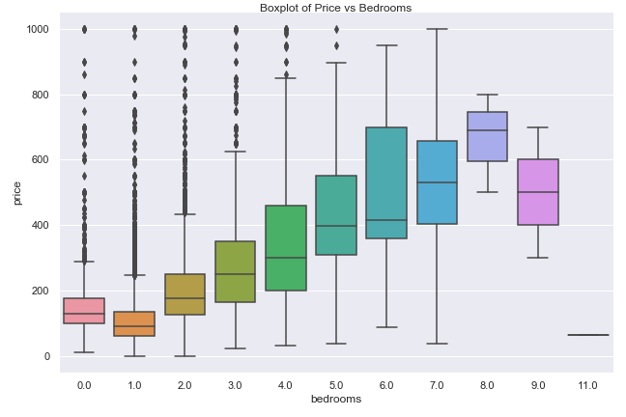
Variable: Number of Bedrooms

Slide 11
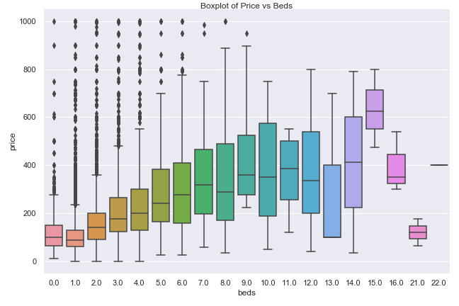
Variable: Number of Beds

Slide 12
Variable: Number of Bathrooms

Slide 13
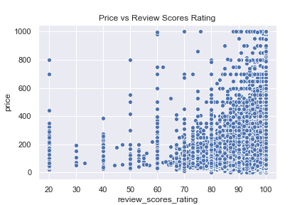
Variable: Review Score

Slide 14
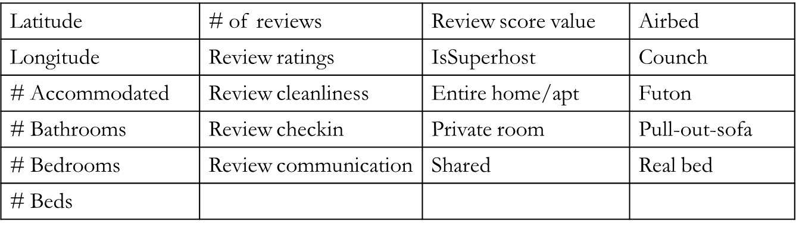
Correlation between Variables and Price

Slide 15
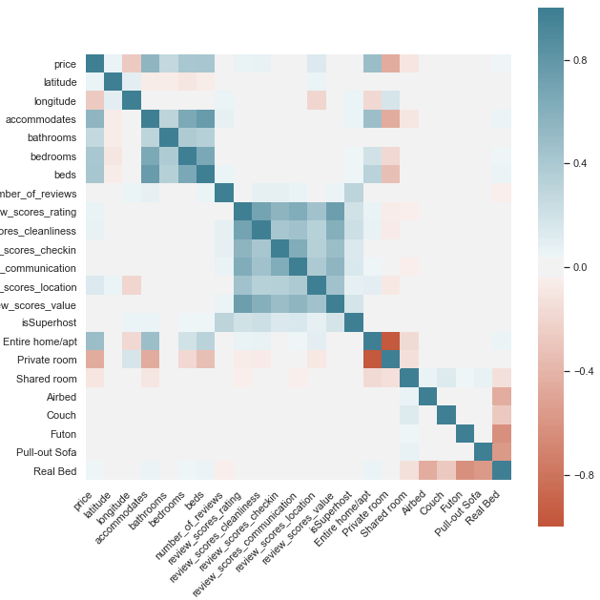
Correlation Matrix of Variables

Slide 16
Correlation Matrix Results
Positively Correlated
  Number of guests property accommodates, 54.9%
  Entire home/apt, 49.0%
  Number of beds, 42.3%
  Bedrooms, 41.1%
  Bathrooms, 26.9%
  Review score location, 13.6%
  Review ratings, 6%
Negatively Correlated
  Private room, -46.0%
  Longitude, -26.2%
  Shared room, -10.5%

Slide 17
Discussion/Conclusion
Goal: to find major drivers of price.
No variable is strongly correlated with price on correlation matrix.
Location is a driver of price, although not strongly reflected in correlation matrix.
Other weakly correlated variables such as number of guests accommodated, type of rental, number of bedrooms, number of bathrooms influence price based on visuals.
Correlation likely influenced by relationship between variables other than price.
Isolated dataset such as number of bedrooms or room type may reveal results consistent with expecations.

Slide 18
Post Mortem
Explore relationship between variables
Isolated dataset by borough and/or variable such as 2 bedrooms or
TBD

