Slide 1
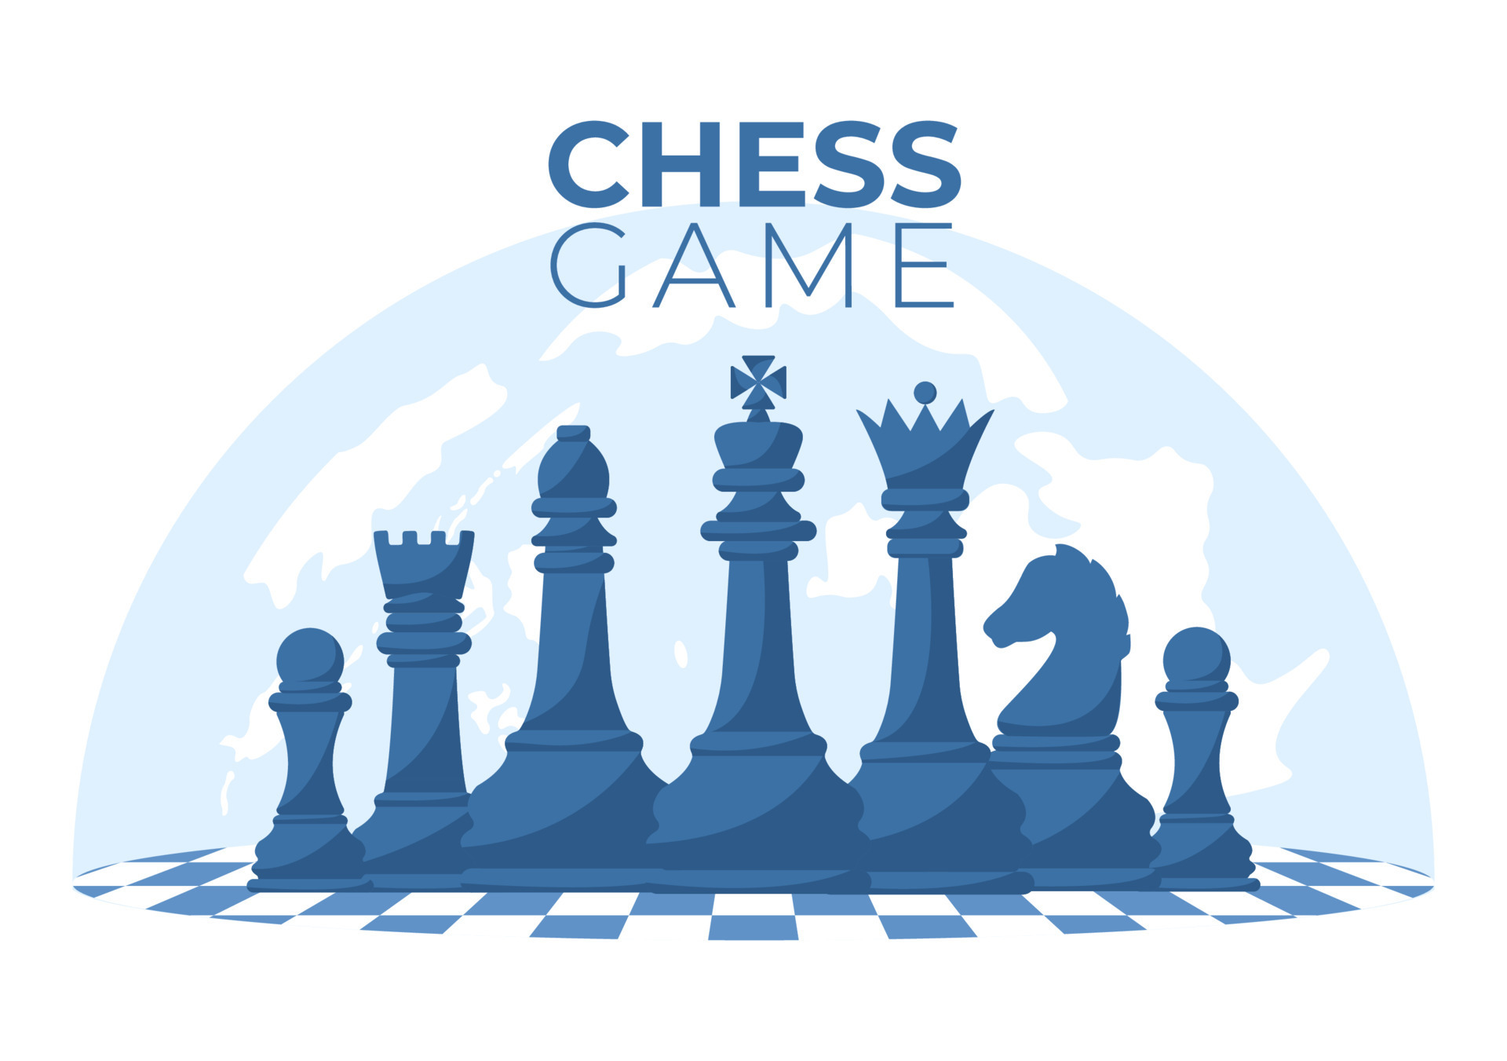
Chess

Slide 2

Structure
DISPATCHER
(abstract class)
BROKER
-&BOARD
-*BARRIERS_HANDLER
ENEMYKINGDISPATCHER
-&BOARD
-*BARRIERS_HANDLER
MYKINGDISPATCHER
-&BOARD
-*BARRIERS_HANDLER
BOARD
-matrix[8][8]
64
MODEL
-&BOARD
-*HANDLERS
-*BROKER
PIECE
(abstract class)
HANDLER
(abstract class)
KING
KING
QUEEN
QUE
CONTROLLER
-*MODEL
-*PIECEPRINTER
-*BOARDPRINTER
KNIGHT
DESIRED
BISHOP
Player1
Player2
BARRIERS
ROOK
AVAILABLE
MOUSE_HANDLER
BOARD_PRINTER
PAWN
EXIST
PIECES_PRINTER
BOARD_VIEW

Slide 3
Board
Board contains 8 * 8 Matrix, each of which is Piece type unique_ptr.
Piece is abstract class and all others derives from it.
Initially it is in “null state”, afterwartds when Controller notifies Model to setBoard it creates BoardMatrix.
The 64 numbers shows that Board aggregates 64 Piece characters.
BOARD
-matrix[8][8]
64
PIECE
(abstract class)
KING
KING
QUEEN
KNIGHT
BISHOP
ROOK
PAWN

Slide 4
HANDLERS
Part of Chain of Responsibilities.
Handlers are.
Piece existence – checks weather specified piece exist.
Available coordinates – checks weather desired location is in Piece’s available coordinates.
Barriers – checks weather there is any piece on the line.
Desired Square – checks weather the desired location is empty, or if not, weather it is enemy.
Queue – checks weather it is that player’s turn.
HANDLER
(abstract class)
QUE
DESIRED
BARRIERS
AVAILABLE
EXIST

Slide 5
EVENT DISPATCHERS
Similar to event driven design pattern.
DISPATCHER
(abstract class)
BROKER
-&BOARD
-*BARRIERS_HANDLER
ENEMYKINGDISPATCHER
-&BOARD
-*BARRIERS_HANDLER
MYKINGDISPATCHER
-&BOARD
-*BARRIERS_HANDLER
Model notifies Broker about and event (successful step).
Broker by its Dispatchers(EnemyKing_Dispatcher, MyKing_Dispatcher) first checks weather it’s King is under check after step, then the second dispatcher checks, weather the enemy’s king is under check and notifies to Model.
Broker is also responsible for pawn event.

Slide 6
Graphical Part
MOUSE_HANDLER is Controlled directly by Controller.
BOARD_PRINTER and PIECES_PRINTER have direct access to BOARD_VIEW and Controller uses them to print Board and moves.
PIECES_PRINTER gets all pieces from Board by Controller. It also creates map in heap and convey its ownership to Model.
BOARD_PRINTER
MOUSE_HANDLER
PIECES_PRINTER
BOARD_VIEW

Slide 7
MODEL
Model is contained by Controller.
Controller uses Model to keep interaction between Graphical part and Logic. It has access to Board, Handlers and Broker.
MODEL
-&BOARD
-*HANDLERS
-*BROKER

Slide 8
CONTROLLER
Controller has access to both graphical and logical parts, it gets inputs from both players then logically tries to implement it, and only in case it gets success in logical part, after that prints graphically.
CONTROLLER
-*MODEL
-*PIECEPRINTER
-*BOARDPRINTER
user1
user2

Slide 9
PROS and CONS
PROS
Pawn Event.
Check Events.
Accurate Mouse Handling.
CONS
Finish not Specified.
Not able to Castle.

Slide 10


