Slide 1
Elevator Project wouter swinkels, Merna Gramoun, Gedewon Jerne

Slide 2
2
System Introduction
Components and peripherals
User Interface
Demo
Questions

Slide 3
Elevator system introduction Our system is a prototype of an elevator that is controlled by hardware buttons and an UI application that also shows the status of the elevator. we have 4 floors that the elevator can go to. The system is using a PD controller for controlling the elevator speed and position.

Slide 4
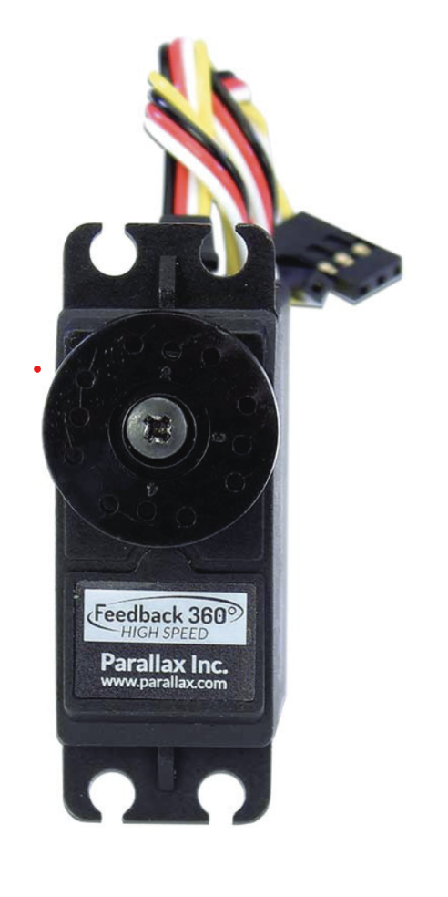
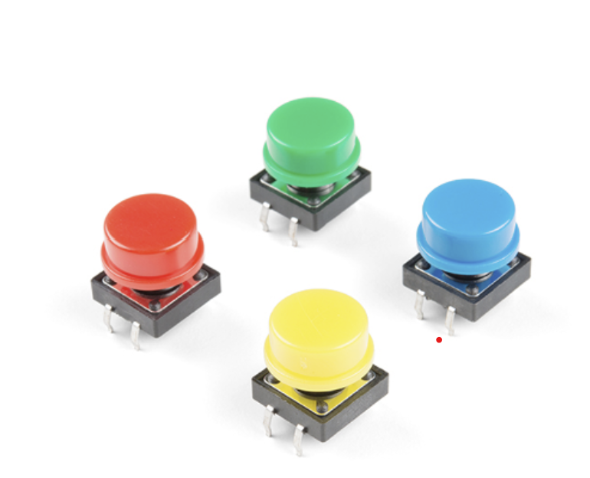
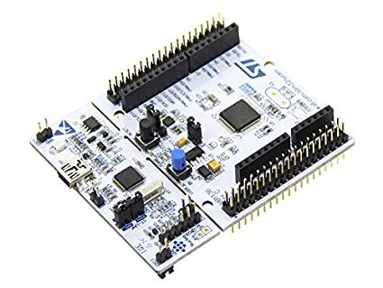
System components
Hardware:
Stm32 nucleo303RE board
360 Parallax servo
Two buttons
3D printed elevator
Node RED app
Communication protocol:
Sockets

Slide 5
Peripherals used
5
Servo output wire connected to pin PB5, timer 4 and channel 1 set as input
Servo input wire connected to PB6, timer 3 and channel 2 set as output
Button for level up connected to PB10
Button for level down connected to PB3

Slide 6
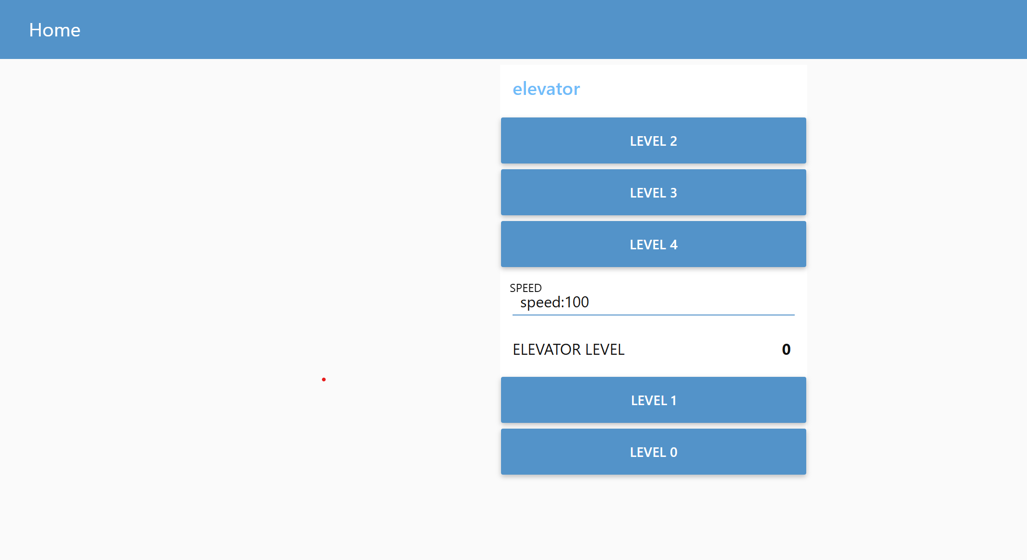
User Interface
By using NodeRED app we can control the elevator position and speed as well as know it location.

Slide 7

Q&A

