Slide 1

CONSUMER BEHAVIOUR
TATA Harrier Pre, Post & Purchase Behaviour Analysis
MBA202325-081 Gezatan Nimal Raj

Slide 2
AGENDA
Executive Summary
RESEARCH METHODOLOGY
COMPETITOR ANALYSIS
PRE-PURCHASE STAGE
PURCHASE STAGE
POST-PURCHASE STAGE
recommendations

Slide 3
EXECUTIVE SUMMARY
In-depth analysis of consumer behavior around Tata Harrier, covering pre-purchase, purchase, and post-purchase stages. Focus on key factors influencing customer satisfaction, cognitive dissonance, and word-of-mouth behavior. Comparison with major competitors: MG Hector, Hyundai Creta, and Kia Seltos. Research integrates both quantitative data from an online survey and qualitative insights from focus group discussions. Provides a comprehensive view of the consumer decision-making process and its impact on Tata Harrier's marketing strategy.
Pre-Purchase Stage
1. Problem Recognition
2. Information Search
3. Decision-Making
Purchase Stage
1. Critical Factors
2. Consumer Segmentation
Post-Purchase Stage
1. Customer Satisfaction
2. Word-of-Mouth Behavior
3. Competitive Analysis

Slide 4
RESEARCH METHODOLOGY
Data
The data was collected through a Google Form circulated to MBA students and professionals
A focus group also was conducted to get some keen insights on purchasing behaviours
Google Form Link: https://forms.gle/gvCorK2fZYhPrp5SA
Participants
A total of 24 car enthusiasts participated in the survey
Analysis also considered competitors like MG Hector, Hyundai Creta, Kia Seltos, Mahindra XUV 700, and Toyota Fortuner
Tools
Collected results were analysed with the help of SPSS and Excel using methos like NPS, Conjoint Analysis, Correlation, etc

Slide 5
COMPETITOR ANALYSIS (TATA HARRIER)
S Comport Design Safety Performance Gearbox Engine
W Quality Fuel Economy Infotainments Screen Hydraulics
O ConnectNext Feature Spare Wheel
T EV Close Competitors Strict Regulation

Slide 6
PRE-PURCHASE STAGE
Problem Recognition
Factors Promoting SUV Purchase
Anticipated Purchas Timeline
Importance of SUV Ownership
Information Search
Trusted Information Sources
Brands of Interest for Test Drives

Slide 7
MARKETING IMPLICATIONS
Timing
Messaging
Advertising Channels
Brand Positioning
Digital Strategy
Competitive Strategy
Product Development
DECISION MAKING MODEL
Most Fitting Rule: Compensatory Decision Rule

Slide 8
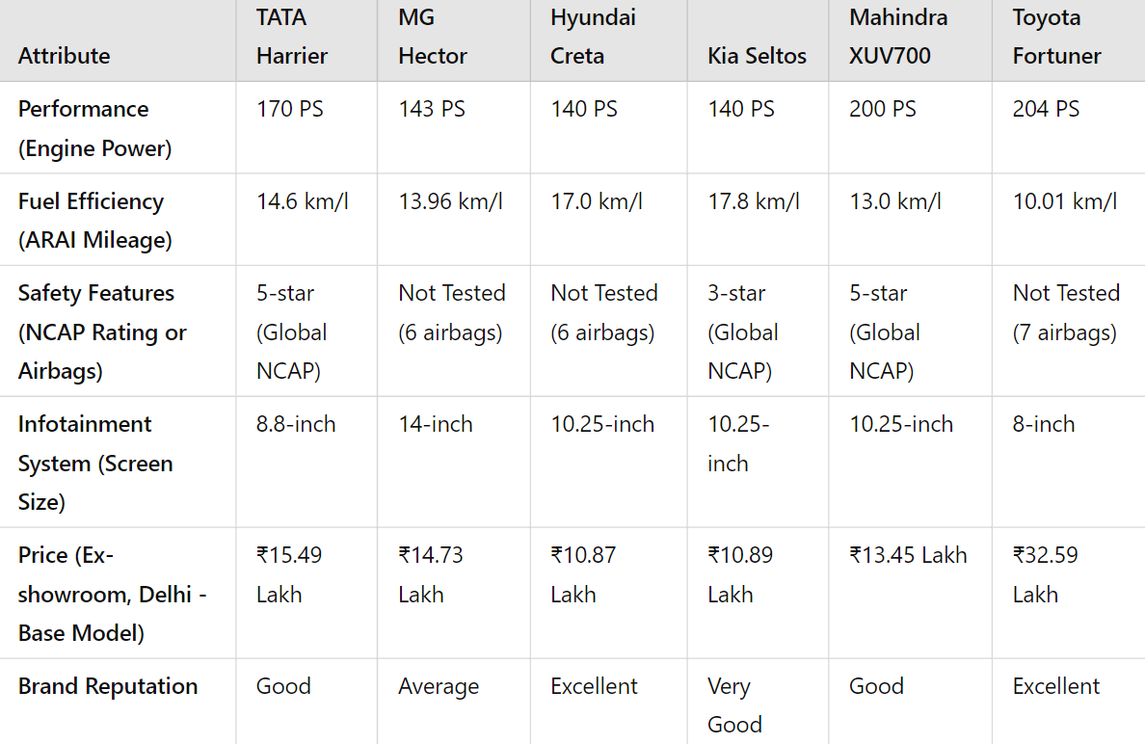

Slide 9
PURCHASE STAGE
The purchase stage is a critical phase in the consumer decision-making process.
We used correlation analysis to uncover the relationships between different factors influencing consumers’ decisions during the purchase stage.
Regression analysis was applied to simulate real-world trade-offs that consumers make when evaluating different vehicle attributes.

Slide 10
RESEARCH FINDINGS - CORRELATION ANALYSIS
Age-based Priorities
Younger consumers (18-21) focus on performance and price – Driving Experience; Older consumers (29-34) prioritize comfort, safety, and fuel efficiency - long-term reliability and cost-saving features
Interconnected Features
Performance, comfort, and fuel efficiency – Mutually supportive in the consumer decision-making process
Safety and Design
Safety-conscious buyers place high importance on design and infotainment
Price Sensitivity and Brand Perception
Price-sensitive consumers expect higher-quality features and modern technology in higher-priced vehicles, linking price to perceived value and brand reputation. Brand reputation is strongly associated with resale value

Slide 11
KEY INSIGHTS
Target younger consumers with messages focused on performance and value-for-money, while appealing to older consumers through comfort, safety, and fuel efficiency.
Emphasize the integration of performance, comfort, and fuel efficiency in marketing, as they are perceived as interconnected features.
Leverage brand reputation and resale value in your messaging to reassure consumers of the long-term benefits of their investment.

Slide 12
RESEARCH FINDINGS - REGRESSION ANALYSIS
Fuel Efficiency Dominates
strongest impact on overall satisfaction, reflecting a consumer preference for long-term savings and cost-effectiveness
Price as a Key Factor
consumers looking for value for money. High prices are justified by better features or technology
Brand Reputation and Trust
crucial for building trust and reducing perceived risk – Higher satisfactory level
Moderate Impact of Performance and Comfort
moderately important but not significant to overall post-purchase satisfaction

Slide 13
KEY INSIGHTS
Emphasize fuel efficiency and price in-product messaging, as these are the top drivers of satisfaction and value.
Position brand reputation as a key selling point to reduce perceived risk and build long-term trust with consumers.
Focus less on design and infotainment, as these factors play a lesser role in shaping overall satisfaction, even though they may influence specific buyer segments.
INTERPRETATION OF RESULTS
Performance, Comfort, and Design may decrease in the purchase stage once consumers are presented with concrete trade-offs like fuel efficiency, price, and brand reputation

Slide 14
POST PURCHASE STAGE- KEY FINDINGS
Pearson Correlation Coefficient (Cognitive Dissonance and Recommendations)
The correlation between Cognitive Dissonance and Word of Mouth is 0.043
Cognitive dissonance has almost no effect on the likelihood of the customer recommending the product to others
Significance (P-value) (Cognitive Dissonance and Word Of Mouth)
The p-value for the correlation is 0.835
Correlation is not statistically significant, and there is no evidence that cognitive dissonance impacts word-of-mouth recommendations
Net Promoter Score (Satisfaction and Promotions)
The net promoter score on calculation came to be 15%
Customers are happy with the brand, and it doesn’t deter them promoting the brand

Slide 15
RECOMMENDATIONS FROM POST PURCHASE
Improving the post-purchase experience and addressing small issues of cognitive dissonance in advance will enable Tata Motors to build stronger customer loyalty, enhance satisfaction, and encourage repeat purchases.
Prioritizing customer service, clear communication, and ongoing feedback can help reduce potential dissatisfaction while leveraging positive word-of-mouth, positioning the Tata Harrier as an even more attractive option for future buyers.

Slide 16
MARKETING STRATEGY RECOMMENDATIONS
Product
In the Indian automotive market, hybrid and electric vehicle (EV) sales are gaining traction, with hybrid variants showing strong growth. The Indian Hybrid vehicle market is expected to grow by 2027.
Pricing
Indian consumers are highly value-conscious, particularly in Tier 2 and Tier 3 cities. Around 33% of car buyers in these regions rely on financing to make purchases affordable. Offering competitive financing options, such as low-interest loans or flexible payment plans, can attract a broader customer base, especially in the compact SUV segment.
Place
As urban car markets are saturated, expanding into smaller cities presents a significant opportunity. Tier 2 and Tier 3 cities account for a growing share of SUV sales, driven by increasing disposable income and infrastructural development.
Promotion
Social media campaigns – Influencer marketing – Collaboration (Lifestyle influencers, Brands); Tata Punch’s positioning as a “micro-SUV” for young buyers saw a boost from influencer promotions and collaborations.

