Slide 1
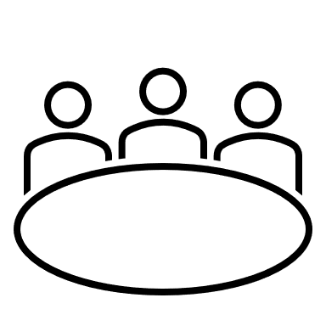
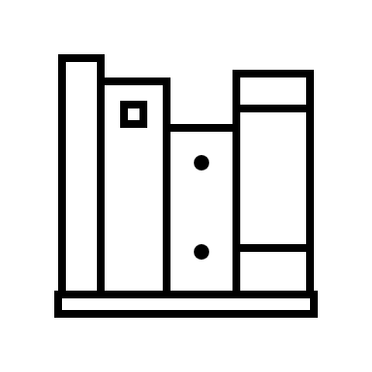

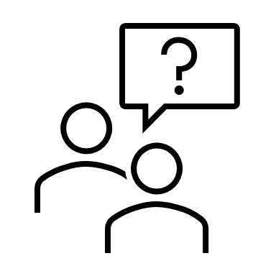
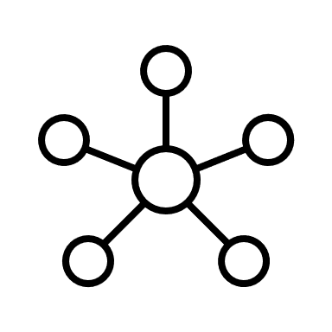



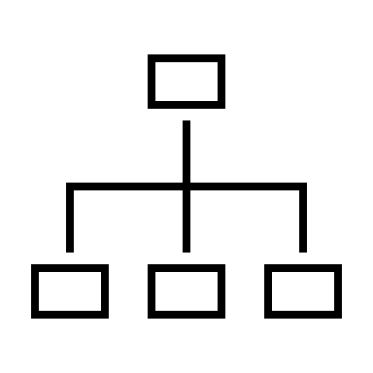
Stakeholder
Metadata
Language Extension
Systems / Kernel / Domain Libraries
Concerns
Viewpoints
Model Packages
Library of View Definitions
Model View

Slide 2

Stakeholder
Metadata
Language Extension
Systems / Kernel / Domain Libraries
Concerns
Viewpoints
Model Packages
Library of View Definitions
View usage
Model View

Slide 3
package 'StakeholdersLibrary' {
item def Stakeholder {
doc /* A generic stakeholder who has a role and specific concerns about the system. */
}
individual item def SecurityExpert :> Stakeholder {
doc /* Ensures the system design meets security requirements and mitigates vulnerabilities. */
}
}
package 'XConcernsStakeholdersConcerns' {
public import StakeholdersLibrary::*;
//private import Viewpoints::*;
concern 'SecurityRequirements' {
doc /*
* What are the Security Requirements?
*/
stakeholder securityExpert: 'StakeholdersLibrary'::SecurityExpert;
}
library package SAF_Stereotypes { abstract occurrence def SAF_LogicalSOI;
abstract occurrence saf_LogicalSOI : SAF_LogicalSOI[*] nonunique; }
package Viewpoints {
public import StakeholdersLibrary::*;
public import Concerns::*;
viewpoint 'SecurityRiskAnalysisViewpoint' {
frame SecurityRequirements;
frame SecurityMeasures;
frame Risk;
require constraint {
doc /* */
}
}
package SAF_Metadata{
private import SAF_Stereotypes;
private import Metaobjects::SemanticMetadata;
metadata def SAF_LogicalSOI :> SemanticMetadata {
:> annotatedElement : SysML::Definition;
:> annotatedElement : SysML::Usage;
redefines baseType = SAF_LogicalSOI meta SysML::Definition;
}
}
library package SAF_ViewExtensions {
doc /*
* This package defines the standard view extensions for SAF .
*/
public import SysML::*;
public import Views::*;
public import StandardViewDefinitions::*;
public import Viewpoints::*;
view def <xxx> SAF_C2_CSTD specializes GeneralView{
doc /*xxx*/
satisfy SecurityRiskAnalysisViewpoint;
}
}
package Test{
private import SAF_Metadata::*; #SAF_LogicalSOI def FFDS;
}
private import SAF_ViewExtensions::*;
view 'SAF Test View':
SAF_C2_CSTD {
expose Test::**;
render asTreeDiagram;
}

