Slide 1
fas_frontend.odp for OpenOffice Impress or LibreOffice Impress
Copyright 2022 Gesellschaft für Systems Engineering e.V. (GfSE)
Licensed under the Apache License, Version 2.0 (the "License");
you may not use this file except in compliance with the License.
You may obtain a copy of the License at
http://www.apache.org/licenses/LICENSE-2.0
Unless required by applicable law or agreed to in writing, software
distributed under the License is distributed on an "AS IS" BASIS,
WITHOUT WARRANTIES OR CONDITIONS OF ANY KIND, either express or implied.
See the License for the specific language governing permissions and
limitations under the License.
This is a quick-and-dirty front-end to the FAS Plugin for SysML v2. It allows the user to enter and group use case activities via OpenOffice / LibreOffice Impress (shapes with solid lines = use case activities / shapes with dashed lines = functional groups).
This little helper may become obsolete, once graphical SysML v2 tools become available.

Slide 2
How to run
Make sure that Miniconda is installed with the sympy package.
Make sure that the "model" to work with is on page 3 of this slide deck (by default, it contains a simplified version of the the well-known "Jukebox" model).
You can optionally use numbers in round brackets to define the order in which the use case activities correspond to matrices in the fas-as-a-formula computation.
Make sure that the information at the bottom of slide 3 is entered correctly
(All folder names need to be specified with a slash or backslash as a last character, e.g. "c:\Temp\“ on Windows or "~/" on Linux for the working folder. Folder names must not
contain spaces).
Make sure that the sub-directories of the "src" folder from this distribution of the plugin are copied into the working folder as specified at the bottom of slide 3.
Make sure that OpenOffice / LibreOffice Impress macros are enabled.
If you want to run a simple demo of the FAS method without SysML, go to slide 5 and press the button. Otherwise, continue with the next steps.
Make sure that the SysML v2 reference implementation for Miniconda is installed.
Choose the demo to run:
  Use the buttons on the right side of slide 3 from top to bottom for a full demo with a SysML v2 repository (see the last slide in this slide deck for explanations).
  Use the button on slide 4 for a demo without an installed SysML v2 repository.
[To learn more about the button “link image snippet” on slide 3, see io\usecase-activity-editor\freesketch\ReadMe.txt]

Slide 3
ioCustomer
musicSource
Only use images in 800x600 size, until scaling is solved.
(1) getMoney
(2) monitorPayment
(4) produceSound
(3) playMusic
Working folder: C:\Temp\
Python home folder: C:\Users\xyz\miniconda3\
Xterm command (Linux only): gnome-terminal

Slide 4
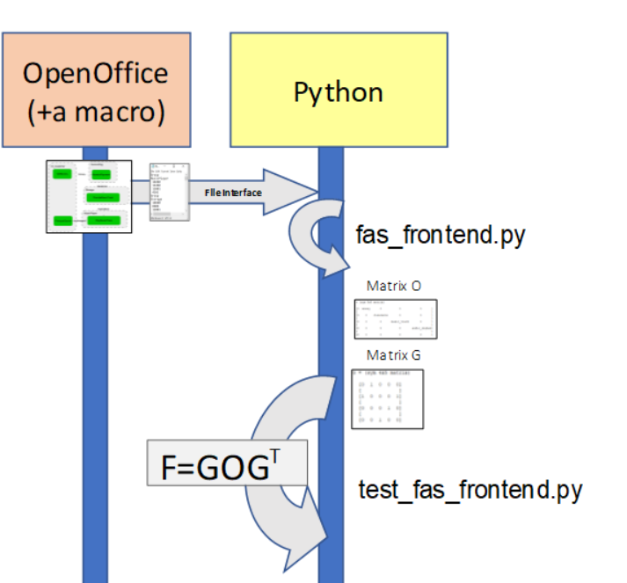
For demos without a connection to a SysML v2 repository
OpenOffice
(+a macro)
Python

Slide 5
For demos without any SysML installation
EASY DEMO
OpenOffice
(+a macro)
Python
run_fas_demo_without_sysml.py

Slide 6
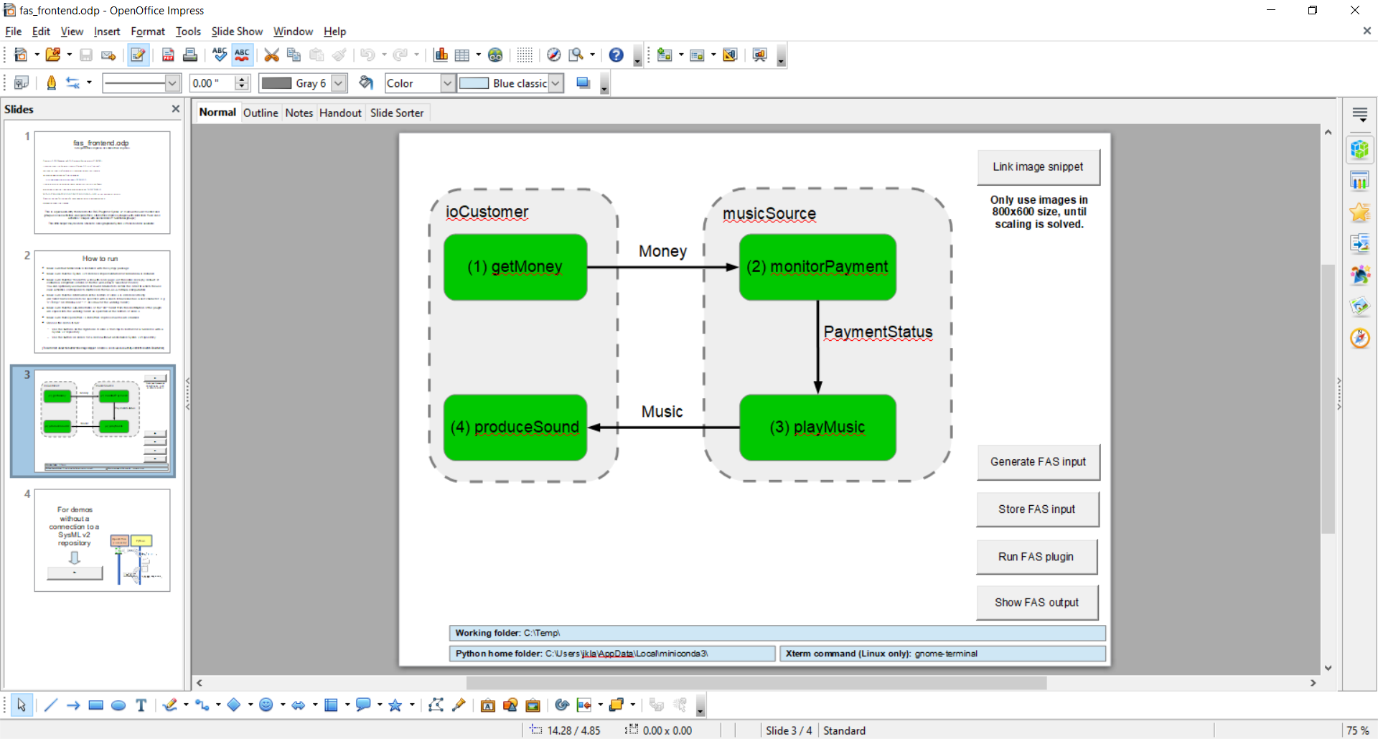



Explanation of the buttons on slide 3
Use case activities (shapes with solid borders) and functional groups (shapes with dashed borders) are the input for applying the FAS method.
Via buttons on slide 3 and the underlying macros, one can call python scripts that support the further work with the entered data via the FAS method:
=> Store the modeled data in the repository.
=> Invoke the FAS plugin to read the data back and transform it into a functional architecture model that is again written to the repository.
=> Invoke a python-based tool to read the functional architecture from the repository and visualize it.
The other buttons are for more advanced use cases. For more information, watch this video:https://www.youtube.com/watch?v=2qpIY1HcfnM and read this text file: https://github.com/GfSE/fas4sysmlv2/blob/main/src/io/usecase-activity-editor/freesketch/ReadMe.txt

Slide 7
IOPower
EnergyDistribution
Cake baking machine example
Based on the following publication (in German):
Weilkiens, T.; Lamm, J.G.: "Happy birthday!
15 Jahre FAS-Methode in der Praxis", in Koch, W.;
Wilke, D.; Dreiseitel, S.; Hofmann, I. (Eds.):
Tag des Systems Engineering - 29.-31. Oktober, Salzburg,
Gesellschaft für Systems Engineering e.V. (GfSE Verlag),
Bremen, Germany, 2025, pp. 28 - 34
How to run this example:
- Move this slide futher up in the slide deck to make it become slide #3.
- Remove this yellow text box
- Run the demo via buttons on this slide.
Only use images in 800x600 size, until scaling is solved.
getEnergy
distributeEnergy
Only use images in 800x600 size, until scaling is solved.
startEnergySupply
CakeManagement
BakingControl
loadOfferOfTheDay
startBakingMachine
IOPayment
createCakeID
acceptPayment
createBakingScript
IOHungryPerson
getCakeSelection
displayCakeCode
Working folder: C:\Temp\
Python home folder: C:\Users\xyz\miniconda3\
Xterm command (Linux only): gnome-terminal

