Slide 1
Exploration of the FAS Method with SysML v2
Functional Architectures Working Group of Gesellschaft für Systems Engineering e.V.
Copyright 2022 Gesellschaft für Systems Engineering e.V. (GfSE)
Licensed under the Apache License, Version 2.0 (the "License");
you may not use this file except in compliance with the License.
You may obtain a copy of the License at
http://www.apache.org/licenses/LICENSE-2.0
Unless required by applicable law or agreed to in writing, software
distributed under the License is distributed on an "AS IS" BASIS,
WITHOUT WARRANTIES OR CONDITIONS OF ANY KIND, either express or implied.
See the License for the specific language governing permissions and
limitations under the License.

Slide 2
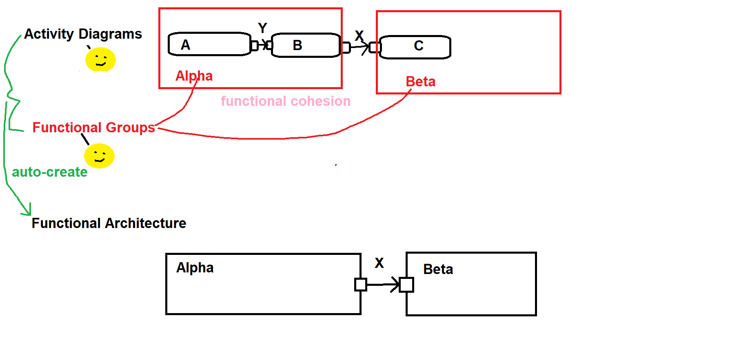
FAS Method
Made by human (or
artificial) intelligence
Made by human (or
artificial) intelligence

Slide 3
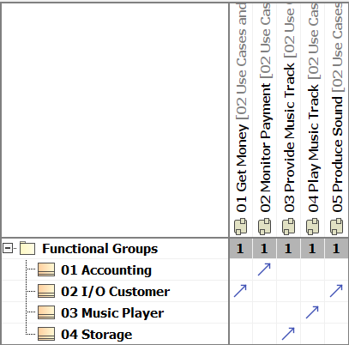
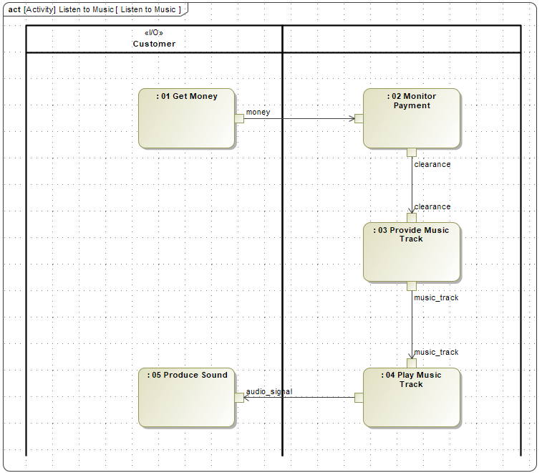
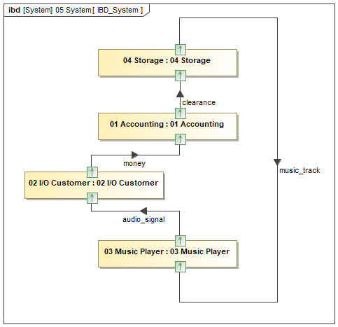
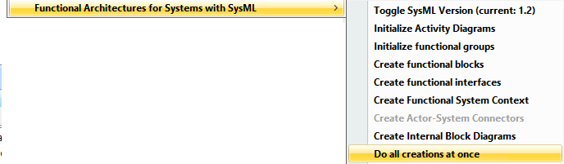
Modeling tool representation of the FAS Method
Functional
Grouping
Object Flows
Functional Architecture
© GfSE
Notes:
Vortragender: Tim

Slide 4
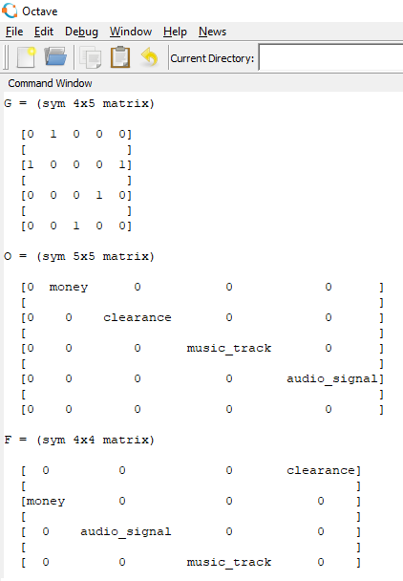

Matrix representation the of FAS Method: F=GOG^{T}
Grouping Matrix G
Object Flow Matrix O
Functional Architecture F
Based on: Lamm, J.G.: "Eine schlanke Formel für den Kern der FAS-Methode, zur einfachen Werkzeug-
Umsetzung der Methode", in Koch, W.; Wilke, D.; Dreiseitel, S.; Kaffenberger, R. (Eds.): Tag des Systems Engineering –
Paderborn 16.-18. November 2022, Gesellschaft für Systems Engineering e.V. (GfSE Verlag), Bremen, Germany, 2022, pp. 127-131.
English summary available here: https://github.com/GfSE/fas4sysmlv2/blob/main/doc/tech-docs/fas/FAS-as-a-formula-2022.odt
© GfSE
Notes:
Vortragender: Tim

Slide 5
Matrix representation the of FAS Method: F=GOG^{T}
Grouping Matrix G
Object Flow Matrix O
Functional Architecture F
Based on: Lamm, J.G.: "Eine schlanke Formel für den Kern der FAS-Methode, zur einfachen Werkzeug-
Umsetzung der Methode", in Koch, W.; Wilke, D.; Dreiseitel, S.; Kaffenberger, R. (Eds.): Tag des Systems Engineering –
Paderborn 16.-18. November 2022, Gesellschaft für Systems Engineering e.V. (GfSE Verlag), Bremen, Germany, 2022, pp. 127-131.
English summary available here: https://github.com/GfSE/fas4sysmlv2/blob/main/doc/tech-docs/fas/FAS-as-a-formula-2022.odt
© GfSE
Notes:
Vortragender: Tim

Slide 6
Architecture of FAS for SysML v2 solution
NEW
FAS for SysML v2
Python app
Docker
Python calls
SysML2 API calls
SQL
Python*
SysML v2
API Service Pilot
Linux
PostgresSQL
Scala / Java
MS Windows or Linux
SQL DB
* The decision has been made not to use the Python API implementation, because the few needed API calls don't
justify the additional installation effort for each user. The new Python code will directly call the REST API.

Slide 7
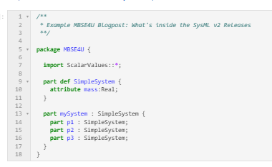
Use of the SysML reference implementation
SysML v2
reference implementation
Use of "jupyter nbconvert" to execute the reference implementation via jupyter notebooks
FAS for SysML v2
Python app
Docker
Python / Jupyter
SysML v2
API Service Pilot
Linux
PostgresSQL
Scala / Java
MS Windows or Linux
SQL DB

Slide 8
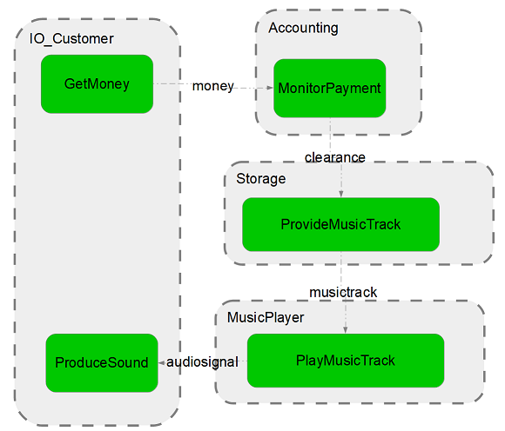
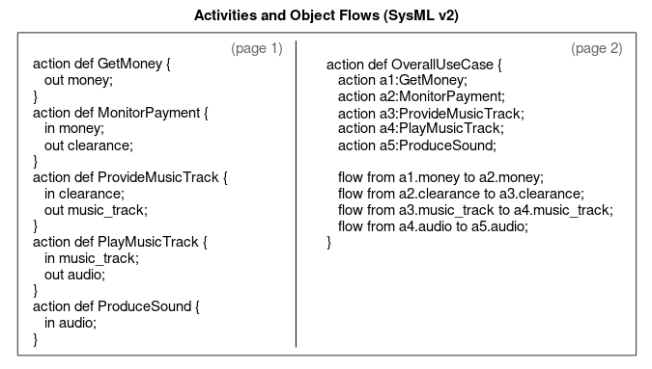
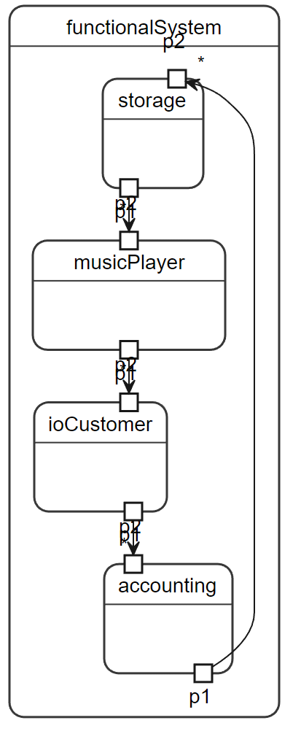
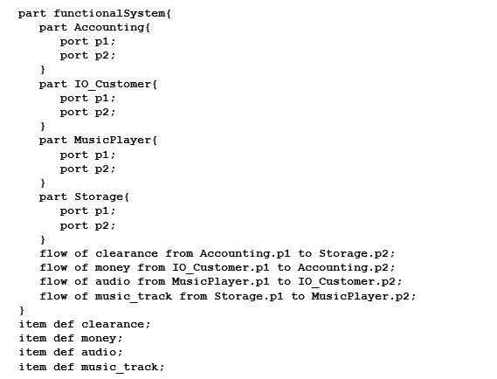
Sample use scenario
OpenOffice
(+a macro)
Local SysML v2 reference implementation
FAS for SysML v2
Python app
SysML v2
API Pilot
execute notebook
%publish <namespace>
Matrix G
Matrix O
F=GOG^{T}

Slide 9
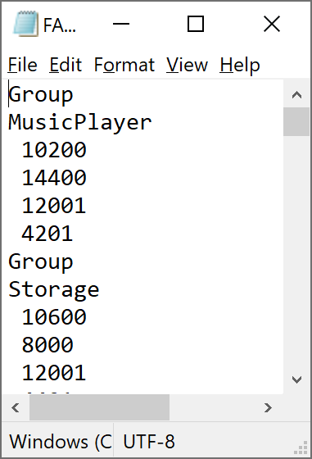
Current state of the implementation (as per July 10th, 2023)
OK
OK
Reading done / Writing to be improved
OpenOffice
(+a macro)
Python
Local SysML v2 reference implementation
FAS for SysML v2
Python app
SysML v2
API Pilot
File Interface
fas_frontend.py
write_fas_input.py
execute notebook
fas input
Matrix O
OK
Matrix G
fas input
fas4sysmlv2_main.py
F=GOG^{T}
TO BE IMPROVED
fas output
blockdiagram_renderer.py
fas output
TO BE IMPROVED

Slide 10
Envisioned final result
Open Source Components
(OpenOffice, Developer resources, libraries, …)
LoLocal SysML v2 reference implementation
FAS for SysML v2
Python app
SysML v2
API Pilot
(or later: The API of
a commercial product)
Use Case Activity
and Functional Group
Modeling Component
(FAS Working Group of INCOSE Germany)
fas4sysmlv2\src\io\usecase-activity-editor
fas4sysmlv2\src\io\usecase-activity-editor
Use Case Activities
Functional Groups
Use Case Activities
+ Functional Groups
FAS Plugin for SysML2
(FAS Working Group)
fas4sysmlv2\src\core
Automatic View Generation Component
(Viewpoints Working Group of INCOSE Germany)
Functional Architecture
fas4sysmlv2\src\io\functional-architecture-browser
Functional
Views

Slide 11
Next steps
Use Case Activity and Functional Group
Modeling Component
(FAS Working Group of INCOSE Germany)
Consider a more graph-optimized editor than OpenOffice / LibreOffice.
FAS Plugin for SysML2
(FAS Working Group)
Provide execution progress indication in real time.
Write to the source project incrementally, instead of creating
a new project for the output.
Allow the user to choose only a subset of the model as the
applicable input for the FAS transformation.
Automatic View Generation Component
(Viewpoints Working Group of INCOSE Germany)
HIGHEST
PRIORITY
Remove a dependency on an external website (e.g. by including
the corresponding python modules instead of executing them
interactively on a third-party website).
Allow the user to choose only a subset of the model as the
applicable input for visualization.
Consider a more graph-optimized visualization tool
Display traceability to FAS input.

Slide 12
Outlook
These will hopefully be replaced by dedicated SysML v2 tools
This will remain ...
... and hopefully be interoperable
with the different SysML v2 tools,
via the API.
Use Case Activity and Functional Group
Modeling Component
(FAS Working Group of INCOSE Germany)
FAS Plugin for SysML2
(FAS Working Group)
Automatic View Generation Component
(Viewpoints Working Group of INCOSE Germany)

Slide 13
Appendix: Software List
Name
Docker
(On Windows only:) Windows Subsystem for Linux
Docker container with PostgresSQL database
Java JDK 11
Scala programming language and sbt build tool
SysML v2 API Services
Python / Anaconda
SysML v2 Reference Implementation for Jupyter Lab
http://interactive.blockdiag.com/

