Slide 1


Slide 3
Outline
Introduction
Motivation
System Overview
Local Positioning System Design
Formation Control System Design
Results
Conclusion and Future Works
References

Slide 4
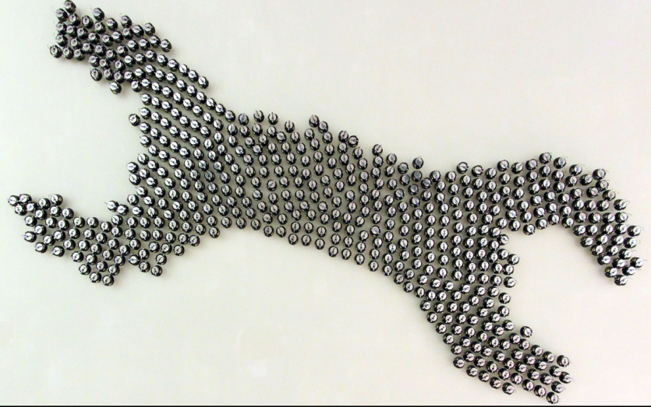
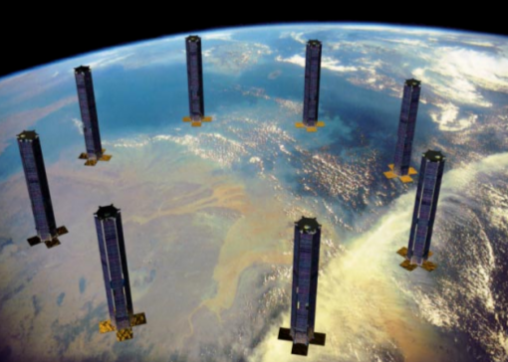
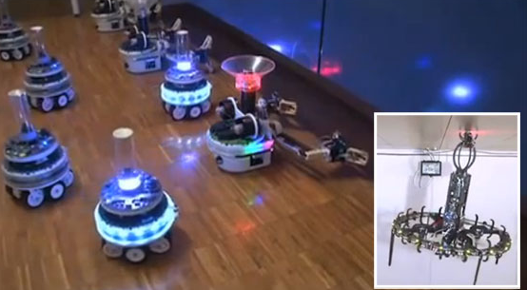
Introduction
This thesis work focuses on dynamic adaptation to achieve changes in formation of swarms consisting of heterogenous mobile robots
[1]
[2]
[3]

Slide 5
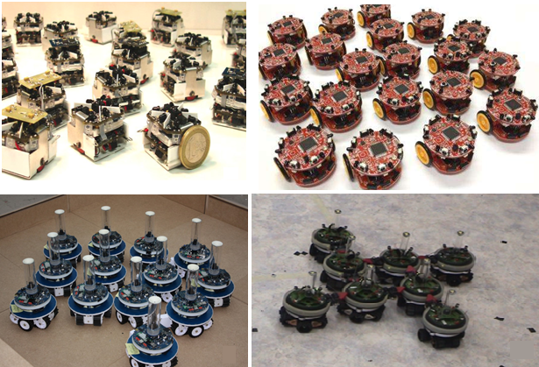
Motivation
The research about the formation control, mainly focuses on swarms with homogenous agents.
[4]
[5]
[6]
[7]

Slide 6
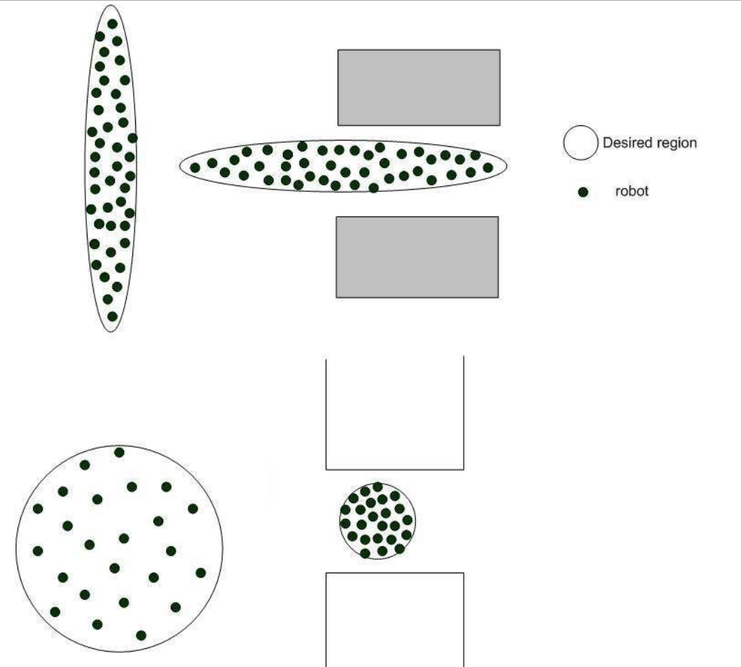
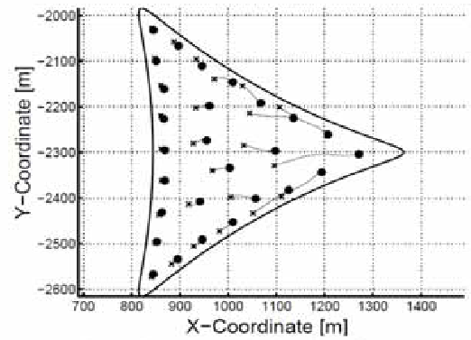
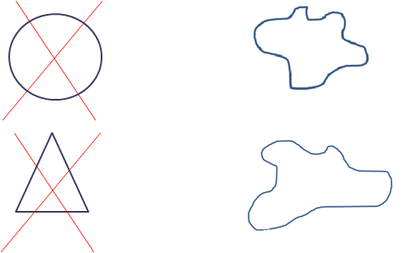
Motivation
Formation control solutions are generally implemented with simple geometrical shapes which don’t change with time.
[9]
Our aim
[8]

Slide 7
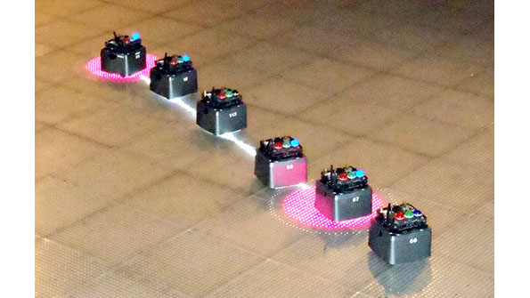
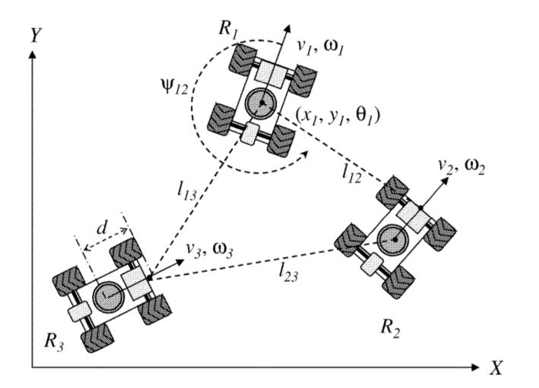
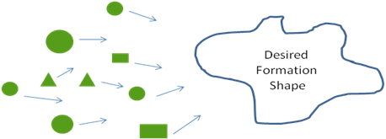
Motivation
Centralized topologies create single point of failure type systems. We aim to implement a decentralized solution to increase the robustness of the system.
[10]
[11]
Our aim

Slide 8
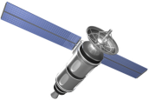
Motivation
One of the most important characteristic of an agent in the swarm is its simplicity and limited sensor & communication capability [12]. Most of the related work assumes that the position data is always available (i.e. can be measured) for each agent in the workspace.
Our aim is to design a local positioning system to provide position information to the agents which do not have the ability to measure its position in the workspace
???
Gps
???
???
???
Gps
???

Slide 9
System Overview
LOCAL POSITIONING SYSTEM
FORMATION CONTROL SYSTEM
Ultrasonic Sensors
Local Trilateration
Route Table
Algorithms
Localization
Timer
State Estimator
Formation Control
Agent
Dynamics
Acc. Sensors
State Propogation
Gyro Sensors
Mag. Sensors
Formation
Shape

Slide 10
Local Positioning System (LPS)
Local positioning system is composed of two main parts.
1)Local Trilateration
This process calculates the position data for the agents which don’t have position sensors by using local neighbors.
2)Route Table Determination
This process creates a mesh network which is a communication backbone in the swarm. It also determines the clusters around the position beacons and provides the order for the local trilateration process.

Slide 11
Local Positioning System (LPS)
1)Local trilateration
Requires at least 3 neighbors
Handles lost agents (agents do not have three neighbors)
The execution order of this process is determined with the help of route tables.
N1(x,y,z)
N2(x,y,z)
Neighbor 1
r1
r2
P(x,y,z)
Neighbor 2
r3
N3(x,y,z)
Agent i
rn
Neighbor 3
Nn(x,y,z)
Neighbor n

Slide 12

Local Positioning System (LPS)
1)Local trilateration
The solution of the position(P(x,y,z)) with the help of positions of neighborscan be reduced to a problem of;
We have an A matrix with a dimension of [n-1] x 2 (where n is the number of neighbors). There are three options for the solution of the problem related with the condition of A matrix,
1) , unique solution (if there are 3 neighbors and A is full column rank matrix)
2) , , minimum norm solution (if there are more neighbors and A is full column rank matrix
3) Find the minimum error/norm solution with nonlinear least squares method, if rank(A) = 1

Slide 13
Local Positioning System (LPS)
1)Local trilateration
Lost agent handling rules;
An agent is called ‘lost’ when it doesn’t have minimum 3 neighbors
If an agent is lost it cannot enter the localization process, and it enters ‘Lost’ mode
If an agent is missing the localization process for 3 times, then it enters ‘Return to Home mode’ in which it is directed to the formation shape center
Lost

Slide 14
Local Positioning System (LPS)
1)Local trilateration
Return to Home Mode
Lost agent aims to
arrive to this point
Movement in real world
Agent’s real
position
Agent’s wrong
position
Estimated movement to
the formation center

Slide 15
Local Positioning System (LPS)
2)Route Table Determination
This process creates the mesh network in the swarm and determines the clusters around position beacons
Agents get in localization process in an order determined with the rank information stored in their route tables.
Destination-Sequenced Distance Vector Routing Protocol (DSDV) algorithms
are used to create the route tables.

Slide 16
Local Positioning System (LPS)
2)Route Table Determination
DSDV is a table driven routing scheme based on Bellman Ford algorithm
Used generally in wireless mesh networks and ad-hoc mobile networks
Solves routing loop problem in Bellman Ford algorithm
Route table for agent 2
Routing Loop Problem
Destination | Next Hop | Metric | Dest. Seq. No
1 | 1 | 1 | 123
3 | 3 | 1 | 516
4 | 4 | 1 | 212
5 | 4 | 2 | 168
6 | 8 | 3 | 372
7 | 8 | 2 | 432
(D,5)
(D,4)
(D,4)
(D,3)
(D,2)
(D,2)
3
5
A
B
C
D
4
Dest. | Next | Metric
… | … | …
D | B | 3, 5, …
Dest. | Next | Metric
… | … | …
D | B | 3, 5, …
Dest. | Next | Metric
… | … | …
D | C | 2, 4, 6,..
6
1
2
7
8

Slide 17
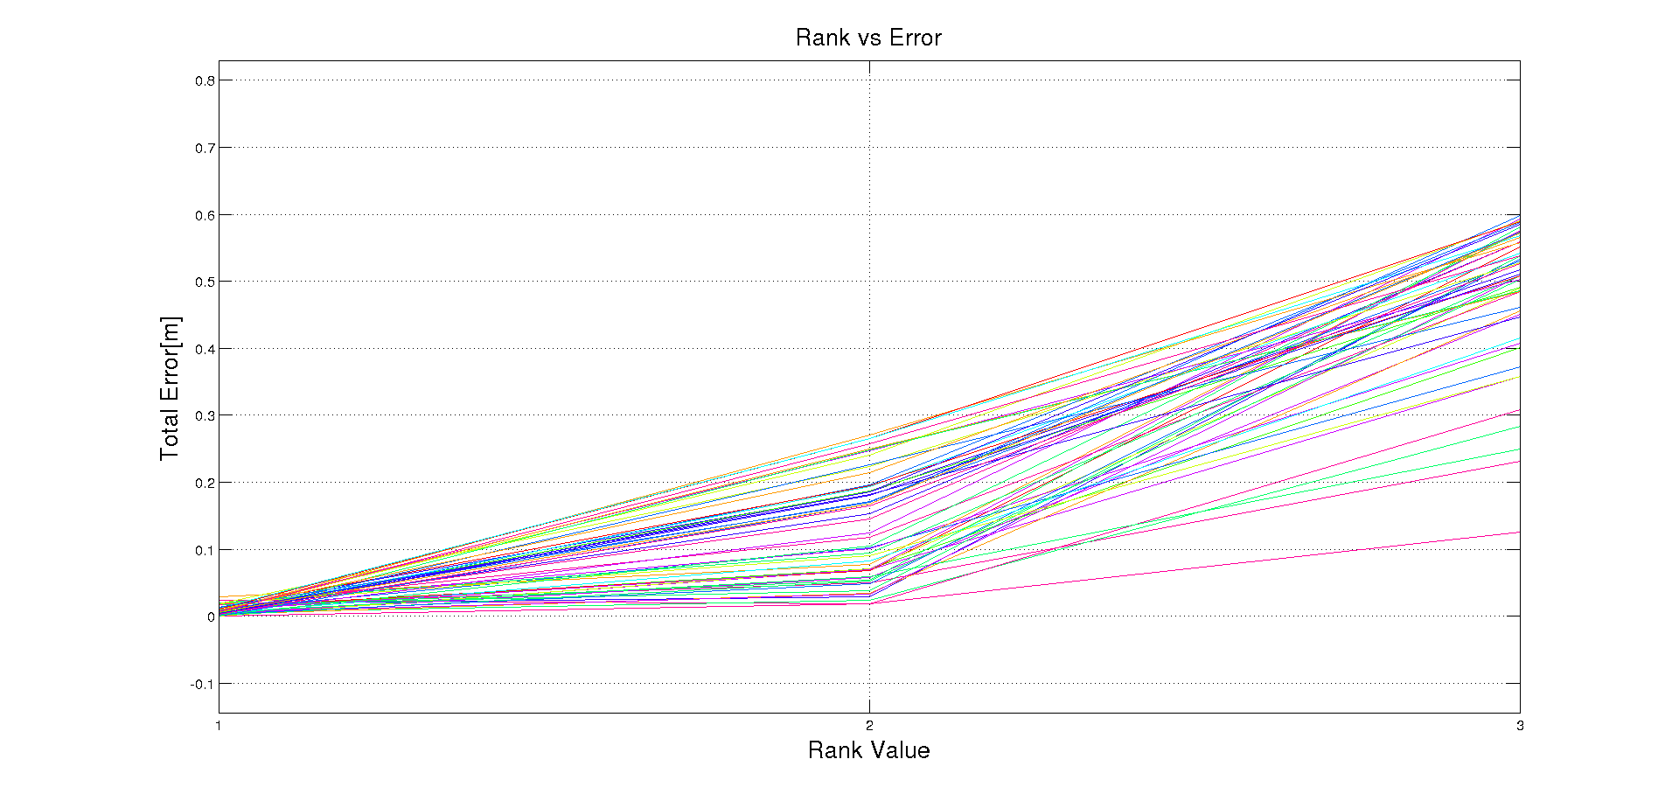
Local Positioning System (LPS)
2)Route Table Determination
Rules for Localization Problem
Agents decide to join the cluster of position agent with minimum metric value(i.e. counts for hops)
This approach minimizes the total error for the positions of agents which are relatively
far away from the beacons.
Localization process must be done with increasing order of counts for hops in a cluster
Position
Beacon

Slide 18
Formation Control System
Three different approaches were used to design the formation control system in this thesis work.
Formation Control Strategies
Potential Field Based Approach
Shape Partitioning Based Approaches
1) Artificial Forces Method
2) Bubble Packing Method
3) Randomized Fractals Method
Directly calculates control laws based upon potential fields
Partitions the desired formation shape into goal states.
Control laws are implemented to reach these goal states.

Slide 19
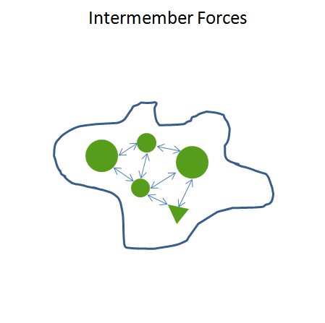
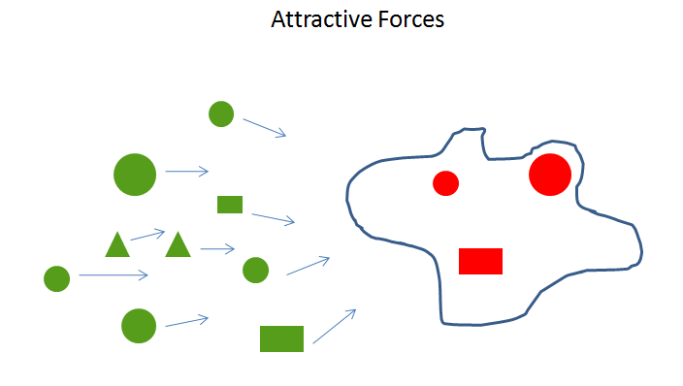

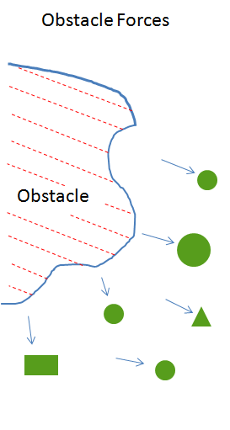
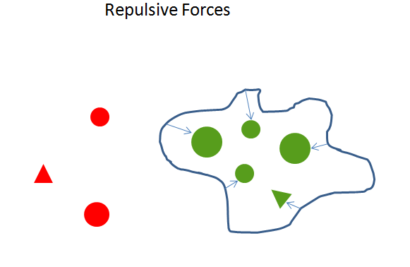
Formation Control System
Artificial Forces Method
Directly defines the control law for individuals with different potential field components.

Slide 20
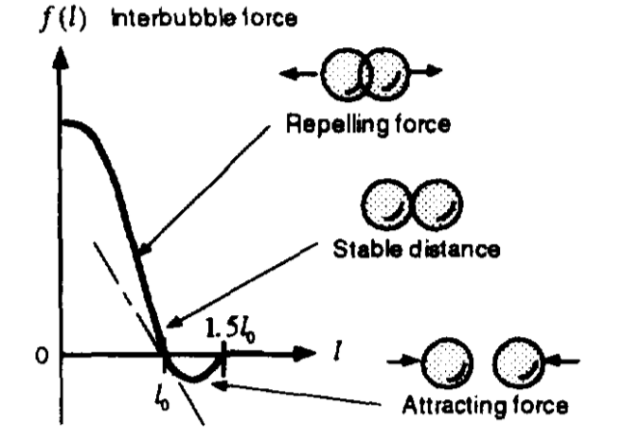
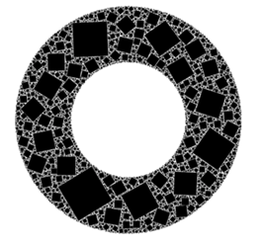
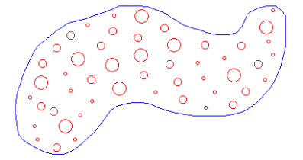
Formation Control System
Bubble Packing and Randomized Fractals Methods
These two methods partition the desired formation shape into goal states with different approaches. The procedure of the assignment of the agents to these goal states are identical.
Bubble Packing
Randomized Factals
[12]
[13]

Slide 21


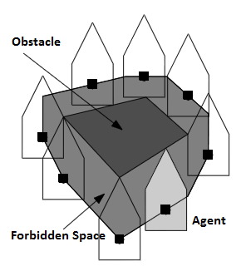
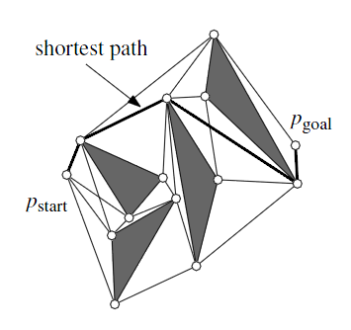
Formation Control System
Bubble Packing and Randomized Fractals Methods
Decision of Goal States
1)Calculation of Free Configuration Space
2)Visibility Graphs
The shortest path between a start and goal among a set S of augmented polygonal obstacles consists of arcs of the visibility graph
Forbidden Space :
[14]
[14]
Forbidden Space
Visibility Graph

Slide 22
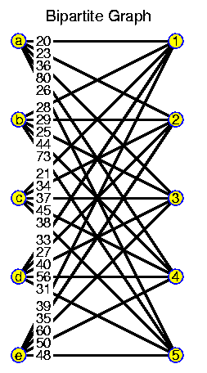
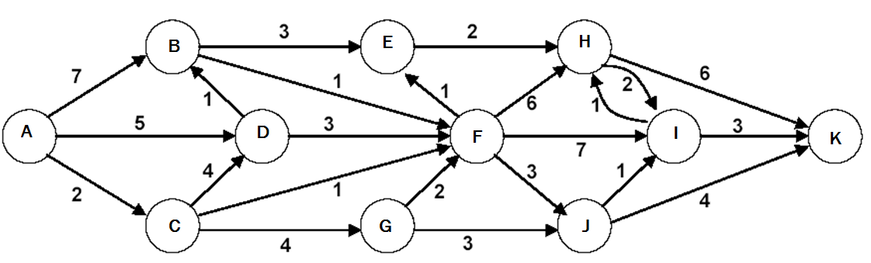
Formation Control System
Bubble Packing and Randomized Fractals Methods
Decision of Goal States
3)Dijkstra’s Algorithm
4)Hungarian Algorithm (Munkres Assignment Algorithm)
Dijkstra's algorithm is a tree search algorithm for finding the shortest paths between nodes in a graph
The shortest path between a start and goal among a set S of augmented polygonal obstacles consists of arcs of the visibility graph
 | Clean Bathroom | Sweep Floors | Wash Windows
Jim | $3 | $3 | $3
Steve | $3 | $2 | $3
Alan | $3 | $3 | $2
[15]
Calculation of Minimum Shortest Path From A to K
[16]

Slide 23
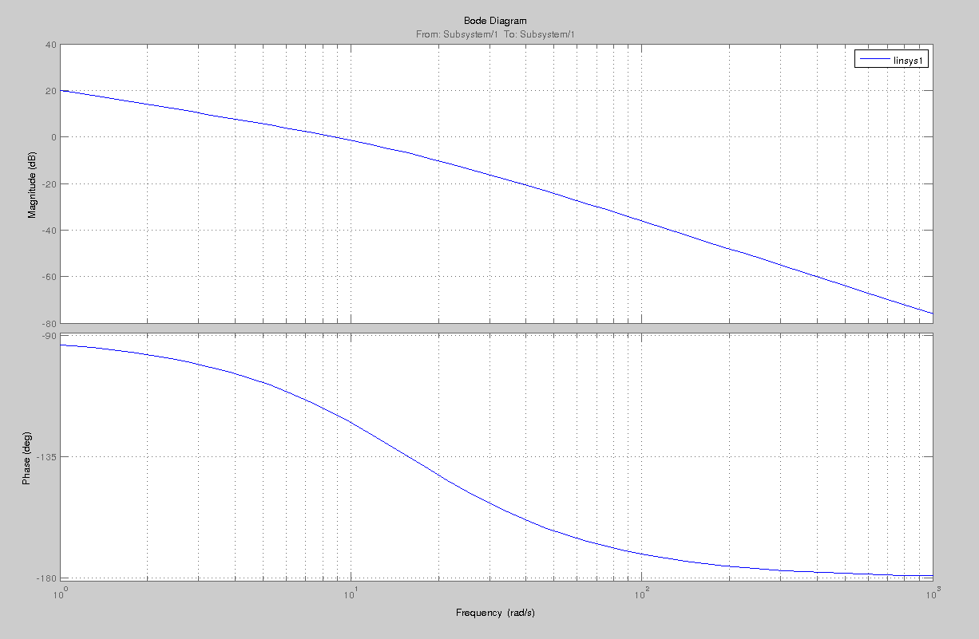
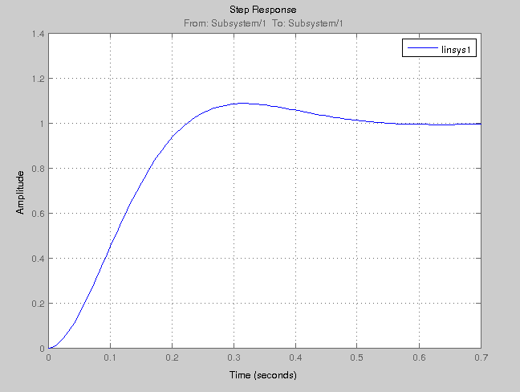
Formation Control System
Bubble Packing and Randomized Fractals Methods
Navigation to Goal States
Goal State
r
1/s
Plant
y
Amplitude
Bearing Angle
x
A1
K
Open loop Bode plots
Step response

Slide 24



Formation Control System
Bubble Packing and Randomized Fractals Methods
Velocity Controller
The dynamical system of agents is augmented with an artificial error state, to design an State feedback with LQR controller;
Q and R matrices used in solving Riccati equations,
where,

Slide 25
References
[1] http://www.eecs.harvard.edu/ssr/projects/progSA/kilobot.html
[2] Martin N, Klupar P, “Techsat 21 And Revolutionizing Space Missions Using Mıcrosatellıtes”,
[3] http://www.swarmanoid.org/swarmanoid_hardware.php.html
[4] S Kornienki, O. Kornienko, and Levi. P. Minimalistic approach towards communication
and perception in microrobotic swarms. In IEEE International Conference on Intelligent Robots and Systems, 2005.
[5] Farshad Arvin, John Murray, Licheng Shi, Chun Zhang, and Shigang Yue. Development
of an autonomous micro robot for swarm robotics. In IEEE International Conference on Mechatronics and Automation, 2014.
[6]Touraj Soleymani, Vito Trianni, Michael Bonani, Francesco Mondada, and Marco Dorigo. Bio-inspired construction with mobile robots and compliant pockets. Robotics and Autonomus Systems, 74:340–350, 2015.
[7] Roderich Grof, Michael Bonani, Mondada Francesco, and Marco Dorigo. Autonomous
self-assembly in a swarm-bot. 22:1115–1130, 2006.
[8] S.P. Hou, C.C. Cheah, and J.J.E. Slotine. Dynamic region following formationcontrol for a swarm of robots. In ICRA, 2009. [9] Samitha Ekanayake and Pubudu Pathirana. Formations of robotic swarm: An artificial force based approach. International Journal of Advanced Robotic Systems,7:173–190, 2010
[10] http://electronicdesign.com/systems/advanced-robots-swarm-nyc-s-museum-math
[11] Aveek Das, Rafael Fierro, Vijay Kumar, James Ostrowski, John Spletzer, and Camilla Taylor. A vision-based formation control framework. IEEE Transactions on Robotics and Automation, 18:813–825, 2002.
[12] Kenji Shimada and David Gossard. Bubble mesh: Automated triangular meshing of non-manifold geometry by sphere packing. In ACM Symposium on Solid Modeling and Applications, 1995.
[13]John Shier and Paul Bourke. An algorithm for random fractal filling of space.Computer Graphics Forum, 32:89–97, 2013.
[14] Mark Berg, Otfried Cheong, Kreveld. Marc, and Marc Overmars. ComputationalGeometry. Springer, 1998.
[15] https://nevraa.wordpress.com/2012/08/08/dijkstra-algoritmasi-ile-en-kisa-yol-bulma/
[16] Jop Frederik Sibeyn. Graph algorithms. https://www8.cs.umu.se/ jopsi/dinf504/chap14.shtml, last visited on April 2016.

