Slide 1


Slide 3
Outline
Introduction
Motivation
System Overview
Local Positioning System Design
Formation Control System Design
Results
Conclusion and Future Works
References

Slide 4
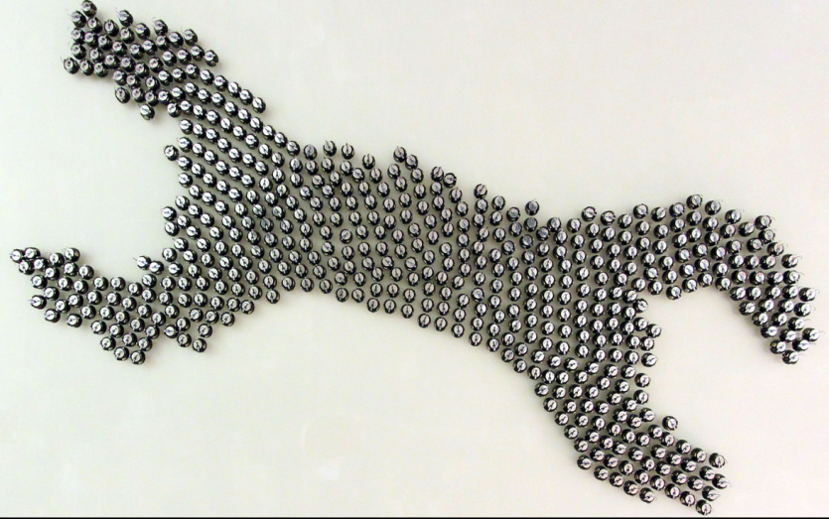
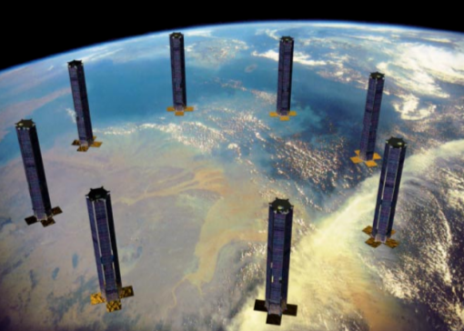
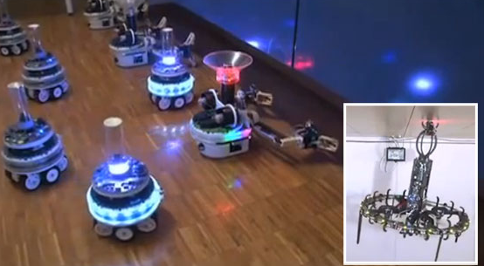
Introduction
This thesis work focuses on dynamic adaptation to achieve changes in formation of swarms consisting of heterogenous mobile robots
[1]
[2]
[3]

Slide 5
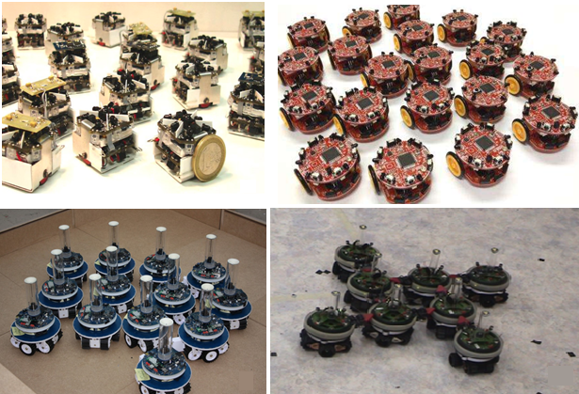
Motivation
The research about the formation control, mainly focuses on swarms with homogenous agents.
[4]
[5]
[6]
[7]

Slide 6
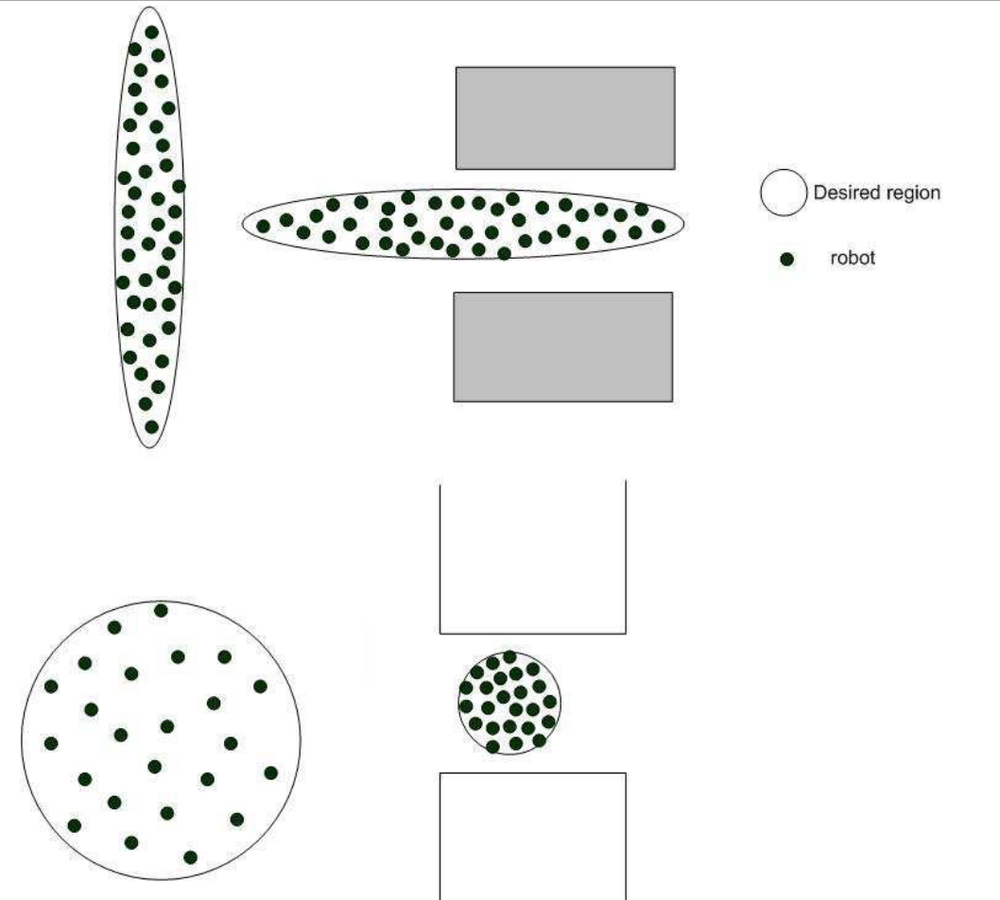
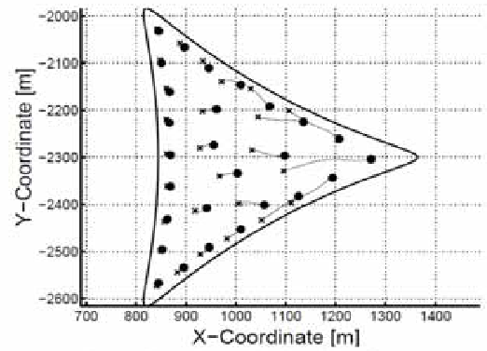

Motivation
Formation control solutions are generally implemented with simple geometrical shapes which don’t change with time.
[9]
Our aim
[8]

Slide 7
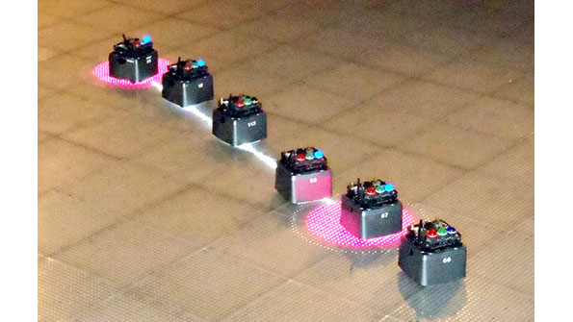
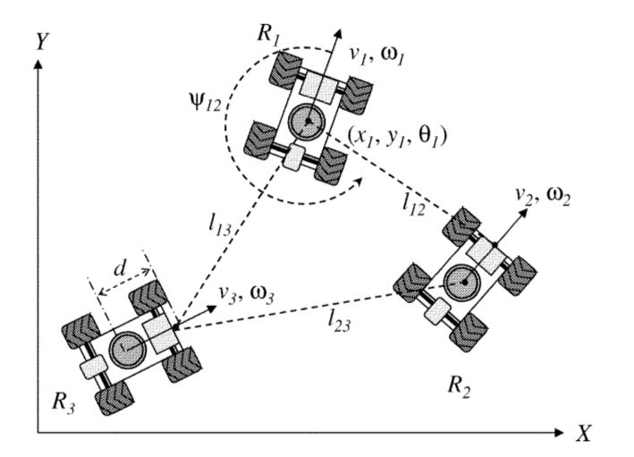
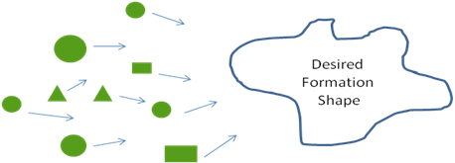
Motivation
Centralized topologies create single point of failure type systems. We aim to implement a decentralized solution to increase the robustness of the system.
[10]
[11]
Our aim

Slide 8
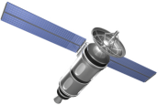
Motivation
One of the most important characteristic of an agent in the swarm is its simplicity and limited sensor & communication capability [12]. Most of the related work assumes that the position data is always available (i.e. can be measured) for each agent in the workspace.
Our aim is to design a local positioning system to provide position information to the agents which do not have the ability to measure its position in the workspace
???
Gps
???
???
???
Gps
???

Slide 9
System Overview
LOCAL POSITIONING SYSTEM
FORMATION CONTROL SYSTEM
Ultrasonic Sensors
Local Trilateration
Route Table
Algorithms
Localization
Timer
State Estimator
Formation Control
Agent
Dynamics
Acc. Sensors
State Propogation
Gyro Sensors
Mag. Sensors
Formation
Shape

Slide 10
Local Positioning System (LPS)

Slide 11
Local Positioning System (LPS)

Slide 12
Local Positioning System (LPS)

Slide 13
Local Positioning System (LPS)

Slide 14
Local Positioning System (LPS)

Slide 15
Local Positioning System (LPS)

Slide 16
Local Positioning System (LPS)

Slide 17
Local Positioning System (LPS)

Slide 18
Local Positioning System (LPS)

Slide 19
References
[1] http://www.eecs.harvard.edu/ssr/projects/progSA/kilobot.html
[2] Martin N, Klupar P, “Techsat 21 And Revolutionizing Space Missions Using Mıcrosatellıtes”,
[3] http://www.swarmanoid.org/swarmanoid_hardware.php.html
[4] S Kornienki, O. Kornienko, and Levi. P. Minimalistic approach towards communication
and perception in microrobotic swarms. In IEEE International Conference on Intelligent Robots and Systems, 2005.
[5] Farshad Arvin, John Murray, Licheng Shi, Chun Zhang, and Shigang Yue. Development
of an autonomous micro robot for swarm robotics. In IEEE International Conference on Mechatronics and Automation, 2014.
[6]Touraj Soleymani, Vito Trianni, Michael Bonani, Francesco Mondada, and Marco Dorigo. Bio-inspired construction with mobile robots and compliant pockets. Robotics and Autonomus Systems, 74:340–350, 2015.
[7] Roderich Grof, Michael Bonani, Mondada Francesco, and Marco Dorigo. Autonomous
self-assembly in a swarm-bot. 22:1115–1130, 2006.
[8] S.P. Hou, C.C. Cheah, and J.J.E. Slotine. Dynamic region following formationcontrol for a swarm of robots. In ICRA, 2009.[10] http://electronicdesign.com/systems/advanced-robots-swarm-nyc-s-museum-math
[9] Samitha Ekanayake and Pubudu Pathirana. Formations of robotic swarm: An artificial force based approach. International Journal of Advanced Robotic Systems,7:173–190, 2010
[10] http://electronicdesign.com/systems/advanced-robots-swarm-nyc-s-museum-math
[11] Aveek Das, Rafael Fierro, Vijay Kumar, James Ostrowski, John Spletzer, and Camilla Taylor. A vision-based formation control framework. IEEE Transactions on Robotics and Automation, 18:813–825, 2002.
[12] Yogeswaran Mohan and S.G. Ponnambalam. An extensive review of research in swarm robotics. In World Congress on Nature & Biologically Inspired Computing, NaBIC, 2009.

