Slide 1
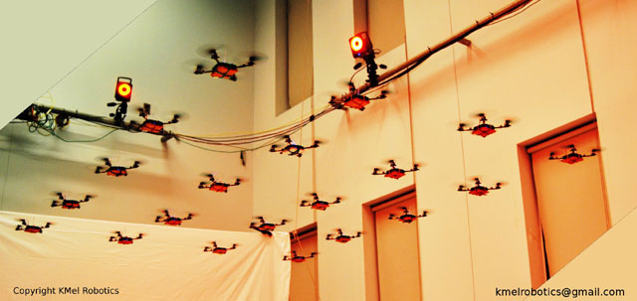
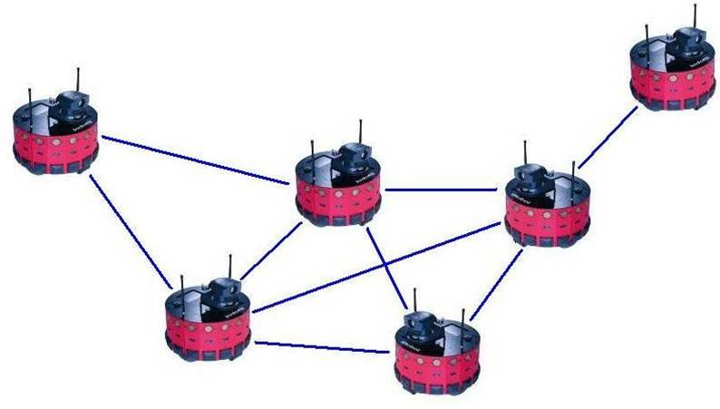
DYNAMIC FORMATION CONTROL WITH HETEROGENEOUS MOBILE ROBOTS

Slide 2
SYSTEM DESIGN
LOCAL POSITIONING
FORMATION CONTROL
Ultrasonic Sensors
Local Trilateration
Route Table
Algorithms
Localization
Timer
State Estimator
Formation Control
Agent
Dynamics
Acc. Sensors
State Propogation
Gyro Sensors
Mag. Sensors
Formation
Shape

Slide 3
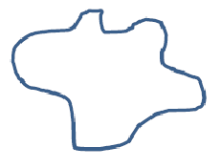
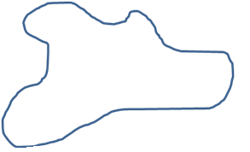
Problems & Requirements
In this project, it is aimed to create a method of formation control for a given complex shape with heterogenous agents.
1) Complex geometric shapes will be requested from the swarm

Slide 4
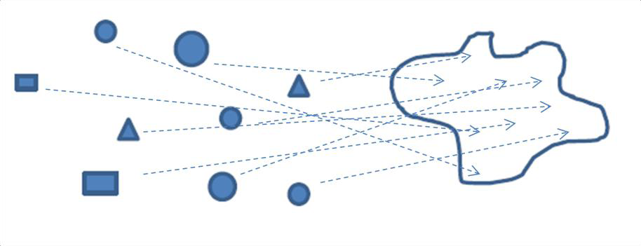
Problems & Requirements
2) Agents will have volumes, they may collide with the other ones and the obstacles in the environment
3) Each agent must decide the location in which it will be positioned in the formation by taking into account energy consumption issues, obstacles in the environment, other agents' decisions/conditions.

Slide 5
Project Breakdown Structure
General formation control problem can be divided into two main parts.
Partitioning complex formation shape into goal states.
In this context, potential goal states positions must be determined in the given complex shape to cover the whole formation homogenously.
Potential Goal States for different types of agents
2) Decision Process Between Possible Goal States
During decision process, the cost of reaching different goal states will be the main criteria for each agent. It is obvious that each agent will try to choose a goal state with minimum cost according to its position and the orientation in the environment. But the cases in which two or more agents are willing to reach the same goal point must be handled to optimize the overall utility of the swarm.

Slide 6
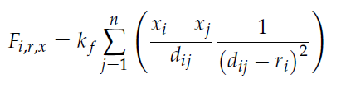
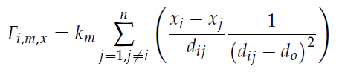

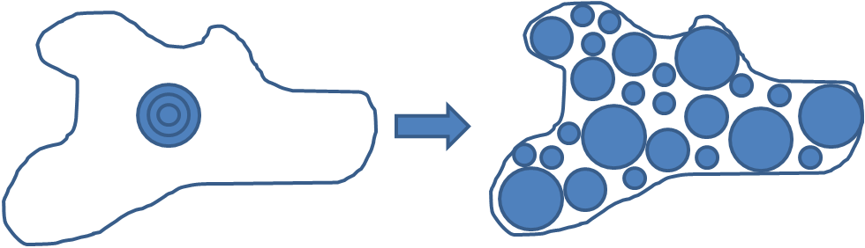
SHAPE PARTITIONING WITH ARTIFICIAL FORCES
This process is used to detect the positions of the goal states in a given complex shape with an offline simulation.
Two artificial forces, resistive and intermember forces will be used to provide a uniform distribution of the agents in the given formation.
Repulsive Forces
Intermember Forces

Slide 7


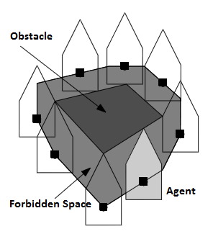
DECISION OF GOAL STATES
At this point, the complex formation control problem is reduced down to
a problem in which every agent is expected to decide individually where to position in a given set of possible goal states
1)Calculation of Free Configuration Space
Forbidden Space :
Forbidden Space

Slide 8
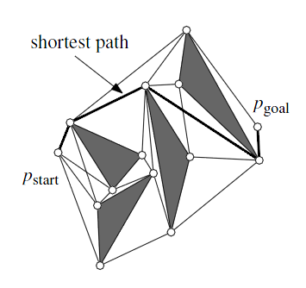
DECISION OF GOAL STATES
2)Visibility Graphs
Consider set of obstacles in the environment is augmented with the Minkowski Sums described in the previous chapter. The shortest path between p_start and p_goal among a set S of augmented polygonal obstacles consists of arcs of the visibility graph
Visibility Graph

Slide 9
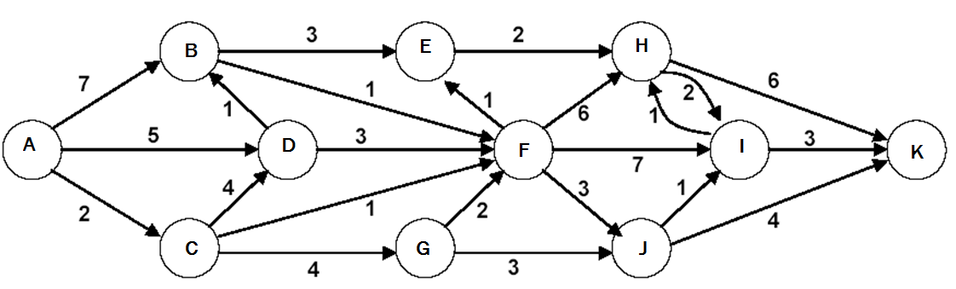
DECISION OF GOAL STATES
3)Dijkstra’s Algorithm
Dijkstra's algorithm is a tree search algorithm for finding the shortest paths between nodes in a graph
Up to now, we have calculated the all possible paths to the given goal states for an agent by using visibility graphs. With the help of Dijkstra’s algorithm , shortest paths and costs to these goal states will be calculated.
Calculation of Minimum Shortest Path From A to K

Slide 10
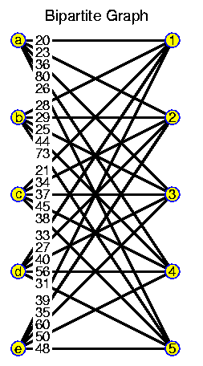
DECISION OF GOAL STATES
4)Hungarian Algorithm (Munkres Assignment Algorithm)
 | Clean Bathroom | Sweep Floors | Wash Windows
Jim | $3 | $3 | $3
Steve | $3 | $2 | $3
Alan | $3 | $3 | $2
The Hungarian method is a combinational optimization algorithm that solves the assignment problem in polynomial time. Worst case time complexity : O (n^3)
Optimality is guaranteed
Time complexity can be made better with some dynamic and incremental implementations.

Slide 11
NAVIGATION
To increase the bandwith of the controllers, desired setpoints are defined in the velocity domain. Velocity setpoints are assumed to have the amplitude proportional with the euclidian distance of each agent to the desired goal state. The direction of these velocity setpoints must have a bearing angle of the line segment drawn from the agent to the goal state.
Goal State
Amplitude
Bearing Angle
A1

Slide 12



VELOCITY CONTROLLER
State feedback with LQR controller;
System is augmented with an artificial error state,
Q and R matrices used in solving Riccati equations,
where,

Slide 13
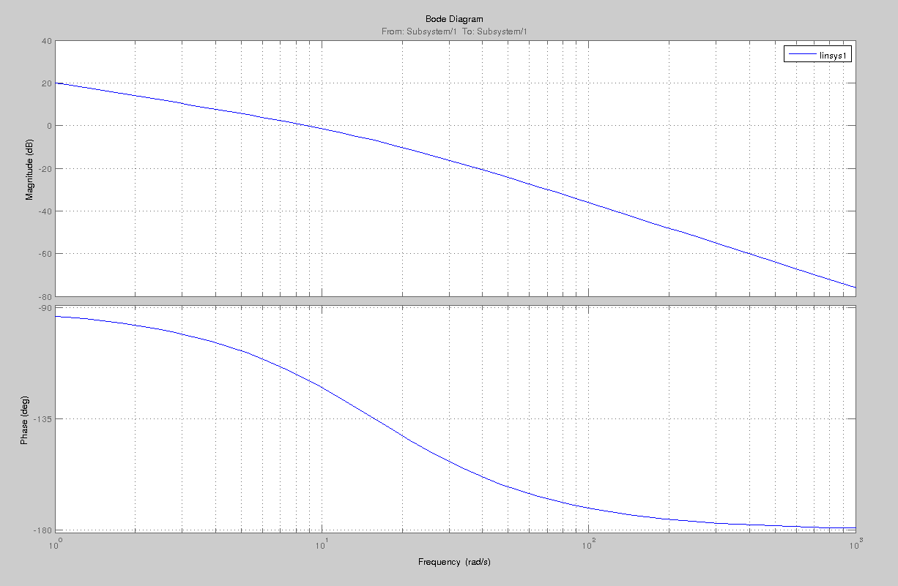
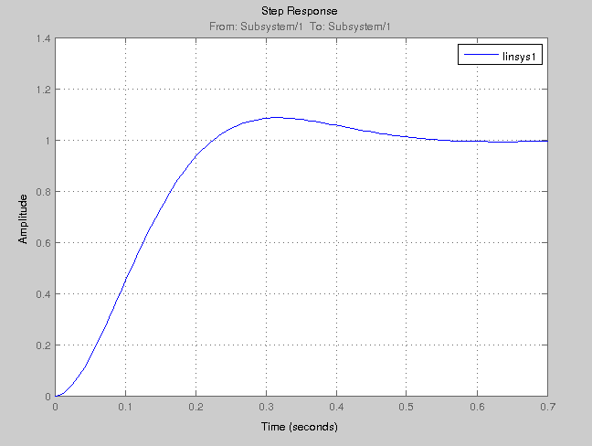
VELOCITY CONTROLLER
r
y
1/s
Plant
x
K
Open loop Bode plots
Step response

Slide 14
SIMULATION ENVIRONMENT
GAZEBO
Goal States
Publisher Interface
Model1
Plugin
Model2
Plugin
....
Modeln
Plugin
MATLAB
Physics Engine
A1
A2
....
An
Gazebo Publisher
Matlab Listener
Formation Shape
Agent State Vectors

Slide 15
LOCAL POSITIONING
Ultrasonic Sensors
Local Trilateration
Route Table
Algorithms
Localization
Timer
Acc. Sensors
State Estimator
State Propogation
True Position&Velocity
Information
Gyro Sensors
Mag. Sensors

