Slide 1
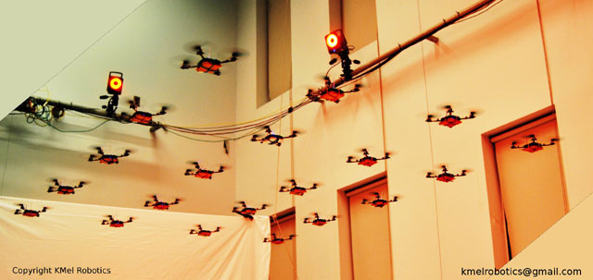
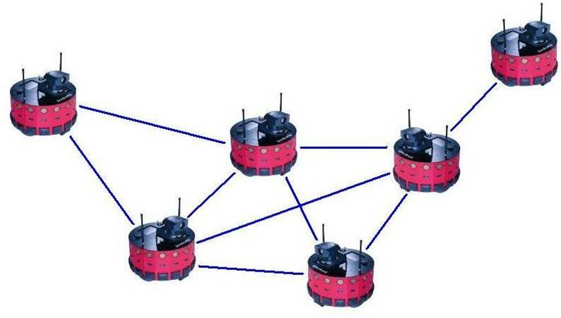
DYNAMIC FORMATION CONTROL WITH HETEROGENEOUS MOBILE ROBOTS

Slide 2
SYSTEM DESIGN
LOCAL POSITIONING
FORMATION CONTROL
Ultrasonic Sensors
Local Trilateration
Route Table
Algorithms
Localization
Timer
State Estimator
Formation Control
Agent
Dynamics
Acc. Sensors
State Propogation
Gyro Sensors
Mag. Sensors
Formation
Shape

Slide 3
PROJECT BREAKDOWN STRUCTURE
Two Main Problems related with project,
Local Positioning System (LPS)
Dynamic Formation Control

Slide 4
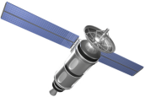
Local Positioning System(LPS)
It is assumed that only some of the
agents have position sensors due to;
Low cost implementation
Power consumption issues
???
???
???
???
Gps
???
???
???
Gps

Slide 5
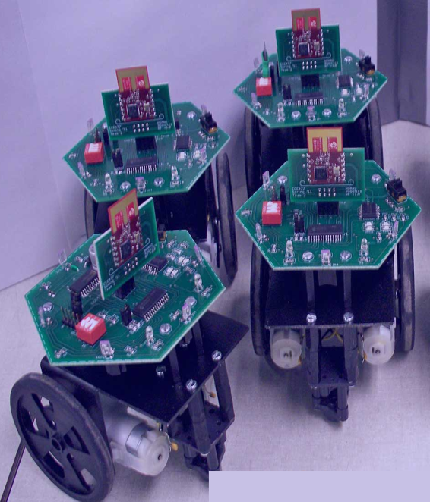
Local Positioning System(LPS)
It is needed to have a localisation solution to provide position data to the rest of the swarm, but there are some problems/restrictions on this problem.
Problem -1
Low sensor capabilities of agents
Due to cost effectiveness and power consumption issued all agents (except for positioning beacons )have low cost MEMS sensors like accelerometers gyroscopes,
magnetometers and ultrasonic sensors.

Slide 6
Local Positioning System(LPS)
Problem -2
Weak Radio Links
Due to power consumption issues every agent has weak radios on board, so every agent has a radio link coverage for closest neighbors and data packets are limited with most critical data (e.g. agent ID, type and position) because of low bandwiths.
Lost

Slide 7
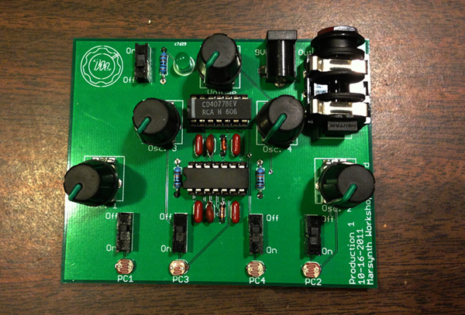
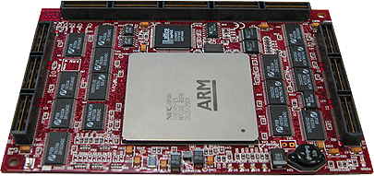


Local Positioning System(LPS)
Problem -3
Low Computing Power
Every agent has low cost processors on board, it is not possible to implement complex algorithms and it is not possible to run localization process with high sampling rates.

Slide 8
Dynamic Formation Control
Problem -1
Complex Closed Contours
Formations shapes will be defined as closed curves with complex shapes and they cannot be identified analytically. On the other hand shapes will be changing dynamically during formation control.

Slide 9
Dynamic Formation Control
Problem -2
Decentalized Structure
There will be no central servers/root nodes to decide agents’ individual positions to get the desired shape. Moreover, agents make their own position choices as unaware of the other agents’ positions and choices.
No decision maker for whole swarm

Slide 10
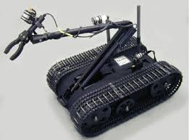
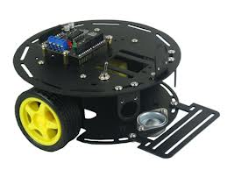
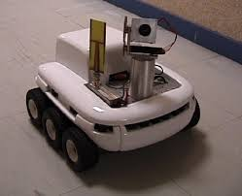
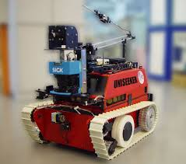
Dynamic Formation Control
Problem -3
Heterogenous Robots with Different Dynamics
Agents will have different volumes and masses (no mass point particles) and they have different dynamics

Slide 11
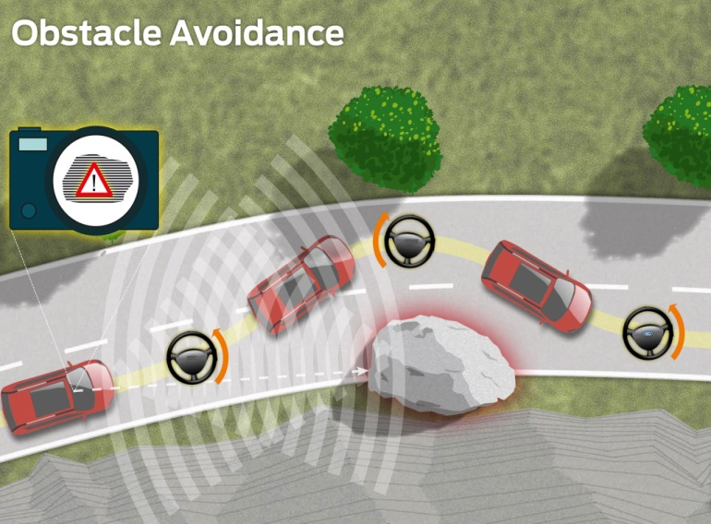
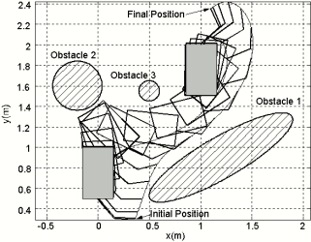
Dynamic Formation Control
Problem -4
Collision Avoidance
Since the point mass approach for the agents are ignored, it is necessary to handle the collision events between agents. On the other side, the collision between the obstacles and the agents must be prevented.

Slide 12
Dynamic Formation Control
Problem -5
Formation Changes
Formation shape must be changed in three ways while keeping the original closed contour;
Orientation Changes
Density/Area Changes
Position Changes

Slide 13
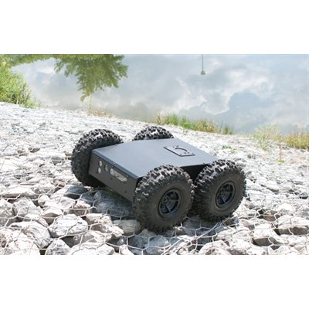
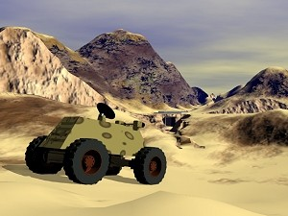
Dynamic Formation Control
Problem -6
Rugged Terrain Approach
Environment for the formation control must be a rough territorty. A 3D environment with some obstacles will be presented for simulations.

Slide 14
LPS System Design
Local positioning system is composed of two main parts.
Route Table Determination
This process determines the clusters around the
Position beacons and provides the order for the
Local trilateration process.
Local Trilateration
It provides position and translational velocity data
To the agents which don’t have position sensors

Slide 15
LPS System Design
Local trilateration process;
Requires at least 3 neighbors
Loops with low frequencies due to computational and power restrictions
Handles lost agents (agents do not have three neighbors)
N1(x,y,z)
N2(x,y,z)
Neighbor 1
r1
r2
P(x,y,z)
Neighbor 2
r3
N3(x,y,z)
Agent i
rn
Neighbor 3
Nn(x,y,z)
Neighbor n

Slide 16

LPS System Design
Solution of the position for agent (P(x,y,z)) can be reduced to a problem of;
Since we have a A matrix with a dimension of (n-1) x 2, there are three options for
The solution of the problem related with the condition of A matrix,
1) , unique solution -> 3 neighbors and A is full column rank matrix
2) , minimum norm solution -> more neighbors and A is full column rank matrix
3) Find the minimum error/norm solution with nonlinear least squares method

Slide 17
LPS System Design
Lost agent handling rules,
An agent is called ‘lost’ when it doesn’t have minimum 3 neighbors
If an agent is lost it cannot enter the localization process
If an agent is missing the localization process for 3-4 times(task dependent)
then it must be directed to the formation shape center (Return to Home condition)
Lost

Slide 18
LPS System Design
Return to Home Approach
Lost agent aims to
arrive to this point
Movement in real world
Agent’s real
position
Agent’s wrong
position
Estimated movement to
the formation center

Slide 19
LPS System Design
Route Table Determination
This process determines the clusters around position beacons and provides
rank information for the agents which are in same clusters
DSDV(Destination-Sequenced Distance Vector Routing Protocol) algorithms
are used
3 no lu plot buraya gelecek

Slide 20
LPS System Design
DSDV
DSDV is a table driven routing scheme based on Bellmam Ford algorithm
Used generally in wireless mesh networks and ad-hoc mobile networks
Solves routing loop problem in Bellman Ford algorithm
Route table for agent 2
Routing Loop Problem
Destination | Next Hop | Metric | Dest. Seq. No
1 | 1 | 1 | 123
3 | 3 | 1 | 516
4 | 4 | 1 | 212
5 | 4 | 2 | 168
6 | 8 | 3 | 372
7 | 8 | 2 | 432
(D,5)
(D,4)
(D,4)
(D,3)
(D,2)
(D,2)
3
5
A
B
C
D
4
Dest. | Next | Metric
… | … | …
D | B | 3, 5, …
Dest. | Next | Metric
… | … | …
D | B | 3, 5, …
Dest. | Next | Metric
… | … | …
D | C | 2, 4, 6,..
6
1
2
7
8

Slide 21
LPS System Design
DSDV Rules for Localization Problem
Metric value for the route table must be counts for hops
Agents must decide to join the cluster of position agent with minimum metric value
This approach minimizes the error rate for the positions of agents which are relatively
far away from the beacons.
Localization process must be done with increasing order of counts for hops in a cluster
2 no lu plot buraya gelecek
Position
Beacon

