Slide 1


Slide 3
Outline
Introduction
Motivation
Local Positioning System Design
Formation Control System Design
Results
Conclusion and Future Works
References

Slide 4
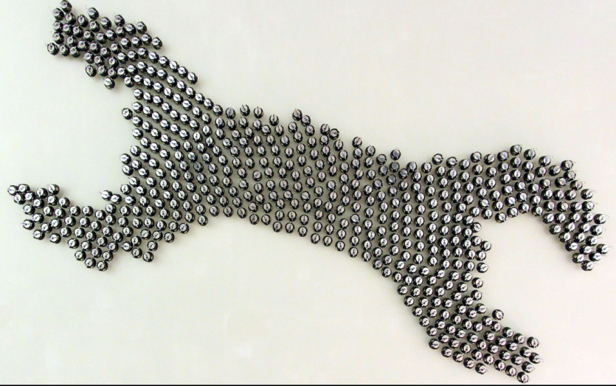
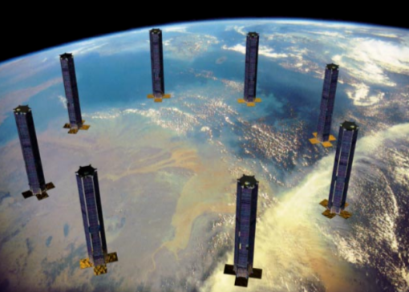
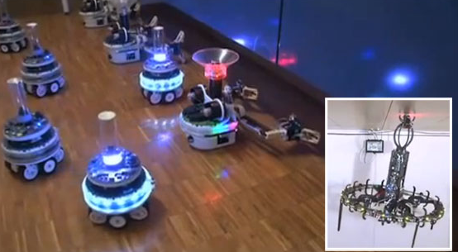
Introduction
This thesis work focuses on dynamic adaptation to achieve changes in formation of swarms consisting of heterogenous mobile robots
[1]
[2]
[3]

Slide 5
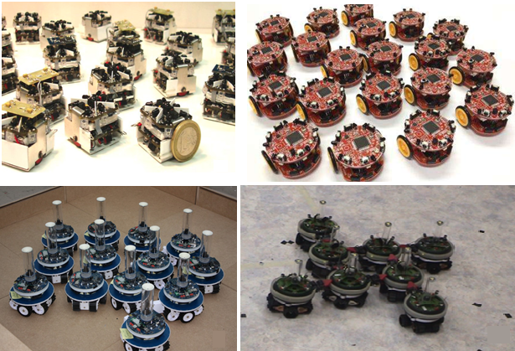
Motivation
The research about the formation control, mainly focuses on swarms with homogenous agents.
[4]
[5]
[6]
[7]

Slide 6
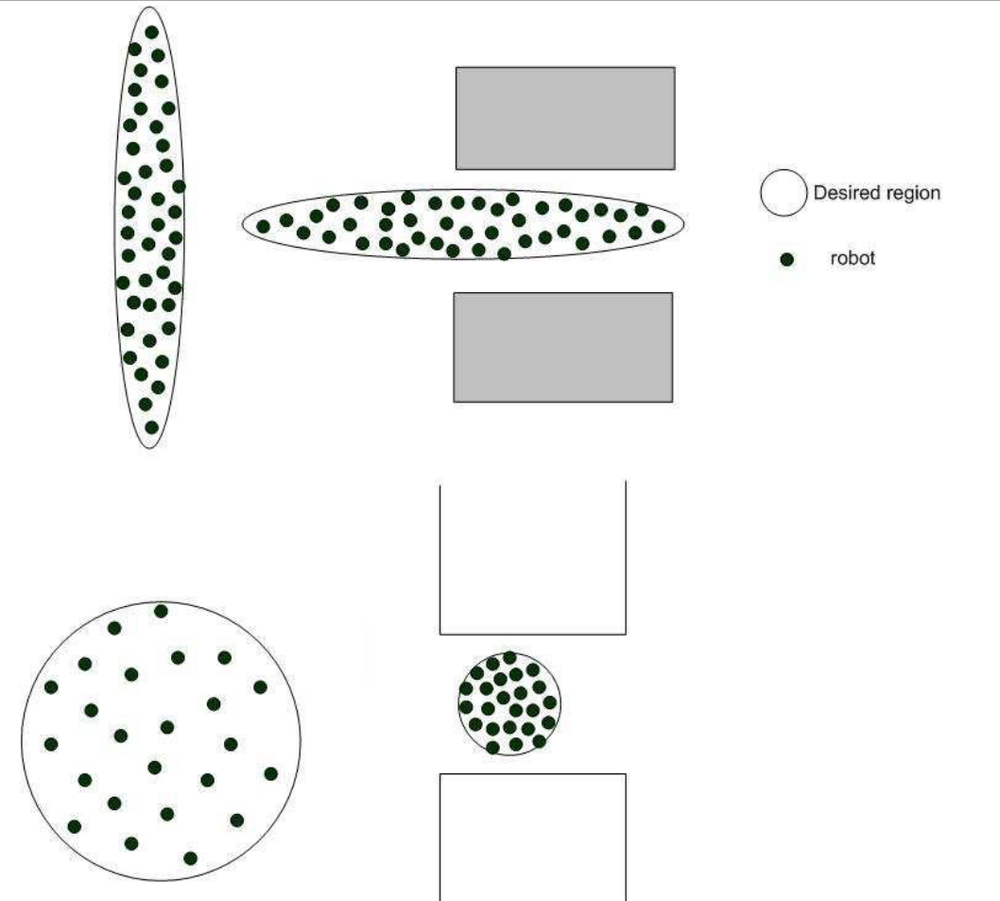
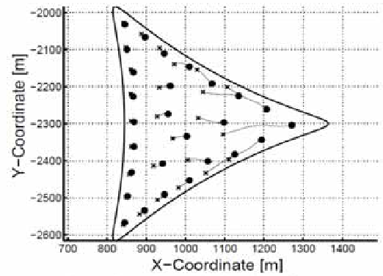

Motivation
Formation control solutions are generally implemented with simple geometrical shapes which don’t change with time.
Our aim

Slide 7
References
[1] http://www.eecs.harvard.edu/ssr/projects/progSA/kilobot.html
[2] Martin N, Klupar P, “Techsat 21 And Revolutionizing Space Missions Using Mıcrosatellıtes”,
[3] http://www.swarmanoid.org/swarmanoid_hardware.php.html
[4] S Kornienki, O. Kornienko, and Levi. P. Minimalistic approach towards communication
and perception in microrobotic swarms. In IEEE International Conference on Intelligent Robots and Systems, 2005.
[5] Farshad Arvin, John Murray, Licheng Shi, Chun Zhang, and Shigang Yue. Development
of an autonomous micro robot for swarm robotics. In IEEE International Conference on Mechatronics and Automation, 2014.
[6]Touraj Soleymani, Vito Trianni, Michael Bonani, Francesco Mondada, and Marco Dorigo. Bio-inspired construction with mobile robots and compliant pockets. Robotics and Autonomus Systems, 74:340–350, 2015.
[7] Roderich Grof, Michael Bonani, Mondada Francesco, and Marco Dorigo. Autonomous
self-assembly in a swarm-bot. 22:1115–1130, 2006.

