Slide 1

Assessment

Slide 2
Zadatak
Teachers teaching Software Engineering are struggling to note down the score students achieve in different assignments during the semester.
Please help them with Windows Forms app that will enable teachers to:
Add students
Add exercises and give score to students for each exercise
Print out the total and maximum possible score for each student
The possible user interface of this app is presented in the next slide.

Slide 3
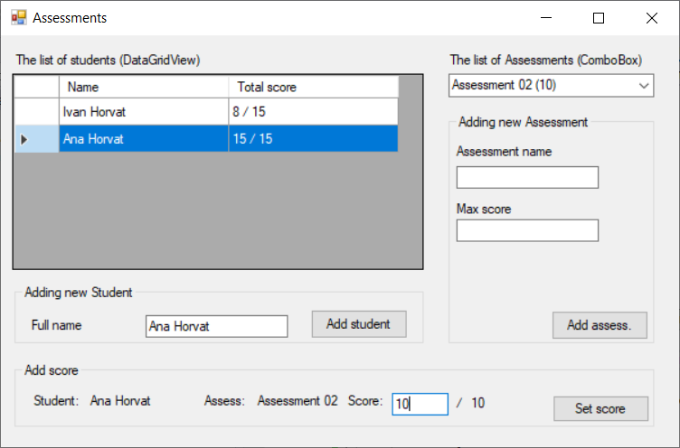
Possible user interface If you don’t know where to start, maybe next slide could help you

Slide 4
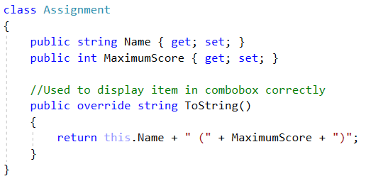
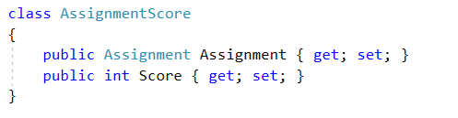
Code bits that could help
Check next slide…

Slide 5
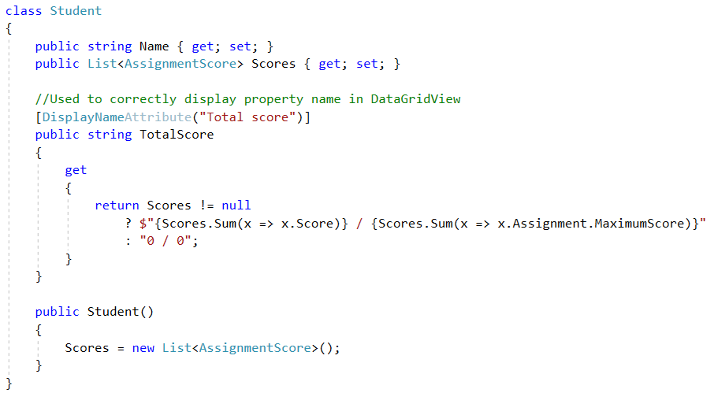
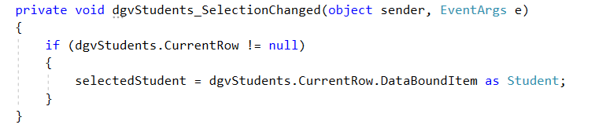
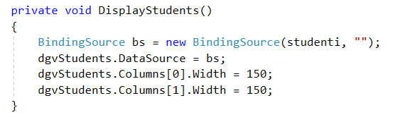
Code bits that could help

