Slide 1
CH1：Random Processes
Problems: (P78-87)
1.1 1.3 1.5
1.11 1.12 1.15
1.22 1.26 1.29

Slide 2
CH1：Random Processes
1.1 Introduction
1.2 Mathematical Definition of a Random Process
1.3 Stationary Processes
1.4 Mean, Correlation, and Covariance Functions
1.5 Ergodic Processes
1.6 Transmission of a Random Process Through a Linear Time-Invariant Filter
1.7 Power Spectral Density
1.8 Gaussian Process
1.9 Noise
1.10 Narrow Noise
1.11 Representation of Narrowband Noise in In-phase and Quadrature Components
1.12 Representation of Narrowband Noise in Envelope and Phase Components
1.13 Sine Wave Plus Narrowband Noise

Slide 3
1.1 Introduction
Deterministic & Stochastic or random
Information-bearing signal, interference, channel noise

Slide 4
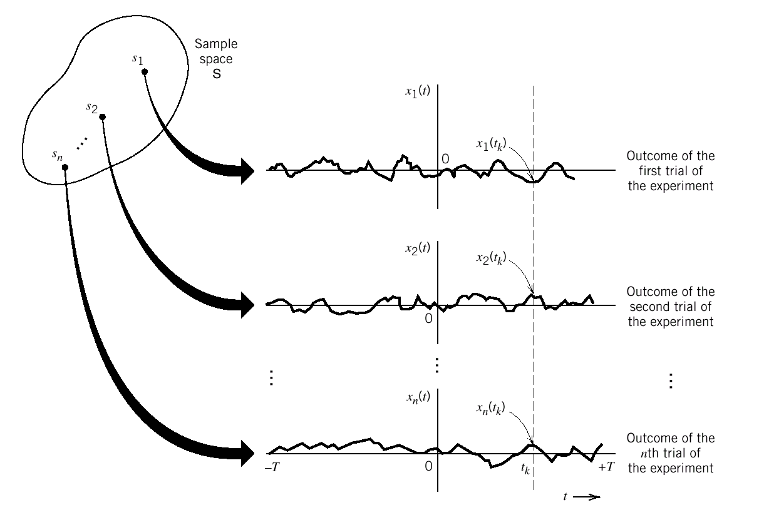
1.2 Mathematical Definition of a Random Process
Figure 1.1 An ensemble of sample functions

Slide 5
1.2 Mathematical Definition of a Random Process
Functions of time / Random variable
Sample Space /Realization or sample function of the random process
Random Variable--OUTCOME--Number
Random Process--OUTCOME--Function of time

Slide 6
1.2 Mathematical Definition of a Random Process
each sample point s a function of time with the rule:
For a fixed sample point , sample function is:
As shown in figure 1.1,for a fixed time , the set of Number
constitutes a random variable.
The random variables become random process.

Slide 7
对随机过程的研究：
随机变量簇&样本函数簇
*统计特性：密度函数、分布函数
*数字特征：数学期望、方差、相关函数、协方差函数

Slide 8
1.3 Stationary Process
*The joint distribution function：
(1)
*Strictly stationary：
for all time shifts τ, all k, and all possible choices of observation times t₁,…, t_{k} the equation(1) always be true.
*Wide-sense stationary：
1、K=1: for all t and .
2、k=2 and τ=- t₁ :
for all and

Slide 9
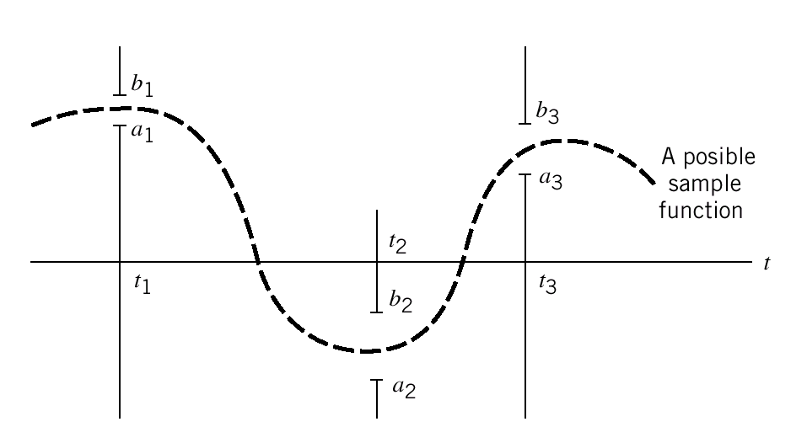
1.3 Stationary Process
Figure 1.2 Illustrating the probability of a joint event

Slide 10
1.3 Stationary Process
Example 1.1
three spatial windows located at times , and , the
Probability of the joint event :
i=1 , 2 , 3
In terms of the joint distribution function, this probability equals:

Slide 11
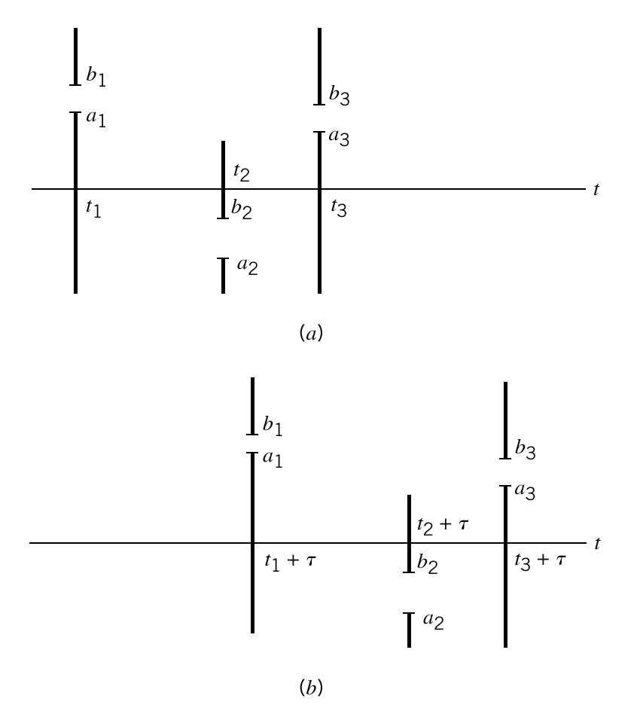
1.3 Stationary Process
Figure 1.3 Illustrating the concept of stationary

Slide 12
1.4 Mean, Correlation, and Covariance Functions
*Mean：
*Variance：
*Auto-correlation function：

Slide 13
1.4 Mean, Correlation, and Covariance Functions
*Auto-covariance function：？？？
*Cross-correlation function：
++++宽平稳和严平稳？

Slide 14
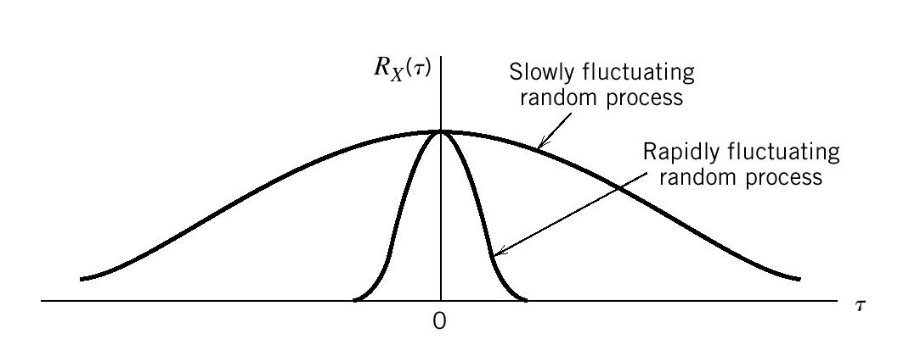
1.4 Mean, Correlation, and Covariance Functions
Figure 1.4 Illustrating the autocorrelation functions of slowly and rapidly fluctuating random processes.

Slide 15
1.4 Mean, Correlation, and Covariance Functions
Stationary process: for all t
Properties of the Autocorrelation Function ：

Slide 16
1.4 Mean, Correlation, and Covariance Functions
Example1.2
a sinusoidal signal with random phase , defined by
where A and constants. is a random variable that is uniformly
distributed over the interval ,that is :

Slide 17
1.4 Mean, Correlation, and Covariance Functions
The autocorrelation function of is:

Slide 18
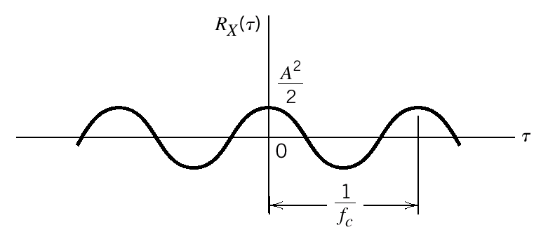
1.4 Mean, Correlation, and Covariance Functions
Figure 1.5 Autocorrelation function of a sine wave with
random phase

Slide 19
1.4 Mean, Correlation, and Covariance Functions
The two cross-correlations of X(t) and Y(t) is :
The correlations of X(t) and Y(t) could be displayed in
Matrix as:
has symmetry relationship as:

Slide 20
1.5 Ergodic processes
The process X(t) is ergodic in the mean if two conditions are
Satisfied:
The process X(t) is ergodic in the autocorrelation function if
two conditions are satisfied:

Slide 21
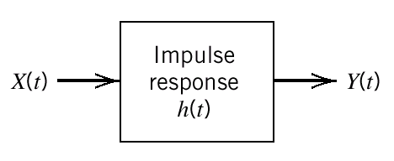
1.6 Transmission of a Random Process Through a Linear Time-Invariant Filter
Figure 1.8 transmission of a random process through a linear
time-invariant filter

Slide 22
1.6 Transmission of a Random Process Through a Linear Time-Invariant Filter
Input random process: X(t)------Stationary Process
Output random process: Y(t)

Slide 23
1.6 Transmission of a Random Process Through a Linear Time-Invariant Filter
The autocorrelation function of Y(t):

Slide 24
1.7 Power Spectral Density
Frequency response is H(f),then:

Slide 25
1.7 Power Spectral Density
Define :
Then:
suppose: ,shown in Figure1.9
is the bandwidth of the filter.
so:

Slide 26
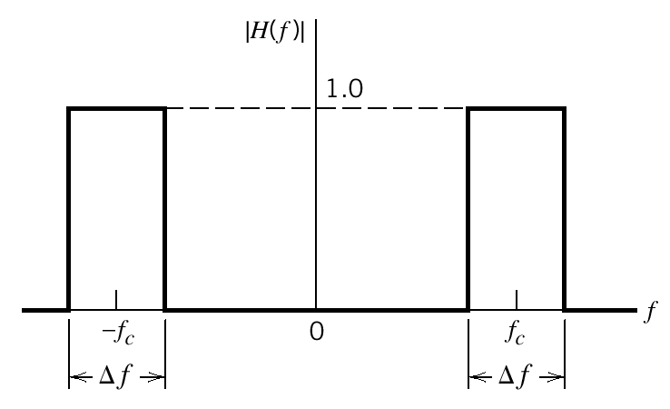
1.7 Power Spectral Density
Figure 1.9 Magnitude response of ideal narrow filter

Slide 27
1.7 Power Spectral Density
Properties of the power spectral density:
, is normalized form of
power spectral density

Slide 28
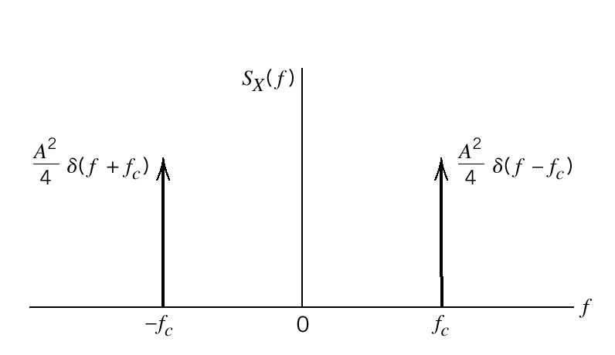
1.7 Power Spectral Density
Figure 1.10 Power spectral density of sine wave with random phase

Slide 29
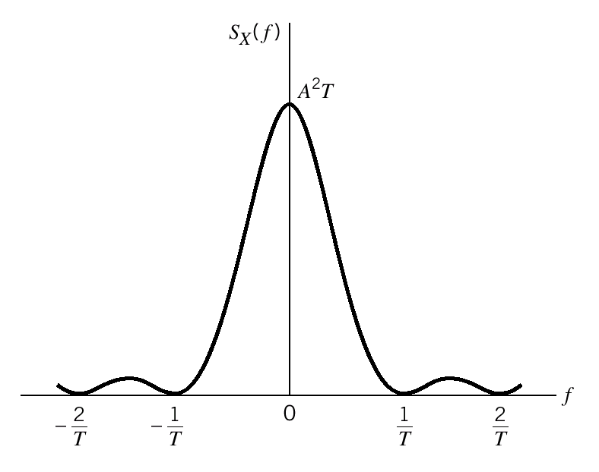
1.7 Power Spectral Density
Figure 1.11 Power spectral density of random binary wave

Slide 30
1.7 Power Spectral Density
Relationship among the power spectral density of the
Input and output random process:

Slide 31
1.7 Power Spectral Density
Relationship among the power spectral density and the
magnitude spectrum of a sample function :
X(f,T) denotes the fourier transform of the truncated function
of original sample function x(t),then:

Slide 32
1.7 Power Spectral Density
we may formulate the following Fourier-transform pair:
so we get :

Slide 33
1.7 Power Spectral Density
The relation between power spectral density and squared
magnitude spectrum of a truncated sample function of the
process is:

Slide 34
1.7 Power Spectral Density
Cross-Spectral Densities:
Define the cross-spectral densities and of this
pair of random processes to be the Fourier transform of their
respective cross-correlation functions as :

Slide 35
1.7 Power Spectral Density
Using the formula for inverse Fourier transformation ,we get:
so we find that and are related by :

Slide 36
1.8 Gaussian Process
If the probability density function of the random variable Y
has the form :
Y is said to have a Gaussian distribution.
The special case when the Gaussian random variable Y is
normalized to have a mean of zero and a variance of
one ,as :
such a normalized Gaussian distribution is written as N(0,1).

Slide 37
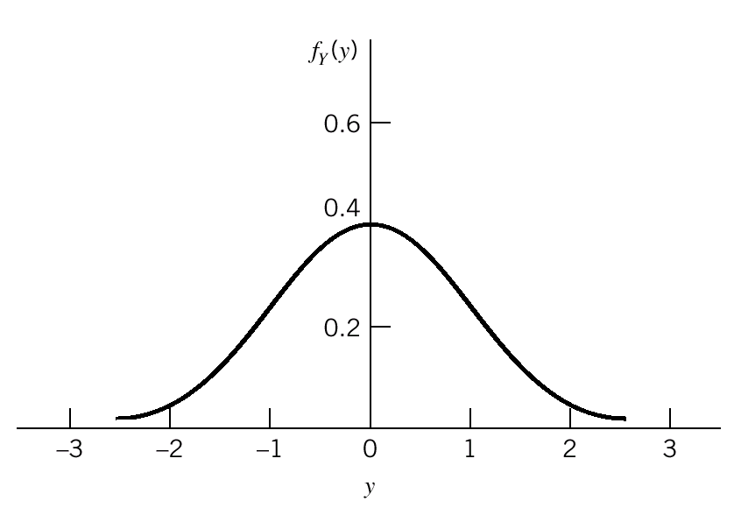
1.8 Gaussian Process
Figure 1.13 Normalized Gaussian distribution

Slide 38
1.8 Gaussian Process
Central Limit Theorem:
Let , i=1,2,…N,be a set of random variables that satisfies :
(1) are statistically independent.
(2) have the same probability distribution with mean
and variance .
The random variables be normalized as :

Slide 39
1.8 Gaussian Process
So that we have :
Define a new random variable :
Then,the central limit theorem states that the probability
distribution of approaches a normalized Gaussian
Distribution N(0,1) in the limit as the number of random
variables approaches infinity.

Slide 40
1.8 Gaussian Process
Properties of a Gaussian Process:
1: If a Gaussian process X(t) is applied to a stable linear filter,
then the random process Y(t) developed at the output of the filter
is also Gaussian.
2: Suppose the set of samples from random
process X(t). If the process X(t) is Gaussian ,then this set of
random variables is jointly Gaussian for any n, and :

Slide 41
1.8 Gaussian Process
3: If a Gaussian process is stationary ,then the process is also
strictly stationary.
4: A set of samples from random Gaussian
process X(t), then :
uncorrelated statistically independent

Slide 42
1.9 Noise
Shot Noise:
Shot noise arises in electronic devices such as diodes and
Transistors because of the discrete nature of current flow in
these device.
Example: a Possion distribution with a mean value :

Slide 43
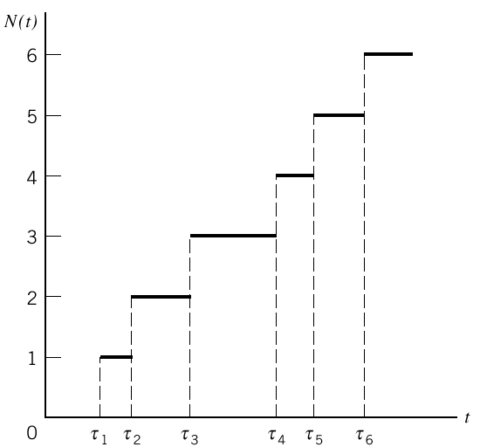
1.9 Noise
Figure 1.14 Sample function of a Possion counting process

Slide 44
1.9 Noise
Thermal Noise:
Thermal noise is the name given to the electrical noise arising
from the random motion of electrons in a conductor.
The central limit theorem indicates that thermal noise is a
Gaussian distributed with zero mean.

Slide 45
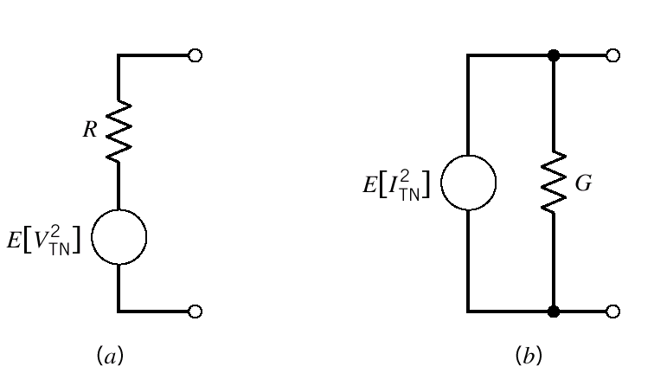
1.9 Noise
Figure 1.15 Models of a noisy resistor

Slide 46
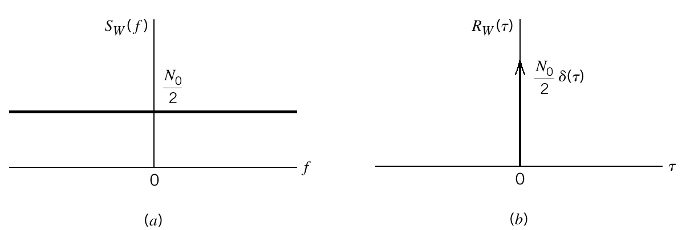
1.9 Noise
White Noise:
The power spectral density of white noise is independent.
Figure 1.16 Characteristics of white noise

Slide 47
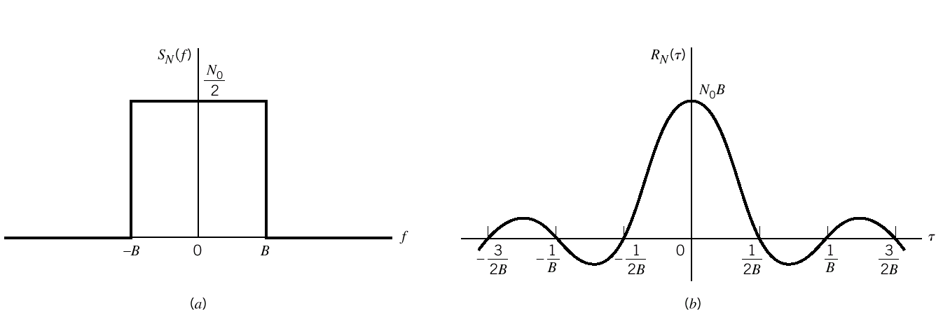
1.9 Noise
Figure 1.17 Characteristics of low-pass filtered white noise
(a)power spectral density (b)autocorrelation function

Slide 48
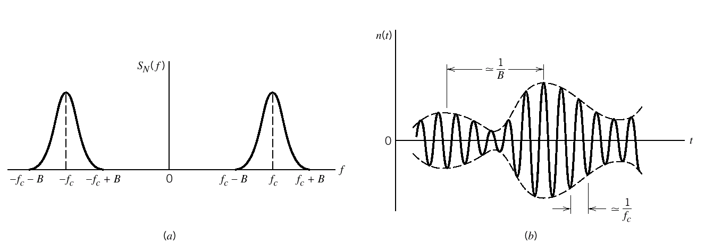
1.10 Narrowband Noise
Figure 1.18 Power spectral density and sample function of narrowband noise

Slide 49
1.10 Narrowband Noise
There are two specific representations of narrow noise:
(1) The narrowband noise is defined in terms of a pair of
components called the in-phase and quadrature components.
(2) The narrowband noise is defined in terms of two other
components called the envelope and phase.

Slide 50
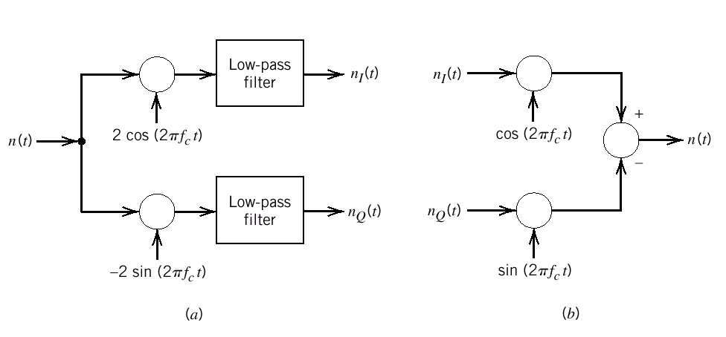
1.11 Representation of Narrowband Noise in terms of In-Phase and Quadrature Components
Standard form:
Figure 1.19 (a) Extraction of in-phase and quadrature components of a narrowband process.(b)Generation of a narrowband process from its in-phase and quadrature components.

Slide 51
1.11 Representation of Narrowband Noise in terms of In-Phase and Quadrature Components
The properties of the in-phase and quadrature components of a
narrowband noise:
(1) and have zero mean.
(2) Gaussian and Gaussian
(3) stationary and Stationary
(4) and have the same power spectral density.

Slide 52
1.11 Representation of Narrowband Noise in terms of In-Phase and Quadrature Components
(5)
(6)
(7) n(t) is Gaussian and its power spectral density is
Symmetric about the mid-band frequency and
are statistically independent.

Slide 53
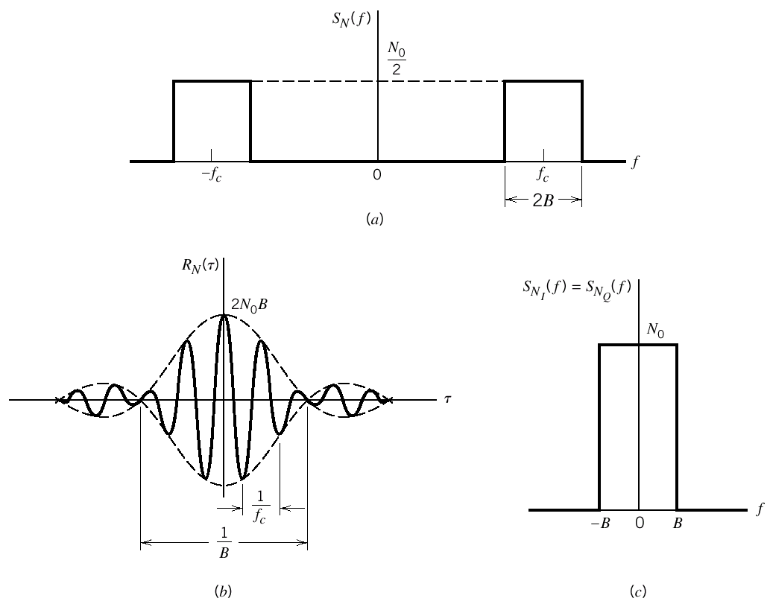
1.11 Representation of Narrowband Noise in terms of In-Phase and Quadrature Components
Figure 1.20 Characteristic of ideal band-pass filtered white noise

Slide 54
1.12 Representation of Narrowband Noise in terms of Envelope and Phase Components
The noise n(t) may be represent as:
:the envelope of n(t) ; : the phase of n(t) ;

Slide 55
1.12 Representation of Narrowband Noise in terms of Envelope and Phase Components
Define :
(Reyleigh distribution)

Slide 56
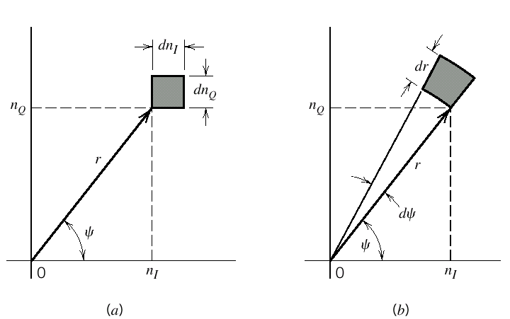
1.12 Representation of Narrowband Noise in terms of Envelope and Phase Components
Figure 1.21 Illustrating the coordinate system for
representation of narrowband noise

Slide 57
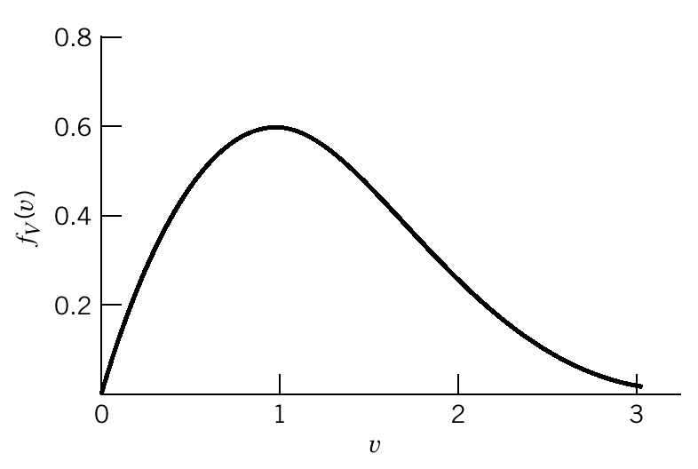
1.12 Representation of Narrowband Noise in terms of Envelope and Phase Components
Figure 1.22 Normalized Rayleigh
distribution:

Slide 58
1.13 Sine Wave Plus Narrowband Noise
where:

Slide 59
1.13 Sine Wave Plus Narrowband Noise
Define:
where:

Slide 60
1.13 Sine Wave Plus Narrowband Noise
Define:
As shown in Figure 1.23

Slide 61
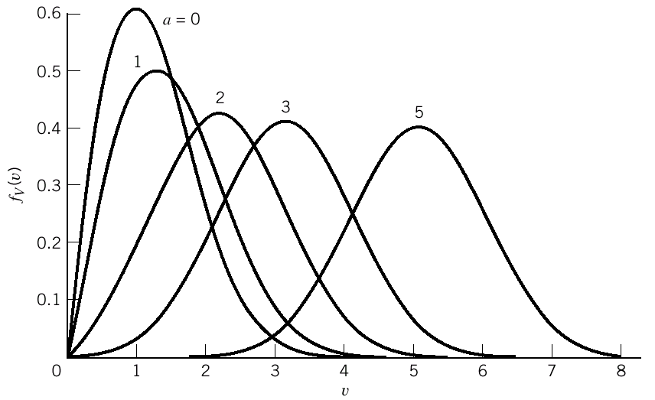
1.13 Sine Wave Plus Narrowband Noise
Figure 1.23 Normalized Rician distribution

Slide 62
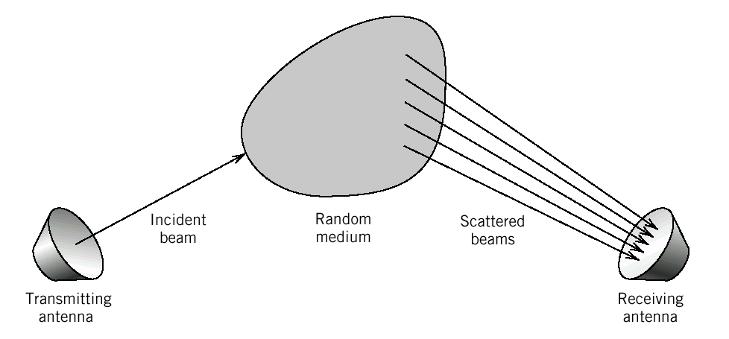
1.14 Computer Experiments:Flat-Fading Channel
Figure 1.24 Model of a multipath channel

Slide 63
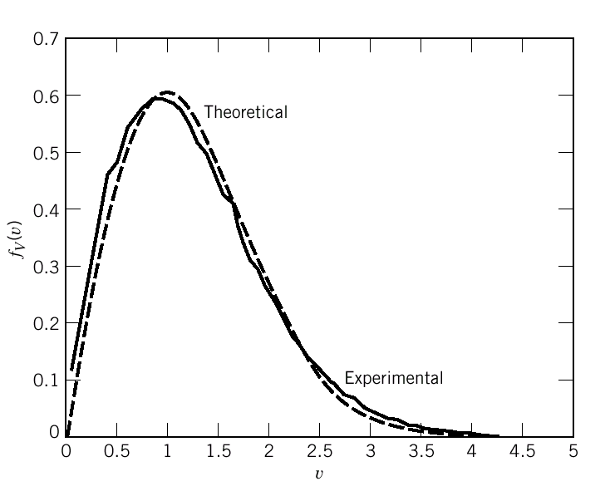
1.14 Computer Experiments:Flat-Fading Channel
Figure 1.25 Probability density function of the envelope of random process X(t)

Slide 64
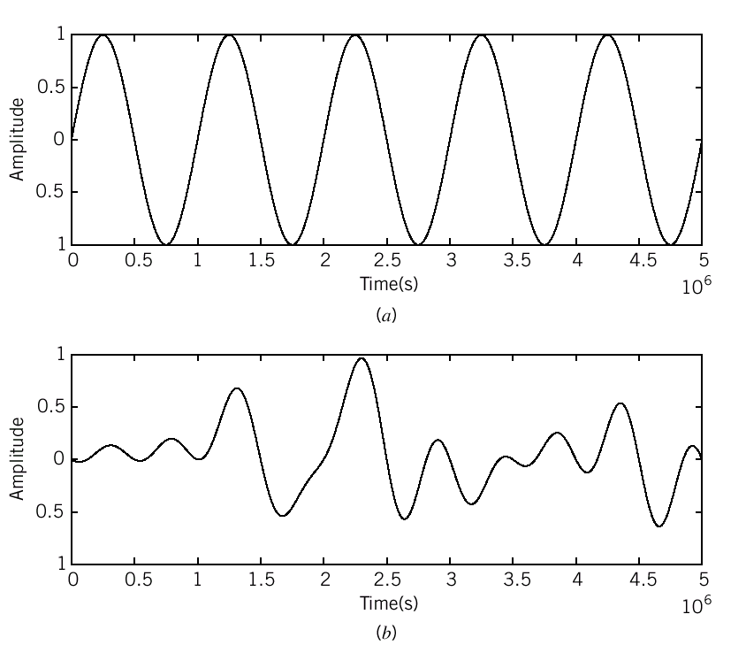
1.14 Computer Experiments:Flat-Fading Channel
Figure 1.26 Effect of Rayleigh fading on a sinusoidal wave

Slide 65
随机过程Y(t)=X₁cosω₀t +X₂sinω₀t，其中，X₁和X₂是相互独立且均值为0、方差为δ²的高斯随机变量，求Y(t)的自协方差函数、功率谱密度以及一维概率密度函数。

