Slide 1
CH2 Continuous-Wave Modulation
Problems: (P166-182)
2.7, 2.8, 2.15, 2.21, 2.28,
2.34, 2.37, 2.41, 2.46, 2.52

Slide 2
CH2 Continuous-Wave Modulation
2.1 Introduction
2.2 Amplitude Modulation
2.3 Linear Modulation Schemes
2.4 Frequency Translation
2.5 Frequency-Division Multiplexing
2.6 Angle Modulation
2.7 Frequency Modulation
2.8 Nonlinear Effects in FM Systems
2.9 Superheterodyne Receiver
2.10 Noise in CW Modulation Systems
2.11 Noise in Linear Receivers Using Coherent Detection
2.12 Noise in AM Receivers Using Envelope Detection
2.13 Noise in FM Receivers
2.14 Computer Experiments: Phase-Locked Loop

Slide 3
2.1 Introduction
Elements of a communication system
Why is Modulation necessary?
What is Modulation?
Wave of AM & FM
Modulating Signal and Modulated Signal
Classify Modulation methods by……
Modulation & Demodulation

Slide 4
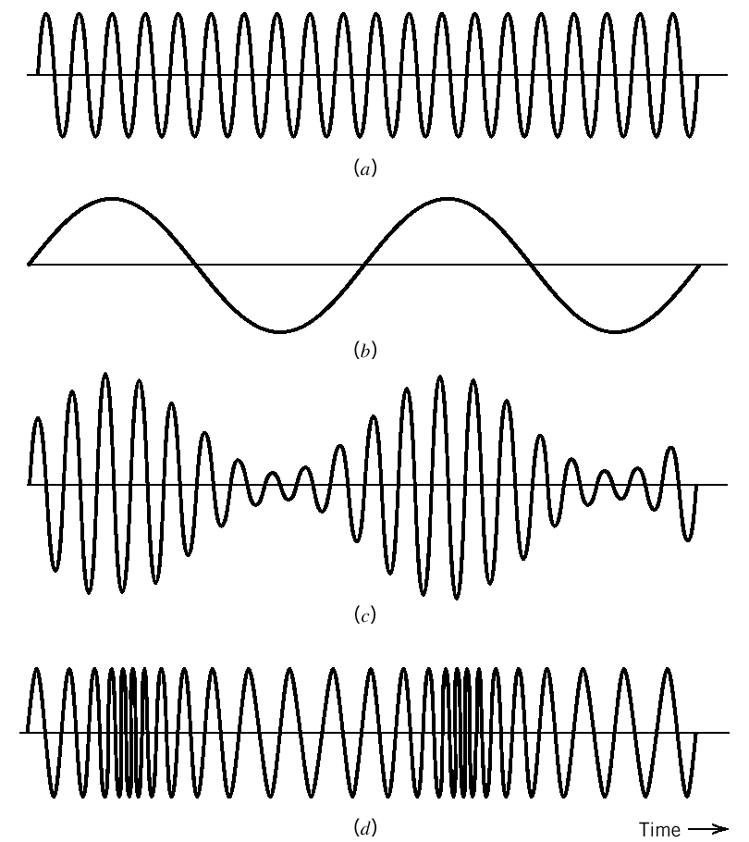
2.1 Introduction
(a) Carrier wave
(b) Sinusoidal modulating signal
(c) Amplitude-modulated signal
(d) Frequency-modulated signal
Fig. 2.2 Illustrating AM and FM signals produced by a signal tone.

Slide 5
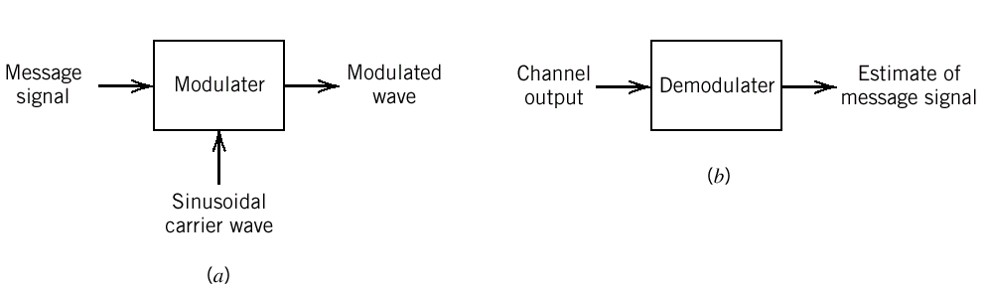
2.1 Introduction
Figure 2.1 Components of a continuous-wave modulation system

Slide 6
2.1 Introduction
Continuous-wave modulation:
Amplitude modulation
the amplitude of the sinusoidal carrier wave is varied
in accordance with the baseband signal.
Angle modulation
the angle of the sinusoidal carrier wave is varied in accordance with the baseband signal.

Slide 7
2.2 Amplitude Modulation
Sinusoidal carrier wave
Carrier amplitude (volt)
Carrier frequency
Amplitude-modulated wave
Amplitude sensitivity
(Constant, volt⁻¹)
Modulating signal (volt)

Slide 8
2.2 Amplitude Modulation
The envelope of s(t) has the same shape as m(t) provided that:
(1) |k_{a}m(t)| < 1 for all t;
(2) F_{c} >> W
|k_{a}m(t)| > 1: overmodulation
(How can we do if overmodulation?)

Slide 9
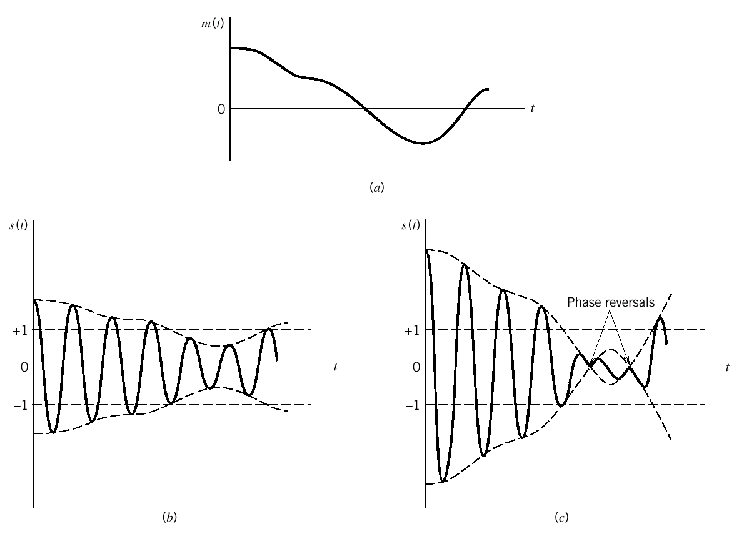
2.2 Amplitude Modulation
Figure 2.3 Illustrating the amplitude modulation process

Slide 10
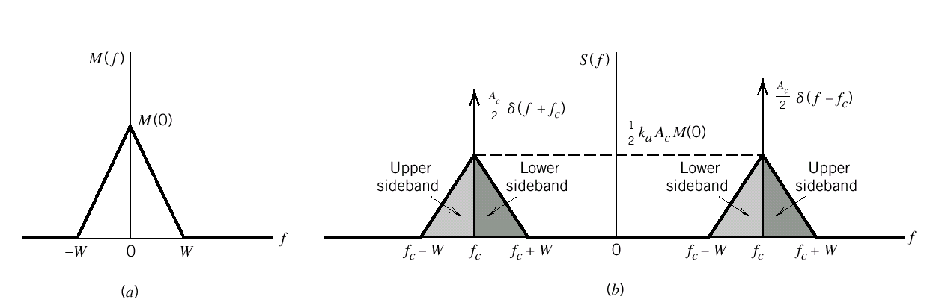
2.2 Amplitude Modulation
Fourier transform of AM modulated signal
Fig. 2.4 (a) Spectrum of baseband signal; (b) Spectrum of AM wave.

Slide 11
2.2 Amplitude Modulation
The Fourier transform of the AM wave s(t) is:
Suppose that the baseband signal is band-limited to the
interval ,as shown in Figure 2.4(a), then the
spectrum S(f) of AM wave is as shown in Figure 2.4(b) .

Slide 12
2.2 Amplitude Modulation
For figure 2.4 ,we should note :
Because of modulation process, baseband signal ’s
negative frequencies becomes visible.
Upper sideband/lower sideband

Slide 13
2.2 Amplitude Modulation
Virtues of Amplitude Modulation:
In the transmitter, amplitude modulation is accomplished
using a nonlinear device
In the receiver, amplitude demodulation could also be
accomplished using a nonlinear device.
Limitations of Amplitude Modulaton:
Amplitude modulation is wasteful of power.
Amplitude modulation is wasteful of bandwidth.

Slide 14
2.3 Linear Modulation Schemes
As shown in Table 2.1 ,we must note:
is solely dependent on the message signal m(t).
is a filtered version of m(t) .
So the spectral modification of the modulation wave s(t)
is solely due to .
++++今天交CH1习题++++

Slide 15
2.3 Linear Modulation Schemes
Definition of linear modulation
s_{I}(t) and s_{Q}(t) are linearly related to the message signal m(t).
Three types of linear modulation
Double sideband-suppressed carrier (DSB-SC)
Single sideband (SSB)
Vestigial sideband (VSB)

Slide 16
2.3 Linear Modulation Schemes
Type of modulation |  |  | Comments
DSB-SC | m(t) | 0
SSB: (a)Upper sideband transmitted (b)Lower sideband transmitted |  |  | m(t):message signal; :Hilbert transform
VSB: (a)Vestige of lower sideband transmitted (b)Vestige of upper sideband transmitted
Table 2.1 Different forms of linear modulation

Slide 17
2.3 Linear Modulation Schemes
DSB-SC Modulation:
As shown in figure 2.5, DSB-SC modulated signal is:
Suppose M(f) is the Fourier transform of m(t), then the
Fourier transform of s(t) is obtained as :

Slide 18
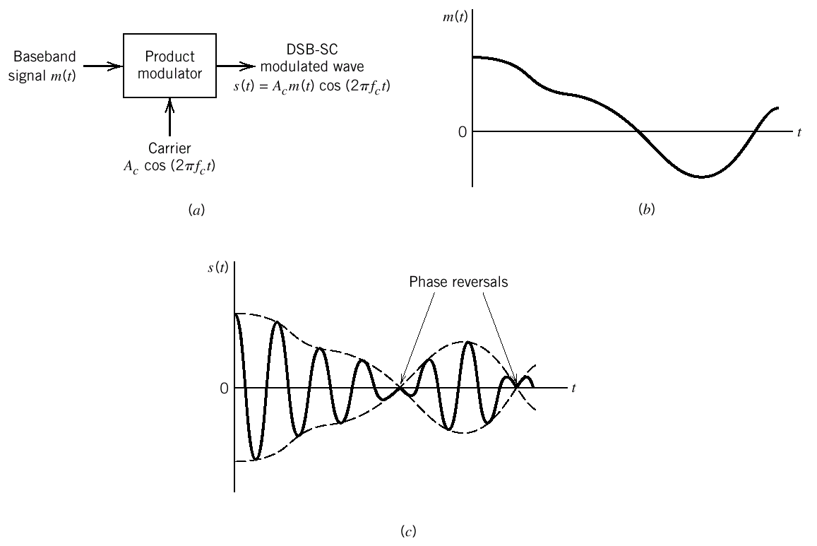
2.3 Linear Modulation Schemes
Figure 2.5 (a)Block diagram of product modulation . (b)Baseband signal . (c)DSB-SC modulation

Slide 19
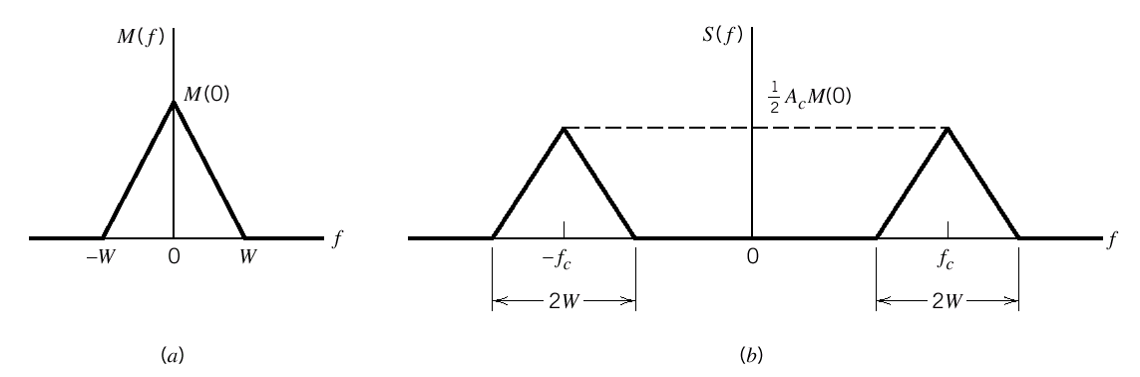
2.3 Linear Modulation Schemes
Coherent Detection:
Figure 2.6 (a)Spectral of baseband signal
(b)Spectral of DSB-SC modulation wave

Slide 20
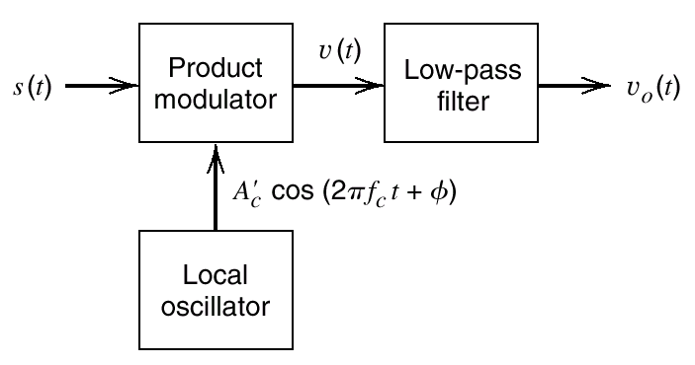
2.3 Linear Modulation Schemes
Figure 2.7 Coherent detector for demodulating DSB-SC modulated wave

Slide 21
2.3 Linear Modulation Schemes
As shown in figure 2.7 , the product modulator output is :
if the cut-off frequency W of the low-pass filter is :
Then the filter output is :

Slide 22
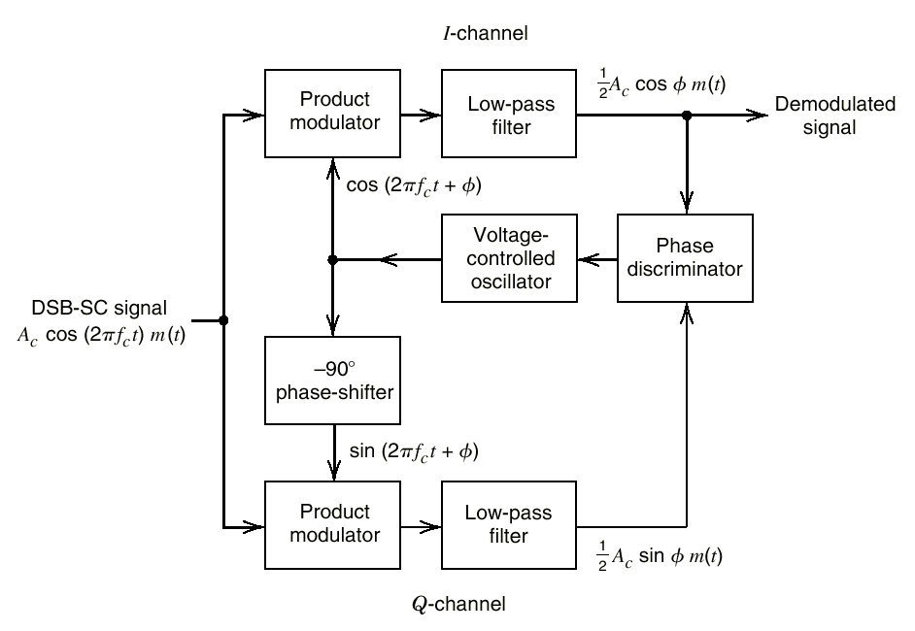
2.3 Linear Modulation Schemes
Costas Receivers:
Figure 2.9 Costas receivers

Slide 23
2.3 Linear Modulation Schemes
Quadrature-Carrier Multiplexing:
The transmitter part involves two separate product modulators
that are supplied with two carrier waves of the same frequency
but differing in phase by –90 degrees:
In the receiver part, s(t) is applied to two separate coherent
detectors. The two carrier have the same frequency but differing
in phase by –90 degrees.

Slide 24
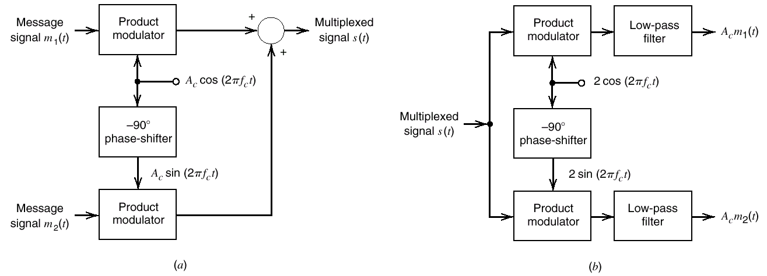
2.3 Linear Modulation Schemes
Figure 2.10 Quadrature-carrier multiplexing system

Slide 25
2.3 Linear Modulation Schemes
SSB Modulation:
Frequency-discrimination method :
Product modulator
Band-pass filter
The requirement of band-pass filter:
The designed sideband lies inside the passband of the filter.
The unwanted sideband lies inside the stopband.
The filter’s transition band is twice the lowest frequency
component of the message signal.

Slide 26
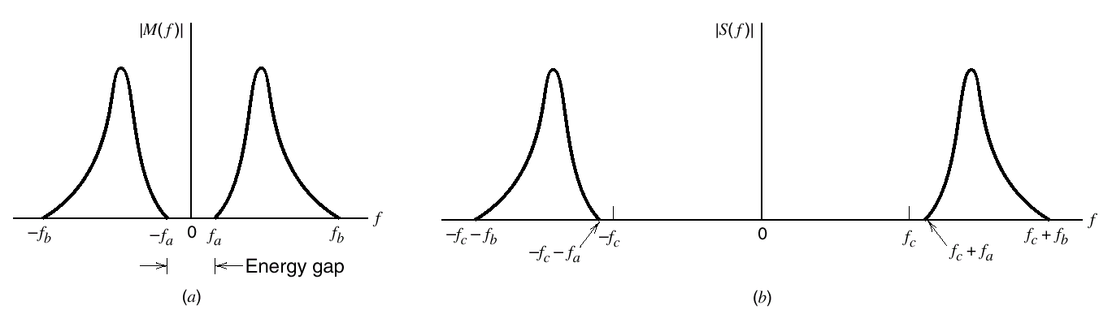
2.3 Linear Modulation Schemes
Figure 2.11 (a)Spectrum of a message signal m(t)
(b)Spectrum of corresponding SSB signal

Slide 27
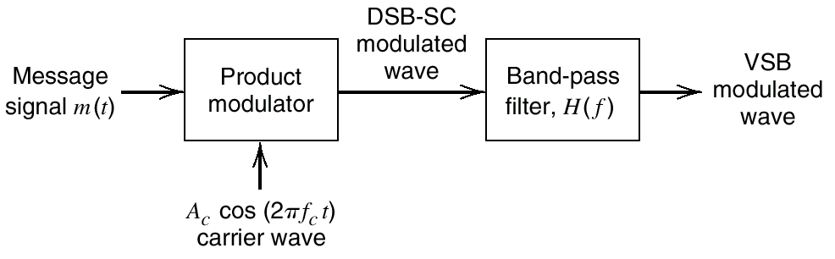
2.3 Linear Modulation Schemes
VSB Modulation:
Figure 2.12 Filtering scheme for the generation of VSB modulated wave

Slide 28
2.3 Linear Modulation Schemes
As shown in Figure 2.12 , the frequency response H(f) of
band-pass filter is :
The sum of the values of the magnitude response |H(f)| at
any two frequencies equally displaced above and below
Then the transmission width of VSB modulation is:

Slide 29
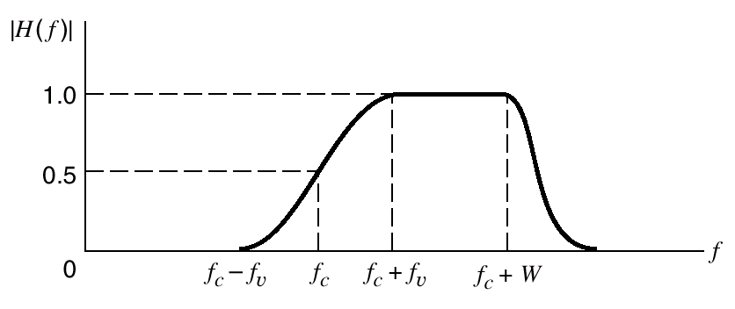
2.3 Linear Modulation Schemes
Figure 2.13 Magnitude response of VSB filter ;only the positive-frequency portion is shown.

Slide 30
2.3 Linear Modulation Schemes
The VSB modulated wave is described in the time domain as:
The plus sign corresponds to the transmission of a vestige of
the upper sideband and the minus sign corresponds to the
transmission of a vestige of the lower sideband .
m’(t) could be obtained by passing the message signal m(t)
through a filter whose frequency response is :

Slide 31
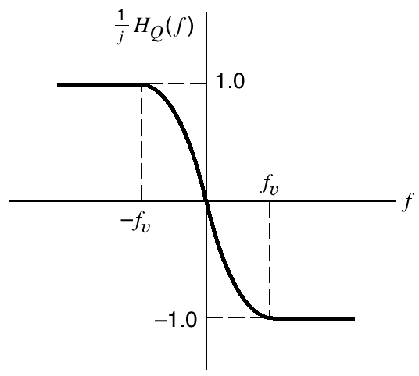
2.3 Linear Modulation Schemes
Figure 2.14 Frequency response of a filter for producing the quadrature component of the VSB modulation wave

Slide 32
2.3 Linear Modulation Schemes
Television Signals:
The video signal exhibits a large bandwidth and significant
low-frequency content,which suggest the use of vestigial
sideband modulation.
Use envelope detection ,which requires the addition of a
carrier to the VSB-modulation wave.

Slide 33
2.3 Linear Modulation Schemes
The input signal to the envelope detector as:
The envelope detector output is:

Slide 34
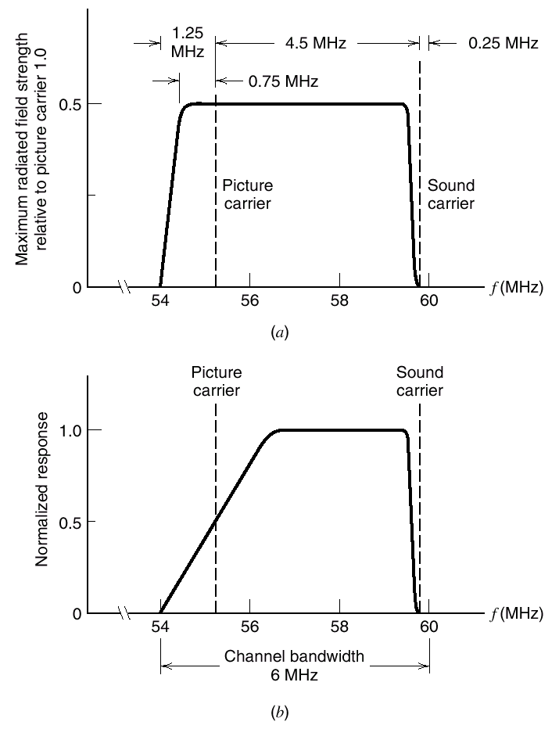
2.3 Linear Modulation Schemes
Figure 2.15 (a)Idealized magnitude spectrum of a transmitted TV signal.(b)Magnitude response of VSB shaping filter in the receiver.

Slide 35
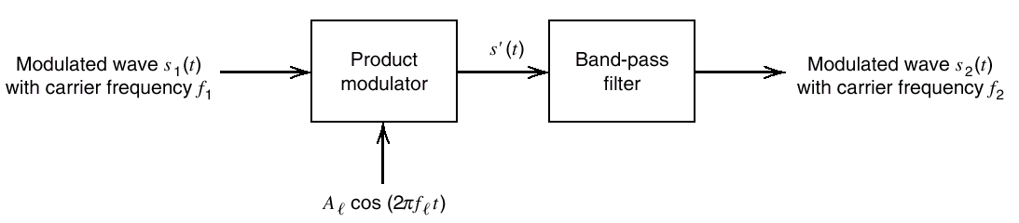
2.4 Frequency Translation
Figure 2.16 Block diagram of mixer

Slide 36
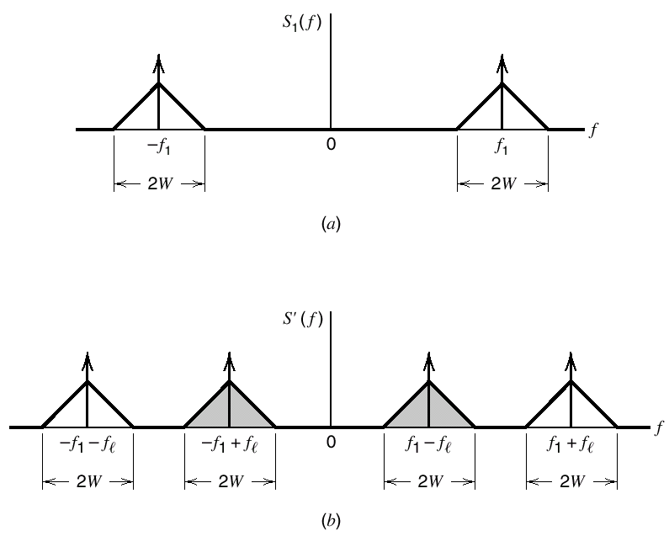
2.4 Frequency Translation
Figure 2.17 (a) Spectrum of modulation signal at the mixer input . (b) Spectrum of the corresponding signal at the output of the product modulation in the mixer.

Slide 37
2.4 Frequency Translation
Up conversion:
Down conversion:

Slide 38
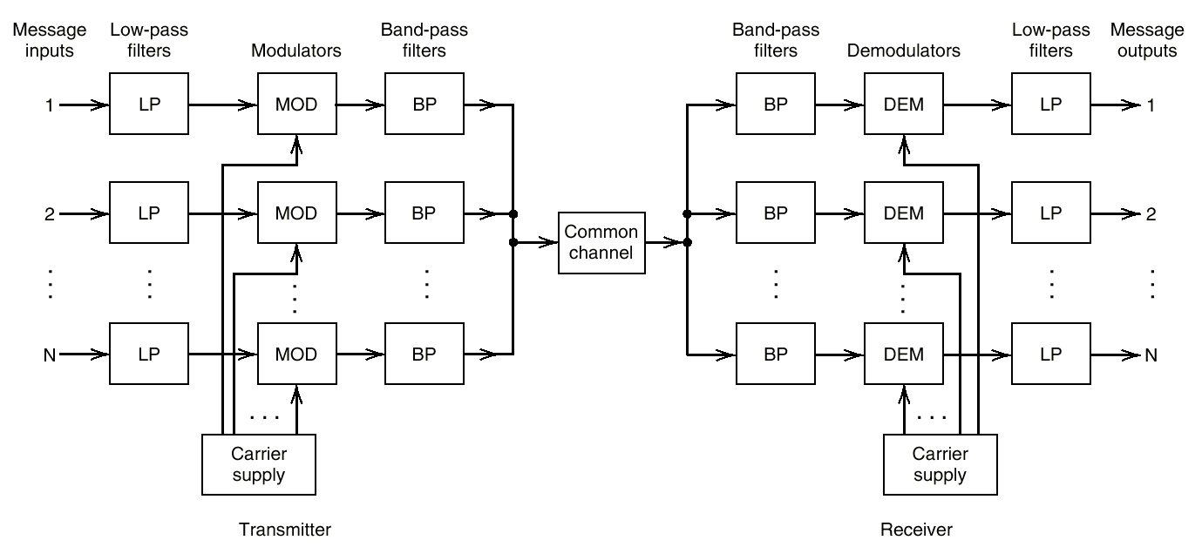
2.5 Frequency-Division Multiplexing
Figure 2.18 Block diagram of FDM system

Slide 39
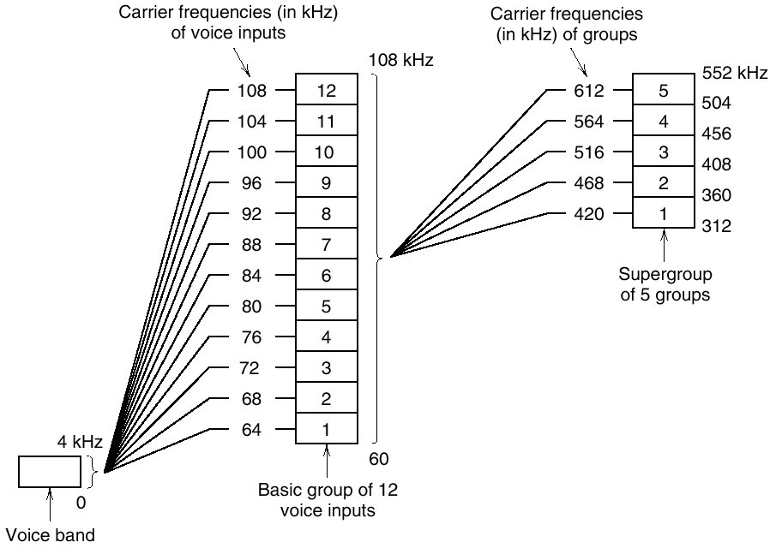
2.5 Frequency-Division Multiplexing
Figure 2.19 Illustrating the modulation steps in an FDM system

Slide 40
2.6 Angle Modulation
Basic Definitions:
:the angle of a modulated sinusoidal carrier .
increases monotonically with time,then:

Slide 41
2.6 Angle Modulation
PM and FM:
PM:the angel is varied linearly with the message
signal m(t),as shown by:
Then the phase-modulated signal is:

Slide 42
2.6 Angle Modulation
FM:the instantaneous frequency is varied linearly with
the message signal , as shown by:
Then :
The frequency-modulated signal is:

Slide 43
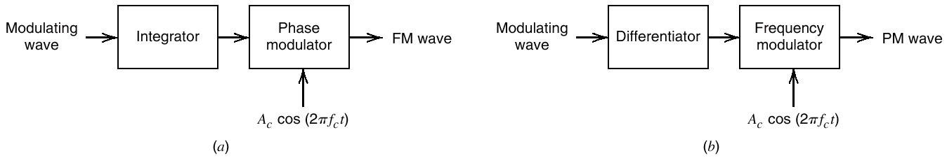
2.6 Angle Modulation
Figure 2.20 Illustrating the relationship between frequency and phase modulation.

Slide 44
2.7 Frequency Modulation
Consider a sinusoidal modulating signal :
Then the instantaneous frequency of the resulting FM signal is:
The angel of the FM signal is :

Slide 45
2.7 Frequency Modulation
The modulation index :
Narrowband FM :
Wideband FM :

Slide 46
2.7 Frequency Modulation
Narrowband Frequency Modulation:
This expression is somewhat similar to the corresponding one
defining an AM signal as:

Slide 47
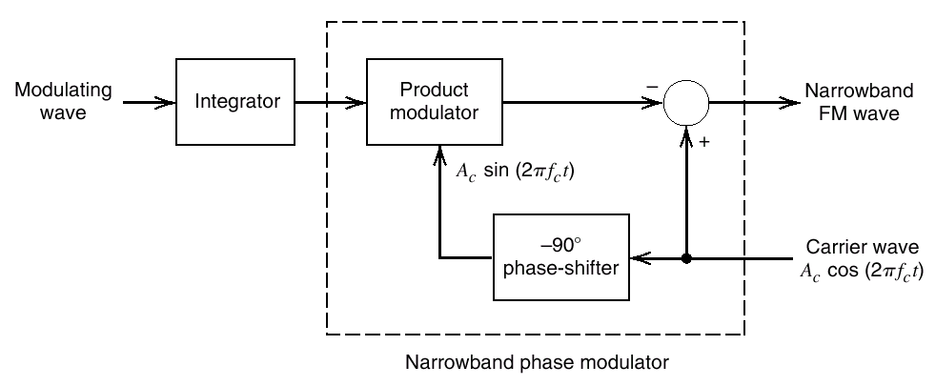
2.7 Frequency Modulation
Figure 2.21 Block diagram of a method for generating a narrowband FM signal

Slide 48
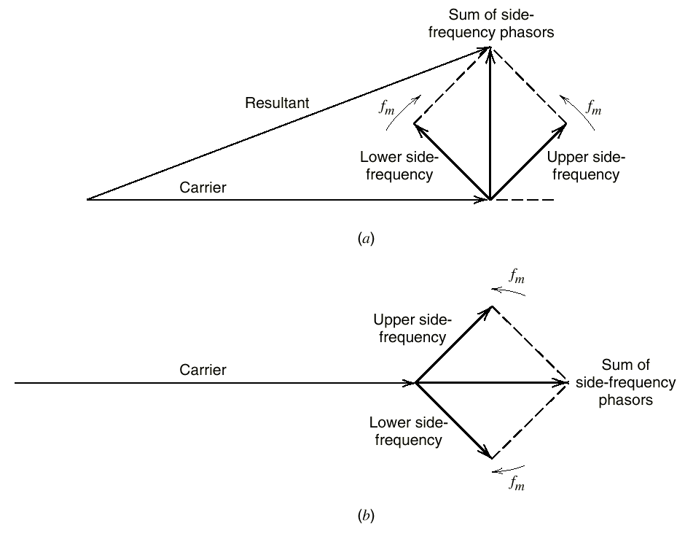
2.7 Frequency Modulation
Figure 2.22 A phasor comparison of narrowband FM and AM waves for sinusoidal modulation

Slide 49
2.7 Frequency Modulation
Wideband Frequency Modulation:
Assume that is large enough , then:
Define :
Expand in the form of a complex Fourier series as:

Slide 50
2.7 Frequency Modulation
The complex Fourier coefficient is :
Define , then:

Slide 51
2.7 Frequency Modulation
The Bessel function of the first kind and argument :
Then:
So, the complex envelope of the FM signal is:

Slide 52
2.7 Frequency Modulation
So the discrete spectrum of s(t) is :
The behavior of the Bessel function is:
for all n ;
if is a small value ,we have :

Slide 53
2.7 Frequency Modulation
Because of the equations before , we have such observations:
The spectrum of an FM signal contains a carrier
component and an infinite set of side frequencies.
For the special case of small compared with unity ,
only the Bessel coefficients and have
significant values ,so the FM signal is composed of a
carrier and a single pair of side frequencies at .
The amplitude of the carrier component varies with
according to .

Slide 54
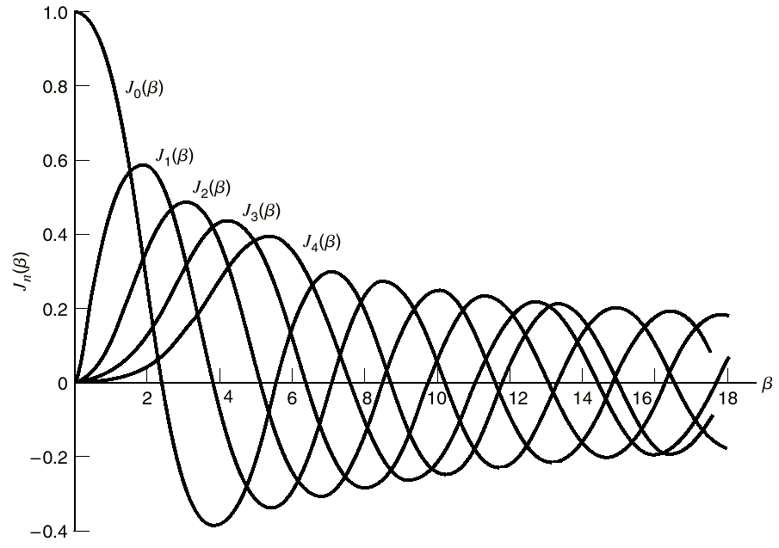
2.7 Frequency Modulation
Figure 2.23 Plots of Bessel functions of the first kind for varying order

Slide 55
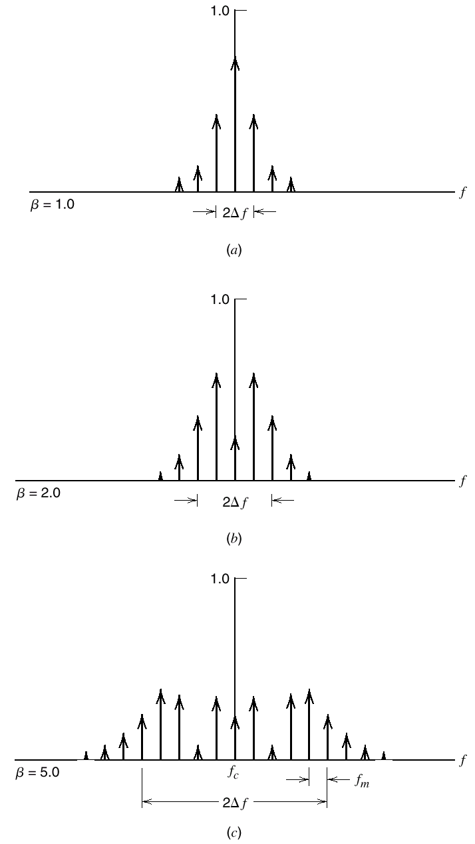
2.7 Frequency Modulation
Figure 2.24 Discrete amplitude spectra of an FM signal

Slide 56
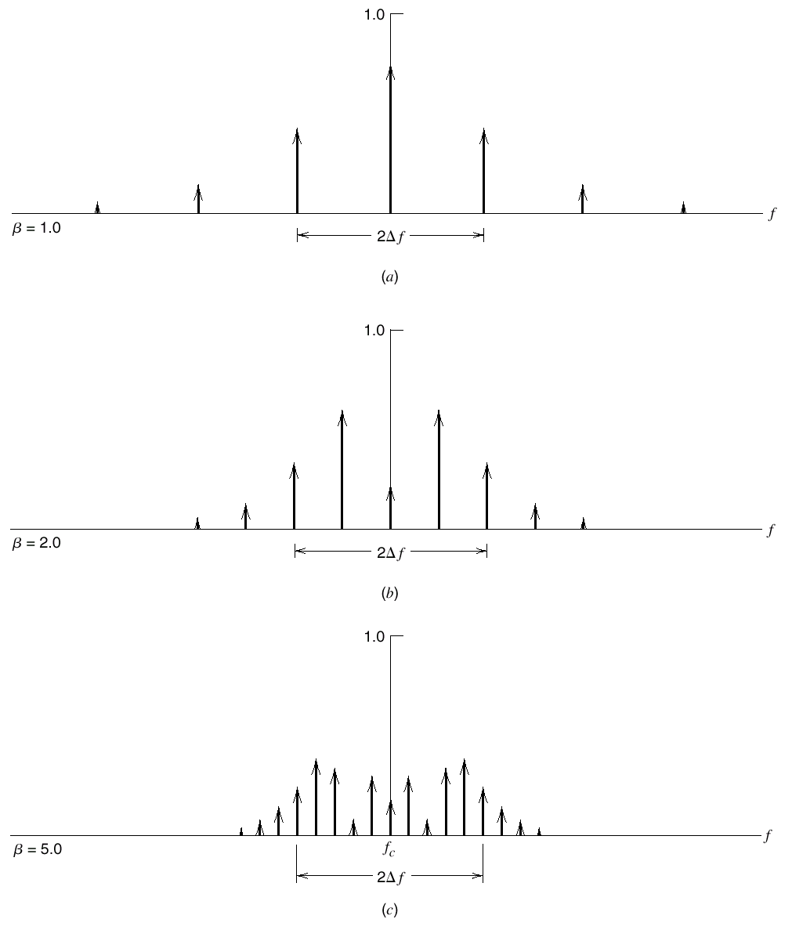
2.7 Frequency Modulation
Figure 2.25 Discrete amplitude spectra of an FM signal

Slide 57
2.7 Frequency Modulation
Transmission Bandwidth of FM Signals:
Carson’s rule :
Consider the more general case of an arbitrary modulating
signal m(t) which highest frequency component denoted by W
,then the actual bandwidth of FM is larger than the value shown
in Figure 2.26 ,but smaller than Carson’s rule’s value.

Slide 58
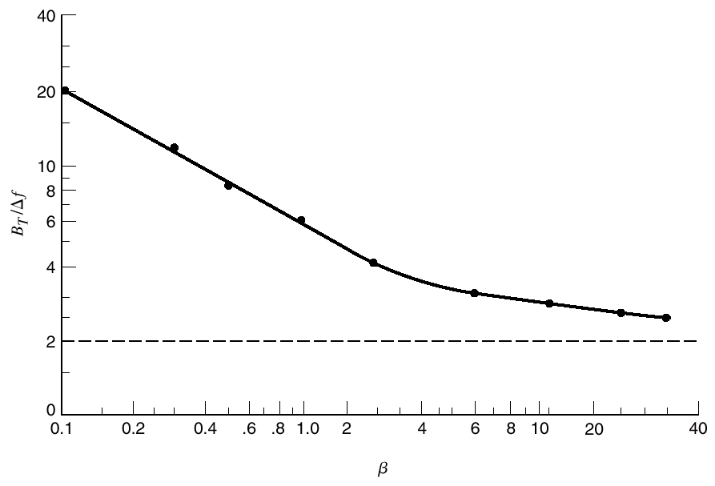
2.7 Frequency Modulation
Figure 2.26 Universal curve for evaluating the 1 percent bandwidth of an FM wave

Slide 59
2.7 Frequency Modulation
Modulation Index | Number of significant side frequencies
0.1 0.3 0.5 1.0 2.0 5.0 10.0 20.0 30.0 | 2 4 4 6 8 16 28 50 70
Table 2.2 Number of significant side frequencies of a wideband FM signal for varying modulation index

Slide 60
2.7 Frequency Modulation
Generation of FM Signals:
Indirect FM
Input FM signal s(t):
The instantaneous frequency is:
After band-pass filter:
The instantaneous frequency is:

Slide 61
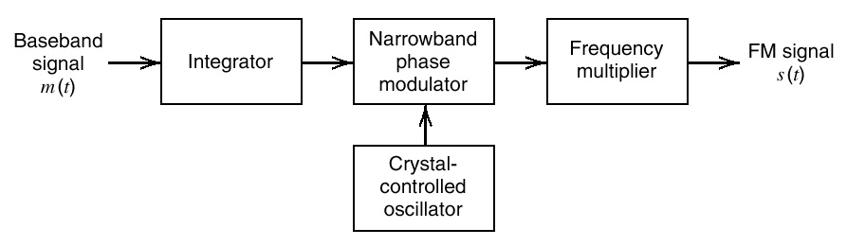
2.7 Frequency Modulation
Figure 2.27 Block diagram of the indirect method of generating a wideband FM signal

Slide 62
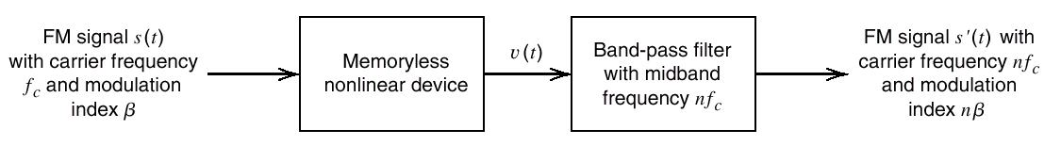
2.7 Frequency Modulation
Figure 2.28 Block diagram of frequency multiplier

Slide 63
2.7 Frequency Modulation
Demodulation of FM Signals:
Directly Demodulation (Here):
Using a frequency discriminator
Indirectly Demodulation (2.14):
Using a phase-locked loop

Slide 64
2.7 Frequency Modulation
The frequency response of frequency discriminator is :

Slide 65
2.7 Frequency Modulation

Slide 66
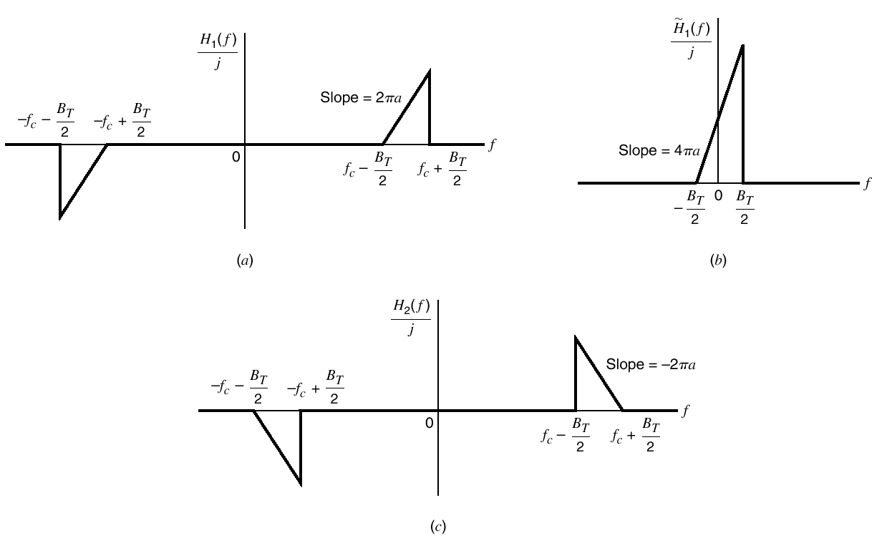
2.7 Frequency Modulation
Figure 2.29 Three kind of frequency response

Slide 67
2.7 Frequency Modulation
The incoming FM signal is:
The carrier frequency is high compared to the transmission
bandwidth of the FM signal s(t),then the complex envelope of s(t)
is:

Slide 68
2.7 Frequency Modulation
Let denote the complex envelope of the response of slope
circuit due to , then the Fourier transform of is :

Slide 69
2.7 Frequency Modulation
So the desired response of the slope circuit is :
If : ,then we can use an envelope detector to
recover the amplitude variations .the output is :

Slide 70
2.7 Frequency Modulation
As shown in figure 2.30 ,the two slope circuits are related by :
Let denote the response of the complementary slope
circuit produced by the incoming FM signal s(t), then

Slide 71
2.7 Frequency Modulation
Then the difference between the two envelopes is:
This is a scaled version of the original message m(t) and free
from bias.
Then we get the model of the ideal frequency discriminator as
a pair of slope circuits with their complex transfer functions ,
followed by envelope detection and finally a summer, as in figure
2.30

Slide 72
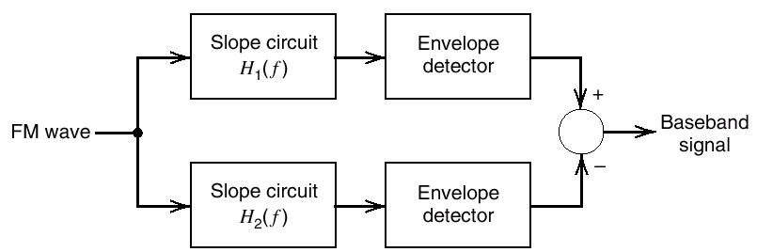
2.7 Frequency Modulation
Figure 2.30 Block diagram of frequency discrimination

Slide 73
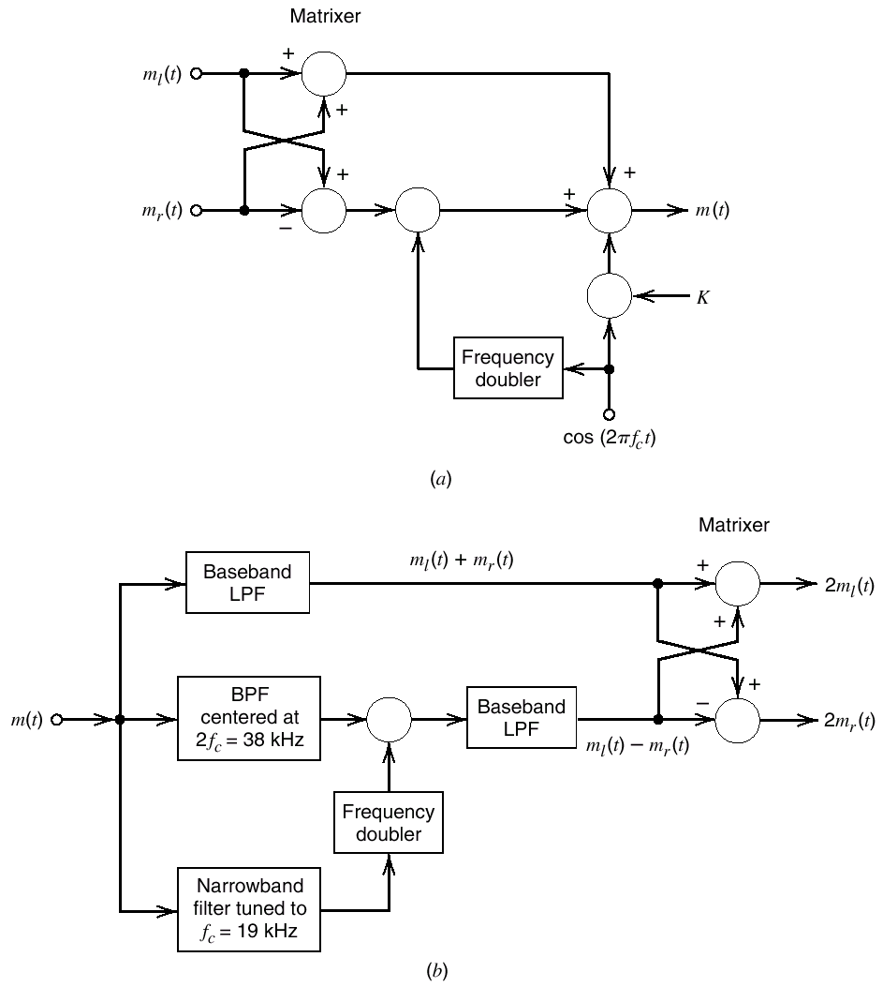
2.7 Frequency Modulation
FM Stereo Multiplexing :
Figure 2.31 FM Stereo Multiplexing

Slide 74
2.8 Nonlinear Effects in FM Systems
Consider a communications channel, the transfer characteristic
of which is nonlinear as :
The FM signal is :
Where

Slide 75
2.8 Nonlinear Effects in FM Systems
Then the output of channel is :

Slide 76
2.8 Nonlinear Effects in FM Systems
For separating the desired FM signal with the carrier frequency
from that with the carrier frequency ,we should have :
Then the output is :

Slide 77
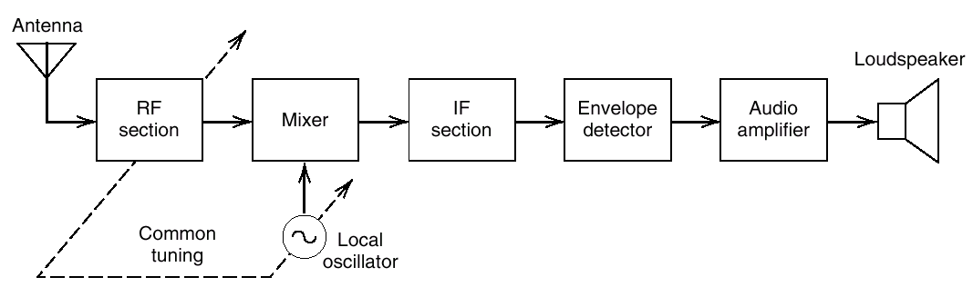
2.9 Superheterodyne Receiver
Figure 2.32 Basic elements of an AM radio receiver of the superheterodyne type

Slide 78
2.9 Superheterodyne Receiver
 | AM Radio | FM Radio
RF carrier range MidBand frequency of IF section IF bandwidth | 0.535-1.605MHz 0.455MHz 10KHz | 88-108MHz 10.7MHz 200KHz
Table 2.3 Typical frequency parameters of AM and FM radio receivers

Slide 79
2.10 Noise in CW Modulation Systems
Two models:
Channel Model: distortionless but perturbed by Additive
White Gaussian Noise(AWGN)
Receiver Model: consisting of an ideal band-pass filter
followed by an ideal demodulator .

Slide 80
2.10 Noise in CW Modulation Systems
Signal-to Noise Ratios : Basic Definitions :
The filtered noise :
is the in-phase noise component and is the
quadrature component.
Output signal-to noise ratio , ,defined as the ratio of the
average power of the demodulated message signal to the average
power of the noise.Then define a figure of merit for the receiver
is:
Figure of merit

Slide 81
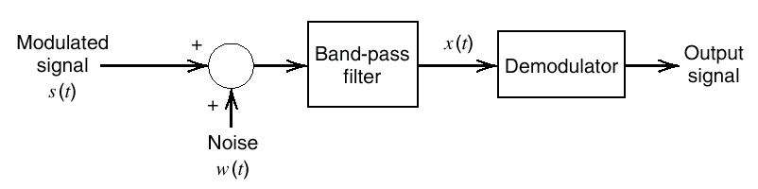
2.10 Noise in CW Modulation Systems
Figure 2.33 Receiver Model

Slide 82
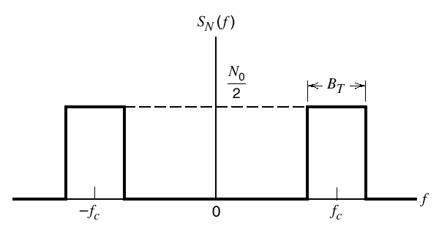
2.10 Noise in CW Modulation Systems
Figure 2.34 Idealized characteristic of band-pass filtered noise

Slide 83
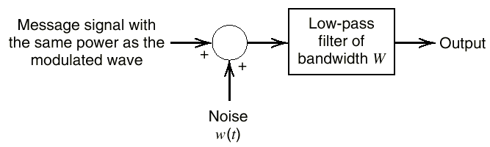
2.10 Noise in CW Modulation Systems
Figure 2.35 The baseband transmission model

Slide 84
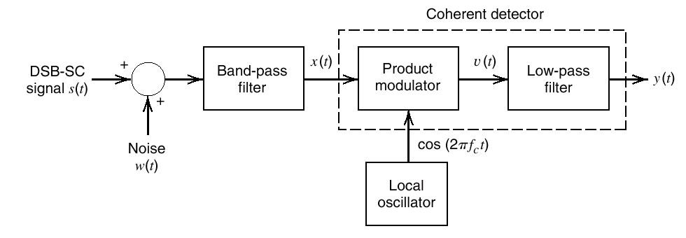
2.11 Noise in Linear Receivers Using Coherent Detection
Figure 2.36 Model of DSB-SC receiver using coherent detection

Slide 85
2.11 Noise in Linear Receivers Using Coherent Detection
The DSB-SC component of the filtered signal x(t) is:
The average power P of the message signal is:

Slide 86
2.11 Noise in Linear Receivers Using Coherent Detection
The total signal at the coherent detector input is:
Then the output of the product-modulator component of the
coherent detector is :

Slide 87
2.11 Noise in Linear Receivers Using Coherent Detection
Then the receiver output is :
m(t) and appear additively at the receiver output.
is completely rejected by the coherent detector .

Slide 88
2.11 Noise in Linear Receivers Using Coherent Detection
The average power of the noise at the receiver output is :
The output signal-to-noise for a DSB-SC receiver using
coherent detector is:

Slide 89
2.11 Noise in Linear Receivers Using Coherent Detection
SSB-SC?

Slide 90
2.12 Noise in AM Receivers Using Envelope Detection
The full AM signal is:
The channel signal-to-noise ratio for AM is :
The filtered signal x(t) to the envelope detector is:

Slide 91
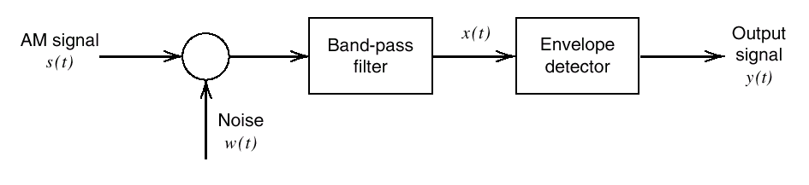
2.12 Noise in AM Receivers Using Envelope Detection
Figure 2.37 Model of AM Receiver

Slide 92
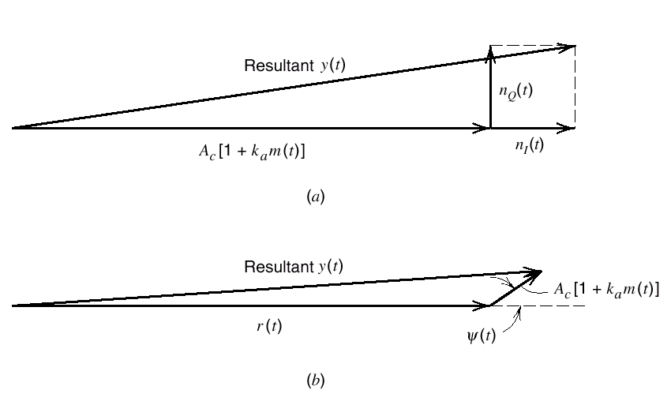
2.12 Noise in AM Receivers Using Envelope Detection
Figure 2.38 Phasor diagram for AM wave plus narrowband noise for the case of high/low carrier-to-noise ratio

Slide 93
2.12 Noise in AM Receivers Using Envelope Detection
Then the receiver output is :
The output y(t) is :
The output signal-to-noise ratio of an AM receiver using an
envelope detector is:

Slide 94
2.12 Noise in AM Receivers Using Envelope Detection
So we get the following fogure of merit for amplitude
Modulation :
with these two conditions:
In the input of envelope detector ,the average noise power
is small compared to the average carrier power .

Slide 95
2.12 Noise in AM Receivers Using Envelope Detection
Threshold Effect :
narrowband noise:
The envelope detector output is:
When the carrier-to-noise ratio is low ,the detector output has
no component strictly proportional to the message signal m(t) .
This is called threshold effect.

Slide 96
2.12 Noise in AM Receivers Using Envelope Detection
General Formula for in Envelope Detection :
the input of an envelope detector is :
The power spectral density of N(t) is:

Slide 97
2.12 Noise in AM Receivers Using Envelope Detection
So the noisy signal at the detector input is :
and are zero-mean, jointly Gaussian,mutually
Independent low-pass random process with identical power
spectral densities as:

Slide 98
2.12 Noise in AM Receivers Using Envelope Detection
The average noise power at the detector input is :
the output signal-to-noise defined as:
The envelope detector output is :

Slide 99
2.12 Noise in AM Receivers Using Envelope Detection
define the mean output signal :
where
define the mean output noise power :

Slide 100
2.12 Noise in AM Receivers Using Envelope Detection
We known that the envelope detector output due to noise alone
is Rayleigh distributed:
the gamma function:

Slide 101
2.12 Noise in AM Receivers Using Envelope Detection
y(t) is the combined presence of signal and noise ,we have:

Slide 102
2.12 Noise in AM Receivers Using Envelope Detection
Using the integral representation:
Using :

Slide 103
2.12 Noise in AM Receivers Using Envelope Detection
So we get the mean output signal as:
Following a similar procedure ,we get the mean-square value
of the detector output y(t) as:

Slide 104
2.12 Noise in AM Receivers Using Envelope Detection
So we get :
So the output signal-to-noise ratio for the envelope detection is:

Slide 105
2.12 Noise in AM Receivers Using Envelope Detection
Two limiting case of the output SNR of envelope detection is:
Large carrier-to-noise ratio:
for
for

Slide 106
2.12 Noise in AM Receivers Using Envelope Detection
Small carrier-to-noise ratio:
for
for

Slide 107
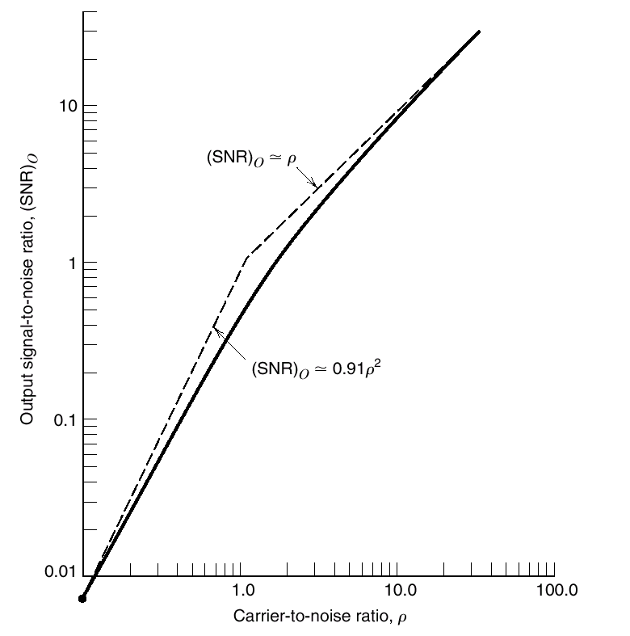
2.12 Noise in AM Receivers Using Envelope Detection
Figure 2.39 Output signal-to-noise ratio of an envelope detector for varying carrier-to-noise ratio

Slide 108
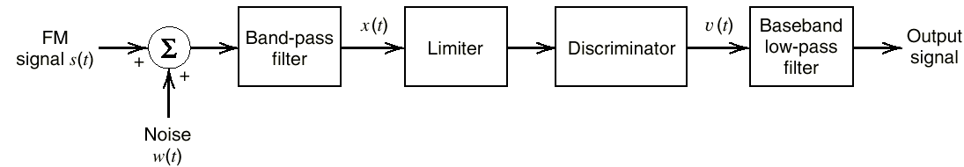
2.13 Noise in FM Receivers
Figure 2.40 Model of an FM receiver

Slide 109
2.13 Noise in FM Receivers
The filtered noise n(t) at the band-pass filter output is :

Slide 110
2.13 Noise in FM Receivers
The incoming FM signal is:
Define

Slide 111
2.13 Noise in FM Receivers
So the noisy signal at the band-pass filter output is :
The phase of the resultant phasor representing s(t)is :

Slide 112
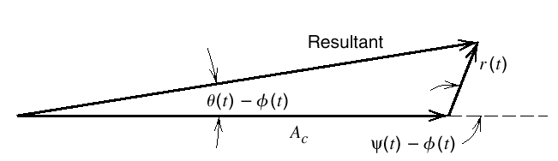
2.13 Noise in FM Receivers
Figure 2.41 Phasor diagram for FM wave plus narrowband noise for the case of high carrier-to-noise ratio

Slide 113
2.13 Noise in FM Receivers
The expression for the phase simplifies as :
The discriminator output is :
where

Slide 114
2.13 Noise in FM Receivers
is simplified as :
The quadrature component of the filtered noise n(t) is :

Slide 115
2.13 Noise in FM Receivers
The power spectral density of the noise is related to the power
spectral density of the quadrature noise component as :
The power spectral density of the noise is :

Slide 116
2.13 Noise in FM Receivers
So the power spectral density of the noise at the receiver output
is :
So the average power of output noise is :

Slide 117
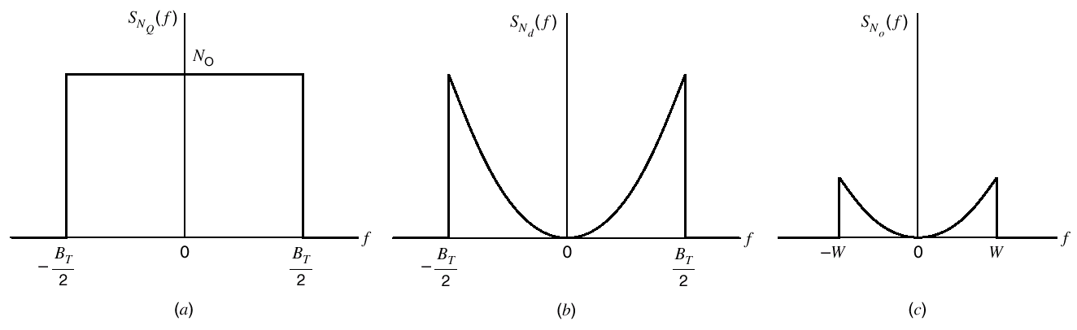
2.13 Noise in FM Receivers
Figure 2.42 Noise analysis of FM receiver

Slide 118
2.13 Noise in FM Receivers
The output signal-to-noise ratio is :
The channel signal-to-noise ratio is :
The figure of merit frequency modulation :

Slide 119
2.13 Noise in FM Receivers
Capture Effect:
The inherent ability of an FM system to minimize the effects
of unwanted signals

Slide 120
2.13 Noise in FM Receivers
FM Threshold Effect :
The composite signal at the frequency discriminator input is :
Define the carrier-to-noise ratio :
As decreased deeply , the threshold is said to occur .

Slide 121
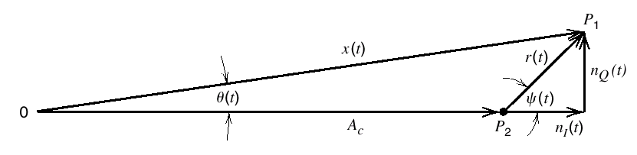
2.13 Noise in FM Receivers
Figure 2.43 Phasor diagram interpretation

Slide 122
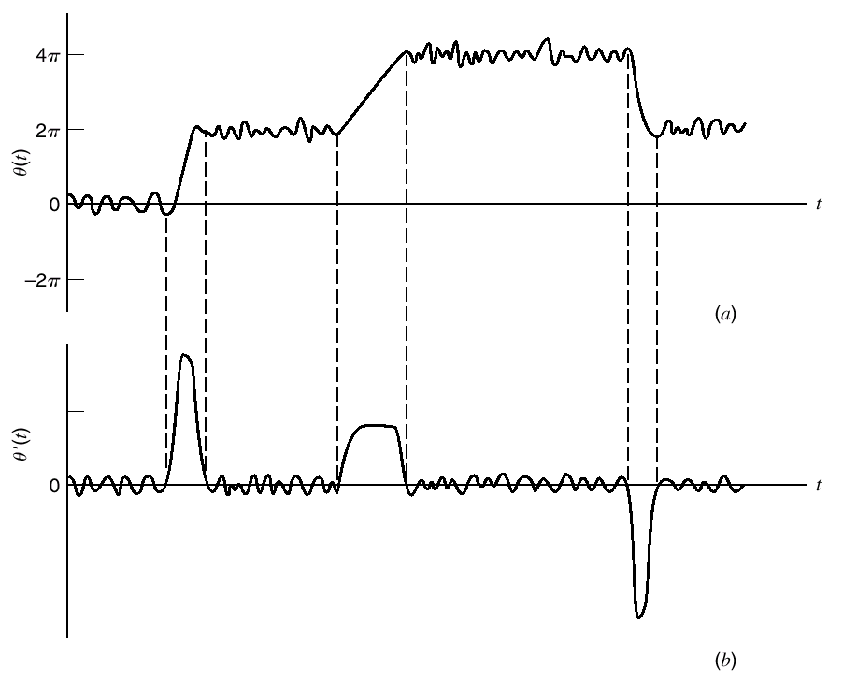
2.13 Noise in FM Receivers
Figure 2.44 Illustrating impluselike components

Slide 123
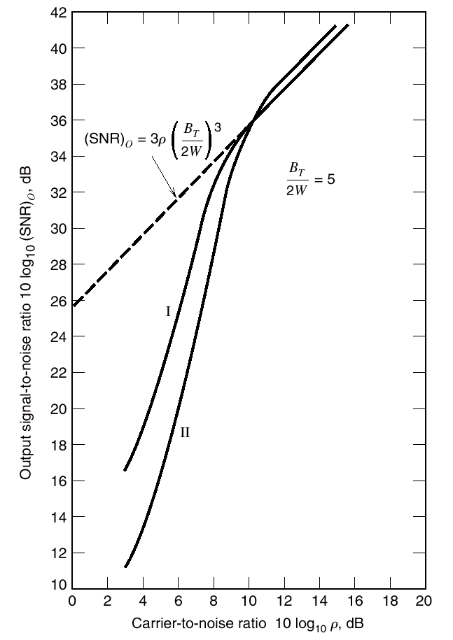
2.13 Noise in FM Receivers
Figure 2.45 Dependence of output signal-to-noise ratio on input carrier-to-noise ratio for FM receiver

Slide 124
2.13 Noise in FM Receivers
FM Threshold Reduction :
The combined presence of an unmodulated carrier and
narrowband noise is :
The FMFB receiver does not respond to the in-phase noise
component , nut that it would demodulated the quadrature noise
component .

Slide 125
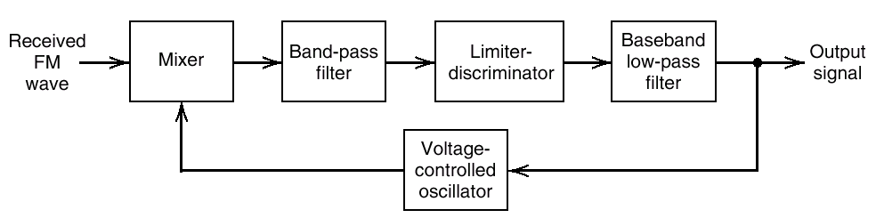
2.13 Noise in FM Receivers
Figure 2.47 FM demodulator with negative feedback

Slide 126
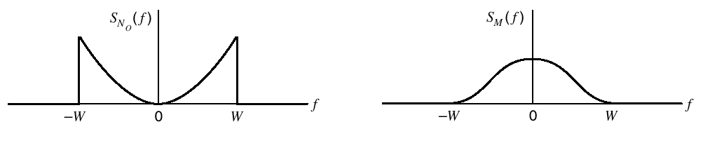
2.13 Noise in FM Receivers
Pre-Emphasis and De-Emphasis in FM :
Figure 2.48 (a) power spectral density of noise at FM receiver output (b) power spectral density of a typical message signal

Slide 127
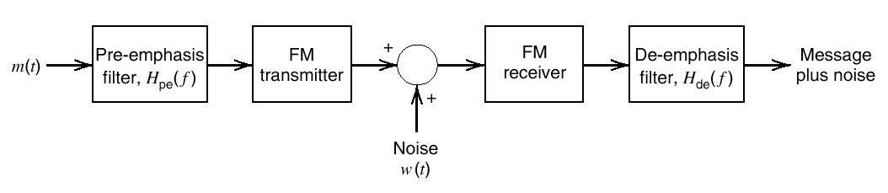
2.13 Noise in FM Receivers
Figure 2.49 Use of pre-emphasis and de-emphasis in an FM system

Slide 128
2.13 Noise in FM Receivers
The frequency response of the de-emphasis filter is :
The modified power spectral density of the noise at the de-
Emphasis filter output is :

Slide 129
2.13 Noise in FM Receivers
So the average power of the modified noise at the receiver
output is :

Slide 130
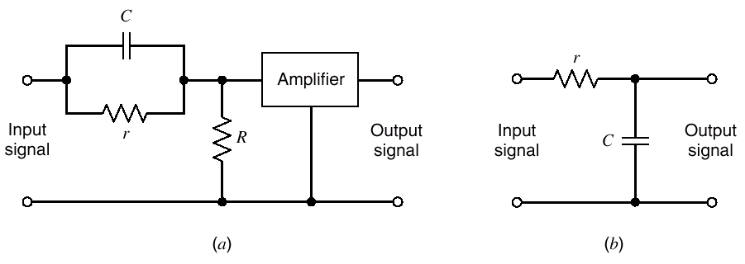
2.13 Noise in FM Receivers
Figure 2.50 (a) Pre-emphasis filter (b) De-emphasis filter

Slide 131
课堂练习
模拟调频系统中，调频载波信号为100cos2π×10⁸t伏特，调制的基带信号为10cos2π×10³t伏特，调频灵敏度K_{F}=1200π弧度/秒伏，试求：(1)该调频信号的表达式；(2)该调频信号的带宽。

Slide 132
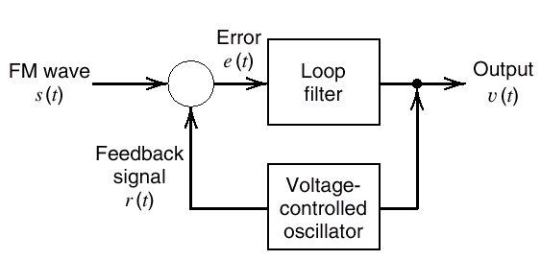
2.14 Computer Experiments: Phase-Locked Loop
Figure 2.51 Phase-locked loop

Slide 133
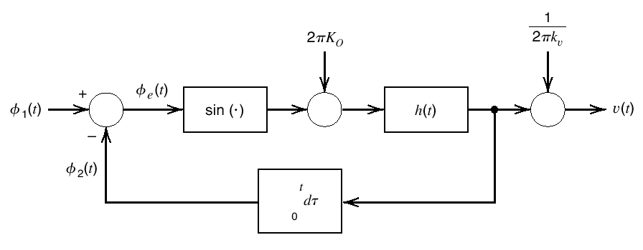
2.14 Computer Experiments: Phase-Locked Loop
Figure 2.52 Nonlinear model of the phase-locked loop

Slide 134

2.14 Computer Experiments: Phase-Locked Loop
Figure 2.53 Variation of the phase error for three different values of damping factor

Slide 135

2.14 Computer Experiments: Phase-Locked Loop
Figure 2.54 Phase-plane portrait for critical damping and sinusoidal modulation

