Slide 1


Department of Computer Engineering
Mini Hackathon - GenHack V1.0
1. PROBLEM STATEMENT DETAILS
2. TEAM SUBMISSION DETAILS
Problem Statement ID:
15
Team No:
P 25
Problem Title:
EmergencyScribe (ResQPulse AI)
Team Member Names:
Gaurav Jadhav
Domain Theme:
Generative AI / Public Safety
3. SUSTAINABLE DEVELOPMENT GOAL
SDG 11.5 · 3.6 · 13.1 · 16.1
SDG :
Slide 01 of 07

Slide 2


SECTION 01
PROPOSED SOLUTION & INNOVATION
Solution Overview
Innovation & Uniqueness
Core Concept & Approach:
Key Differentiators:
One alert from one messy report. ResQPulse AI turns an emergency report, typed or spoken, into a structured, prioritised, explainable alert for a 112 dispatcher.
Three models, one pipeline. Whisper transcribes the voice, DistilBERT classifies the incident (8 types) and scores severity 1 to 5, Flan-T5 extracts location, people, injuries, hazards and a summary.
Built for the dispatcher. Severity-sorted queue, map pins, suggested responders and SDG tags. A human confirms, dispatches or dismisses every alert.
Working prototype. FastAPI backend and Streamlit app running real models offline on a laptop, tested end to end with typed and voice input.
A full alert, not just a label: type, continuous severity, fields and summary.
Explainable: an attention heatmap shows which words drove the decision.
Voice in: editable transcript so the dispatcher can fix a misheard word.
Duplicate reports flagged so ten messages about one fire do not become ten alerts.
Small models, no cloud: DistilBERT and Flan-T5-base run offline.
Honest evaluation: scored on 144 real reports the models never saw.
Team P 25
Slide 02 of 07

Slide 3

SECTION 02
TECHNICAL APPROACH & ARCHITECTURE
Technology Stack
System Architecture / Flow Diagram
Frontend: Streamlit, Folium map
Backend: Python FastAPI
Database: in-memory store with JSONL logs for alerts and dispatcher corrections
Hardware/IoT: none, runs on a laptop with a microphone
AI / Cloud: PyTorch and Hugging Face: DistilBERT, Flan-T5-base, faster-whisper small.en, MiniLM duplicate check; scikit-learn baseline; trained on Kaggle T4 GPUs
Maps: offline gazetteer, OpenStreetMap Nominatim
Typed report
Text from the call taker or a message
DistilBERT
Incident type (8 classes)
Severity 1 to 5
Attention heatmap
FastAPI
Builds the alert
Geocodes the place
Suggests responders
Tags SDGs
Flags duplicates
Logs corrections
Streamlit dashboard
Alert card
Attention heatmap
Severity-sorted queue
Incident map
Confirm, dispatch or dismiss
Voice call
Whisper small.en turns speech into text
Dispatcher can edit it
Flan-T5
Location, people, injuries, hazards, summary
Typed reports go to both models; voice goes through Whisper first. A human reviews every alert.
Team P 25
Slide 03 of 07

Slide 4
SECTION 03
METHODOLOGY AND MEASURABLE IMPACT
Methodology
Measurable Impact
1. Data. Real crisis tweets (HumAID, CrisisLexT26, Kaggle negatives, about 37,000 after cleaning) plus 710 call-style reports written by Claude, with a fixed schema: 8 incident types, severity 1 to 5.
2. Train. DistilBERT with two heads (type: cross-entropy, severity: masked MSE). Flan-T5-base fine-tuned to write the alert fields. TF-IDF + logistic regression as the baseline.
3. Serve. Whisper, then classify with attention rollout, then extract fields (retry, rule fallback, people-count rule), then geocode, suggest responders and check for duplicates.
4. Evaluate. One script on held-out sets: 107 call-style reports, 7,755 real tweets (6 crises never seen) and a 144-report gold set audited by a person.
5. Human in the loop. The dispatcher confirms, dispatches or dismisses; every correction is logged for later learning.
91%
of real emergencies caught (baseline 71%)
98%
of the most severe reports not dismissed (baseline 75%)
0.77
macro F1 on real reports (baseline 0.56)
0.75
severity RMSE on call-style reports (MSE 0.57)
~3 s
per report on a laptop, fully offline
Team P 25
Slide 04 of 07

Slide 5
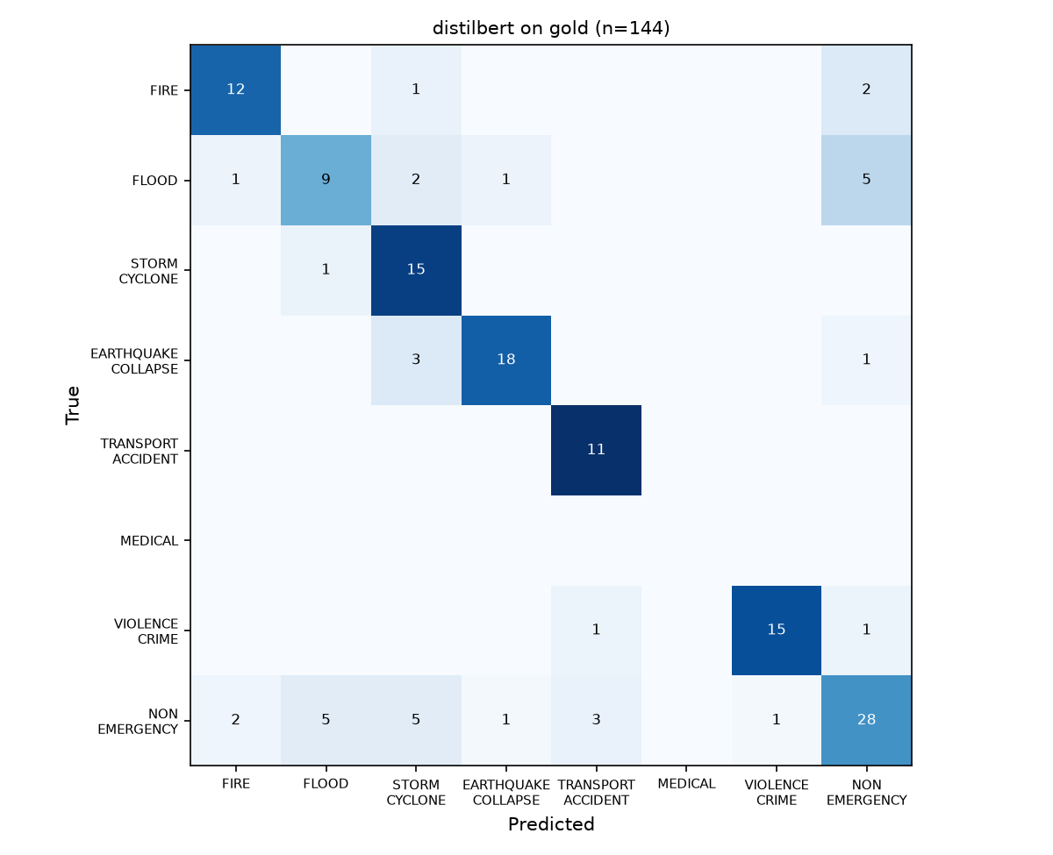
SECTION 04
Results
Result
Confusion Matrix (Gold)
Incident type: baseline → our DistilBERT
Test set | Macro precision | Macro recall | Macro F1
Gold: 144 real reports | 0.61 → 0.76 | 0.59 → 0.79 | 0.56 → 0.77
Call-style: 107 reports | 0.89 → 0.96 | 0.86 → 0.96 | 0.87 → 0.96
Real tweets: 7,755 | 0.73 → 0.79 | 0.62 → 0.75 | 0.63 → 0.75
Safety, severity, extraction and voice
Metric | Value
Real emergencies caught / severe reports not dismissed (gold) | 0.91 / 0.98
False alarms on non-emergencies (gold) | 0.38
Severity RMSE / MSE, call-style reports (107) | 0.75 / 0.57
Severity RMSE / MSE, real reports (gold 144) | 1.33 / 1.77
Field extraction: output parses / location F1 (call-style) | 100% / 0.78
Whisper word error rate, synthetic voices (clean / noisy) | 9.9% / 15.5%
DistilBERT on 144 real reports. Strongest gains: violent crime and fire, where word counting fails.
Gold labels were written by Claude and checked by a person (30 of 30 agreed). Voice was tested on text-to-speech audio, not real callers.
Team P 25
Slide 05 of 07

Slide 6
SECTION 05
FEASIBILITY & RISK MITIGATION
Feasibility
Potential Risks
Mitigation Plan
Built and tested in 12 hours: data, three models, API and dashboard, 52 automated tests.
Small models: DistilBERT and Flan-T5-base run on a laptop, about 3 s per report.
Free tools only: Kaggle T4 GPUs, Hugging Face, open datasets.
Demonstrated: typed and voice reports through the real models to a prioritised queue and map.
False alarms: 38% of non-emergency tweets flagged on the gold set.
Severity: weaker on news-style text (RMSE 1.33).
Data: no real 112 calls; MEDICAL is synthetic only; gold labels by Claude.
Voice: place names and numbers misheard (word error 10 to 16%).
Scope: English only.
Human in the loop: a dispatcher confirms every alert and can edit the transcript.
Recall first: 98% of severe reports kept; false alarms cost less than misses.
Fallbacks: rule-based extractor, offline models, mock mode, backup demo video.
Next: real anonymised 112 transcripts, Hindi, Marathi and Hinglish, learning from logged corrections.
Team P 25
Slide 06 of 07

Slide 7
SECTION 06
RESEARCH & REFERENCES
Key Reference Sources
Dataset Sources:
HumAID, Alam et al., ICWSM 2021: crisisnlp.qcri.org/humaid_dataset
CrisisLexT26, Olteanu et al., 2015: crisislex.org/data-collections.html
Kaggle, Natural Language Processing with Disaster Tweets (negatives): kaggle.com/competitions/nlp-getting-started
Ours: 710 call-style reports and a 144-report gold set: kaggle.com/datasets/ggauravj05/resqpulse-data
Research Papers / Patent References:
Vaswani et al., Attention Is All You Need, 2017; Sanh et al., DistilBERT, 2019
Chung et al., Scaling Instruction-Finetuned Language Models (Flan-T5), 2022
Abnar and Zuidema, Quantifying Attention Flow in Transformers (attention rollout), ACL 2020
Radford et al., Robust Speech Recognition via Large-Scale Weak Supervision (Whisper), 2022
Open Source Libraries & APIs:
PyTorch, Hugging Face Transformers, faster-whisper, sentence-transformers (all-MiniLM-L6-v2), scikit-learn
FastAPI, Streamlit, Folium, rapidfuzz; OpenStreetMap Nominatim for geocoding
Team P 25
Slide 07 of 07

