Slide 1
KL UNIVERSITY • BACHUPALLY CAMPUS, HYDERABAD
Department of Computer Science & Engineering
Resume Screening and Job Matching
Ranking candidates against a job description using NLP and text similarity
PRESENTED BY
UNDER THE GUIDANCE OF
2520030465 Guttikonda Gayathri
2520030260 Sai Sowseelya V
Mr. G. Raghavendra
Designation, Department of CSE
KLH Bachupally Campus
B.Tech II Year | Minor Project - Review 1 | Academic Year 2026-27
Notes:
Model template - Minor Project review presentation for B.Tech II year. Replace every placeholder in angle brackets. Title slide: speak for 30 seconds - greet the panel, state the title, introduce the team and the guide. Do not read the slide word for word.

Slide 2
AGENDA
Contents
1
Introduction & Domain Background
7
Methodology & Modules
2
Problem Statement & Motivation
8
Tools and Technologies
3
Literature Survey
9
Work Completed / Demo
4
Research Gap Identified
10
Expected Outcome & Conclusion
5
Objectives of the Project
11
References
6
Proposed System Architecture
Dept. of CSE | KL University, Bachupally Campus
2
Notes:
Keep the agenda to one slide. In a 10-12 minute review, spend the most time on literature survey, objectives and work completed.

Slide 3
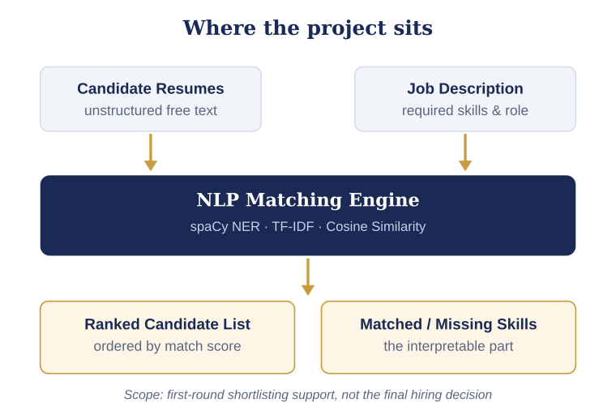
SECTION 1
Introduction & Domain Background
What is the domain?
Natural Language Processing applied to recruitment technology. Resumes are unstructured free text, so shortlisting is really a text-understanding and information-retrieval problem.
Why is it relevant today?
Automated screening is already practical: reported systems reach about 85% text parsing accuracy and 92% ranking accuracy against manual shortlisting [1].
Where does your project sit?
We build the matching layer - extracting skills with spaCy NER and scoring each resume against a job description using TF-IDF and Cosine Similarity.
Scope of Review 1
Dataset finalised, literature surveyed and the matching pipeline designed. Implementation is in progress.
Dept. of CSE | KL University, Bachupally Campus
3
Notes:
60-90 seconds. Start broad (the domain), end narrow (your specific task). Avoid definitions copied from Wikipedia - the panel will ask for the source.

Slide 4
SECTION 2
Problem Statement & Motivation
PROBLEM STATEMENT
" Existing recruitment workflows depend on manual resume reading because resumes are unstructured free text, which makes first-round shortlisting slow, inconsistent and hard to scale as applications per opening rise. "
1
2
3
Who is affected?
What is the cost of the problem?
Why solve it now?
Recruiters and campus placement cells screening high volumes of resumes per opening - and candidates whose relevant skills get overlooked in a manual pass.
Screening is the most repetitive stage of hiring. Automated systems already reach 92% ranking accuracy [1], showing how much of this effort is mechanical.
Public resume corpora and mature NLP libraries (spaCy, scikit-learn) make this feasible, and surveyed systems stop at a score without reporting which skills are missing.
Dept. of CSE | KL University, Bachupally Campus
4
Notes:
The problem statement must be ONE sentence. If you need two sentences, the scope is too wide for a minor project. The panel's first question is usually: who exactly benefits?

Slide 5
SECTION 3
Literature Survey
10 papers studied; the 4 most relevant to resume-to-job-description matching are shown here.
S.No | Author & Year | Title / Technique Used | Dataset / Tools | Key Findings | Limitation / Gap
1 | Tejaswini et al. (2022) | ML-based resume ranking; Cosine Similarity + KNN | Resume & JD text; Python | 85% text parsing accuracy, 92% ranking accuracy | Returns a rank only - no matched / missing skill feedback
2 | Fareed, Kaganurmath & Rajath (2021) | Resume classification and ranking using KNN and Cosine Similarity | Resume corpus; Python | Classifies resumes into job categories, then ranks within a category | KNN cost grows with corpus size; no NER-based skill extraction
3 | Kinge, Mandhare, Chavan & Chaware (2022) | Resume screening using Machine Learning and NLP (proposed system) | Resume text; NLP pipeline | Defines an end-to-end screening pipeline for e-recruitment | Proposal stage - limited quantitative evaluation reported
4 | Schneider et al. (2025), CareerBERT | Transformer embeddings for resume-to-job matching (ESCO) | ESCO taxonomy, job advertisements | Embeddings capture semantic relations that TF-IDF alone misses | Large pretrained model - heavy to train and deploy on ordinary hardware
The last column is where our research gap comes from - every paper returns a score, none returns the skill gap.
Dept. of CSE | KL University, Bachupally Campus
5
Notes:
Do not read the table aloud. Speak about the trend: what most papers did, what results they reached, and what all of them left unsolved. Row 1 is a worked example - delete it and put your own paper there.

Slide 6
SECTION 4
Research Gap Identified
GAP 1 - DATA
OUR PROJECT ADDRESSES
Most surveyed systems are evaluated on private or unspecified resume sets; few report results on a public, category-labelled corpus.
Gap 2: our system returns an explicit matched and missing skill list, not just a score - on a public dataset (Gap 1), using a CPU-only pipeline (Gap 3).
GAP 2 - METHOD
Existing work does not report which required skills a candidate has and which they are missing - only a single similarity score.
GAP 3 - DEPLOYMENT
Traceability: Gap 2 comes from the limitation column of papers [1], [2] and [3]; Gap 3 comes from paper [4].
Transformer-based matching improves semantics but is heavy; a lightweight, interpretable pipeline for ordinary hardware is under-explored.
Every gap above is taken from the last column of the literature survey table on the previous slide.
Dept. of CSE | KL University, Bachupally Campus
6
Notes:
This is the slide that separates a good review from an average one. State 2-3 gaps only, and make sure each one maps to a paper you listed.

Slide 7
SECTION 5
Objectives of the Project
Four objectives, each demonstrable by the final review and mapped one-to-one to a result.
To collect & prepare the Kaggle Resume Dataset together with a set of job descriptions as the working corpus.
1
To design & implement a spaCy NER module for skill extraction and a TF-IDF + Cosine Similarity module for scoring.
2
To evaluate ranking quality using Precision@k and agreement with a manually shortlisted set of candidates.
3
To deploy & demonstrate an interface that returns a ranked table with each candidate's match score, matched skills and missing skills.
4
Tip: objectives and results must match one-to-one at the final review.
Dept. of CSE | KL University, Bachupally Campus
7
Notes:
Avoid vague verbs - study, understand, analyse. Use build, classify, detect, compare, deploy. Four objectives is the right number for a minor project.

Slide 8
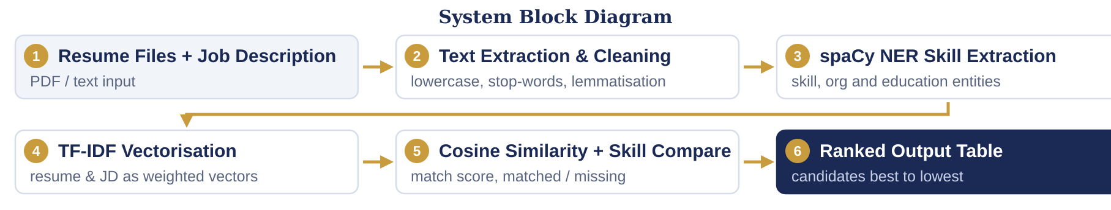
SECTION 6
Proposed System Architecture
INPUT
PRE-PROCESSING
CORE MODULE
OUTPUT
Resume files +
job description
Cleaning, stop-words,
lemmatisation
spaCy NER, TF-IDF,
Cosine Similarity
Ranked list + score
+ skill gaps
Dept. of CSE | KL University, Bachupally Campus
8
Notes:
Walk the panel through the diagram left to right in under a minute, naming the input and the output first. Be ready to say where your contribution sits.

Slide 9
SECTION 7
Methodology & Modules
1
Module 1 - Data
2
Module 2 - Processing
Kaggle Resume Dataset (resume text across professional categories) plus collected job descriptions; split into a development set and a held-out evaluation set.
Text extraction, lowercasing, stop-word removal and lemmatisation, followed by TF-IDF vectorisation over the combined resume and job-description corpus.
3
Module 3 - Core Logic
4
Module 4 - Interface
spaCy NER extracts skill entities; Cosine Similarity scores each resume against the JD. Chosen over KNN as it needs no labelled training data and scales to any batch size.
A Streamlit front end to upload resumes and paste a job description, returning a ranked table of candidates with score, matched skills and missing skills.
Dept. of CSE | KL University, Bachupally Campus
9
Notes:
One module per team member works well - it also answers the panel question 'who did what'.

Slide 10
SECTION 8
Tools and Technologies
SOFTWARE
HARDWARE / PLATFORM
Language: Python 3.11
NLP: spaCy (en_core_web_sm) for NER
ML: scikit-learn (TfidfVectorizer, cosine_similarity)
Data: Pandas, NumPy
Front end: Streamlit
IDE: VS Code / Jupyter Notebook
Processor: Intel i5 or above
RAM: 8 GB minimum
GPU / Cloud: not required - CPU only pipeline
Sensors or devices: none
Deployment: localhost (Streamlit), Render optional
Version control: < GitHub repository link >
Dept. of CSE | KL University, Bachupally Campus
10
Notes:
Name versions where you know them. If you have a GitHub repository, show the link here - it is strong evidence of real work.

Slide 11
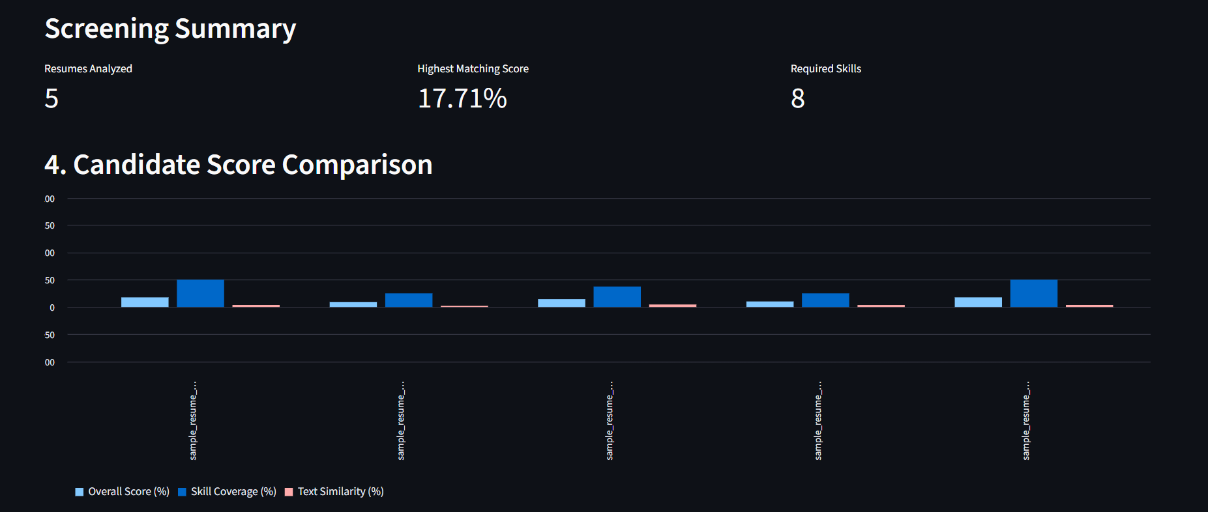
SECTION 9
Work Completed / Demo
Literature survey (10 papers)
Completed
Dataset collection - Kaggle Resume Dataset
Completed
Text cleaning & pre-processing pipeline
Completed
TF-IDF + Cosine Similarity scoring
Completed
spaCy NER skill extraction
Completed
Streamlit interface & evaluation
Completed
Insert a screenshot of your ranked-output table or notebook here before the review. One working output beats three slides of claims.
Dept. of CSE | KL University, Bachupally Campus
11
Notes:
Be honest about status. Panels reward accurate self-assessment and penalise claims that fall apart under one question.

Slide 12
SECTION 10
Expected Outcome & Conclusion
DELIVERABLE
MEASURABLE TARGET
BEYOND THE LAB
A working system that ranks resumes against a job description and lists each candidate's matched and missing skills.
Top-5 ranking agreeing with a manual shortlist, and scoring a batch of 50 resumes in under 2 seconds on a CPU.
Usable by campus placement cells and small recruitment teams for first-round shortlisting support.
CONCLUSION
Manual resume screening is slow and inconsistent because resumes are unstructured text. The surveyed literature ranks candidates but never reports which required skills are missing, and the systems that capture semantics are too heavy for ordinary hardware. Our system closes that gap with a CPU-only spaCy NER + TF-IDF + Cosine Similarity pipeline that returns both a match score and an explicit skill gap. Future scope: transformer embeddings for semantic matching, deliberately left out of this scope.
Dept. of CSE | KL University, Bachupally Campus
13
Notes:
Do not introduce anything new here. The conclusion restates the problem, the gap and the promise - nothing else.

Slide 13
SECTION 11
References
IEEE style, numbered in the order they are cited in the slides. All eight references below were consulted during the survey.
[1] K. Tejaswini, V. Umadevi, S. M. Kadiwal and S. Revanna, "Design and development of machine learning based resume ranking system," Global Transitions Proceedings, vol. 3, no. 2, pp. 371-375, 2022.
[2] R. T. Fareed, S. Kaganurmath and V. Rajath, "Resume classification and ranking using KNN and cosine similarity," International Journal of Engineering Research & Technology (IJERT), vol. 10, no. 8, 2021.
[3] B. Kinge, S. Mandhare, P. Chavan and S. M. Chaware, "Resume screening using machine learning and NLP: a proposed system," IJSRCSEIT, vol. 8, no. 2, pp. 253-258, 2022.
[4] J. Schneider et al., "CareerBERT: Matching resumes to ESCO jobs in a shared embedding space for generic job recommendations," arXiv preprint arXiv:2503.02056, 2025.
[5] H. Sajid et al., "Resume parsing framework for e-recruitment," in Proc. 16th Int. Conf. on Ubiquitous Information Management and Communication (IMCOM), Seoul, Korea, 2022, pp. 1-8.
[6] A. Gugnani, V. K. R. Kasireddy and K. Ponnalagu, "Generating unified candidate skill graph for career path recommendation," in Proc. IEEE Int. Conf. on Data Mining Workshops (ICDMW), 2018, pp. 328-333.
[7] S. T. Al-Otaibi and M. Ykhlef, "A survey of job recommender systems," International Journal of Physical Sciences, vol. 7, no. 29, pp. 5127-5142, 2012.
[8] UpdatedResumeDataSet, "Resume Dataset," Kaggle, 2020. [Online]. Available: https://www.kaggle.com/datasets/gauravduttakiit/resume-dataset [Accessed: DD-MM-YYYY].
References [1]-[4] are the papers shown in the literature survey table; [5]-[8] are the remaining surveyed sources and the dataset.
Dept. of CSE | KL University, Bachupally Campus
14
Notes:
Use Google Scholar's 'Cite' option and pick MLA/IEEE, then fix the formatting by hand. Never cite a blog, a YouTube video or a paper you have not opened.

Slide 14
Thank You
Questions & Suggestions
Team: Guttikonda Gayathri, Sai Sowseelya V | Guide: Mr. Raghavendra | Dept. of CSE, KLH Bachupally
Notes:
Keep the deck open on the architecture slide during questions - most panel questions point back to it.

