Slide 1
Verilog HDL 硬件描述语言
刘 鹏
浙江大学信息与电子工程学院
liupeng@zju.edu.cn

Slide 2
HDLs
Basic Idea:
Language constructs describe circuits with two basic forms:
Structural descriptions similar to hierarchical netlist.
Behavioral descriptions use higher-level constructs (similar to conventional programming).
Originally designed to help in abstraction and simulation.
Now “logic synthesis” tools exist to automatically convert from behavioral descriptions to gate netlist.
Greatly improves designer productivity.
However, this may lead you to falsely believe that hardware design can be reduced to writing programs!
“Structural” example:
Decoder(output x0,x1,x2,x3;
inputs a,b)
{
wire abar, bbar;
inv(bbar, b);
inv(abar, a);
nand(x0, abar, bbar);
nand(x1, abar, b );
nand(x2, a, bbar);
nand(x3, a, b );
}
“Behavioral” example:
Decoder(output x0,x1,x2,x3;
inputs a,b)
{
case [a b]
00: [x0 x1 x2 x3] = 0x0;
01: [x0 x1 x2 x3] = 0x2;
10: [x0 x1 x2 x3] = 0x4;
11: [x0 x1 x2 x3] = 0x8;
endcase;
}

Slide 3
Design Methodology
Structure and Function (Behavior) of a Design
HDL Specification
Simulation
Synthesis
Verification: Design
Behave as Required?
Functional: I/O Behavior
Register-Level (Architectural)
Logic-Level (Gates)
Transistor-Level (Electrical)
Timing: Waveform Behavior
Generation: Map
Specification to
Implementation

Slide 4
Quick History of HDLs
ISP (circa 1977) - research project at CMU
Simulation, but no synthesis
Abel (circa 1983) - developed by Data-I/O
Targeted to programmable logic devices
Not good for much more than state machines
Verilog (circa 1985) - developed by Gateway (now Cadence)
Similar to Pascal and C, originally developed for simulation
Fairly efficient and easy to write
80s Berkeley develops synthesis tools
IEEE standard
VHDL (circa 1987) - DoD sponsored standard
Similar to Ada (emphasis on re-use and maintainability)
Simulation semantics visible
Very general but verbose
IEEE standard

Slide 5
Verilog
Supports structural and behavioral descriptions
Structural
Explicit structure of the circuit
How a module is composed as an interconnection of more primitive modules/components
E.g., each logic gate instantiated and connected to others
Behavioral
Program describes input/output behavior of circuit
Many structural implementations could have same behavior
E.g., different implementations of one Boolean function

Slide 6
Verilog Introduction
the module describes a component in the circuit
Two ways to describe:
Structural Verilog
List of components and how they are connected
Just like schematics, but using text
A net list
tedious to write, hard to decode
Essential without integrated design tools
Behavioral Verilog
Describe what a component does, not how it does it
Synthesized into a circuit that has this behavior
Result is only as good as the tools
Build up a hierarchy of modules

Slide 7
Structural Model - XOR
module name
module xor_gate ( out, a, b ); input a, b; output out; wire abar, bbar, t1, t2; inverter invA (abar, a); inverter invB (bbar, b); and_gate and1 (t1, a, bbar); and_gate and2 (t2, b, abar); or_gate or1 (out, t1, t2);
endmodule
port list
declarations
Built-in gates
statements
a
t1
and1
out
b
invB
or1
interconnections
and2
t2
Instance name
invA
Composition of primitive gates to form more complex module
Note use of wire declaration!
By default, identifiers are wires

Slide 8
Structural Model: 2-to1 mux
//2-input multiplexor in gates
module mux2 (in0, in1, select, out);
input in0,in1,select;
output out;
wire s0,w0,w1;
not (s0, select);
and (w0, s0, in0),
(w1, select, in1);
or (out, w0, w1);
endmodule // mux2
Notes:
comments
“module”
port list
declarations
wire type
primitive gates
Instance names?
List per type

Slide 9
Simple Behavioral Model
Combinational logic
Describe output as a function of inputs
Note use of assign keyword: continuous assignment
module and_gate (out, in1, in2); input in1, in2; output out;
assign out = in1 & in2;
endmodule
Output port of a primitive must be first in the list of ports
Restriction does not apply to modules
When is this evaluated?

Slide 10
2-to-1 mux Behavioral Description
// Behavioral model of 2-to-1
// multiplexor.
module mux2 (in0,in1,select,out);
input in0,in1,select;
output out;
//
reg out;
always @ (in0 or in1 or select)
if (select) out=in1;
else out=in0;
endmodule // mux2
Notes:
behavioral descriptions use the keyword always followed by blocking procedural assignments
Target output of procedural assignments must of type reg
(not a real register)
Unlike wire types where the target output of an assignment may be continuously updated, a reg type retains it value until a new value is assigned (the assigning statement is executed).
Optional initial statement
Sensitivity list

Slide 11
Behavioral 4-to1 mux
Notes:
No instantiation
Case construct equivalent to nested if constructs.
Definition: A structural description is one where the function of the module is defined by the instantiation and interconnection of sub-modules.
A behavioral description uses higher level language constructs and operators.
Verilog allows modules to mix both behavioral constructs and sub-module instantiation.
//Does not assume that we have
// defined a 2-input mux.
//4-input mux behavioral description
module mux4 (in0, in1, in2, in3, select, out);
input in0,in1,in2,in3;
input [1:0] select;
output out;
reg out;
always @ (in0 in1 in2 in3 select)
case (select)
2’b00: out=in0;
2’b01: out=in1;
2’b10: out=in2;
2’b11: out=in3;
endcase
endmodule // mux4

Slide 12
Mixed Structural/Behavioral Model
Example 4-bit ripple adder
module full_addr (S, Cout, A, B, Cin);
input A, B, Cin;
output S, Cout;
assign {Cout, S} = A + B + Cin;
endmodule
module adder4 (S, Cout, A, B, Cin);
input [3:0] A, B;
input Cin;
output [3:0] S;
output Cout;
wire C1, C2, C3;
full_addr fa0 (S[0], C1, A[0], B[0], Cin);
full_addr fa1 (S[1], C2, A[1], B[1], C1);
full_addr fa2 (S[2], C3, A[2], B[2], C2);
full_addr fa3 (S[3], Cout, A[3], B[3], C3);
endmodule
Behavior
Structural
Order of ports?

Slide 13
Verilog Data Types and Values
Bits - value on a wire
0, 1
X - don’t care/don’t know
Z - undriven, tri-state
Vectors of bits
A[3:0] - vector of 4 bits: A[3], A[2], A[1], A[0]
Treated as an unsigned integer value
e.g. , A < 0 ??
Concatenating bits/vectors into a vector
e.g., sign extend
B[7:0] = {A[3], A[3], A[3], A[3], A[3:0]};
B[7:0] = {4{A[3]}, A[3:0]};
Style: Use a[7:0] = b[7:0] + c; Not: a = b + c; // need to look at declaration

Slide 14
Verilog Numbers
14 - ordinary decimal number
-14 - 2’s complement representation
12’b0000_0100_0110 - binary number with 12 bits (_ is ignored)
12’h046 - hexadecimal number with 12 bits
Verilog values are unsigned
e.g., C[4:0] = A[3:0] + B[3:0];
if A = 0110 (6) and B = 1010(-6) C = 10000 not 00000 i.e., B is zero-padded, not sign-extended

Slide 15
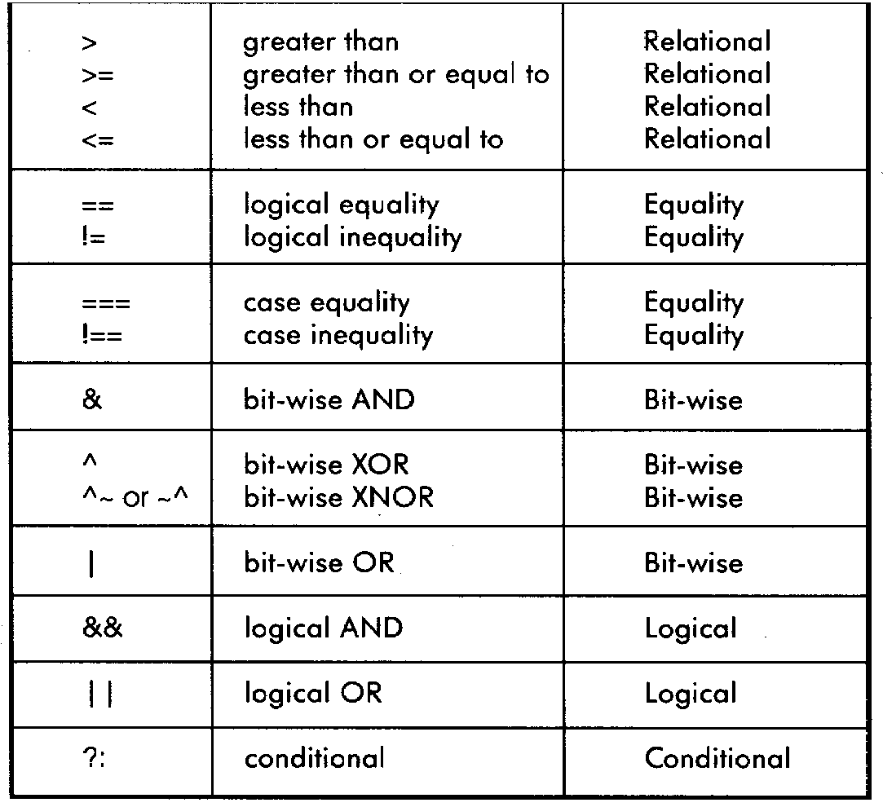
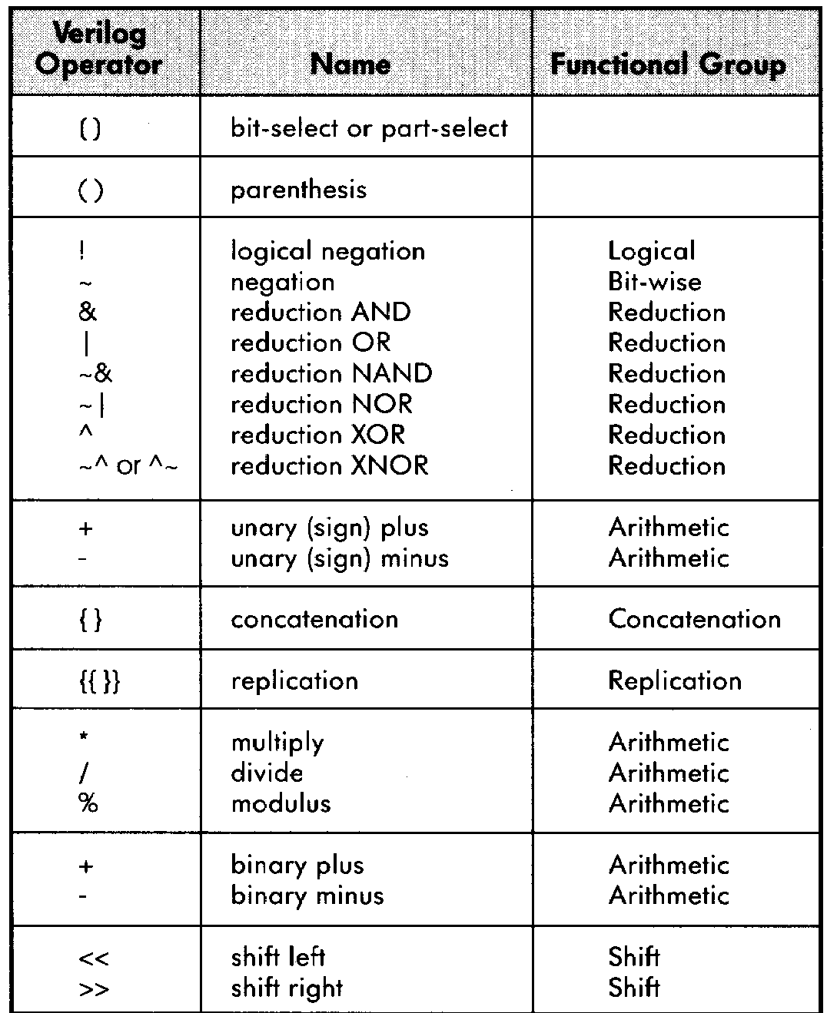
Verilog Operators

Slide 16
Verilog Variables
wire
Variable used simply to connect components together
reg
Variable that saves a value as part of a behavioral description
Usually corresponds to a wire in the circuit
Is NOT necessarily a register in the circuit
usage:
Don’t confuse reg assignments with the combinational continuous assign statement!
Reg should only be used with always blocks (sequential logic, to be presented …)

Slide 17
Verilog Module
Corresponds to a circuit component
“Parameter list” is the list of external connections, aka “ports”
Ports are declared “input”, “output” or “inout”
inout ports used on tri-state buses
Port declarations imply that the variables are wires
module name
ports
module full_addr (A, B, Cin, S, Cout); input A, B, Cin; output S, Cout; assign {Cout, S} = A + B + Cin; endmodule
inputs/outputs

Slide 18
Verilog Continuous Assignment
Assignment is continuously evaluated
assign corresponds to a connection or a simple component with the described function
Target is NEVER a reg variable
Dataflow style
use of Boolean operators (~ for bit-wise, ! for logical negation)
assign A = X | (Y & ~Z);
assign B[3:0] = 4'b01XX;
assign C[15:0] = 4'h00ff;
assign #3 {Cout, S[3:0]} = A[3:0] + B[3:0] + Cin;
bits can take on four values (0, 1, X, Z)
variables can be n-bits wide (MSB:LSB)
use of arithmetic operator
multiple assignment (concatenation)
delay of performing computation, only used by simulator, not synthesis

Slide 19
Comparator Example
module Compare1 (A, B, Equal, Alarger, Blarger); input A, B; output Equal, Alarger, Blarger; assign Equal = (A & B) | (~A & ~B); assign Alarger = (A & ~B); assign Blarger = (~A & B); endmodule

Slide 20
Comparator Example
// Make a 4-bit comparator from 4 1-bit comparators module Compare4(A4, B4, Equal, Alarger, Blarger); input [3:0] A4, B4; output Equal, Alarger, Blarger; wire e0, e1, e2, e3, Al0, Al1, Al2, Al3, B10, Bl1, Bl2, Bl3; Compare1 cp0(A4[0], B4[0], e0, Al0, Bl0); Compare1 cp1(A4[1], B4[1], e1, Al1, Bl1); Compare1 cp2(A4[2], B4[2], e2, Al2, Bl2); Compare1 cp3(A4[3], B4[3], e3, Al3, Bl3); assign Equal = (e0 & e1 & e2 & e3); assign Alarger = (Al3 | (Al2 & e3) |
(Al1 & e3 & e2) |
(Al0 & e3 & e2 & e1)); assign Blarger = (~Alarger & ~Equal); endmodule

Slide 21
可综合的组合逻辑电路设计
组合逻辑电路
任何时刻电路的输出仅与该时刻的输入有关的数字电路被称为组合逻辑电路
组合电路不含有反馈，不含有记忆元件，仅仅通过若干门电路连接实现的
组合逻辑的表达一般有3种方式：
真值表、逻辑表达式、电路原理图

Slide 22
可综合的组合逻辑电路设计
使用Verilog HDL描述组合电路有多种方式
(1) 与真值表对应地是用户自定义原语
(2) 与电路图对应地是门级建模即结构描述
(3) 与逻辑表达式对应地称为行为描述

Slide 23
可综合的组合逻辑电路设计
用Verilog语言可以有多种方式描述组合电路，但是有些综合工具不支持每一种描述方式
大多数综合工具可综合下面三种形式描述的组合电路
门级模型、数据流模型、行为级模型
（1）门级模型
门级模型是描述逻辑门以及逻辑门之间连接关系的模型，通过门原语描述电路

Slide 24
可综合的组合逻辑电路设计
Verilog HDL中提供了丰富的门类型关键字，用于电路的门级描述。
Verilog HDL有关类型的关键字比较常用的有：
not 非门 | nor 或非门
and 与门 | xor 异或门
nand 与非门 | xnor 异或非门
or 或门 | buf 缓冲器

Slide 25
可综合的组合逻辑电路设计
调用门原语的句法如下：
门类型关键字 实例化的门名称(端口列表)
端口列表按下列顺序列出：
(输出，输入1，输入2，输入3 ， ……)；
对于三态门，则按如下顺序列出端口
(输出，输入，使能控制端)；
比如：
and myand(out, in1, in2, in3)；//三输入与门
and amd1(out, in1, in2)； //二输入与门
buffif1 mytri(out, in, enable)； //高电平使能的三态门

Slide 26
可综合的组合逻辑电路设计
例: 2-4译码器
module decoder(D, A, B, enable)
Output [ 3:0] D;
input A, B;
Input enable;
wire A_not, B_not, enable_not;
not G1(A_not, A) ，
G2(B_not, B),
G3(enable, enable_not);
nand G4(D[0], A_not, B_not, enable_not) ,
G5(D[1], A_not, B, enable_not) ,
G6(D[2], A, B_not, enable_not) ,
G7(D[3], A, B, enable_not) ;
endmodule

Slide 27
可综合的组合逻辑电路设计
数据流模型
利用连续赋值语句assign来描述一个组合电路
综合工具可以把用连续赋值描述的电路翻译成布尔等式并优化
它对操作数进行不同的操作以得到需要的结果，提供了多种对操作数的操作

Slide 28
可综合的组合逻辑电路设计
symbol operation
+ binary addition
– binary subtraction
& bitwise AND
^ bitwise XOR
︱ bitwise OR
～ bitwise not
== equality
> greater than
< less than
{ } concatenation
? : conditional

Slide 29
可综合的组合逻辑电路设计
例: 4位加法器
module adder4(cout, sum, ina, inb, cin);
output [3: 0] sum;
output cout;
input [3: 0] ina, inb;
input cin;
assign {cout, sum} = ina + inb + cin;
endmodule

Slide 30
可综合的组合逻辑电路设计
例: 4位比较器
module mag_compare
( output A_it_B, A_eq_B, A_gt_B,
input [3:0] A, B
);
assign A_it_B = (A<B);
assign A_gt_B = (A>B);
assign A_eq_B = (A=B);
endmodule

Slide 31
可综合的组合逻辑电路设计
行为级模型
行为级模型通常用来描述时序逻辑电路，但有时候也可以用来描述组合逻辑电路
行为级模型使用关键词always来进行描述，其声明格式如下：
always <时序控制 or 事件控制> <语句>
always语句在仿真过程中是不断活动的
always语句后面跟着的过程快是否执行，则要看它的触发条件是否满足

Slide 32
可综合的组合逻辑电路设计
例: 2-to-1选择器
module mux(m_out, A, B, select);
output m_out;
input A, B, select;
reg m_out;
always @(A or B or select);
if (select == 1) m_out = A;
else m_out = B;
endmodule
当信号A，B，select中的任何一个发生变化时，将会触发下面语句执行

Slide 33
可综合的组合逻辑电路设计
例: 4-to-1选择器
module mux
( output reg m_out, input in_0, in_1, in_2, in_3，input [1:0] select);
always @(in_0, in_1, in_2, in_3, select)
case(select)
2’b00: m_out = in_0;
2’b01: m_out = in_1;
2’b10: m_out = in_2;
2’b11: m_out = in_3;
endcase
endmodule

Slide 34
可综合的组合逻辑电路设计
Test Bench
编写test bench 的目的是验证设计的正确性。通过模拟各种可能的情况查看输入输结果是否符合设计的要求。简单的test bench要向设计提供向量，人工验证输出
除了使用always语句外，它还使用initial来产生激励给被测试的模块

Slide 35
可综合的组合逻辑电路设计
在这个例子中用initial语句在仿真开始时对变量A，B进行初始化，这个初始化的过程不需要任何仿真时间，在10ns之后，变量A变1,20ns之后变量A为0，B为1。
initial 模块如下：
initial
begin
A = 0;
B = 0;
#10 A = 1;
#20 A = 0; B = 1;
end

Slide 36
可综合的组合逻辑电路设计
Verilog中常用的系统任务
$display(p1,p2,…,pn);将参数p2到pn按p1给定的格式输出,自动的在输出后换行
$write（p1p2 ,…,pn ；与$display相同，只是在输出后不换行
$monitor 提供了监视和输出参数列表中的表达式或变量值的功能
$time 返回一个64位的整数来表示当前仿真时刻
$finish 退出仿真

Slide 37
可综合的组合逻辑电路设计
激励模块的格式通常如下所示：
Module test_module_name
//Declare local reg and wire identifiers（标识符）
//Instantiate(实例化) the design module under test
//Specify a stopwatch, using $finish to terminate the simulation
//Generate stimulus ,using initial and always statements
//Display the output response
endmodule

Slide 38
可综合的组合逻辑电路设计
例: 2-1选择器的test bench
module mux;
wire t_mux_out;
reg t_A,t_B;
reg t_select;
parameter stop_time=50;
mux M1(t_mux_out, t_A,t_B, t_select);
initial # stop_time $finish;
initial begin
t_select = 1; t_A = 0; t_B = 1;
#10 t_A = 1; t_B = 0;

Slide 39
可综合的组合逻辑电路设计
#10 t_select = 0;
#10 t_A = 0; t_B = 1;
end
initial begin
$monitor(“time=“”, $time, “select=%b A=%b B=%b OUT=%b,
t_select, t_A,t_B, t_mux_out);
end
endmodule

Slide 40
测试
测试是一个专门用来给电路的HDL模型施加的一个激励的HDL程序，目的是测试和观察其在激励下的响应
典型的测试模块没有输入和输出，加到设计模块用于模拟的输入信号在激励模块中定义为局部reg型数据。显示设计模块的测试输出在激励模块中定义为局部wire型数据。用局部的标识来例化测试的模块
测试模块的HDL格式：
module test_module_name;
//Declare local reg and wire identifiers
//Instantiate the design module under test
//Specify a stopwatch, using $finish to terminate the simulation
//Generate stimulus, using initial and always statements
//Display the output response (text or graphics (or both))
endmodule

Slide 41
最终思考
Verilog类似于C语言，Verilog描述硬件
多个物理元素的并行性
时序关系
仿真和综合
画出电路图，采用Verilog语言描述
理解语言的元素
模块、端口、线、寄存器、原语、连续赋值、阻塞赋值、敏感列表、层次化
最好方式：实践动手
行为级结构隐藏了电路细节
设计人员需要管理结构、数据通信、并行性和设计的时序

