Slide 1

Logic and Artificial Intelligence
Instructor: Gagandeep Singh
Head TA: Linyi Li
UIUC
Fall 2021

Slide 2
Training to minimize adversarial examples
Networks trained with standard training are usually not robust, adversarial training is a standard method for improving network robustness. Two types of adversarial training method exist: empirically and provably robust training

Slide 3
Empirical vs. provable defenses
Metric | Empirical vs provable defenses
Standard accuracy | Loss of accuracy is observed for both, more for networks trained with provable defenses

Slide 4
Empirical vs. provable defenses
Metric | Empirical vs provable defenses
Standard accuracy | Loss of accuracy is observed for both, more for networks trained with provable defenses
Adversarial accuracy | Difficult to craft examples for both, provable defenses are relatively harder to break

Slide 5
Empirical vs. provable defenses
Metric | Empirical vs provable defenses
Standard accuracy | Loss of accuracy is observed for both, more for networks trained with provable defenses
Adversarial accuracy | Difficult to craft examples for both, provable defenses are relatively harder to break
Formal guarantees | Networks with provable defense are easier to prove than those trained with empirical defenses

Slide 6
Empirical vs. provable defenses
Metric | Empirical vs provable defenses
Standard accuracy | Loss of accuracy is observed for both, more for networks trained with provable defenses
Adversarial accuracy | Difficult to craft examples for both, provable defenses are relatively harder to break
Formal guarantees | Networks with provable defense are easier to prove than those trained with empirical defenses
Scalability | Provable defenses are less scalable, e.g., no good provable defense exist for ImageNet

Slide 7
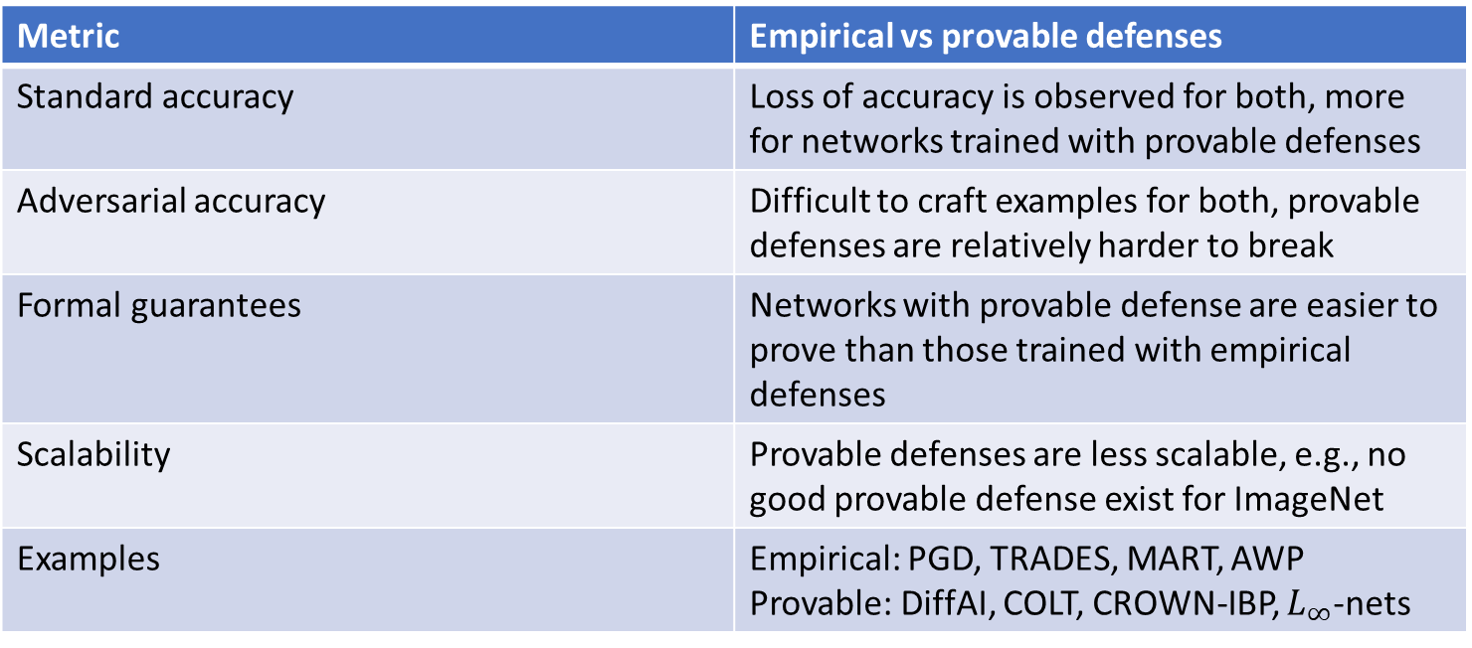
Empirical vs. provable defenses
Metric | Empirical vs provable defenses
Standard accuracy | Loss of accuracy is observed for both, more for networks trained with provable defenses
Adversarial accuracy | Difficult to craft examples for both, provable defenses are relatively harder to break
Formal guarantees | Networks with provable defense are easier to prove than those trained with empirical defenses
Scalability | Provable defenses are less scalable, e.g., no good provable defense exist for ImageNet
Examples | Empirical: PGD, TRADES, MART, AWP Provable: DiffAI, COLT, CROWN-IBP, $L_{∞}$-nets

Slide 8

Defense as optimization problem
find $θ$
minimize $ρ\left(θ\right)$
where $ρ\left(θ\right)=E$ $[max L\left(θ, x′, y\right)]$
$$\left(x,y\right)\sim D$$
$$x′∈φ(x)$$
$φ\left(x\right) \text{denotes} \text{the} \text{perturbation} \text{region} \text{around} \text{point} x\text{, }\text{that} \text{is}\text{, }\text{we} \text{want} \text{all} \text{points} \text{in} φ\left(x\right) \text{to} \text{classify} \text{the} \text{same} \text{as} \text{x} \text{. }$For $L_{∞}$-robustness, $φ(x)$ is $\{x^{′}∣|\left|x−x^{′}\right||_{∞}≤ε\}$

Slide 9

Solving the inner maximization problem
FGSM linearizes the inner optimization problem
$$x+ε sgn⁡(∇_{x}L(θ,x,y))$$
PGD is an iterative attack and considered more powerful than FGSM
$$x^{t+1}=π_{φ(x)}(x^{t}+α\operatorname{sgn}\left(∇_{x}L\left(θ,x,y\right)\right))$$

Slide 10


PGD defense in practice
Step 1: select a mini-batch $B$ of examples from dataset $D$
Step 2: compute $B_{max}$ by applying PGD attack as follows to every point $(x,y) ∈$ $B$:
$xmax=$ $argmax L\left(θ, x′, y\right)$
$$x′∈φ(x)$$
Step 3: solve outer problem:
$θ′=$ $θ$ - $\frac{1}{|B_{max}|} \sum_{\left(x_{max}, y\right) ∈B_{max} }{∇_{θ} L(θ,xmax ,y)}$
Step 4: goto Step 1. Various stopping criteria, including reaching a certain number of epochs.
The conversion of the original min-max problem to the 4 steps above is based on Danskin’s theorem

Slide 11
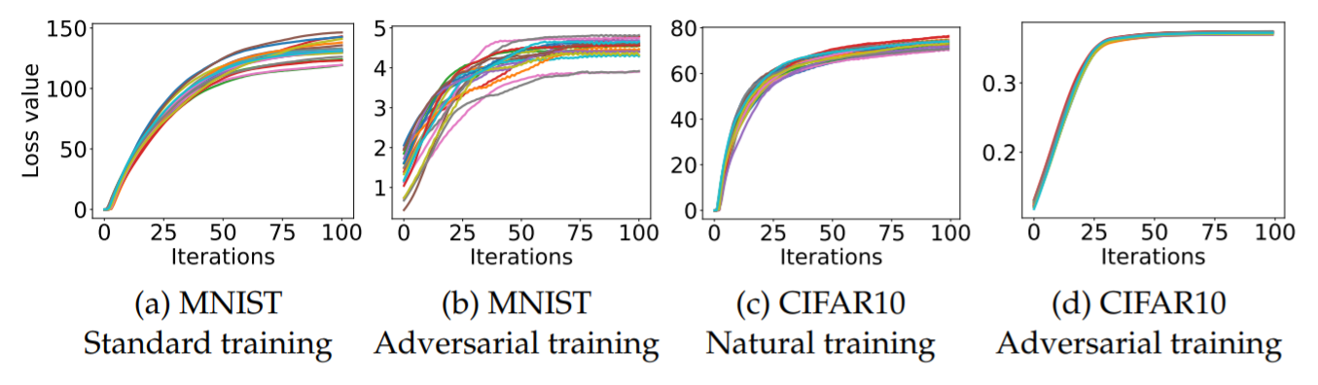
Why do we think we can find a good approximate solution to the inner maximization problem?

Slide 12
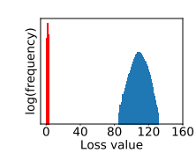
Why do we think we can find a good approximate solution to the inner maximization problem?
Experiments show that many local maxima inside $φ\left(x\right)$ have well-concentrated loss values. This is inline with why we believe neural network training is possible (many local minima with similar values).
Graph is for a single example: goal is to maximize the cross-entropy loss measured for 100,000 random starting points in $φ\left(x\right)$.
The red graph indicates the value of the loss $L$for an adversarially trained network.
The blue graph is for the loss $L$of a non-adversarially trained network.
Notes:
-> value is much smaller
-> concentrated.

Slide 13
Notes on defenses
Model capacity matters: larger networks are more defendable and less easy to be attacked with transferrable examples. Training smaller nets with PGD has negative effects on accuracy.
Training with adversarial examples from PGD attacks (many steps and project) tends to perform better than training with adversarial examples from FGSM attacks (one step, no projection).
Even on larger networks, defenses can negatively affect accuracy. More research is needed here. By this we mean that after the network is trained, we test its accuracy on the test set. And there, it is more robust yet more points classify incorrectly.

Slide 14
Can certification benefit training?
Verifying networks which are not meant to be robust will certainly produce worse results (smaller epsilon provability) than verifying networks which are trained to be provably robust.
Note that there is a difference between training the network to be experimentally robust (e.g., PGD defense) vs. training the network to be provably robust (what we see next).
So, can we then use certification for training the network to be robust?

Slide 15

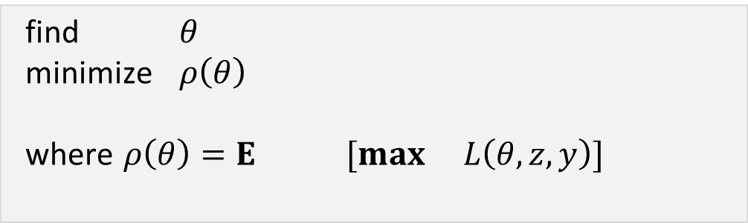

Provable defense
find $θ$
minimize $ρ\left(θ\right)$
where $ρ\left(θ\right)=E$ $[max L\left(θ, z, y\right)]$
$$\left(x,y\right)\sim D$$
$$z∈γ(g\left(φ(x)\right))$$

Slide 16

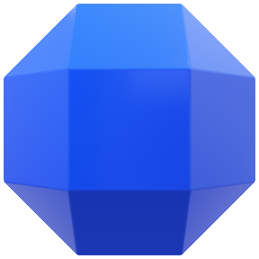
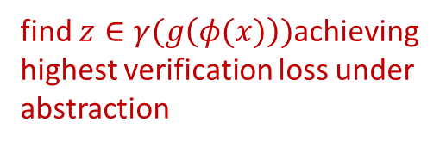
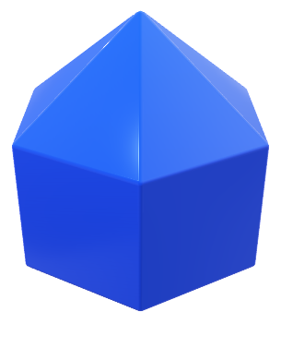

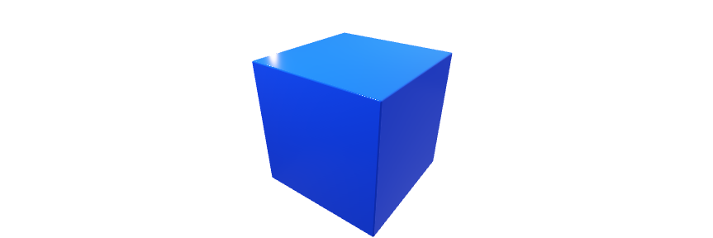

Differentiable abstract interpretation
Key idea: automatic differentiation on symbolic representation of$g\left(φ(x)\right)$
...
Training
find $z∈γ(g\left(φ(x)\right))$achieving highest verification loss under abstraction
$$φ(x)$$
Backpropagate the resulting loss to update weights

Slide 17
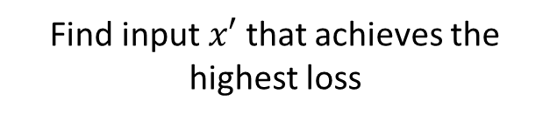


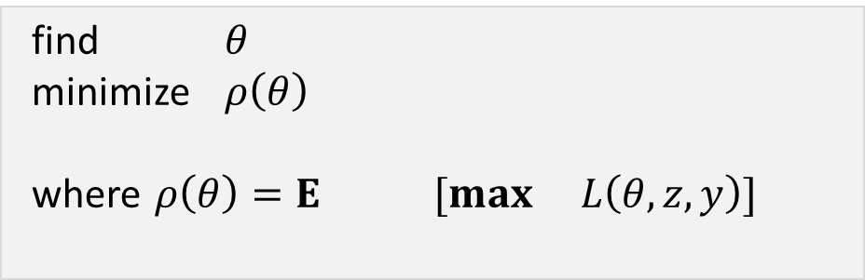

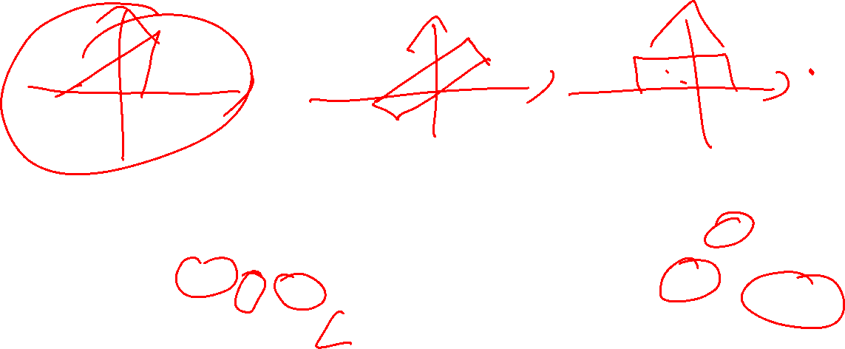
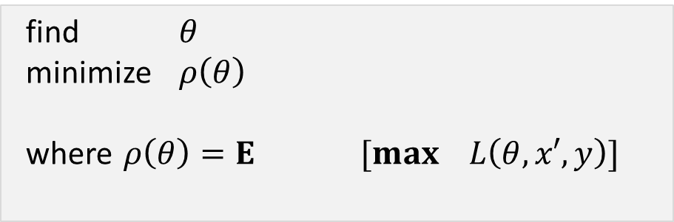

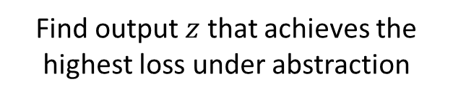
Empirical defense
Provable defense
find $θ$
minimize $ρ\left(θ\right)$
where $ρ\left(θ\right)=E$ $[max L\left(θ, x′, y\right)]$
find $θ$
minimize $ρ\left(θ\right)$
where $ρ\left(θ\right)=E$ $[max L\left(θ, z, y\right)]$
$$\left(x,y\right)\sim D$$
$$\left(x,y\right)\sim D$$
$$x′∈φ(x)$$
$$z∈γ(g\left(φ(x)\right))$$
Find input $x′$ that achieves the highest loss
Find output $z$ that achieves the highest loss under abstraction

Slide 18
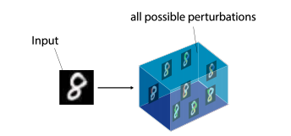

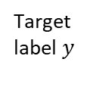



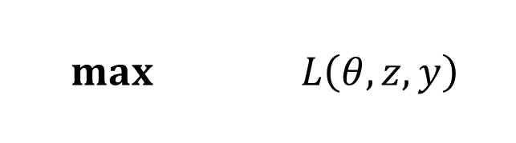

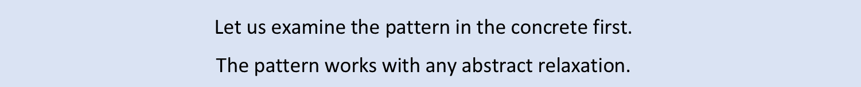

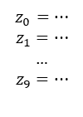


Provable Defenses: General method
$$max L\left(θ, z, y\right)$$
$$z∈γ(g\left(φ(x)\right))$$
$$\text{Let} \text{us} \text{examine} \text{the} \text{pattern} \text{in} \text{the} \text{concrete} \text{first}\text{. }$$
$$\text{The} \text{pattern} \text{works} \text{with} \text{any} \text{abstract} \text{relaxation}\text{. }$$
$$z_{0}=…$$
$$z_{1}=…$$
…
$$z_{9}=…$$
Target
label $y$
$$x$$
Bound $f^{\#}$ propagation
z₁
z₃
Concretize
$$γ$$
z₂
z₂₄₂₃₂
Compute
$$L$$
...
Apply$L \text{to} \text{each} z\text{, }\text{then} \text{combine}$
$$φ(x)$$
zonotope
0.55
$φ\left(x\right)$ region captures possible perturbations, e.g., L$∞$ball
Here we picked Zonotope, but can be any relaxation

Slide 19
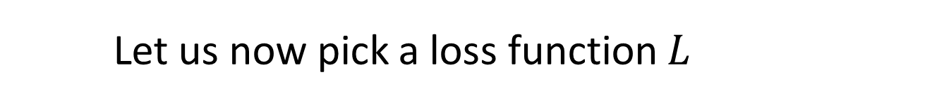
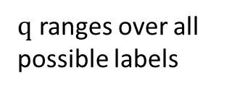


Let us now pick a loss function $L$
$$L(z,y)=max (z_{q} −z_{y})$$
$$q≠y$$
target label
a vector
of logits
$q$ ranges over all possible labels

Slide 20


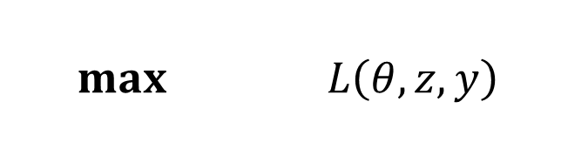



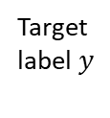
Provable defenses with a given loss
$$max L\left(θ, z, y\right)$$
Lets define $L$ to be:
$$z∈γ(g\left(φ(x)\right))$$
$$L(z,y)=max (z_{q} −z_{y})$$
$$q≠y$$
target label
a vector
of logits
$$z_{0}=…$$
$$z_{1}=…$$
…
$$z_{9}=…$$
Target
label $y$
$$x$$
Bound $f^{\#}$ propagation
z₁
z₃
Concretize
$$γ$$
z₂
z₂₄₂₃₂
Compute
$$L$$
...
Apply$L \text{to} \text{each} z\text{, }\text{then} \text{take} \text{max} \text{one}$
$$φ(x)$$
zonotope
0.55
$φ\left(x\right)$ region captures possible perturbations, e.g., L$∞$ball

Slide 21

Provable defenses with a given loss
$$max L\left(θ, z, y\right)$$
Lets define $L$ to be:
$$z∈γ(g\left(φ(x)\right))$$
$$L(z,y)=max (z_{q} −z_{y})$$
$$q≠y$$
target label
a vector
of logits
$$z_{0}=…$$
$$z_{1}=…$$
…
$$z_{9}=…$$
Target
label $y$
$$x$$
Bound $f^{\#}$ propagation
z₁
z₃
Concretize
$$γ$$
z₂
z₂₄₂₃₂
Compute
$$L$$
...
Apply$L \text{to} \text{each} z\text{, }\text{then} \text{take} \text{max} \text{one}$
$$φ(x)$$
zonotope
Key problem: set of vectors could be infinite or very large, so we cannot just enumerate.
How do we address this?
0.55
$φ\left(x\right)$ region captures possible perturbations, e.g., L$∞$ball

Slide 22





Provable defenses in the abstract
$$max L\left(θ, z, y\right)$$
Lets define $L$ to be:
$$z∈γ(g\left(φ(x)\right))$$
$$L(z,y)=max (z_{q} −z_{y})$$
$$q≠y$$
target label
a vector
of logits
e.g. [0.1, 0.3]
$$z_{0}=…$$
$$z_{1}=…$$
…
$$z_{9}=…$$
$$d_{0}=z_{0}−z_{y}$$
$${max⁡(box(d}_{0}))$$
$$x$$
Bound $f^{\#}$ propagation
$$z_{0}=…$$
…
$$z_{9}=…$$
$$d_{0}=…$$
…
$$d_{9}=…$$
0.3
...
e.g. [-0.4, -0.1]
zonotope
0.3
$$φ(x)$$
$$d_{9}=z_{9}−z_{y}$$
$${max⁡(box(d}_{9}))$$
-0.1
$φ\left(x\right)$ region captures possible perturbations, e.g., L$∞$ball
Simply, an affine transform which is exact for zonotope.
Plug in lower and upper bounds of epsilons into the expression to get the interval.

Slide 23





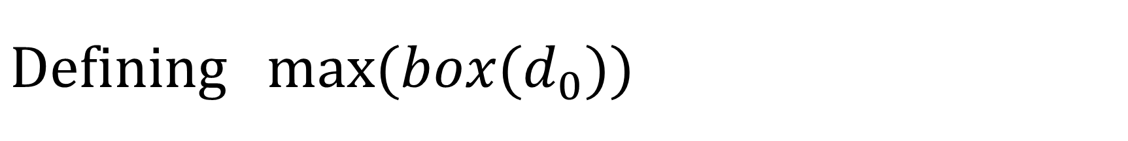



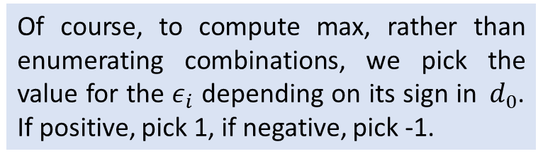




$$Defining{ max⁡(box(d}_{0}))$$
$$d_{0}=3+ε_{1}−2ε_{2}$$
$$ε_{1} and{ ε}_{2} range over [−1,1]$$
$$d_{−1,−1}=3−1+2=4$$
$$plug in −1 for both$$
$$d_{−1, 1}=3−1−2=0$$
$$plug in −1 for{ ε}_{1}, and 1 for{ ε}_{2}$$
$$d_{1, −1}=3+1+2=6$$
$$plug in 1 for{ ε}_{1}, and −1 for{ ε}_{2}$$
$$d_{1, 1}=3+1−2=2$$
$$plug in 1 for both$$
Of course, to compute max, rather than enumerating combinations, we pick the value for the $ε_{i}$ depending on its sign in${ d}_{0}$. If positive, pick 1, if negative, pick -1.
$$d_{box}=[0, 6]$$
$max⁡(d_{box})$ = 6

Slide 24










































$$[−1,1]$$
$$w_{13}$$
$$max⁡(0,x_{3})$$
$$w_{50}$$
$$x_{1}$$
$$x_{3}$$
$$x_{5}$$
$$o_{0}$$
$$w_{14}$$
$$w_{51}$$
$$f(φ)$$
$$w_{23}$$
$$w_{60}$$
$$x_{2}$$
$$x_{4}$$
$$x_{6}$$
$$o_{1}$$
$$[−1,1]$$
$$w_{24}$$
$$max⁡(0,x_{4})$$
$$w_{61}$$
$$[−1,1]$$
$$w_{13}$$
$$max^{\#}⁡(0,x_{3})$$
$$w_{50}$$
$$x_{1}$$
$$x_{3}$$
$$x_{5}$$
$$o_{0}$$
$$w_{14}$$
$$w_{51}$$
$$g(φ)$$
$$w_{23}$$
$$w_{60}$$
$$x_{2}$$
$$x_{4}$$
$$x_{6}$$
$$o_{1}$$
$$[−1,1]$$
$$w_{24}$$
$$max^{\#}⁡(0,x_{4})$$
$$w_{61}$$

Slide 25
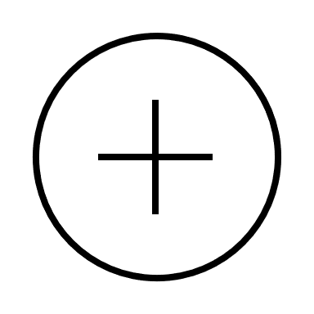








































$$[−1,1]$$
$$w_{13}$$
$$max⁡(0,x_{3})$$
$$w_{50}$$
$$x_{1}$$
$$x_{3}$$
$$x_{5}$$
$$o_{0}$$
$$w_{14}$$
$$w_{51}$$
Network for lower bounds
$$w_{23}$$
$$w_{60}$$
$$x_{2}$$
$$x_{4}$$
$$x_{6}$$
$$o_{1}$$
$$[−1,1]$$
$$w_{24}$$
$$max⁡(0,x_{4})$$
$$w_{61}$$
$$[−1,1]$$
$$w_{13}$$
$$max⁡(0,x_{3})$$
$$w_{50}$$
$$x_{1}$$
$$x_{3}$$
$$x_{5}$$
$$o_{0}$$
$$w_{14}$$
$$w_{51}$$
Network for upper bounds
$$w_{23}$$
$$w_{60}$$
$$x_{2}$$
$$x_{4}$$
$$x_{6}$$
$$o_{1}$$
$$[−1,1]$$
$$w_{24}$$
$$max⁡(0,x_{4})$$
$$w_{61}$$

Slide 26
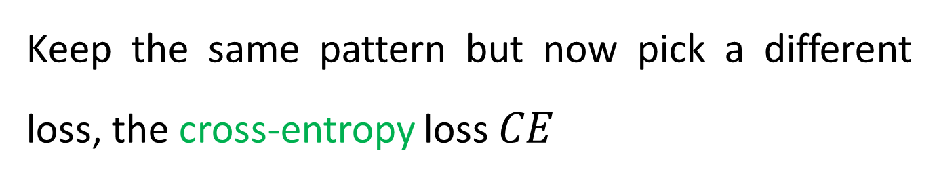

IBP defense from DeepMind
Keep the same pattern but now pick a different loss, the cross-entropy loss $CE$
$$L\left(z,y\right)=CE(z,y)$$
This is in the concrete, but we need to work in the abstract.

Slide 27









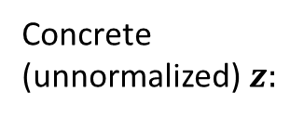






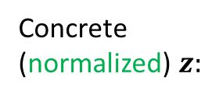




















IBP defense from DeepMind
Keep the same pattern but now pick a different loss, the cross-entropy loss $CE$
$$L\left(z,y\right)=CE(z,y)$$
Concrete
(unnormalized)$z:$
Concrete
(normalized)$z:$
$$Abstract z^{\#}:$$
Let $y=4$
$$[l_{0}, u_{0}]$$
Pick $u_{i}$ if $y≠i$
Pick $l_{i}$ if $y= i$
$$u_{0}$$
$$u_{0}′$$
$$[l_{1}, u_{1}]$$
$$u_{1}$$
$$u_{1}′$$
$$[l_{2}, u_{2}]$$
$$u_{2}$$
Apply $softmax$
$$u_{2}′$$
$$CE(z,y)$$
$$[l_{3}, u_{3}]$$
$$u_{3}$$
$$u_{3}′$$
$$[l_{4}, u_{4}]$$
$$l_{4}$$
$$l_{4}′$$
0.22
$$[l_{5}, u_{5}]$$
$$u_{5}$$
$u_{5}$’
$$[l_{6}, u_{6}]$$
$$u_{6}$$
$$u_{6}′$$
$$[l_{7}, u_{7}]$$
$$u_{7}$$
$$u_{7}′$$
$$[l_{8}, u_{8}]$$
$$u_{8}$$
$u_{8}$’
$$[l_{9}, u_{9}]$$
$$u_{9}$$
$u_{9}$’

Slide 28
Additional heuristics
Annealing on the size of $φ(x)$ – start with small region around $x$ (small $ε$) and gradually grow it during training
Process the last layer with a relational analysis
Combining standard CE loss with robust CE loss in a weighted manner, the weights are adjusted dynamically

Slide 29
Fundamental challenges
Cheap relaxations (e.g., Box) scale to large networks. But it introduces a lot of infeasible points in the final output shape. The deeper the network is, the more the capacity increases for higher accuracy, but the more we are training w.r.t. assigning labels to infeasible points. Thus, typically training with Box scales with accuracy drops substantially
Naturally we would like to reduce the number of infeasible points. However, the more precise the relaxation (e.g., Zonotope over Box), the more difficult the optimization problem becomes (as we saw). This has led to the situation where more precise relaxations during training do not actually bring better results in provability and where further loss tweaking is not enough

Slide 30
Empirical vs. provable defenses
Metric | Empirical vs provable defenses
Standard accuracy | Loss of accuracy is observed for both, more for networks trained with provable defenses
Adversarial accuracy | Difficult to craft examples for both, provable defenses are relatively harder to break
Formal guarantees | Networks with provable defense are easier to prove than those trained with empirical defenses
Scalability | Provable defenses are less scalable, e.g., no good provable defense exist for ImageNet
Examples | Empirical: PGD, TRADES, MART, AWP Provable: DiffAI, COLT, CROWN-IBP, $L_{∞}$-nets

Slide 31
We need a new, clean and simple provable defense method where optimization problem is much more tractable, where we can train w.r.t to convex relaxations and improve provability w.r.t to them, and where more precise relaxations actually produce better provability results

Slide 32
Convex layerwise adversarial training (COLT)
Key observations
Networks trained with empirical defenses may be robust but the convex relaxation that we use for the proofs might be imprecise
When the verifier fails, there may already points in the intermediate shapes whose image in the output space violates the robustness property
Can we remove these counter examples in the intermediate shapes?

Slide 33
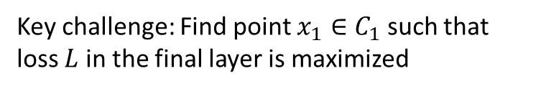










COLT training
Key idea: combine adversarial and provable defense
Key challenge: Find point $x_{1}∈C_{1}$ such that
loss $L$ in the final layer is maximized
Optimization problem to train the network:
$\min_{θ}\max_{x_{1}∈C_{1}}{L(}h_{3}\left(h_{2}\left(x_{1}\right)\right), y_{true})$
$$L\left(x_{3},y_{true}\right)$$
$$x_{0}∈C_{0}$$
$$h_{1}$$
$$h_{2}$$
$$h_{3}$$
$$x_{3}=h_{3}(h_{2}\left(x_{1}\right))$$
$$x_{1}∈C_{1}$$
$$x_{2}∈C_{2}$$
$$x_{3}∈C_{3}$$
The approach can be instantiated with any convex shape, in the paper the authors use Zonotopes

Slide 34
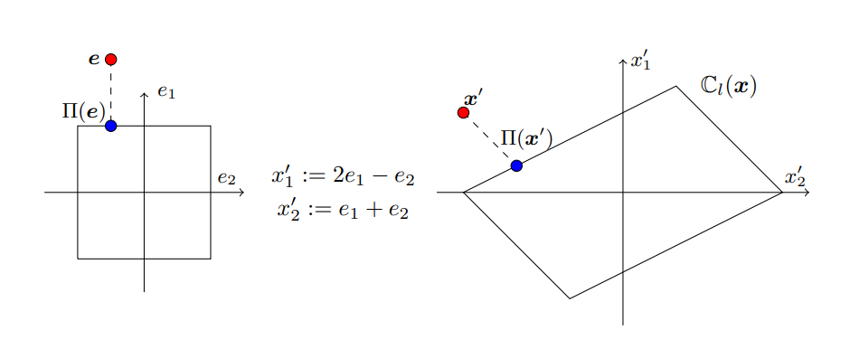
How to project onto a Zonotope?

Slide 35


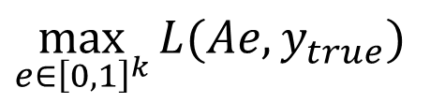
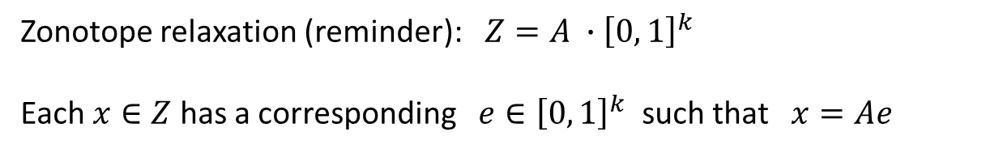
Maximizing loss inside of zonotope relaxation
Solved via standard PGD (projection on Box)
Projection on Zonotope solved via projection on Box (via change of variables)
$$\max_{e∈{\left[0, 1\right]}^{k}}{L(Ae, y_{true})}$$
$$=$$
$$\max_{x∈Z}{L\left(x, y_{true}\right)}$$
Zonotope relaxation (reminder):$Z=A ∙{\left[0, 1\right]}^{k}$ Each $x∈Z$ has a corresponding $e∈{\left[0, 1\right]}^{k}$ such that $x=Ae$

Slide 36
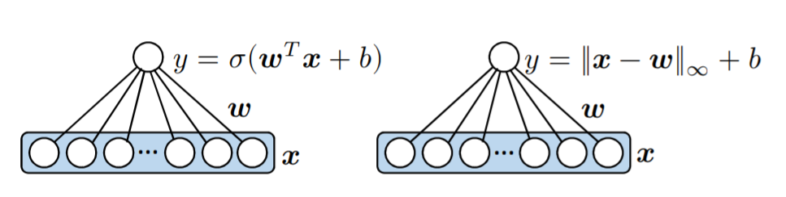
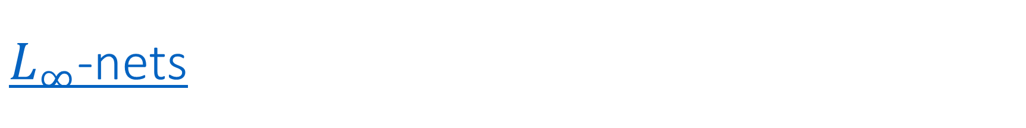
$L_{∞}$-nets
By construction, $L_{∞}$-nets have a global Lipschitz constant of 1

Slide 37
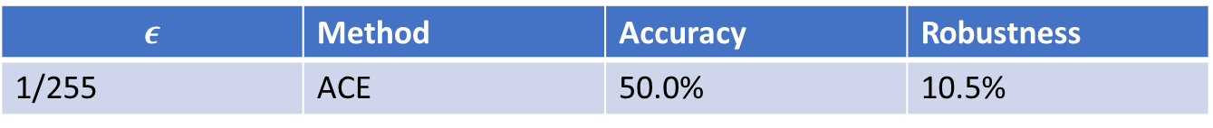
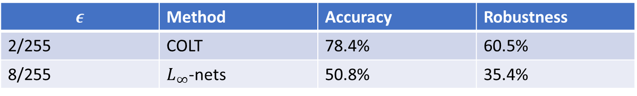
State-of-the-art published results
CIFAR10
$$ε$$ | Method | Accuracy | Robustness
2/255 | COLT | 78.4% | 60.5%
8/255 | $L_{∞}$-nets | 50.8% | 35.4%
Tiny-ImageNet
$$ε$$ | Method | Accuracy | Robustness
1/255 | ACE | 50.0% | 10.5%

