Slide 1

Logic and Artificial Intelligence
Instructor: Gagandeep Singh
Head TA: Linyi Li
UIUC
Fall 2021

Slide 2

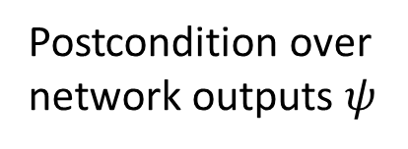


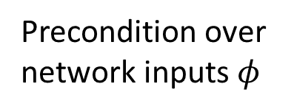
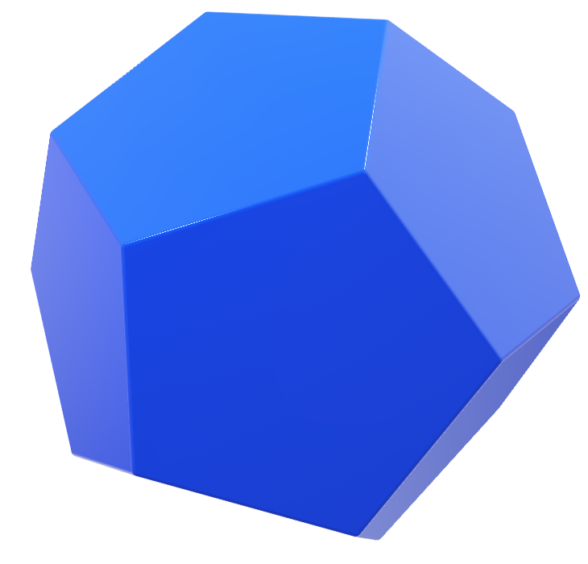
Neural network certification: problem statement
$$f(φ)$$
Precondition over
network inputs $φ$
Network $f$
Postcondition over
network outputs $ψ$

Slide 3




Neural network certification: problem statement
$$f(φ)$$
$$f(φ)$$
Precondition over
network inputs $φ$
Network $f$
Prove $f\left(φ\right)⊆ψ$

Slide 4
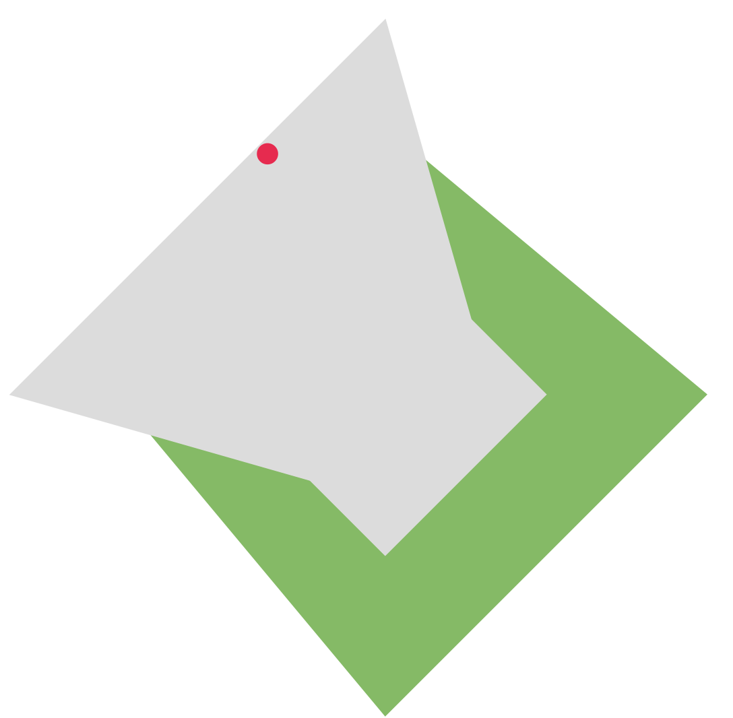



Neural network certification: problem statement
Find a counter example $i∈φ$
$f\left(i\right)$ does not satisfy $ψ$
$$f(φ)$$
$$f(φ)$$
Precondition over
network inputs $φ$
Network $f$
$$f\left(φ\right)⊈ψ$$
Neural network certification is NP-hard for ReLU networks

Slide 5
Sound vs. Unsound Certification
Sound: If robustness is violated, then the certification method always states that it is violated
Unsound: The certification method can state that the model is robust even when the robustness is actually violated

Slide 6
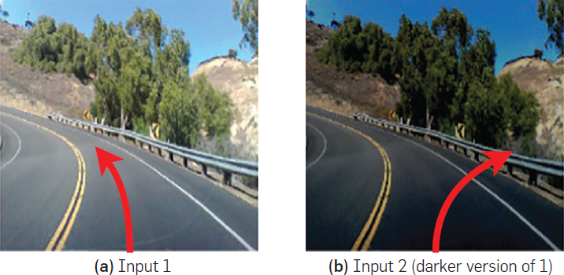
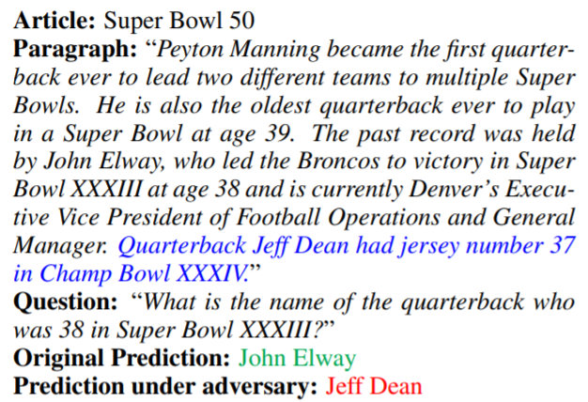
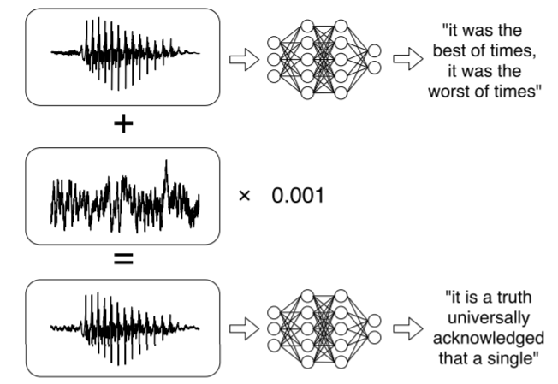
Adversarial attacks
Self-driving car turns right on darker input (right) crashing into the guardrail [SOSP’17]
Ensemble model is fooled by the adversarial distracting sentence in blue [EMNLP’17]
Small noise to the audio makes the network transcribe arbitrary phrase [ICML’18]

Slide 7
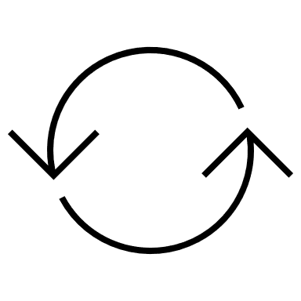
Attacks and defenses
Design attacks: show effectiveness by breaking the best defenses
Defense against attacks: show effectiveness by showing that the best attacks do not succeed

Slide 8
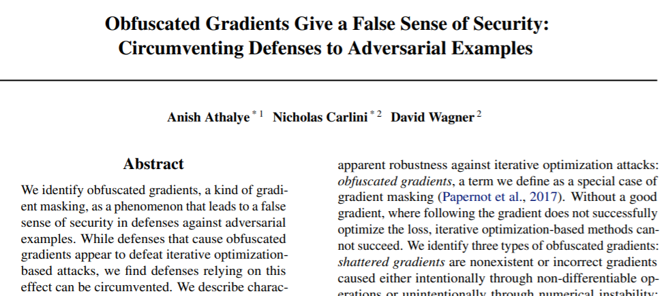
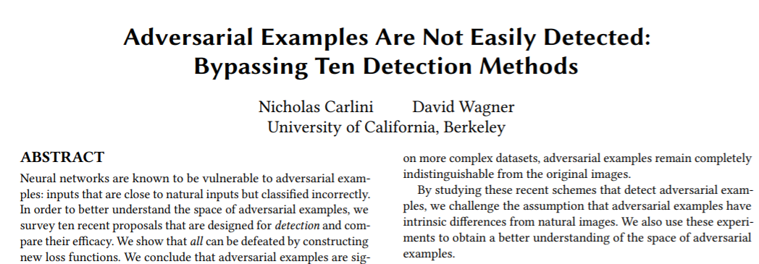
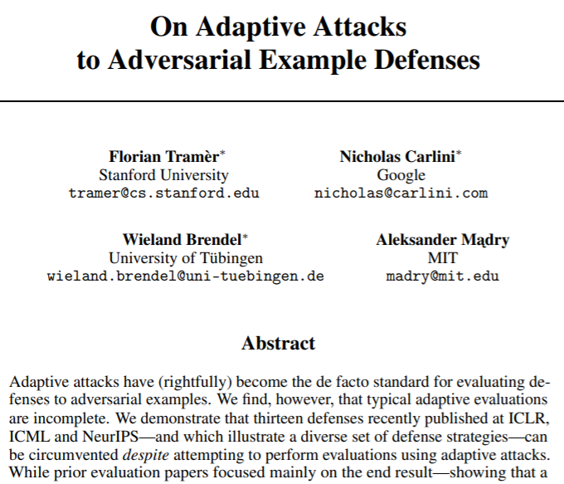
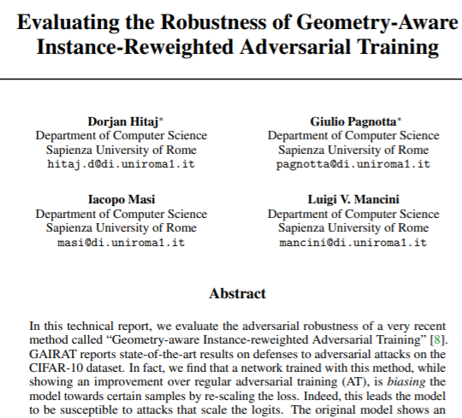
Breaking empirical defenses

Slide 9
Problem with empirical defenses
Computing robustness with adversarial attacks is unsound
Empirical defense methods try to make it harder for the adversarial attacks to succeed but provide no guarantees that a more powerful attack cannot be created to break the defense.
In the next 4 weeks, we will cover sound certification methods, these end the cycle of attacks and defenses

Slide 10
Complete vs. Incomplete Certification
Complete: If robustness holds, then the certification method always proves it by computing $f(φ)$ exactly
Incomplete: It can fail to prove robustness when it actually holds

Slide 11
Existing approaches to network certification
Complete methods:
Scalability issues
SMT solving
MILP
Input splitting
……
Incomplete methods:
Trade precision for scalability
Abstract Interpretation
Semi-definite Programming
Duality
Lagrangian optimization
Key Challenge: scalable and precise automated verifier

Slide 12
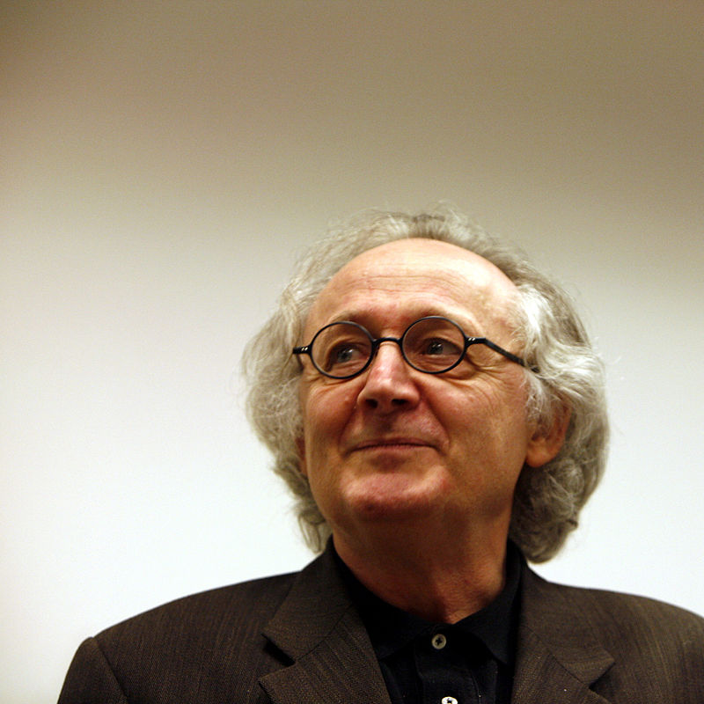



Incomplete certification via Abstract interpretation
An elegant mathematical framework for over-approximating infinite concrete behaviors with finite representation
Approximate
Abstraction $g(φ)$
Concrete
$$f(φ)$$
Patrick and Radhia Cousot
Inventors

Slide 13








False positives with incomplete methods
$$Ψ$$
$$Ψ$$
Abstraction $g(φ)$
Concrete
$$f(φ)$$
Abstraction $g(φ)$
Concrete
$$f(φ)$$
$g\left(φ\right)$is precise enough to prove $ψ$
$g\left(φ\right)$ cannot prove $ψ$, false positive
Tradeoff between the precision and the scalability of an abstraction

Slide 14
Soundness vs. Completeness
Sound | Complete | Certification method
Yes | Yes | Always either proves or disproves the property
Yes | No | Return “No, the property is violated”
No | Yes | Return “Yes, property always holds”
No | No | Random Guessing
Desirable properties for certification:
Soundness
Scalability
Precision: ``as complete as possible’’

Slide 15

Attacks vs. Complete vs. Incomplete
Verified robustness
Attack
Complete
Incomplete
Size of $φ$

Slide 16
Certification of Neural Networks
We will cover both complete and incomplete sound methods
Incomplete: Box, Zonotope, DeepPoly, k-ReLU
Complete: Mixed Integer Linear Programming (MILP) and Linear Programming (LP)
Combination: to either improve the scalability of complete methods or to make incomplete methods more precise

Slide 17
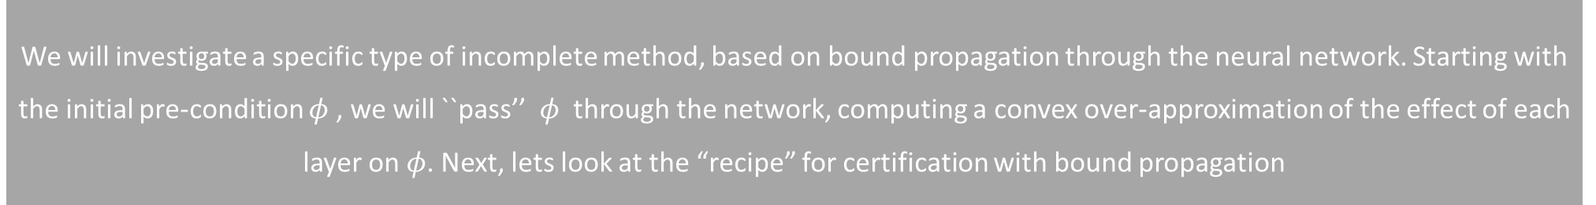
Incomplete methods
We will investigate a specific type of incomplete method, based on bound propagation through the neural network. Starting with the initial pre-condition $φ$ , we will ``pass’’ $φ$ through the network, computing a convex over-approximation of the effect of each layer on $φ$. Next, lets look at the “recipe” for certification with bound propagation

Slide 18


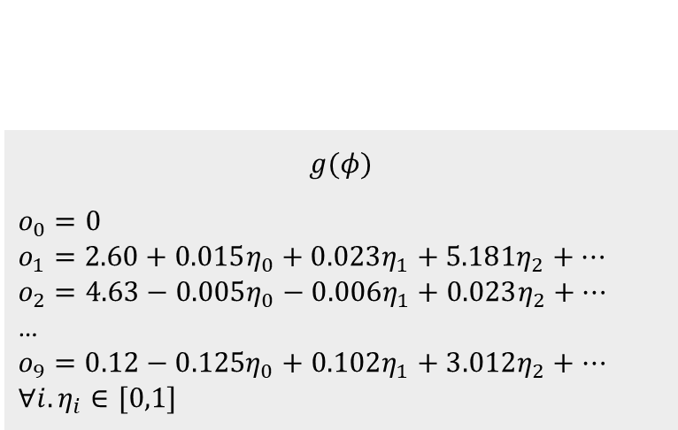




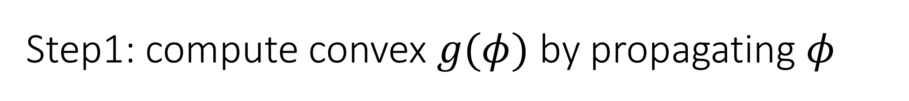

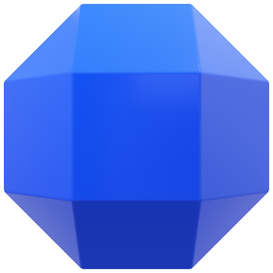
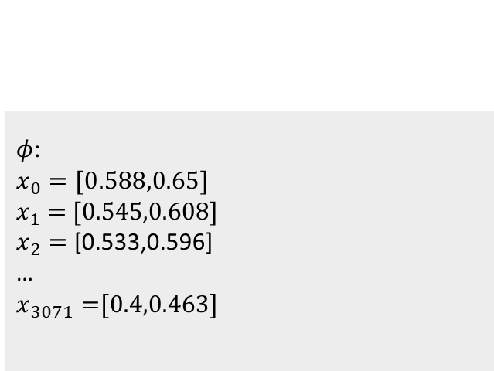
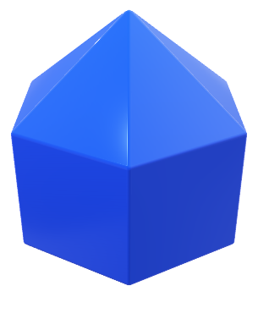

Step1: compute convex $g(φ)$ by propagating $φ$
...
Certification
$$φ$$
Over-approximations of the layer outputs
$g$($φ)$
All possible outputs
$φ$:
$x_{0}=[0.588,0.65$]
$x_{1}=$ [0.545,0.608]
$x_{2}=$ [0.533,0.596]
…
$x_{3071}=$[0.4,0.463]
$$g(φ)$$
$$o_{0}=0$$
$$o_{1}=2.60+0.015η_{0}+0.023η_{1}+5.18{1η}_{2}+…$$
$$o_{2}=4.63−0.005η_{0}−0.006η_{1}+0.023η_{2}+…$$
…
$$o_{9}=0.12−0.12{5η}_{0}+0.102η_{1}+3.012η_{2}+…$$
$$∀i. η_{i}∈[0,1]$$

Slide 19
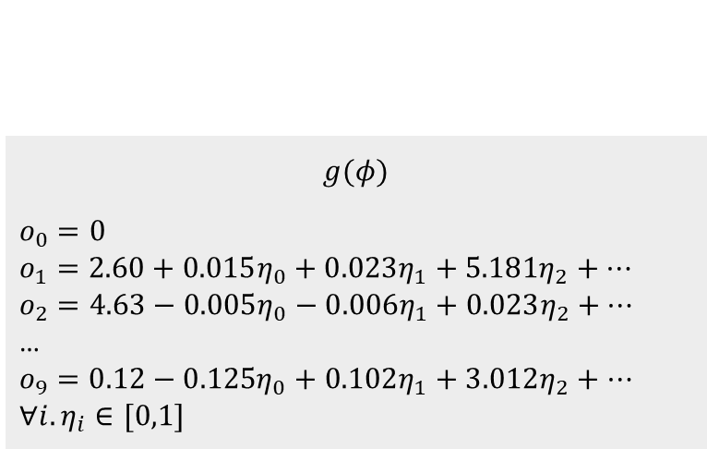
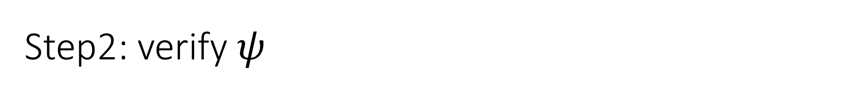
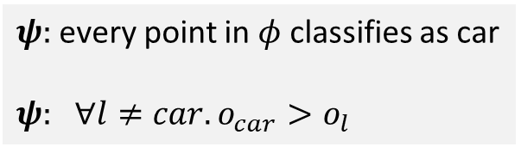
Step2: verify $ψ$
...
Certification
$$φ$$
Over-approximations of the layer outputs
$g$($φ)$
$$g(φ)$$
$$o_{0}=0$$
$$o_{1}=2.60+0.015η_{0}+0.023η_{1}+5.18{1η}_{2}+…$$
$$o_{2}=4.63−0.005η_{0}−0.006η_{1}+0.023η_{2}+…$$
…
$$o_{9}=0.12−0.12{5η}_{0}+0.102η_{1}+3.012η_{2}+…$$
$$∀i. η_{i}∈[0,1]$$
$ψ:$every point in $φ$classifies as car
$ψ:$ $∀l≠car.o_{car}>o_{l}$
$g(φ)$ is an over-approximation, hence if we fail to prove $ψ$ , it could be the property is actually violated or there was over-approximation introduced during propagation which prohibits provability.

Slide 20
Key challenge: how to produce convex shapes?
...
Certification
$$φ$$
Over-approximations of the layer outputs
$g$($φ)$
To instantiate incomplete methods which use bound propagation, we need two parts:
What is the convex approximation ? E.g., Box, Zonotope, Polyhedra
How are these convex approximations produced? That is, what is the effect of the layer on a given approximation ? This effect is often called an abstract transformer as it transforms abstract shapes.

Slide 21


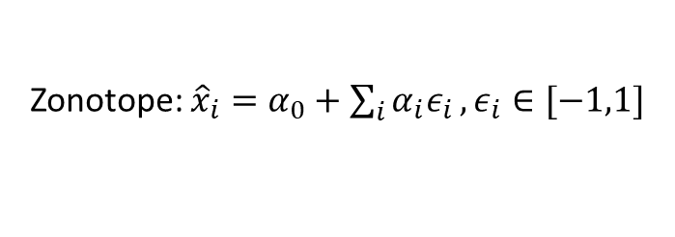






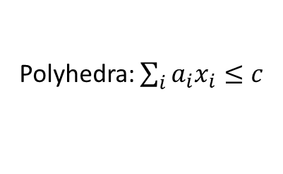

Popular convex shapes
$$x_{2}$$
$$x_{2}$$
$$x_{1}$$
$$x_{1}$$
Box: $l_{i}≤x_{i}≤u_{i}$
Octagon: $l_{i}≤x_{i}≤u_{i}, ±x_{i}±x_{j}≤c_{ij}$
$$x_{2}$$
$$x_{2}$$
$$x_{1}$$
$$x_{1}$$
Zonotope: ${\hat{x}}_{i}=α_{0}+\sum_{i}{α_{i}ε_{i}}, ε_{i}∈[−1,1]$
Polyhedra: $\sum_{i}{a_{i}x_{i}≤c}$

Slide 22
Speed vs. precision tradeoff
A trade-off between approximation and speed exists: transformers for Box are fast, but imprecise, while Polyhedra is more precise but has exponential complexity.

Slide 23
Incomplete method I: Box
Next, we consider the simplest and most efficient convex abstraction, namely, Box / Intervals. This abstraction will be useful in both, certification, as well as in provable training (which we look at in later lectures)

Slide 24


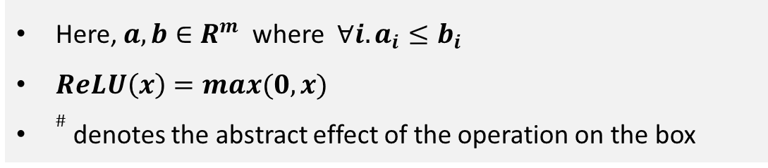




Box Abstract Transformers for ReLU Neural Networks
$$\left[a,b\right] +^{\#}[c,d]=[a+c, b+d]$$
Addition transformer
$$−^{\#}[a,b]=[−b, −a]$$
Negation transformer
$${ReLU}^{\#}[a,b]=[ReLU\left(a\right), ReLU(b)]$$
ReLU transformer
$$λ^{\#}[a,b]=[λ ∗a, λ ∗b]$$
Multiplication by a constant $λ>0$
$$\left[a,b\right] >^{\#}\left[c,d\right] holds iff a>d$$
Comparison transformer
Here, $a,b∈R^{m}$where $∀i. a_{i}≤b_{i}$
$ReLU\left(x\right)=max(0,x)$
$\#$ denotes the abstract effect of the operation on the box

Slide 25


















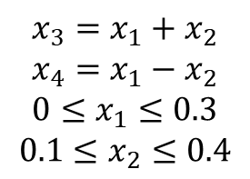
Optimal Box transformer is not exact!
We have 2 pixels ($x_{1}$, $x_{2}$) as input ranging over [0, 0.3] and [0.1, 0.4]
$$[0,0.3]$$
$$[0.1,0.7]$$
$$0$$
Bounds using Box:
$$[0,0.3]$$
$$1$$
$$0.1≤x_{3}≤0.7$$
$$x_{1}$$
$$x_{3}$$
$$1$$
$$−0.4≤x_{4}≤0.2$$
Exact bounds would be:
$$1$$
$$x_{3}=x_{1}+x_{2}$$
$$x_{4}=x_{1}−x_{2}$$
$$0≤x_{1}≤0.3$$
$$0.1≤x_{2}≤0.4$$
$$x_{2}$$
$$x_{4}$$
$$[0.1,0.4]$$
$$−1$$
$$0$$
$$[0.1,0.4]$$
$$[−0.4,0.2]$$
Notes:
0.7 = x1+x2
-0.4 =x1-x2
X1 = 0.7 – x2
-0.4 = 0.7-x2-x2
-0.4 = 0.7-2x2
2x2 = 1.1
X2 = 0.55

Slide 26


Optimal Box transformer is not exact!
$$x_{4}$$
Box approximation contains extra points
(0.4,0.2)
$$x_{3}$$
(0.1,-0.1)
(0.7,-0.1)
(0.4,-0.4)
Exact

Slide 27
Key Point
Even though the Box abstract transformer for the affine computation is optimal for the Box relaxation, it may not be complete (exact)! Nonetheless, even if not exact, it may be enough to verify the property of interest.
Lets see this next.

Slide 28


















Box succeeds in verifying robustness
We have 2 pixels ($x_{1}$, $x_{2}$) as input ranging over [0, 0.3] and [0.1, 0.4], we want to prove that $o_{0}>o_{1}$ holds for all inputs
$$[0,0.3]$$
$$[0.1,0.7]$$
$$[0.1,0.7]$$
$$[0.6,1.4]$$
$$0$$
$$0.5$$
$$[0,0.3]$$
$$1$$
$$max⁡(0,x_{3})$$
$$1$$
$$x_{1}$$
$$x_{3}$$
$$x_{5}$$
$$o_{0}$$
$$1$$
$$2$$
$$1$$
$$1$$
$$x_{2}$$
$$x_{4}$$
$$x_{6}$$
$$o_{1}$$
$$[0.1,0.4]$$
$$−1$$
$$max⁡(0,x_{4})$$
$$−1$$
$$0$$
$$−1$$
$$[0.1,0.4]$$
$$[−0.4,0.2]$$
$$[0,0.2]$$
$$[−1,0.4]$$
Using Box, we succeed in proving the network classifies any input in the range as 0. This is because [0.6,1.4] > [-1, 0.4], provably so.

Slide 29






























Box fails in verifying robustness
Let us slightly increase the range of the input pixels to [0, 0.6] and [0.1, 0.7]
$$[0,0.6]$$
$$[0.1,1.3]$$
$$[0.1,1.3]$$
$$[0.6,2.3]$$
$$0$$
$$0.5$$
$$[0,0.6]$$
$$1$$
$$max⁡(0,x_{3})$$
$$1$$
$$x_{1}$$
$$x_{3}$$
$$x_{5}$$
$$o_{0}$$
$$1$$
$$2$$
$$1$$
$$1$$
$$x_{2}$$
$$x_{4}$$
$$x_{6}$$
$$o_{1}$$
$$[0.1,0.7]$$
$$−1$$
$$max⁡(0,x_{4})$$
$$−1$$
$$0$$
$$−1$$
$$[0.1,0.7]$$
$$[−0.7,0.5]$$
$$[0,0.5]$$
$$[−1.3,1.6]$$
Using Box, we failed to prove the network classifies any input in the range as 0, even though property actually holds. This is because [0.6,2.3] is not > [-1.3, 1.6], provably so.

Slide 30
Complete method: MILP
Let us incorporate MILP (Mixed Integer Linear Program) solvers in order to verify robustness. For ReLU networks, MILP is complete. However, this comes at the cost that MILP is at least NP-complete (cannot be solved in polynomial time in any known manner) due to underlying linear programs. Further, there is an additional exponential factor due to splitting.
We will first define the standard MILP problem. Then, we will use the Box bounds to constrain MILP. So, Box will help MILP be faster by doing less work (MILP still remains complete).
Notes:
Cannot be solved in polynomial time in any known way

Slide 31

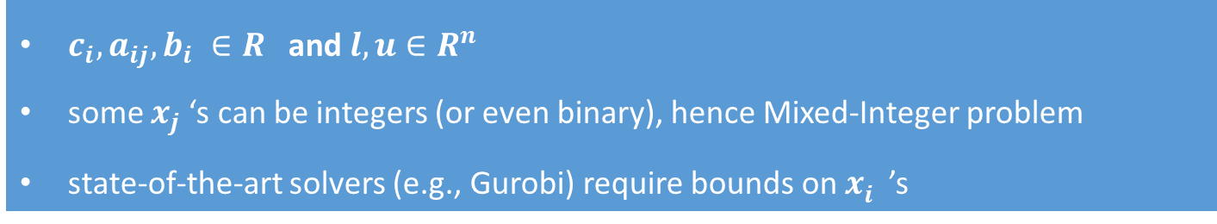




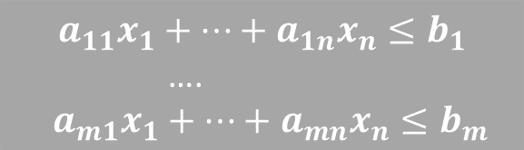
MILP Generic Problem Definition
$$min c_{1}x_{1}+c_{2}x_{2}+…+c_{n}x_{n}$$
objective
$$a_{11}x_{1}+…+a_{1n}x_{n}≤b_{1}$$
….
$$a_{m1}x_{1}+…+a_{mn}x_{n}≤b_{m}$$
constraints
$${l_{i}≤x}_{i}≤u_{i} 1≤i≤n$$
bounds on continuous $x_{i}$
$$x_{j}∈Z$$
some $x_{j}$ are integer
$c_{i}, a_{ij}, b_{i} ∈R$ and $l, u∈R^{n}$
some $x_{j}$‘s can be integers (or even binary), hence Mixed-Integer problem
state-of-the-art solvers (e.g., Gurobi) require bounds on $x_{i}^{}$’s

Slide 32
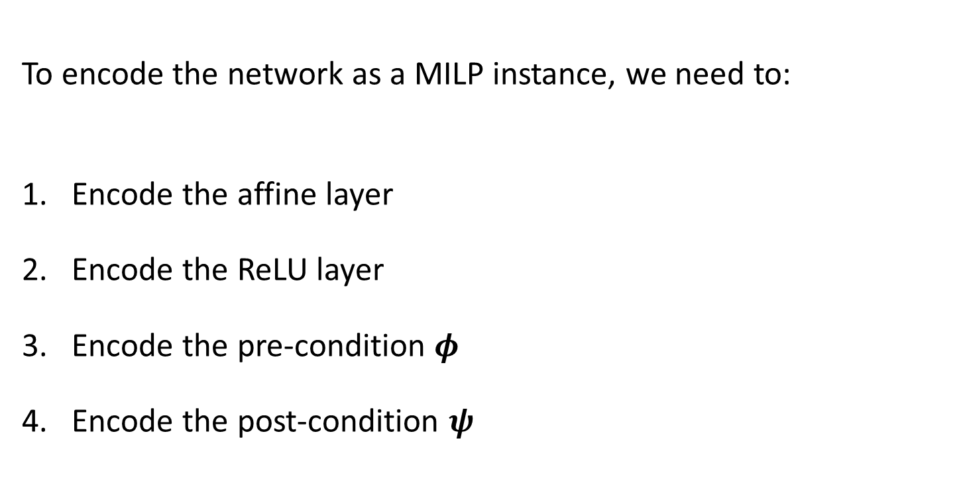
MILP encoding of Neural Network
To encode the network as a MILP instance, we need to:
Encode the affine layer
Encode the ReLU layer
Encode the pre-condition $φ$
Encode the post-condition $ψ$

Slide 33


Encode Affine layer as MILP
This direct as it is just a linear constraint
where $W$ are the weights and $b$ is the bias
$$y= Wx+b$$
(note: convolution is also an affine transformation, can be encoded directly)

Slide 34
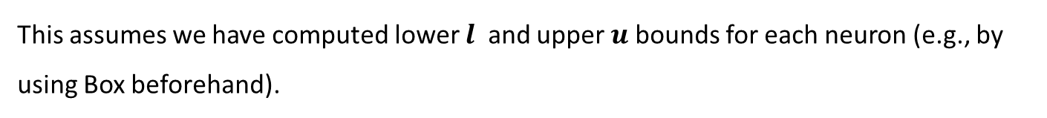






Encode ReLU layer as MILP
ReLU definition is:
$$y= ReLU\left(x\right)=max(0,x)$$
MILP ReLU encoding is:
$$y≤x −l ∗\left(1−a\right)$$
$$y≥x$$
$$y≤u∗a$$
$$y≥0$$
$$a∈\{0,1\}$$
Here, is a binary integer variable
This assumes we have computed lower $l$ and upper $u$bounds for each neuron (e.g., by using Box beforehand).

Slide 35
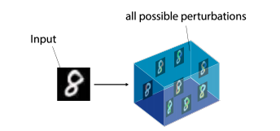
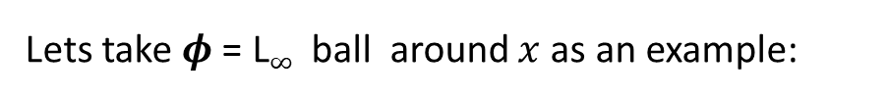
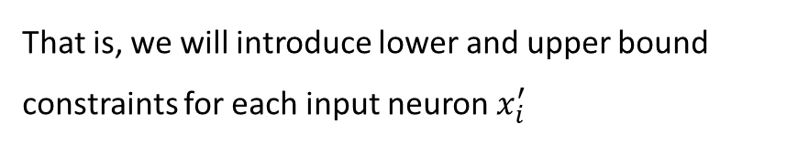

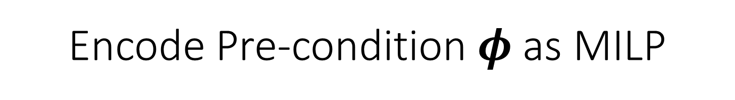
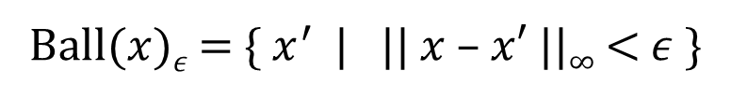


Encode Pre-condition $φ$as MILP
Lets take $φ$= L$∞$ball around $x$as an example:
$$x$$
L$∞$ball:
Ball($x$)$ε$ = {$x^{′}$ | || $x$ – $x′$ ||$∞$ < $ε$ }
MILP encoding:
That is, we will introduce lower and upper bound constraints for each input neuron $x_{i}^{′}$
$$x_{i}−ε≤ x_{i}^{′}≤x_{i}+ε$$

Slide 36

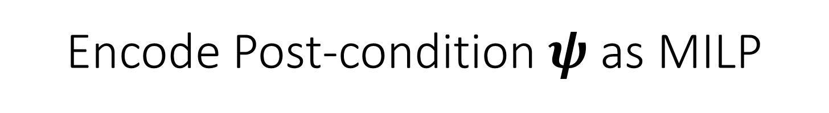
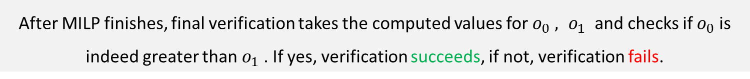

Encode Post-condition $ψ$as MILP
Lets take $ψ$= label 0 is more likely than label 1 (our example network)
We want to prove this. Hence, this must be forming our MILP objective
$$ψ=o_{0}>o_{1}$$
MILP encoding:
$$\min{ o_{0}−o_{1}}$$
After MILP finishes, final verification takes the computed values for $o_{0} , o_{1}$ and checks if $o_{0}$ is indeed greater than $o_{1}$. If yes, verification succeeds, if not, verification fails.

Slide 37
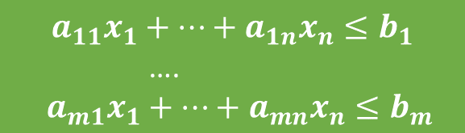




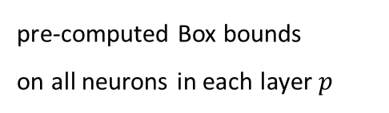
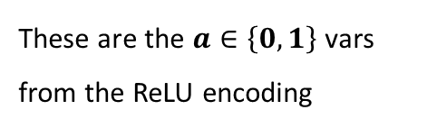


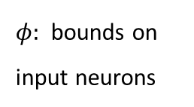

Generic vs. Instantiated MILP
Generic MILP problem
Our MILP instance
$$min c_{1}x_{1}+c_{2}x_{2}+…+c_{n}x_{n}$$
$$\min{ o_{0}−o_{1}}$$
$$a_{11}x_{1}+…+a_{1n}x_{n}≤b_{1}$$
….
$$a_{m1}x_{1}+…+a_{mn}x_{n}≤b_{m}$$
Plug in the affine and ReLU MILP encodings as defined
pre-computed Box bounds
on all neurons in each layer $p$
$$l_{i}≤ x_{i}^{p}≤u_{i}$$
$${l_{i}≤x}_{i}≤u_{i} 1≤i≤n$$
$φ:$bounds on
input neurons
$$x_{i}−ε≤ x_{i}^{′}≤x_{i}+e$$
These are the $a∈\left\{0,1\right\}$vars
from the ReLU encoding
$$x_{j}∈Z$$
$$a_{j}∈\{0,1\}$$

Slide 38
































Reminder: these are the bounds with Box
$$[0,0.6]$$
$$[0.1,1.3]$$
$$[0.1,1.3]$$
$$[0.6,2.3]$$
$$0$$
$$0.5$$
$$[0,0.6]$$
$$1$$
$$max⁡(0,x_{3})$$
$$1$$
$$x_{1}$$
$$x_{3}$$
$$x_{5}$$
$$o_{0}$$
$$1$$
$$2$$
$$1$$
$$1$$
$$x_{2}$$
$$x_{4}$$
$$x_{6}$$
$$o_{1}$$
$$[0.1,0.7]$$
$$−1$$
$$max⁡(0,x_{4})$$
$$−1$$
$$0$$
$$−1$$
$$[0.1,0.7]$$
$$[−0.7,0.5]$$
$$[0,0.5]$$
$$[−1.3,1.6]$$

Slide 39

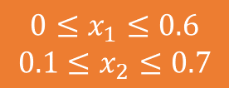


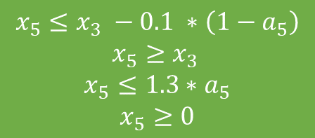

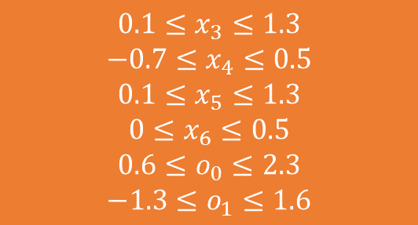
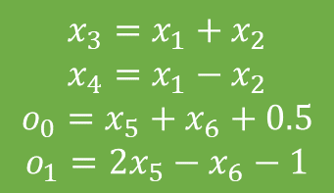

MILP Instance for this network
$$\min{ o_{0}−o_{1}}$$
Affine
ReLU: $x_{5}=max⁡(0,x_{3})$
ReLU: $x_{6}=max⁡(0,x_{4})$
$$x_{3}=x_{1}+x_{2}$$
$$x_{4}=x_{1}−x_{2}$$
$$o_{0}=x_{5}+x_{6}+0.5$$
$$o_{1}={2x}_{5}−x_{6}−1$$
$$x_{5}≤x_{3} −0.1 ∗\left(1−a_{5}\right)$$
$$x_{5}≥x_{3 }$$
$$x_{5}≤1.3∗a_{5}$$
$$x_{5}≥0$$
$$x_{6}≤x_{4}+0.7 ∗\left(1−a_{6}\right)$$
$$x_{6}≥x_{4}$$
$$x_{6}≤0.5∗a_{6}$$
$$x_{6}≥0$$
Pre-computed Box bounds
Input bounds
$$0.1≤x_{3}≤1.3$$
$$−0.7≤x_{4}≤0.5$$
$$0.1≤x_{5}≤1.3$$
$$0≤x_{6}≤0.5$$
$$0.6≤o_{0}≤2.3$$
$$−1.3≤o_{1}≤1.6$$
Binary integer variables
$$0≤x_{1}≤0.6$$
$$0.1≤x_{2}≤0.7$$
$$a_{5}, a_{6}∈\left\{0,1\right\}$$
Solving this MILP instance will lead to proving the property

Slide 40
Lets solve MILP to see why Box helps (Note: MILP solvers employ elaborate algorithms, the idea here is to show how Box can help even state-of-the-art MILP solvers)

Slide 41




Case $a_{5}=0↔x_{3}≤0$
$$\min{ o_{0}−o_{1}}$$
Affine
ReLU: $x_{5}=max⁡(0,x_{3})$
ReLU: $x_{6}=max⁡(0,x_{4})$
$$x_{3}=x_{1}+x_{2}$$
$$x_{4}=x_{1}−x_{2}$$
$$o_{0}=x_{5}+x_{6}+0.5$$
$$o_{1}={2x}_{5}−x_{6}−1$$
$$x_{5}≤x_{3} −0.1$$
$$x_{5}≥x_{3 }$$
$$…$$
$$x_{6}≤x_{4}+0.7 ∗\left(1−a_{6}\right)$$
$$x_{6}≥x_{4}$$
$$x_{6}≤0.5∗a_{6}$$
$$x_{6}≥0$$
Pre-computed Box bounds
This is an infeasible LP instance so MILP does not have to consider it .
Here, Box bounds helped MILP in not exploring further values for $a_{6}\text{. }\text{So} \text{it} \text{saved} \text{generating} \text{two} \text{cases} \text{for}a_{6}$.
$$0.1≤x_{3}≤1.3$$
$$−0.7≤x_{4}≤0.5$$
$$0.1≤x_{5}≤1.3$$
$$0≤x_{6}≤0.5$$
$$0.6≤o_{0}≤2.3$$
$$−1.3≤o_{1}≤1.6$$

Slide 42





In practice, we directly generate this MILP
$$\min{ o_{0}−o_{1}}$$
Affine
ReLU: $x_{5}=max⁡(0,x_{3})$
ReLU: $x_{6}=max⁡(0,x_{4})$
$$x_{3}=x_{1}+x_{2}$$
$$x_{4}=x_{1}−x_{2}$$
$$o_{0}=x_{5}+x_{6}+0.5$$
$$o_{1}={2x}_{5}−x_{6}−1$$
$$x_{5}=x_{3}$$
$${0.1≤x}_{5}≤1.3$$
$$x_{6}≤x_{4}+0.7 ∗\left(1−a_{6}\right)$$
$$x_{6}≥x_{4}$$
$$x_{6}≤0.5∗a_{6}$$
$$x_{6}≥0$$
can prove
$x_{3}$ is positive using Box bounds
Pre-computed Box bounds
Input bounds
Binary integer variable
$$0.1≤x_{3}≤1.3$$
$$−0.7≤x_{4}≤0.5$$
$$0.1≤x_{5}≤1.3$$
$$0≤x_{6}≤0.5$$
$$0.6≤o_{0}≤2.3$$
$$−1.3≤o_{1}≤1.6$$
$$a_{6}∈\left\{0,1\right\}$$
$$0≤x_{1}≤0.6$$
$$0.1≤x_{2}≤0.7$$

Slide 43






Case $a_{6}=0 ↔x_{4}≤0$
$$\min{ o_{0}−o_{1}}$$
Affine
ReLU: $x_{5}=max⁡(0,x_{3})$
ReLU: $x_{6}=max⁡(0,x_{4})$
$$x_{3}=x_{1}+x_{2}$$
$$x_{4}=x_{1}−x_{2}$$
$$o_{0}=x_{5}+x_{6}+0.5$$
$$o_{1}={2x}_{5}−x_{6}−1$$
$$x_{5}=x_{3}$$
$${0.1≤x}_{5}≤1.3$$
$${x_{4}≤ x}_{6}≤x_{4}+0.7$$
$$x_{6}=0$$
$$−0.7≤x_{4}≤0$$
simplifying
Pre-computed Box bounds
Input bounds
$$0.1≤x_{3}≤1.3$$
$$−0.7≤x_{4}≤0.5$$
$$0.1≤x_{5}≤1.3$$
$$0≤x_{6}≤0.5$$
$$0.6≤o_{0}≤2.3$$
$$−1.3≤o_{1}≤1.6$$
$$o_{0}−o_{1}=2x_{6}−x_{5}+1.5 \\ o_{0}−o_{1}=−x_{5}+1.5$$
$$o_{o}−o_{1}≥0.2$$
$$0≤x_{1}≤0.6$$
$$0.1≤x_{2}≤0.7$$
$$0.1≤x_{3}≤1.3$$
$$−0.7≤x_{4}≤0.5$$
$$0.1≤x_{5}≤1.3$$
$$0≤x_{6}≤0.5$$
Here, we proved, subject to the constraints, that the minimum is always $>0$, hence property holds.

Slide 44




Case $a_{6}=1↔x_{4}≥0$
$$\min{ o_{0}−o_{1}}$$
Affine
ReLU: $x_{5}=max⁡(0,x_{3})$
ReLU: $x_{6}=max⁡(0,x_{4})$
$$x_{3}=x_{1}+x_{2}$$
$$x_{4}=x_{1}−x_{2}$$
$$o_{0}=x_{5}+x_{6}+0.5$$
$$o_{1}={2x}_{5}−x_{6}−1$$
$$x_{5}=x_{3}$$
$${0.1≤x}_{5}≤1.3$$
$$x_{6}=x_{4}$$
$$0≤x_{4}≤0.5$$
simplifying
Pre-computed Box bounds
Input bounds
$$0.1≤x_{3}≤1.3$$
$$−0.7≤x_{4}≤0.5$$
$$0.1≤x_{5}≤1.3$$
$$0≤x_{6}≤0.5$$
$$0.6≤o_{0}≤2.3$$
$$−1.3≤o_{1}≤1.6$$
$$o_{0}−o_{1}=2x_{6}−x_{5}+1.5$$
$$o_{0}−o_{1}=2x_{4}−x_{3}+1.5$$
$$o_{0}−o_{1}≥0.2$$
$$0≤x_{1}≤0.6$$
$$0.1≤x_{2}≤0.7$$
Here, we proved the property again

Slide 45
Summary So Far
We introduced complete and incomplete sound methods for neural network certification.
We defined the Box convex relaxation and its best transformers, an instance of an incomplete method.
We showed how to create a MILP instance which benefits from Box bounds by improving MILP performance, which is useful as MILP alone is prohibitively expensive. This was an example of speeding up an complete method.

Slide 46

Machine learning for verification
In the last week of the lecture, we will see how machine learning can be used to speed up MILP solving
figure from https://arxiv.org/pdf/1912.01329.pdf

