Slide 1
KıwıOS
İntroduction of

Slide 2
Introductıon of kıwıos
KiwiOS is a,fast,secure,user-friendly opereting system.
KiwiOS was written by two peope,including me,using C and Assembly languages.
We are still working on this project for 3 years.
The System kernel was written entirely by me.

Slide 3
The kıwıOS kernel
The KiwiOS kernel has extensive hardware support.
Extensive driver support.
Kernel has own file system named by KEFS2(Kiwi Extented File System).
And supports for many file systems(FAT,NTFS,EXT4)
Advanced kernel modules
There is a module called SEKiwi for kernel security
Power managemeng drivers (ACPI)
Network and sound cards support(intel device support)

Slide 4
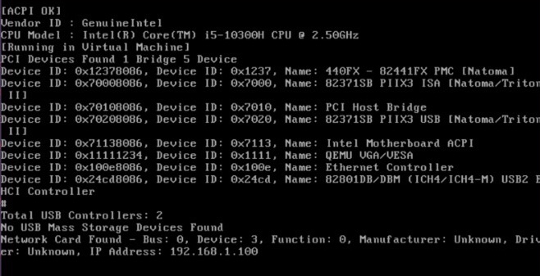
İmage:Kiwios booting,kernel ınıt progress

Slide 5
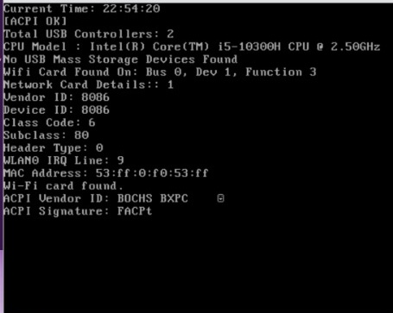

Slide 6
Regular file management
Journaling
Regular partition management
Block management
And more...

Slide 7
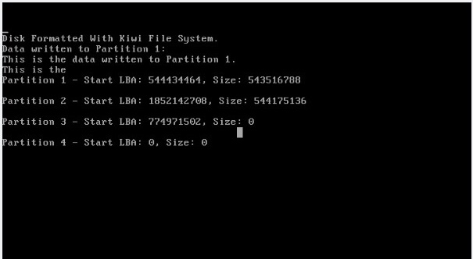

Slide 8
Basic-user-friendly guı
Simple to use interface.
Fluent speed.
Two interface option (Modern GUI / Nostalgia Theme :) )

Slide 9
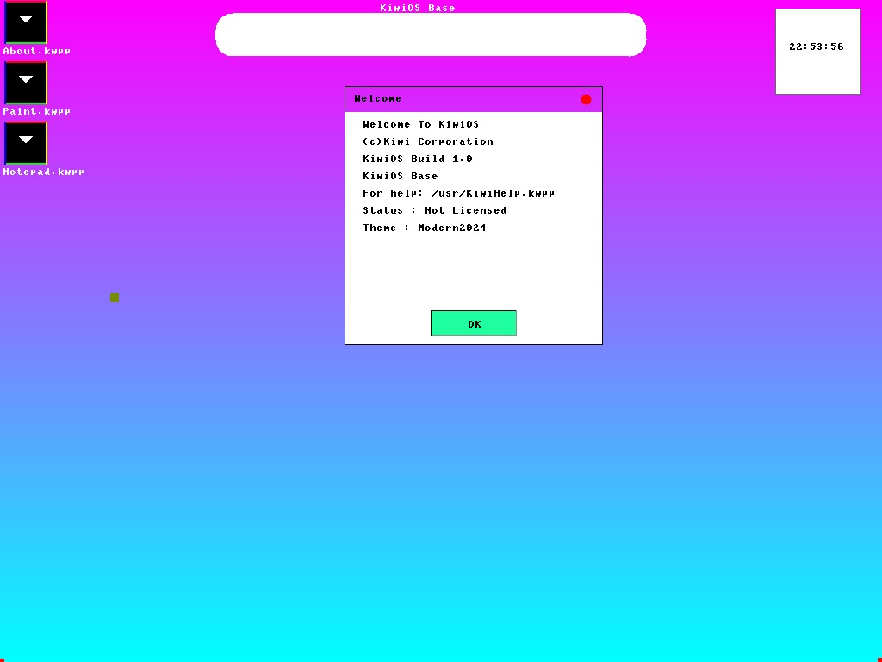
THE MODERN THEME

Slide 10
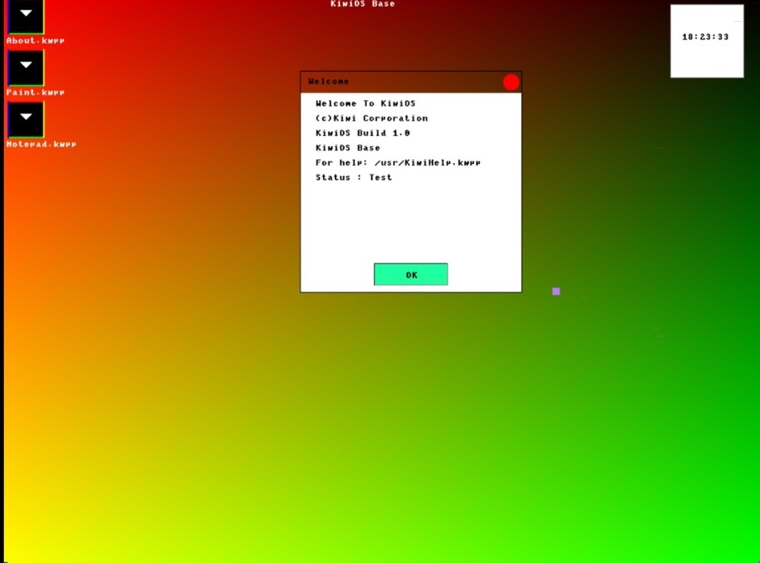

Slide 11
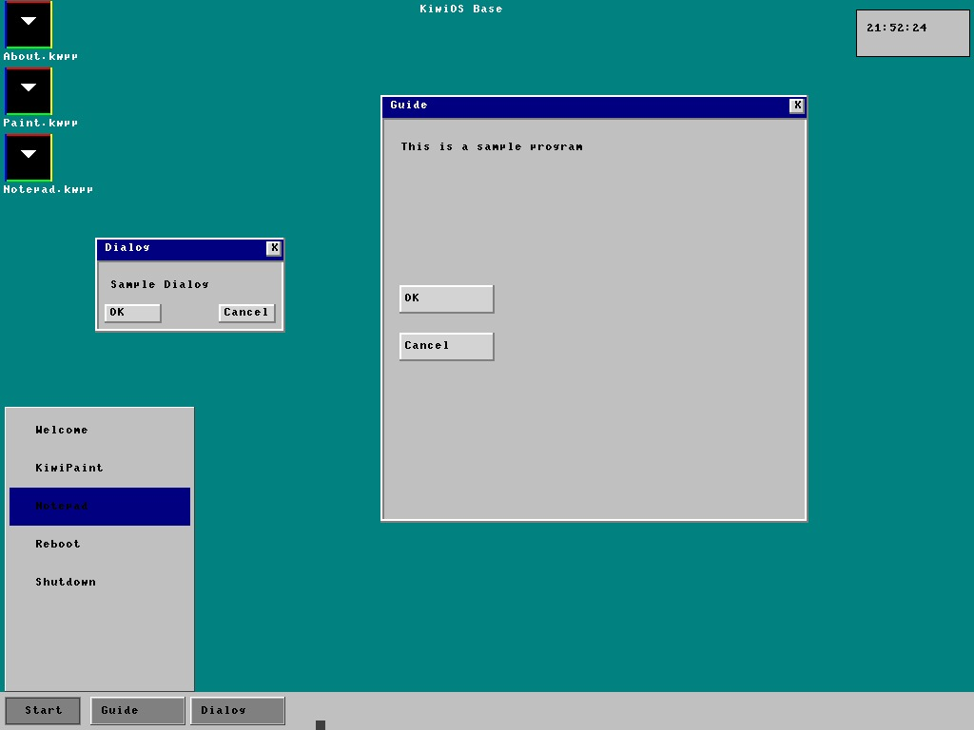
The nostalgia theme

Slide 12
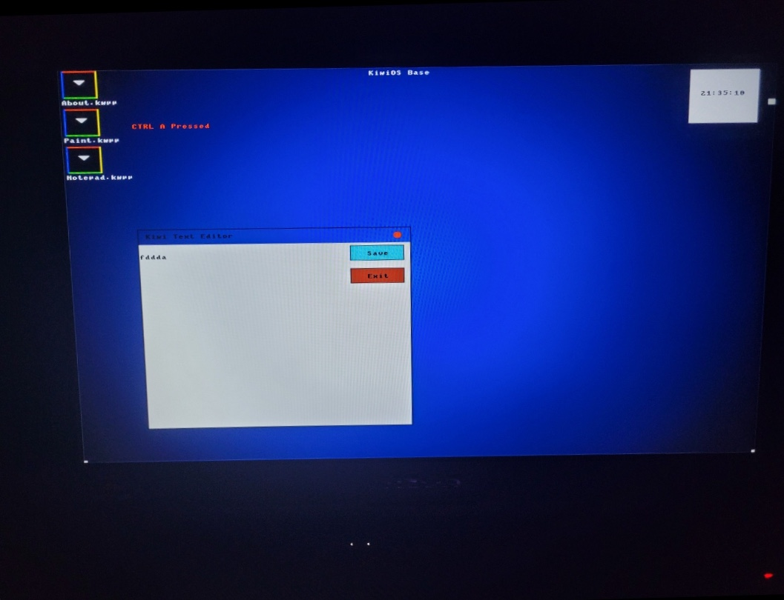
KiwiOS ON REAL HARDWARE

Slide 13
Basic infos about project
KiwiOS has been developed for 3 years.
This project is being developed for Teknofest international competitions and daily use.
There are more than 100 thousand lines of code in the KiwiOS kernel
I wrote the entire kernel myself

Slide 14
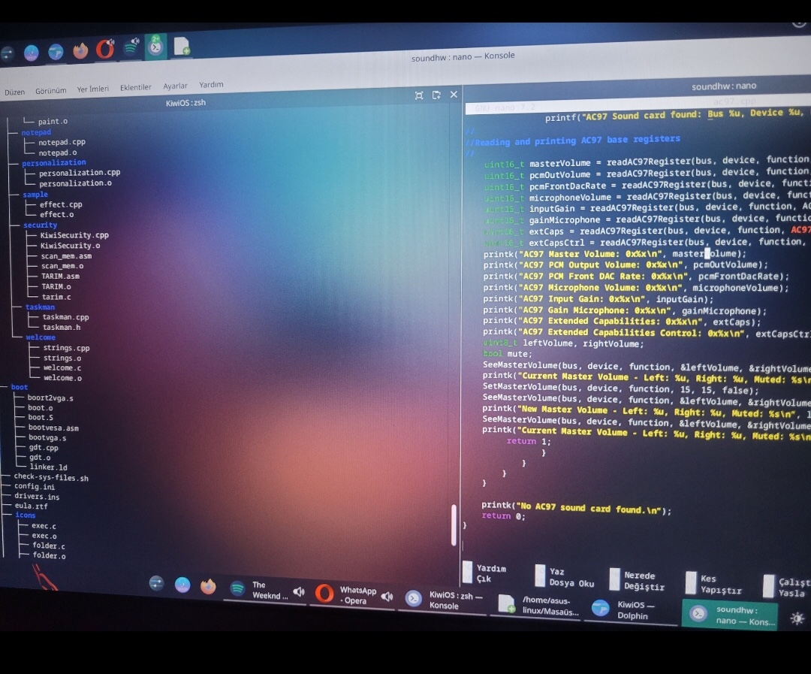
A picture from the moment of project development

