Slide 1
Guided Capstone Project
Big Mountain Resort

Slide 2
Problem Identification
Context and Main feature
12 lifts (1 new, cost: 1.5M),
2 T-bars,
1 terrain park and
105 trails from which the largest is 3.3 miles long.
Its vertical drop: 2353ft.
Every year, the resort receives 350K people.
Constraints
Recent cost increase by 1 540 000.00 demands ticket price to cover the new chair installation.
Lack of information about differential values of properties and resort facilities.

Slide 3
Problem Identification
What prizing strategies exist for Big Mountain to capitalize its facilities adequately and increase the total income in this season.
Perception:
Big Mountain’s facilities are not capitalized adequately.

Slide 4
Key Findings
Considered Features:
Vertical drop.
Snow making acres.
Total number of chairs.
Number of Fast quads.
Number of runs.
Number of miles of the longest run.
Skiable terrain

Slide 5
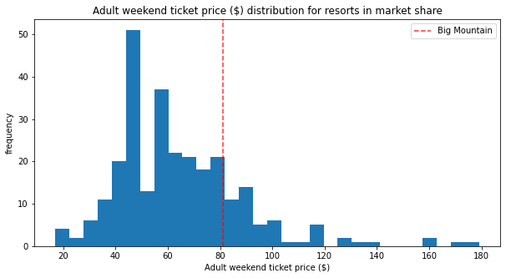
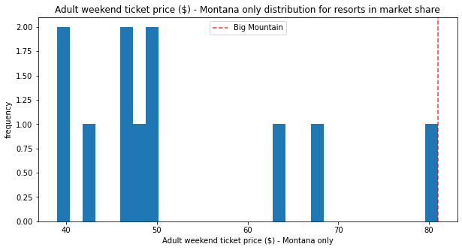
Market Context
Global Context
Big Mountain sits above the average ticket price in the market…
…. and has the highest ticket price in Montana.
Montana

Slide 6
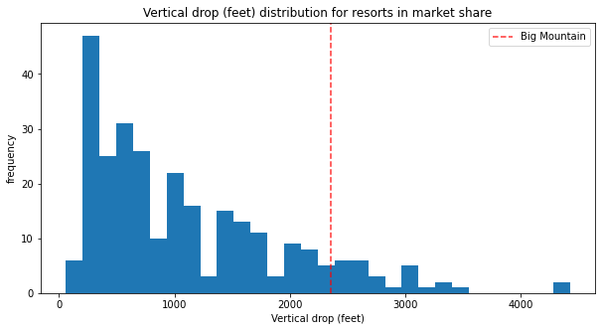
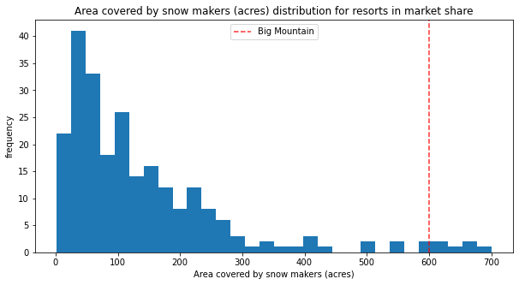
Market Context
Considered features:
The two with greatest influence upon the model:
Vertical Drop
(Attractive to tourists)
Area covered by snow makers
(Snow guarantee)
Big Mountain is well above the average.

Slide 7
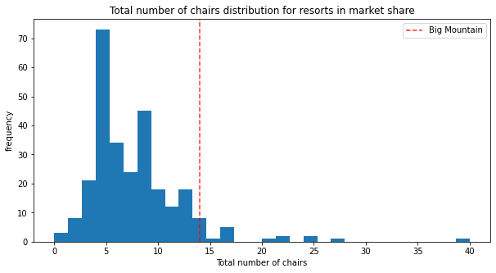
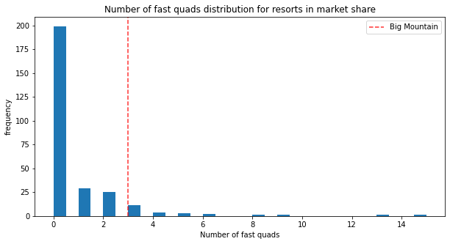
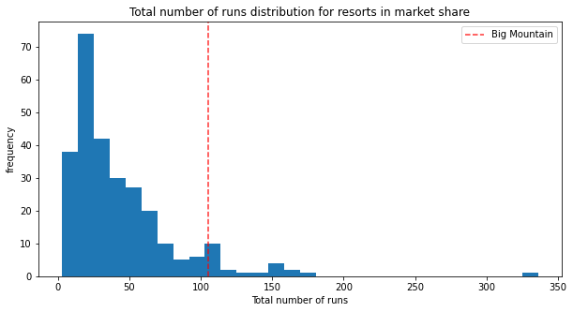
Market Context
Total number of chairs
Other features:
Total number of chairs.
Number of runs.
Number of Fast Quads.
Number of Fast Quads
Number of Runs

Slide 8
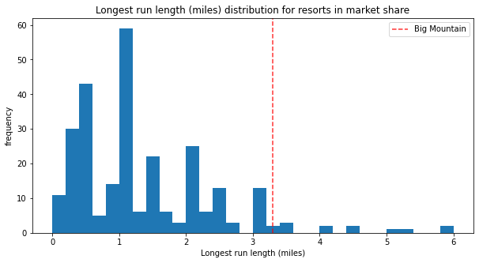
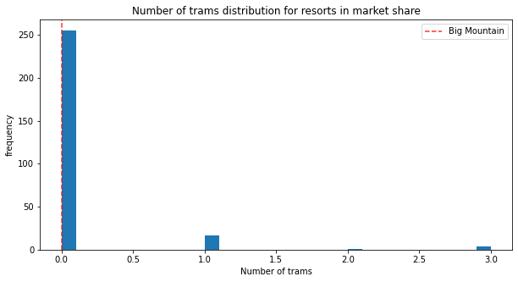
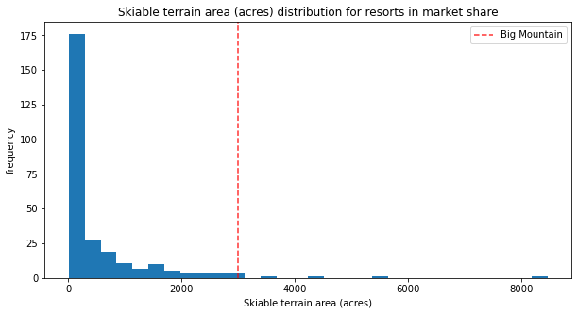
Market Context
Longest run length
Number of trams
Features with little influence on the model:
Longest run length.
Number of trams.
Skiable terrain area.
Skiable terrain area

Slide 9
The model and the Predictions
Based on the previous features the predicted price is:
$ 98.07 (mas = $ 10.46)
which means:
According to the model, Big Mountain resort is undercharging the ticket price.
$ 87.61
$ 87.61
$ 98.07
$ 108.53
$ 10.46
$ 10.46
Current price

Slide 10
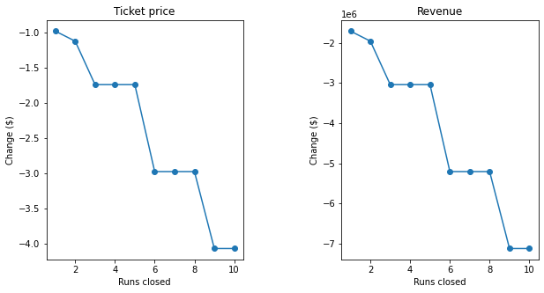
The model and the Predictions
Alternatives:
Taking into account an expected number of visitors and and an average stay of five days:
Closing least used runs
Increase Vertical Drop either with or without snow coverage
Ticket price increase: $ 1.55
Total Income: $ 2, 708, 333.00
Reduction of ticket price support
Increase longest run by 0.2 miles
No change in ticket price

