Slide 1
Country-specific Autonomous System Connectivity Analysis
Grayson Guan

Slide 2
Goal
Investigate the AS connectivity within a country or region.
Gain insights of the local ASes.
Learn about how ASes are actually connected in reality.
Learn to use different tools to analyze the Internet.
Notes:
The initial goal was to determine if ASes can still be connected without reach outside of a country or region’s border.
Since this area is very much of a stranger to me, I don't really know what I will find out, so hopefully, I can gain some insights of some of the ASes investigated.
Also I hoped to see how ASes are actually connected in reality, also learn about different tools one can use to collect data and analyze the Interent.

Slide 3
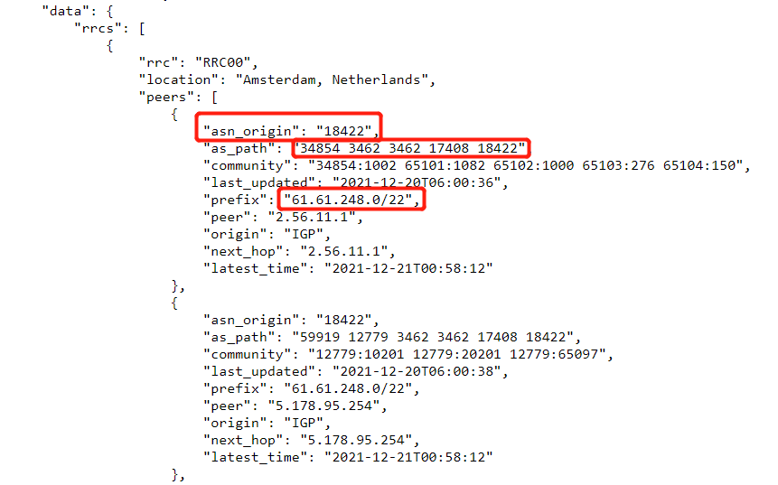
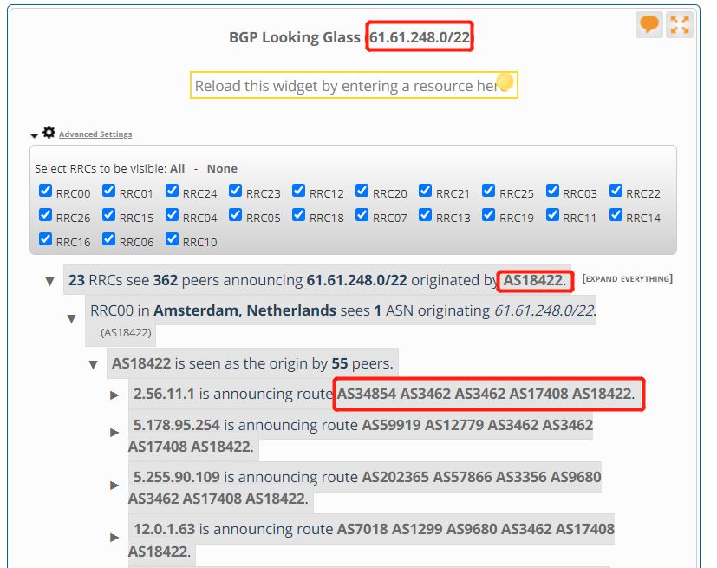
Solution
Looking Glass
CenturyLink
Hurricane Electric Network
RIPEstat [4]
https://stat.ripe.net/data/looking-glass/data.json?resource=61.61.248.0/22
Notes:
In order to get the connectivity information of a region, we need to know the AS-paths for every AS in that country.
We can use public Looking Glass servers to gain currently available AS-paths.
I was obsessed with make this project into a workable program, so I decided to use the ripestat looking glass
With this in our hand, as long as we have the AS numbers and prefixes, we can collect all the routes we need
For couple reasons

Slide 4
Data Collection
Collect all ASN registered in a country
Collect all prefixes under every ASN
Collect all routes from Looking Glass
Notes:
So the first two Problem facing us at the beginning is to gather the AS numbers of that country and the ip prefixes under every AS.

Slide 5
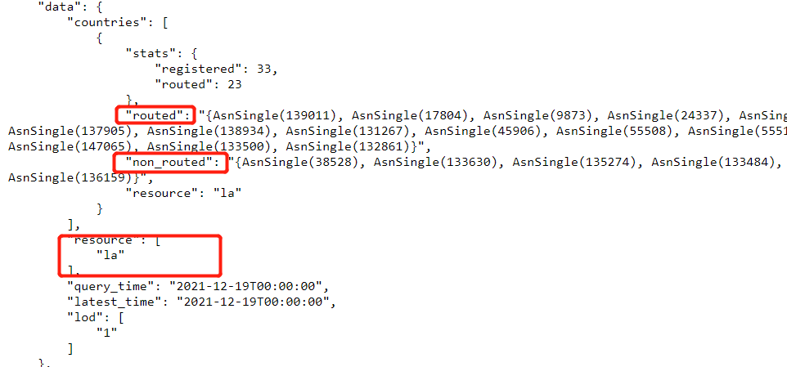
Data Collection
Collect all ASN registered in a country
RIPEstat Data API
ASN in a country
Country ASN
Verification
ipinfo.io[5]
Using Laos as an example
https://stat.ripe.net/data/country-asns/data.json?resource=la&lod=1
Notes:
Click
Using Laos as an example, the data call returns us with the ASNs categorized to routed and non_routed.

Slide 6
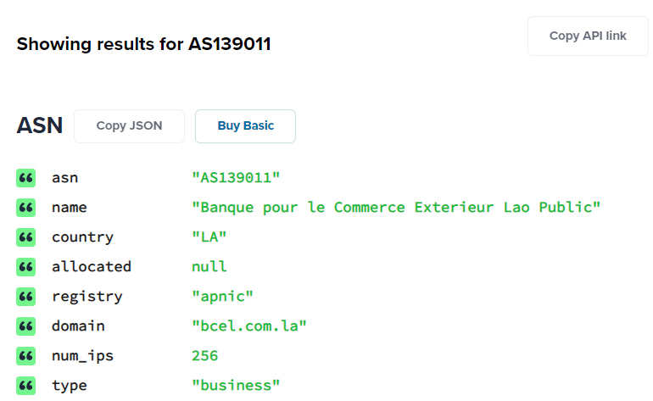
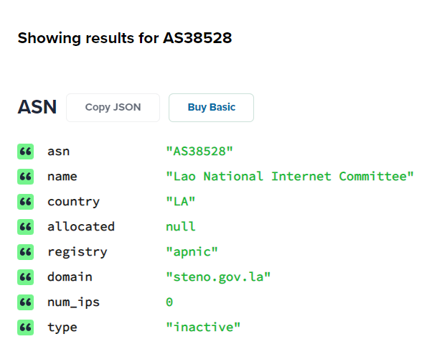
Data Collection
Routed
139011
17804
9873
24337
Non-Routed
38528
133630
135274
133484
Notes:
To verify what non-routed actually means we referred to ipinfo.io.
Basically the non-routed ASes are registered but not currently in use.

Slide 7
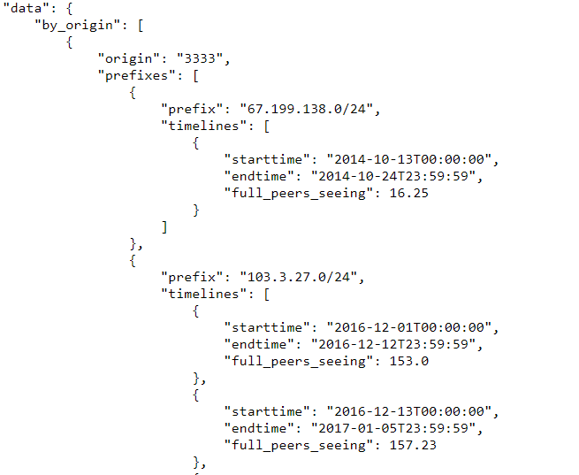
Data Collection
Collect all prefixes under every ASN
RIPEstat Data API
Routing History
https://stat.ripe.net/data/routing-history/data.json?resource=AS3333
Notes:
The routing history data call allows us to get all the prefixes under a specific AS. Even Though we may get some prefixes that no longer belongs to the AS, they can be filtered out when we do the query with looking glass.
With all the prefixes under every AS registered under a specific country, we are ready to feed them to our looking glass query

Slide 8
Data Processing
All paths to same origin ASN are saved to a file named after the ASN.

Slide 9
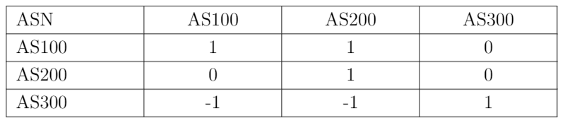
Data Processing
Domestic route
An AS-path that does not include any AS registered in a different country
External route
An AS-path that include at least one AS registered in a different country
Notes:
Now we have all the Paths, we need to find a way to determine what kind of paths exist from one AS to another. Domestic? External? Or no path detected.
In this table if there exist at least domestic path from AS100 to AS200, and only external routes to AS300
Second row shows there are only external routes from AS200 to AS100, and AS200 to AS300
There is no routes in our data shows AS300 can connect to AS100 or AS200

Slide 10
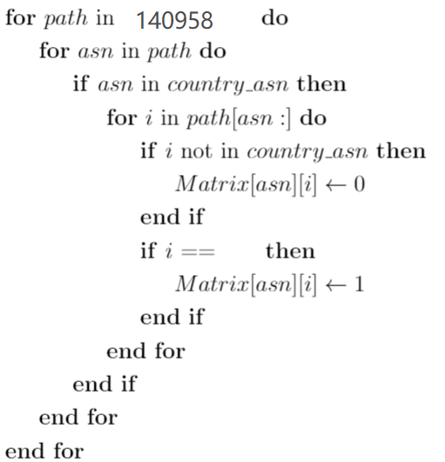
Data Processing
["15605", "6939", "46997", "10241", "140958"]
["6939", "46997", "10241", "140958"]
["49605", "6939", "46997", "10241", "140958"]
["60501", "6939", "46997", "10241", "140958"]
["24482", "6939", "46997", "10241", "140958"]
["202032", "6939", "46997", "10241", "140958"]
140958

Slide 11
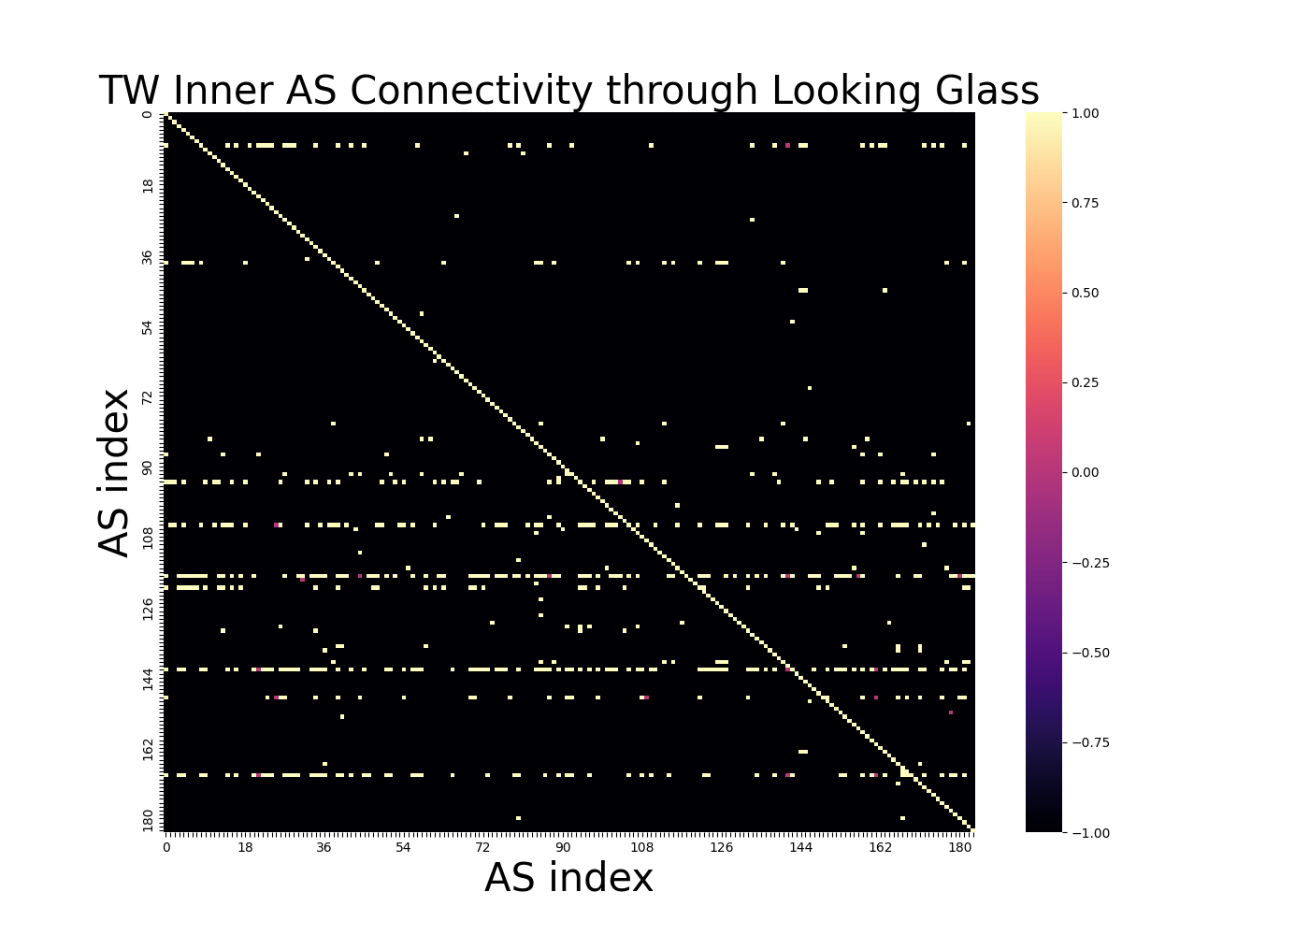
Results Visualization
Who are they?
Why do these exist?
Notes:
Explain graph
There are a few things we can look into.
The graph shows that only a few ASes can reach many other ASes, who owns these ASes, what do they do?
Very few ASes can be reach through external routes
In all 214 ASNs, we found 34 ASNs that do not have any connection with other local ASNs.
Our program also provide us with a text report to assist us on looking for ASes with different characteristics, such as ASes with high reachability, ASes can only be reached by external routes, or ASes with no local connections.

Slide 12
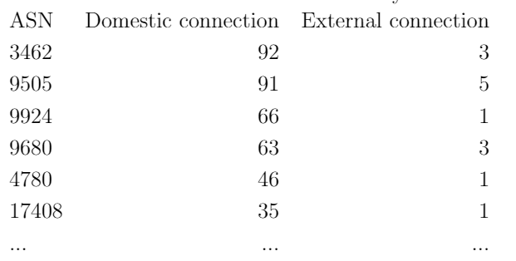
Result
The following are some of the major ISPs in the Taiwan region
AS3462, AS9505, AS9680
Chunghwa Telecom
AS9924
Taiwanmobile
AS4780
Far Eas Tone Telecommunications
AS17408
Chief Telecom
Note: This table shows the number of local ASes can be reached by the listed AS through domestic routes and external routes.

Slide 13
Result
AS3462 can reach 3 ASes only through external route
AS131605, AS59268, AS38854
Notes:
AS3462 can reach 3 ASes only through external route
AS3462 is one of the major isp we mention from last slide chunghwa telecom

Slide 14
AS131605
Verify with path file
Can only be reached through AS138698 and AS17408
Verify with “ipinfo.io”
Owned by INVENTEC BESTA
Upstream AS17408 (local), AS8698(CN)
Company website
Inventec Besta Co., Ltd. established Besta (Kun Shan) Co., LTD. in 2008. [1]
In 2007 Inventec Besta Co., LTD. established iSing99 Music (Shanghai) Technology Co., LTD. [1]
Notes:
However later on, I found AS131605 actually can be reached by AS3462 through domestic route on a later run.
The ipinfo.io information checks out with our data as well. Our AS131605 path file shows To reach AS131605, one has to connect through 17408 or 138698

Slide 15
AS59268
Verify with path file
Can only be reached through AS139750(HK)
Verify with ipinfo.io
Owned by QLinks
Upstream include AS139750
AS139750
Owned by IDCServices.net Inc.
IDCServices provide service for ISP and Internet route optimization service[2].
Notes:
I had a hard time finding a website for the company, but we were able to find more information about AS139750
AS139750 is owned by IDCServices, it is very possible that QLinks uses their Internet route optimization service.

Slide 16
AS38854
Verify with path file
Can only be reached through AS21859
Verify with ipinfo.io
Upstream AS21859
Owned by Zenlayer
Notes:
Zenlayer is an edge cloud services provider based in the US, and upstream AS21859 is owned by Zenlayer as well.
Out of the 34 ASes that do not have any connections, there are only 5 inactive ASes. The rest are very similar to the ASes can only be reached through external routes. Most of them have strong evidence of oversea business connection.
On the other hand, since our method can only acquire a snapshot of AS-paths, so it is possible that in this round of looking glass query, we did not observe any path.

Slide 17
Result
Reminder
Notes:
What would it mean for ASes which can be reached by many other AS, and very few AS
Instead of there exist saying there exist domestic route from AS100 to AS200, we are going to take the transpose of this matrix,
so the cell AS100, AS200 would mean there exist domestic route from AS200 to AS100.

Slide 18
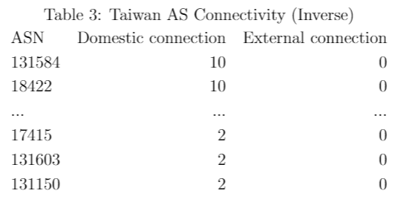
Result
AS131584
Taiwan Intelligent Fiber Optic Network
AS18422
Industrial Technology Research Institute
AS17415
Ming Yi Tea Farm
AS131603
World Start
Note: This table shows the number of local ASes can reach the listed AS through domestic routes and external routes.
AS131150
Education Bureau in Kaohsiung City
Notes:
For the Taiwan region, our data showed that the most reachable ASes can only be reached by 10 other ASes, and the least is 2 and one of the two is themselves.
Small isps
AS131584 Fiber optic provide high speed internet through installing optic fibers.
AS18422 Research center
Many of their upstreams are large ISPs we have seen earlier
S131584 and AS18422
AS17415, Tea farm
AS131603, World start server hosting and leasing for small firms (entry level)
and AS131150 can only be reach by 2 other ASes,

Slide 19
Citation
INVENTEC BESTA. https://www.besta.com.tw/zh-tw/Page/introduction.
“IDCServices Services.” IDCServices.net Inc, https://www.idcservices.net/services.
“Zenlayer About Us.” Zenlayer, https://www.zenlayer.com/about-us/.
“RIPEstat Data_Api.” RIPEstat, https://stat.ripe.net/docs/data_api.
“IPinfo Search.” IPinfo, https://ipinfo.io/account/search.
User, Super. “World Star Introduction.” 華世達有限公司, https://worldstar.net.tw/introduction.html.

