Slide 1

Introduction to Artificial Intelligence
Constraint Satisfaction Problems
ITS 265

Slide 2
What is search for?
There are assumptions about the world:
a single agent,
deterministic actions,
fully observed state,
discrete state space
Planning: sequences of actions
The path to the goal is the important thing
Paths have various costs, depths
Heuristics give problem-specific guidance
A state space is searched

Slide 3
Constraint Satisfaction Problems
When a problem must comply with some designated constraints – new search methods and a deeper understanding of the problem structure are needed.
A special subset of search problems.
Constraint Satisfaction Problems consist of three components:
X is a set of variables {X₁, . . ., X_{n}}
D is a set of domains, {D₁, . . ., D_{n}}, one for each variable.
A domain consists of a set of allowable values {v₁, . . ., v_{n}} for a variable X_{i}.
C is a set of constraints that specify allowable combinations of values.
Each constraint C_{j} consists of a pair < scope, rel > where scope is a tuple of variables that participate in the constraint and rel is a relation that defines the values that those variables can take on.

Slide 4

CSP Example: Map Coloring
Problem: Select a color from given set of colors for each territory that no two adjacent territories have the same color
Variable:
Domain of variables:
Constraints:
X = {WA, NT, Q, NSW, V, SA, T}
D = {red, green, blue}
C = {WA ≠ NT, WA ≠ SA, SA ≠ Q, SA ≠ NSW, …}

Slide 5
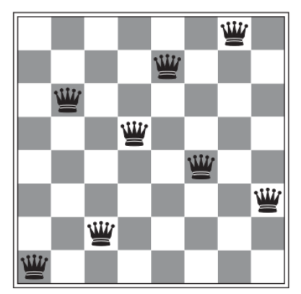
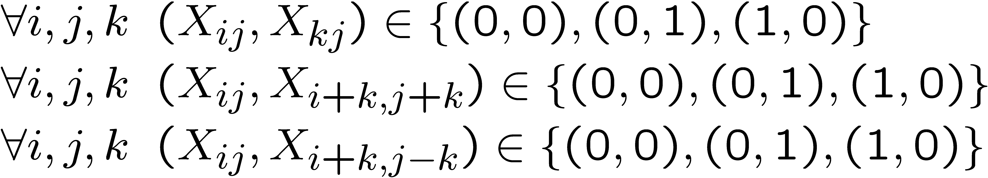
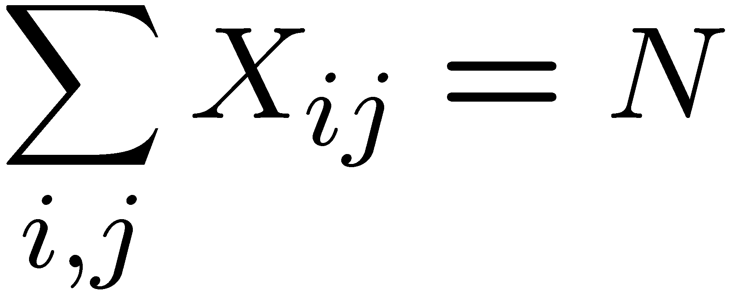
CSP Example: N-Queens
Problem: Place N Queens on an NxN chessboard such that no two Queens threaten each other
Variables: X = ?
Domain of variables: D = ?
Constraints: C = ?
Coordinate of each square; X_{ij} where i, j = 1, 2, .., N
{0, 1}; X_{ij} = 1 => Queen exist at i, j
Enumerate each possible disallowed configuration

Slide 6

CSP Example: N-Queens
Problem: place N Queens on an NxN chessboard such that no two Queens threaten each other
Variables: X =
Domain of variables: D =
Constraints: C =
1
2
3
4
5
6
N
One variable for each row; Q_{k} where k = 1, 2, .., N
{1,, 2, …, N}
Enumerate disallowed configurations
Implicit:
…
Explicit:

Slide 7
Constraint Graph
Binary CSP: each constraint related at most two variables
A binary CSP can be represented as a constraint graph
Constraint graph: nodes are variables, arc show constraints
General purpose CSP algorithms use the graph structure to speed up search

Slide 8

Example: Cryptarithmetic
Problem: Find digit for each alphabet (each has different digit)
Variables:
Domains:
Constraints:
F, T, U, W, R, O, X₁, X₂, X₃
{0, 1, 2, 3, 4, 5, 6, 7, 8, 9} for all variables
All different (F, T, U, W, R, O)
O + O = R + 10*X₁
X₁ + W + W = U + 10*X₂
X₂ + T + T = O + 10*X₃
X₃ = F

Slide 9
Example: Constraint Graph
Problem: Find digit for each alphabet (each has different digit)
Variables:
Domains:
Constraints:
F, T, U, W, R, O, X₁, X₂, X₃
{0, 1, 2, 3, 4, 5, 6, 7, 8, 9} for all variables
All different (F, T, U, W, R, O)
O + O = R + 10*X₁
X₁ + W + W = U + 10*X₂
X₂ + T + T = O + 10*X₃
X₃ = F

Slide 10
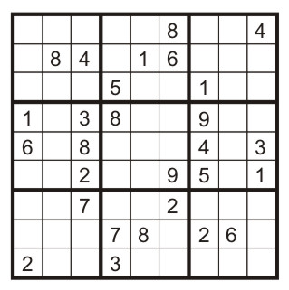
Example: Sudoku Puzzle
Game: Fill in all remaining squares such that no digit appears twice in any row, column or 3x3 box.
Variables: Each (open) square (81)
Domains: (1, 2, …, 9}
Constraints:
9-way alldiff for each column
9-way alldiff for each row
9-way alldiff for each region
(or can have a bunch of pairwise inequality constraints)

Slide 11
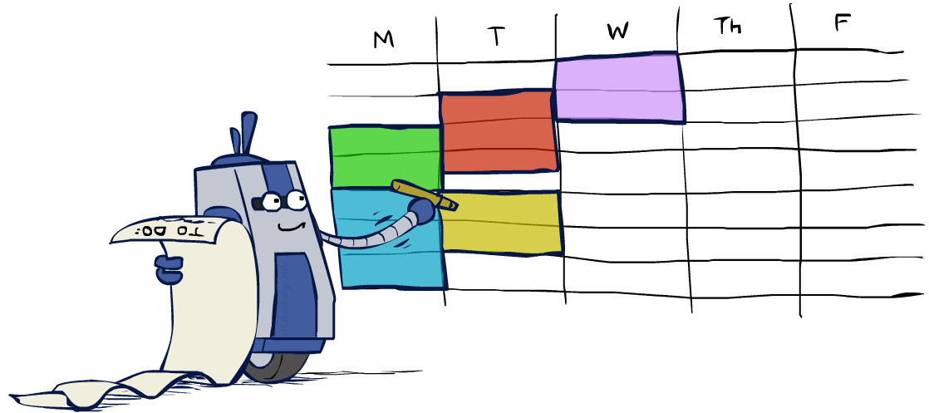
Real-World CSPs
Assignment problems: e.g., who teaches what class
Timetabling problems: e.g., which class is offered when and where?
Hardware configuration
Transportation scheduling
Factory scheduling
Circuit layout
Fault diagnosis
… lots more!
Many real-world problems involve real-valued variables…

Slide 12
CSP Standard Search Formulation
States are defined by the values assigned so far (partial assignments).
Initial state: the empty assignment, {}
Successor function: assign a value to an unassigned variable
Goal test: the current assignment is complete and satisfies all constraints

Slide 13
Search Methods
Color Map Problem
What would BFS do?
What would DFS do?
What would A* do?

Slide 14
Search Methods
D = {R, B, G}
WA = R
NT = R
WA = R
NT = R
Q = R
WA = R
NT = R
Q = B
WA = R
WA = R
NT = B
WA = R
NT = R
Q = G
WA = R
NT = G
How many nodes are expanded in the worst case?
3⁷ = 2,197

Slide 15

Backtracking Search
To improve standard search for CSP problems, the simplest method is BackTracking

Slide 16
Backtracking Search
Backtracking search is the basic uninformed algorithm for solving CSPs
Idea 1: One variable at a time
Variable assignments are commutative, so fix ordering -> better branching factor!
I.e., [WA = red then NT = green] same as [NT = green then WA = red]
Only need to consider assignments to a single variable at each step
Idea 2: Check constraints as you go
I.e. consider only values which do not conflict previous assignments
Might have to do some computation to check the constraints
“Incremental goal test”
Depth-First Search with these two improvements is called backtracking search

Slide 17
Backtracking Search
When a node is expanded, check each successor state to see if it satisfy constraint before adding it to the queue
D = {R, B, G}

Slide 18
CSP – BackTracking Algorithm
CSP – need to making a bunch of decisions in parallel in AI.
The decision can be “constrained” by a set of variables that describe some aspect of the problem.
A set of variables: X₁, X₂, X₃, . . . X_{n} are used to describe some aspect of a problem.
For example: Regions on a map, tasks in an assembly process
Each variable can have a set of values from a domain D of possible values.
For example: X₁ = {1, 2, 3, 4}
Can have different domains for each variable.
The variables can have constraints that don’t allow certain values to be set for the variables.
For example: X₁ ≠ 3 (unary - only involves one variable)
Can be solved by removing it from X₁ set of domain of values -> {1,2,4})
X₃ > X₄ (binary)
Solution: Assign a value to each variable such that none of the constraints are broken.
Simplest (not necessarily best) algorithm to do this is Backtracking Search.

Slide 19
CSP - Backtracking
Step 1: A = 1
(partial assignment – don’t know values of B and C yet), check constraints
Step 2: A = 1, B = 1
(constraint broken A is not > than B, therefore not possible assignment of the values and need to backtrack to last decision make – B assignment)
Step 3: A = 1, B = 2
(constraint broken – A is not > B)
Step 4: A = 1, B = 3
(constraint broken – A is not > B again -> backtrack to A)
Step 5: A = 2, B = 1
(all constraints satisfied –> now go to C variable)
Step 6: A = 2, B = 1, C = 1
( B ≠ C constraint violated -> backtrack)
Step 7: A = 2, B = 1, C = 2
(A ≠ C constraint violated -> backtrack)
Step 8: A = 2, B = 1, C = 3
(SOLUTION – no constraints violated)
Given: three variables: A, B, and C
where: each variable has a domain of allowable values of 1, 2, and 3:
_{A = {1, 2, 3}}
_{B = {1, 2, 3}}
_{C = {1, 2, 3}}
_{Given Constraints:}
_{A > B}
_{B ≠ C}
_{A ≠ C}
Backtracking Algorithm: Process of going through each of the possible values one at a time and if a value breaks a constraint then backtrack to last decision made and try different value.

Slide 20
Backtracking Search
Backtracking = DFS + variable-ordering + fail-on-violation
Backtracking enables us the ability to solve a problem as big as 25-Queens

Slide 21
Constraint Propagation: Inference in CSPs
A state-space search algorithm makes progress in only one way: by expanding a node to visit the successors.
Constraint propagation may be intertwined with search or be done as a preprocessing step.
Key idea – local consistency
Consistency is an inference mechanism to rule out certain variable assignments, which in turn enhances the search. The simplest consistency check tests a current assignment against the set of constraints.
If each variable is a node in a graph and each binary constraint is an edge, then enforcing consistency in the graph causes inconsistent values to be eliminated throughout the graph.
Techniques:
Node consistency
Arc consistency – (AC-3 algorithm)
Path consistency
K-consistency
Global constraints

Slide 22
AC-3 Algorithm
Simplifies CSP by using constraints to prune out values from the domains of the variables.
Run AC3 to reduce variable domains.
Use simple backtracking to find solutions.
Turn each binary constraints into two arcs.
A ≠ B becomes arc A ≠ B and B ≠ A
Algorithm treats the left-hand side of the constraint and right-hand side of constraint DIFFERENTLY.
Add all the created arcs to an agenda that is checking the arcs.
How it works:
Repeat until agenda is empty
Take an arc (X_{i}, X_{j}) off the agenda and check it.
For every value of X_{i} there must be some value for X_{j} that fits the constraint.
Remove any inconsistent domain values for X_{i} .
If X_{i} has changed, add all arcs of the form (X_{k}, X_{i}) to the agenda.
Once this is done, we have an arc consistent problem which is easier to solve.

Slide 23
AC-3 Algorithm
Step 3: Take first arc off agenda and go through all the values of A against constraint A > B.
This is false so take 1 out of domain list.
A = {2, 3}
Step 4: Take 2 off list and check against constraint against any value for B.
Constraint is satisfied.
Step 5: Remove item (A > B) from agenda.
Step 6: Because domain of A has changed, we look for any arcs that have A on right hand side (see Step 1).
Arc (B < A) is already on the agenda so we don’t have to add it.
Step 7: Check B against the next constraint on agenda (B < A).
The value of 3 in B domain of values does not meet this constrain:
Remove it from the values.
B = {1, 2}
Step 8: Remove item (B < A) from agenda.
_{A = {1, 2, 3}}
_{B = {1, 2, 3}}
_{C = {1, 2, 3}}
_{Given Constraints:}
_{A > B}
_{B = C}
Step 1: Develop ARCS. Step 2: Add to agenda.
A > B A > B
B < A B < A
B = C B = C
C = B C = B

Slide 24
AC-3 Algorithm
Step 9: Check constraints that have B on right hand side because domain values have changed for B.
Found A > B and C = B
Add A > B back to agenda.
Step 10: Check agenda item B = C
Values are fine, no pruning needed from domain values. Remove from agenda.
Step 11: Check agenda item C = B
3 has no matching value in B
Prune it from list of values of C
C = {1, 2}
Step 12: C domain has changed so check C on right side of any arcs.
B = C matches,
So add it back to agenda.
Step 13: Check A > B again.
Values pass constraint check.
Remove A > B from agenda.
Step 14: Check B =C
Value checks pass constraint check.
Remove B =C from agenda.
PROBLEM IS NOW ARC CONSISTENT
Makes it easier to solve than using standard method such as Backtracking.
_{A = {2, 3}}
_{B = {1, 2}}
_{C = {1, 2, 3}}
ARCS Agenda
A > B
B < A
B = C B = C
C = B C = B
A > B (step 9)
B = C

Slide 25

Improving Backtracking
Ordering of variables and values
Which variable should be assigned next?
In what order should its values be tried?
Can we detect inevitable failure early?
Using inference in search – Forward Checking

Slide 26
Ordering: MRV heuristic
Minimum remaining values (MRV) for next variable
Heuristic rule: choose the variable with the fewest legal moves
it will immediately detect failure if X has no legal values or moves
Also called “most constrained variable”
“Fail-fast” ordering

Slide 27

Ordering: Degree heuristic
Degree heuristic for next variable
Heuristic rule: select variable that involved in the largest number of constraints on other unassigned variables
Useful for tie breaker after MRV
Choose the variable with the most constraints on remaining variables

Slide 28
Ordering: Least Constraining Value
Least Constraining Value for next value
Heuristic rule: given a choice of variable, choose the least constraining value
I.e., the one that rules out the fewest values in the remaining variables
Note that it may take some computation to determine this! (E.g., rerunning filtering)
Combining these ordering ideas makes
1000 queens feasible
Allow 1 value for SA
NT
Q
WA
SA
NSW
NT
V
WA
Q
SA
NSW
V
NT
Q
WA
SA
NSW
V
Allow 0 value for SA

Slide 29
MRV vs. LCV
Why MRV (minimum values, most constraining) for variable selection, and LCV (maximum values, least constraining) for value selection?
MRV for variable selection
Minimize the branching factor (i.e., expanding nodes)
Smaller number of expanding node will speed up the search
LCV for value selection
Maximize the chance of early success
If fail at current node, it will look for every possible values and orders anyway
If not fail, it will find it early
LCV rules out lowest possible solution and search the most possible solution at current node

Slide 30
Forward Checking
Forward checking is the easiest way to prevent future conflicts.
Instead of performing arc consistency to the instantiated variables, it performs restricted form of arc consistency to the not yet instantiated variables
Forward checking detects the inconsistency earlier than simple backtracking and thus it allows branches of the search tree that will lead to failure to be pruned earlier than with simple backtracking.
Track domain for each unassigned variable
Initialize with domains from problem statement
Each time you expand a node, update domains of all unassigned variables

Slide 31
Forward Checking
WA
NT
Q
SA
NSW
V

Slide 32
Consistency of A Single Arc
An arc X → Y is consistent iff for every x in the tail there is some y in the head which could be assigned without violating a constraint
Forward checking?
Enforcing consistency of arcs pointing to each new assignment
NT
Q
WA
SA
NSW
V

Slide 33
Arc Consistency of an Entire CSP
A simple form of propagation makes sure all arcs are consistent:
Important: If X loses a value, neighbors of X need to be rechecked!
Arc consistency detects failure earlier than forward checking
Can be run as a preprocessor or after each assignment
What’s the downside of enforcing arc consistency?
NT
Q
WA
SA
NSW
V
Remember: Delete from the tail!

Slide 34
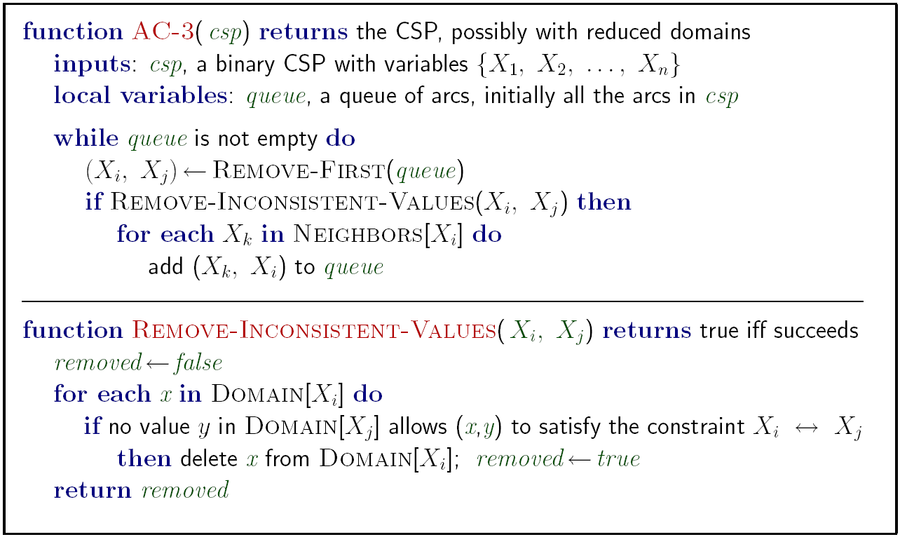
Enforcing Arc Consistency in a CSP

Slide 35
Forward checking and Arc
Forward checking is a special type of enforcing arc consistency
Only enforcing the arcs pointing into the newly assigned variable.

Slide 36


Limitations of Arc Consistency
ARC is Consistent, but….
After enforcing arc consistency:
Can have one solution left
Can have multiple solutions left
Can have no solutions left (and not know it)
Arc consistency still runs inside a backtracking search!
2 SOLUTION
ARC is Consistent, but….
NO SOLUTION

Slide 37
Summary: CSPs
CSPs are a special kind of search problem:
States are partial assignments
Goal test defined by constraints
Basic solution: backtracking search
Speed-ups:
Ordering
Filtering
Structure – turns out trees are easy!

Slide 38
References
Book: AI, A Modern Approach by Russel and Norvig
AIMA of book: http://aima.cs.berkeley.edu/
AI in UC Berkeley: ai.berkeley.edu

