Slide 1
Use Komodia’s Redirector as an anonymizer
The detailed manual can be seen at: http://www.komodia.com/KRDR_install.pdf

Slide 2
Step 1
Install Komodia’s Redirector
(Trial is for 32 bit environments only)
(Under Vista make sure to use UAC enabled command prompt)

Slide 3
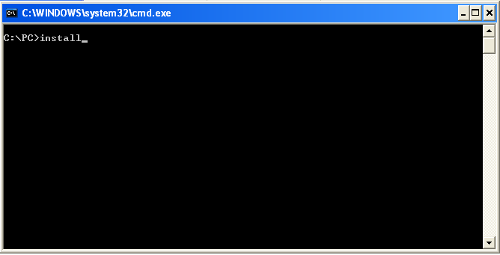
Run the install command under command prompt
It should print out several screen of output, it’s normal

Slide 4
Step 2
Configure which applications you want to intercept

Slide 5
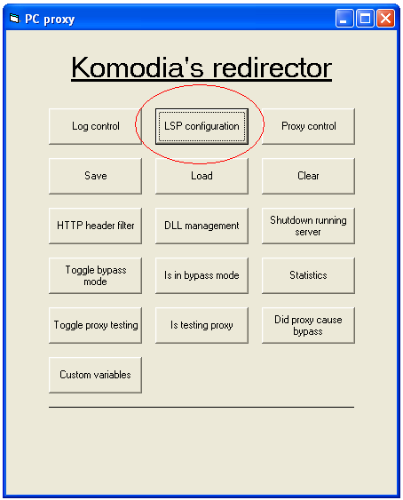
Run the PCController.exe
And select “LSP Configuration”

Slide 6
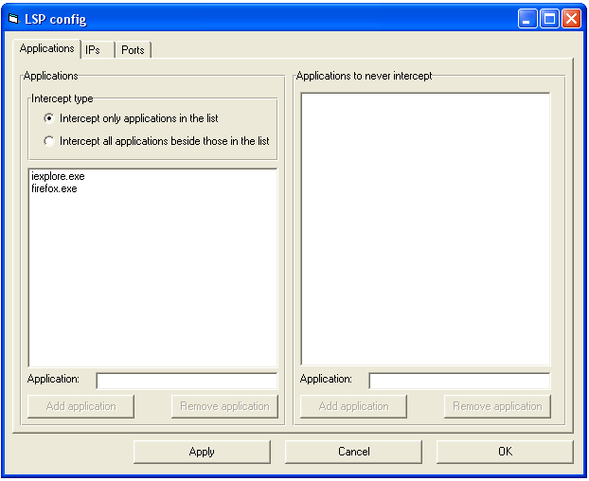
Option 1: Configure interception based on application names

Slide 7
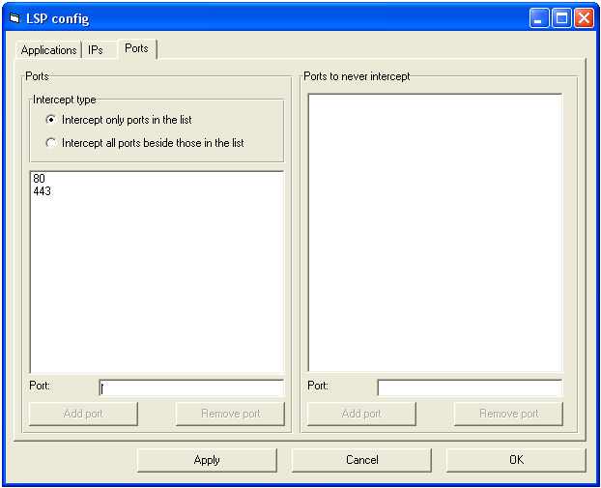
Option 2: Configure interception based on ports

Slide 8
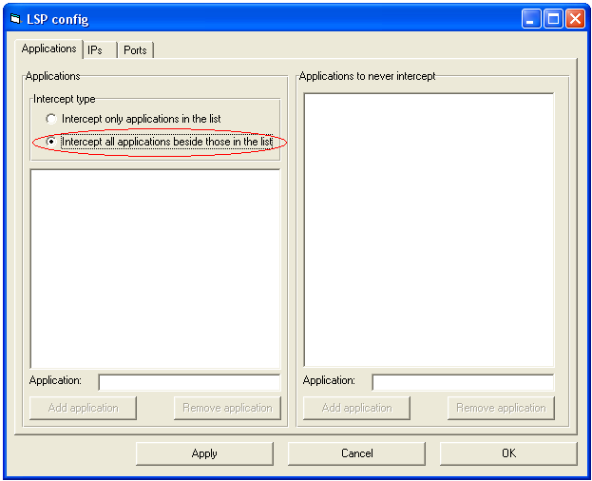
Option 3: Configure interception to intercept all traffic

Slide 9
Step 3
Set proxy server

Slide 10
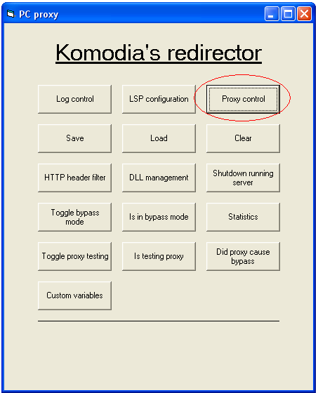
In the PCController.exe main screen select “Proxy control”

Slide 11
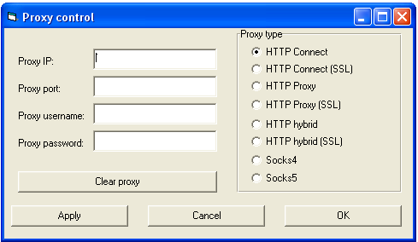
Set your proxy server and type

Slide 12
Step 4 (Optional)
Set HTTP header processing

Slide 13
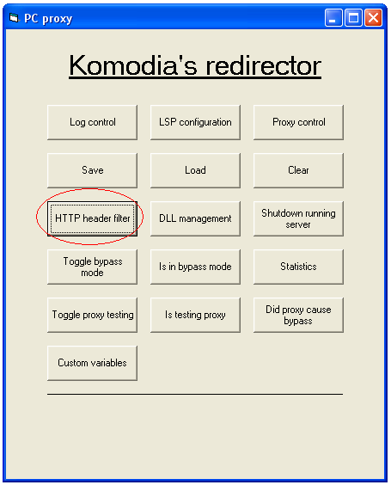
In the PCController.exe main screen select “HTTP header filter”

Slide 14
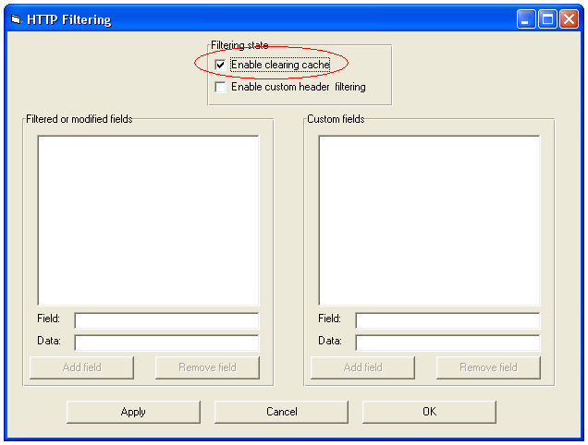
To enable Redirector to prevent browser from using cache

Slide 15
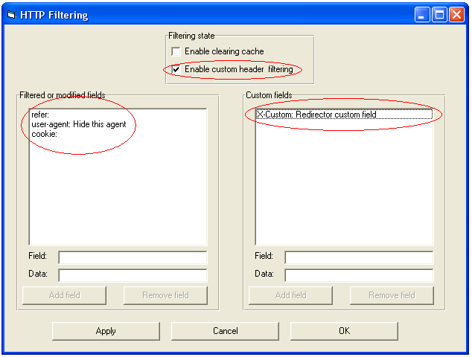
To enable Redirector to modify the HTTP header flags

Slide 16
Step 5
Save settings, so it will persist computer restarts

Slide 17
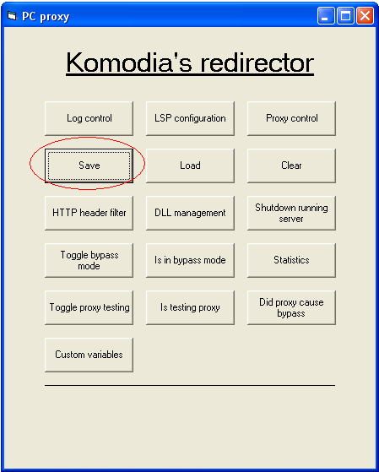
In the PCController.exe main screen select “Save”

Slide 18
Finished
Redirector is configured and ready to anonymize
Thanks for watching

