Slide 1
Use Komodia’s Redirector as a Parental control solution
The detailed manual can be seen at: http://www.komodia.com/KRDR_install.pdf

Slide 2
Step 1
Install Komodia’s Redirector
(Trial is for 32 bit environments only)
(Under Vista make sure to use UAC enabled command prompt)

Slide 3
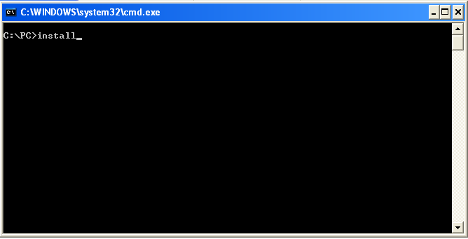
Run the install command under command prompt
It should print out several screen of output, it’s normal

Slide 4
Step 2
Configure which applications you want to intercept

Slide 5
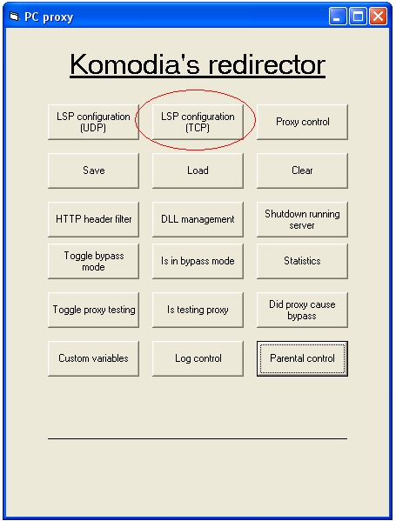
Run the PCController.exe
And select “LSP Configuration”

Slide 6
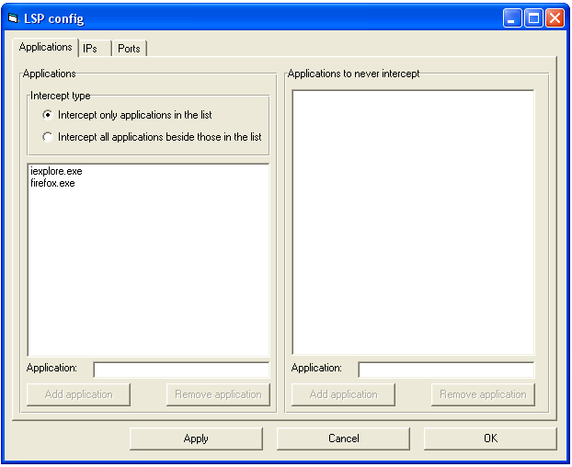
Option 1: Configure interception based on application names

Slide 7
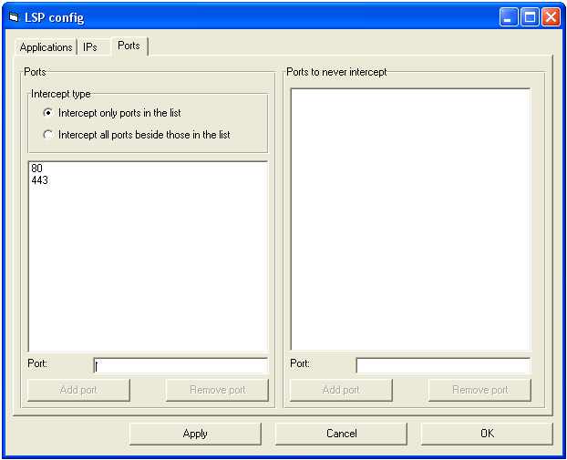
Option 2: Configure interception based on ports

Slide 8
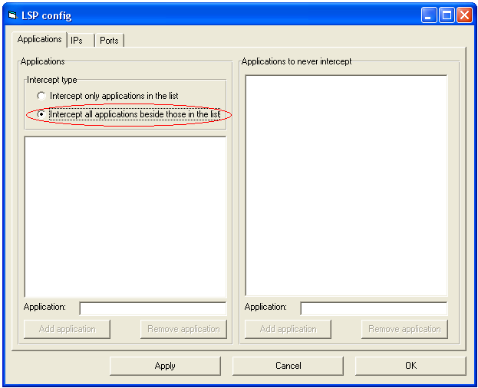
Option 3: Configure interception to intercept all traffic

Slide 9
Step 3
Enable parental control

Slide 10
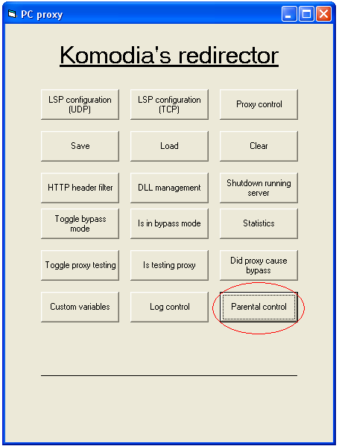
In the PCController.exe main screen select “Parental control”

Slide 11
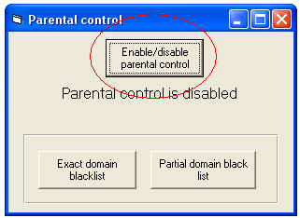
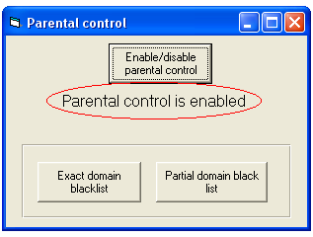
Enable Parental control
Before
After

Slide 12
Step 4
Set domains to block

Slide 13
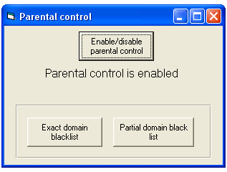
Choose which mode to use
Partial domain blacklist will block domains ending with the domain you typed, for example if you add komodia.com, the www.komodia.com will be blocked as well
Exact domain blacklist will block domains exactly as type, for example if you add www.komodia.com then komodia.com will not be blocked
Another example: adding com to the list will block every web site ending with com

Slide 14
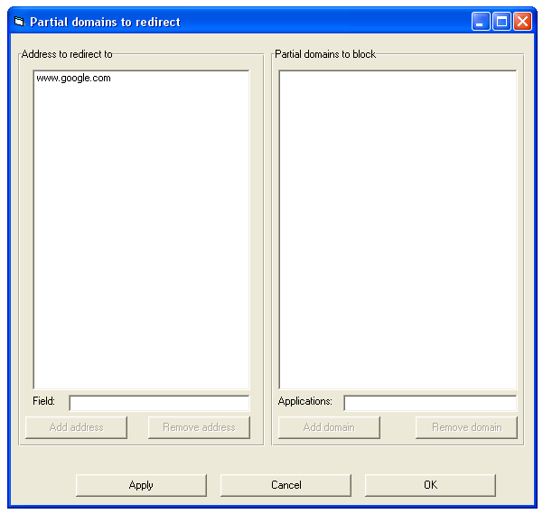
Add an address to redirect to
* Use only the domain name, don’t add http:// or https://
** You can have multiple redirect to addresses, and in each different web sites to redirect

Slide 15
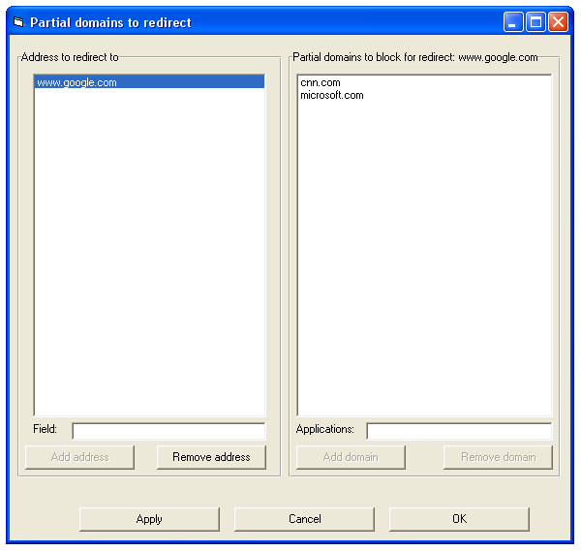
Add addresses to block
When the user will enter CNN or Micorosft’s web site he will be redirected into Google’s website

Slide 16
Step 5
Save settings, so it will persist computer restarts

Slide 17
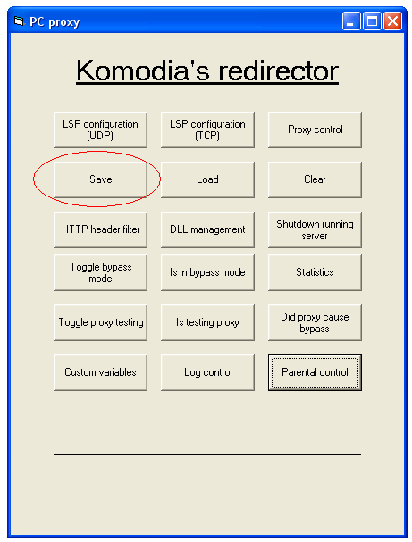
In the PCController.exe main screen select “Save”

Slide 18
Finished
Redirector is configured and ready to protect your users
Thanks for watching

