Slide 1
Flight Delay Analytics
End-to-End Data Engineering Pipeline on AWS
Varun Gehlot | DAMG7370 Final Project
Northeastern University Seattle | Spring 2026 | April 20, 2026
97,702
34.4%
88.6%
5
Flights Analyzed
Delay Rate
ML Accuracy
AWS Services

Slide 2
Project Background & Business Goals
THE PROBLEM
THE SOLUTION
Flight delays cost the U.S. economy $33B+ annually.
20% of all domestic flights are delayed.
No unified platform to understand delay root causes.
Airlines lack pre-flight prediction tools.
Real-time Kafka streaming pipeline on AWS EC2.
S3 data lake + RDS PostgreSQL star schema.
Interactive Streamlit dashboard with 8 charts.
ML model predicting delays at 88.6% accuracy.
01
Ingest
02
Store
03
Visualize
04
Predict
Stream 100k records via Kafka
S3 lake + RDS star schema
Interactive 8-chart dashboard
Random Forest delay classifier

Slide 3
System Architecture
INGEST
BTS Dataset
Kafka Producer
EC2 + Kafka
Kafka Consumer
flights.csv · 5.8M rows
Local Python · kafka-python
t2.micro · flight-delays topic
Local · writes to S3
STORE
S3 raw/
ETL · etl.py
S3 processed/
RDS PostgreSQL
flights_raw.csv · 100k rows
Clean · IS_DELAYED flag
flights_cleaned.csv
Star schema · 4 tables
Streamlit Dashboard + ML Model → localhost:8501 | 88.6% accuracy

Slide 4
Data Source
BTS Flight On-Time Performance Data - 2015
Key Columns
Source: Bureau of Transportation Statistics / Kaggle
578MB raw CSV 5.8 million rows, full year 2015
100,000 records streamed via Kafka pipeline
97,702 clean records after ETL (2,298 dropped)
IS_DELAYED = 1 if ARRIVAL_DELAY > 15 mins (FAA standard)
21 columns including delay breakdown by cause
AIRLINE
ORIGIN_AIRPORT
DESTINATION_AIRPORT
SCHEDULED_DEPARTURE
DEPARTURE_DELAY
ARRIVAL_DELAY
IS_DELAYED (derived)
WEATHER_DELAY
LATE_AIRCRAFT_DELAY
DISTANCE
AIR_TIME
Data Transformation
Records
Quality
Target col
Delay cols
5,800,000 rows
Nulls present
No delay flag
Raw delays
↓
↓
↓
↓
97,702 rows
Nulls removed
IS_DELAYED = 0/1
Validated + cleaned

Slide 5
EC2 + Kafka Streaming Pipeline
1
EC2 Instance
2
Producer
3
Kafka Broker
4
Consumer
t2.micro Ubuntu
Kafka 3.6.1 + ZooKeeper
Heap: -Xmx256M
Reads flights.csv
row by row
Sends to topic
Port 9092
Buffers messages
flight-delays topic
Reads from topic
Batches 100k records
Writes to S3 raw/
EC2 Configuration
Pipeline Results
Instance: i-019dff52eff788bfd · Region: us-east-2
Public IP: 3.21.126.255
Ports: 22 (SSH) · 9092 (Kafka) · 2181 (ZooKeeper)
Heap tuned to -Xmx256M to fix OOM on free tier
100,000 records streamed successfully
Consumer wrote flights_raw.csv → S3 raw/
No data loss or offset errors

Slide 6
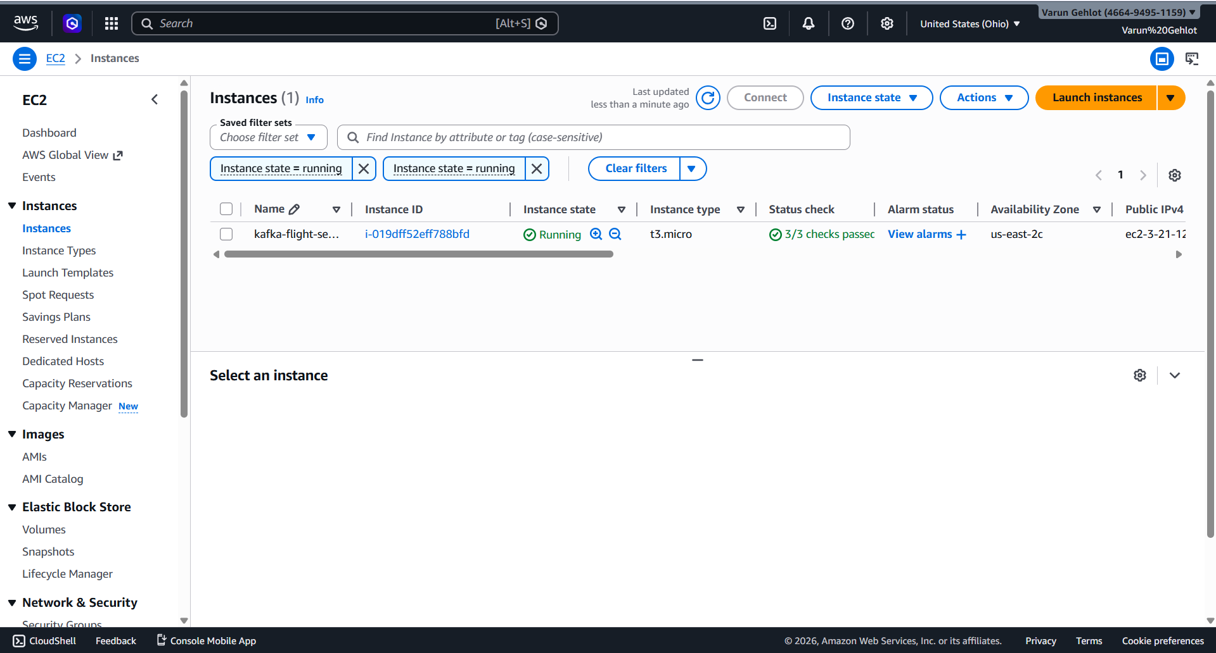
EC2 Instance - Live

Slide 7
S3 Data Lake Structure
S3 Bucket: flight-delay-analytics-varun (us-east-2)
📁 raw/
📁 processed/
📁 scripts/
flights_raw.csv
flights_cleaned.csv
producer.py
100,000 records
97,702 records
consumer.py
Unprocessed Kafka output
Nulls removed
etl.py
Written by consumer.py
IS_DELAYED column added
build_star_schema.py

Slide 8
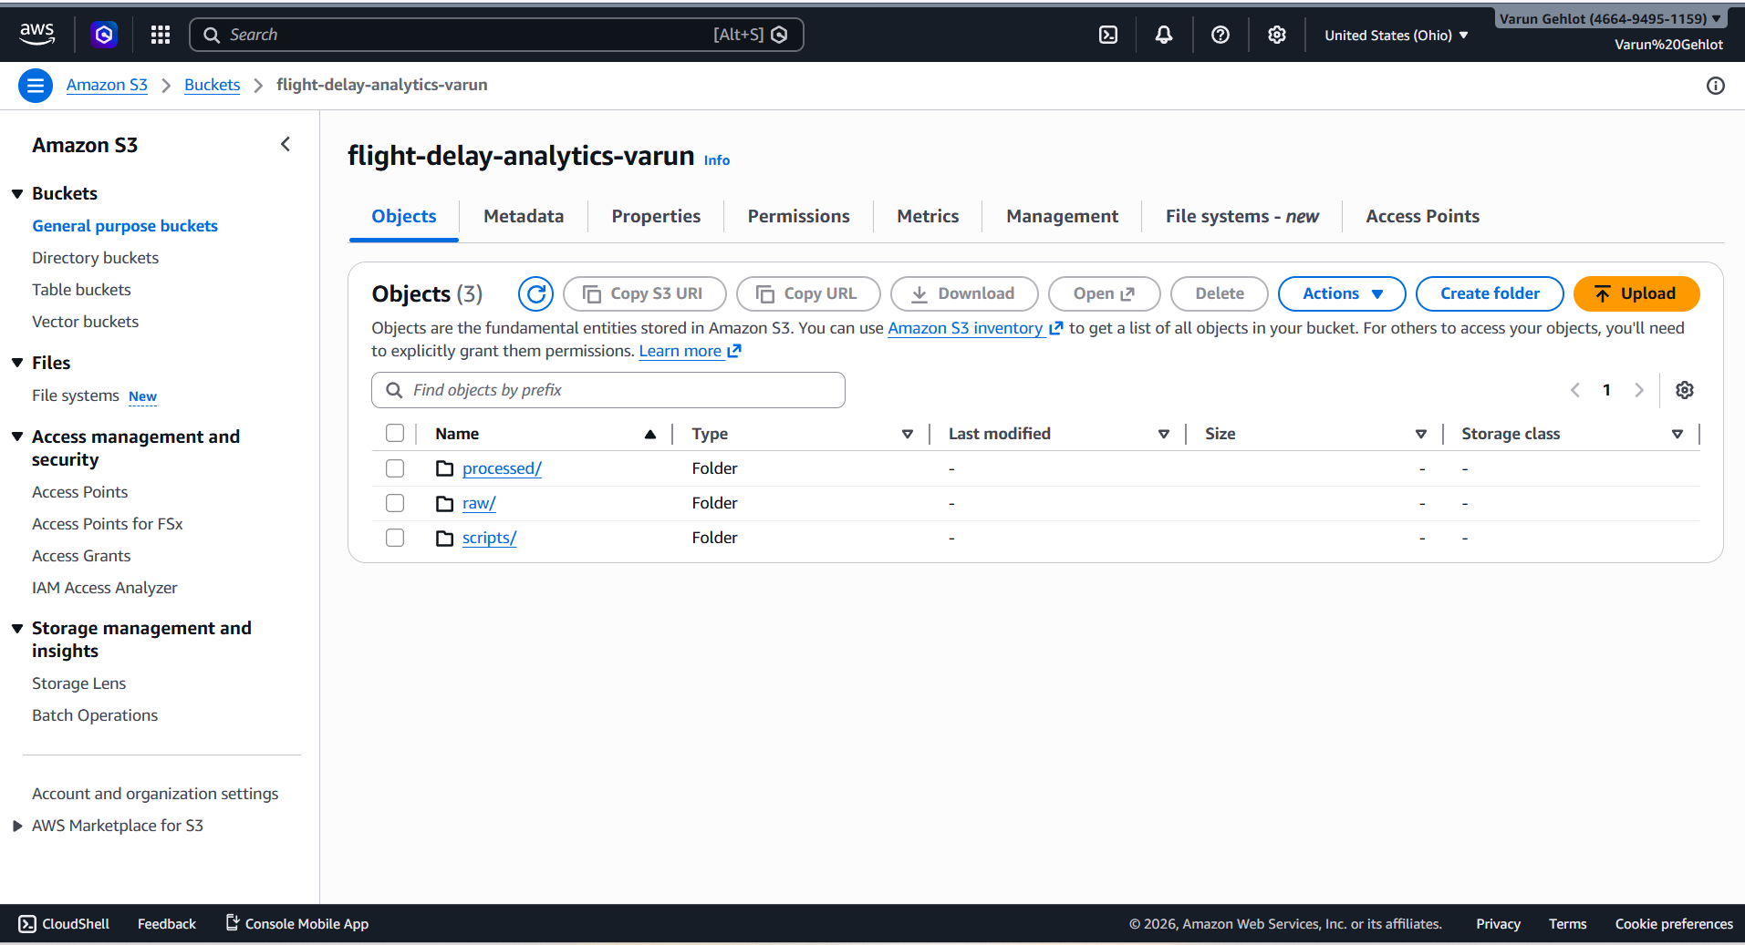
S3 Bucket

Slide 9
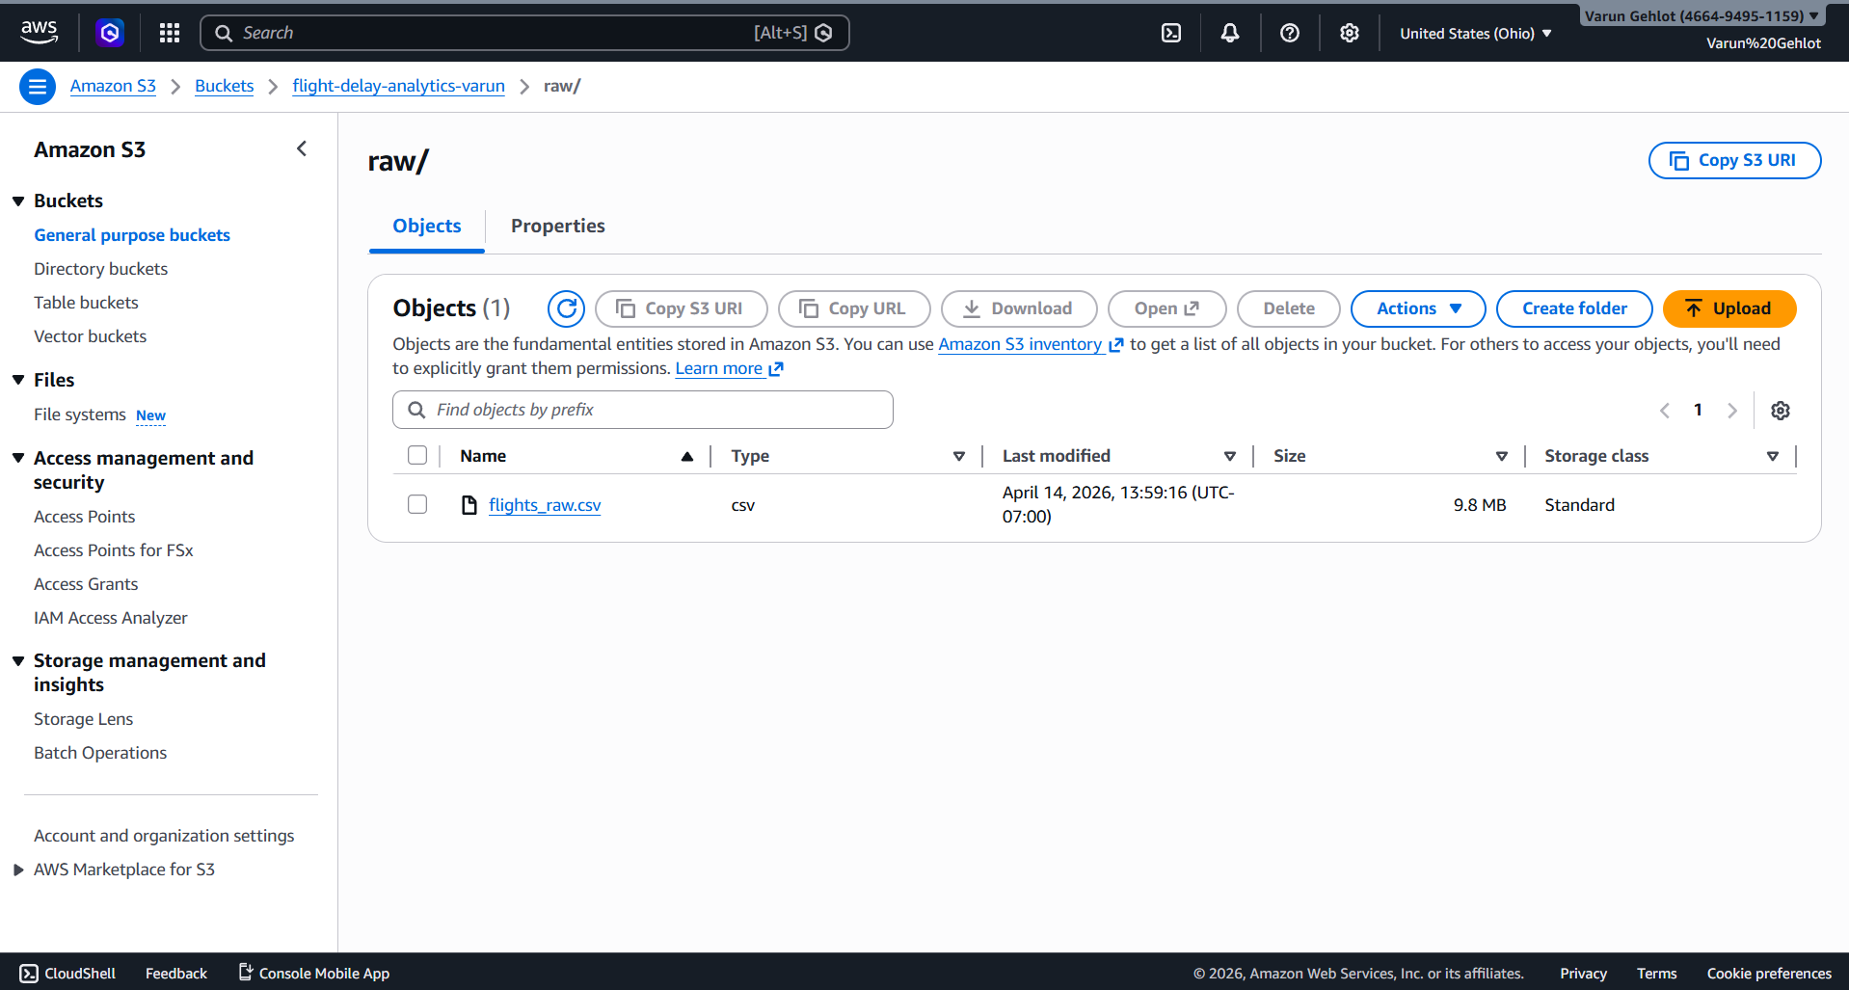
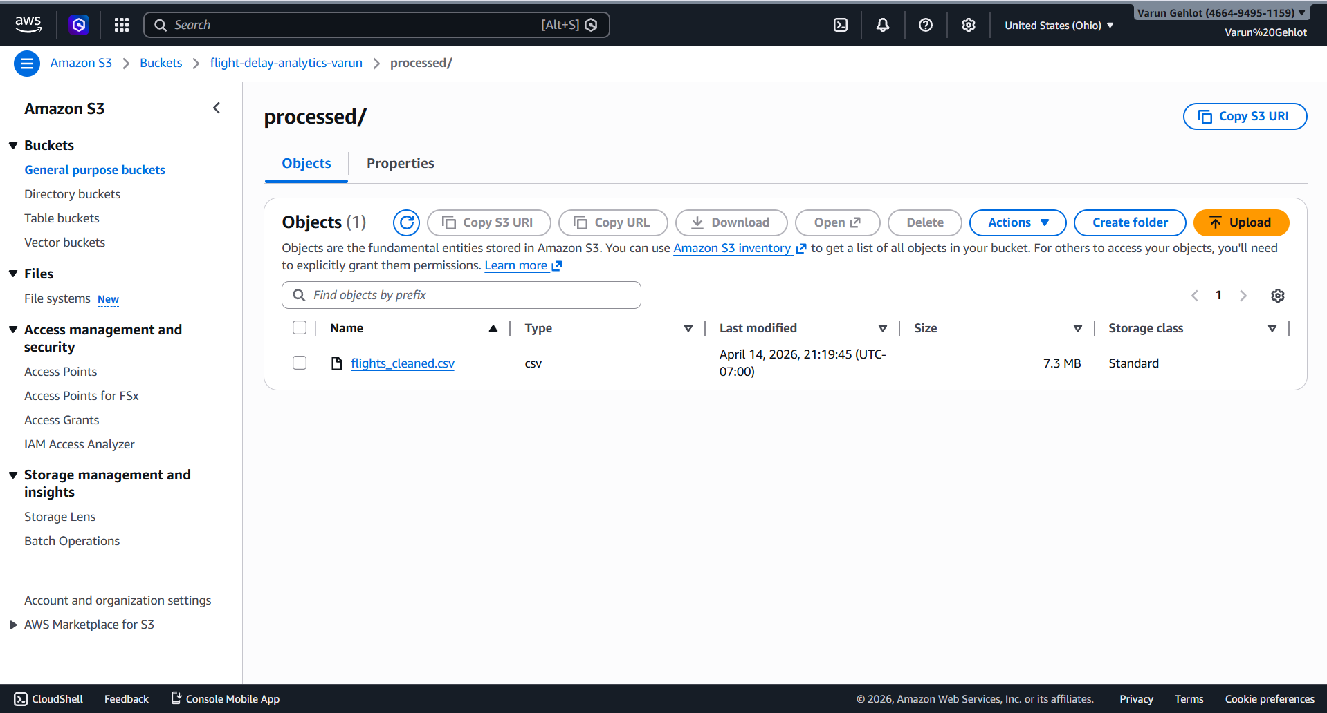
S3 Bucket: Live Evidence
📁 raw/
📁 processed/

Slide 10
ETL & Data Cleaning
Extract
Transform
Load
Read flights_raw.csv
from S3 raw/ via boto3
pandas.read_csv()
Drop null critical cols
Create IS_DELAYED flag
Fill delay NaN → 0
Write flights_cleaned.csv
to S3 processed/
Load → RDS fact_flights
100,000
2,298
97,702
33,608
91
Records in
Records dropped
Records out (clean)
Delayed (34.4%)
Cancelled
IS_DELAYED Rule: ARRIVAL_DELAY > 15 minutes → IS_DELAYED = 1 | Otherwise → IS_DELAYED = 0 (FAA industry standard)

Slide 11
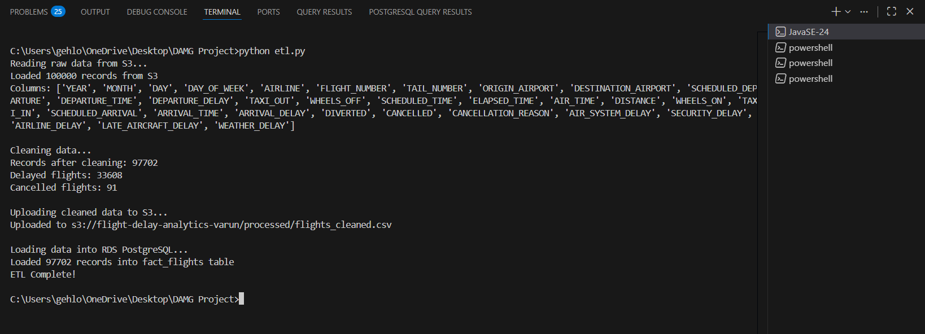
ETL Pipeline

Slide 12
Star Schema & Database Load
dim_airline
14 rows
airline_code
airline_name
fact_flights
dim_date
97,702 rows
ARRIVAL_DELAY · DEPARTURE_DELAY
DISTANCE · AIR_TIME
IS_DELAYED · CANCELLED
AIRLINE · ORIGIN · DESTINATION
7 rows
date_key · full_date
month_name · day_name
season · is_weekend
dim_airport
312 rows
airport_code
airport_name · city · state

Slide 13

Star Schema

Slide 14
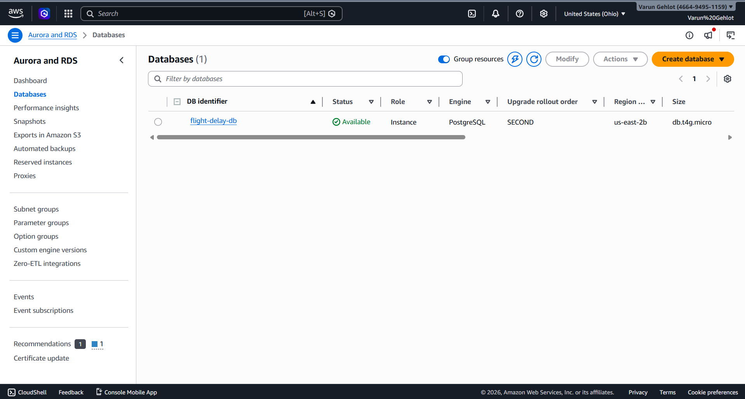
RDS

Slide 15
Streamlit Dashboard
localhost:8501 · 3 sections · 8 interactive charts · queries live from RDS PostgreSQL
Section 1: Flight Delay Trends
Section 2: Operational Analysis
Section 3: What-If Predictor
Delay rate by airline (American Eagle: 56.4%)
Avg arrival delay by airline
Delay rate by day of week (Sunday: 48%)
Delay rate by departure hour
Top 10 most delayed origin airports
Delay causes: Late Aircraft #1 (900k mins)
Top 10 worst routes (JFK→EGE: 199 min)
Weekend 45.9% vs Weekday 29%
Model KPIs: 88.63% accuracy, 82.95% F1
Feature importance chart
Pick airline, route, day, time of day
Live delay probability gauge (green/red)

Slide 16
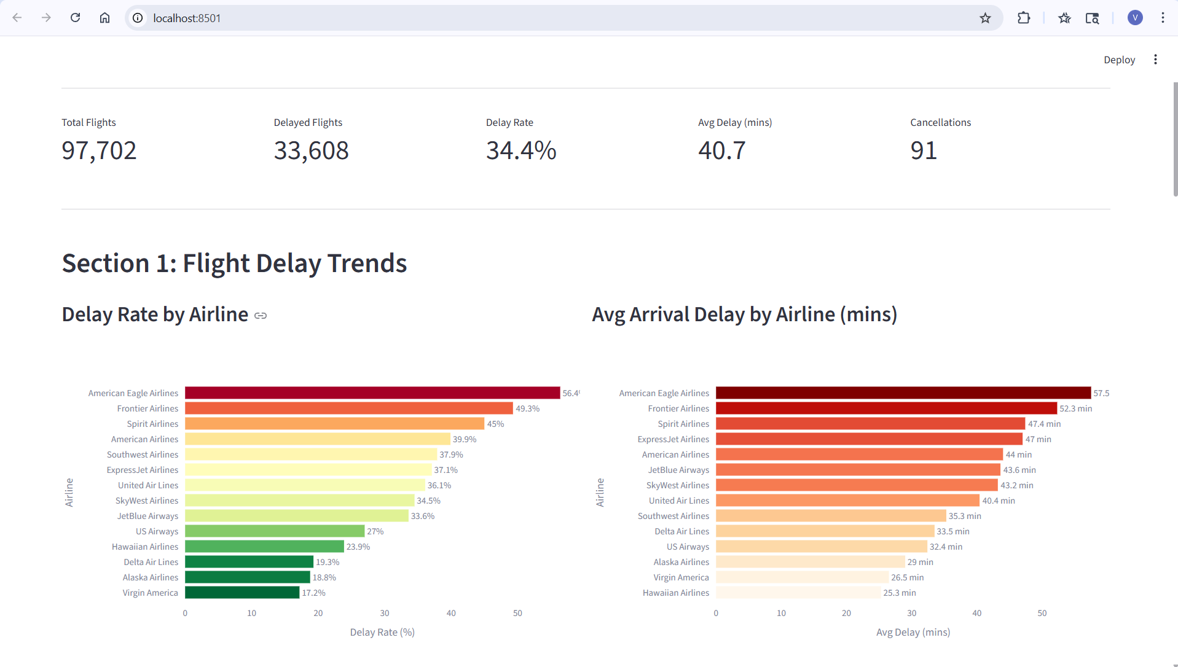
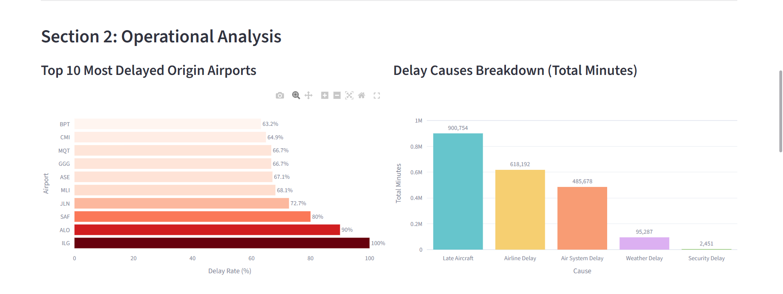
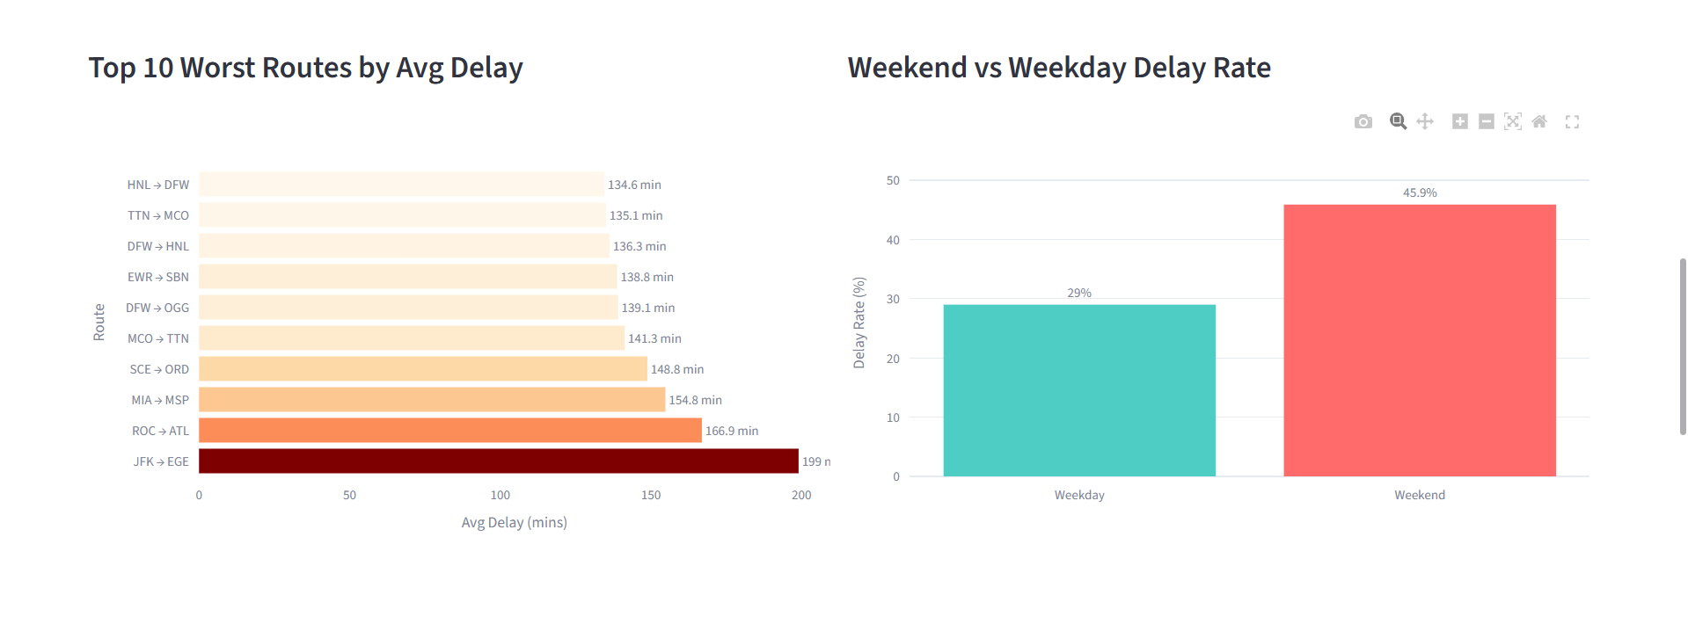
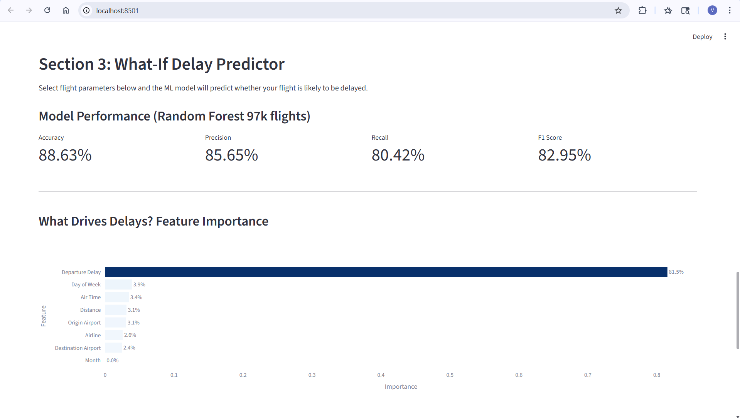
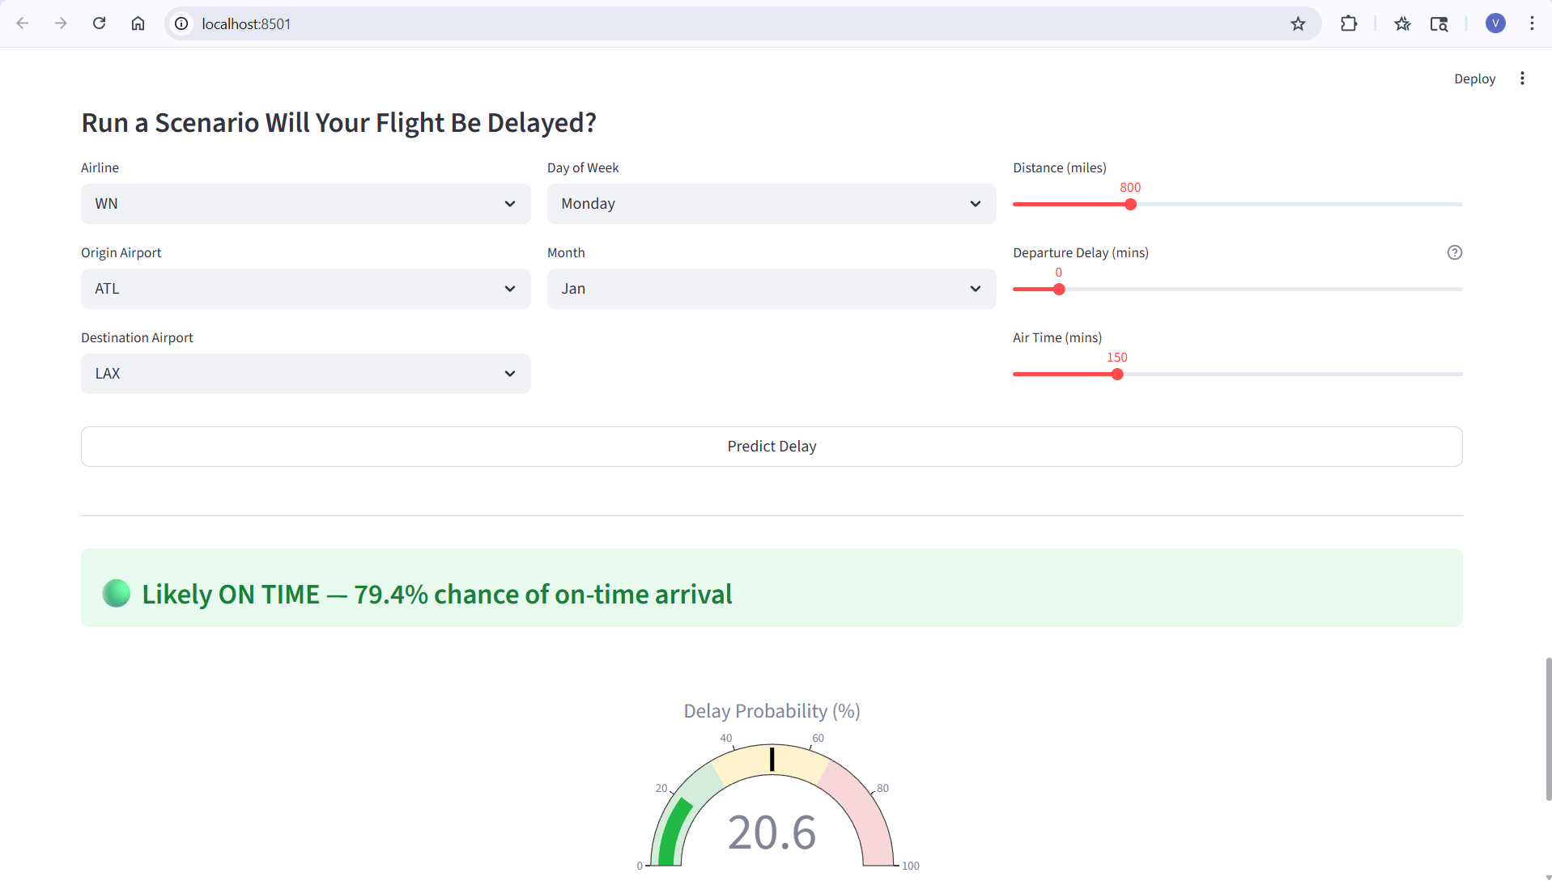
Streamlit Dashboard - Demo
localhost:8501 · 3 sections · 8 interactive charts · queries live from RDS PostgreSQL

Slide 17
ML Model - Delay Prediction
88.63%
85.65%
80.42%
82.95%
Accuracy
Precision
Recall
F1 Score
Model Configuration
Feature Importance
Algorithm: Random Forest Classifier (scikit-learn)
n_estimators: 100 trees · max_depth: 12
class_weight: balanced (handles 66/34 imbalance)
Train/Test: 80/20 stratified split
Train: 78,161 rows | Test: 19,541 rows
Departure Delay
81.5%
Day of Week
3.9%
Air Time
3.4%
Distance
3.1%
Origin Airport
3.1%
Airline
2.6%
Confusion Matrix: 11,913 True On-Time · 5,406 True Delayed · 906 False Alarms · 1,316 Missed Delays

Slide 18
Key Findings
34.4%
American Eagle
ILG Airport
199 min
Overall delay rate
Worst airline
Most delayed origin
Worst route avg delay
33,608 of 97,702 flights
56.4% delay rate
100% delay rate
JFK → EGE
45.9% vs 29%
Late Aircraft
Sunday
81.5%
Weekend vs Weekday
#1 delay cause
Worst day of week
Top ML feature
Weekends significantly worse
900,754 total mins
48% vs 21% Thursday
Departure delay dominates

Slide 19
What's Working & Known Limitations
✅ What's Working
⚠️ Known Limitations
Kafka pipeline end-to-end (Producer → EC2 → Consumer)
S3 data lake raw/ and processed/ zones populated
ETL cleans 97,702 records and loads to RDS
Star schema 4 tables loaded in RDS PostgreSQL
Streamlit dashboard live at localhost:8501
All 8 charts rendering with real RDS data
Random Forest: 88.63% accuracy, F1 82.95%
What-If predictor with live probability gauge
100k sample from January 2015 only (winter data)
No weather data enrichment from NOAA
dim_airport has no city/state detail
EC2 Kafka needs manual restart after reboot
Dashboard runs locally not cloud deployed
ML departure delay signal may overfit
Solo project reduced depth vs team projects

Slide 20
Thank You
Flight Delay Analytics: End-to-End AWS Data Engineering Pipeline
Varun Gehlot · DAMG7370 · Northeastern University Seattle · Spring 2026
97,702
88.6%
5
8
Records
ML Accuracy
AWS Services
Charts
🔗 https://github.com/GhVarun7 · 📧 gehlot.v@northeastern.edu · Questions Welcome!
CSV → Kafka → EC2 → S3 → ETL → RDS PostgreSQL → Streamlit + Random Forest ML

