Slide 1
CARRY SELECT ADDER
🌑By: [GHAAYATHRI DEVI K]

Slide 2
AIM
To Design and implement 16-bit carry-select adder with a uniform block size of 4.

Slide 3
ABSTRACT
Adders are basic building blocks of any processor or data path application. For the design of high-performance processing units high speed adders with low power consumption is a requirement. Carry Select Adder (CSA) is known to be one of the fastest adders used in many data processing applications. In this project, we present a new CSLA architecture using NAND gates alone. It employs multiplexers and full-adders for calculation of sum and carry of two 16-bit numbers.

Slide 4
Introduction to hack-ALU
The results in hardware simulator can be fetched in two different ways:
Interactive simulation: by loading the chip and manually giving in the input we get the outputs corresponding to various values.
Using test script: by loading the chip and test script file(text file containing various inputs for checking the functioning of a chip) into the hardware simulator we get a table containing the set of inputs given in test script and the outputs corresponding to those inputs.

Slide 5
INTRODUCTION
Adding two numbers using a calculator, we get the answer in a few milliseconds, but the addition of two five-digit numbers for instance is not so facile. It has many procedures like computing the sum of each digit, computing the carry and propagating the carry to the next digit. How the calculator performs such clumsy tasks in a very short time? What is mechanism happening behind the calculator for performing this task? What is the name of the circuit used for performing this clumsy task? Which circuit calculates the sum of two numbers most swiftly and efficiently? This project aims on giving the most suitable answer for all such question.
Firstly, the circuit which is used for performing this strenuous task is known as an adder. An adder is a digital circuit that performs addition of numbers. In a more technical way, it is a digital circuit which adds up the amplitude of two propagating waves.

Slide 6
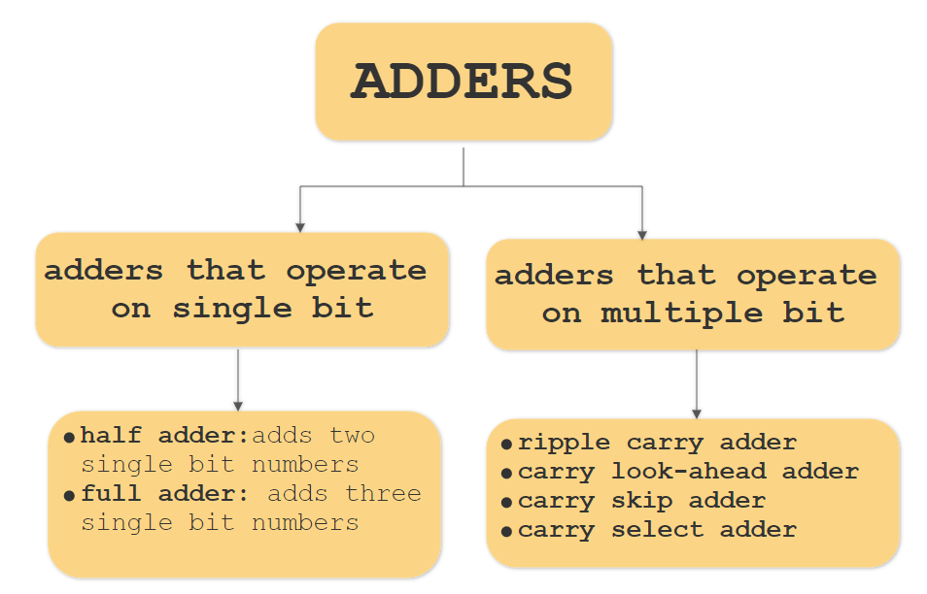
TYPES OF ADDERS

Slide 7
Carry select adder
A carry-select adder is a particular way to implement an adder, which is a logic element that computes the (n+1)-bit sum of two n-bit numbers. The carry-select adder is simple but rather fast. The carry-select adder generally consists of ripple carry adders and a multiplexer. Adding two n-bit numbers with a carry-select adder is done with two adders (therefore two ripple carry adders), in order to perform the calculation twice, one time with the assumption of the carry-in being zero and the other assuming it will be one. After the two results are calculated, the correct sum, as well as the correct carry-out, is then selected with the multiplexer once the correct carry-in is known. The number of bits in each carry select block can be uniform, or variable.

Slide 8
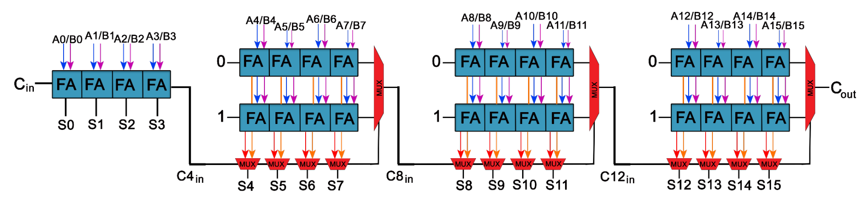
CHIP DESIGN

Slide 9
COMPONENTS USED
NAND gate
Multiplexer
Half adder
Full adder
Ripple carry adder

Slide 10
Multiplexer
The term ‘multiplexing’ describes the operation of sending one or more analogue or digital signals over a common transmission line at different times or speeds. The device used for multiplexing is called Multiplexer.
It is shortly called MUX. It is a combinational logic circuit designed to switch one of several input lines to a single common output line by the application of a control signal, called selection lines. Multiplexers operate like very fast acting multiple position rotary switches connecting or controlling multiple input lines called “channels” one at a time to the output.

Slide 11
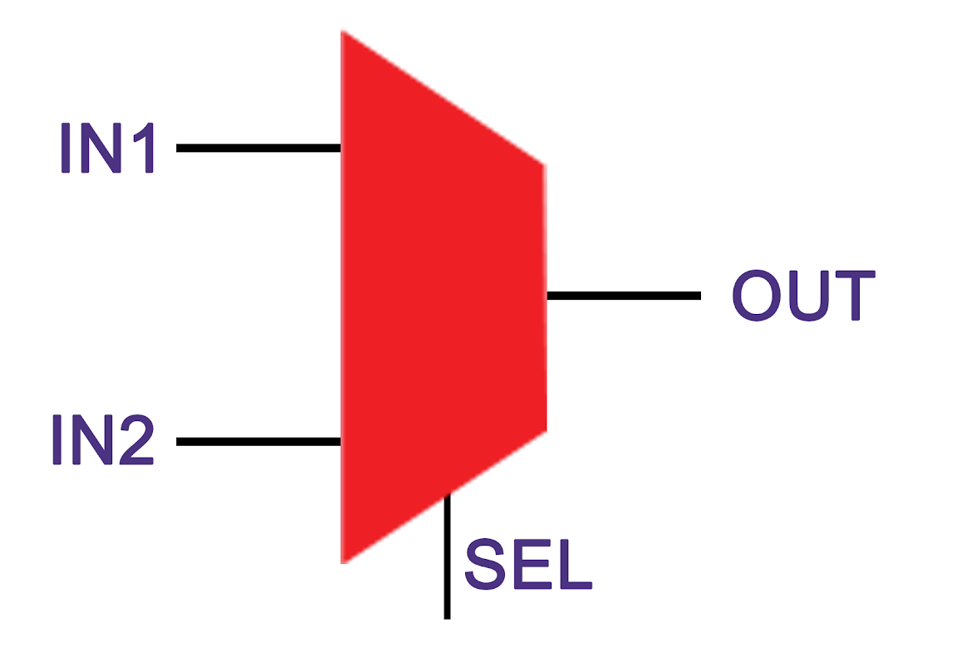
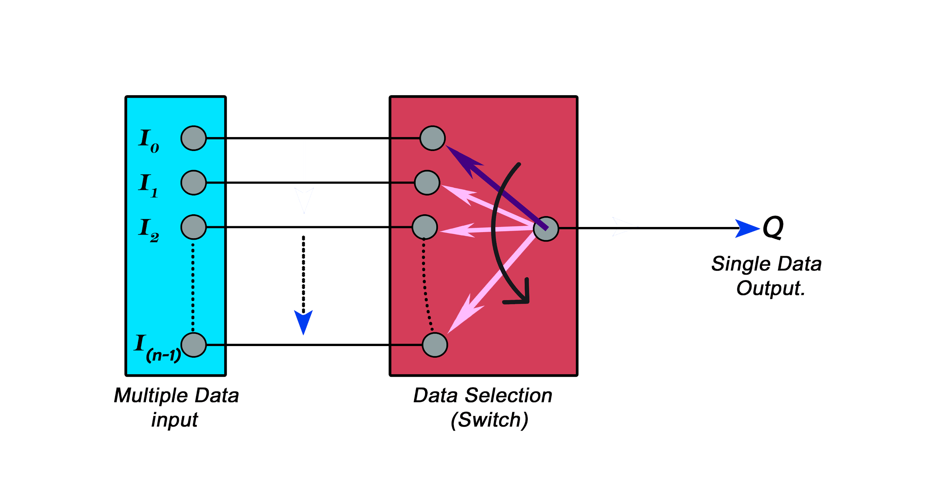
Basic Working of MUX
Number of input lines: 2
Number of selection lines: 1
Number of output lines: 1

Slide 12
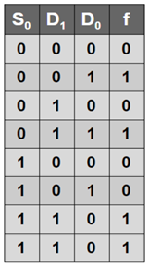
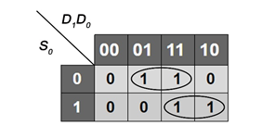
Truth table
K - map
From K-Map, we derived a relation,
f = S.D₁ + S.D₀

Slide 13
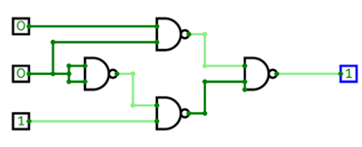
2:1 MUX - From NAND gate
This is a 2-1 MUX constructed from NAND gates.
When data of selection line input is LOW, then I₀ is selected and comes as output, while the other input is blocked.
When data of selection line input is HIGH, then I₁ is selected and comes as output, while the other input is blocked.

Slide 14
HDL - code CHIP Mux { IN a, b, sel; OUT out; PARTS: Nand(a=sel,b=sel,out=notsel); Nand(a=a,b=notsel,out=out1); Nand(a=b,b=sel,out=out2); Nand(a=out1,b=out2,out=out); }
Test file load Mux.hdl, output-file Mux.out, compare-to Mux.cmp, output-list a%B3.1.3 b%B3.1.3 sel%B3.1.3 out%B3.1.3; set a 0, set b 0, set sel 0, eval, output; set sel 1, eval, output; set a 0, set b 1, set sel 0, eval, output; set sel 1, eval, output; set a 1, set b 0, set sel 0, eval, output; set sel 1, eval, output; set a 1, set b 1, set sel 0, eval, output; set sel 1, eval, output;
Compare file | a | b | sel | out | | 0 | 0 | 0 | 0 | | 0 | 0 | 1 | 0 | | 0 | 1 | 0 | 0 | | 0 | 1 | 1 | 1 | | 1 | 0 | 0 | 1 | | 1 | 0 | 1 | 0 | | 1 | 1 | 0 | 1 | | 1 | 1 | 1 | 1 |

Slide 15
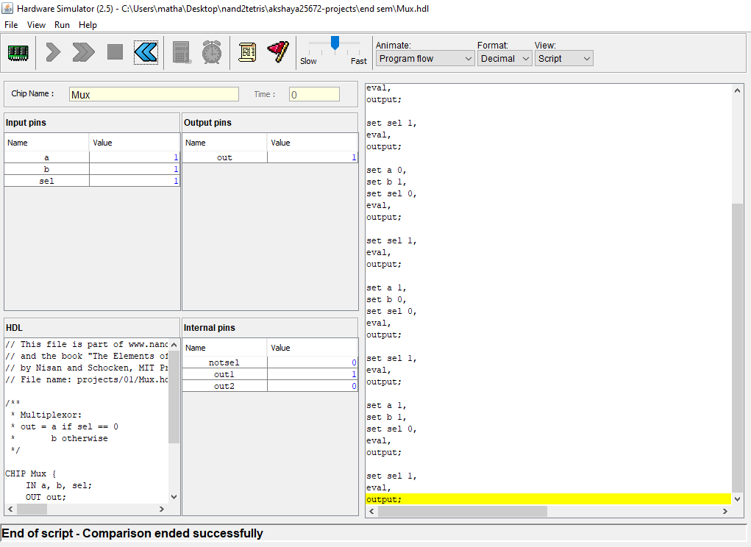
Simulation output of Mux 2:1

Slide 16
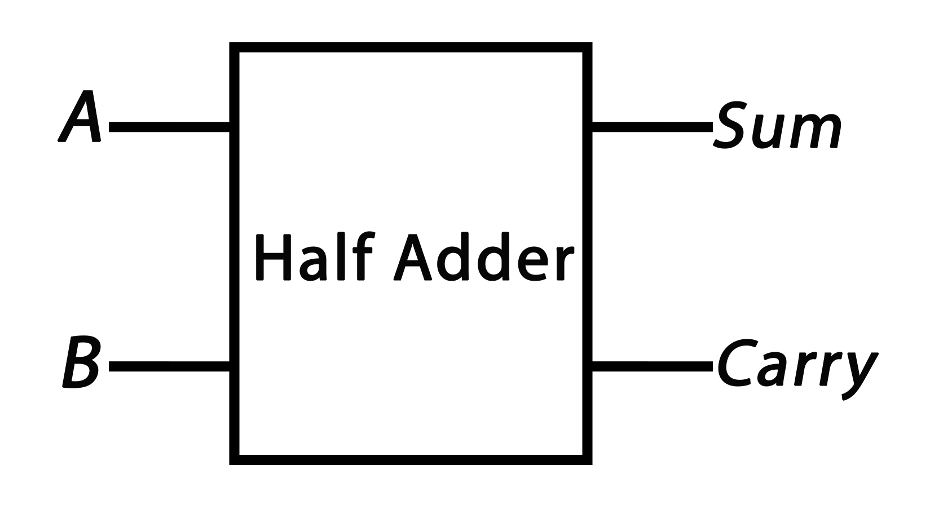
Half adder
Schematic Diagram
It is a combinational circuit that adds two single binary digits A and B.
It has two outputs, sum (S) and carry (C).
The carry signal represents an overflow into the next digit of a multi-digit addition.
The simplest half-adder design, incorporates an XOR gate for Sum and an AND gate for Carry.
The input variables of a half adder are called the augend and addend bits. The output variables are the sum and carry.

Slide 17
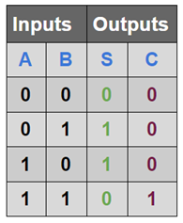
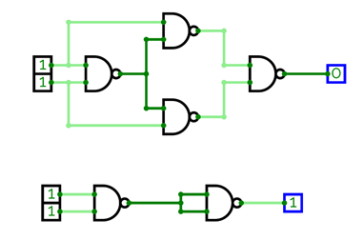
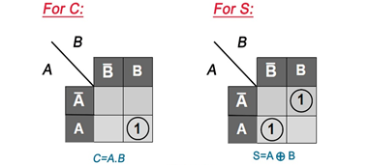
Truth table
Logical implementation
K - map

Slide 18
Test file: load HAnand.hdl, output-file HAnand.out, compare-to HAnand.cmp, output-list a%B3.1.3 b%B3.1.3 sum%B3.1.3 carry%B3.1.3; set a 0, set b 0, eval, output; set a 0, set b 1, eval, output; set a 1, set b 0, eval, output; set a 1, set b 1, eval, output;
HDL code: CHIP HAnand { IN a, b; // 1-bit inputs OUT sum, // Right bit of a + b carry; // Left bit of a + b PARTS: Nand(a=a, b=b, out=ab); Nand(a=a, b=ab, out=aab); Nand(a=b, b=ab, out=abb); Nand(a=aab, b=abb, out=sum); Nand(a=ab, b=ab, out=carry); }
Compare file: | a | b | sum | carry | | 0 | 0 | 0 | 0 | | 0 | 1 | 1 | 0 | | 1 | 0 | 1 | 0 | | 1 | 1 | 0 | 1 |

Slide 19
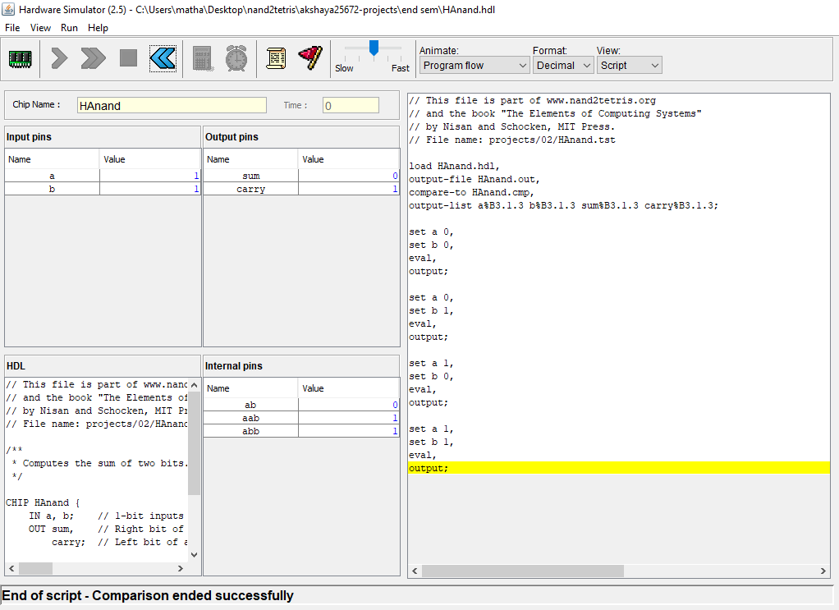
Simulation output of HAnand gate

Slide 20
Full adder
A full adder adds binary numbers and accounts for values carried in as well as out.
A one-bit full-adder adds three one-bit numbers, often written as A, B, and Cin.
Here,
(i) A and B are the operands
(ii) Cin is a bit carried in from the previous less-significant stage.
Construction of Full Adder from Half Adder:
A full adder can also be constructed from two half adders by connecting A and B to the input of one half-adder, then taking its sum-output S as one of the inputs to the second half adder and C_{in} as its other input, and finally the carry outputs from the two half-adders are connected to an OR gate. The sum-output from the second half adder is the final sum output (S) of the full adder and the output from the OR gate is the final carry output (Cout).

Slide 21
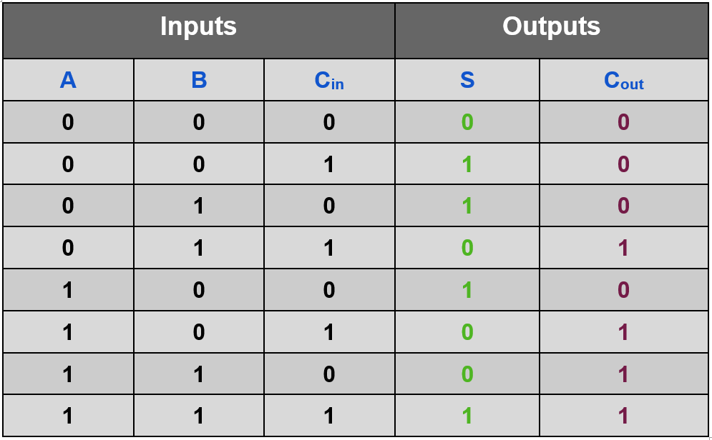
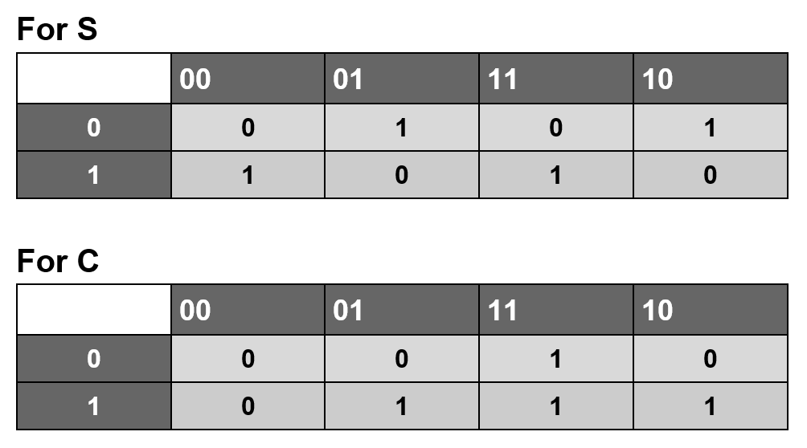
Truth table
K - map

Slide 22
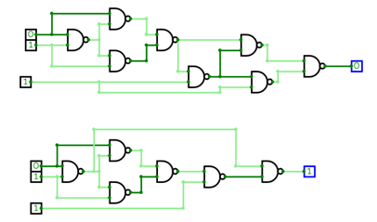
Logical implementation

Slide 23
HDL - code CHIP FAnand { IN a, b, c; // 1-bit inputs OUT sum, // Right bit of a + b + c carry; // Left bit of a + b + cbc PARTS: Nand(a=a, b=b, out=ab); Nand(a=a, b=ab, out=aab); Nand(a=b, b=ab, out=abb); Nand(a=aab, b=abb, out=axb); Nand(a=axb, b=c, out=axbc); Nand(a=axbc, b=axb, out=sum1); Nand(a=axbc, b=c, out=sum2); Nand(a=sum1, b=sum2, out=sum); Nand(a=ab,b=axbc, out=carry); }
Test file load FAnand.hdl, output-file FAnand.out, compare-to FAnand.cmp, output-list a%B3.1.3 b%B3.1.3 c%B3.1.3 sum%B3.1.3 carry%B3.1.3; set a 0, set b 0, set c 0, eval, output; set c 1, eval, output; set b 1, set c 0, eval, output; set c 1, eval, output; set a 1, set b 0, set c 0, eval, output; set c 1, eval, output; set b 1, set c 0, eval, output; set c 1, eval, output;
Compare file | a | b | c | sum | carry | | 0 | 0 | 0 | 0 | 0 | | 0 | 0 | 1 | 1 | 0 | | 0 | 1 | 0 | 1 | 0 | | 0 | 1 | 1 | 0 | 1 | | 1 | 0 | 0 | 1 | 0 | | 1 | 0 | 1 | 0 | 1 | | 1 | 1 | 0 | 0 | 1 | | 1 | 1 | 1 | 1 | 1 |

Slide 24
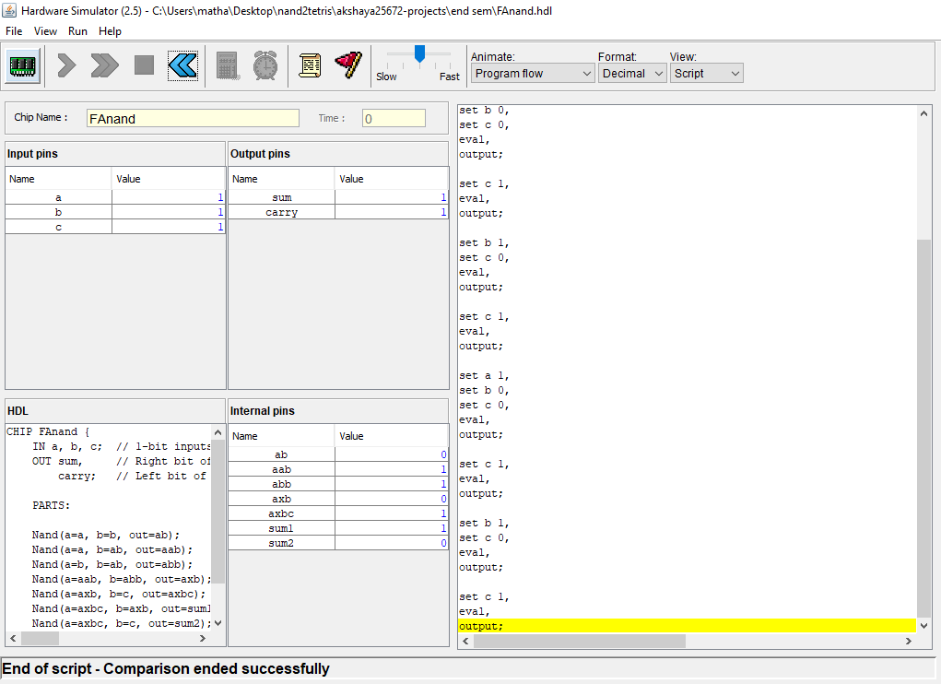
Simulation output of FAnand gate

Slide 25
Ripple carry adder
Combinational circuit consisting of Full adder and Half adder.
It is constructed by cascading multiple full adders in parallel to add an n-bit number.
For an n- bit parallel adder, there must be ‘n’ number of full adder circuits. The carry-out of each full adder is the carry-in of the succeeding next most significant full adder.
Since, each carry bit gets rippled into the next stage, it is called a ripple carry adder.
In a ripple carry adder, the sum and carry-out bits of any half adder stage is not valid until the carry-in of that stage occurs.
Reason: The propagation delays inside the logic circuitry
Propagation delay is time elapsed between the application of an input and occurrence of the corresponding output. Carry propagation delay is the time elapsed between the application of the carry in signal and the occurrence of the carry-out (C-out) signal.

Slide 26
Working of Ripple Carry Adder:
Sum-out S0 and carry out C-out of the Full Adder 1 is valid only after the propagation delay of Full Adder 1.
In the same way, Sum-out S3 of the Full Adder 4 is valid only after the joint propagation delays of Full Adder 1 to Full Adder 4.
Hence, the final result of the ripple carry adder is valid only after the joint propagation delays of all full adder circuits inside it.

Slide 27
Truth table
FullAdder - 0 |  |  |  |  | FullAdder - 1 |  |  |  |  | FullAdder - 2 |  |  |  |  | FullAdder - 3
Inputs |  |  | Outputs |  | Inputs |  |  | Outputs |  | Inputs |  |  | Outputs |  | Inputs |  |  | Outputs
A₀ | B₀ | C₀ | S₀ | C₁ | A₁ | B₁ | C₁ | S₁ | C₂ | A₂ | B₂ | C₂ | S₂ | C₃ | A₃ | B₃ | C₃ | S₃ | C_{OUT}
0 | 0 | 0 | 0 | 0 | 0 | 0 | 0 | 0 | 0 | 0 | 0 | 0 | 0 | 0 | 0 | 0 | 0 | 0 | 0
0 | 0 | 1 | 1 | 0 | 0 | 0 | 0 | 0 | 0 | 0 | 0 | 0 | 0 | 0 | 0 | 0 | 0 | 0 | 0
0 | 1 | 0 | 1 | 0 | 0 | 1 | 0 | 1 | 0 | 0 | 1 | 0 | 1 | 0 | 0 | 1 | 0 | 1 | 0
0 | 1 | 1 | 0 | 1 | 0 | 1 | 1 | 0 | 1 | 0 | 1 | 1 | 0 | 1 | 0 | 1 | 1 | 0 | 1
1 | 0 | 0 | 1 | 0 | 1 | 0 | 0 | 1 | 0 | 1 | 0 | 0 | 1 | 0 | 1 | 0 | 0 | 1 | 0
1 | 0 | 1 | 0 | 1 | 1 | 0 | 1 | 0 | 1 | 1 | 0 | 1 | 0 | 1 | 1 | 0 | 1 | 0 | 1
1 | 1 | 0 | 0 | 1 | 1 | 1 | 1 | 1 | 1 | 1 | 1 | 1 | 1 | 1 | 1 | 1 | 1 | 1 | 1
1 | 1 | 1 | 1 | 1 | 1 | 1 | 1 | 1 | 1 | 1 | 1 | 1 | 1 | 1 | 1 | 1 | 1 | 1 | 1

Slide 28
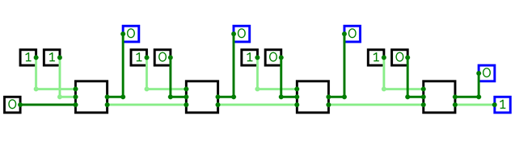
Logical implementation

Slide 29
COMPUTATION OF SUM AND CARRY
STAGE 1:
Calculation of S₀
S₀ = A₀ + B₀ + C_{in}
Calculation of C₀
C₀ = A₀ B₀ + B₀ C_{in} + C_{in} A₀
STAGE 2:
When C₀ is fed as input to the full adder B, it activates the full adder B.
Full adder B computes the sum bit and carry bit as-
Calculation of S₁
S₁ = A₁ + B₁ + C₀
Calculation of C₁
C₁ = A₁ B₁ + B₁ C₀ + C₀ A₁
STAGE 3:
When C₂ is fed as input to the full adder C, it activates the full adder C.
Full adder C computes the sum bit and carry bit as-
Calculation of S₂
S₂ = A₂ + B₂ + C₂
Calculation of C₂
C₂ = A₂ B₂ + B₂ C₂ + C₂ A₂
STAGE 4:
When C₃ is fed as input to the full adder D, it activates the full adder D.
Full adder D computes the sum bit and carry bit as –
Calculation of S₃
S₃ = A₃ + B₃ + C₂
Calculation of C3
C₃ = A₃ B₃ + B₃ C₂ + C₂ A₃

Slide 30
HDL - code CHIP RippleCarryAdder4Bit { IN a[4], b[4],c; OUT out[4],cout; PARTS: FAnand(a=a[0],b=b[0],c=c,sum=out[0],carry=carry1); FAnand(a=a[1],b=b[1],c=carry1,sum=out[1],carry=carry2); FAnand(a=a[2],b=b[2],c=carry2,sum=out[2],carry=carry3); FAnand(a=a[3],b=b[3],c=carry3,sum=out[3],carry=cout); }
Test file load RippleCarryAdder4Bit.hdl, output-file RippleCarryAdder4Bit.out, compare-to RippleCarryAdder4Bit.cmp, output-list a%D2.2.2 b%D2.2.2 c%D2.1.2 out%D2.2.2 cout%B3.1.3; set a 1, set b 1, set c 0, eval, output; set a 1, set b 1, set c 1, eval, output; set a 15, set b 0, set c 0, eval, output; set a 15, set b 0, set c 1, eval, output;
Compare file | a | b | c | out | cout | | 1 | 1 | 0 | 2 | 0 | | 1 | 1 | 1 | 3 | 0 | | 15 | 0 | 0 | 15 | 0 | | 15 | 0 | 1 | 0 | 1 |

Slide 31
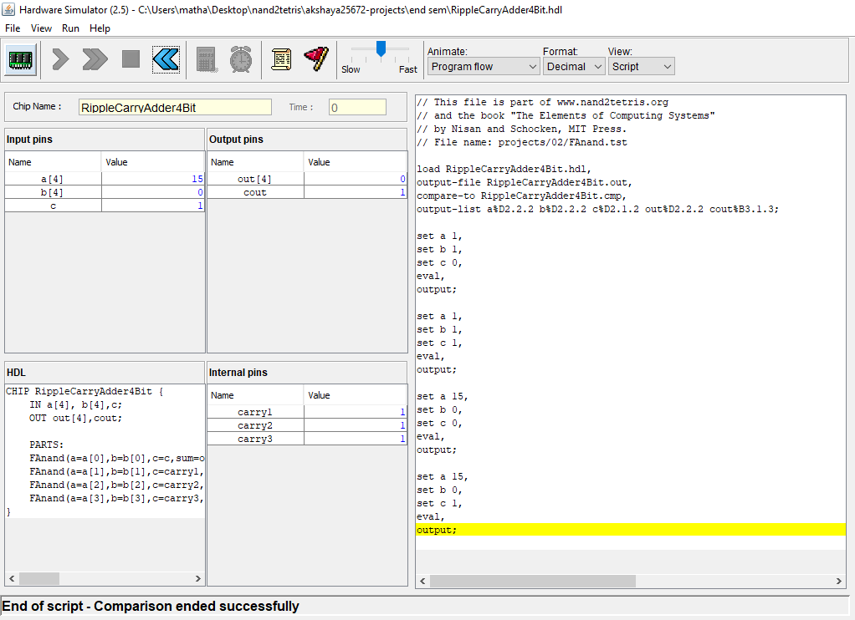
Simulation output of RippleCarryAdder4Bit gate

Slide 32
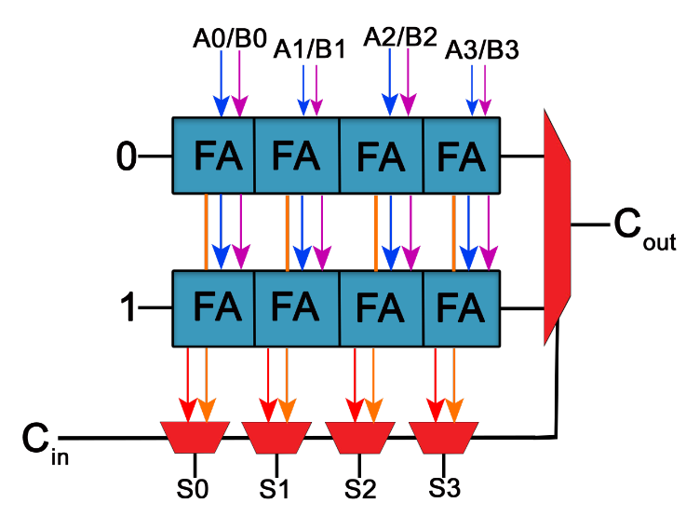
Block
The chip named block used in this project is not a standard one. Here, it is used to speed up the process of addition in a carry select adder.
The block consists of two 4- bit ripple carry adders and multiplexer. The ripple carry adder here is used to calculate the sum and carry while adding two 4-bit numbers in which one has the carry input as 1 and the other one as zero, and the multiplexer is used to select the required output from those two.

Slide 33
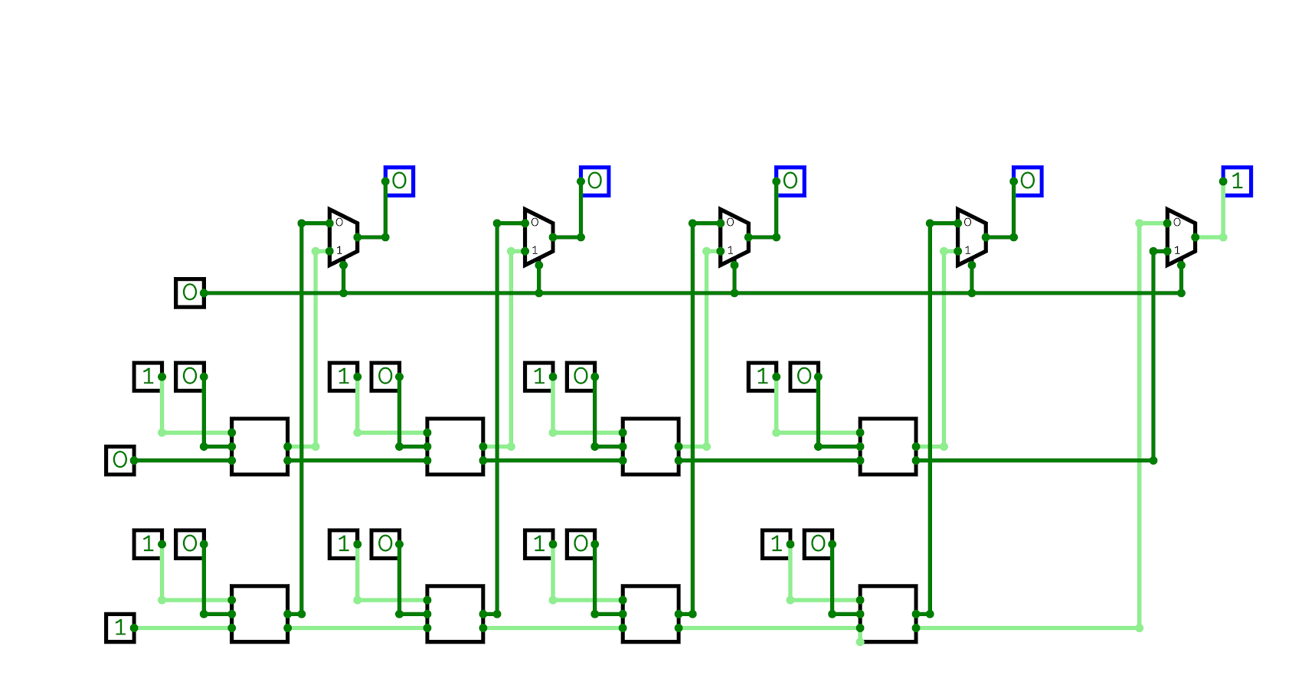
Block logic circuit

Slide 34
Block
HDL - code CHIP block { IN a[4], b[4],c; OUT out[4],cout; PARTS: FAnand(a=a[0],b=b[0],c=false,sum=out11,carry=carry11); FAnand(a=a[1],b=b[1],c=carry11,sum=out12,carry=carry12); FAnand(a=a[2],b=b[2],c=carry12,sum=out13,carry=carry13); FAnand(a=a[3],b=b[3],c=carry13,sum=out14,carry=cout1); FAnand(a=a[0],b=b[0],c=true,sum=out21,carry=carry21); FAnand(a=a[1],b=b[1],c=carry21,sum=out22,carry=carry22); FAnand(a=a[2],b=b[2],c=carry22,sum=out23,carry=carry23); FAnand(a=a[3],b=b[3],c=carry23,sum=out24,carry=cout2); Mux(a=out11,b=out21,sel=c,out=out[0]); Mux(a=out12,b=out22,sel=c,out=out[1]); Mux(a=out13,b=out23,sel=c,out=out[2]); Mux(a=out14,b=out24,sel=c,out=out[3]); Mux(a=cout1,b=cout2,sel=c,out=cout); }

Slide 35
Test script load block.hdl, output-file block.out, compare-to block.cmp, output-list a%D1.2.1 b%D1.2.1 c%B3.1.3 out%D1.2.1 cout%B3.1.3; set a 2, set b 5, set c 0, eval, output; set c 1, eval, output; set a 5, set c 0, eval, output; set c 1, eval, output;
Compare file | a | b | c |out | cout | | 2 | 5 | 0 | 7 | 0 | | 2 | 5 | 1 | 8 | 0 | | 5 | 5 | 0 | 10 | 0 | | 5 | 5 | 1 | 11 | 0 | | 15 | 0 | 0 | 15 | 0 | | 15 | 0 | 1 | 0 | 1 | | 15 | 15 | 0 | 14 | 1 | | 15 | 15 | 1 | 15 | 1 |

Slide 36
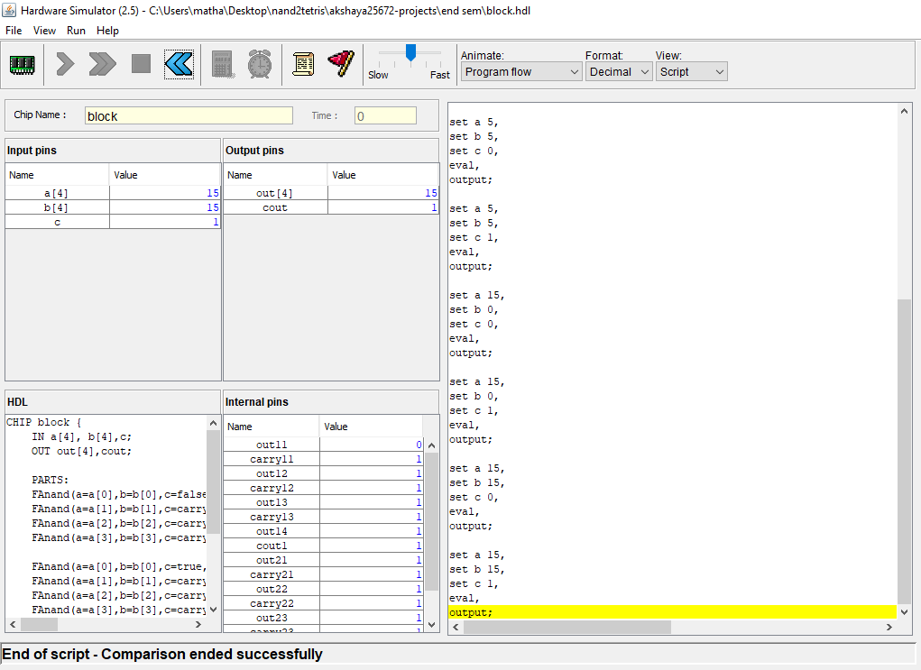
Simulation of a BLOCK

Slide 37
WORKING OF CSLA
The carry select adder uses multiple narrow adders to create fast wide adders. It breaks the addition problem into smaller groups. It is one of the fast-type of adder. The adder consists of two independent units. Each unit implements the addition operation in parallel. It consists of two parallel adders (ripple carry adder) and a multiplexer. For two given numbers A(n-bit) and B(n-bit), we perform addition twice.
With carry in = '0'
With carry in = '1'
Once the correct carry-in is known, the correct sum is selected by a mux. For a multi-bit adder, the number of bits in each carry select block can be either uniform or variable.

Slide 38
Working of CSLA - continued
In our Carry Select Adder, we add two 16 - bit numbers.
In our design , there are 4 blocks totally. Each block has 2 ripple carry adders and four 2:1 MUXes. (Except, the first block, which has one ripple carry adder and no MUX).
The first block computes the sum of first 4 bits of two 16-bit numbers based on the Carry-in given. It then generates Carry-out and four bits of sum of two bits (S₃, S₂, S₁, S₀).
The generated Carry-out goes as a selection line for 2:1 MUX es of second block. The second block has 2:1 MUX for selecting the sum of two 16-bit numbers, generated by two ripple carry adders, based on the Carry-out of first block. Since, two ripple carry adders are there, two Carry-out will be generated. The Carry-out of the first block acts as a selection line for this 2:1 MUX to select the required the carry. Now, the required Carry-out and Sum-out (Next four bits – S₇, S_{6,} S_{5,} S₄) is selected.

Slide 39
Working of CSLA - continued
This Carry-out goes as a selection line for 2:1 MUX es in third block. So, the required Sum-out (Next four bits - S₁₁, S_{10,} S_{9,} S₈) and Carry-out are generated.
This Carry-out goes to fourth block as selection line for 2:1 MUX es. So, the required Sum-out (Next four bit – S₁₅, S_{14,} S_{13,} S₁₂) and Carry-out (Final Carry-out) is selected.
Thus, a Sum and Carry-out is generated.
This is how a sum and carry is generated in Carry-Select-Adder.

Slide 40

CHIP Working Animation:
1
0
1
1
1
0
0
0
0
1
1
0
0
1
1
1
0
1
1
0
1
0
1
0
1
0
1
0
1
0
1
0
1
1
0
0
0
1
1
0
0
1
1
1
0
1
1
0
1
1
1
0
0

Slide 41
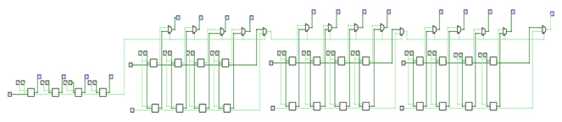
CHIP SIMULATION IN CIRCUIT VERSE
https://circuitverse.org/users/66575/projects/clsa

Slide 42
TIME TAKEN FOR COMPUTATION - Comparison between Ripple Carry Adder and Carry Select Adder
For Ripple Carry Adder:
The computation time is given by:
Where k₁ is the delay through one adder cell and n is the number of bits.
T = k₁ * n

Slide 43
For Carry Select Adder:
If we divide the adder into blocks, each with 2 parallel paths, then the completion time T becomes,
Where k₂ is time needed by the multiplexer of the next block to select the actual output carry.
Suppose the n-bit adder is divided into 'M' blocks, and that each block contains 'P' adder cells in series,
The Completion time T for overall carry output signal is composed of two parts.
The propagation delay through the first block
The propagation delay through the mux block
T = Pk₁ + (M-1) * k₂
Let, n = M * P
Then,
On differentiating with respect to M, we get
T = (k₁ * n/2) + k₂
T = (n/m) * k₁ + (M-1) * k₂
M = sqrt(n*k₁/k₂)

Slide 44
CSLA (binary input)
HDL -code CHIP CSLA { IN a[16], b[16]; OUT out[16],cout; PARTS: RippleCarryAdder4Bit(a=a[0..3],b=b[0..3],out=out[0..3],cout=c1); block(a=a[4..7],b=b[4..7],c=c1,out=out[4..7],cout=c2); block(a=a[8..11],b=b[8..11],c=c2,out=out[8..11],cout=c3); block(a=a[12..15],b=b[12..15],c=c3,out=out[12..15],cout=cout); }
Compare file | a | b | out | cout | | 0000000000000000 | 0101010101010101 | 0101010101010101 | 0 | | 1010101010101010 | 0101010101010101 | 1111111111111111 | 0 | | 0011001100110011 | 1100110011001100 | 1111111111111111 | 0 | | 1111111111111111 | 0000000000000001 | 0000000000000000 | 1 |

Slide 45
Test file load CSLA.hdl, output-file CSLA1.out, compare-to CSLA1.cmp, output-list a%B3.16.3 b%B3.16.3 out%B3.16.3 cout%B3.1.3; set a %B0000000000000000, set b %B0101010101010101, eval, output; set a %B1010101010101010, set b %B0101010101010101, eval, output; set a %B0011001100110011, set b %B1100110011001100, eval, output; set a %B1111111111111111, set b %B0000000000000001, eval, output;

Slide 46
CSLA (decimal input)
HDL -code CHIP CSLA { IN a[16], b[16]; OUT out[16],cout; PARTS: RippleCarryAdder4Bit(a=a[0..3],b=b[0..3],out=out[0..3],cout=c1); block(a=a[4..7],b=b[4..7],c=c1,out=out[4..7],cout=c2); block(a=a[8..11],b=b[8..11],c=c2,out=out[8..11],cout=c3); block(a=a[12..15],b=b[12..15],c=c3,out=out[12..15],cout=cout); }

Slide 47
Test file load CSLA.hdl, output-file CSLA.out, compare-to CSLA.cmp, output-list a%D1.5.1 b%D1.5.1 out%D1.5.1 cout%B3.1.3; set a 13, set b 11, eval, output; set a 2468, set b 4628, eval, output; set a 25855, set b 25855, eval, output; set a 32767, set b 1, eval, output;
Compare file | a | b | out | cout | | 13 | 11 | 24 | 0 | | 2468 | 4628 | 7096 | 0 | | 25855 | 25855 | 13826 | 0 | | 32767 | 1 | 32768 | 0 |

Slide 48
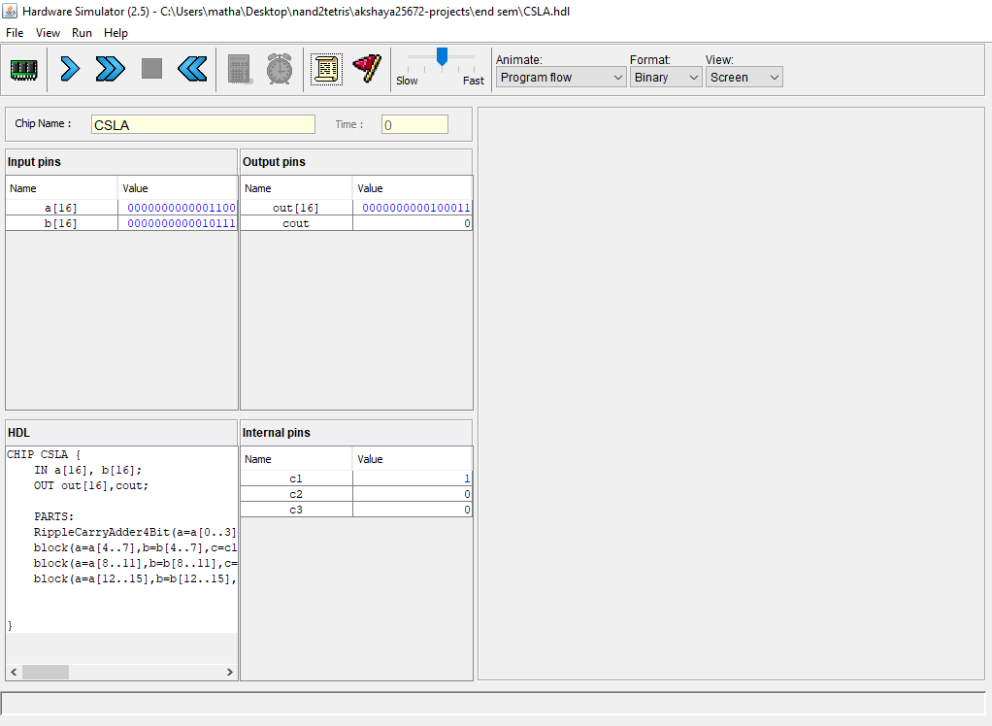
Simulation of CSLA - Interactive (Binary Input)

Slide 49
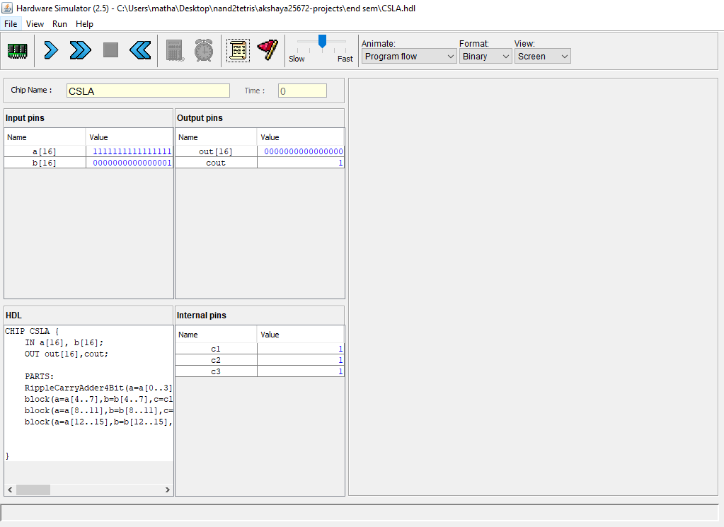

Slide 50
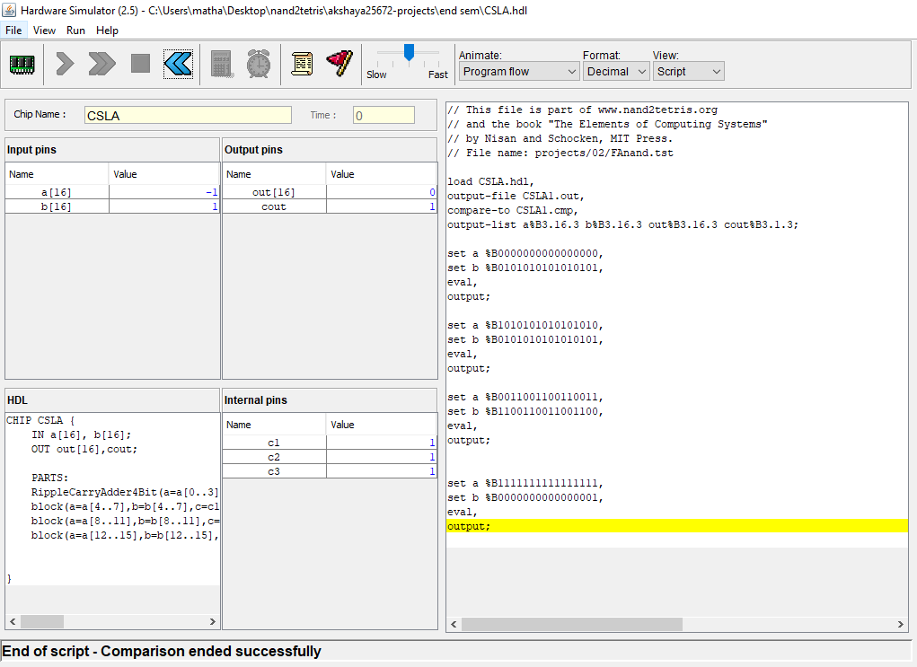
Simulation of CSLA - Script Based (Binary Input)

Slide 51
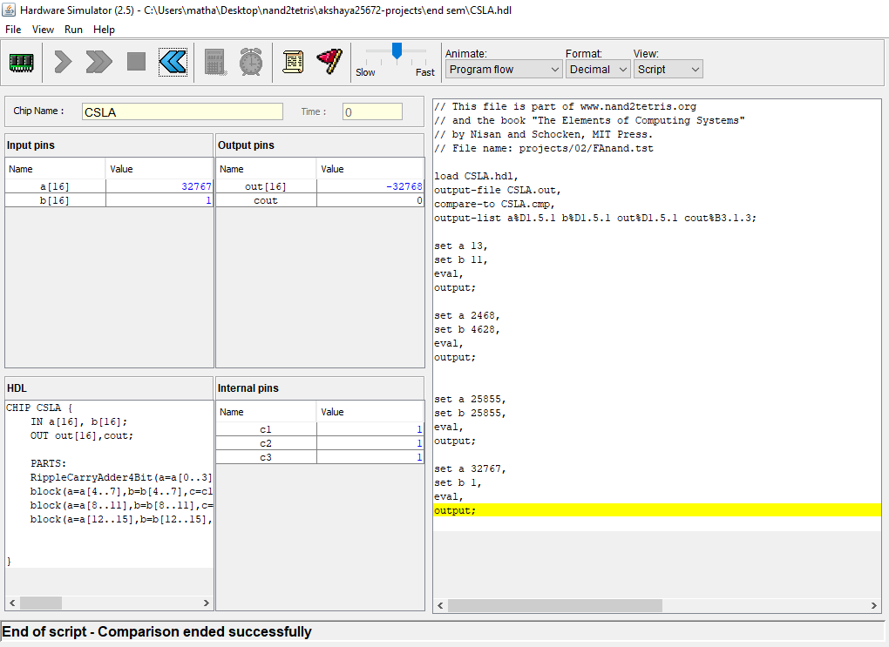
Simulation of CSLA - Script Based (Decimal Input)

Slide 52
APPLICATIONS OF CSLA
In arithmetic logic units
In high speed multipliers
Finite impulse response
Digital signal processing
Digital image processing
Advanced processor design

Slide 53
Reference:
http://nand2tetris-questions-and-answers-forum.32033.n3.nabble.com/Errata-Bugs-and-Such-f32642.html
The elements of computing systems building a modern computer from first principles by Nisan, NoamSchocken, Shimon (z-lib.org)
https://en.wikipedia.org/wiki/Carry-select_adder
https://tams.informatik.uni-hamburg.de/applets/hades/webdemos/20-arithmetic/20-carryselect/adder_carryselect.html
http://www.aoki.ecei.tohoku.ac.jp/arith/mg/algorithm.html#fsa_csl

Slide 54
Thank you

