Slide 1
Bootstrap
Framework : responsive web pages : websites , web Appliation

Slide 2
Layout : RWD | FWD | AWD
Relative measure units

Slide 3
Layout : RWD | FWD | AWD
Width:1000px
absolute measure units

Slide 4
Layout : RWD | FWD | AWD
Media query

Slide 5
RWD : RWD + AWD

Slide 6
Bootstrap
Version 5
CSS
js
Bs.css
Bs.min.css
Bs.grid.css
Bs.grid.min.css
Predefined classes you can use it
Bs.js
Bs.min.js
Bs.bundle.js
Bs.bundle.min.js
Predefined behaviout you can use it
Without comments
Without tabs
Without new lines
p{
width:100px;
height:200px;
}
Development iti.css => for development
p{width:100px;height:200px;}
Development iti.min.css => for production version

Slide 7
Bs version 3
JQ
Popper.js : dropdown ,….
BS.js

Slide 8
Bs version 4
Popper.js : dropdown ,….
BS.js

Slide 9
Bs version 5
Popper.js : dropdown ,….
BS.js
BS.bundle.js

Slide 10
Components: 3 parts for any component : html css js
Index.html
contact.html

Slide 11
attributes
data-attributes names : = “”
Data-dimiss=“alert”
Data-dimiss=“modal”
Data-target
Data-toggle=“dropdown | collapse”
Data-interal
data-slide-to
Data-slide

Slide 12
card
card
Card-header
Card-body
Card-footer

Slide 13
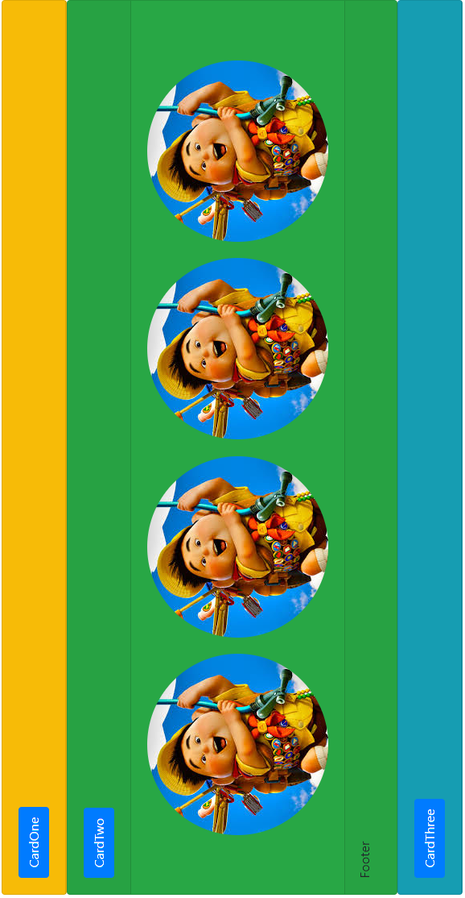
Task

Slide 14
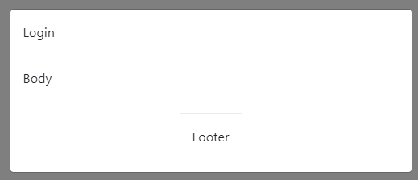
Task modal and modal dialoge
Apply validation
Username nasr
pass iti
User name :
User pass :
ok
cancel
Dismiss
Display data

Slide 15
ID | Name | university
1000 | Ahmed | Mansoura
 |  |  | Details
 |  |  | details
Task : open modal or modal dialoge display all details abut clicked person

Slide 16
Carousel : slide show
Controls:
Next
prev
Carousel inner :
Contains carousel items :
carousel
Details
indicators

Slide 17
classes
attributes
Carousel
Carousel-indicators
Carousel-caption
Carousel-inner
Carousel-item
Carousel-control-prev
Carousel-control-next
Active
slide
Data-target
Data-interval
data-ride
Data-slide-to
Data-slide

Slide 18
Version 5 attributes
Version 4
Data-dismiss
Version 5
Data-bs-dismiss

Slide 19
download
Offline
Cdn link : cdnlink for css | cdnlink for js
Install bs npm
Install nuget

Slide 20
Device Screens
Breakpoints :
1- 576px
2-768px
3-992px
4-1200px
5-1400px
Screens infix :
Xs : extra small
Sm : small
Md : medium
Lg : large
Xl:extra large
Xxl:extra extra large
Extra Small
small
medium
large
Extra large
Extra extra large
0 – 575.999
576-767.99
768-991.999
992—1199.99
1200-1399.99
1400 and more
xs
sm
md
lg
xl
xxl
Bs : version3
Bs : version4
Bs : version5

Slide 21
Basic structure for bs file
Bs.css
Offline
<html>
<head>
<meta name=“viewport” content=“width=device-width;initial-scale=1”/>
<display data over mobile >
<link href=“bs.css” rel=“stylesheet”/>
<link href=“cdn link” />
</head>
</html>
Cdnlink :
Content delivery network
Using CDN
Install bs :
Node js
npm
Think mobile first
Nuget package
Getbootstrap.com

Slide 22
Grid System
Div : 6columns
Div : 6columns

Slide 23
typography

Slide 24
fontawesome
Our have to link css file : cdn using cdnjs

