Slide 1

Winning a space Race with data science

Slide 2


Outline
Executive Summary
Introduction
Methodology
Results
Visualization – Charts
Dashboard
Conclusion
Appendix

Slide 3
Executive Summary
Summary of methodologies
Data Collection through API
Data Collection with Web Scraping
Data Wrangling
Exploratory Data Analysis with SQL
Exploratory Data Analysis with Data Visualization
Interactive Visual Analytics with Folium
Machine Learning Prediction
Summary of all results
Exploratory Data Analysis result
Interactive analytics in screenshots
Predictive Analytics result

Slide 4
Introduction
Project background and context
Space X advertises Falcon 9 rocket launches on its website with a cost of 62 million dollars; other providers cost upward of 165 million dollars each, much of the savings is because Space X can reuse the first stage. Therefore, if we can determine if the first stage will land, we can determine the cost of a launch. This information can be used if an alternate company wants to bid against space X for a rocket launch. This goal of the project is to create a machine learning pipeline to predict if the first stage will land successfully.
Problems to find answers to:
What are the factors needed to be determined in case the rocket landed successfully?
The interaction amongst different features that decide the success rate,
What’re the operating conditions we need to ensure a successful landing program.

Slide 5
Section 1
Methodology:

Slide 6
Data Collection
Different approaches were utilized to gather information. The data was obtained by issuing a get request to the SpaceX API. The response content was subsequently decoded as a Json by invoking the .json() function and then transformed into a pandas dataframe by using .json_normalize(). After that, the data was scrubbed, assessed for absent values, and these were substituted where appropriate. Additionally, web scraping was carried out on Wikipedia for Falcon 9 launch details using BeautifulSoup. The aim was to retrieve the launch data as an HTML table, extract the data from the table, and change it into a pandas dataframe to facilitate subsequent examination.

Slide 7
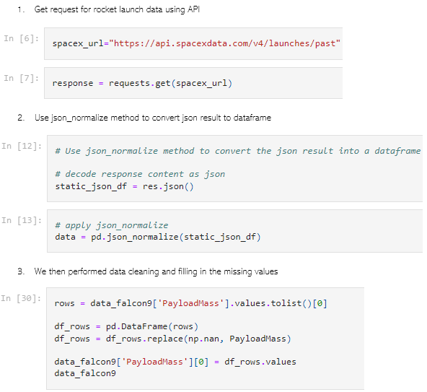
Data Collection – SpaceX API
To gather the necessary information, we employed the get request function from the SpaceX API. Subsequently, we performed some basic data cleaning and reorganization, including data wrangling and formatting.

Slide 8
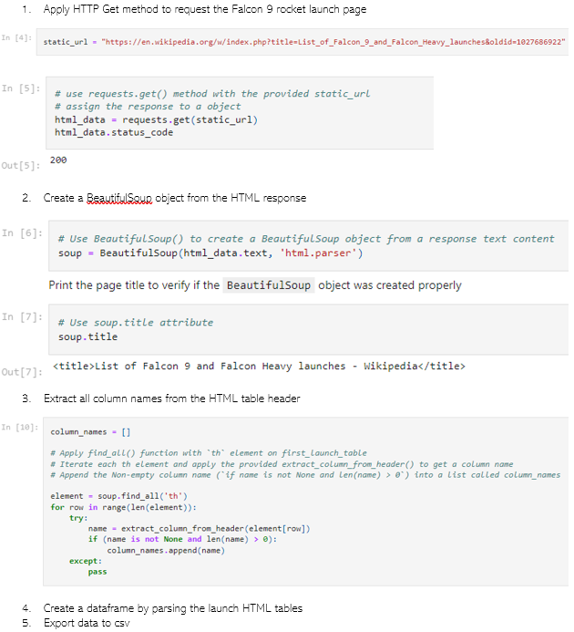
Data Collection - Scraping
We utilized web scraping with BeautifulSoup to extract Falcon 9 launch records from a website. After parsing the data table, we transformed it into a pandas dataframe for further analysis.

Slide 9
Data Wrangling
We conducted exploratory data analysis to determine the training labels, which involved calculating the quantity of launches that occurred at each site, as well as the number and frequency of orbits. Additionally, we generated a landing outcome label based on the outcome column, and subsequently saved the outcomes as a csv file.

Slide 10
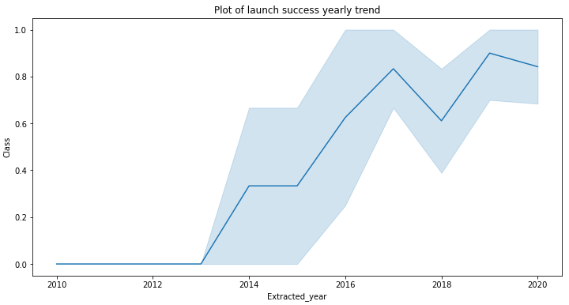
EDA with Data Visualization
To gain insight into the data, we utilized data visualization to examine the connection between flight number and launch site, payload and launch site, success rate of each orbit type, flight number and orbit type, as well as the yearly trend of launch success.

Slide 11
EDA with SQL
We imported the SpaceX dataset into a PostgreSQL database directly from the Jupyter Notebook without exiting it. Using SQL for exploratory data analysis, we gained insight into the data. We composed queries to discover information such as the distinct names of launch sites involved in space missions, the total payload mass transported by boosters launched by NASA's CRS program, the average payload mass transported by the F9 v1.1 booster version, the overall number of successful and failed mission outcomes, and details about failed landing outcomes on drone ships, including the booster version and launch site names.

Slide 12
Build an Interactive Map with Folium
We designated all of the launch sites and utilized map objects such as markers, circles, and lines to indicate the success or failure of launches for each site on the folium map. Launch outcomes were classified as 0 or 1, with 0 representing failure and 1 representing success. By utilizing color-coded marker clusters, we were able to identify which launch sites had a higher rate of success. We also calculated the distances between each launch site and its surrounding areas, answering questions such as whether the launch sites were located near railways, highways, and coastlines, as well as if there was a certain distance maintained between the launch sites and nearby cities.

Slide 13
Build a Dashboard with Plotly Dash
We developed an interactive dashboard using Plotly dash. This dashboard displayed pie charts to depict the total launches from specific sites, as well as scatter graphs that depicted the relationship between outcome and payload mass (measured in kilograms) for different booster versions.

Slide 14
Predictive Analysis (Classification)
First, we imported and processed the data using numpy and pandas. Next, we separated our data into training and testing sets. We then constructed multiple machine learning models and optimized them by adjusting various hyperparameters through GridSearchCV. To evaluate our models, we utilized accuracy as the performance metric, and improved the models by refining feature engineering and algorithm tuning. Finally, we identified the highest performing classification model.

Slide 15
Results
Exploratory data analysis results
Interactive analytics demo in screenshots
Predictive analysis results

Slide 16
Section 2
Insights from EDA

Slide 17
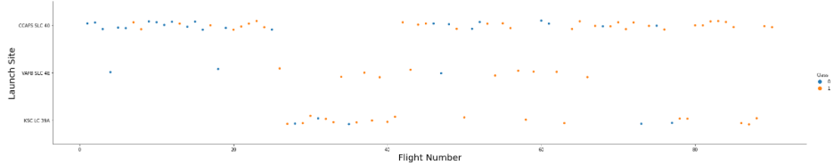
Flight Number vs. Launch Site
From the plot, we found that the larger the flight amount at a launch site, the greater the success rate at a launch site.

Slide 18
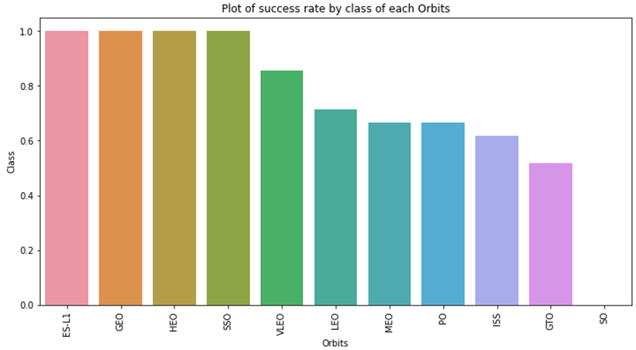
Success Rate vs. Orbit Type
From the plot, we can see that ES-L1, GEO, HEO, SSO, VLEO had the most success rate.

Slide 19
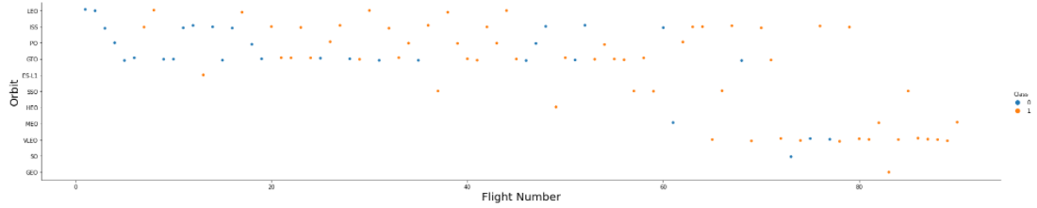
Flight Number vs. Orbit Type
The plot below shows the Flight Number vs. Orbit type. We observe that in the LEO orbit, success is related to the number of flights whereas in the GTO orbit, there is no relationship between flight number and the orbit.

Slide 20
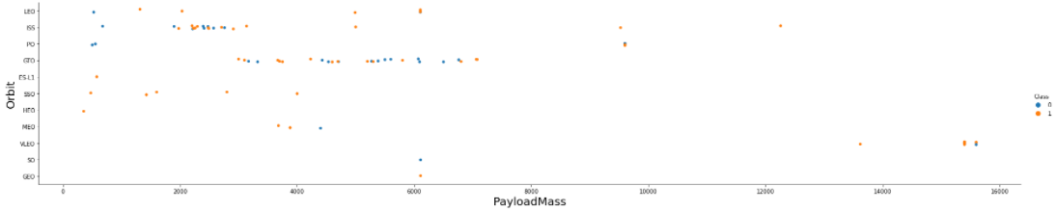
Payload vs. Orbit Type
We can observe that with heavy payloads, the successful landing are more for PO, LEO and ISS orbits.

Slide 21
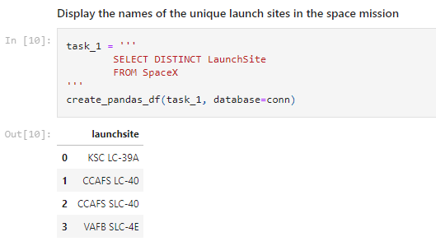
All Launch Site Names
We used the key word DISTINCT to show only unique launch sites from the SpaceX data.

Slide 22
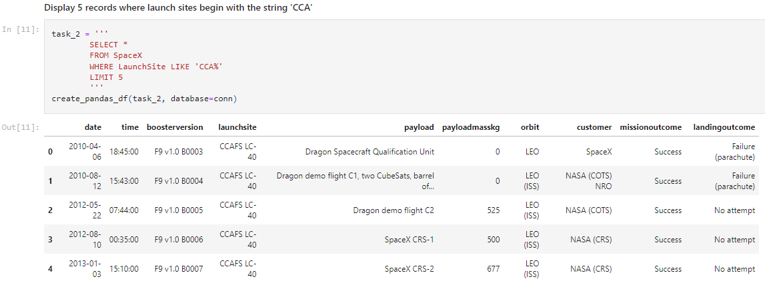
Launch Site Names Begin with 'CCA'
We used the query above to display 5 records where launch sites begin with `CCA`

Slide 23
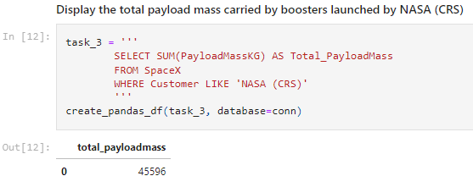
Total Payload Mass
We calculated the total payload carried by boosters from NASA as 45596 using the query below

Slide 24
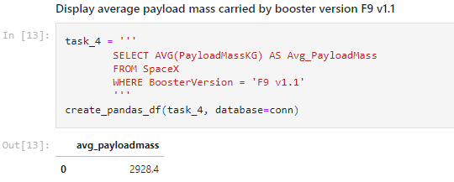
Average Payload Mass by F9 v1.1
We calculated the average payload mass carried by booster version F9 v1.1 as 2928.4

Slide 25
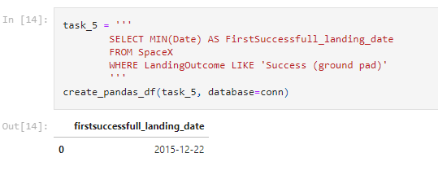
First Successful Ground Landing Date
We observed that the dates of the first successful landing outcome on ground pad was 22nd December 2015

Slide 26
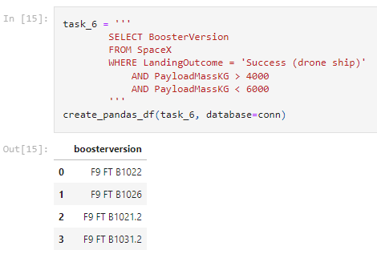
We used the WHERE clause to filter for boosters which have successfully landed on drone ship and applied the AND condition to determine successful landing with payload mass greater than 4000 but less than 6000

Slide 27
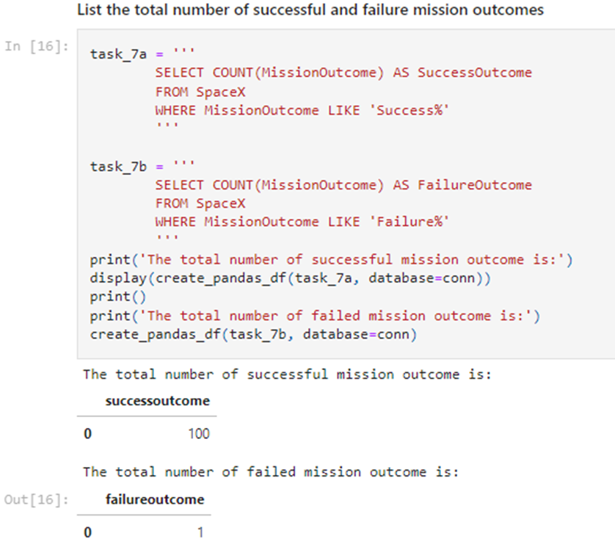
We used wildcard like ‘%’ to filter for WHERE MissionOutcome was a success or a failure.

Slide 28
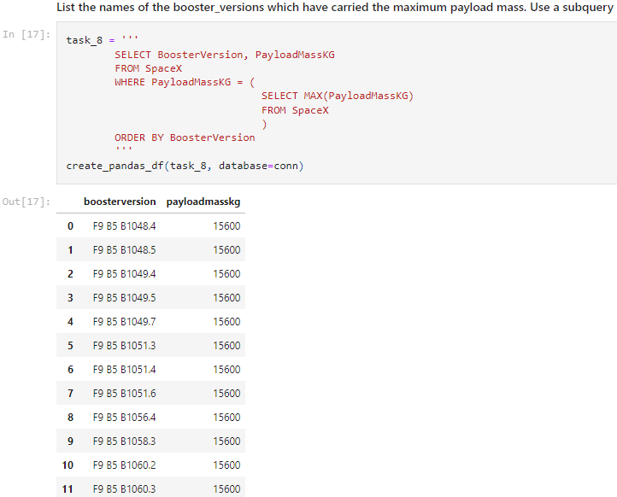
Boosters Carried Maximum Payload
We determined the booster that have carried the maximum payload using a subquery in the WHERE clause and the MAX() function.

Slide 29
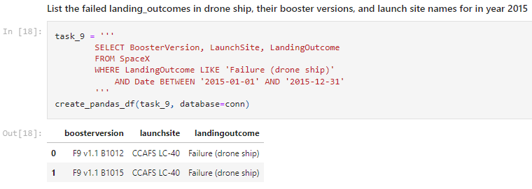
2015 Launch Records
We used a combinations of the WHERE clause, LIKE, AND, and BETWEEN conditions to filter for failed landing outcomes in drone ship, their booster versions, and launch site names for year 2015

Slide 30
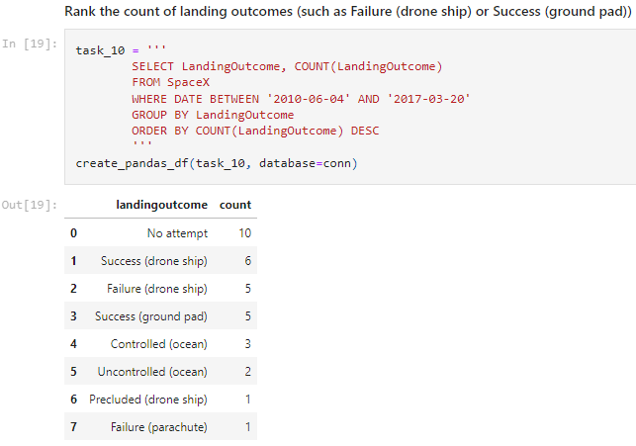
We selected Landing outcomes and the COUNT of landing outcomes from the data and used the WHERE clause to filter for landing outcomes BETWEEN 2010-06-04 to 2010-03-20.
We applied the GROUP BY clause to group the landing outcomes and the ORDER BY clause to order the grouped landing outcome in descending order.

Slide 31
Section 3
Launch sites Proximites Analysis

Slide 32
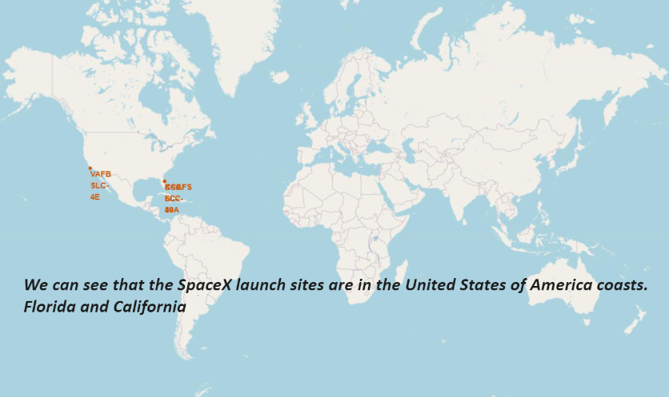
All launch sites global map markers

Slide 33
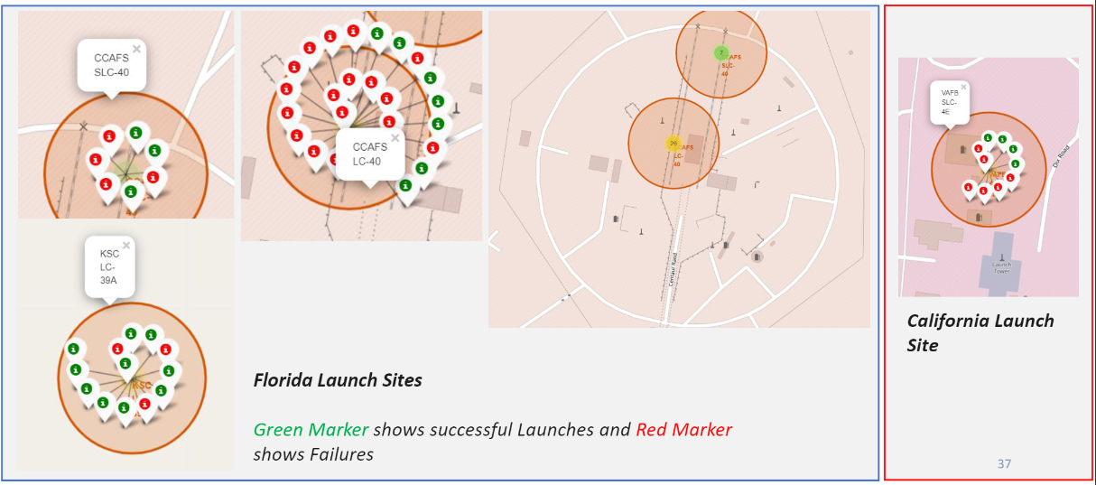
Markers showing launch sites with color labels

Slide 34
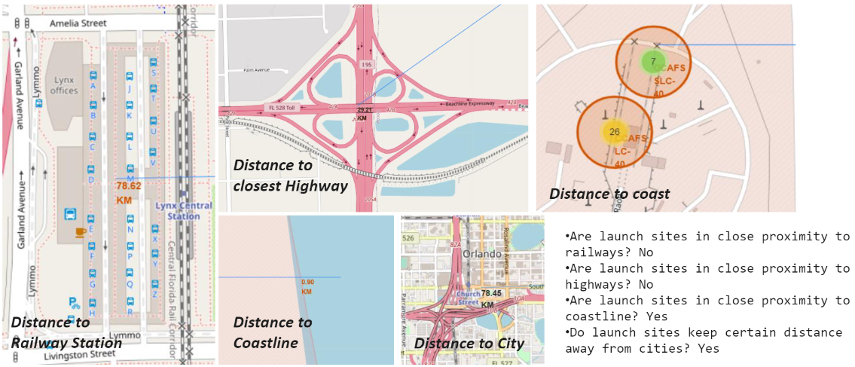
Launch Site distance to landmarks

Slide 35
Section 4
Dashboard with plotly dash

Slide 36
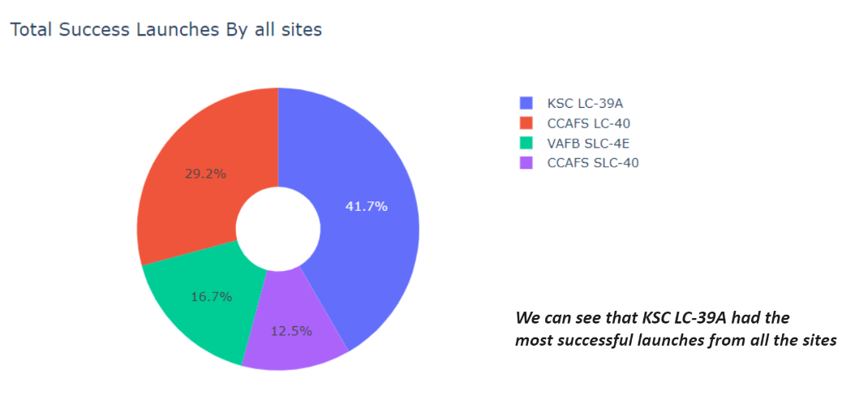
Pie chart showing the success percentage achieved by each launch site

Slide 37
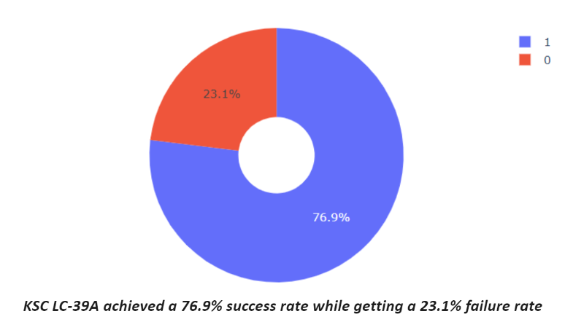
Pie chart showing the Launch site with the highest launch success ratio

Slide 38
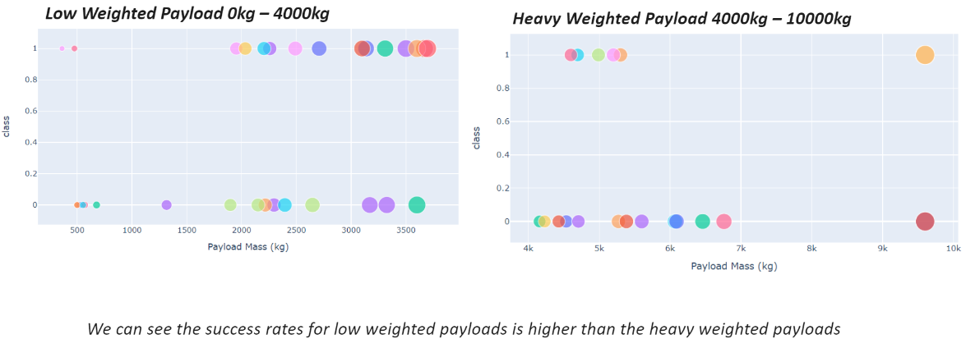
Scatter plot of Payload vs Launch Outcome for all sites, with different payload selected in the range slider

Slide 39
Section 4:
Classification

Slide 40
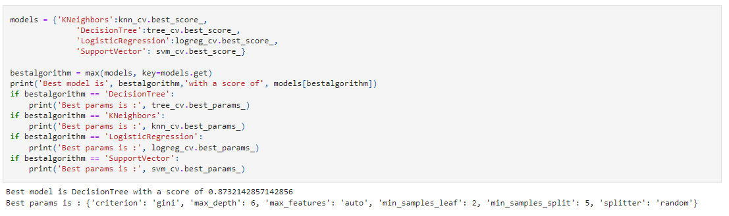
The decision tree classifier is the model with the highest classification accuracy

Slide 41
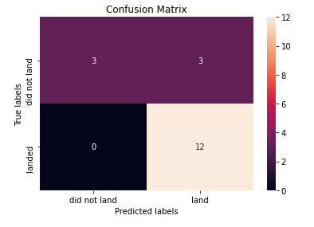
Confusion Matrix
Upon analyzing the confusion matrix for the decision tree classifier, we discovered that the classifier is capable of accurately differentiating between various classes. However, a significant issue exists with false positives, where the classifier incorrectly identifies unsuccessful landings as successful landings.

Slide 42
Conclusions
Based on our analysis, we have determined that:
Launch sites with higher flight amounts tend to have higher success rates.
The launch success rate has been steadily increasing since 2013 and through 2020.
Orbits such as ES-L1, GEO, HEO, SSO, and VLEO had the highest success rates.
KSC LC-39A had the most successful launches compared to any other site.
The decision tree classifier is the most effective machine learning algorithm for this particular task.

Slide 43
Thank you!

