Slide 1
CSE 3400 - Introduction to Computer & Network Security (aka: Introduction to Cybersecurity) Lecture 11 Public Key Cryptography– Part II
Ghada Almashaqbeh
UConn
From Textbook Slides by Prof. Amir Herzberg
UConn

Slide 2
Outline
Number theory review.
2

Slide 3
Public Key Encryption
3

Slide 4
Public Key Cryptosystem
Key length l
KeyGen KG
Encryption Key e
(public)
(e,d)
Decryption Key d
(private)
e
d
Plaintext
m
Encrypt E
Ciphertext c=E_{e}(m)
Decrypt D
Plaintext m=D_{d}(E_{e}(m))

Slide 5
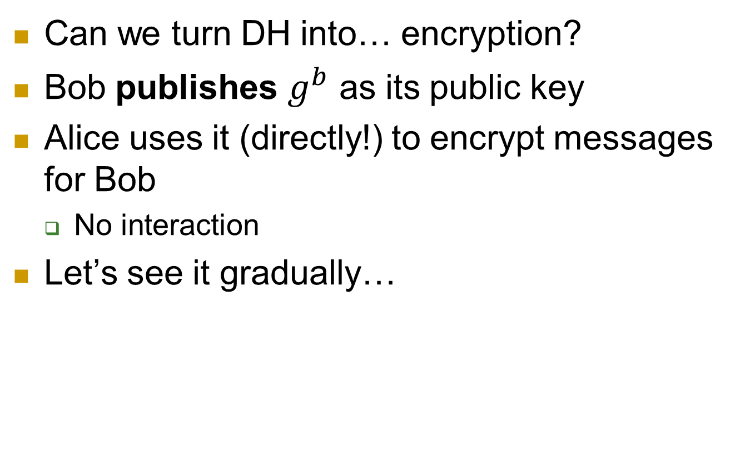
Using DH: for Encryption?
Can we turn DH into… encryption?
Bob publishes $g^{b}$ as its public key
Alice uses it (directly!) to encrypt messages for Bob
No interaction
Let’s see it gradually…

Slide 6

Turning [DH] to Public Key Cryptosystem
Select random prime p and generator g
Alice: secret key a, public key P_{A}= gª mod p
Bob: secret key b, public key P_{B}= $g^{b}$ mod p

Slide 7
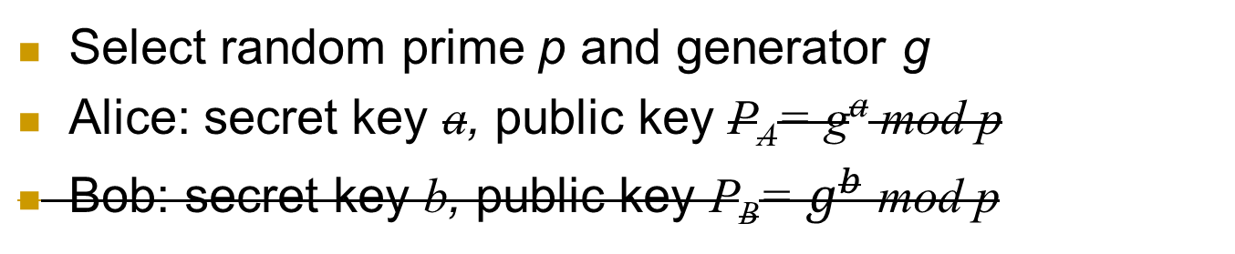
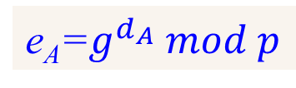
Turning [DH] to Public Key Cryptosystem
Select random prime p and generator g
Alice: secret key a, public key P_{A}= gª mod p
Bob: secret key b, public key P_{B}= $g^{b}$ mod p
d_{A}
e_{A}=$g^{d_{A}} mod p$
(Bob will encrypt – does not have keys)

Slide 8


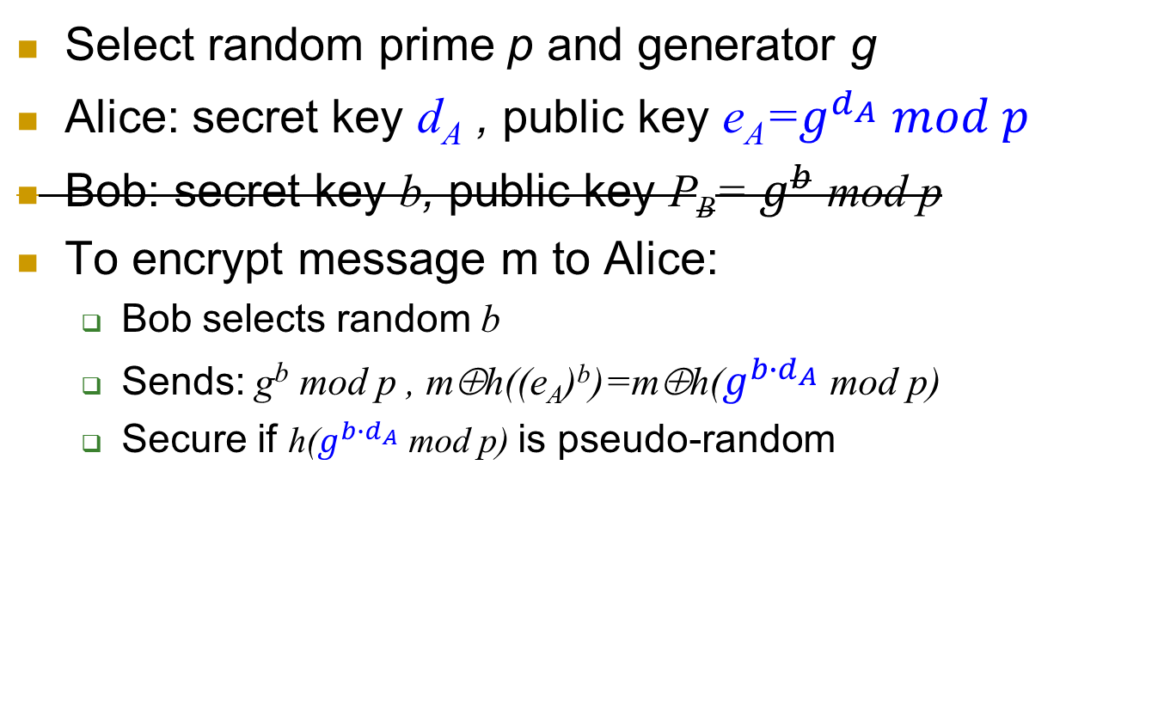

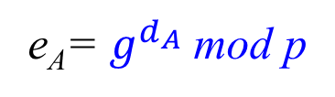
Turning [DH] to Public Key Cryptosystem
Select random prime p and generator g
Alice: secret key d_{A} , public key e_{A}=$g^{d_{A}} mod p$
Bob: secret key b, public key P_{B}= $g^{b}$ mod p
To encrypt message m to Alice:
Bob selects random b
Sends: g^{b} mod p , m⊕h((e_{A})^{b})=m⊕h($g^{{b∙d}_{A}}$ mod p)
Secure if h($g^{{b∙d}_{A}}$ mod p) is pseudo-random
Alice
e_{A}= $g^{d_{A}}$ mod p
Bob
g^{b} mod p , m⊕ h($g^{{b∙d}_{A}}$ mod p)

Slide 9
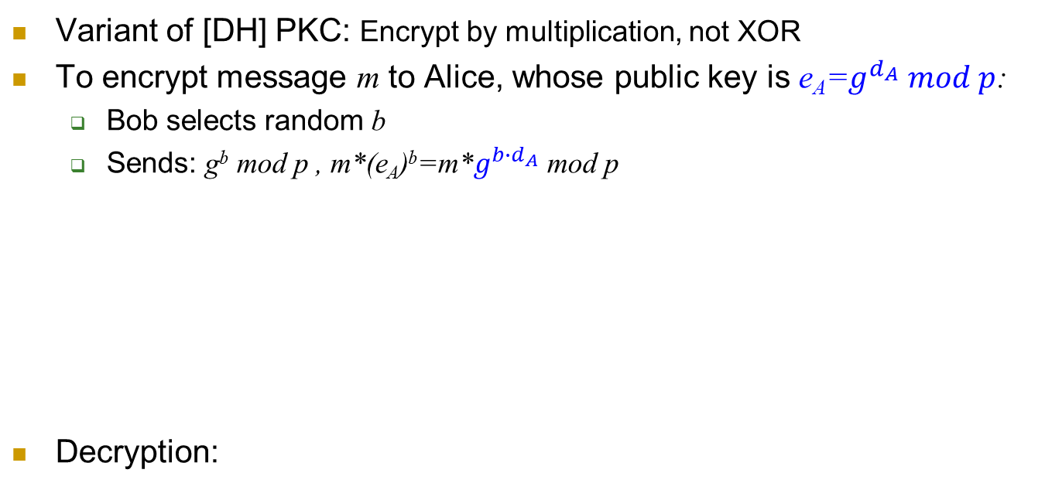

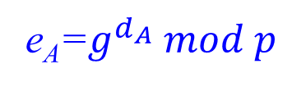
El-Gamal Public Key Cryptosystem
Variant of [DH] PKC: Encrypt by multiplication, not XOR
To encrypt message m to Alice, whose public key is e_{A}=$g^{d_{A}} mod p$:
Bob selects random b
Sends: g^{b} mod p , m*(e_{A})^{b}=m*$g^{{b∙d}_{A}}$ mod p
Decryption:
Alice
e_{A}=$g^{d_{A}} mod p$
Bob
Select
random b
(g^{b} mod p , (m* $e_{A}^{b}$) mod p)

Slide 10


El-Gamal Public Key Cryptosystem
Encryption:
Decryption:
Correctness:

Slide 11
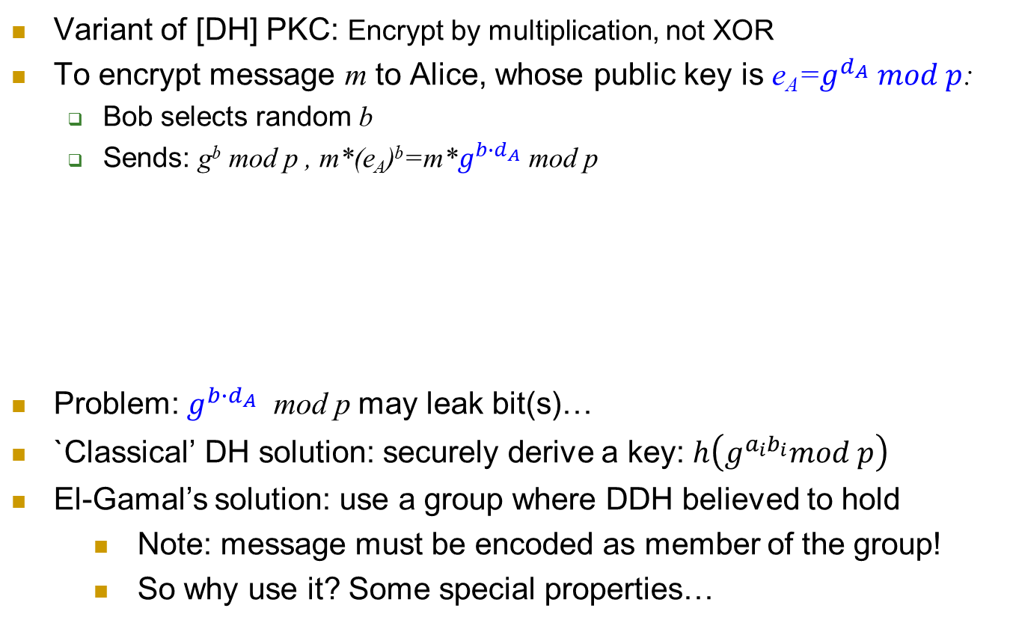

El-Gamal Public Key Cryptosystem
Variant of [DH] PKC: Encrypt by multiplication, not XOR
To encrypt message m to Alice, whose public key is e_{A}=$g^{d_{A}} mod p$:
Bob selects random b
Sends: g^{b} mod p , m*(e_{A})^{b}=m*$g^{{b∙d}_{A}}$ mod p
Problem: $g^{{b∙d}_{A}}$ mod p may leak bit(s)…
`Classical’ DH solution: securely derive a key: $h\left(g^{a_{i}b_{i}}mod p\right)$
El-Gamal’s solution: use a group where DDH believed to hold
Note: message must be encoded as member of the group!
So why use it? Some special properties…
Alice
e_{A}=$g^{d_{A}} mod p$
Bob
Select
random b
(g^{b} mod p , (m* $e_{A}^{b}$) mod p)

Slide 12
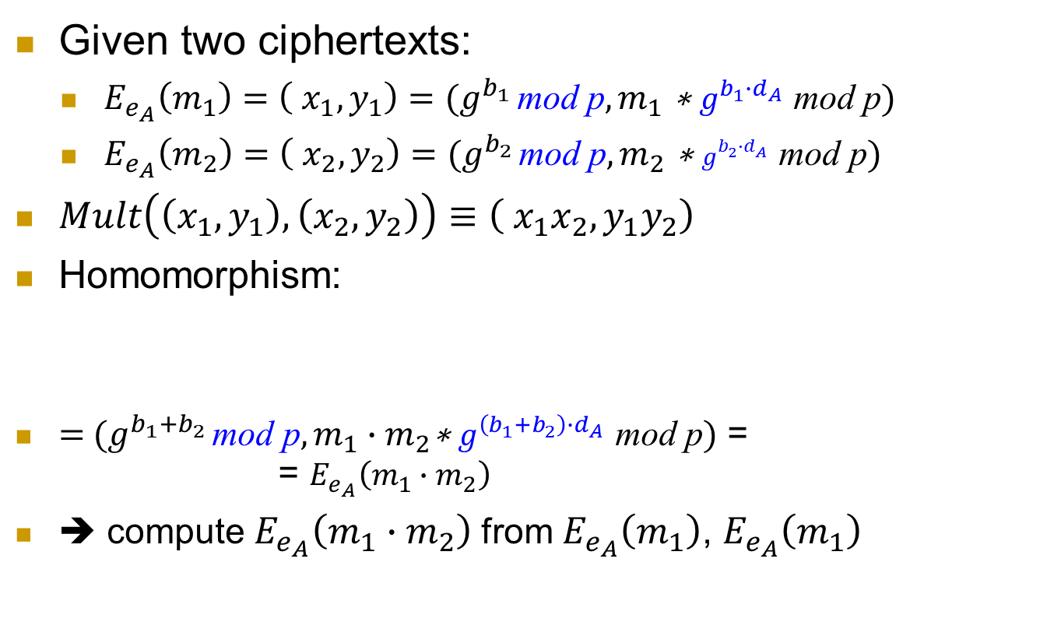
El-Gamal PKC: homomorphism
Given two ciphertexts:
$E_{e_{A}}\left(m_{1}\right)=\left( x_{1},y_{1}\right)=(g^{b_{1}} \text{mod} \text{p},m_{1} \text{∗ }g^{{b_{1}∙d}_{A}} \text{mod} \text{p})$
$E_{e_{A}}\left(m_{2}\right)=\left( x_{2},y_{2}\right)$ $=(g^{b_{2}} \text{mod} \text{p},m_{2} \text{∗ }g^{{b_{2}∙d}_{A}} \text{mod} \text{p})$
$Mult\left(\left(x_{1},y_{1}\right),\left(x_{2},y_{2}\right)\right)≡\left( x_{1}x_{2},y_{1}y_{2}\right)$
Homomorphism:
$=$ $(g^{b_{1}+b_{2}} \text{mod} \text{p},m_{1}∙m_{2}\text{∗ }g^{{\left(b_{1}+b_{2}\right)∙d}_{A}} \text{mod} \text{p})$ = = $E_{e_{A}}\left(m_{1}∙m_{2}\right)$
➔ compute $E_{e_{A}}\left(m_{1}∙m_{2}\right)$from $E_{e_{A}}\left(m_{1}\right)$, $E_{e_{A}}\left(m_{1}\right)$

Slide 13
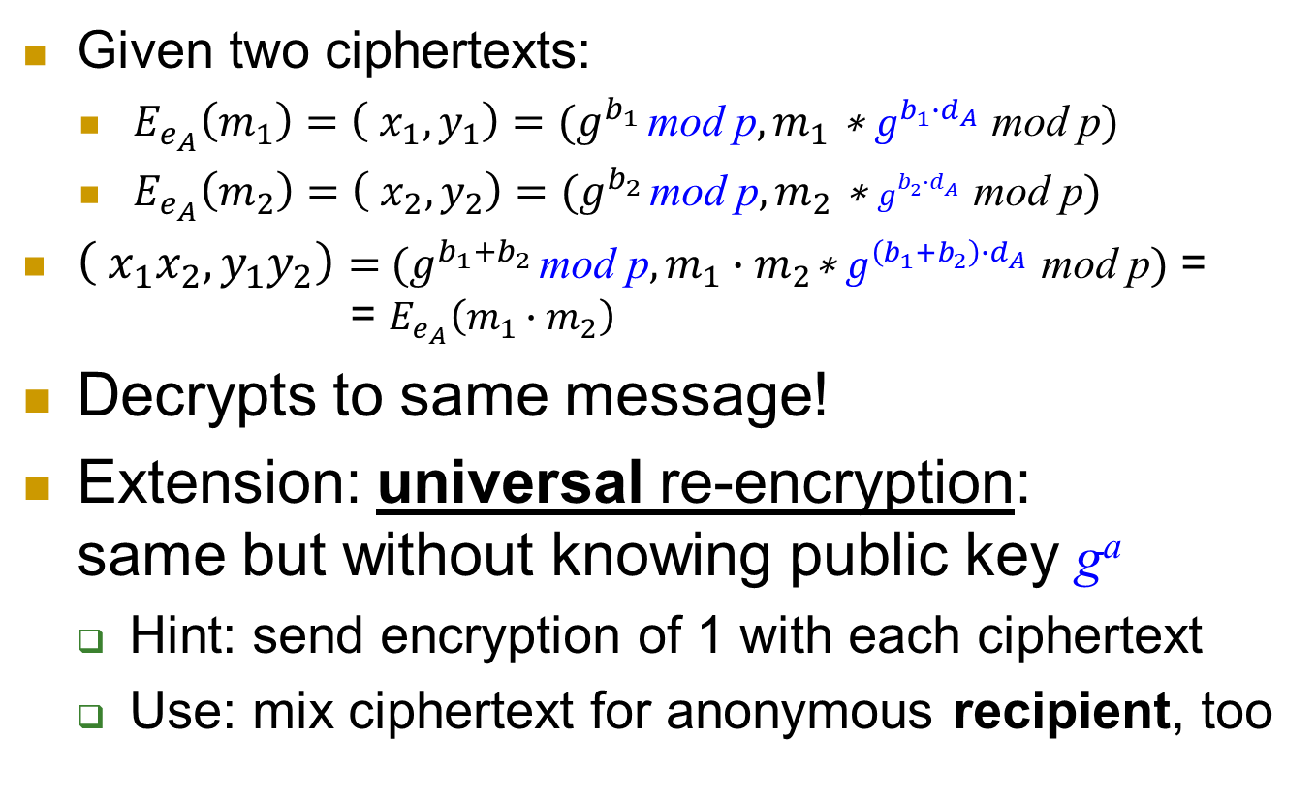
El-Gamal PKC: homomorphism
Given two ciphertexts:
$E_{e_{A}}\left(m_{1}\right)=\left( x_{1},y_{1}\right)=(g^{b_{1}} \text{mod} \text{p},m_{1} \text{∗ }g^{{b_{1}∙d}_{A}} \text{mod} \text{p})$
$E_{e_{A}}\left(m_{2}\right)=\left( x_{2},y_{2}\right)$ $=(g^{b_{2}} \text{mod} \text{p},m_{2} \text{∗ }g^{{b_{2}∙d}_{A}} \text{mod} \text{p})$
$\left( x_{1}x_{2},y_{1}y_{2}\right)=$ $(g^{b_{1}+b_{2}} \text{mod} \text{p},m_{1}∙m_{2}\text{∗ }g^{{\left(b_{1}+b_{2}\right)∙d}_{A}} \text{mod} \text{p})$ = = $E_{e_{A}}\left(m_{1}∙m_{2}\right)$
Decrypts to same message!
Extension: universal re-encryption: same but without knowing public key gª
Hint: send encryption of 1 with each ciphertext
Use: mix ciphertext for anonymous recipient, too

Slide 14

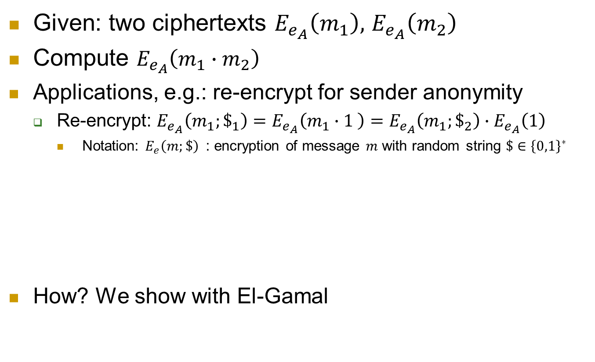




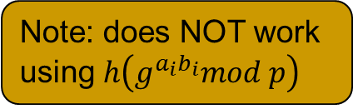

Homomorphic Encryption
Given: two ciphertexts $E_{e_{A}}\left(m_{1}\right),$ $E_{e_{A}}\left(m_{2}\right)$
Compute $E_{e_{A}}\left(m_{1}∙m_{2}\right)$
Applications, e.g.: re-encrypt for sender anonymity
Re-encrypt: $E_{e_{A}}\left(m_{1};\$_{1}\right)=E_{e_{A}}\left(m_{1}∙1 \right)=E_{e_{A}}\left(m_{1};\$_{2}\right)∙E_{e_{A}}\left(1\right)$
Notation: $E_{e}\left(m;\$\right)$ : encryption of message $m$ with random string $\$∈{\left\{0,1\right\}}^{∗}$
How? We show with El-Gamal
Bob
$$c_{B}=E_{A}(m_{B};\$_{1})$$
M₁
$${c′}_{C},{c′}_{B}$$
M₂
$${c′′}_{B},{c′′}_{C}$$
Alice
Charlie
$${c′}_{B}=E_{A}(m_{B};\$_{3})$$
$$c_{C}=E_{A}(m_{C};\$_{2})$$
$${c′}_{C}=E_{A}(m_{C};\$_{4})$$
Note: does NOT work using $h\left(g^{a_{i}b_{i}}mod p\right)$

Slide 15
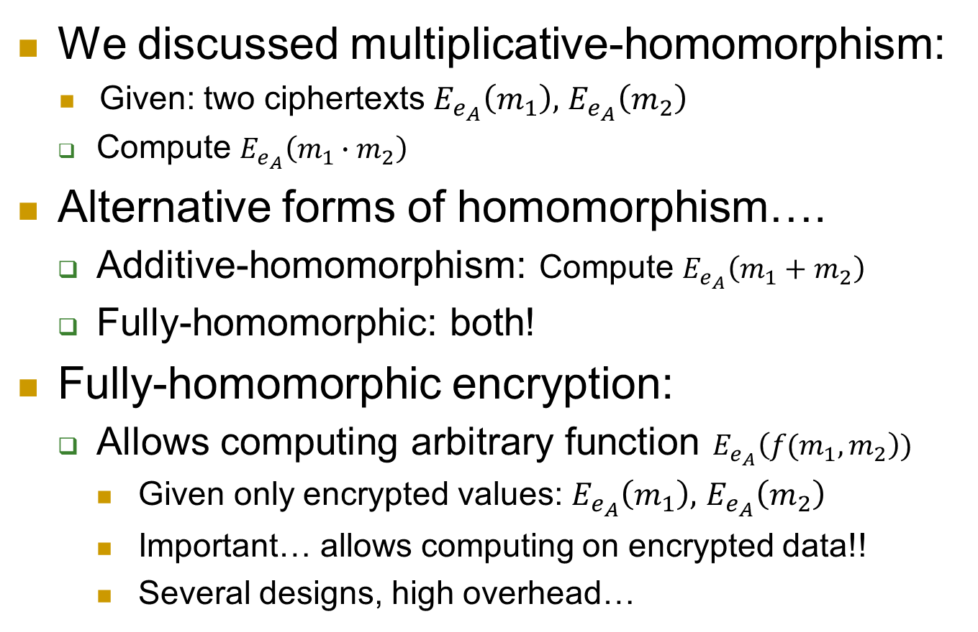
Fully-homomorphic encryption?
We discussed multiplicative-homomorphism:
Given: two ciphertexts $E_{e_{A}}\left(m_{1}\right),$ $E_{e_{A}}\left(m_{2}\right)$
Compute $E_{e_{A}}\left(m_{1}∙m_{2}\right)$
Alternative forms of homomorphism….
Additive-homomorphism: Compute $E_{e_{A}}\left(m_{1}+m_{2}\right)$
Fully-homomorphic: both!
Fully-homomorphic encryption:
Allows computing arbitrary function $E_{e_{A}}\left({f(m}_{1},m_{2}\right))$
Given only encrypted values: $E_{e_{A}}\left(m_{1}\right),$ $E_{e_{A}}\left(m_{2}\right)$
Important… allows computing on encrypted data!!
Several designs, high overhead…

Slide 16
El-Gamal PKC: homomorphism
Given two ciphertexts:
$E_{e_{A}}\left(m_{1}\right)=\left( x_{1},y_{1}\right)=(g^{b_{1}} \text{mod} \text{p},m_{1} \text{∗ }g^{{b_{1}∙d}_{A}} \text{mod} \text{p})$
$E_{e_{A}}\left(m_{2}\right)=\left( x_{2},y_{2}\right)$ $=(g^{b_{2}} \text{mod} \text{p},m_{2} \text{∗ }g^{{b_{2}∙d}_{A}} \text{mod} \text{p})$
$\left( x_{1}x_{2},y_{1}y_{2}\right)=$ $(g^{b_{1}+b_{2}} \text{mod} \text{p},m_{1}∙m_{2}\text{∗ }g^{{\left(b_{1}+b_{2}\right)∙d}_{A}} \text{mod} \text{p})$ = = $E_{e_{A}}\left(m_{1}∙m_{2}\right)$
Decrypts to same message!
Extension: universal re-encryption: same but without knowing public key gª
Hint: send encryption of 1 with each ciphertext
Use: mix ciphertext for anonymous recipient, too

Slide 17
RSA Public Key Cryptosystem
2002 Turing
Award
First proposed – and still widely used
Not really covered in this course – take crypto!
Some basic details…
Select two large primes p,q ; let n=pq
Select prime e (public key: <n,e>)
Or co-prime with Φ(n) =(p-1)(q-1)
Let private key be d=e⁻¹ mod Φ(n) (i.e., ed=1 mod Φ(n))
Encryption: RSA.E_{e,n}(m)=m^{e} mod n
Decryption: RSA.D_{d,n}(c)=c^{d} mod n
Correctness: D_{d,n}(E_{e,n}(m))= (m^{e})^{d} = m^{ed} = m mod n
Intuitively: ed=1 mod Φ(n) ➔ m^{ed} = m mod n
But why ?
A bit of number-theory `magic’…

Slide 18
Euler Theorem & Function φ_{n}= Φ(n)
Euler’s Theorem: if a, n are co-primes then a^{Φ(n)}=1 mod n
Co-primes: no common divisor, i.e. gcd(a, n)=1
Where Φ(n), called Euler function of n, is the number of positive integers less than n and co-prime to n.
For every prime p holds Φ(p)=p-1
Φ(p)=(p-1) for any prime p
Φ(pq)=(p-1)(q-1) for any primes p,q
Why? pq has common divisor with p, 2p,.. (q-1)p, q, 2q, …(p-1)q
So number of smaller co-primes: (pq-1)-[(p-1)+(q-1)]=pq-p-q+1=(p-1)(q-1)
n | 1 | 2 | 3 | 4 | 5 | 6 | 7 | 8 | 9 | 10 | 11 | 12 | 13 | 14 | 15
Φ(n) | 1 | 1 | 2 | 2 | 4 | 2 | 6 | 4 | 6 | 4 | 10 | 4 | 12 | 6 | 8

Slide 19
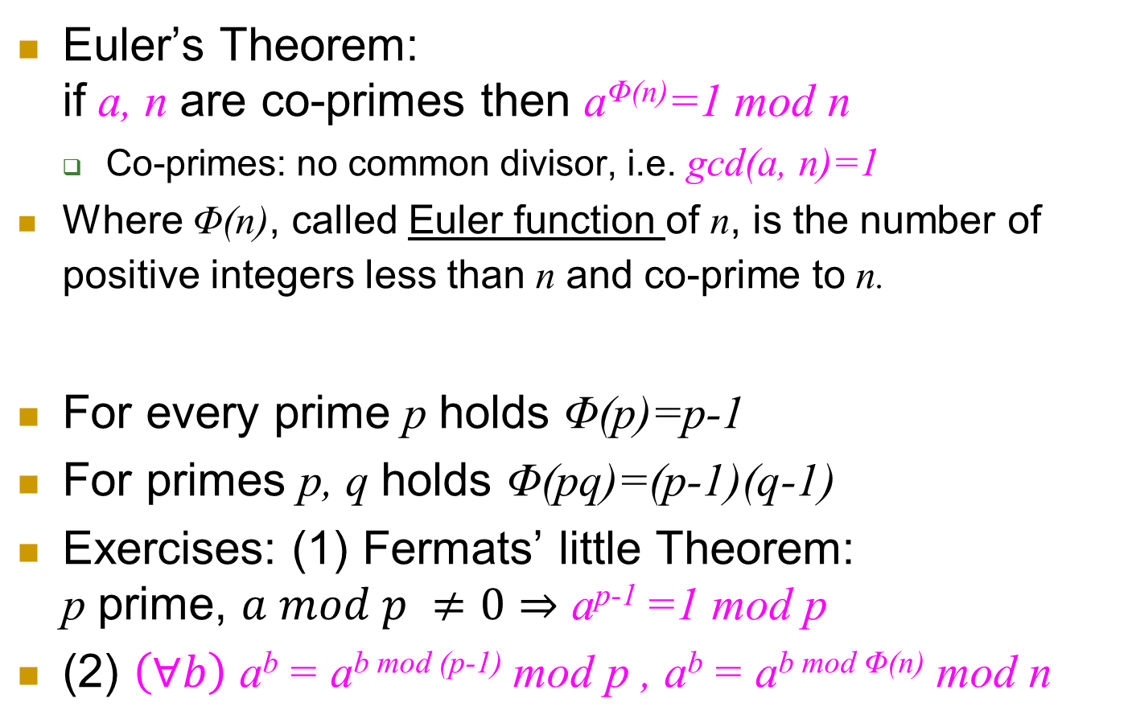
Euler Theorem & Function φ_{n}= Φ(n)
Euler’s Theorem: if a, n are co-primes then a^{Φ(n)}=1 mod n
Co-primes: no common divisor, i.e. gcd(a, n)=1
Where Φ(n), called Euler function of n, is the number of positive integers less than n and co-prime to n.
For every prime p holds Φ(p)=p-1
For primes p, q holds Φ(pq)=(p-1)(q-1)
Exercises: (1) Fermats’ little Theorem: p prime, $a mod p ≠0⇒$ a^{p-1} =1 mod p
(2) $\left(∀b\right)$ a^{b} = a^{b mod (p-1)} mod p , a^{b} = a^{b mod Φ(n)} mod n
n | 1 | 2 | 3 | 4 | 5 | 6 | 7 | 8 | 9 | 10 | 11 | 12 | 13 | 14 | 15
Φ(n) | 1 | 1 | 2 | 2 | 4 | 2 | 6 | 4 | 6 | 4 | 10 | 4 | 12 | 6 | 8
Notes:
In Fermat’s theorem, we use the fact that a, p are co-prime (since a mod p is not 0)

Slide 20
RSA Public Key Cryptosystem
Select two large primes p,q and let n=pq
➔ Φ(n)=Φ(pq)=(p-1)(q-1)
Select prime e; public key: <n,e>
Private key: d=e⁻¹ mod Φ(n) ➔ ed=1+l Φ(n) for some l
Encryption: RSA.E_{e,n}(m)=m^{e} mod n
Decryption: RSA.D_{d,n}(c)=c^{d} mod n
Correctness: D_{d,n}(E_{e,n}(m))= m^{ed} mod n
m^{ed}=m^{ed}= m^{1+l Φ(n)} =m m^{l Φ(n)} =m (m^{Φ(n)} )^{l}
m^{ed} mod n =m (m^{Φ(n)} mod n )^{l} mod n
Eulers’Theorem: m^{Φ(n)} mod n=1 mod n
➔ D_{d,n}(E_{e,n}(m))= m^{ed} mod n=m 1^{l} mod n =m

Slide 21
RSA Public Key Cryptosystem
Correctness: D_{d,n}(E_{e,n}(m))= m^{ed} mod n
m^{ed}=m^{ed}= m^{1+l Φ(n)} =m m^{l Φ(n)} =m (m^{Φ(n)} )^{l}
m^{ed} mod n =m (m^{Φ(n)} mod n )^{l} mod n
Eulers’Theorem: m^{Φ(n)} mod n=1 mod n
➔ D_{d,n}(E_{e,n}(m))= m^{ed} mod n=m 1^{l} mod n =m
Comments:
m<n ➔ m= m mod n
Eulers’ Theorem holds (only) if m, n are co-primes
If not co-primes? Use Chinese Reminder Theorem
A nice, not very complex argument
But: beyond our scope – take Crypto!

Slide 22
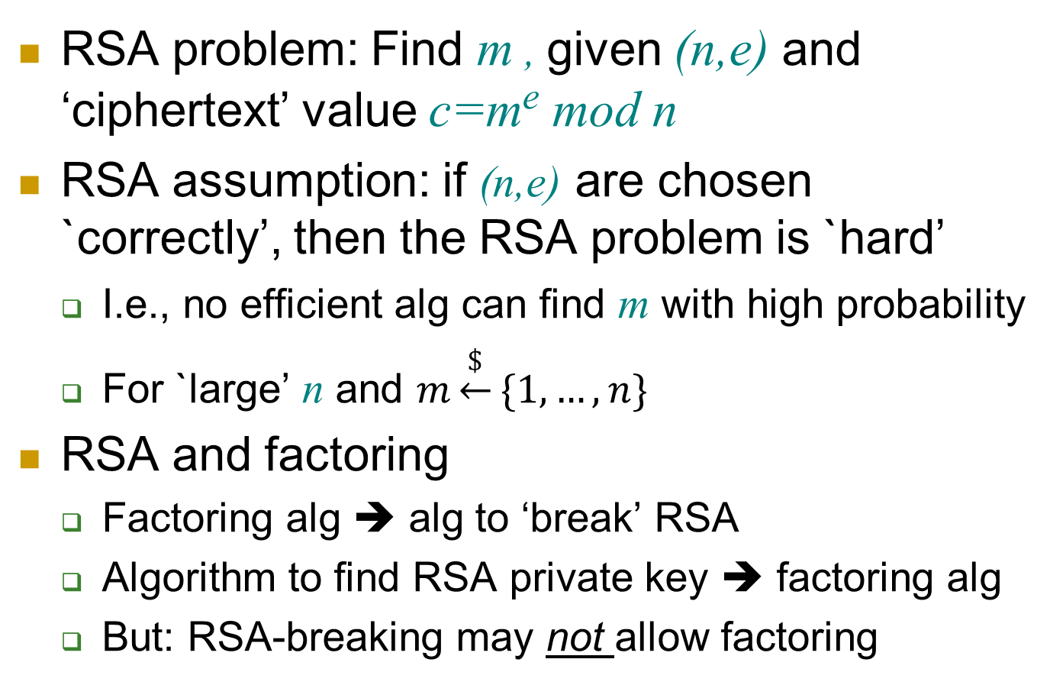
The RSA Problem and Assumption
RSA problem: Find m , given (n,e) and ‘ciphertext’ value c=m^{e} mod n
RSA assumption: if (n,e) are chosen `correctly’, then the RSA problem is `hard’
I.e., no efficient alg can find m with high probability
For `large’ n and $m\underset{←}{\$}\{1,…,n\}$
RSA and factoring
Factoring alg ➔ alg to ‘break’ RSA
Algorithm to find RSA private key ➔ factoring alg
But: RSA-breaking may not allow factoring
Does not prevent exposure of partial information
May not be secure for a non-random message
Does not ensure randomization (indistinguishablity)

Slide 23
Padding RSA
Pad and Unpad functions:
Encryption with padding:
Decryption with unpad:
Required to…
Add randomization
Prevent detection of repeating plaintext
Prevent ‘related message’ attack (to allow use of tiny e)
Detect, prevent (some) chosen-ciphertext attacks
Early paddings schemes subject to CCA attacks
Even ‘Feedback-only CCA’ (aware of unpad failure)

Slide 24
Conclusions
Public key cryptography is important:
Improved resiliency to key exposure
Easier key management, distribution
Signatures!
But:
Requires an asymmetric problem/function:
Easy to decrypt/sign with private key, hard without it
Easy to encrypt/verify (using only public key)
Assumptions
Much slower
Longer keys, messages

Slide 25

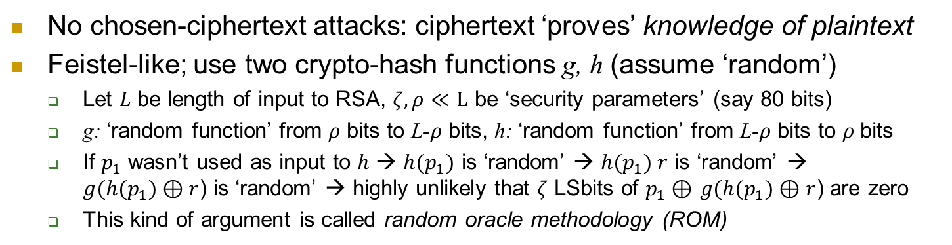
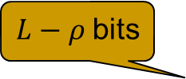

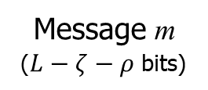
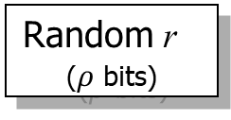
Optimal Asymmetric Encryption Padding (OAEP)
No chosen-ciphertext attacks: ciphertext ‘proves’ knowledge of plaintext
Feistel-like; use two crypto-hash functions g, h (assume ‘random’)
Let $L$ be length of input to RSA, $ζ,ρ≪L$ be ‘security parameters’ (say 80 bits)
g: ‘random function’ from $ρ$ bits to L-$ρ$ bits, h: ‘random function’ from L-$ρ$ bits to $ρ$ bits
If $p_{1}$ wasn’t used as input to $h$ → ${h(p}_{1})$ is ‘random’ → ${h(p}_{1}) r$ is ‘random’ → ${g(h(p}_{1})⊕r$) is ‘random’ → highly unlikely that $ζ$ LSbits of $p_{1}⊕$ ${g(h(p}_{1})⊕r$) are zero
This kind of argument is called random oracle methodology (ROM)
Message m
($L−ζ−ρ$ bits)
Random r
($ρ$ bits)
0^{𝜁}
g( )
Plaintext
$L−ρ$bits
h( )
$ρ$bits
Padded Plaintext p₁
p₂
Textbook RSA: $c={(p_{1}||p_{2})}^{e}\text{mod} n$

Slide 26
OAEP & PKCS #1 Version 2.0
Let’s prove CCA-security… for simpler RSA variant !
m
r
0^{k}
g( )
Plaintext
h( )
s
t
Padded Plaintext

Slide 27
How does Bob know Alice’s public key?
Depends on threat model…
Passive (`eavesdropping`) adversary: just send it
Off-path (`blind`) adversary: use nonce
Man-in-the-Middle (MITM): authenticate
Authenticate – how?
MAC: requires shared secret key
Public key signature scheme: authenticate using public key
Certificate: public key of entity – signed by certificate authority (CA)

Slide 28
Digital Signature
28

Slide 29

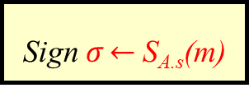

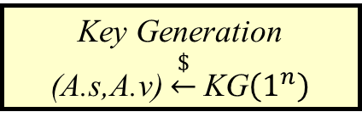
Public Key Digital Signatures
Key Generation
(A.s,A.v) $\underset{←}{\$}$KG$\left(1^{n}\right)$
Key length n
Alice’s private
signing key A.s
Alice’s public verification key A.v
A.s
A.v
Message
m
Sign $σ\underset{←}{}$S_{A.s}(m)
$$σ$$
$$(m,σ)$$
Verify V_{A.v}(m, σ)
Sign using a private, secret signature key (A.s for Alice)
Validate using a public key (A.v for Alice)
Everybody can validate signatures at any time
Provides authentication, integrity and evidence / non-repudiation
MAC: ‘just’ authentication+integrity, no evidence, can repudiate

Slide 30
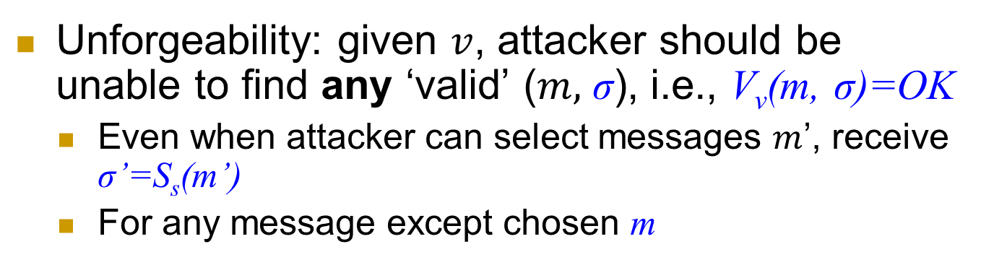
PK Signatures: Unforgeability Requirement
Key Generation
(A.s,A.v) $\underset{←}{\$}$KG$\left(1^{n}\right)$
Key length n
Alice’s private
signing key A.s
Alice’s public verification key A.v
A.s
A.v
Message
m
Sign $σ\underset{←}{}$S_{A.s}(m)
$$σ$$
$$(m,σ)$$
Verify V_{A.v}(m, σ)
Unforgeability: given $v$, attacker should be unable to find any ‘valid’ ($m,$ σ), i.e., V_{v}(m, σ)=OK
Even when attacker can select messages $m$’, receive σ’=S_{s}(m’)
For any message except chosen m

Slide 31
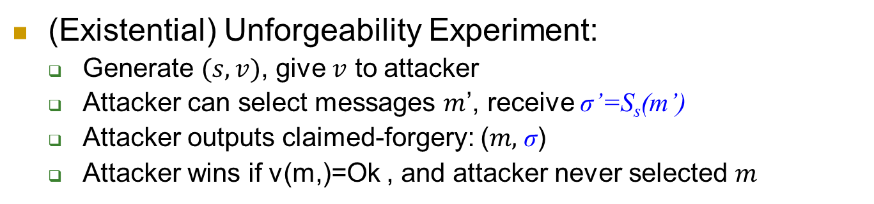
PK Signatures: Unforgeability Requirement
Key Generation
(A.s,A.v) $\underset{←}{\$}$KG$\left(1^{n}\right)$
Key length n
Alice’s private
signing key A.s
Alice’s public verification key A.v
A.s
A.v
Message
m
Sign $σ\underset{←}{}$S_{A.s}(m)
$$σ$$
$$(m,σ)$$
Verify V_{A.v}(m, σ)
(Existential) Unforgeability Experiment:
Generate $(s,v)$, give $v$ to attacker
Attacker can select messages $m$’, receive σ’=S_{s}(m’)
Attacker outputs claimed-forgery: ($m,$ σ)
Attacker wins if v(m,)=Ok , and attacker never selected $m$
Notes:
Similarly to different notions of indistinguishable encryption, there are different notions of unforgeability, but we focus on `existential unforgeability’ which is the strongest notion (and the one usually used): attacker can’t generate signature on _any_ message not signed using private key.

Slide 32
Public Key Certificate
Certificate: signature by Certificate Authority (CA) over subject’s public key and attributes (e.g., domain name)
CA.v (CA’s validation key)
A web site
Browser
More: in TLS/PKI lectures…

Slide 33
RSA Signatures
Secret signing key s, public verification key v
Short (<n) messages: RSA signing with message recovery
First attempt:
RSA.S_{s}(m)= m^{s} mod n, RSA.V_{v}(m,x)={ OK if m=x^{v} mod n; else, FAIL }
Hmm… for any x, let m=x^{v} mod n ; then RSA.V_{v}(m,x)= OK
Unforgeability requirement fails: attacker has a forgery !
Preventing `random signatures’ ?
RSA.S_{s}(m)= pad(m)^{s} mod n, RSA.V_{v}(m,x)={OK if m=unpad(x^{v} mod n); else, FAIL}
Pad, unpaid: redundancy added (pad) and verified (unpad)
Long messages: ??
Hint: use collision resistant hash function (CRHF)
Notes:
33
(c) Amir Herzberg, http://AmirHerzberg.com, Bar Ilan University
04/07/06

Slide 34



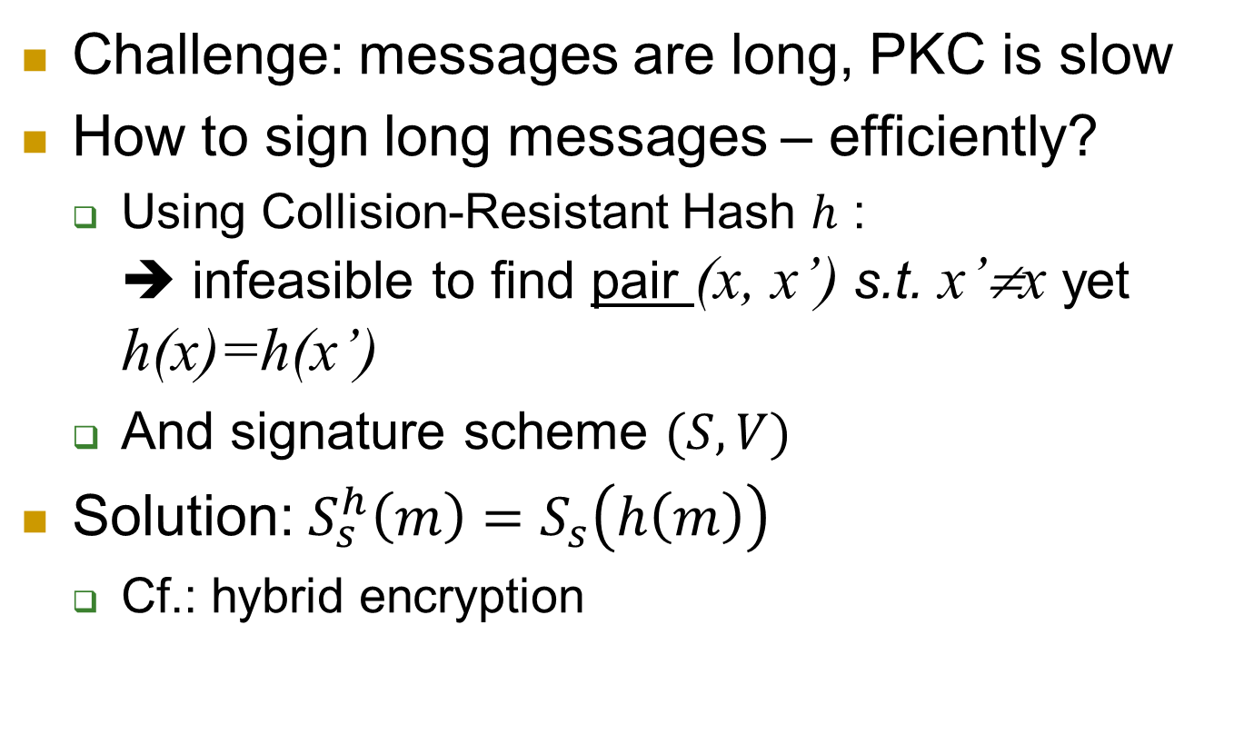
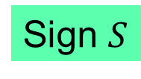


The Hash-then-Sign Paradigm
Challenge: messages are long, PKC is slow
How to sign long messages – efficiently?
Using Collision-Resistant Hash $h$ : ➔ infeasible to find pair (x, x’) s.t. x’≠x yet h(x)=h(x’)
And signature scheme $(S,V)$
Solution: $S_{s}^{h}\left(m\right)=S_{s}\left(h\left(m\right)\right)$
Cf.: hybrid encryption
Message $m$
Hash $h$
$$h(m)$$
Sign $S$
$$S_{s}^{h}\left(m\right)$$

Slide 35
RSA Signatures
Secret signing key s, public verification key v
Short (<n) messages: RSA signing with message recovery
RSA.S_{s}(m)= R(m)^{s} mod n, RSA.V_{v}(x)={R⁻¹(x^{v} mod n); error if undefined}
R(.) : redundancy function ; make random string unlikely to be valid signature
Long messages: hash-then-sign, RSA_h, h:{0,1}*→{0.1}^{L}
Aka signature with appendix
RSA_h.S_{s}(m)=m||[h(m)]^{s} mod n
RSA_h.V_{v}(m || x)=m iff h(m)=x^{v} mod n (else: error)
m, m’ s.t. h(m)=h(m’) ➔ sign(h(m))=sign(h(m’))
h is (keyless) collision resistant hash function (CRHF) ➔ infeasible to find pair (x, x’) s.t. x’≠x yet h(x)=h(x’)
Notes:
35
(c) Amir Herzberg, http://AmirHerzberg.com, Bar Ilan University
04/07/06

Slide 36
Discrete-Log Digital Signature?
RSA allowed encryption and signing… based on assuming factoring is hard
Can we sign based on assuming discrete log is hard?
Most well-known, popular scheme: DSA
Digital Signature Algorithm, by NSA/NIST
Details: crypto course
We’ll discuss simpler, less efficient El-Gamal Signatures

Slide 37
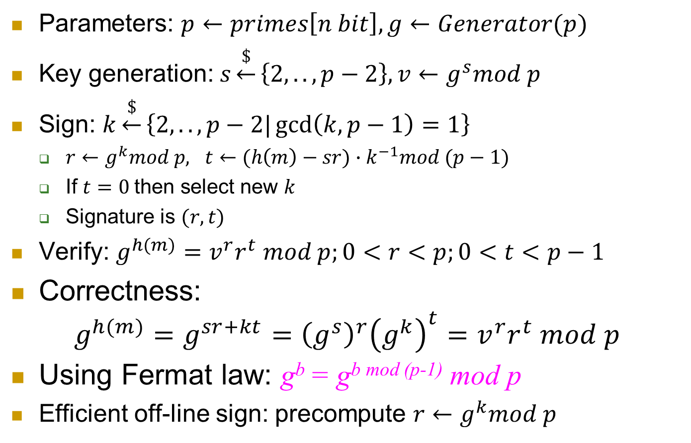
El-Gamal signatures
Parameters: $p←primes\left[n bit\right], g←Generator(p)$
Key generation: $s\underset{←}{\$}\left\{2,..,p−2\right\}, v←g^{s}mod p$
Sign: $k\underset{←}{\$}\left\{2,..,p−2|\gcd\left(k, p−1\right)=1\right\}$
$r←g^{k}mod p, t←{(h\left(m\right)−sr)∙k}^{−1}mod (p−1)$
If $t=0$then select new $k$
Signature is $(r,t)$
Verify: $g^{h(m)}=v^{r}r^{t} mod p;0<r<p;0<t<p−1$
Correctness: $g^{h(m)}=g^{sr+kt}={\left(g^{s}\right)}^{r}{\left(g^{k}\right)}^{t}=v^{r}r^{t} mod p$
Using Fermat law: g^{b} = g^{b mod (p-1)} mod p
Efficient off-line sign: precompute $r←g^{k}mod p$

Slide 38
Summary
Public key crypto allows:
Easier key management, distribution
Key agreement (DH): only need authenticated channel
Encryption: easier distribution, maintenance – public key
Resiliency to key exposure (PFS and PRS)
Signatures
Certificate: public key and a signature authenticating it
Evidences
Handling VIL messages: hash-then-sign
Next: Public Key Infrastructure (PKI) and TLS

Slide 39
Covered Material From the Textbook
Chapter 6
Sections 6.

Slide 40

Thank You!

