Slide 1
CSE 3400 - Introduction to Computer & Network Security (aka: Introduction to Cybersecurity) Lecture 4 Encryption – Part III (and Pseudo-randomness)
Ghada Almashaqbeh
UConn
From Textbook Slides by Prof. Amir Herzberg
UConn

Slide 2
Outline
Block ciphers.
Pseudorandom permutations (PRPs).
Defining security of encryption.
Encryption modes.
Real world use cases.
2

Slide 3
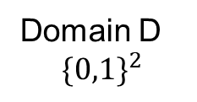
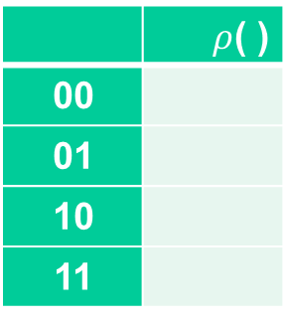
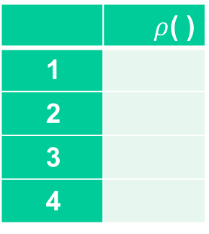
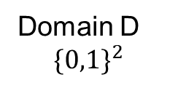
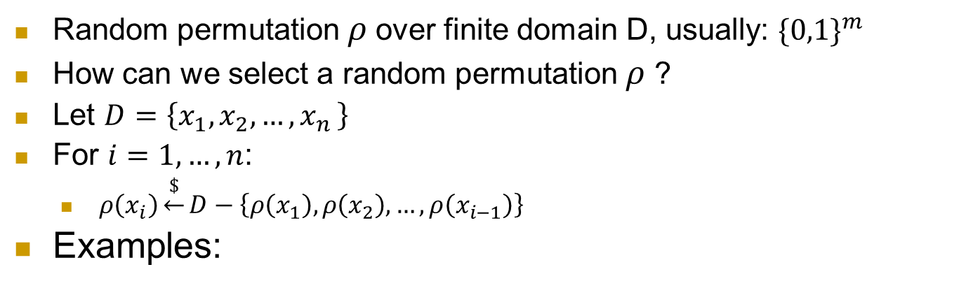
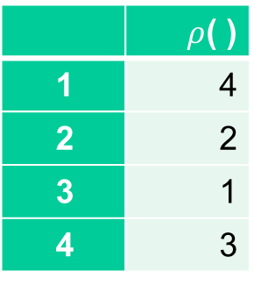

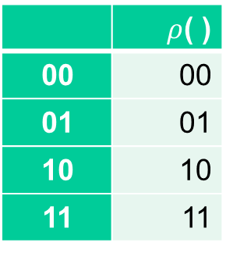
What is a random permutation $ρ$ ?
Random permutation $ρ$over finite domain D, usually: ${\{0,1\}}^{m}$
How can we select a random permutation $ρ$ ?
Let $D=\left\{x_{1},x_{2},…,x_{n }\right\}$
For $i=1,…, n$:
$ρ\left(x_{i}\right)\underset{←}{\$}D−\left\{ρ\left(x_{1}\right),ρ\left(x_{2}\right),…,ρ\left(x_{i−1}\right)\right\}$
Examples:
 | $ρ$( )
1
2
3
4
 | $ρ$( )
1 | 4
2 | 2
3 | 1
4 | 3
 | $ρ$( )
00
01
10
11
 | $ρ$( )
00 | 00
01 | 01
10 | 10
11 | 11
Domain D
$${\{0,1\}}^{2}$$
Domain D
$${\{0,1\}}^{2}$$

Slide 4
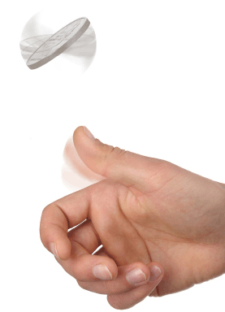


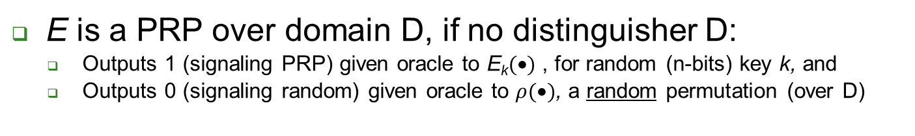
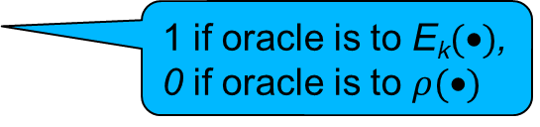


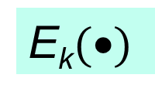
Pseudo-Random Permutation (PRP) and their Indistinguishabity Test
E is a PRP over domain D, if no distinguisher D:
Outputs 1 (signaling PRP) given oracle to E_{k}$(•)$ , for random (n-bits) key k, and
Outputs 0 (signaling random) given oracle to $ρ(•)$, a random permutation (over D)
n-bit Key k
k
x₁,x₂,…,x_{i}
x₁,x₂,…,x_{i}
E_{k}$(•)$
?
$$ρ(•)$$
…, E_{k}(x_{i})
…, $ρ$(x_{i})
Box 1: E_{k}$(•)$
Box 0: random permutation
1 if oracle is to E_{k}$(•)$,
0 if oracle is to $ρ(•)$

Slide 5
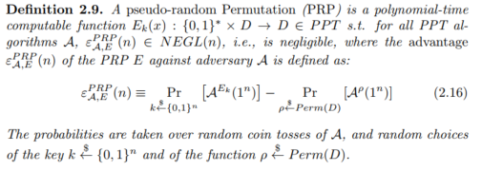
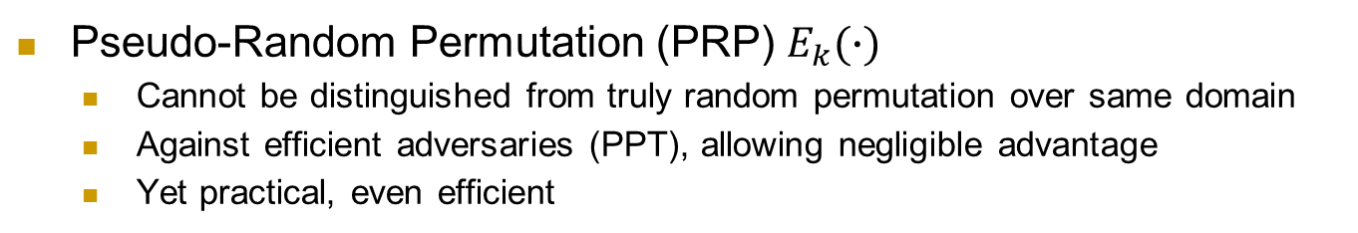
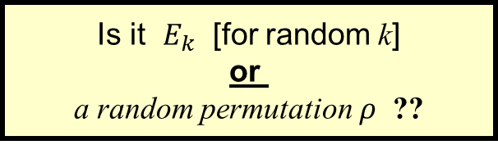
Pseudo-Random Permutation (PRP)
Pseudo-Random Permutation (PRP) $E_{k}(∙)$
Cannot be distinguished from truly random permutation over same domain
Against efficient adversaries (PPT), allowing negligible advantage
Yet practical, even efficient
Is it $E_{k}$ [for random k]
or a random permutation $ρ$ ??
x

Slide 6
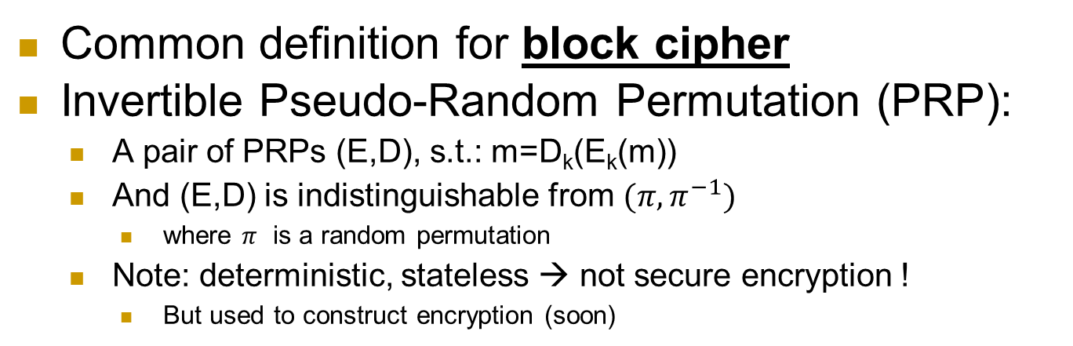
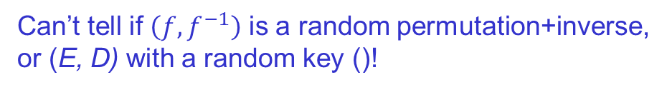
Block Cipher: Invertible PRP (E, D)
Common definition for block cipher
Invertible Pseudo-Random Permutation (PRP):
A pair of PRPs (E,D), s.t.: m=D_{k}(E_{k}(m))
And (E,D) is indistinguishable from $(π, π^{−1})$
where $π$ is a random permutation
Note: deterministic, stateless → not secure encryption !
But used to construct encryption (soon)
f← E_{k}(.) or D_{k}(.) [for random k]
or f← random n-bit permutation or its inverse
x
f(x)
Can’t tell if $\left(f,f^{−1}\right)$ is a random permutation+inverse, or (E, D) with a random key ()!

Slide 7
Block Ciphers
Block Cipher: a basic crypto building block
E_{k} , D_{k} : m=D_{k} (E_{k} (m))
Basis for encryption
Data Encryption Standard (DES): US NIST, 1977-2001, 64-bit blocks, 56 bit keys ➔ exhaustive search
Advanced Encryption Standard (AES): NIST 2002-?, 128-bit blocks, 128 bit keys
64 bit block
128 bit block
56-bit key
DES
1977-2001
128/192/256 bit key
AES
2002-?
64 bit block
128 bit block

Slide 8
News!!! ConCrypt Announcement
ConCrypt Inc. announced a new block cipher, the CES, which is features 500 bit key, yet is four time more efficient than AES, with only 128 bit key!!!
`CES was proven by leading experts to be more secure than AES’
Possible conclusions:
This class may not be necessary anymore
Or another?

Slide 9
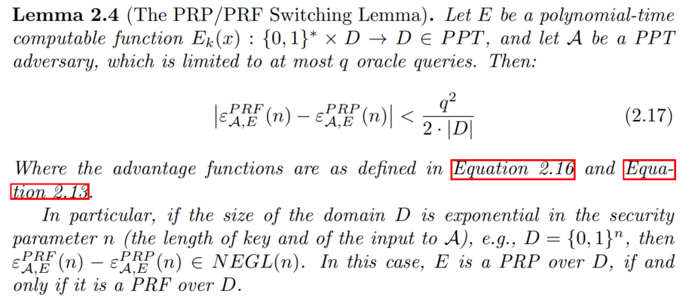


Constructing block-cipher, PRP
Focus: constructions from a PRF $f_{k}(∙)$
PRFs seem easier to design (less restrictions)
First: ‘plain’ PRP $E_{k}(∙)$ (not a block cipher)
What is the simplest construction to try?$E_{k}(x)$=______
$$f_{k}(x)$$

Slide 10
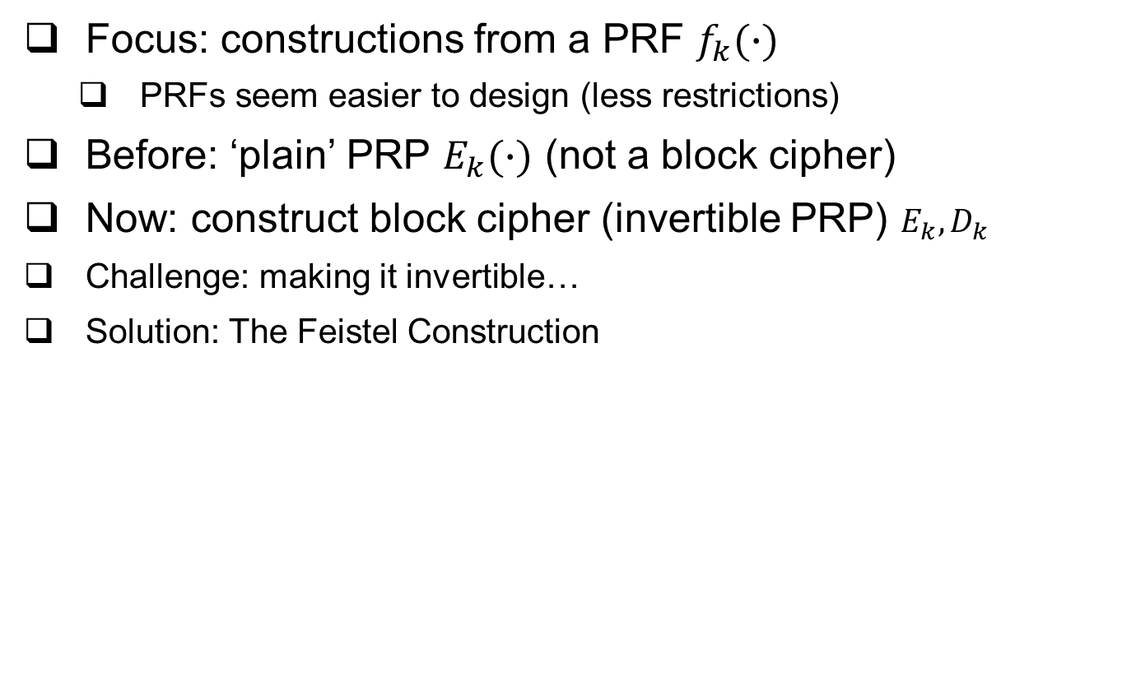
Constructing block-cipher, PRP
Focus: constructions from a PRF $f_{k}(∙)$
PRFs seem easier to design (less restrictions)
Before: ‘plain’ PRP $E_{k}(∙)$ (not a block cipher)
Now: construct block cipher (invertible PRP) $E_{k}, D_{k}$
Challenge: making it invertible…
Solution: The Feistel Construction

Slide 11






The Feistel Block-cipher Construction
Turn PRF F_{k} into a block cipher
Three ‘rounds’ suffice [LR88]
Used in DES (but not in AES)
With 16 ‘rounds’
$$m_{0,…,n−1}$$
$$m_{n,…,2n−1}$$
+
F_{k}()
$$L_{k}\left(m\right)$$
F_{k}()
+
F_{k}()
$$R_{k}\left(m\right)$$
+
$$g_{k}\left(m\right)$$

Slide 12

Crypto Building-Blocks Principle
Design and focus cryptanalysis efforts on few basic functions: simple, easy to test, replaceable
Construct schemes from basic functions
Provably secure constructions: attack on scheme ➔ attack on function
Allows replacing broken/suspect functions
Allows upgrading to more secure/efficient function
E.g., encryption from block cipher (or PRG/PRF/PRP)
Block-cipher, PRG,PRF,PRP: deterministic, stateless, FIL (Fixed-Input-Length)
Encryption: randomized/stateful, VIL (Variable-Input-Length)
Notes:
Another advantage is that robust combiner for function usually gives robust combiner for scheme (and usually, it is simpler than direct combiner for scheme)

Slide 13
Why standardize block ciphers, and not encryption?
Crypto building blocks principle, rephrased: design, cryptanalyze simple function, use function to construct more complex scheme
Design, cryptanalyze PRF; use it to build block cipher; and block cipher to construct cryptosystem
Attack on cryptosystem ➔ attack on block cipher, PRF
Design (FIL, deterministic, stateless) PRF, construct (VIL, randomized/stateful) cryptosystem
Easier to design and to combine:
Given two PRFs F, F’, let F’’_{k,k’}(x)=F_{k}(x)⊕F’_{k’}(x)
If either F or F’ is a secure PRF ➔ F’’ is secure PRF
This is a robust combiner for PRFs (block ciphers: also not hard)
Next: Feistel construction of Block-cipher from PRF!

Slide 14
We defined security for PRG, PRF and PRP. Block cipher too (informally). But… what about security of encryption??
A bit tricky, in fact.

Slide 15
Defining Secure Encryption
Attacker capabilities:
Computational limitations? ➔ PPT
Ciphertext only (CTO), Known / chosen plaintext attack (KPA/CPA), Chosen ciphertext (CCA)?
What’s a successful attack?
Key recovery ?
May be impossible yet weak cipher…
(Full) Message recovery?
What of partial exposure, e.g., m∈{“Advance”, “Retreat”}
Prudent: attacker ‘wins’ for any info on plaintext

Slide 16
Conservative Design Principle
When designing, evaluating a cryptosystem…
Consider most powerful attacker (CTO< KPA< CPA)
Be as general as possible – cover many applications
And `easiest’ attacker-success criteria
Not message/key recovery!
Make it easy to use securely, hard to use insecurely!
When designing, evaluating a system
Which use some cryptosystem
Restrict attacker’s capabilities (e.g., avoid known/chosen plaintext)

Slide 17
Cryptanalysis Success Criteria
Key recovery ? -- meaningless
(Full) Message recovery? – may be an overkill. E.g., when m∈{“Advance”, “Retreat”}
Can’t learn anything at all about plaintext – how to define? Can we achieve it ?
Well-defined notion: ‘semantic security’ [crypto course]
Indistinguishability: Eve ‘wins’ if she distinguishes between encryptions of (any) two messages
We focus on indistinguishability:
In crypto course: equivalent to semantic security

Slide 18
Defining Secure Encryption
Attacker’s capabilities:
Computational limitations? ➔ PPT
Ciphertext only (CTO), Known / chosen plaintext attack (KPA/CPA), Chosen ciphertext (CCA)?
Attacker’s goal: distinguish btw encryptions of two messages
Which messages? Let adversary choose!
Intuition: encryption is like ‘perfect disguise’

Slide 19


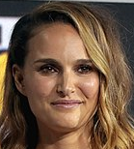

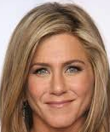
The Disguise Indistinguishability Test/Party
J (Judge/Jacob): choses actress, see disguised
Many times, actresses…………….. : Rachel, Lea, Natalie, …
J picks two of them… say: Rachel, Lea
J sees one of them (disguised)
Who is it?
Rachel, please!
J
Change
room
Choice: Rachel and Lea
It’s _______!
Notes:
Lea Thompson, Rachel Green (character from Friends, played by ), Natalie Portman

Slide 20
The Disguise Indistinguishability Test/Party
Basic rules:
Actresses change custom each time
All are roughly same size
Can’t ask a giant to disguise as a dwarf !
Rachel, please!
J
Change
room
Choice: Rachel and Lea
It’s _______!
Notes:
Lea Thompson, Rachel Green (character from Friends, played by ), Natalie Portman

Slide 21






IND-CPA-Encryption Test (1st try)
Flip coins to select random bit b and key k
A (adversary) gives message m, receives E_{k}(m)
Repeat if desired (with different messages m)
Chosen Plaintext Attack
A gives two messages (m₀,m₁), receives c*=E_{k}(m_{b})
A output b* , and ‘wins’ if b*=b
$$n,b$$
$$m$$
$
A
k
$${\left\{0,1\right\}}^{n}$$
$$Ek(m )$$
E_{k}(.)
$$m0 , m1$$
$$c∗=Ek(mb )$$
A wins if b*=b
b*

Slide 22






IND-CPA-Encryption Test (1st try): too easy!!
This test is too easy!! The adversary can easily win!!
How?????????
Hint: messages can be arbitrary binary strings
Namely, m, m₀ , m₁ ∈ {0,1}^*
Solution: let m₀=0 , m₁=1111111111111111111111111111
If c*=E_{k}(m_{b}) is `short’, output b*=0; if ‘long’, output b*=1
$$n,b$$
$$m$$
$
A
k
$${\left\{0,1\right\}}^{n}$$
$$Ek(m )$$
E_{k}(.)
$$m0 , m1$$
$$c∗=Ek(mb )$$
A wins if b*=b
b*

Slide 23






IND-CPA-Encryption Test (fixed)
Flip coins to select random bit b and key k
A (adversary) gives message m, receives E_{k}(m)
Repeat if desired (with another message)
Chosen Plaintext Attack
A gives messages (m₀,m₁) s.t. |m₀|=|m₁| , receives E_{k}(m_{b})
A output b* , and ‘wins’ if b*=b
$$n,b$$
$$m$$
$
A
k
$${\left\{0,1\right\}}^{n}$$
$$Ek(m )$$
E_{k}(.)
$m0 , m1$s.t. $|m0|=|m1|$
$$c∗=Ek(mb )$$
A wins if b*=b
b*

Slide 24
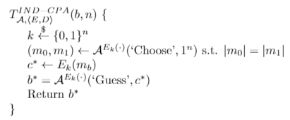






IND-CPA-Encryption Test (fixed)
Or, as pseudo-code:
Oracle notation
$$n,b$$
$$m$$
$
A
k
$${\left\{0,1\right\}}^{n}$$
$$Ek(m )$$
E_{k}(.)
$m0 , m1$s.t. $|m0|=|m1|$
$$c∗=Ek(mb )$$
A wins if b*=b
b*

Slide 25
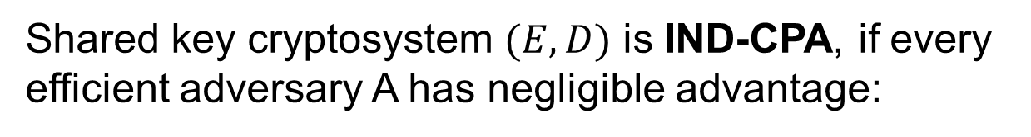
Definition: IND-CPA Encryption
Shared key cryptosystem $(E,D)$ is IND-CPA, if every efficient adversary A has negligible advantage:

Slide 26
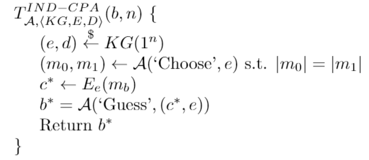
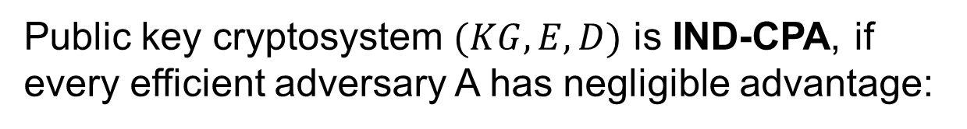
Definition: IND-CPA Pub-Key Encryption
Public key cryptosystem $(KG,E,D)$ is IND-CPA, if every efficient adversary A has negligible advantage:

Slide 27






IND-CPA : distinguish monoalph. sub.!
Students split to pairs: adversary and `tester’
Tester selects (or receives) `random’ (k, b)
k is monoalphabetic substitution table: E_{k}(abc)=k(a)||k(b)||k(c)
Adversary gives message(s) m, receives E_{k}(m)
Then adversary gives m₀ , m₁ … receives E_{k}(m_{b})
Adversary finds b !! How?
$$n,b$$
$$m$$
$
A
k
$${\left\{0,1\right\}}^{n}$$
$$Ek(m )$$
E_{k}(.)
$m0 , m1$s.t. $|m0|=|m1|$
$$c∗=Ek(mb )$$
A wins if b*=b
b*
Monoalphabetic substitution
is not IND-CPAistinguishable!

Slide 28
Can IND-CPA encryption be deterministic?
No!! But why? Suppose E_{k}(x) is deterministic…
Assume messages are words (arbitrary length).
A gives m=_________ , receives c=E_{k}(m)
A gives m₀=_________ , m₁=________, receives c*=E_{k}(m_{b})
A outputs 1 if _________ , 0 otherwise - and wins!!
Conclusion: IND-CPA Encryption must be randomized
$$n,b$$
$$m$$
$
A
k
$${\left\{0,1\right\}}^{n}$$
$$Ek(m )$$
E_{k}(.)
$m0 , m1$s.t. $|m0|=|m1|$
$$c∗=Ek(mb )$$
A wins if b*=b
b*

Slide 29
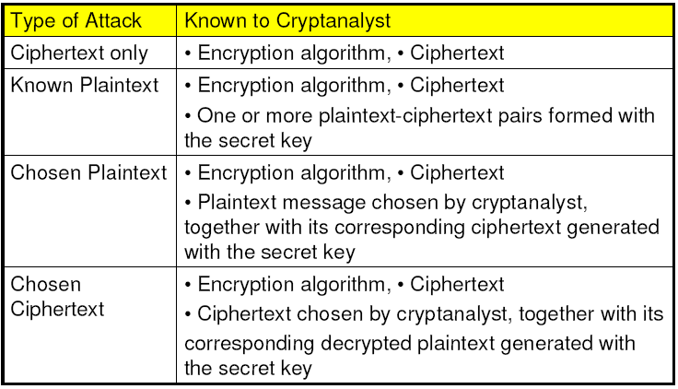
Attacker Capabilities / Model
C
(KPA)
(CPA)
(CCA)
And… Probabilistic Polynomial Time (PPT) !
Notes:
note def of attacker model and precise security defs in general is crucial for any security system , not just crypto!

Slide 30
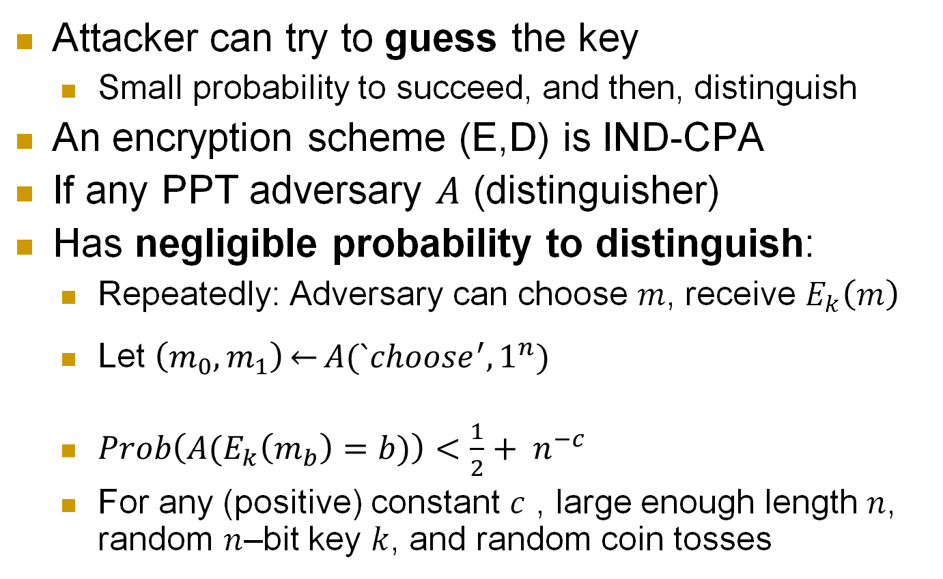
IND-CPA Encryption: negligible advantage
Attacker can try to guess the key
Small probability to succeed, and then, distinguish
An encryption scheme (E,D) is IND-CPA
If any PPT adversary $A$ (distinguisher)
Has negligible probability to distinguish:
Repeatedly: Adversary can choose $m$, receive $E_{k}\left(m\right)$
Let $\left(m_{0},m_{1}\right)\underset{←}{}A(`choose^{′},1^{n})$
$Prob\left(A(E_{k}\left(m_{b}\right)=b)\right)<\frac{1}{2}+ n^{−c}$
For any (positive) constant $c$ , large enough length $n$, random $n$–bit key $k$, and random coin tosses
Notes:
30
10/30/11

Slide 31
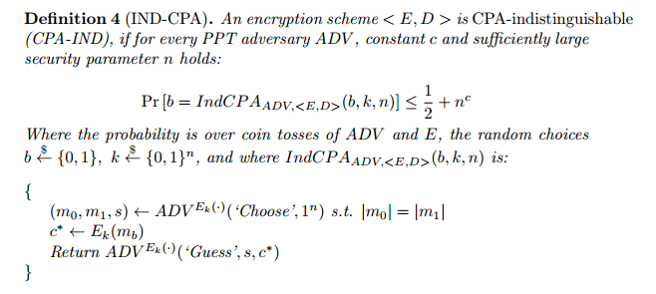
Hidden foil: definition of IND-CPA secure encryption

Slide 32
What’s next? Present a secure cryptosystem? … provably secure w/o assumptions ? Unlikely: Proof of security ➔ P ≠ NP (similar argument to PRF) Instead, let’s build secure encryption from PRF ! (I.e.: PRF is secure ➔ encryption is IND-CPA) Actually, we’ll use block cipher (and build it)

Slide 33
PRP→Encryption: Modes of Operation
`Modes of operation’: use block cipher (PRP), to...
Encrypt long (Variable Input Length, VIL) messages
Randomize/add state for security
Often: use random/stateful Initialization Vector (IV)
Use longer or shorter keys
Longer key (e.g., Triple-DES): better security (at least against exhaustive search)
Shorter key: intentionally-weakened version, e.g. to meet export regulations
Other tasks (e.g., message authentication)

Slide 34
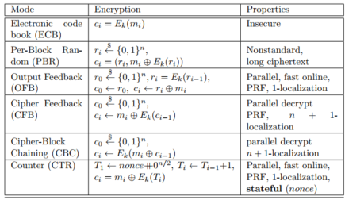
Encryption Modes of Operation

Slide 35



Block Cipher Modes of Operation
For encryption
Later: modes for message authentication
Assume plaintext is in blocks: m₀||m₁||…
Electronic Code Book mode (ECB): encryption c_{i}=E_{k}(m_{i}), decryption m_{i}=D_{k}(c_{i})
`Encrypt` E_{k}
`Decrypt` D_{k}
m_{i}
c_{i}
m_{i}
Which of these is ECB encryption? Why?

Slide 36
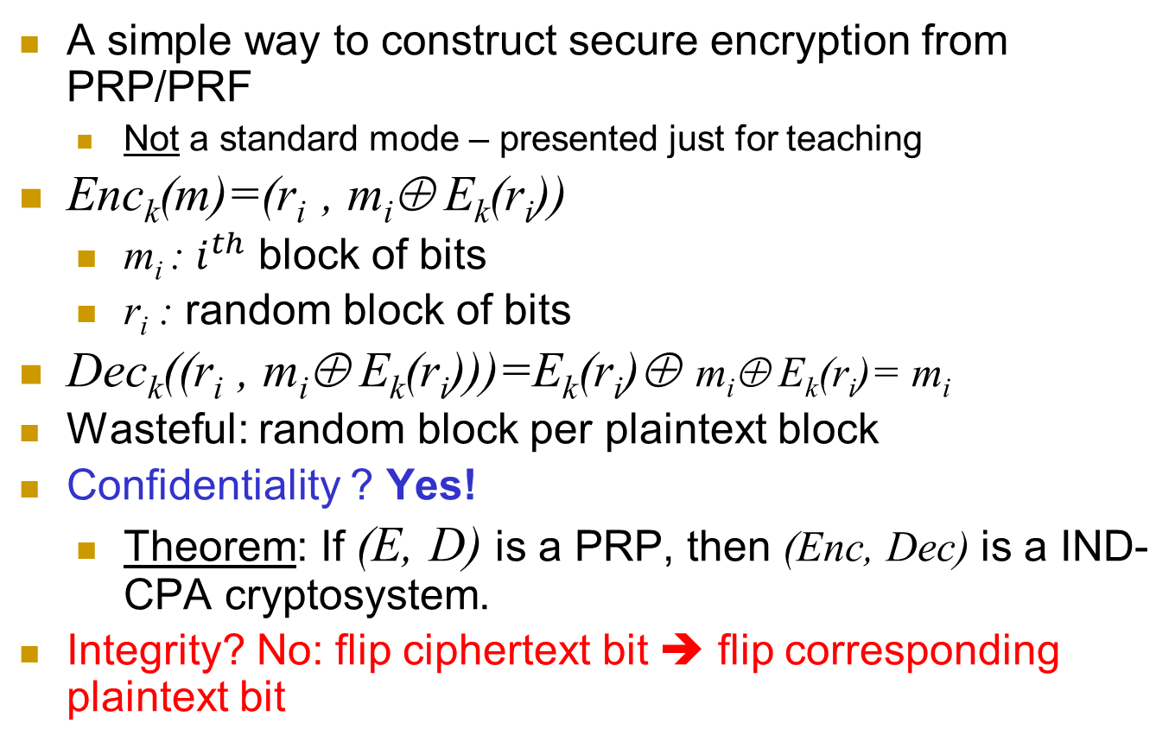
Per-Block Random (PBR) mode
A simple way to construct secure encryption from PRP/PRF
Not a standard mode – presented just for teaching
Enc_{k}(m)=(r_{i} , m_{i}⊕ E_{k}(r_{i}))
m_{i} : $i^{th}$ block of bits
r_{i} : random block of bits
Dec_{k}((r_{i} , m_{i}⊕ E_{k}(r_{i})))=E_{k}(r_{i})⊕ m_{i}⊕ E_{k}(r_{i})= m_{i}
Wasteful: random block per plaintext block
Confidentiality ? Yes!
Theorem: If (E, D) is a PRP, then (Enc, Dec) is a IND-CPA cryptosystem.
Integrity? No: flip ciphertext bit ➔ flip corresponding plaintext bit

Slide 37

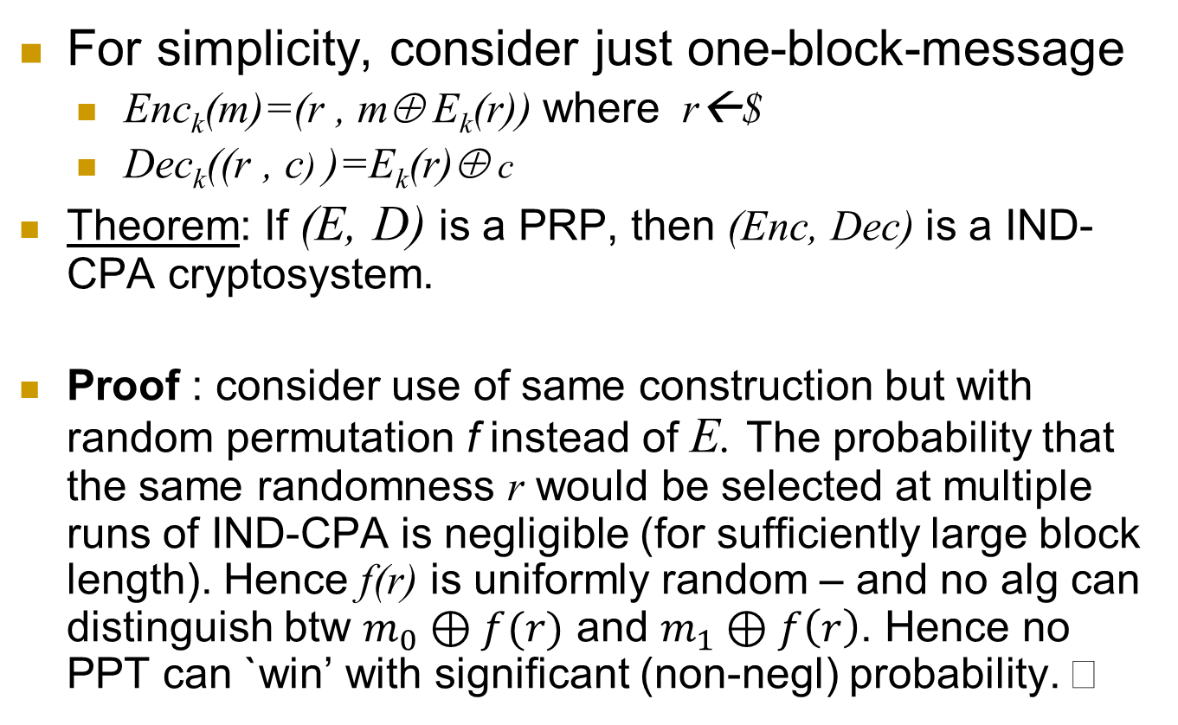
Per-block random mode is IND-CPA
For simplicity, consider just one-block-message
Enc_{k}(m)=(r , m⊕ E_{k}(r)) where r←$
Dec_{k}((r , c) )=E_{k}(r)⊕ c
Theorem: If (E, D) is a PRP, then (Enc, Dec) is a IND-CPA cryptosystem.
Proof : consider use of same construction but with random permutation f instead of E. The probability that the same randomness r would be selected at multiple runs of IND-CPA is negligible (for sufficiently large block length). Hence f(r) is uniformly random – and no alg can distinguish btw $m_{0}⊕f(r)$ and $m_{1}⊕f\left(r\right)$. Hence no PPT can `win’ with significant (non-negl) probability.

Slide 38
Encryption Modes of Operation
We saw two...
ECB (insecure!): c_{i}=E_{k}(m_{i})
Per-Block Random (PBR): r_{i}←$, c_{i} = (r_{i} , m_{i}⊕ E_{k}(r_{i}))
We’ll see three more…
Output Feedback (OFB)
Cipher Feedback (CFB)
Cipher-block-chaining (CBC)
Others exist (for encryption – and other tasks)
All operate on blocks (e.g., 128 bits = 16 bytes)

Slide 39
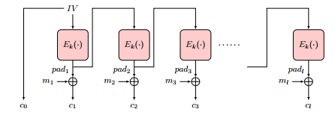
Output-Feedback (OFB) Mode
Goal: encrypt long (multi-block) messages, with less random bits
Generate and send less random bits – cf. to per-block random
How? Use random bits only for first block (`initialization vector’)
To encrypt next blocks of message, use output of previous block
Namely, a block-by-block stream cipher
Encryption: pad₀←IV, pad_{i} ← E_{k}(pad_{i-1} ), c₀ ← pad_{0,} c_{i} ← pad_{i}⊕ m_{i}
Decryption: ?

Slide 40
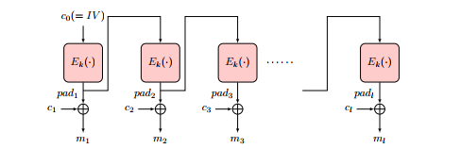
Output-Feedback (OFB) Mode
Goal: encrypt long (multi-block) messages, with less random bits
Generate and send less random bits – cf. to per-block random
How? Use random bits only for first block (`initialization vector’)
To encrypt next blocks of message, use output of previous block
Namely, a block-by-block stream cipher
Encryption: pad₀←IV, pad_{i} ← E_{k}(pad_{i-1} ), c₀ ← pad_{0,} c_{i} ← pad_{i}⊕ m_{i}
Decryption: pad₀ ← c_{0,} pad_{i} ← E_{k}(p_{i-1} ), m_{i} ← pad_{i}⊕ c_{i}

Slide 41
Output-Feedback (OFB) Mode
Encryption: pad₀←IV, pad_{i} ← E_{k}(pad_{i-1} ), c₀ ← pad_{0,} c_{i} ← pad_{i}⊕ m_{i}
Decryption: pad₀ ← c_{0,} pad_{i} ← E_{k}(p_{i-1} ), m_{i} ← pad_{i}⊕ c_{i}
Offline pad computation: compute pad in advance
Online computation: only (parallelizable) XOR !
Bit errors are bitwise localized (corrupt only one bit)
No integrity: Flip ciphertext bit ➔ flip corresponding decrypted plaintext bit
Can we protect integrity?

Slide 42
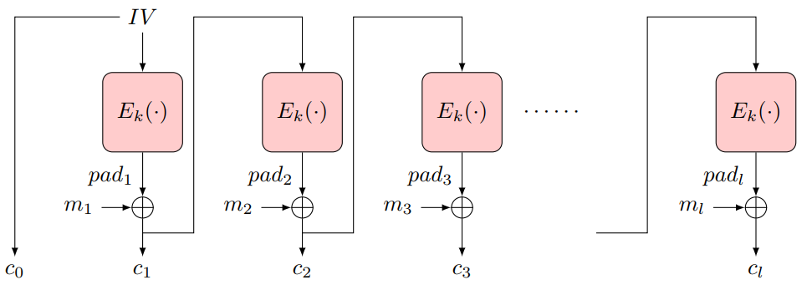
Cipher-Feedback Block (CFB) Encryption
Random first block c₀ (`initialization vector’, IV)
XOR ‘pad’ E_{k}(c₀) with plaintext to obtain: c₁ = m₁⊕ E_{k}(c₀)
Repeat: c_{i} = m_{i}⊕ E_{k}(c_{i-1})

Slide 43
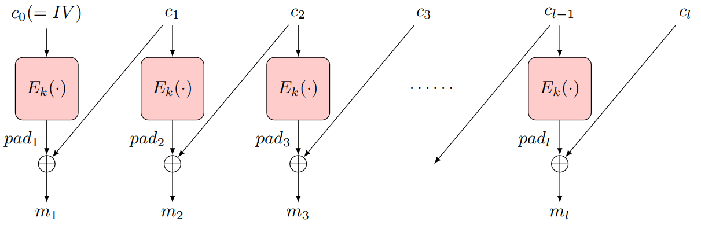
Cipher-Feedback Block (CFB) Encryption
Random first block c₀ (`initialization vector’, IV)
XOR ‘pad’ E_{k}(c₀) with plaintext to obtain: c₁ = m₁⊕ E_{k}(c₀)
Repeat: c_{i} = m_{i}⊕ E_{k}(c_{i-1})
CFB Encryption
CFB Decryption

Slide 44
Cipher-Feedback Block (CFB) Encryption
Random first block c₀ (`initialization vector’, IV)
XOR ‘pad’ E_{k}(c₀) with plaintext to obtain: c₁ = m₁⊕ E_{k}(c₀)
Repeat: c_{i} = m_{i}⊕ E_{k}(c_{i-1})
Ciphertext: c₀, c₁ = m₁⊕ E_{k}(c₀), … , c_{i} = m_{i}⊕ E_{k}(c_{i-1})
Can’t pre-compute `pad’ offline ☹
Decryption: c_{i}⊕ E_{k}(c_{i-1})= m_{i}⊕ E_{k}(c_{i-1}) ⊕ E_{k}(c_{i-1})= m_{i}
Parallelizable
Bit/block errors are 2-block localized (corrupt only 2 blocks)
Integrity? A bit…
Flip ciphertext bit ➔ flip corresponding decrypted plaintext bit
But also corrupt next plaintext block
Except for last block: no `next block’
Can we protect integrity (even) better?

Slide 45
Cipher Block Chaining (CBC) Mode
Random first block c₀ (`initialization vector’, IV)
i>0: c_{i} = E_{k}(c_{i-1} ⊕ m_{i})
Parallel decryption
But no offline precomputing
Integrity: flip bit in c[i] ➔ flip bit in m[i+1] … But also corrupt m[i]
May suffice to ensure integrity for many applications
But not all!
Split plaintext m to l bit blocks m[1],…
m[1] | m[2] | … | m[n]
IV
E
E
E
k
c[0] | c[1] | … | c[n]
Ciphertext c[0],c[1]…
Notes:
45
10/30/11

Slide 46
Security of CBC mode
Thm: If block-cipher E is a (strong) pseudo-random permutation ➔CBC#E is IND-CPA-secure encryption
Proof: omitted (crypto course ☺ )
Not secure against Chosen-Ciphertext Attack (CCA)
Intuitively: attacker can choose ciphertext and get its decryption, except for the `challenge ciphertext’
Definition, details: beyond scope of this course
We briefly describe Feedback-CCA: practical variant

Slide 47
Security of CBC mode (2)
Thm: If block-cipher E is a (strong) pseudo-random permutation ➔CBC#E is IND-CPA-secure encryption
Proof: omitted (crypto course ☺ )
Observation: CBC is Not IND-CCA-Secure
CCA (Chosen ciphertext attack), intuitively: attacker can choose ciphertext and get its decryption, except for the `challenge ciphertext’
Definition, details: crypto course
Exercise: show CBC is Not IND-CCA-Secure
Feedback-CCA: practical variant of CCA
Just returns <ERROR, OK> for any ciphertext
Error – for incorrectly padded decryption (next)

Slide 48
Encryption Modes of Operation

Slide 49
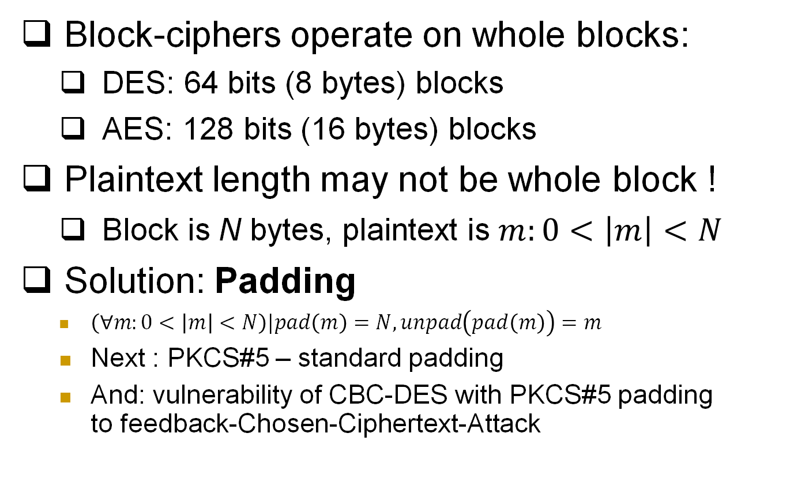
Note: Padding Encryption
Block-ciphers operate on whole blocks:
DES: 64 bits (8 bytes) blocks
AES: 128 bits (16 bytes) blocks
Plaintext length may not be whole block !
Block is N bytes, plaintext is $m:0<\left|m\right|<N$
Solution: Padding
$\left(∀m:0<\left|m\right|<N\right)|pad\left(m\right)=N, unpad\left(pad\left(m\right)\right)=m$
Next : PKCS#5 – standard padding
And: vulnerability of CBC-DES with PKCS#5 padding to feedback-Chosen-Ciphertext-Attack
skip

Slide 50
PKCS#5* padding (e.g.: 8 byte block)
If |m| mod 8 = 7 (one byte short of block): Pad(m)=m || ’1’
If |m| mod 8 = 6: Pad(m)=m || ’22’
….
If |m| mod 8 = 1: Pad(m)=m || ’7777777’
If |m| mod 8 = 0 (string end on complete block): Pad(m)=m || ’8…8’
Unpad(m): {
If |m| mod 8 = 0 then
{if m[1]=’1’ then return UnPad(m)=m[|m|…2]
if m[1..2]=‘22’ then return UnPad(m)=m[|m|…3]
…}
Unpad(m)=ERROR }
Examples: 1. pad(‘abcde’)=‘abcde22’, pad(‘stranger’)=‘stranger88888888’ [padding of longer strings]
2. unpad(‘5/5/2021’)=‘5/5/202’;
3. unpad(‘UnPad’) = ?
3. Show how padding facilitates exhaustive search
Notes:
* I think I’ve simplified a bit, if I’m not wrong, PKCS actually concatenates the corresponding binary strings (01x, etc.), but this is simpler and attack is essentially the same

Slide 51
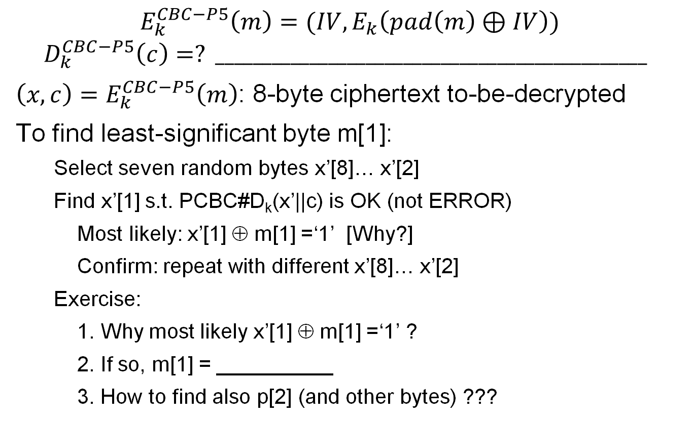
Feedback-CCA attack on CBC with PKCS#5
$$E_{k}^{CBC−P5}\left(m\right)=(IV,E_{k}\left(pad\left(m\right)⊕IV\right))$$
$$D_{k}^{CBC−P5}\left(c\right)=? ______________________________________________$$
${\left(x,c\right)=E}_{k}^{CBC−P5}\left(m\right)$: 8-byte ciphertext to-be-decrypted
To find least-significant byte m[1]:
Select seven random bytes x’[8]… x’[2]
Find x’[1] s.t. PCBC#D_{k}(x’||c) is OK (not ERROR)
Most likely: x’[1] ⊕ m[1] =‘1’ [Why?]
Confirm: repeat with different x’[8]… x’[2]
Exercise:
1. Why most likely x’[1] ⊕ m[1] =‘1’ ?
2. If so, m[1] = __________
3. How to find also p[2] (and other bytes) ???

Slide 52
Ensuring CCA Security
Give no feedback on failure? Harder to resolve problems ☹
Possible with minor changes to PKCS#5 unpad, e.g.:
Check only last byte (other added bytes randomized)
If last byte is not valid (‘1’ to ‘8’): return entire message (no pad)
Decryption never returns ERROR ➔ foils padding attack!
Better: `prevent` decryption queries!
How?
Use secret key (also) to `sign/authenticate` ciphertext…
And decrypt only properly authenticated ciphertext
Output `failure` if given unauthenticated ciphertext
How to authenticate? We’ll see in next lecture…
Instead we see how not to authenticate - and encrypt…
Another real-life example… WEP

Slide 53
Use Case: WEP (In)Security
WEP: Wired Equivalent Privacy
Known insecure (2001!), still widely used
Between mobile and access point
Often same key is shared to all mobiles
Confidentiality: RC4 encryption (PRG)
Seed: 24-bit per-packet `IV' and 40/104 bit key
WEP_{k}(m;IV)=[IV,RC4(IV||k)+(m||crc(m)]
Integrity and authenticity: CRC [next]
And optional (init) authentication exchange

Slide 54

WEP Integrity
Integrity: 32-bit CRC
Linear: CRC(m+m')=CRC(m)+CRC(m')
+ is XOR
WEP(m)=RC4+[m||CRC(m)]
Insecure:

Slide 55
WEP Authentication… & Encryption
`Authentication` - two options:
Open-System Authentication [=no authentication]
Shared-Key Authentication:
Access point sends a (random) challenge message m
Mobile selects random IV and sends WEP(m;IV)
Shared-key auth is a known-plaintext oracle!
Deadly for 40-bit cipher ☹
Known challenge message m ➔ known RC4(IV||k)
~ 2^24 req’ ➔ known RC4(IV||k) for most IVs
Attacker can decrypt most messages!

Slide 56
WEP Encryption
24-bit IV-reuse: WEP_{k}(m)=[IV,RC4(IV,k)+(m||crc(m)]
Shared-key authentication gives R,WEP(R)
Easy decryption on IV reuse!
Hence: use open-system (i.e., no) authentication
Even w/o auth: same-pad `encryption’ for messages using same IV...
Exploit insecure integrity
Change dest IP to attacker → get plaintext!
Exploit WEP use of `plain' RC4 (not RC4-drop)

Slide 57
Hybrid Encryption (`enveloping`)
Public key cryptosystems (PKG,PKE,PKD) are slow
Also: most (e.g. RSA) have fixed block size (FIL)
Using a long block size is veeeery slooow
Using CBC etc. is also too wasteful
Use VIL secret key cryptosystem (SKG,SKE,SKD) (e.g. CBC,OTP); encrypt shared key and use it to encrypt plaintext
e
Encryption
Decryption
k ←SKG(1^{k})
ck
ck← PKE_{e}(k)
k← PKD_{d}(ck)
Plaintext p
c
c←SKE_{k}(p)
SKD_{k}(c)
Notes:
57
10/30/11

Slide 58
Encryption: at what phase?
Related goals:
Compression
Error-detection code
Integrity, authentication
Can’t compress ciphertext
Redundancy in plaintext may help attacker
➔ Compress then Encrypt
Message
Compress
Plaintext
Encrypt
Ciphertext
But: compress-then-encrypt is not IND-CPA-Secure! Why?? Challenge: define, solve…

Slide 59
Exploiting Length-Exposure
Side-channel attacks on TLS sites
CRIME and TIME attacks
Web 2.0: auto-suggest/complete, preload…
Script sends keystrokes, server responds
Size of response may reveal keystrokes, choices
See: Chen et al, `Side channel Leaks in Web Applications’, S&P 2010 (and follow-ups)

Slide 60
Encryption: at what phase?
Plaintext redundancy
☺ Authenticates ?
☹ May help attacker
E.g.: turn KPA into COA ! [GSM]
So: compressing plaintext is good!
Can’t compress ciphertext
➔ Compress then Encrypt
Message
Compress
Plaintext
Encrypt
Ciphertext
Compress-then-encrypt is not IND-CPA-Secure! Why?? Challenge: define, solve…

Slide 61
Error Detection / Correction
EDC/ECC on plaintext?
Motivation: detect fake ciphertext (integrity)
But may help attacker
Adds (much) redundancy to plaintext
Validate key guess
Turn KPA into COA [GSM]
And: error in ciphertext invalidates EDC/ECC !
➔ Better: Encrypt before Error Detection
Message
Compress
Plaintext
Code
Plaintext
EDC
Encrypt
Ciphertext

Slide 62
Encryption and Error Detection (2)
Does Encrypt-then-Add-EDC protect integrity?
No…
Example: WEP (next)
Integrity / authenticity: next topic
Message
Compress
Plaintext
Encrypt
Ciphertext
Code
Ciphertext
EDC

Slide 63
Encryption: Final Words
Basic goal of cryptography
Focus: computationally-limited adversaries
Principles:
Kerckhoff’s: Known Design
Sufficient Key Space
Crypto Building Block: build schemes from simple, standard functions
Constructions & reductions: PRG→PRF→PRP→Enc
Secure system design: easy to use securely, hard to use incorrectly!

Slide 64
Encryption: Final Words...
Many variants…
One important example is Homomorphic encryption: E(m₁+m₂)=EncAdd(E(m₁),E(m₂))
Where EncAdd is an efficient algorithm
Fully-homomorphic : also E(m1*m2)=EncMult(E(m1), E(m2))
Very inefficient designs, huge keys… but lots of research!

Slide 65

Thank You!

