Slide 1
CSE 3400 - Introduction to Computer & Network Security (aka: Introduction to Cybersecurity) Lecture 9 Shared Key Protocols – Part II
Ghada Almashaqbeh
UConn
From Textbook Slides by Prof. Amir Herzberg
UConn

Slide 2
Outline
The .
2

Slide 3
Shared-Key Handshake and Record Protocols: Topics
Introduction to (shared key) crypto-protocols
Record protocols
Handshake protocols: entity authentication
Handshake: extensions
Key-setup handshakes
GSM handshake case study, and:
Key distribution
Ciphersuite negotiation and downgrade attacks
Improving resiliency to key exposures

Slide 4
2PP: Extensions and Variants
Authenticate messages m_{A}, m_{B} : include in MAC
Note: also ensures freshness
But: Bob sends `response’ before receiving ‘request’
How to authenticated fresh request-response ?
Alice
Bob
A, N_{A}
m_{B} , N_{B} , Mac_{k}(2 || A←B ||N_{A} || N_{B} ||m_{B} )
m_{A} , Mac_{k}(3 || A→B || N_{A} || N_{B} || m_{A} )
Notes:
4
(c) Amir Herzberg, http://AmirHerzberg.com, Bar Ilan University
11/13/11

Slide 5
2PP: Extensions and Variants
Authenticate messages m_{A}, m_{B} : include in MAC
Authenticated fresh request-response, V1: two rounds
‘Four-way handshake’
Can we ensure freshness but only in one round?
Alice
Bob
A, N_{A}
N_{B}
Remember
N_{A},N_{B}
req , Mac_{k}(3 || A→B || N_{A} || N_{B} || req )
resp , Mac_{k}(4 || A←B ||N_{A} || N_{B} ||resp )
Notes:
5
(c) Amir Herzberg, http://AmirHerzberg.com, Bar Ilan University
11/13/11

Slide 6
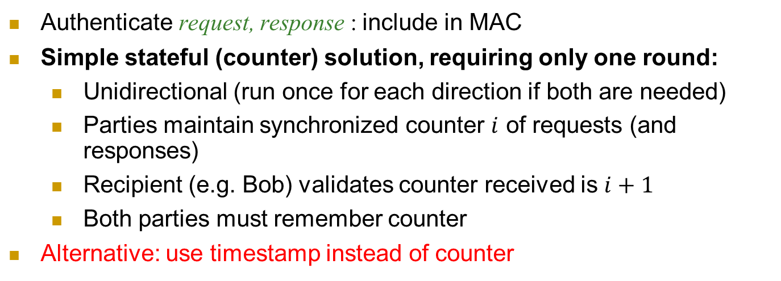

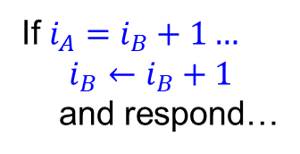


Counter-Based Authenticated Request/Response
Authenticate request, response : include in MAC
Simple stateful (counter) solution, requiring only one round:
Unidirectional (run once for each direction if both are needed)
Parties maintain synchronized counter $i$ of requests (and responses)
Recipient (e.g. Bob) validates counter received is $i+1$
Both parties must remember counter
Alternative: use timestamp instead of counter
Alice
Bob
req, i_{A}, Mac_{k}(1 || A→B || $i_{A}$ || req)
If $i_{A}=i_{B}+1…$
$$i_{B}←i_{B}+1$$
and respond…
If $i_{A}=i_{B}…$
resp, i_{B} , Mac_{k}(2 || A←B || $i_{B}$ ||resp )
Notes:
6
(c) Amir Herzberg, http://AmirHerzberg.com, Bar Ilan University
11/13/11

Slide 7
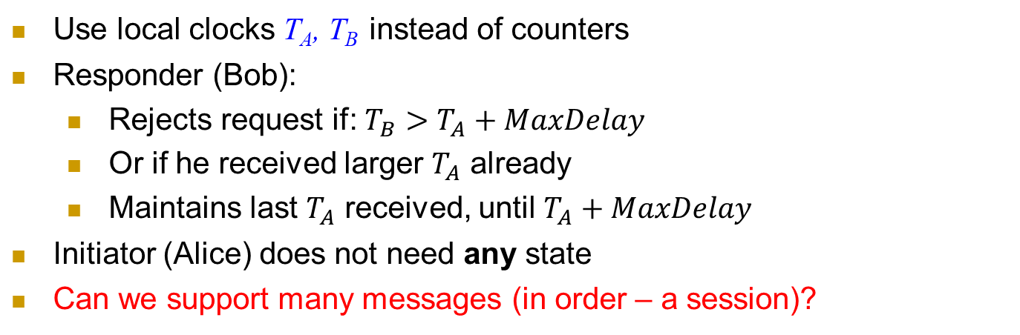
Time-Based Authenticated Request/Response
Use local clocks T_{A}, T_{B} instead of counters
Responder (Bob):
Rejects request if: $T_{B}>T_{A}+MaxDelay$
Or if he received larger $T_{A}$ already
Maintains last $T_{A}$ received, until $T_{A}+MaxDelay$
Initiator (Alice) does not need any state
Can we support many messages (in order – a session)?
Alice
Bob
req, T_{A}, Mac_{k}(1 || A→B || T_{A} || req)
Validate T_{A}
is new
resp , Mac_{k}(2 || A←B ||T_{A} ||resp )
Remember T_{A}
Notes:
7
(c) Amir Herzberg, http://AmirHerzberg.com, Bar Ilan University
11/13/11

Slide 8
2PP: Extensions and Variants
Authenticate session: add sequence numbers
Combine handshake and record protocols
Can we also use the key to protect confidentiality, too? How?
Alice
Bob
A, N_{A}
N_{B}
req1 , Mac_{k}(3 || A→B || N_{A} || N_{B} || req1 )
resp1 , Mac_{k}(4 || A←B ||N_{A} || N_{B} ||resp1 )
req2 , Mac_{k}(5 || A→B || N_{A} || N_{B} || req2 )
resp2 , N_{B} , Mac_{k}(6 || A←B ||N_{A} || N_{B} ||resp2 )
Notes:
8
(c) Amir Herzberg, http://AmirHerzberg.com, Bar Ilan University
11/13/11

Slide 9
2PP: Extensions and Variants
Secure connection: authentication, freshness, secrecy
Independent keys: for encryption k.e, for authentication: k.a
How can we derive them both from a single key k ?
k.e=PRP_{k}(“Encrypt”), k.a=PRP_{k}(“MAC”)
Hmm… same key encrypts all messages, in all sessions ☹
Can we improve security, by changing keys, e.g., btw sessions ?
Alice
Bob
A, N_{A}
N_{B}
E_{k.e}(req) , Mac_{k.a}(3 || A→B || N_{A} || N_{B} || E_{k.e}(req) )
E_{k.e}(resp) , Mac_{k.a}(4 || A←B ||N_{A} || N_{B} || E_{k.e}(resp))
Notes:
9
(c) Amir Herzberg, http://AmirHerzberg.com, Bar Ilan University
11/13/11

Slide 10
Shared-Key Handshake and Record Protocols: Topics
Introduction to (shared key) crypto-protocols
Entity Authentication
Record Authentication (entities+messages)
Key-setup handshakes
GSM handshake case study, and:
Key distribution
Ciphersuite negotiation and downgrade attacks
Improving resiliency to key exposures

Slide 11
2PP: Extensions and Variants
Independent session keys, e.g. k=PRF_{MK}(N_{A},N_{B})
Or, `directly’ for authentication and for encryption: k.e=PRF_{MK}(“Encrypt”, N_{A},N_{B}), k.a=PRF_{MK}(“MAC”, N_{A},N_{B})
Improves security:
Exposure of session key does not expose (long-term) ‘master key’ MK
And does not expose keys of other sessions
Limited amount of ciphertext exposed with each session key k (or k.e)
Better: separate keys from A→B from keys from B→A (why? how?)
Later: reduce risk also from exposure of Master Key MK
Alice
Bob
A, N_{A}
N_{B}
E_{k.e}(req) , Mac_{k.a}(3 || A→B || N_{A} || N_{B} || E_{k.e}(req) )
E_{k.e}(resp) , N_{B} , Mac_{k.a}(4 || A←B ||N_{A} || N_{B} || E_{k.e}(resp))
Notes:
11
(c) Amir Herzberg, http://AmirHerzberg.com, Bar Ilan University
11/13/11

Slide 12
Shared-Key Handshake and Record Protocols: Topics
Introduction to (shared key) crypto-protocols
Record protocols
Handshake protocols: entity authentication
Handshake: extensions
Key-setup handshakes
GSM handshake case study, and:
Key distribution
Ciphersuite negotiation and downgrade attacks
Improving resiliency to key exposures

Slide 13
Key Distribution Center (KDC)
KDC: shares keys with all parties (k_{A}, k_{B}…)
Goal: help parties (A, B) establish k_{AB}
A time-based, stateless KDC variant:
Alice: 2PP with KDC, receive k_{AB} and Bob’s ticket
Ticket: encrypted, authenticated k_{AB}
Use time to ensure freshness and limit usage
Client (Alice)
KDC
Server (Bob)
2PP (Alice to KDC): k_{AB} , Ticket
Ticket + 2PP (Alice to Bob): use k_{AB} as shared key
Notes:
KDC = TGS (Ticket Granting Server) [Kerberos]

Slide 14
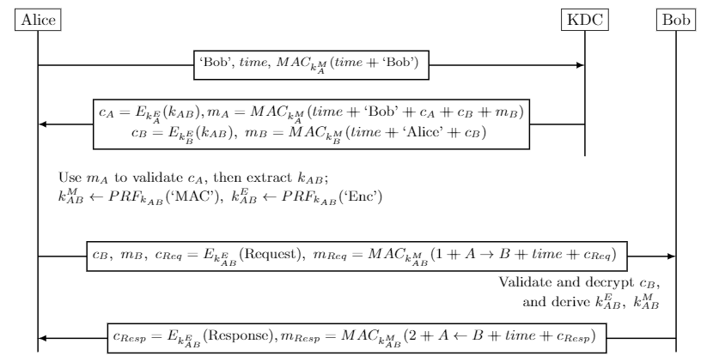
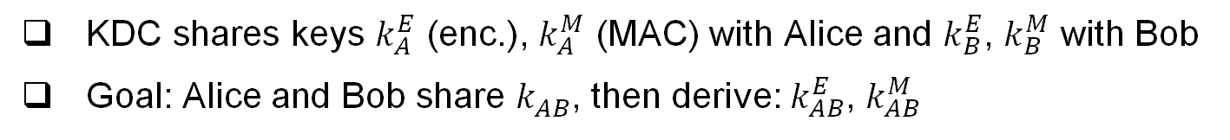
KDC Protocol
KDC shares keys $k_{A}^{E}$ (enc.), $k_{A}^{M}$ (MAC) with Alice and $k_{B}^{E}$, $k_{B}^{M}$ with Bob
Goal: Alice and Bob share $k_{AB}^{}$, then derive: $k_{AB}^{E}$, $k_{AB}^{M}$

Slide 15
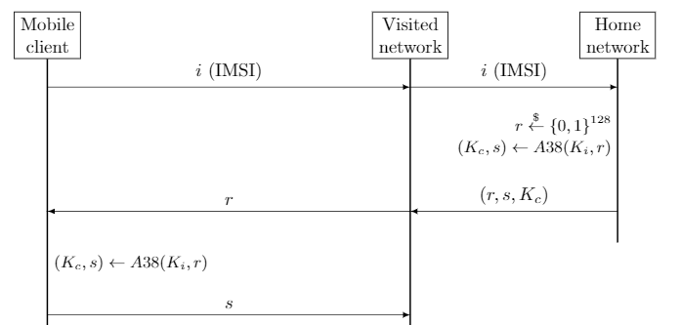
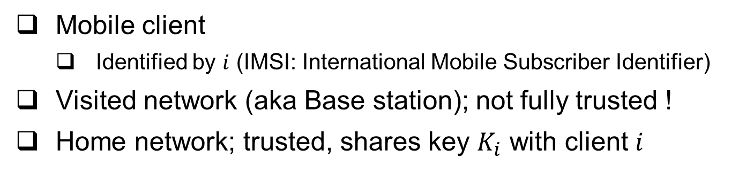
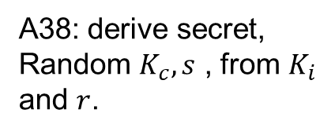
The GSM Handshake Protocol
Mobile client
Identified by $i$ (IMSI: International Mobile Subscriber Identifier)
Visited network (aka Base station); not fully trusted !
Home network; trusted, shares key $K_{i}$ with client $i$
A38: derive secret,
Random $K_{c}, s$ , from $K_{i}$ and $r$.
GSM spec: OWF
But really should be…
a PRF !

Slide 16
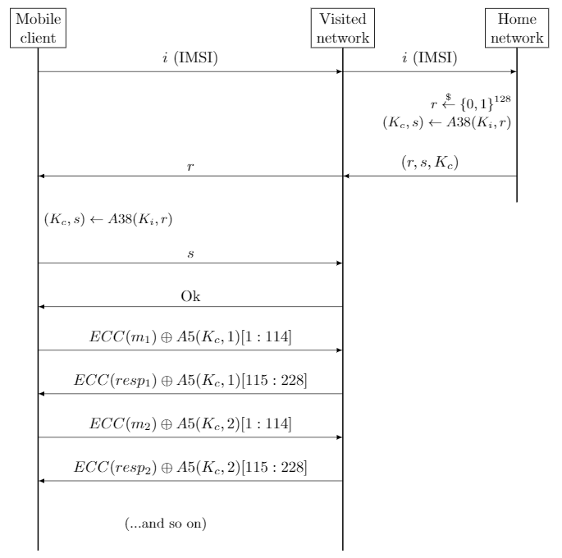
A5: provide ‘pad’ for encryption
Several variants: A5/1 - `regular’
A5/2 - `waak’
A5/3 – more secure
Really should be…
a PRF !

Slide 17
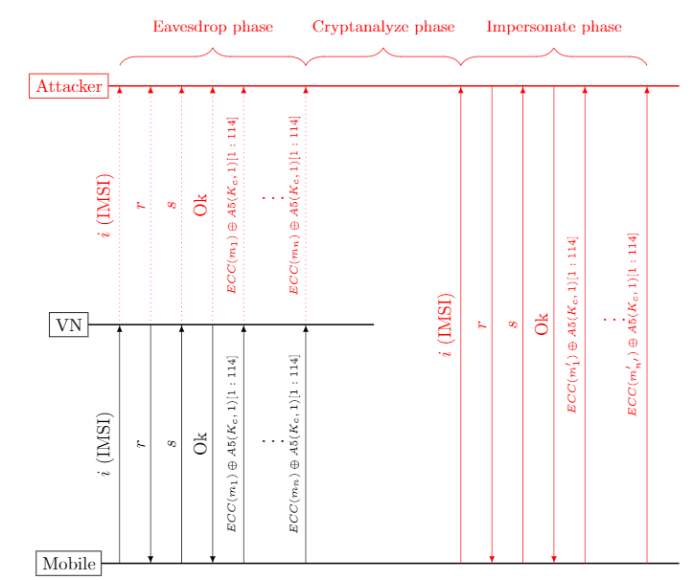
Visited-net Impersonation Attack
Note: does NOT
Impersonate mobile, only
Visited network.
And requires key…

Slide 18
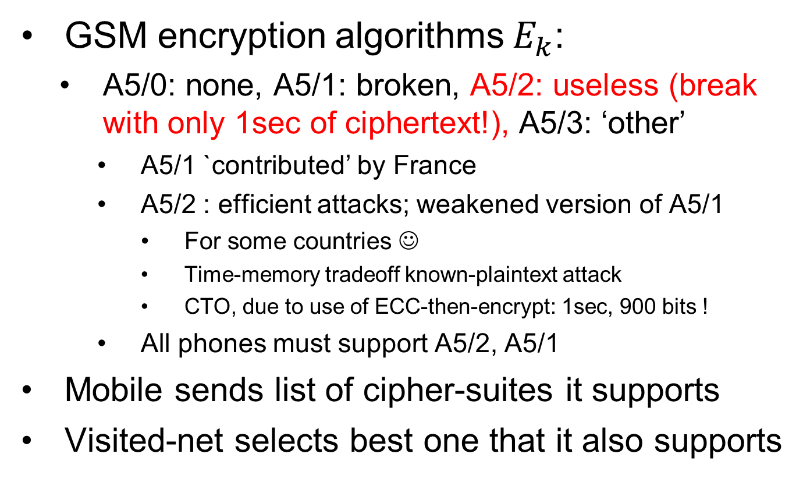
GSM: Cipher Suites
GSM encryption algorithms $E_{k}$:
A5/0: none, A5/1: broken, A5/2: useless (break with only 1sec of ciphertext!), A5/3: ‘other’
A5/1 `contributed’ by France
A5/2 : efficient attacks; weakened version of A5/1
For some countries ☺
Time-memory tradeoff known-plaintext attack
CTO, due to use of ECC-then-encrypt: 1sec, 900 bits !
All phones must support A5/2, A5/1
Mobile sends list of cipher-suites it supports
Visited-net selects best one that it also supports

Slide 19
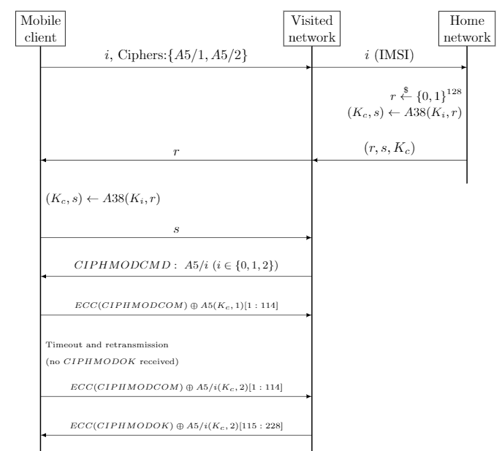
GSM
Handshake,
With
Cipher-negotiation.

Slide 20
Cipher mode messages, negotiation
Mobile sends list of supported ciphers
VN sends choice in: CIPHMODCMD
Cipher Mode Command
Mobile confirms by sending encrypted: CIPHMODCOM: cipher mode complete
If not received (in few msecs), VN disconnects
VN Acks: CIPHMODOK: cipher mode Ok
If not received, mobile resends CIPHMODCOM

Slide 21
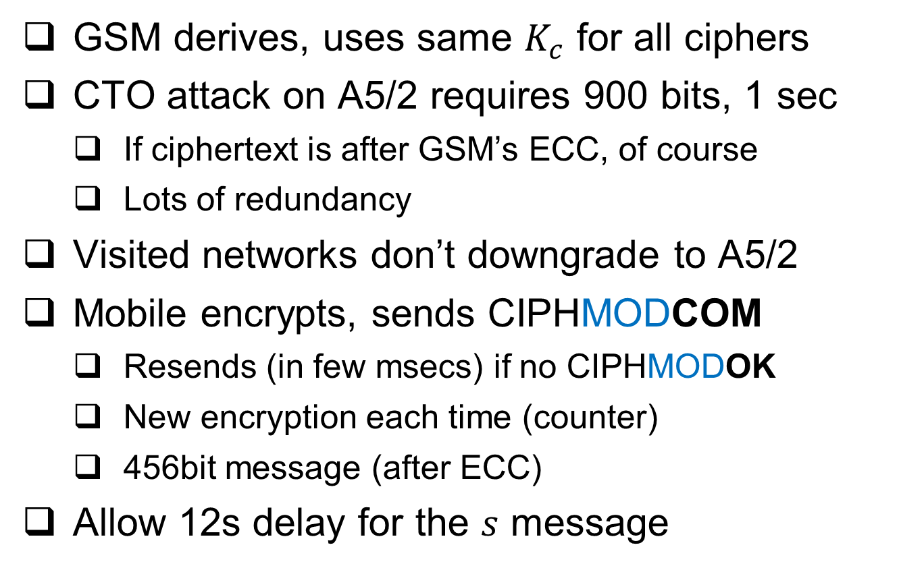
GSM ciphersuite facts: for fun and profit
GSM derives, uses same $K_{c}$ for all ciphers
CTO attack on A5/2 requires 900 bits, 1 sec
If ciphertext is after GSM’s ECC, of course
Lots of redundancy
Visited networks don’t downgrade to A5/2
Mobile encrypts, sends CIPHMODCOM
Resends (in few msecs) if no CIPHMODOK
New encryption each time (counter)
456bit message (after ECC)
Allow 12s delay for the $s$ message

Slide 22

GSM: Simplified* Downgrade Attack
Efficient attack known only for A5/2; Client, Visited-net normally prefers A5/3 or A5/1, which are harder to break. Attack forces use of A5/2 !!
Client
MitM
Visited network
IMSI, Ciphers {A5/1, A5/2}
IMSI, Ciphers {A5/2}
r
r
s
Start, CipherSuite (A5/2)
$m⨁E_{k}^{A5/2}(1$)
* Standard says Visited-nets should not agree to use A5/2, since all clients support A5/1 ➔ this attack fails for conforming VNs

Slide 23
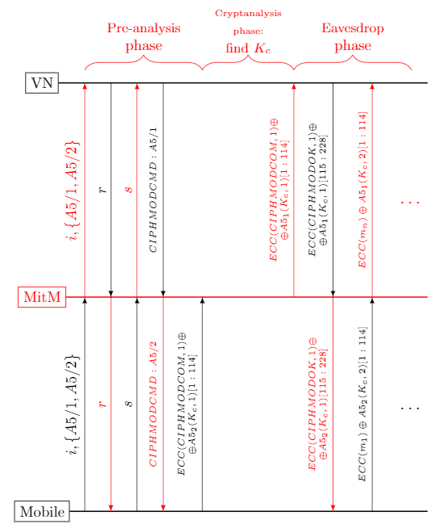
2nd Simplified downgrade attack
Fail in practice, since:
1. VN would time-out since CIPHMODCOM
Is not received in few milliseconds
2. And CIPHMODCOM
is only 456 bits
Attack needs 900!

Slide 24


GSM: ‘Real’ Downgrade Attack
Works even if VN insists to use A5/1; attacker tricks client to use A5/2. That suffices, since GSM uses same key for all cryptosystems!
Client
MitM
Visited-Net (VN)
IMSI, Ciphers {A5/1, A5/2}
IMSI, Ciphers {A5/1, A5/2}
r
r
s
Start, CipherSuite (A5/2)
$m⨁E_{k}^{A5/2}(1$)
Max1 ~ 10sec
Cryptanalyze, find k (<1sec)
s
Start, CipherSuite (A5/1)
$m⨁E_{k}^{A5/1}(1$)
Max2 << 1sec

Slide 25
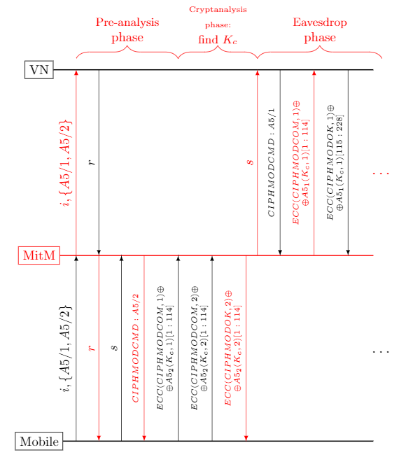

Slide 26
Shared-Key Handshake and Record Protocols: Topics
Introduction to (shared key) crypto-protocols
Record protocols
Handshake protocols: entity authentication
Handshake: extensions
Key-setup handshakes
GSM handshake case study, and:
Key distribution
Ciphersuite negotiation and downgrade attacks
Improving resiliency to key exposures

Slide 27
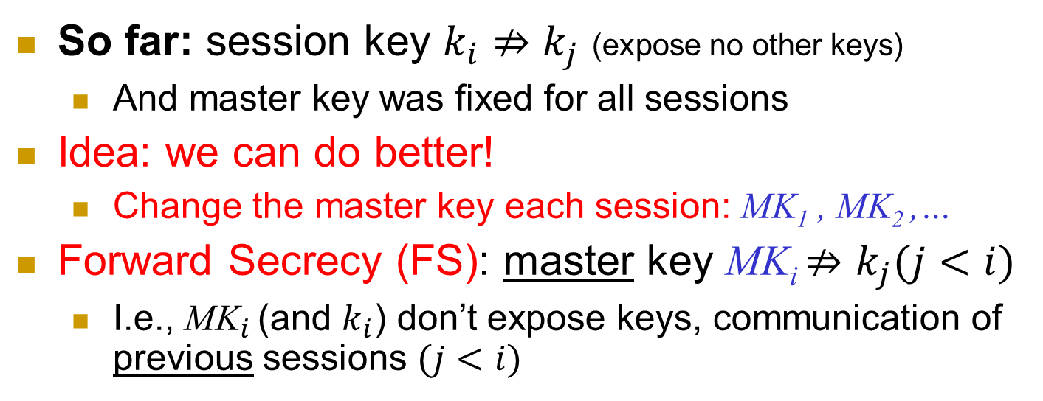



Improve resiliency to key exposures
So far: session key $k_{i}⇏k_{j}$ (expose no other keys)
And master key was fixed for all sessions
Idea: we can do better!
Change the master key each session: MK₁ , MK₂ ,…
Forward Secrecy (FS): master key MK_{i} $⇏k_{j}(j<i)$
I.e., ${\text{MK}}_{i}$ (and $k_{i}$) don’t expose keys, communication of previous sessions $(j<i)$
Secure MK₁
Keys Exposed
MK₂
Stays insecure
MK₃
$$k_{1}={PRF}_{{MK}_{1}}(N_{A}(1)||N_{B}(1))$$
$$k_{2}={PRF}_{{MK}_{2}}(N_{A}(2)||N_{B}(2))$$
$$k_{3}=…$$
Notes:
27
(c) Amir Herzberg, http://AmirHerzberg.com, Bar Ilan University
11/13/11
`Perfect’ is not really the right term… but that’s the commonly used term.

Slide 28

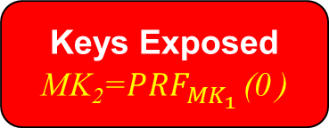
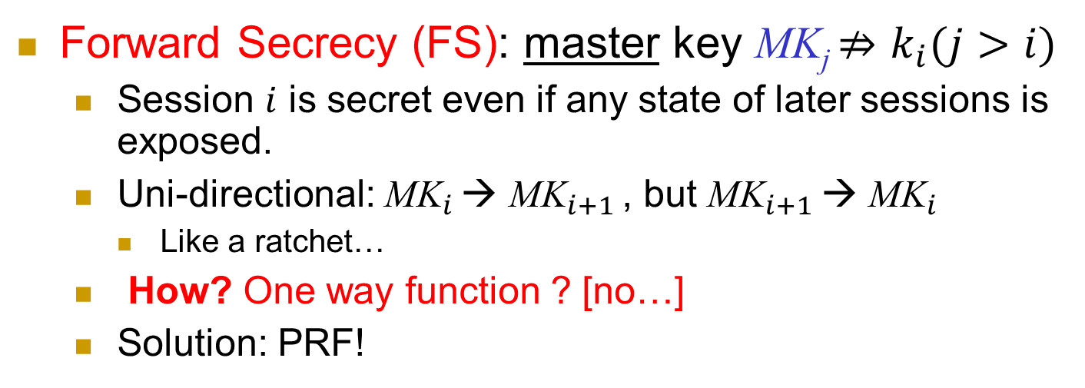

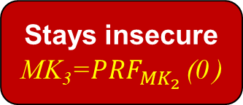
Improve resiliency to key exposures
Forward Secrecy (FS): master key MK_{j} $⇏k_{i}(j>i)$
Session $i$ is secret even if any state of later sessions is exposed.
Uni-directional: ${\text{MK}}_{i}$ → ${\text{MK}}_{i+1}$ , but ${\text{MK}}_{i+1}$ → ${\text{MK}}_{i}$
Like a ratchet…
How? One way function ? [no…]
Solution: PRF!
MK_{i}=${PRF}_{{MK}_{i−1}}$ (0 )
Secure MK₁
Keys Exposed
MK₂=${PRF}_{{MK}_{1}}$ (0 )
Stays insecure
MK₃=${PRF}_{{MK}_{2}}$ (0 )
$$k_{1}={PRF}_{{MK}_{1}}(N_{A}(1)||N_{B}(1))$$
$$k_{2}={PRF}_{{MK}_{2}}(N_{A}(2)||N_{B}(2))$$
$$k_{3}=…$$
Notes:
28
(c) Amir Herzberg, http://AmirHerzberg.com, Bar Ilan University
11/13/11
`Perfect’ is not really the right term… but that’s the commonly used term.

Slide 29
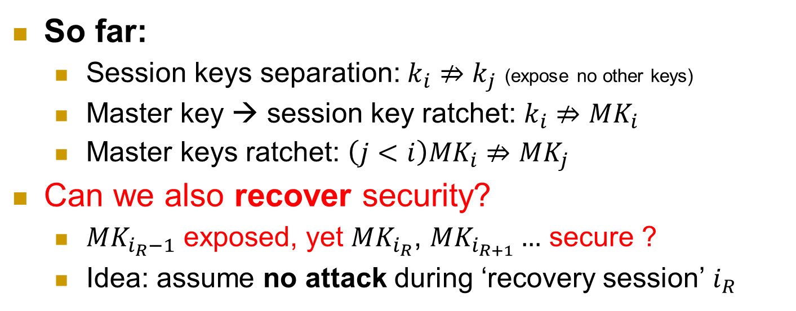


Improve resiliency to key exposures
So far:
Session keys separation: $k_{i}⇏k_{j}$ (expose no other keys)
Master key → session key ratchet: $k_{i}⇏{MK}_{i}$
Master keys ratchet: ${\left(j<i\right)MK}_{i}⇏{MK}_{j}$
Can we also recover security?
${MK}_{i_{R}−1}$ exposed, yet ${MK}_{i_{R}}$, ${MK}_{i_{R+1}}…$ secure ?
Idea: assume no attack during ‘recovery session’ $i_{R}$
Keys Exposed
MK₁
No attack: recover !
MK₂
Stays secure
MK₃
$$k_{1}={PRF}_{{MK}_{1}}(N_{A}||N_{B})$$
$$k_{2}={PRF}_{{MK}_{2}}(N_{A}||N_{B})$$
$$k_{3}=…$$
Notes:
29
(c) Amir Herzberg, http://AmirHerzberg.com, Bar Ilan University
11/13/11
`Perfect’ is not really the right term… but that’s the commonly used term.

Slide 30

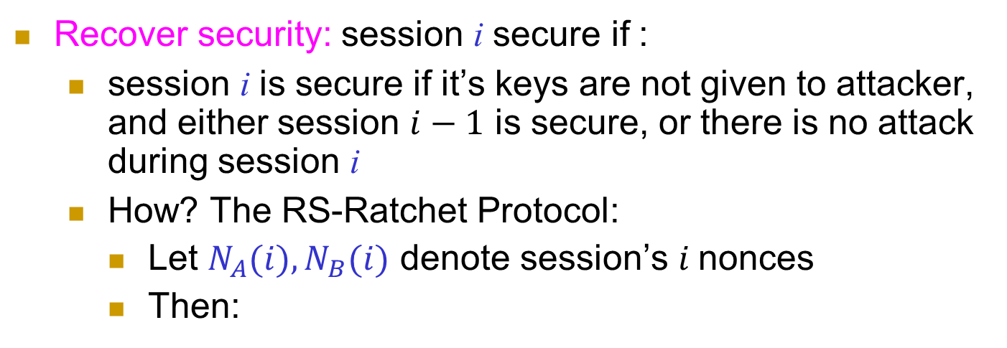
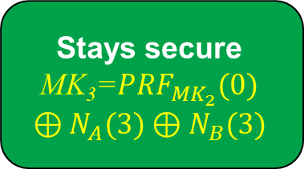
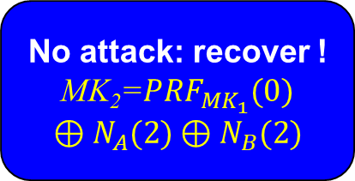



Recover Security (RS)
Recover security: session i secure if :
session i is secure if it’s keys are not given to attacker, and either session $i−1$ is secure, or there is no attack during session i
How? The RS-Ratchet Protocol:
Let $N_{A}(i), N_{B}(i)$ denote session’s $i$nonces
Then:
$$\text{MK}\text{i}={PRF}_{{MK}_{i−1}}(0)⊕N_{A}(i)⊕N_{B}(i)$$
Keys Exposed
MK₁
No attack: recover !
MK₂=${PRF}_{{MK}_{1}}(0)⊕N_{A}(2)⊕N_{B}(2)$
Stays secure
MK₃=${PRF}_{{MK}_{2}}(0)$ $$⊕N_{A}(3)⊕N_{B}(3)$$
$$k_{1}={PRF}_{{MK}_{1}}(N_{A}(1)||N_{B}(1))$$
$$k_{2}={PRF}_{{MK}_{2}}(N_{A}(2)||N_{B}(2))$$
$$k_{3}=…$$
Notes:
30
(c) Amir Herzberg, http://AmirHerzberg.com, Bar Ilan University
11/13/11
`Perfect’ is not really the right term… but that’s the commonly used term.

Slide 31
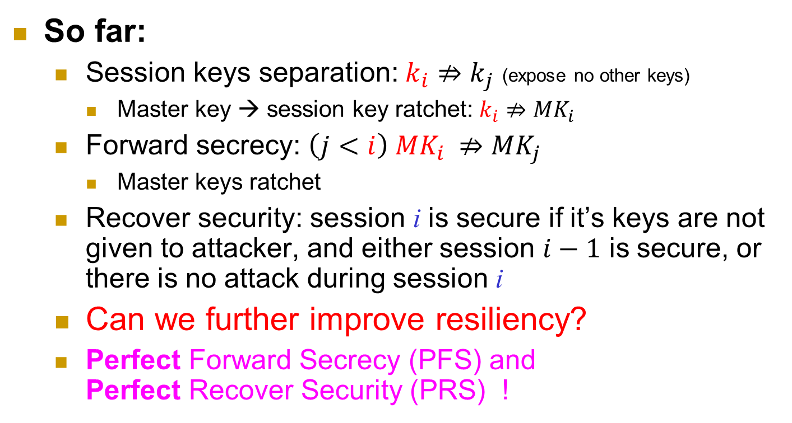
Improve resiliency to key exposures
So far:
Session keys separation: $k_{i}⇏k_{j}$ (expose no other keys)
Master key → session key ratchet: $k_{i}⇏{MK}_{i}$
Forward secrecy: ${\left(j<i\right) MK}_{i} ⇏{MK}_{j}$
Master keys ratchet
Recover security: session i is secure if it’s keys are not given to attacker, and either session $i−1$ is secure, or there is no attack during session i
Can we further improve resiliency?
Perfect Forward Secrecy (PFS) and Perfect Recover Security (PRS) !
Notes:
31
(c) Amir Herzberg, http://AmirHerzberg.com, Bar Ilan University
11/13/11
`Perfect’ is not really the right term… but that’s the commonly used term.

Slide 32
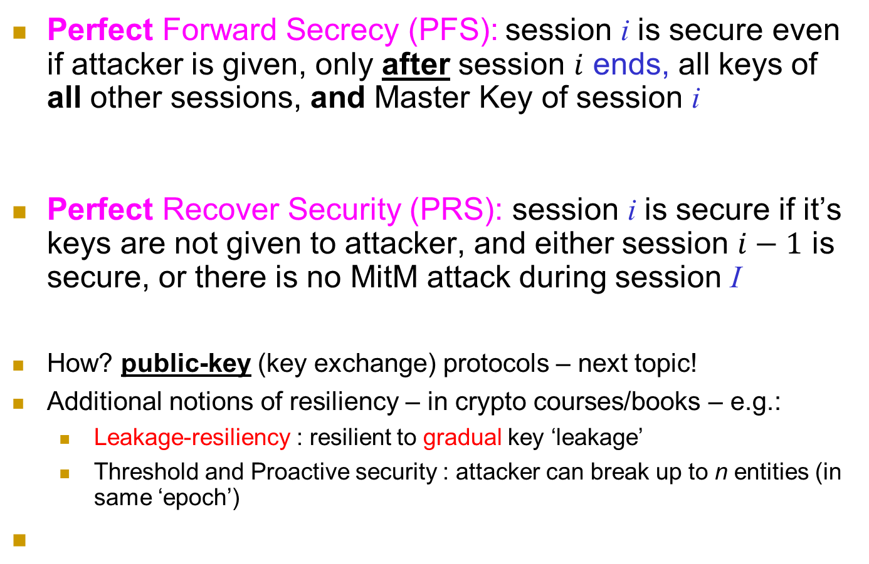
Perfect Forward, Recover Secrecy
Perfect Forward Secrecy (PFS): session i is secure even if attacker is given, only after session $i$ ends, all keys of all other sessions, and Master Key of session i
Perfect Recover Security (PRS): session i is secure if it’s keys are not given to attacker, and either session $i−1$ is secure, or there is no MitM attack during session I
How? public-key (key exchange) protocols – next topic!
Additional notions of resiliency – in crypto courses/books – e.g.:
Leakage-resiliency : resilient to gradual key ‘leakage’
Threshold and Proactive security : attacker can break up to n entities (in same ‘epoch’)
Notes:
32
(c) Amir Herzberg, http://AmirHerzberg.com, Bar Ilan University
11/13/11
`Perfect’ is not really the right term… but that’s the commonly used term.

Slide 33
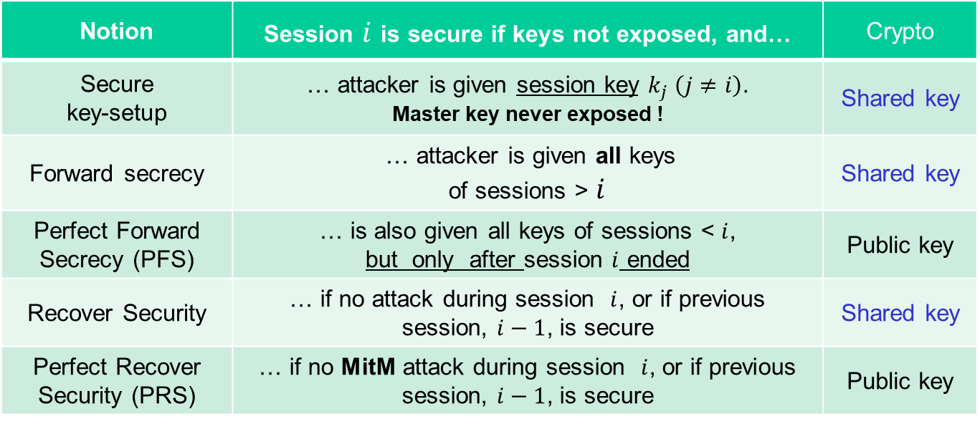
Resiliency Notions: Shared + Public Key
Notion | Session $i$ is secure if keys not exposed, and… | Crypto
Secure key-setup | … attacker is given session key $k_{j} \left(j≠i\right)$. Master key never exposed ! | Shared key
Forward secrecy | … attacker is given all keys of sessions > $i$ | Shared key
Perfect Forward Secrecy (PFS) | … is also given all keys of sessions < $i$, but only after session $i$ ended | Public key
Recover Security | … if no attack during session $i$, or if previous session, $i−1$, is secure | Shared key
Perfect Recover Security (PRS) | … if no MitM attack during session $i$, or if previous session, $i−1$, is secure | Public key
Secure key setup
FS
PFS
RS
PRS
Notes:
33
(c) Amir Herzberg, http://AmirHerzberg.com, Bar Ilan University
11/13/11
`Perfect’ is not really the right term… but that’s the commonly used term.

Slide 34
Conclusion
Secure handshake protocols seem easy…
But are easy to get wrong!
Many vulnerable proposed, deployed systems
Precise definitions and proofs are not so simple
Also: many variants
Advanced features require public key crypto
Next: public key cryptology
Key Exchange
Encryption
Signatures
Notes:
34
(c) Amir Herzberg, http://AmirHerzberg.com, Bar Ilan University
11/13/11

Slide 35
Covered Material From the Textbook
Chapter 5
Sections

Slide 36

Thank You!

