Slide 1
CSE 3400 - Introduction to Computer & Network Security (aka: Introduction to Cybersecurity) Lecture 13 Public Key Infrastructure – Part II
Ghada Almashaqbeh
UConn
From Textbook Slides by Prof. Amir Herzberg
UConn

Slide 2
Outline
The
2

Slide 3
Certificate Revocation
3

Slide 4
Certificate Revocation
Reasons for revoking certificates
Key compromise
CA compromise
Affiliation changed (changing DN or other attribute)
Superseded (replaced)
Cessation – not longer needed
How to inform relying parties? Few options…
Do not inform – wait for end of (short?) validity period
Distribute Certificate Revocation List (CRL)
Ask - Online Certificate Status Protocol (OCSP)

Slide 5
X.509 CRL Format

Slide 6
Revocation with CRLs is Difficult
If CRLs contain all revoked certificates (which did not expire)… it may be huge!
CRLs are not immediate
Who is responsible until CRL is distributed?
Frequent CRLs ➔ even more overhead!
Solutions:
More efficient CRL schemes
CRL distribution point – split certificates to several CRLs
Authorities Revocation List (ARL): list only revoked CAs
Delta CRL – only new revocations since last `base CRL`
Browsers mostly do not check CRLs. Instead:
Online Certificate Status Protocol (OCSP)
Short validity for certificates

Slide 7
Short-Term Certificates
Idea: short validity period of certificates, so no need to revoke them
Concern: overhead of signing many certificates each (short) period
Solution: Hash-chain short-term certificate renewal
Yearly-signed certificate, monthly-preimage-renewal
December: sign new yearly cert, with h⁽¹²⁾(x)
Random x
Each month, expose a preimage: h⁽¹¹⁾(x), h⁽¹⁰⁾(x) , …
Validate extension, e.g.: h⁽¹¹⁾(x)=h(h⁽¹⁰⁾(x) )

Slide 8
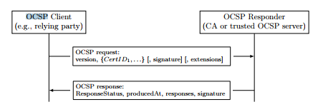
Online Certificate Status Protocol (OCSP)
Improve efficiency, freshness cf. to CRLs
Client asks CA about cert during handshake
CA signs response (real-time)

Slide 9
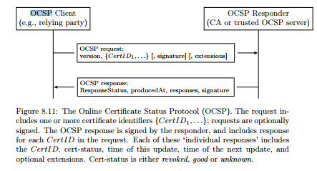
Online Certificate Status Protocol (OCSP)

Slide 10
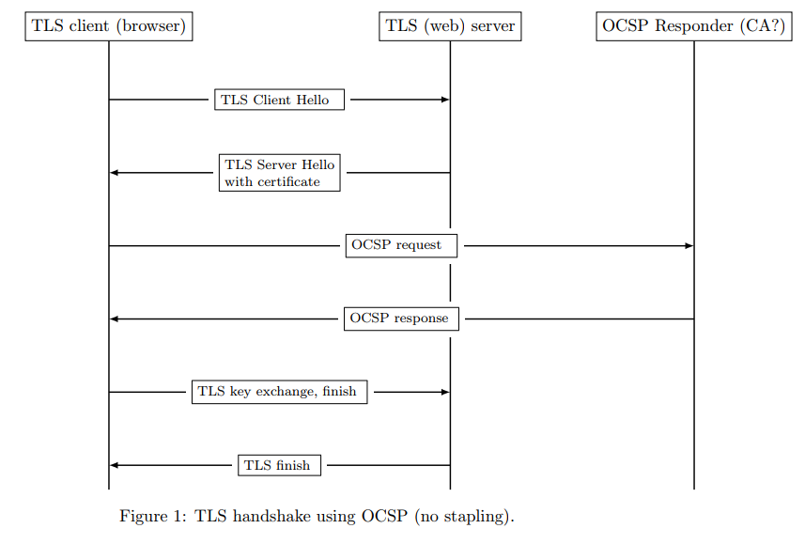

Slide 11
Online Certificate Status Protocol (OCSP)
Client asks CA about cert during handshake
CA signs response (real-time)
Challenges:
Privacy: expose (domain, client) to CA
Load on CA
Delay (latency): on average, almost a second
Reliability: what if CA fails? No connectivity?
➔ Most browsers skip OCSP or soft-fail: continue w/o OCSP response
Better way to do OCSP?

Slide 12
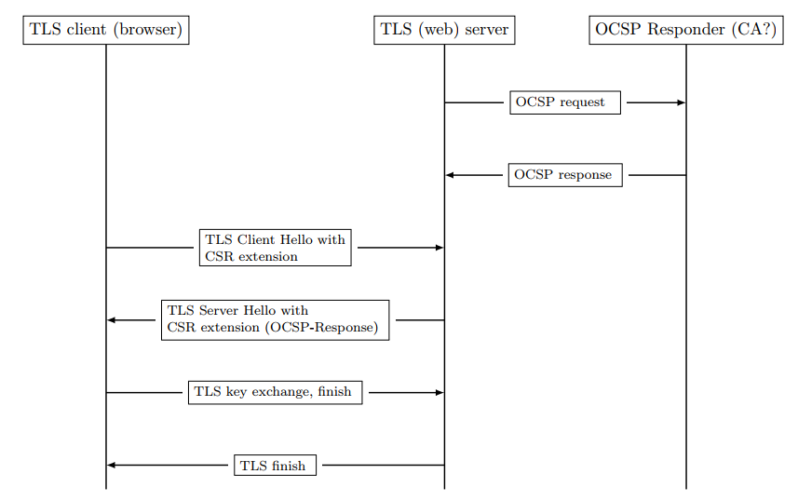

OCSP-Stapling
Server runs OCSP, sends (`staples’) the CA-signed response (CSR) during TLS handshake
Improve efficiency, privacy, reliability
Challenge: many servers don’t staple!
Or: staple `sometimes/usually’
Notes:
Some web servers, Nginx in particular, do `lazy OCSP queries’ and staple only when the already have the OCSP response. Others like Apache fail in other ways, e.g., if they get error or no response, they throw existing OCSP response (even if still valid).

Slide 13
OCSP-Stapling
Server runs OCSP, sends (`staples’) the CA-signed response during TLS handshake
Challenge: many servers don’t staple!
Or, worse: staple `sometimes/usually’
So, try OCSP? Connect anyway? Disconnect?
Solution: `Must-staple’ cert. extension
RFC 7633
Mark as not critical
As it may not be supported by some browsers
Notes:
Some web servers, Nginx in particular, do `lazy OCSP queries’ and staple only when the already have the OCSP response. Others like Apache fail in other ways, e.g., if they get error or no response, they throw existing OCSP response (even if still valid).

Slide 14
Online Certificate Status Protocol (OCSP)
Most browsers don’t use CRLs. Why?
Efficiency, freshness concerns
OCSP: check cert-status `as needed’
Signed responses (from trusted CA/server)

Slide 15
Online Certificate Status Protocol (OCSP)

Slide 16
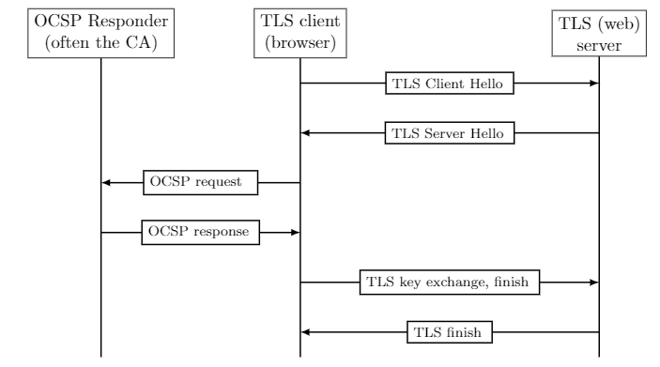
‘Classical OCSP’: browser sends request

Slide 17
Online Certificate Status Protocol (OCSP)
Client asks CA about cert during handshake
CA signs response (real-time)
Challenges:
Privacy: expose (domain, client) to CA
Load on CA
Delay (latency): on average, almost a second
Reliability: what if CA fails? No connectivity?
➔ Most browsers skip OCSP or soft-fail: continue w/o OCSP response
Vulnerable!

Slide 18
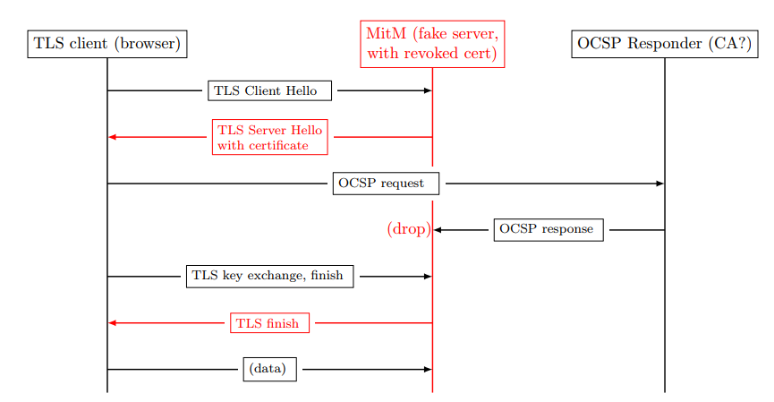
MitM soft-fail attack on ‘classic OCSP’

Slide 19
Soft-Fail is too Soft. Why do it ???
Why not deploy OCSP without soft-fail?
Foiling the MitM soft-fail attack !
Hard-Fail: browser refuses connection unless/until receiving (good) OCSP response
Possible answers?
Good idea. Google, MS and Apple are dummies.
No way, users will switch browsers.
Principle: User Experience (UX) > Security
‘Precedence rule’

Slide 20
OCSP-Stapling
Server runs OCSP, sends (`staples’) the CA-signed response during TLS handshake
Improve efficiency, privacy, reliability
Challenge: many servers don’t staple, or: staple `sometimes/usually’
Solution: `must staple’ Cert extension
Mark non-critical (Why??)
Notes:
Some web servers, Nginx in particular, do `lazy OCSP queries’ and staple only when the already have the OCSP response. Others like Apache fail in other ways, e.g., if they get error or no response, they throw existing OCSP response (even if still valid).

Slide 21
Attacking… Stapled OCSP
Stapled-OCSP is usually vulnerable!
Idea of vulnerability:
Most servers don’t staple
And some staple… but not always
How can browser know if staple or not??
Allows variant of soft-fail attack!

Slide 22
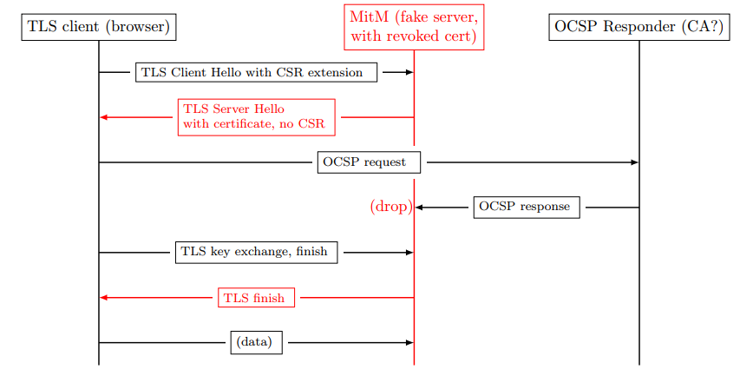
Attack on Soft-Fail Stapled-OCSP client

Slide 23
Must-Staple Certificate Extension
Solution to attack on stapled-OCSP clients: site signals it supports stapled OCSP
How? Add ‘must staple’ x.509 extension
A server sending this cert must staple!
Note: extensions should be non-critical!
Else, a non-supporting client cannot use cert.
How does this prevent attack?

Slide 24
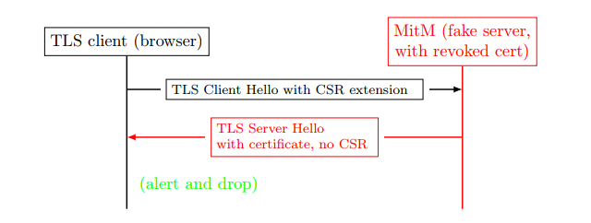
OCSP with Must-Staple Extension
Principle: Defenses should not be bypassed due to failures. If defenses are bypassed upon failure, attacker will cause failures to bypass defenses.

Slide 25
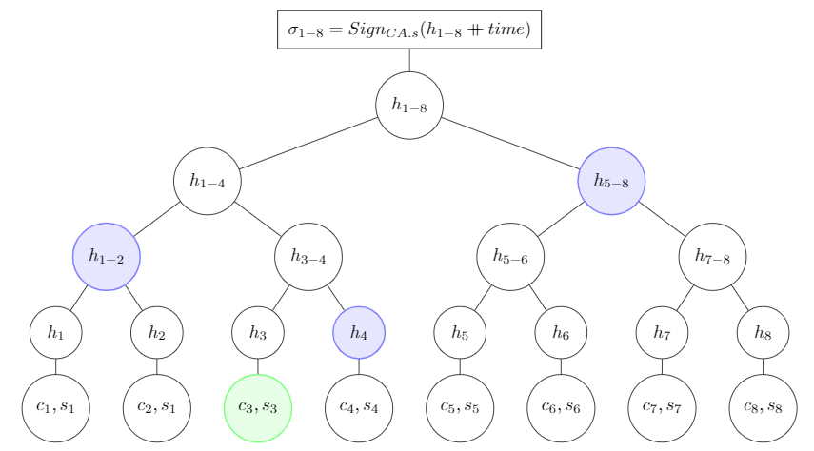
Optimizing OCSP Responses (1)
OCSP overhead is high – esp. if frequent
Several optimizations possible, e.g.: Merkle digest-tree, Proof-of-Inclusion (PoI):

Slide 26
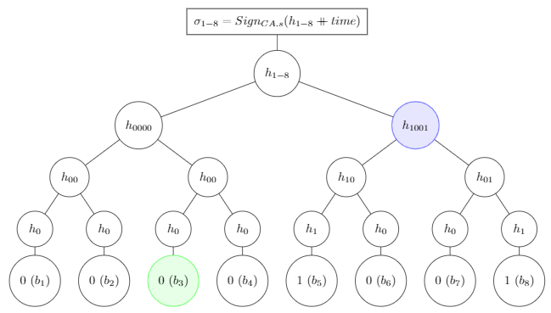
Signed Revocations-Status Merkle-Tree
A further optimization: send digest and PoI in revocations-status Merkle tree:

Slide 27
PKI Lecture: Topics
Introduction
X.509 Certificates
Intermediate-CAs and Certificate Path Validation
Revoking certificates
Dealing with CA failures: CT (Certificate Transparency) and other defenses
Conclusions and challenges…

Slide 28
Why and How CAs fail?
Many CAs `trusted’ in browsers (as root)
‘Domain-Validated’ certificates
Several well-known failures
DigiNotar, Comodo, Stuxnet, …
Every CA can certify any domain (name)
Name constraints NOT applied (esp. to roots)
Some CAs may be negligible or even rogue
Bad certificates:
Equivocation: rogue certificates for same name as a legit cert
Misleading certificates, e.g., similar name
Can we improve defense against bad CA?

Slide 29
Defenses against CA failures
Use name constraints to limit risk
who can issue global TLDs (.com, etc.)?
Static key pinning: `burned-in’ public keys
Detected MitM in Iran: rogue DigiNotar cert of Google
Limited: changing keys? Which keys to preload ?
Dynamic Pinning: HTTP Public-Key Pinning (HPKP)
Server: I always use this PK / Cert / Chain
Client: remember, implement, detect & report attacks
Concerns: key loss/exposure, changing keys (recover security)
Still, Trust-On-First-Use (TOFU) can be helpful
E.g. for security policies: OCSP-must-stapling or CAs-pinning
Certificate Transparency (CT): Accountability
Public, auditable certificates log
Notes:
Potentially mention/add: Origin-bound certificates, threshold scheme

Slide 30
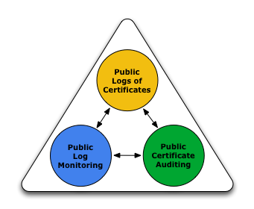
Certificate Transparency (CT) [RFC6962]
X.509, PKIX: CAs sign cert
Accountability: identify issuer, given (rogue) cert
Challenge: find rogue cert
Unrealistic to expect relying parties to detect !
Google detected in Iran - since Chrome had pinned Google’s PK
Proposed solution: Certificate Transparency
Functions: Logging, Monitoring and Auditing
Loggers provide public logs of certificates
Monitors monitor certificates logged for detection of suspect certificates
Auditing (auditors?): check for misbehaving loggers
Google, CAs,…
Relying party
(browser)
CAs, Facebook, others

Slide 31
Certificate Transparency (CT): Goals
➔ Easier to detect, revoke rogue certificates
➔ Easier to detect, dis-trust rogue CAs: No (real) accountability without transparency !
What about rogue loggers ?
Option 1: Honest-Logger CT (HL-CT) [RFC6962]
Assume honest logger [out of two loggers – redundancy]
In Google we trust ?
Option 2: NTTP-Secure CT (NS-CT):
Monitors, relying-parties detect misbehaving loggers
Relying party decides which monitor(s) it relies on (trusts) !
Original CT goal: ‘no trusted third party’

Slide 32
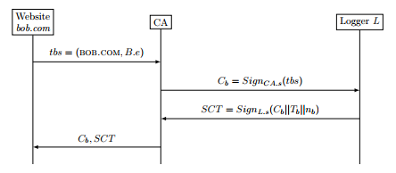
Honest-Logger CT: Issuing Certificate
Subject, e.g. website, sends request
Request contains ‘To Be Signed’ fields: name, public-key
CA validates request, signs cert, sends to logger
Logger adds cert to log, signs and returns (signed) SCT
CA sends cert + SCT to subject (e.g., website)
TBS=To Be
Signed

Slide 33
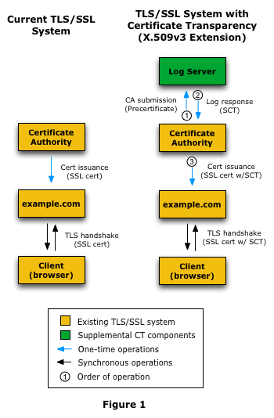
X.509 vs. HL-CT: Issuing process
SCT: Signed
Certificate Timestamp
(time that the certificate was added to log, serial number)

Slide 34
Honest-Logger CT: Issuing Certificate
Issuer (CA) must send every cert to logger
Logger returns Signed Certificate Timestamp (SCT)
Validate that the cert was logged at given time
CA gives cert, SCT to subject (e.g., website)
Subject sends SCT (with cert) to relying party
Relying party ‘knows’ cert was logged (and when)
How do we use logs to detect rogue certs?

Slide 35
Detecting rogue certs in log: Monitors
Goal: early detection of rogue certs in log
Logs should be publicly available
Name-owners can monitor the log
Download, check log for relevant names
☹ high overhead to everyone!
Instead: monitors do this (for many names)
Several such monitors, loggers already operate
Download only new certificates
And: ask log for seq# and/or date of last logged cert
Ask log to send range of certs: <from-to>
Optionally: maintain all certs (to check new names)

Slide 36
Monitor Detects Rogue Certificates
Owner asks to monitor relevant domain names
Monitor asks for certs [Range, e.g., all new]
Usually periodically; assume daily (typical)
Monitor sends to owner new certs for same domain name
Or suspect as misleading: combo, homographic, similar,…
Domain
owner
Domain(s), $
Monitor
Send certs [from.. to..]
Logger
Logger
Logger
New certs
New certs
for domain
or misleading

Slide 37
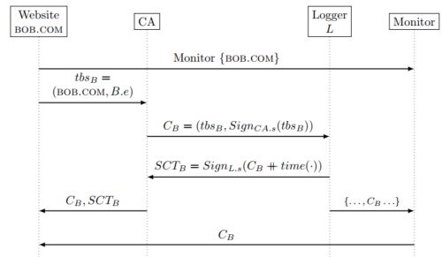
Monitoring in Honest-Logger CT
Notes:
Note: if site wants also report of certs issued _before_ time of sending monitor request, then monitor must maintain (or download again) all older certificates from logger.
TBS stands for To Be Signed

Slide 38
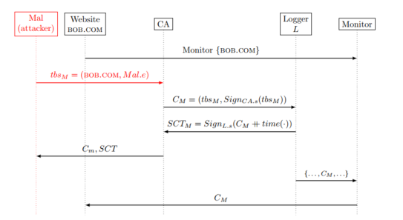
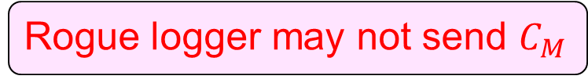
HL-CT: Detecting Rogue Certificate
T
Rogue logger may not send $C_{M}$

Slide 39
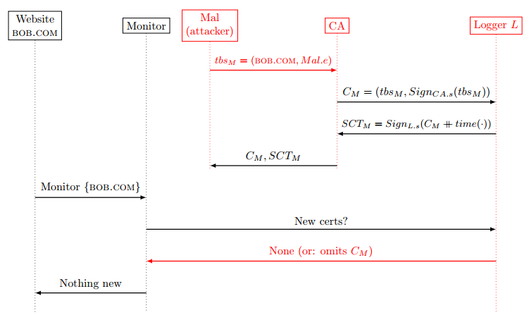
HL-CT: Omitted-Cert Attack by Rogue Logger
Collusion of rogue CA and rogue Logger

Slide 40
Security against Logger-CA Collusion: two options
Option 1: redundancy: SCTs signed by multiple loggers
Current approach in Google’s Chrome; req’s two SCTS (one Google)
If you require more redundancy… good luck finding certificates!
How many loggers? Which loggers? Overhead ?
Google’s logger + a logger selected by (untrusted??) CA
‘In Google we Trust’ ?
Option 2: avoid ‘honest-logger’ assumption
Two variants: AnG-CT and NS-CT
AnG-CT: Audit and Gossip to detect rogue logger
Roughly follows RFC6962 and original CT publications
Complex, expose user privacy, … : see textbook if interested
NTTP-Secure CT (NS-CT):
Ensures `no trusted third party’ by Proofs-of-Misbehavior (PoM)
Notes:
Note: many loggers are also CAs!

Slide 41
Audit-and-Gossip (AnG) Certificate Transparency
Logger keeps certs in Merkle tree
Protocol uses digest, PoI and PoC mechanisms
Signed, timestamped digest: Signed Tree Head (STH)
Logger must respond to several audit requests:
Request for STH+PoI, for given certificate
Request for PoC, for given pair of STHs
Request for current STH
Request for certificates, logged between given start/end times
Gossip: sharing of STHs among entities
To detect ‘split world attack’: different STHsto to different entities
My interpretation of `original’ CT
Using Audit and Gossip to detect rogue loggers
No complete spec published so `extrapolating’
Notes:
Note: many loggers are also CAs!

Slide 42
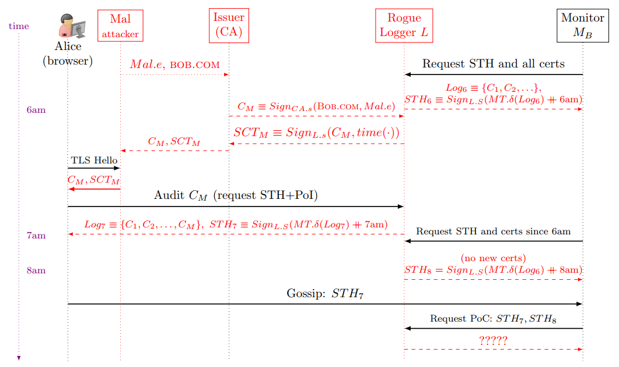
Audit-and-Gossip (AnG) Certificate Transparency

Slide 43
What is missing in AnG-CT ?
AnG-CT may fail to provide Proof-of-Misbehavior
Logger never sends the STH for a rogue SCT !
Relying party receives no response… what can it do ??
Or, never responds to request for PoC for ‘rogue STH’…
Also: AnG-CT does not address revocation transparency ➔ vulnerable to ‘zombie certificate attack’: send ‘valid’ response to OCSP query for a revoked certificate
And: AnG-CT relying parties expose visited website
Next: NTTP-Secure (NS) Certificate Transparency
Also based on Audit and Gossip, but addressing above issues
NTTP = No Trusted Third Party (e.g., logger not trusted)
Simplified: no SCT, logger responds only daily with STH (can be changed to give SCT for immediate responses, certs)

Slide 44
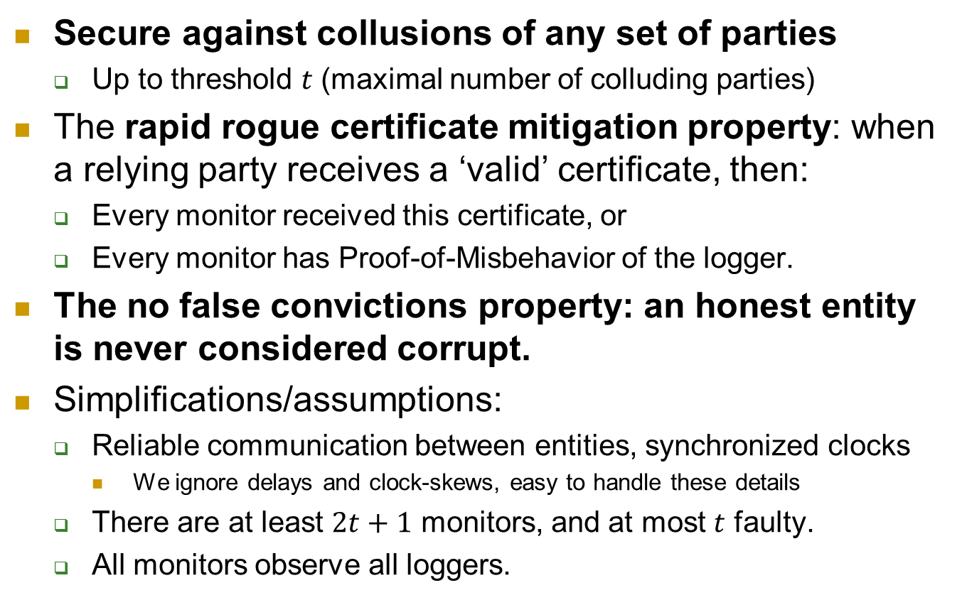
NTTP-Secure CT: Goals and Assumptions
Secure against collusions of any set of parties
Up to threshold $t$ (maximal number of colluding parties)
The rapid rogue certificate mitigation property: when a relying party receives a ‘valid’ certificate, then:
Every monitor received this certificate, or
Every monitor has Proof-of-Misbehavior of the logger.
The no false convictions property: an honest entity is never considered corrupt.
Simplifications/assumptions:
Reliable communication between entities, synchronized clocks
We ignore delays and clock-skews, easy to handle these details
There are at least $2t+1$ monitors, and at most $t$ faulty.
All monitors observe all loggers.

Slide 45
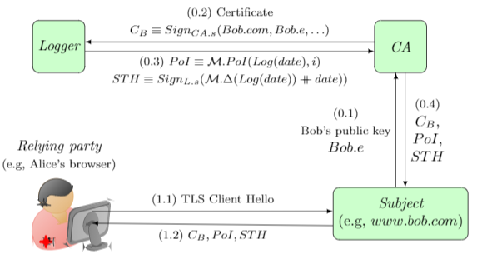
NS-CT : Simplification and Issue Process
Loggers issue Signed Tree Head (STH) every 24 hours
And `immediately’ provide it to all monitors
Response to CA includes STH and Proof-of-Inclusion (PoI)
CA, subject, relying party validate STH and PoI
Issue process almost unchanged – but takes 24 hours…

Slide 46
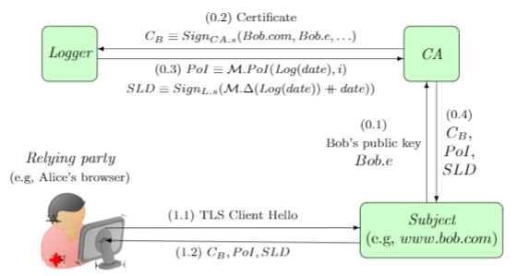
NTTP-Secure CT Issue Process

Slide 47
NS-CT: Audit detects an omitted cert
Logger
NewCerts, STH
Monitor
(Signed daily Log Digest)
PoI’, STH’
C’_{i}
CA
Req, pk, $
C’_{i} ,PoI’, STH’
Ok: Signed(STH)
or
Proof-of-Misbehavior (PoM): STH ≠STH’
STH’
Site
C’_{i} ,PoI’, STH’
Browser

Slide 48
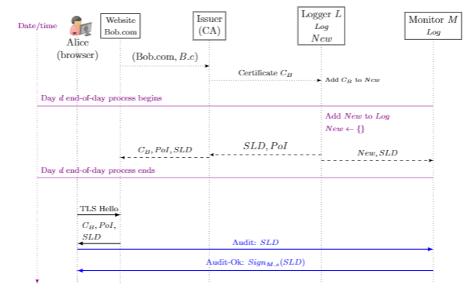
NS-CT Auditing Process (no omission)

Slide 49
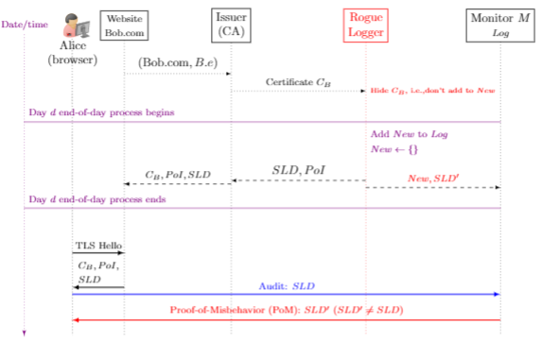
Proof-of-Misbehaving Logger: Omitted Cert.
Notes:
scenario assumes that the Monitor has the Merkle cert-tree for this logger, computed all certificates issued till time Tb (or later)

Slide 50
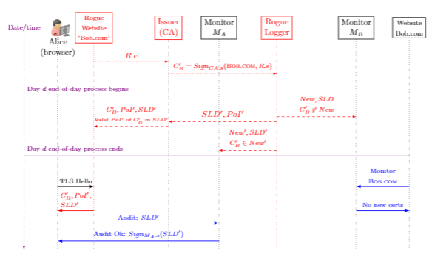
NS-CT w/o Gossip: Split-World Attack

Slide 51
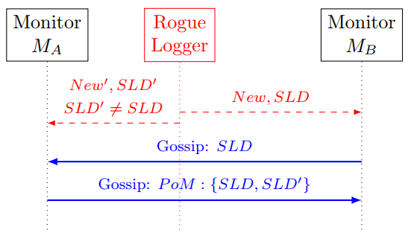
Inter-Monitor Gossip foils Split-World Attack

Slide 52
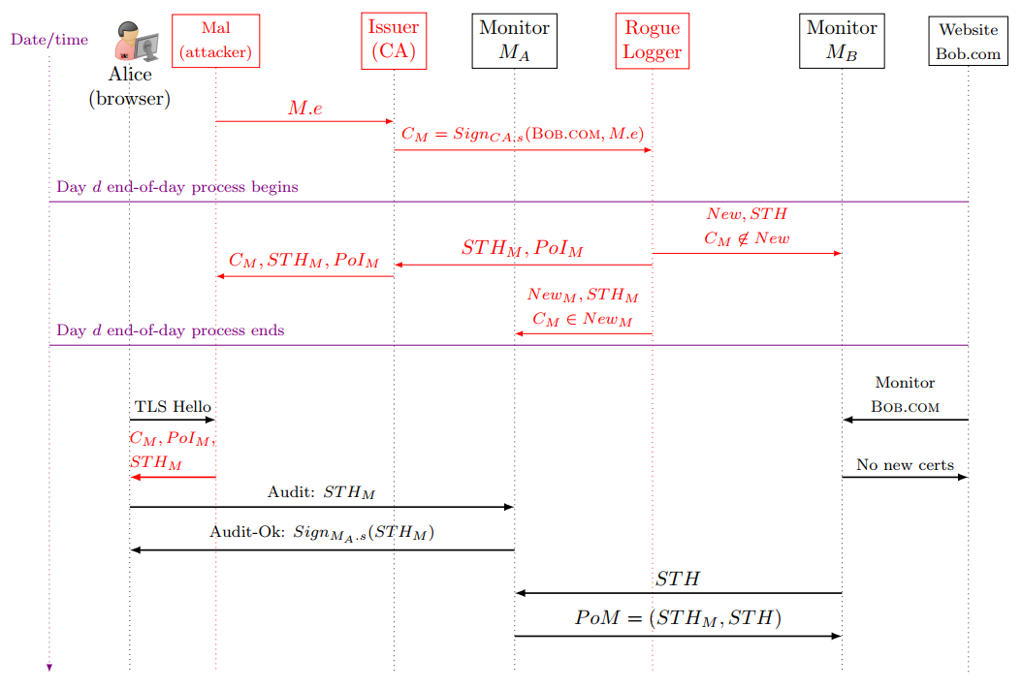

Slide 53
Summary: benefits of CT
Benefits for websites:
Detect rogue certs for domain (same or misleading)
Once detected, owners can mitigate risk
Demand revocation, removal of CA from root program, …
Benefit to users: less likely to fall victim…
Benefit to trustworthy CAs: reduced competition from shady CAs
Overall: more secure PKI !
Not covered here:
Auditing and proving misbehavior of rogue monitors
The Zombie-certificate attack
Transparent revocation in NS-CT (prevents Zombie-cert attack)

Slide 54
Covered Material From the Textbook
Chapter 8:
Sections 8.1, 8.2, …

Slide 55

Thank You!

