Slide 1
CSE 3400 / CSE 5850 Introduction to Cryptography and Cybersecurity
/ Introduction to Cybersecurity
Lecture 4
Encryption – Part III
(and Pseudo-randomness)
Ghada Almashaqbeh
UConn
Adapted from the textbook slides

Slide 2
Outline
Block ciphers.
Pseudorandom permutations (PRPs).
Defining security of encryption.
Encryption modes.
2

Slide 3
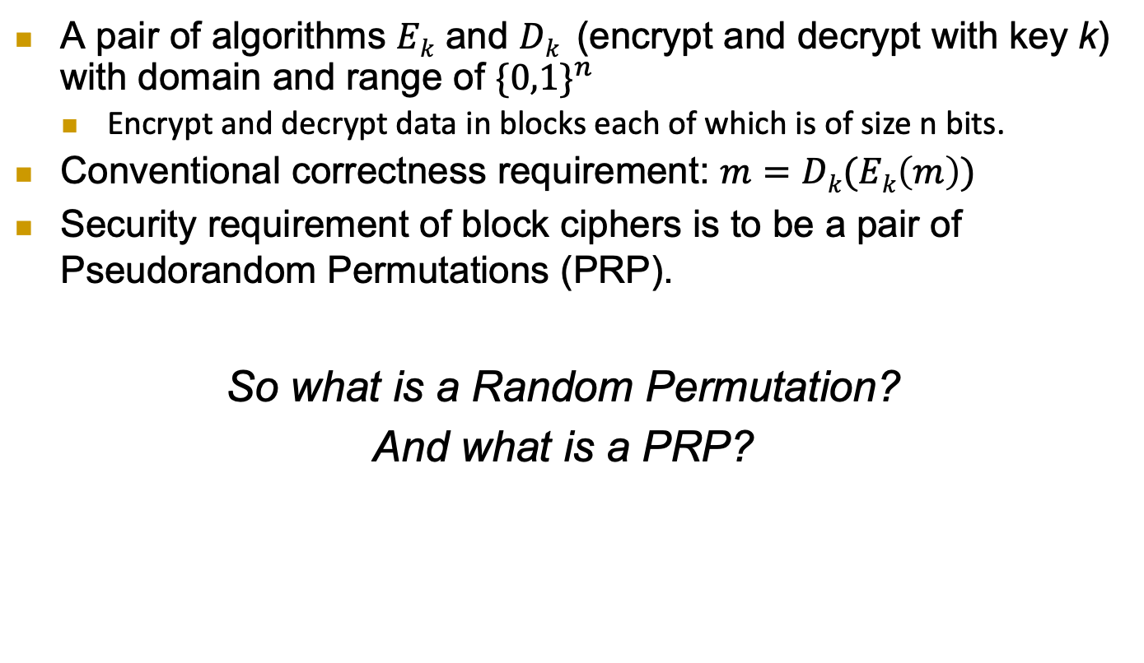
Block Ciphers
A pair of algorithms $Ek$ and $Dk$ (encrypt and decrypt with key k) with domain and range of ${\{0,1\}}^{n}$
  Encrypt and decrypt data in blocks each of which is of size n bits.
Conventional correctness requirement: $m=Dk(Ek\left(m\right))$
Security requirement of block ciphers is to be a pair of Pseudorandom Permutations (PRP).
So what is a Random Permutation?
And what is a PRP?
3

Slide 4
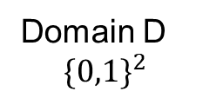
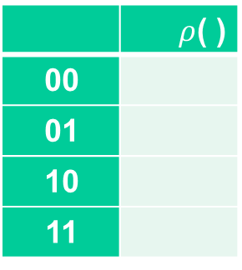
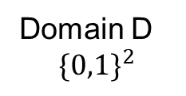
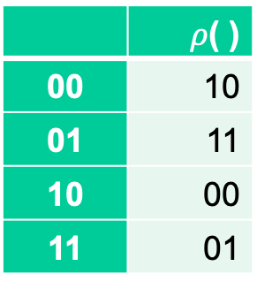
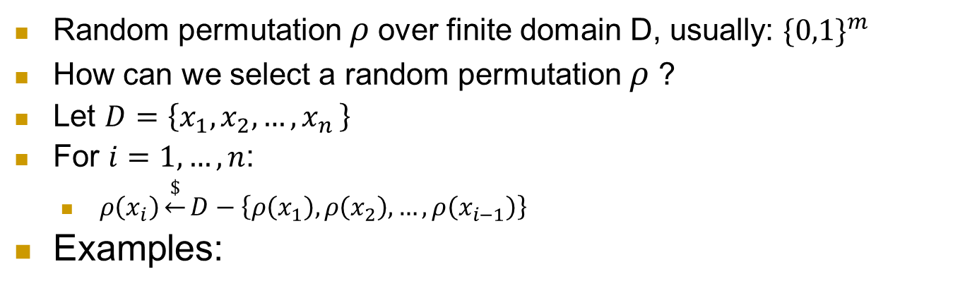
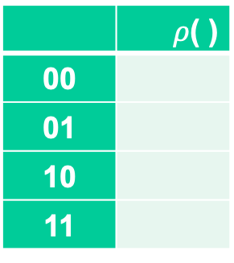

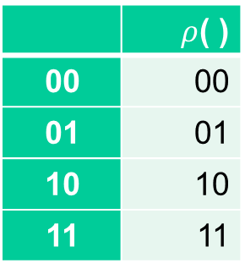
What is a random permutation $ρ$ ?
Random permutation $ρ$over finite domain D, usually: ${\{0,1\}}^{m}$
How can we select a random permutation $ρ$ ?
Let $D=\left\{x_{1},x_{2},…,x_{n }\right\}$
For $i=1,…, n$:
  $ρ\left(x_{i}\right)\underset{←}{\$}D−\left\{ρ\left(x_{1}\right),ρ\left(x_{2}\right),…,ρ\left(x_{i−1}\right)\right\}$
Examples:
 | $ρ$( )
00
01
10
11
 | $ρ$( )
00 | 10
01 | 11
10 | 00
11 | 01
 | $ρ$( )
00
01
10
11
 | $ρ$( )
00 | 00
01 | 01
10 | 10
11 | 11
Domain D
$${\{0,1\}}^{2}$$
Domain D
$${\{0,1\}}^{2}$$
4

Slide 5


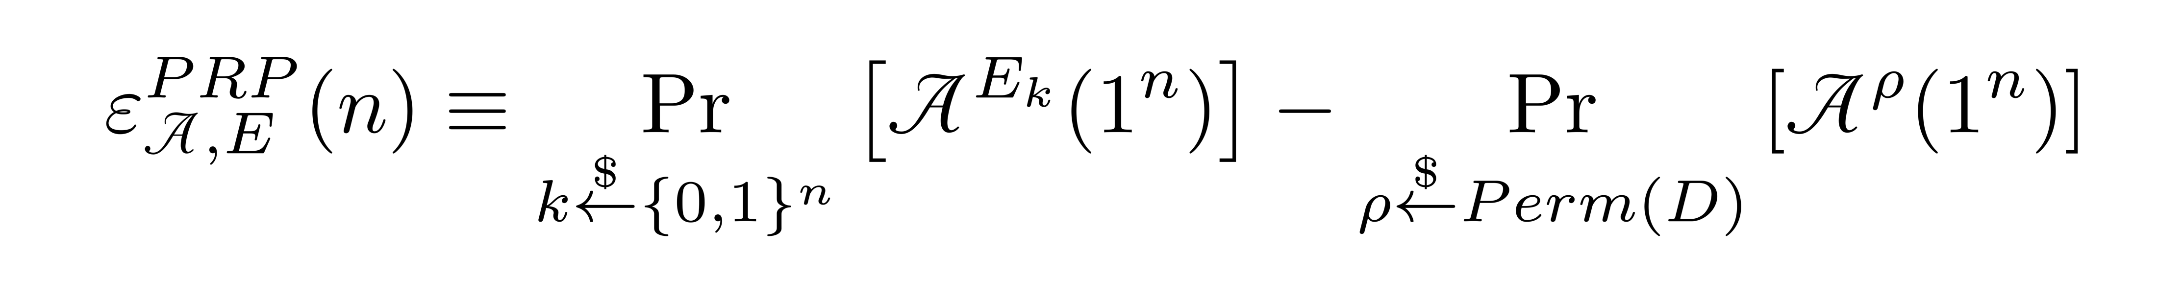
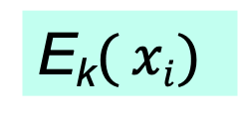
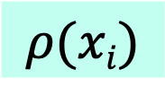
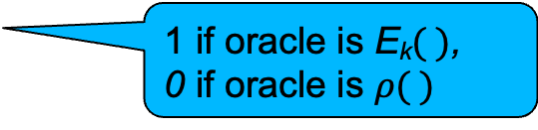


Pseudorandom Permutation (PRP) and their Indistinguishability Test
E is a PRP over domain D, if no distinguisher or attacker A can distinguish E from a random permutation with non-negligible probability.
  So A’s advantage is negligible.
n-bit Key k
k
x₁,x₂,…,x_{i}
x₁,x₂,…,x_{i}
E_{k}$( xi)$
?
$$ρ(xi)$$
…, E_{k}(x_{i})
…, $ρ$(x_{i})
E_{k}$( )$
Random permutation
1 if oracle is E_{k}$( )$,
0 if oracle is $ρ( )$
5

Slide 6
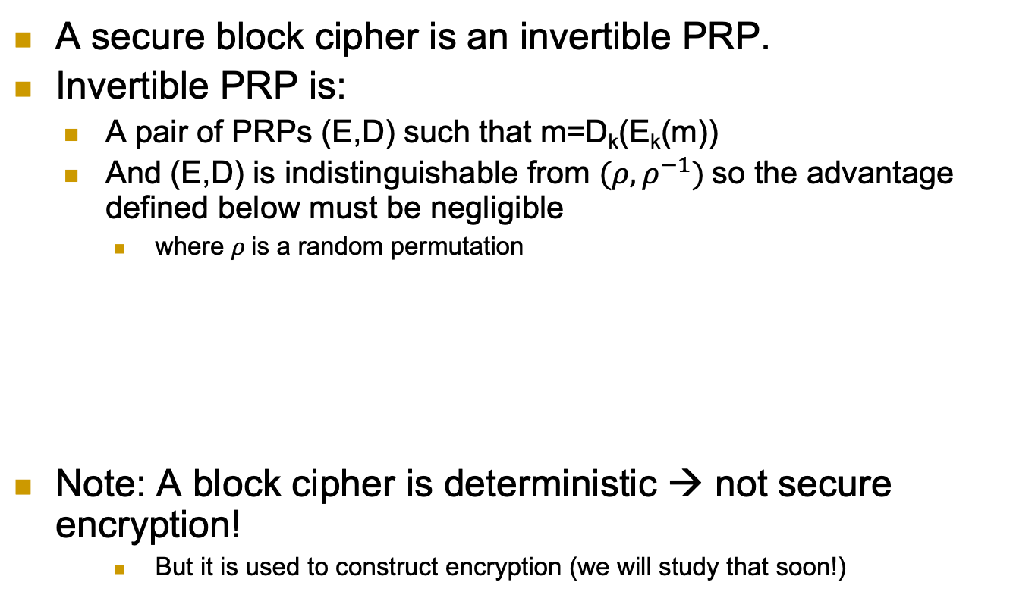
Block Cipher: Invertible PRP (E, D)
A secure block cipher is an invertible PRP.
Invertible PRP is:
  A pair of PRPs (E,D) such that m=D_{k}(E_{k}(m))
  And (E,D) is indistinguishable from $(ρ, ρ^{−1})$so the advantage defined below must be negligible
    where $ρ$is a random permutation
Note: A block cipher is deterministic → not secure encryption!
    But it is used to construct encryption (we will study that soon!)
6

Slide 7
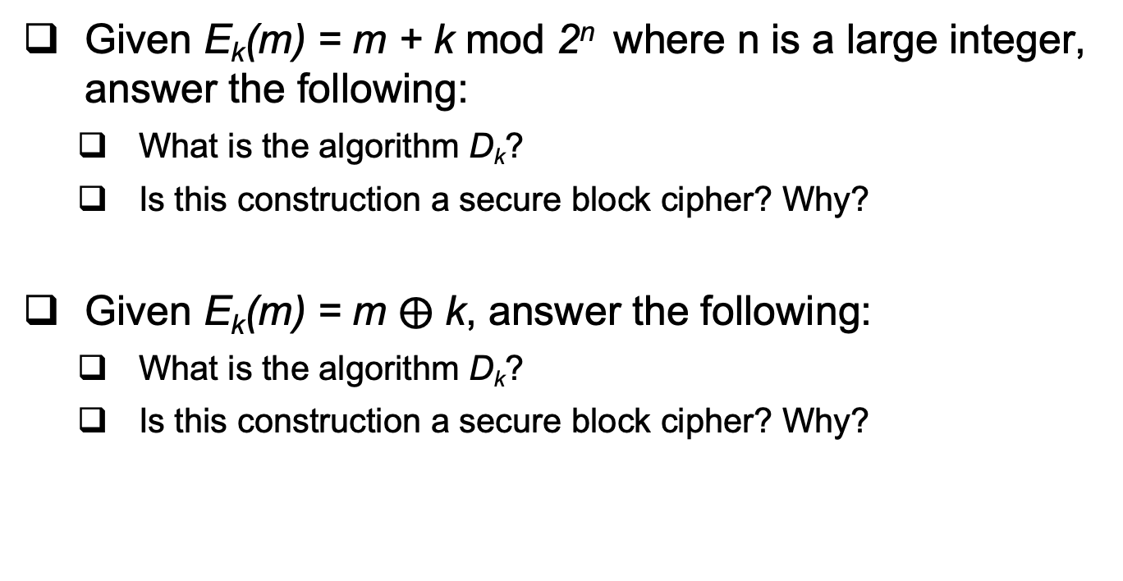
Examples
Given E_{k}(m) = m + k mod 2^{n} where n is a large integer, answer the following:
  What is the algorithm D_{k}?
  Is this construction a secure block cipher? Why?
Given E_{k}(m) = m $⨁$ k, answer the following:
  What is the algorithm D_{k}?
  Is this construction a secure block cipher? Why?
7

Slide 8
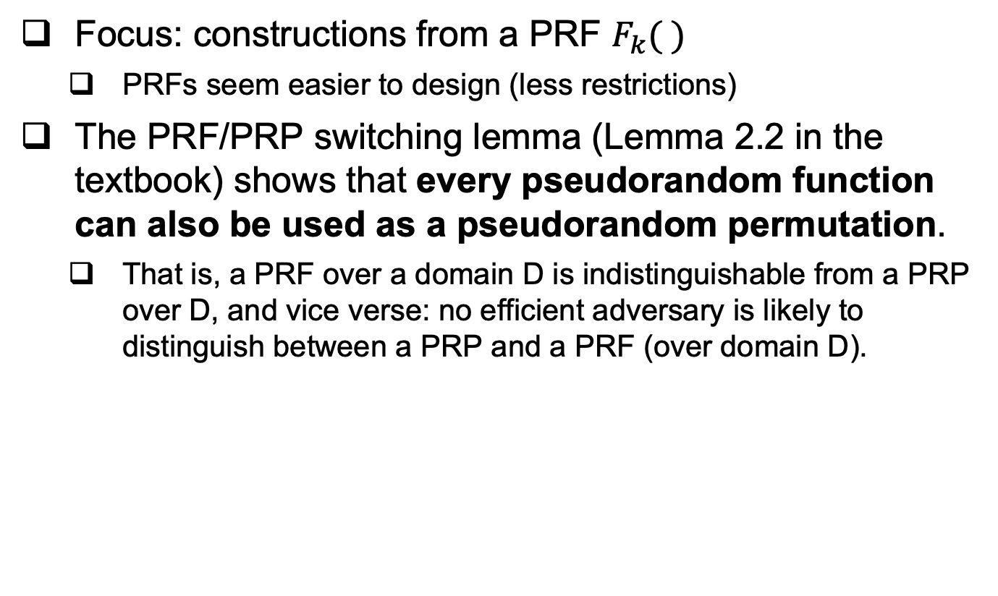
Constructing a PRP
Focus: constructions from a PRF $F_{k}( )$
  PRFs seem easier to design (less restrictions)
The PRF/PRP switching lemma (Lemma 2.2 in the textbook) shows that every pseudorandom function can also be used as a pseudorandom permutation.
  That is, a PRF over a domain D is indistinguishable from a PRP over D, and vice verse: no efficient adversary is likely to distinguish between a PRP and a PRF (over domain D).
8

Slide 9

Constructing a block cipher (i.e., an invertible PRP)
A PRF $F_{k}(∙)$ can be used as a PRP
But a block cipher requires an invertible PRP!!!
Challenge: how to make a PRF invertible?
  One solution: The Feistel Construction
9

Slide 10
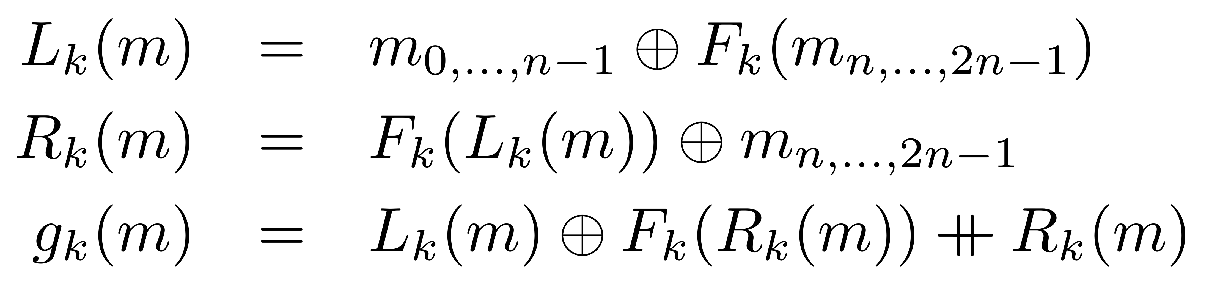





The Feistel Block-cipher Construction
Turn PRF F_{k} into a block cipher
  Three ‘rounds’ suffice for security [LR88]
Used in DES (but not in AES)
  With 16 ‘rounds’
  (DES and AES are symmetric key encryption schemes used in practice, AES replaced DES.)
$$m_{0,…,n−1}$$
$$m_{n,…,2n−1}$$
+
F_{k}()
$$L_{k}\left(m\right)$$
F_{k}()
+
F_{k}()
$$R_{k}\left(m\right)$$
+
$$g_{k}\left(m\right)$$
10

Slide 11
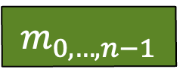



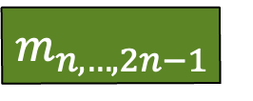
The Feistel Block-cipher Construction
The secure construction uses different round keys (derived from k). For decryption the order of these keys is reversed.
$$m_{0,…,n−1}$$
$$m_{n,…,2n−1}$$
+
F_{k1}()
$$L_{k}\left(m\right)$$
F_{k2}()
+
F_{k3}()
$$R_{k}\left(m\right)$$
+
$$g_{k}\left(m\right)$$
11

Slide 12

Cryptography Building Blocks Principle
Construct schemes from basic functions
  Provably secure constructions:
  attack on scheme ➔ attack on function
  Allows replacing broken functions
  Allows upgrading to more secure/efficient functions
E.g., encryption from block cipher (or PRG/PRF/PRP)
  Block cipher, PRG, PRF, PRP: deterministic, stateless,
  FIL (Fixed-Input-Length)
  Encryption: randomized, can be stateful or stateless,
  VIL (Variable-Input-Length)
12
Notes:
Another advantage is that robust combiner for function usually gives robust combiner for scheme (and usually, it is simpler than direct combiner for scheme)

Slide 13
We defined security for PRG, PRF, PRP, and Block ciphers.
How about defining security of encryption??
13

Slide 14
Defining Secure Encryption
Attacker capabilities:
  Computational limitations ➔ PPT
  Ciphertext only (COA), Known / chosen plaintext attack (KPA/CPA), Chosen ciphertext (CCA)?
What’s a successful attack?
  Key recovery ?
    May be impossible yet weak encryption scheme…
  (Full) Message recovery?
    How about partial exposure, e.g., m∈{“Advance”, “Retreat”}
  Answer: attacker ‘wins’ for exposing any info on plaintext
14

Slide 15
Conservative Design Principle
When designing, evaluating a cryptosystem…
  Consider most powerful attacker (COA< KPA< CPA < CCA)
  Be as general as possible – cover many applications
  And `easiest’ attacker-success criteria
    Not full message/key recovery!
  Make it easy to use securely, hard to use insecurely!
When designing, deploying a system (that uses some cryptographic primitives)
  Restrict attacker’s capabilities (e.g., avoid known/chosen plaintext)
15

Slide 16
Cryptanalysis Success Criteria for Encryption
  Learn anything at all about plaintext – how to define? Can we achieve it ?
    Well-defined notion: ‘semantic security’ [crypto course]
  So an encryption scheme is secure if the attacker cannot learn anything about the plaintext that he did not know in advance.
  Indistinguishability: Eve ‘wins’ if she can distinguish between encryptions of (any) two messages
    The attacker chooses these two messages.
    We focus on indistinguishability for CPA attacker. In crypto course: equivalent to semantic security
16

Slide 17






IND-CPA-Encryption Test (1st try)
Flip coins to select random bit b and key k
A (adversary) gives message m, receives E_{k}(m)
  Can ask for a polynomial number of encryptions (i.e., can make a polynomial number of encryption oracle queries over any message it wishes)
  Chosen Plaintext Attack (CPA)
A gives two messages (m₀,m₁), receives c*=E_{k}(m_{b})
A output b* , and ‘wins’ if b*=b
$$n,b$$
$$m$$
$
A
k
$${\left\{0,1\right\}}^{n}$$
$$Ek(m )$$
E_{k}(.)
$$m0 , m1$$
c$∗ =Ek(mb)$
A wins
if b*=b
b*
17

Slide 18






IND-CPA-Encryption Test (1st try): too easy
This test is too easy!! The adversary can easily win!!
How?
Hint: messages can be arbitrary binary strings
  Namely, m, m₀ , m₁ ∈ {0,1}*
  Solution: let m₀=0 , m₁=111111111111111111
  If c*=E_{k}(m_{b}) is `short’, output b*=0; if ‘long’, output b*=1
$$n,b$$
$$m$$
$
A
k
$${\left\{0,1\right\}}^{n}$$
$$Ek(m )$$
E_{k}(.)
$$m0 , m1$$
c$∗ =Ek(mb)$
A wins
if b*=b
b*

Slide 19






IND-CPA-Encryption Test (fixed)
Flip coins to select random bit b and key k
A (adversary) gives message m, receives E_{k}(m)
  Chosen Plaintext Attack
A gives messages (m₀,m₁) s.t. |m₀|=|m₁| , receives E_{k}(m_{b})
A output b* , and ‘wins’ if b*=b
$$n,b$$
$$m$$
$
A
k
$${\left\{0,1\right\}}^{n}$$
$$Ek(m )$$
E_{k}(.)
$m0 , m1$s.t. $|m0|=|m1|$
c$∗ =Ek(mb)$
A wins
if b*=b
b*

Slide 20
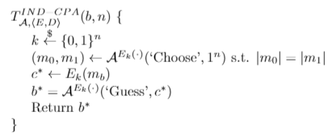
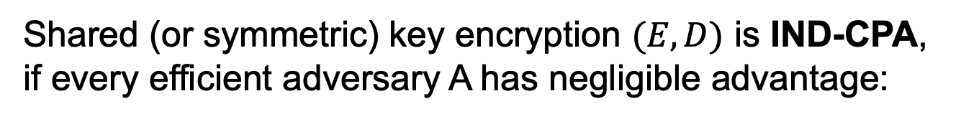
Definition: IND-CPA Encryption
Shared (or symmetric) key encryption $(E,D)$ is IND-CPA, if every efficient adversary A has negligible advantage:

Slide 21






Can IND-CPA encryption be deterministic?
No!! But why? Suppose E_{k}(m) is deterministic…
A can ask E_{k} to encrypt m₀ and m₁ and then check which one is equal to the challenge ciphertext → always wins!
Conclusion: IND-CPA Encryption must be randomized
  Even if you encrypt the same m over and over again, a new ciphertext will be produced.
$$n,b$$
$$m$$
$
A
k
$${\left\{0,1\right\}}^{n}$$
$$Ek(m )$$
E_{k}(.)
$m0 , m1$s.t. $|m0|=|m1|$
c$∗ =Ek(mb)$
A wins
if b*=b
b*

Slide 22
What’s next?
Construct a secure encryption scheme?
… provably secure without assumptions ?
Unlikely: Proof of security ➔ P ≠ NP
(similar argument to PRF)
Instead, let’s build secure encryption from PRFs !
(That is, PRF is secure ➔ encryption is IND-CPA)
Actually, we’ll use block cipher (recall the PRF/PRP switching lemma) to build encryption schemes under what is called “Modes of operation.”
22

Slide 23
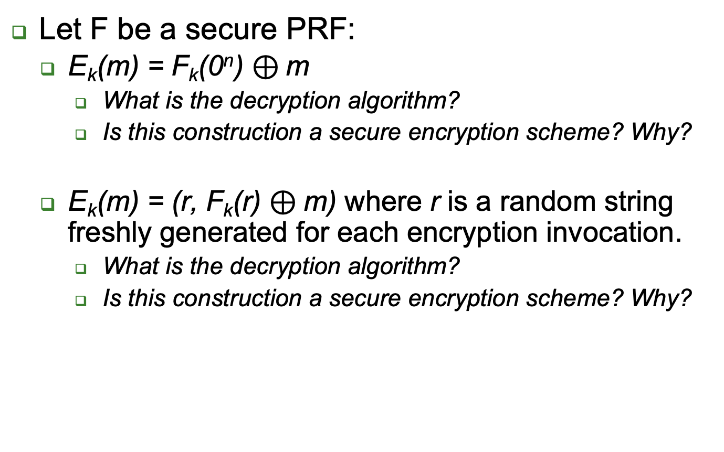
Examples
Let F be a secure PRF:
  E_{k}(m) = F_{k}(0^{n}) $⊕$m
    What is the decryption algorithm?
    Is this construction a secure encryption scheme? Why?
  E_{k}(m) = (r, F_{k}(r) $⊕$m) where r is a random string freshly generated for each encryption invocation.
    What is the decryption algorithm?
    Is this construction a secure encryption scheme? Why?
23

Slide 24
Encryption: Modes of Operation
`Modes of operation’: use block cipher (PRP), to encrypt long (Variable Input Length, VIL) messages
Randomize/add state for security
  Often: use random or stateful Initialization Vector (IV)
Use long keys
  Better security (at least against exhaustive search)
Assume plaintext message is in blocks: m₀||m₁||…
  An integer number of blocks, each block is n bits.

Slide 25
Encryption Modes of Operation
25

Slide 26
Electronic Code Book mode (ECB)
Encryption c_{i}=E_{k}(m_{i}), decryption m_{i}=D_{k}(c_{i})
  Each message m is composed of l blocks, m₁ … m_{l}, and each m_{i} is n bit block , and same for c and c_{i}

Slide 27



Electronic Code Book mode (ECB)
Encryption c_{i}=E_{k}(m_{i}), decryption m_{i}=D_{k}(c_{i})
Insecure!! (do not use it!) Which of these is ECB encryption? Why?

Slide 28
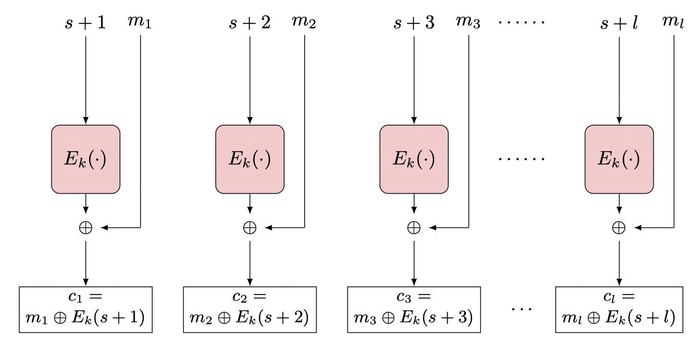
Counter (CTR) Mode
Random counter (or `initialization vector’, IV, or s)
  i>0: c_{i} = E_{k}(s+ i) ⊕ m_{i}
  m_{i} = E_{k}(s + i) ⊕ c_{i}
Parallel encryption and decryption with offline precomputing
How to decrypt?
If a PRF is used as the PRP (or E_{k}), then it is CPA (provably secure).
Error propagation:
  flip bit in c_{i} ➔ flip bit in m_{i}
Notes:
28
10/30/11

Slide 29
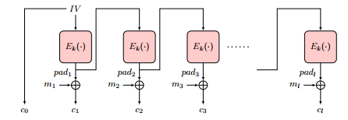
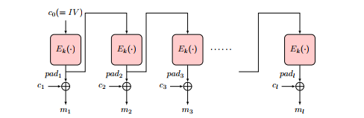
Output-Feedback (OFB) Mode
Goal: encrypt long (multi-block) messages, with less random bits
How? Use random bits only for first block (`initialization vector’)
  To encrypt next blocks of message, use output of previous block
  Namely, a block-by-block stream cipher
  Encryption: pad₀←IV,
  pad_{i} ← E_{k}(pad_{i-1} ),
  c₀ ← pad_{0,} c_{i} ← pad_{i}⊕ m_{i}
Decryption:
pad₀ ← c_{0,}
pad_{i} ← E_{k}(p_{i-1} ),
m_{i} ← pad_{i}⊕ c_{i}
29

Slide 30
Output-Feedback (OFB) Mode
Offline pad computation: compute pad in advance
  Online computation: only (parallelizable) XOR !
Bit errors are bitwise localized
  Corrupting a one bit in the ciphertext corrupts only one bit in the plaintext.
30

Slide 31
Cipher Block Chaining (CBC) Mode
Random first block c₀ (`initialization vector’, IV)
i>0: c_{i} = E_{k}(c_{i-1} ⊕ m_{i}), m_{i} = c_{i-1} ⊕ D_{k}(c_{i})
Parallel decryption
  But no offline precomputing
  How about encryption? Sequential (it is a chain!)
Error propagation:
  flip bit in c_{i} ➔ flip bit in m_{i+1} and corrupt m_{i}
Notes:
31
10/30/11

Slide 32
Security of CBC mode
Theorem: If block-cipher E is a (strong) pseudo-random permutation ➔CBC is IND-CPA-secure encryption
Proof: omitted (crypto course ☺ )

Slide 33
Covered Material From the Textbook
Sections 2.8, 2.9, and 2.10 excluding:
  2.9.6
  2.10.4
  2.10.7
  2.10.8
  2.10.10
  CCA security
  Integrity (we will cover this topic separately when we study MACs later)

Slide 34

Thank You!

