Slide 1
CSE 3400/CSE 5850 - Introduction to Cryptography & Cybersecurity
/ Introduction to Cybersecurity)
Lecture 5
Message Authentication Codes
Ghada Almashaqbeh
UConn
Adapted from the textbook slides

Slide 2
Outline
Motivation.
Message Authentication Codes (MACs) definition.
MAC security definition.
MAC constructions.
Combining message authentication and encryption.
2

Slide 3



Encryption Ensures Confidentiality
k
k
m=“Hi”
E
D
m
c=E_{k}(m)
c
Man-in-the-Middle (MitM) attacker
‘learns nothing’ about message
Notes:
3
10/30/11

Slide 4
Integrity and Authentication?
k
k
m=“Hi”
E
D
c=E_{k}(m)
c'
m‘=D_{k}(c’)
m’=“Bye”
How can the recipient know that the message was not tampered with and it is the original one sent by the sender?
Notes:
4
10/30/11

Slide 5
Does Encryption Prevent Forgery?
Cannot be guaranteed.
  Several secure encryption schemes are malleable (an attacker might be able to alter the ciphertext, and hence, the decrypted plaintext will be different).
Bitwise stream ciphers (& OTP) are malleable.
  Given c=m⊕k, attacker can send c⊕mask, to invert any bit in decrypted message.
Example, send “Pay Bob $100” encrypted using OTP.
  Eve can change it to “Pay Eve $100” (note that this is a KPA attacker). How?
    Take the ciphertext of the letter “B” above, denote it as c[4].
    Note that c[4] = k[4] ⊕ “B” (note that we do know the key!)
    Compute a mask that does the following: c[4] ⊕ mask = k[4] ⊕ “E” (this boils down to computing “B” ⊕ mask = “E” )
    Repeat that for the rest of the letters.

Slide 6
Message Authentication Codes (MACs)
A MAC allows a recipient to validate that a message was not tampered with and that it was sent by a key holder
Valid MAC ➔ Only Sponge and I know k. So he sent m.
It is a symmetric key setup!
m=“Hi”, MAC_{k}(m)
Key k
Key k
Notes:
6
(c) Amir Herzberg, http://AmirHerzberg.com, Bar Ilan University
11/13/11

Slide 7
Message Authentication Codes (MACs)
Use shared key k to authenticate messages
Pair (tag , m) is valid iff tag=MAC_{k}(m)
Very efficient
Does not support non-repudiation!
  Sponge may say that the key k has
  been stolen, and so someone else sent
  the message.
k = ??
MAC
(
) = ??
k
“Bye”
“Hi”
“Bye”
+
+
MAC
(“Hi”)
tag ??
k
Alice
Key
k
Key
k
Notes:
7
(c) Amir Herzberg, http://AmirHerzberg.com, Bar Ilan University
11/13/11
Message sent together with Tag=MAC_{k}(m)
Received message, tag are valid iff Tag=MAC_{k}(m)
Efficient (often even more than shared-key encryption)
But: Alice can later deny having sent m to Bob (why?)

Slide 8
Defining MAC Security
Following the `conservative design principle’:
Consider most powerful attacker
  Let attacker receive tag for any message it wants (so it has an oracle access to MAC_{k}).
Attacker success criteria:
  Attacker wins if it can produce a valid tag for any new message
    So a tag over a message that the attacker asked the oracle to authenticate will not be accepted as forgery.
Notes:
8
(c) Amir Herzberg, http://AmirHerzberg.com, Bar Ilan University
11/13/11
Message sent together with Tag=MAC_{k}(m)
Received message, tag are valid iff Tag=MAC_{k}(m)
Efficient (often even more than shared-key encryption)
But: Alice can later deny having sent m to Bob (why?)

Slide 9
MAC Security Definition
Notes:
9
(c) Amir Herzberg, http://AmirHerzberg.com, Bar Ilan University
11/13/11
Message sent together with Tag=MAC_{k}(m)
Received message, tag are valid iff Tag=MAC_{k}(m)
Efficient (often even more than shared-key encryption)
But: Alice can later deny having sent m to Bob (why?)

Slide 10

On the Use of MACs
MAC_{k}(m) may expose information about m! MACs are not required to achieve confidentiality, only authenticity!
  Example: Let MAC be any secure MAC. Define MAC’_{k}(m)=MAC_{k}(m)||Lsb(m), where Lsb is least significant bit.
MAC shows a key-holder computed it
  Could be any key holder (even recipient)…
Replay attacks: an old message (and its tag) is being resent.
  Need to Ensure freshness (more about this later).
Cat, Sponge (or I) sent m.
m=“Hi”, MAC_{k}(m)
Key k
Key k
Key k
Notes:
10
(c) Amir Herzberg, http://AmirHerzberg.com, Bar Ilan University
11/13/11

Slide 11
Constructing Secure MACs
Provable-secure constructions from:
  PRF/PRP/Block ciphers (next)
    First: PRF/PRP → Fixed-Input-Length (FIL) MAC
  Hash functions (later) – even more efficient.
Robust combiner of (two) MAC candidates:
  MAC_{k,k’}(m)=f_{k}(m)||f’_{k’}(m), MAC_{k,k’}(m)=f_{k}(m)⊕f’_{k’}(m) are secure MAC, if either f or f’ is a secure MAC.
Notes:
11
(c) Amir Herzberg, http://AmirHerzberg.com, Bar Ilan University
11/13/11

Slide 12
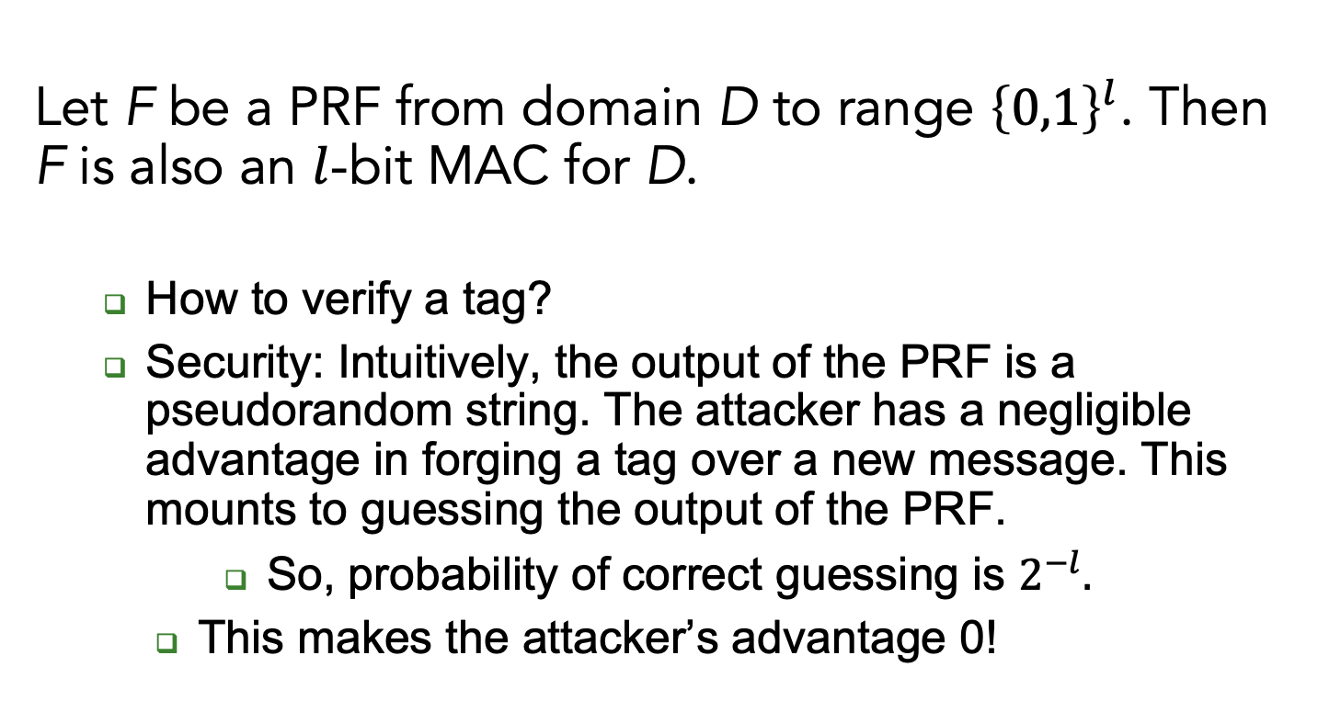
Theorem: Every PRF is also a MAC
Let F be a PRF from domain D to range ${\left\{0,1\right\}}^{l}$. Then F is also an $l$-bit MAC for D.
  How to verify a tag?
  Security: Intuitively, the output of the PRF is a pseudorandom string. The attacker has a negligible advantage in forging a tag over a new message. This mounts to guessing the output of the PRF.
      So, probability of correct guessing is $2^{−l}.$
    This makes the attacker’s advantage 0!
Notes:
12
(c) Amir Herzberg, http://AmirHerzberg.com, Bar Ilan University
11/13/11

Slide 13
Using a Block Cipher for MAC
  A PRF is a MAC for l-bit messages.
  (l.n)-bit FIL MAC from n-bit PRP (block cipher): use CBC-MAC – a variant of CBC
Problem 1: block cipher is PRP, not PRF
  Solution: the switching lemma says that a PRP is also a PRF!
Notes:
13
(c) Amir Herzberg, http://AmirHerzberg.com, Bar Ilan University
11/13/11

Slide 14
Using a Block Cipher for MAC
Problem 2: block ciphers are defined only for (short) fixed input length (FIL)
  Ideally a MAC should work for any input string (Variable Input Length – VIL)
  We already had a similar problem… where?
    Block ciphers.
  We solved by using various encryption modes of operation.
  A solution for MACs: the CBC-MAC mode of operation!
Notes:
14
(c) Amir Herzberg, http://AmirHerzberg.com, Bar Ilan University
11/13/11

Slide 15
CBC-MAC
Split plaintext m into blocks
Fixed, known (zero)
Initialization Vector (IV)
The tag is the ciphertext of the last block
CBC-MACE_{k}(m₁||m₂||..||m_{l} ) = E_{k}(m_{l}⊕E_{k}(…E_{k}(m₁))))
Recall: MACs are deterministic functions
Notes:
15
(c) Amir Herzberg, http://AmirHerzberg.com, Bar Ilan University
11/13/11
Parallel mode – see [BR02]

Slide 16
CBC-MAC
  Widely deployed standard
  More efficient ‘modes’ exist
    E.g., allow for parallel computation.
  It is provably secure.
  But what of VIL (variable-length input) MAC?
Notes:
16
(c) Amir Herzberg, http://AmirHerzberg.com, Bar Ilan University
11/13/11
Corollary follows from `FIL-PRF is FIL-MAC` theorem

Slide 17
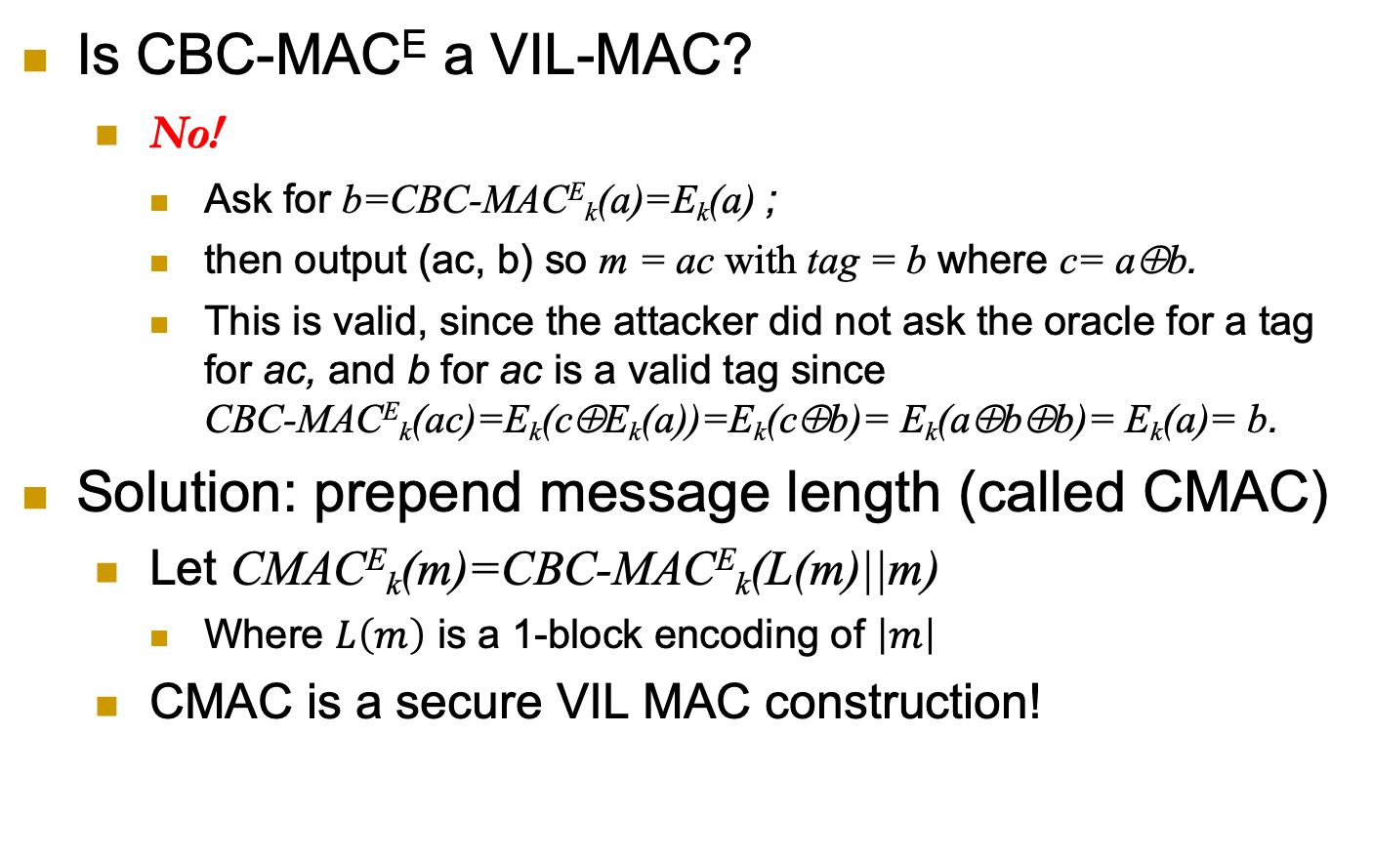
CBC-MAC-based VIL-MAC
Is CBC-MACE a VIL-MAC?
  No!
    Ask for b=CBC-MACE_{k}(a)=E_{k}(a) ;
    then output (ac, b) so m = ac with tag = b where c= a⊕b.
    This is valid, since the attacker did not ask the oracle for a tag for ac, and b for ac is a valid tag since
    CBC-MACE_{k}(ac)=E_{k}(c⊕E_{k}(a))=E_{k}(c⊕b)= E_{k}(a⊕b⊕b)= E_{k}(a)= b.
Solution: prepend message length (called CMAC)
  Let CMACE_{k}(m)=CBC-MACE_{k}(L(m)||m)
    Where $L\left(m\right)$ is a 1-block encoding of $\left|m\right|$
  CMAC is a secure VIL MAC construction!
Notes:
17
(c) Amir Herzberg, http://AmirHerzberg.com, Bar Ilan University
11/13/11
KR

Slide 18
Examples of MAC Constructions
Are the following constructions secure MACs:
Let E_{k} be a secure block cipher that takes input of length n bits. For a message m of length 2n bits, compute the tag as:
MAC_{k}(m) = E_{k}(m_{L}) xor E_{k}(m_{R})
Let G be a secure PRG. For a message m of length n bits, compute the tag as:
MAC_{k}(m) = k xor G(m)

Slide 19
Combining Authentication and Encryption
For confidentiality, use encryption
For authentication, use MAC
For both confidentiality and authentication?
  Option 1: Combine MAC and encryption
    Possible pitfalls (vulnerabilities)
  Option 2: Authenticated-encryption schemes (or modes)
    Easier to deploy (securely)
    Generic combination of MAC and Encryption schemes
    Or direct combined constructions (can be more efficient)
Notes:
19
(c) Amir Herzberg, http://AmirHerzberg.com, Bar Ilan University
11/13/11

Slide 20
Generic MAC and Encryption Combinations
Three standards, three ways…
  Authenticate and encrypt (A&E):
    c = Enc(m), tag = MAC(m), send (c, tag)
  Authenticate then encrypt (AtE):
    tag = MAC(m), c = Enc(m, tag), send c
  Encrypt then authenticate (EtA):
    c = Enc(m), tag = MAC(c), send (c, tag)
Some of these may be vulnerable even when combining some secure encryption and MAC schemes!
Notes:
20
(c) Amir Herzberg, http://AmirHerzberg.com, Bar Ilan University
11/13/11

Slide 21
Security of Generic MAC/Enc Combinations
A&E may be vulnerable!
  Example:
    Let MAC be any secure MAC scheme
    Let MAC’_{k’}(m)=MAC_{k’}(m)|| lsb(m)
    MAC’ is a secure MAC.
    But A&E(m) leaks least significant bit of m (even if the encryption scheme is secure!!!).
  Recall that the security guarantee of a MAC is about integrity (or preventing forgery)!
    It has nothing to do with confidentiality!
What about AtE, EtA ?
  AtE: also may be vulnerable (not IND-CPA)!
  EtA is provably secure.
Notes:
21
(c) Amir Herzberg, http://AmirHerzberg.com, Bar Ilan University
11/13/11

Slide 22
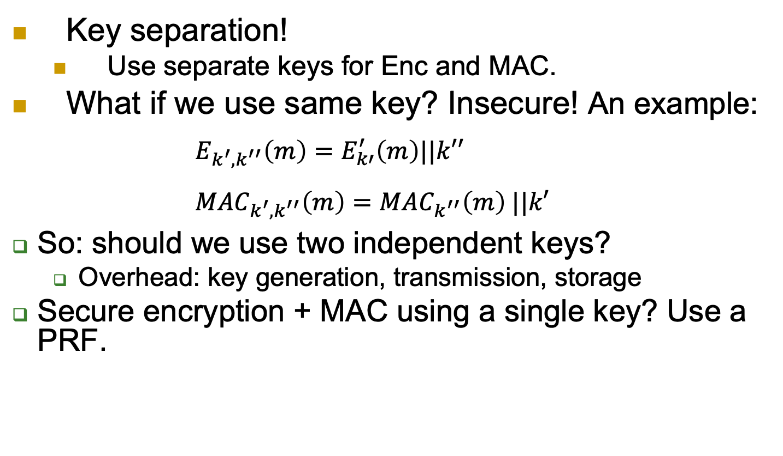
Keys for MAC and Encryption?
  Key separation!
  Use separate keys for Enc and MAC.
What if we use same key? Insecure! An example:
  $$E_{k^{′},k^{′′}}\left(m\right)=E_{k′}^{′}\left(m\right)||k′′ \\ {MAC}_{k^{′},k^{′′}}\left(m\right)={MAC}_{k^{′′}}\left(m\right) ||k′$$
So: should we use two independent keys?
  Overhead: key generation, transmission, storage
Secure encryption + MAC using a single key? Use a PRF.
  Solution: k_{mac}:= PRF_{k}(`MAC’), k_{enc}:= PRF_{k}(‘Encrypt’)
Notes:
22
(c) Amir Herzberg, http://AmirHerzberg.com, Bar Ilan University
11/13/11

Slide 23
Covered Material From the Textbook
Chapter 4
  Sections 4.1, 4.2, 4.3, and 4.4 except sections 4.4.1 and 4.4.5.
  Section 4.5.3 (only what we covered in class) except sections 4.5.3.4, 4.5.4, 4.5.5

Slide 24

Thank You!

