Slide 1
CSE 3400/ CSE 5850 - Introduction to Cryptography & Cybersecurity
/ Introduction to Cybersecurity
Lecture 6
Hash Functions – Part I
Ghada Almashaqbeh
UConn
Adapted from textbook slides

Slide 2
Outline
Introduction and motivation.
Collision Resistant Hash Functions (CRHF).
CRHF applications.
Other notions of security.
  TCR, SPR, OWF.
Randomness extraction.
The random oracle model.
2

Slide 3



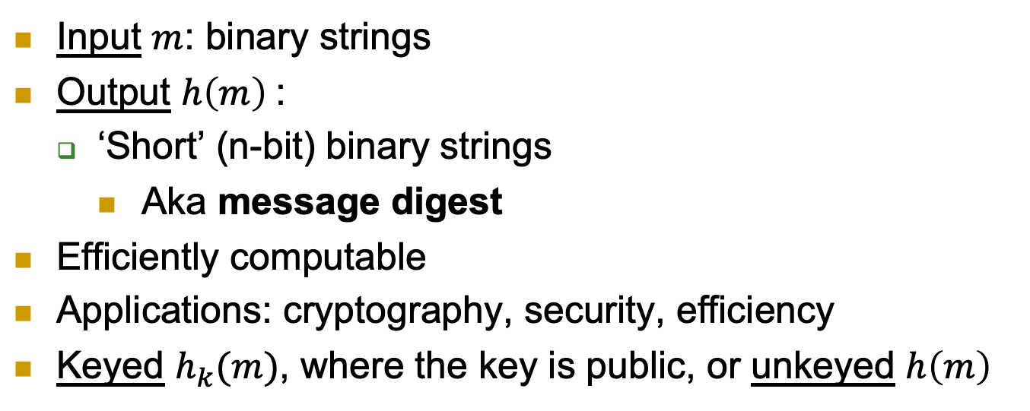



Hash Functions
Input $m$: binary strings
Output $h\left(m\right)$:
  ‘Short’ (n-bit) binary strings
    Aka message digest
Efficiently computable
Applications: cryptography, security, efficiency
Keyed $h_{k}(m)$, where the key is public, or unkeyed $h\left(m\right)$
$$m$$
$$m$$
k
$$h$$
$$h$$
$$h(m)$$
$$h(m)$$

Slide 4

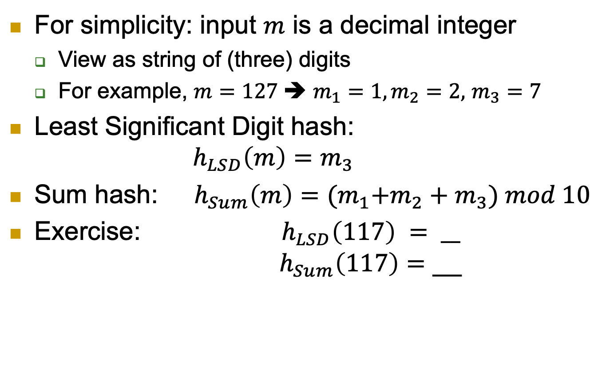


Hash Functions: Simple Examples
$$m$$
$$h$$
For simplicity: input $m$ is a decimal integer
  View as string of (three) digits
  For example, $m=127$➔ $m_{1}=1,m_{2}=2,$ $m_{3}=7$
Least Significant Digit hash:
$h_{LSD}\left(m\right)=m_{3}$
Sum hash: $h_{Sum}\left(m\right)={{(m}_{1}+m_{2}+m}_{3}) mod 10$
Exercise: ${ h}_{LSD}\left(117\right) {= __}_{}$
$h_{Sum}\left(117\right)=$ __
$$h(m)$$
7
9
Note: the above are insecure hash functions, these are just toy examples to grasp the concept of hashing.

Slide 5


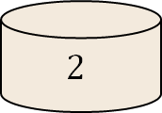

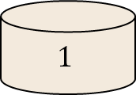
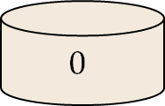
Motivation: Hashing for Efficiency
Input: large set (e.g., integers or strings)
Goal: map `randomly’ to few bins
  E.g., to ensure efficiency – load balancing, etc.
341,
3342,
870,
571,
31,
452,
80,
….
$$h_{LSD}$$
341,
571,
31,
….
3342,
452,
….
870,
80,
….
. . .
$$1$$
$$2$$
. . .
$$0$$

Slide 6


Collisions?
Input: large set (e.g., integers or strings)
Goal: map `randomly’ to few bins
  E.g., to ensure efficiency – load balancing, etc.
  Adversary chooses inputs that hash to same bin
32,
42,
52,
62,
31,
452,
80,
….
$$h_{LSD}$$
Inputs to overload the `2’ bin
31,
….
32, 42,
52, 62,
452,
….
80,
….
. . .
$$1$$
$$2$$
. . .
$$0$$
Denial-of-Service
Attack

Slide 7


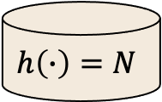
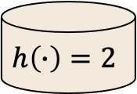

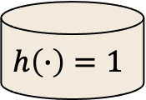
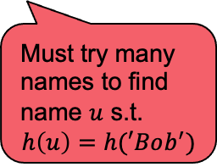
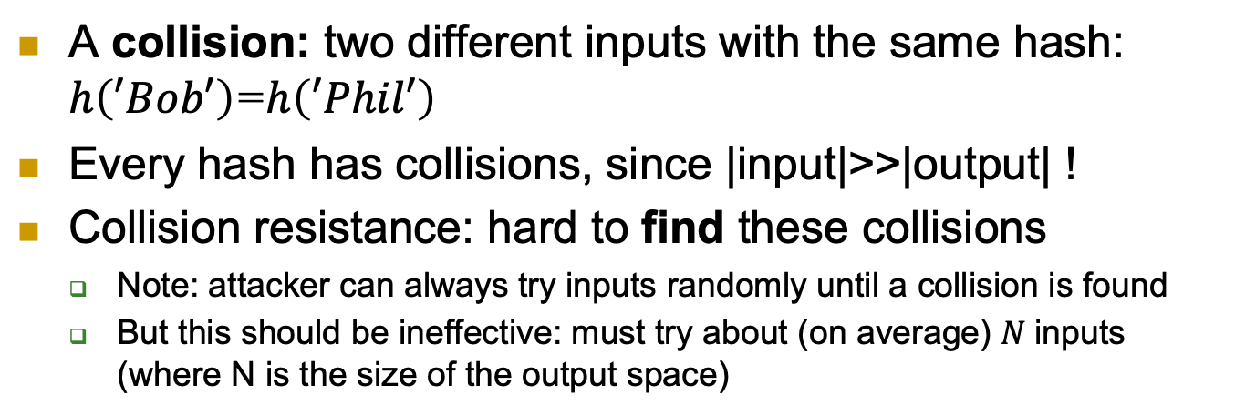
Security Goal: Collision Resistance
A collision: two different inputs with the same hash: $h\left(′Bob′\right)$=$h\left(′Phil′\right)$
Every hash has collisions, since |input|>>|output| !
Collision resistance: hard to find these collisions
  Note: attacker can always try inputs randomly until a collision is found
  But this should be ineffective: must try about (on average) $N$inputs (where N is the size of the output space)
Mal
Abe
Don
Phil
Ron
John
Sue
Bob
….
Hash $h\left(∙\right)$
Must try many names to find name $u$ s.t.
$$h\left(u\right)=h(′Bob^{′})$$
Phil, Bob, …
$$h\left(∙\right)=1$$
$$h\left(∙\right)=2$$
. . .
$$h\left(∙\right)=N$$

Slide 8

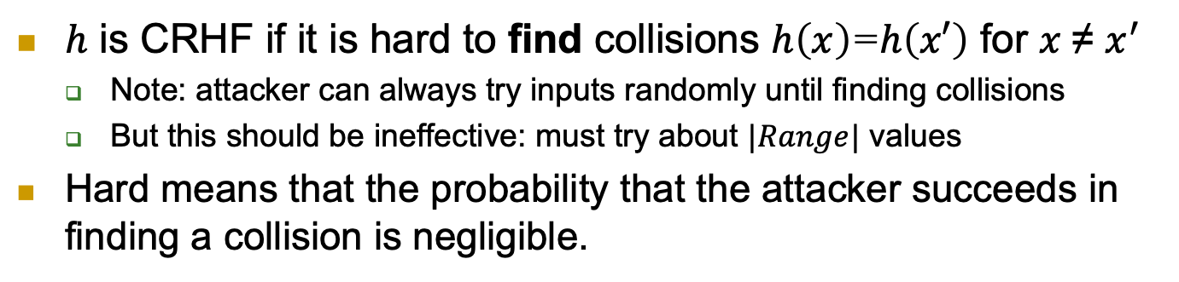



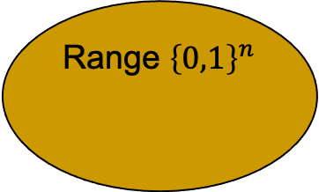
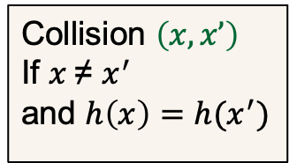
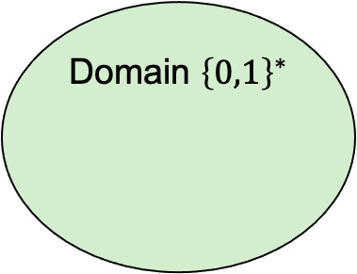

Collision Resistant Hash Function (CRHF)
$h$ is CRHF if it is hard to find collisions $h\left(x\right)$=$h\left(x′\right)$ for $x$≠ $x^{′}$
  Note: attacker can always try inputs randomly until finding collisions
  But this should be ineffective: must try about $|Range|$ values
Hard means that the probability that the attacker succeeds in finding a collision is negligible.
$$1^{n}$$
Domain ${\left\{0,1\right\}}^{∗}$
Hash function $h\left(∙\right)$
Range ${\left\{0,1\right\}}^{n}$
Adversary
$$x∘$$
Collision $\left(x,x’\right)$
If $x$≠ $x^{′}$
and $h\left(x\right)=h(x^{′})$
$$x′∘$$
$$∘h\left(x\right)=h(x^{′})$$

Slide 9
Keyless Collision Resistant Hash Function (CRHF)

Slide 10
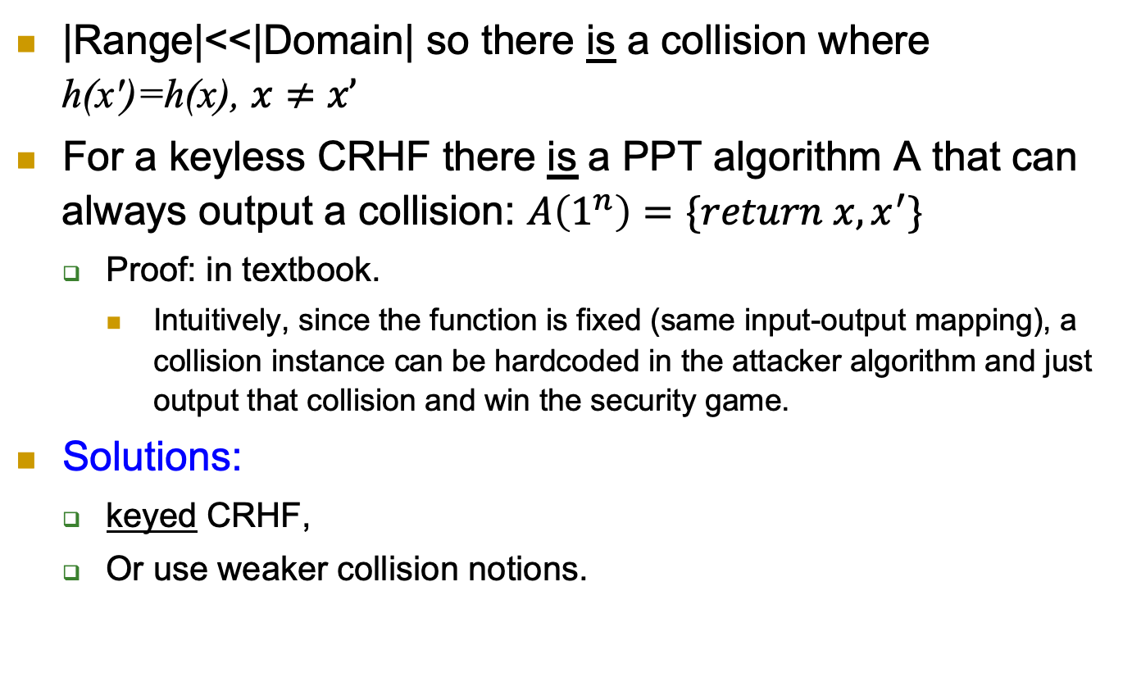
Keyless CRHF Do Not Exist!
|Range|<<|Domain| so there is a collision where h(x')=h(x), $x≠x’$
For a keyless CRHF there is a PPT algorithm A that can always output a collision: $A\left(1^{n}\right)=\{return x, x^{′}\}$
  Proof: in textbook.
    Intuitively, since the function is fixed (same input-output mapping), a collision instance can be hardcoded in the attacker algorithm and just output that collision and win the security game.
Solutions:
  keyed CRHF,
  Or use weaker collision notions.

Slide 11


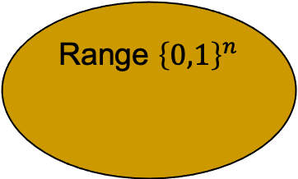
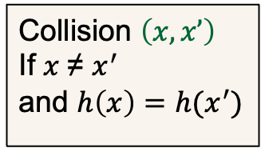
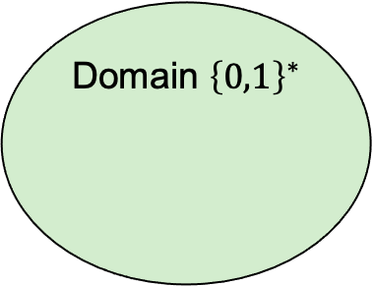

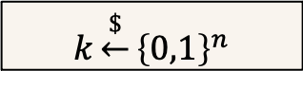

Keyed CRHF
$$k\underset{←}{\$}{\left\{0,1\right\}}^{n}$$
Domain ${\left\{0,1\right\}}^{∗}$
Hash function $h_{k}\left(∙\right)$
Range ${\left\{0,1\right\}}^{n}$
Adversary
$$x∘$$
$$x′∘$$
$$h_{k}\left(x\right)=h_{k}(x^{′})$$
Collision $\left(x,x’\right)$
If $x$≠ $x^{′}$
and $h\left(x\right)=h(x^{′})$
Adversary knows k but not in advance – cannot `know` a collision
Often referred to as ACR-hash (Any Collision Resistance)
Notes:
11
(c) Amir Herzberg, http://AmirHerzberg.com, Bar Ilan University
04/07/06

Slide 12
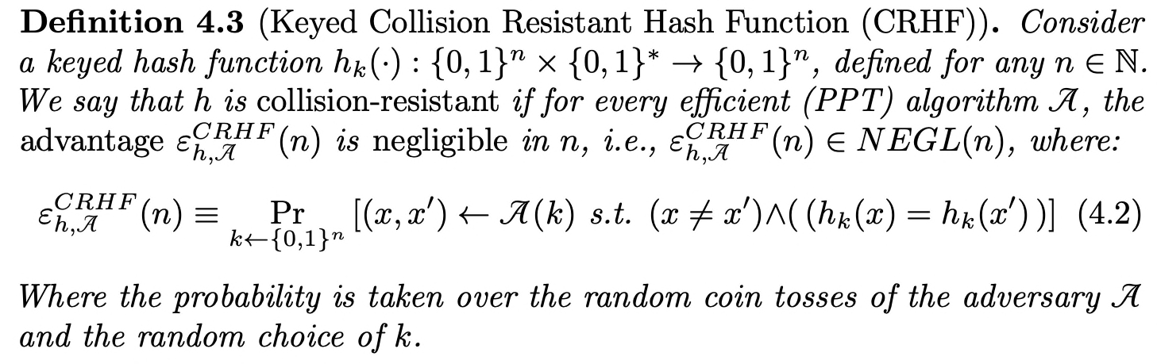
Keyed CRHF - Definition
Notes:
12
(c) Amir Herzberg, http://AmirHerzberg.com, Bar Ilan University
04/07/06

Slide 13

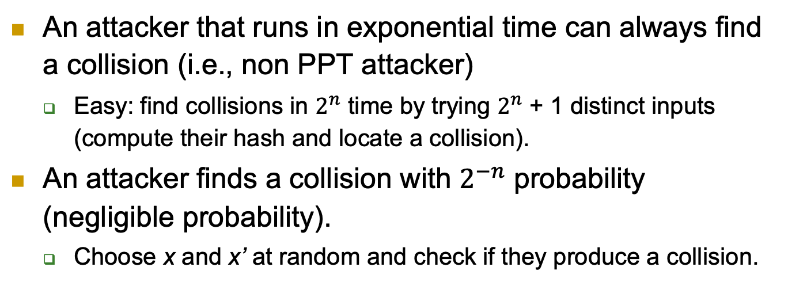


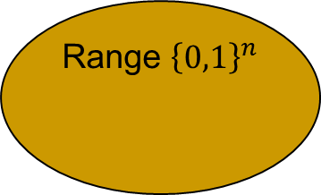
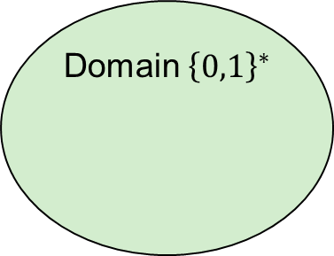

Generic Collision Attacks
Domain ${\left\{0,1\right\}}^{∗}$
Hash function $h\left(∙\right)$
Range ${\left\{0,1\right\}}^{n}$
$$x∘$$
$$x′∘$$
$$∘h\left(x\right)=h(x^{′})$$
An attacker that runs in exponential time can always find a collision (i.e., non PPT attacker)
  Easy: find collisions in $2^{n}$ time by trying $2^{n}$ + 1 distinct inputs (compute their hash and locate a collision).
An attacker finds a collision with $2^{−n}$ probability (negligible probability).
  Choose x and x’ at random and check if they produce a collision.
Notes:
13
(c) Amir Herzberg, http://AmirHerzberg.com, Bar Ilan University
04/07/06
CR>SPR [and SPR<OWF if |domain|>>|range|
Which property is required for signatures? For deriving DH/El-gamal keys?

Slide 14
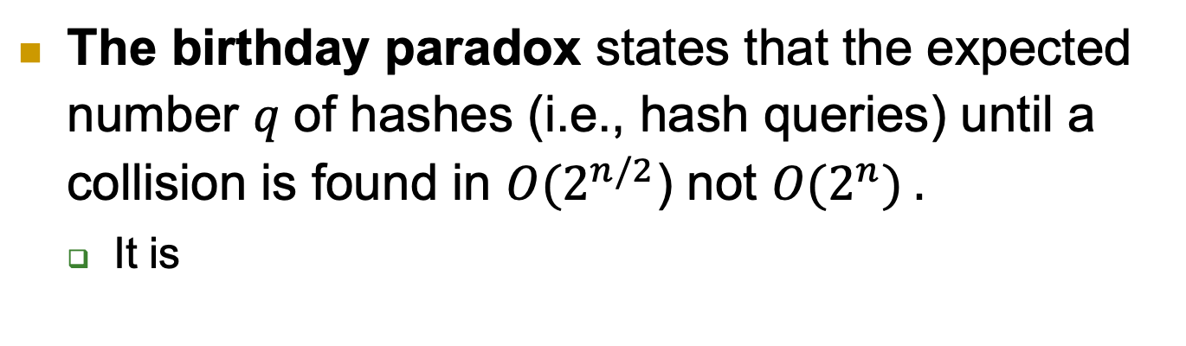
The Birthday Paradox
The birthday paradox states that the expected number 𝑞 of hashes (i.e., hash queries) until a collision is found in $O(2^{n/2}$) not ${O(2}^{n}) .$
  It is
Notes:
14
(c) Amir Herzberg, http://AmirHerzberg.com, Bar Ilan University
04/07/06
CR>SPR [and SPR<OWF if |domain|>>|range|
Which property is required for signatures? For deriving DH/El-gamal keys?

Slide 15
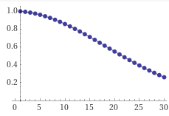






The Birthday Attack (‘Paradox’)
Probability of NO birthday-collision:
  Two persons: (364/365)
  Three persons: (364/365)*(363/365)
  …
  $n$ persons: $\prod_{i=1}^{n−1}{\frac{365−i}{365}}$
  So, for 23 individuals, the probability
  of birthday collision is about 0.5
Jan | Feb | Mar | Apr | May | Jun | Jul | Aug | Sep | Oct | Nov | Dec

Slide 16
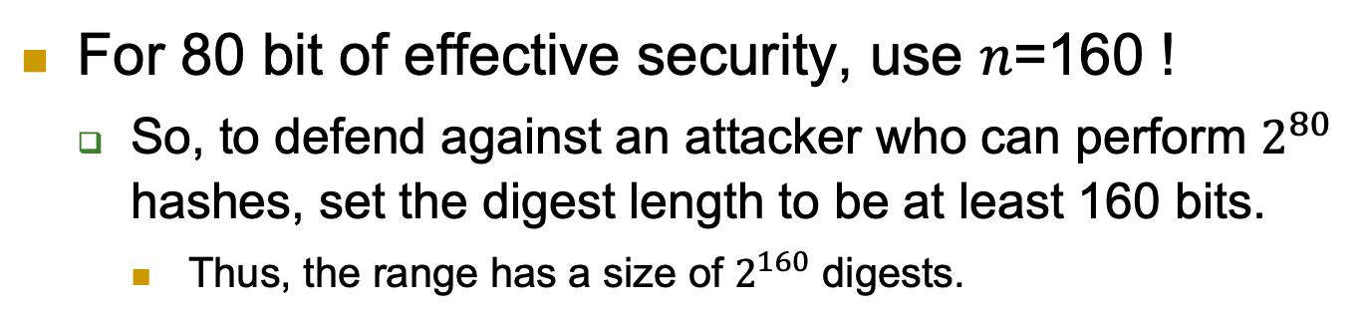
The Birthday Paradox
For 80 bit of effective security, use 𝑛=160 !
  So, to defend against an attacker who can perform $2^{80}$ hashes, set the digest length to be at least 160 bits.
    Thus, the range has a size of $2^{160}$ digests.
Notes:
16
(c) Amir Herzberg, http://AmirHerzberg.com, Bar Ilan University
04/07/06
CR>SPR [and SPR<OWF if |domain|>>|range|
Which property is required for signatures? For deriving DH/El-gamal keys?

Slide 17
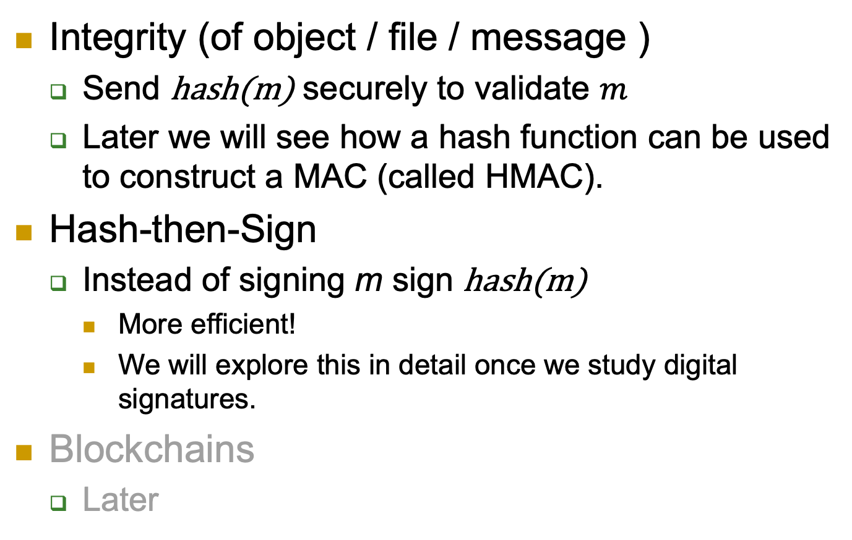
Collision-Resistance: Applications
Integrity (of object / file / message )
  Send hash(m) securely to validate $m$
  Later we will see how a hash function can be used to construct a MAC (called HMAC).
Hash-then-Sign
  Instead of signing m sign hash(m)
    More efficient!
    We will explore this in detail once we study digital signatures.
Blockchains
  Later

Slide 18
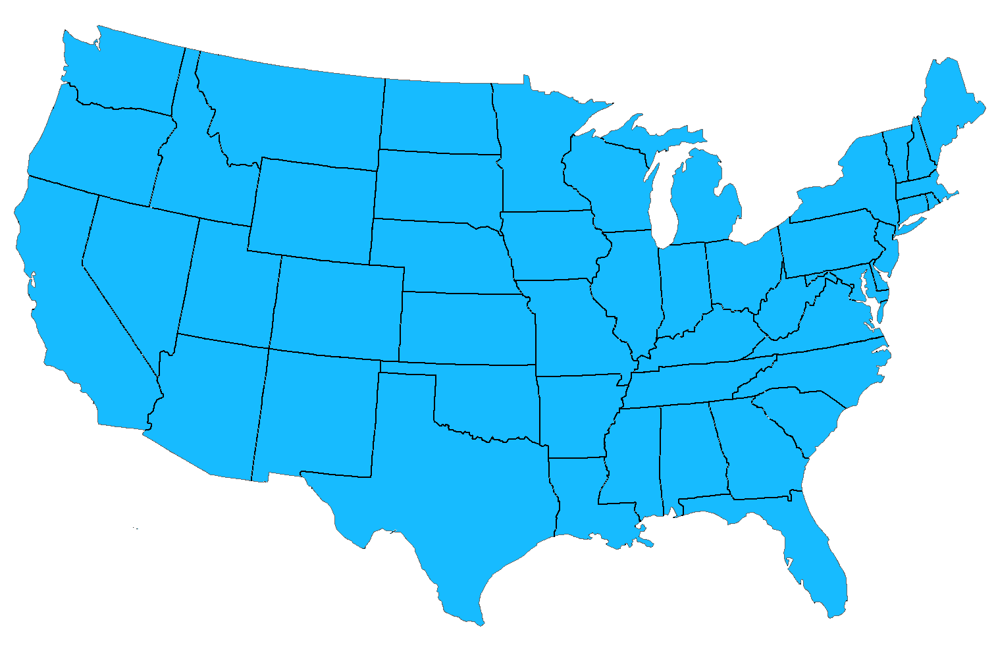
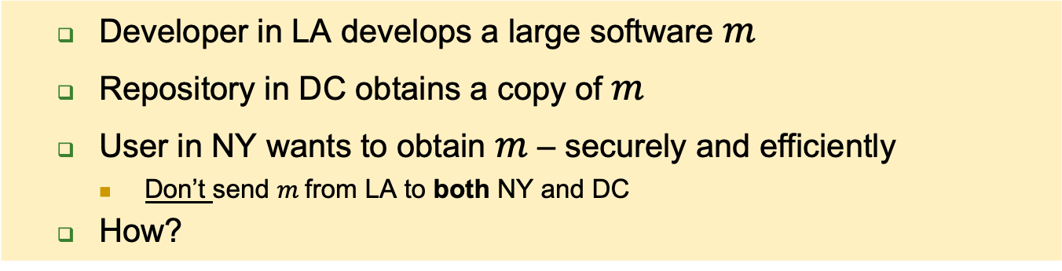

CRHF and Software Distribution
  Developer in LA develops a large software $m$
  Repository in DC obtains a copy of $m$
  User in NY wants to obtain $m$ – securely and efficiently
    Don’t send $m$from LA to both NY and DC
  How?
NY
User
DC
LA
$$m$$
Repository
Developer

Slide 19

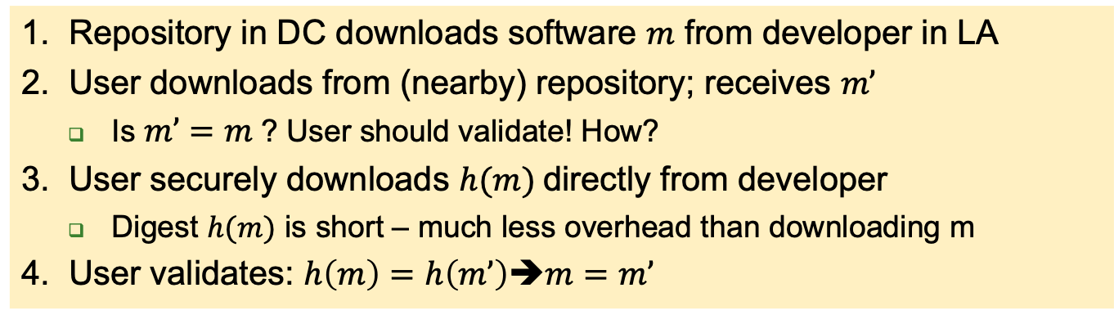




CRHF: secure, efficient SW distribution
1. Repository in DC downloads software $m$ from developer in LA
2. User downloads from (nearby) repository; receives $m’$
  Is $m’=m$? User should validate! How?
3. User securely downloads $h(m)$directly from developer
  Digest $h(m)$ is short – much less overhead than downloading m
4. User validates: $h\left(m\right)=h\left(m’\right)$➔$m=m’$
NY
User
NY
3
$$h(m)$$
2
$$m′$$
DC
$$m$$
DC
$$h$$
LA
Repository
LA
1
$$m$$
$$m$$
$$h(m)$$
Developer

Slide 20
Other Notions of Security
Collision resistance provides the strongest guarantee.
  Gives more freedom to the adversary; the adversary wins if it finds any two inputs with the same digest.
    No conditions on these two inputs other than being in the domain of the hash function.
Other security notions (sufficient for many applications):
  Target collision resistance (TCR).
  Second preimage resistance.
  First preimage resistance.
Birthday paradox (or attack) does not work against these weaker notions.
  It is for collision resistance; find any two inputs that collide!

Slide 21
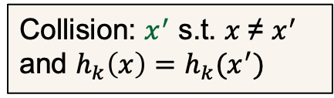

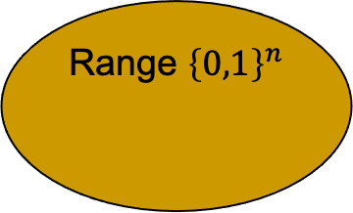

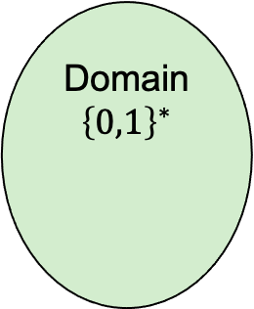

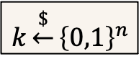

Target CRHF (TCR Hash Function)
$$1^{n}$$
Adversary
Domain ${\left\{0,1\right\}}^{∗}$
Hash function $h_{k}\left(∙\right)$
Range ${\left\{0,1\right\}}^{n}$
$$k\underset{←}{\$}{\left\{0,1\right\}}^{n}$$
x
$$x∘$$
Adversary
$$x′∘$$
$$h_{k}\left(x\right)=h_{k}(x^{′})$$
Collision: $x^{′}$ s.t. $x$≠ $x^{′}$ and $h_{k}\left(x\right)=h_{k}(x^{′})$
Adversary must select target before knowing key
Notes:
21
(c) Amir Herzberg, http://AmirHerzberg.com, Bar Ilan University
04/07/06

Slide 22

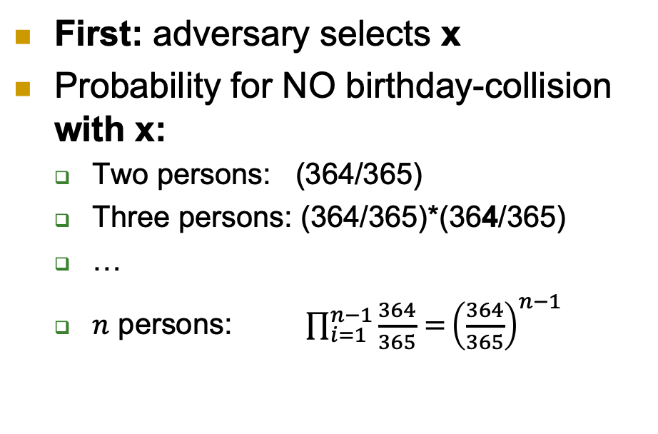


TCR and Birthday Paradox?
First: adversary selects x
Probability for NO birthday-collision
with x:
  Two persons: (364/365)
  Three persons: (364/365)*(364/365)
  …
  $n$ persons: $\prod_{i=1}^{n−1}{\frac{364}{365}=}{\left(\frac{364}{365}\right)}^{n−1}$
$$1^{n}$$
Adversary
$$k\underset{←}{\$}{\left\{0,1\right\}}^{n}$$
x
Adversary
Collision: $x^{′}$ s.t. $x$≠ $x^{′}$ and $h_{k}\left(x\right)=h_{k}(x^{′})$
Jan | Feb | Mar | Apr | May | Jun | Jul | Aug | Sep | Oct | Nov | Dec

Slide 23
We (mostly) focus on keyless hash…
Although there are no CRHFs and theory papers focus on keyed hash
But…
  It’s a bit less complicated and easier to work with.
  No need to consider both ACR (this stands for Any Collision Resistance, which is the same as CRHF) and TCR
    Why?
  Modifying to CRHF is quite trivial
    Just make it keyed!
  Usually used in practice: code libraries, standards, …

Slide 24








2nd-Preimage-Resistant Hash (SPR)
Hard to find collision with a specific random x.
  So the attacker’s advantage, probability of finding such a collision, in the following game is negligible.
  $$x\underset{←}{\$}{\left\{0,1\right\}}^{l}$$
Domain ${\left\{0,1\right\}}^{∗}$
Hash function $h\left(∙\right)$
Range ${\left\{0,1\right\}}^{n}$
Adversary
First preimage
$$x∘$$
Second
preimage
$$x′∘$$
$$∘h\left(x\right)=h(x^{′})$$
Collision: $x^{′}$ s.t. $x$≠ $x^{′}$ and $h\left(x\right)=h (x^{′})$ and $l≥n$
Use with care!
(think carefully about the security you want to achieve and see if SPR suffices)
Notes:
24
(c) Amir Herzberg, http://AmirHerzberg.com, Bar Ilan University
04/07/06

Slide 25

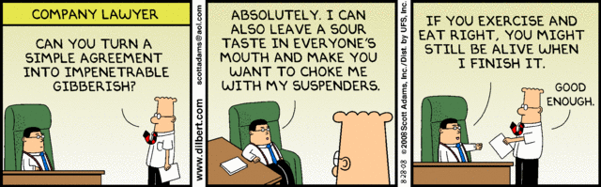
CRHF/SPR vs. Applications
CRHF secure for signing, SW-distribution
How about SPR hash (weak-CRHF)?
  SW-distribution? YES
  Hash-then-sign? NO
Why?
  Attacker can’t impact SW to be distributed
  But… attacker may be able to impact signed msg!
Will/Contract/…
Sign(h(Will/Contract/…))

Slide 26


SPR: Collisions to Chosen Messages
Or: Alice and Mal, the corrupt lawyer
Mal finds two `colliding wills’, GoodW and BadW:
  GoodW: contents agreeable to Alice
  h(GoodW)=h(BadW)
  Alice Signs good will: Sign(h(GoodW))
Later… Mal presents to the court:
h(GoodP)=h(BadP)
GoodW: ‘I leave all to Bob’
Sign_{A}(h(GoodW))
BadW: ‘I leave all to Mal’, Sign_{A}(h(BadW))
$$$$

Slide 27
SPR: collisions to chosen message
Or: Alice and Mal, the corrupt lawyer
Mal finds two `colliding wills’, GoodW and BadW:
  GoodW: contents agreeable to Alice
  h(GoodW)=h(BadW)
  Alice Signs good will: Sign_{A}(h(GoodW))
Later… Mal presents to the court:
Is such attack realistic?
Or SPR is enough ‘in practice’? Yes it is! This attack usually relies on having a specific format for messages, like a fixed prefix chosen by the attacker.
h(GoodP)=h(BadP)
GoodW: ‘I leave all to Bob’
Sign_{A}(h(GoodW))
BadW: ‘I leave all to Mal’, Sign_{A}(h(BadW))
$$$$

Slide 28
Examples
1) Let h_{k} be a keyed CRHF. Is h_{k}’ = h_{k}(h_{k}(x)) a CRHF? Why?
2) For x parsed as x = x₁||x₂||x_{3 ,} let h(x₁||x₂||x₃) = x₁ + x₂ + x₃ mod 2^{n}, is h a CRHF? Why? Is it an SPR? Why?
3) Let h_{k}(m) be a TCR hash function. Construct h_{k}’(m) = 0^{n} if m[1: |k|] = k and h_{k}(m) otherwise (recall that the hash function input can be of any length).
  Is h_{k}’ a CRHF? Why?
  Is h_{k}’ a TCR? Why?

Slide 29
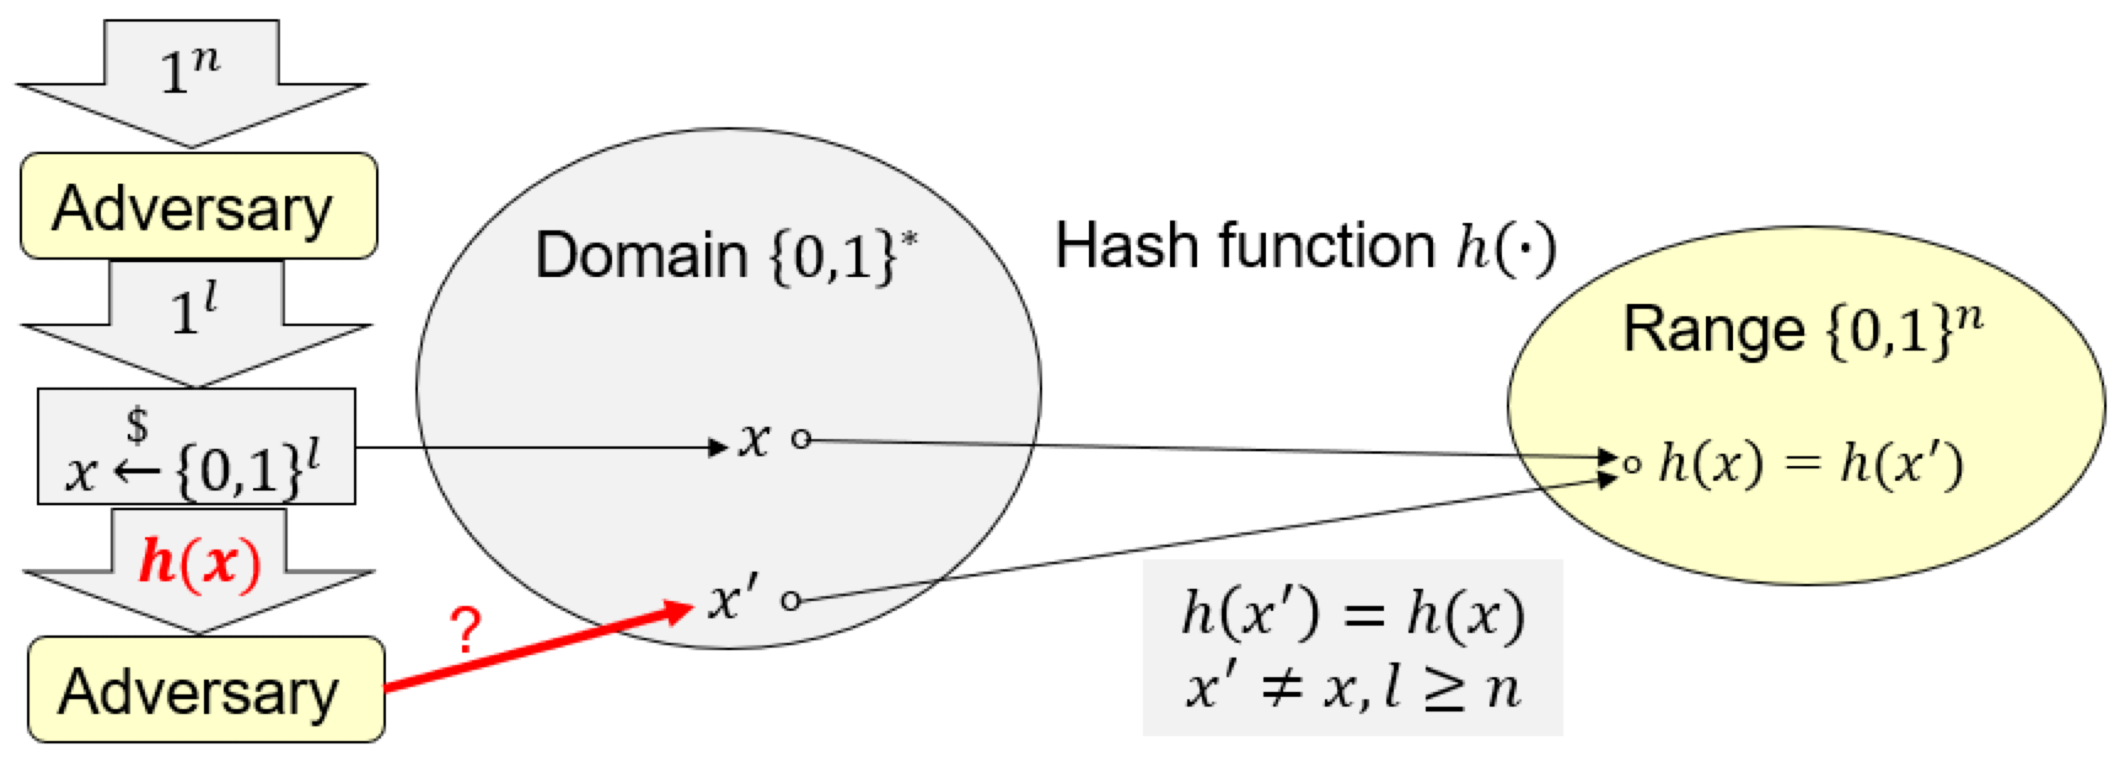
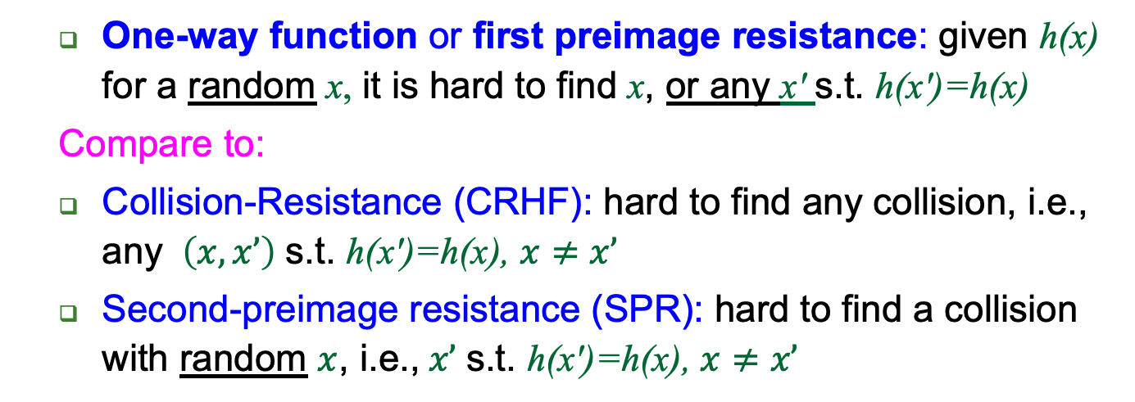
One-Way Function (OWF)
  One-way function or first preimage resistance: given h(x) for a random x, it is hard to find x, or any x' s.t. h(x')=h(x)
  Compare to:
  Collision-Resistance (CRHF): hard to find any collision, i.e., any $\left(x,x’\right)$ s.t. h(x')=h(x), $x≠x’$
  Second-preimage resistance (SPR): hard to find a collision with random $x$, i.e.,$x’$ s.t. h(x')=h(x), $x≠x’$
Notes:
29
(c) Amir Herzberg, http://AmirHerzberg.com, Bar Ilan University
04/07/06

Slide 30
Exercise
Let h₁, h₂ be both CRHF and OWF
Use them to construct:
  h_{CRHF} - CRHF but not OWF
  h_{OWF} - OWF but not CRHF

Slide 31
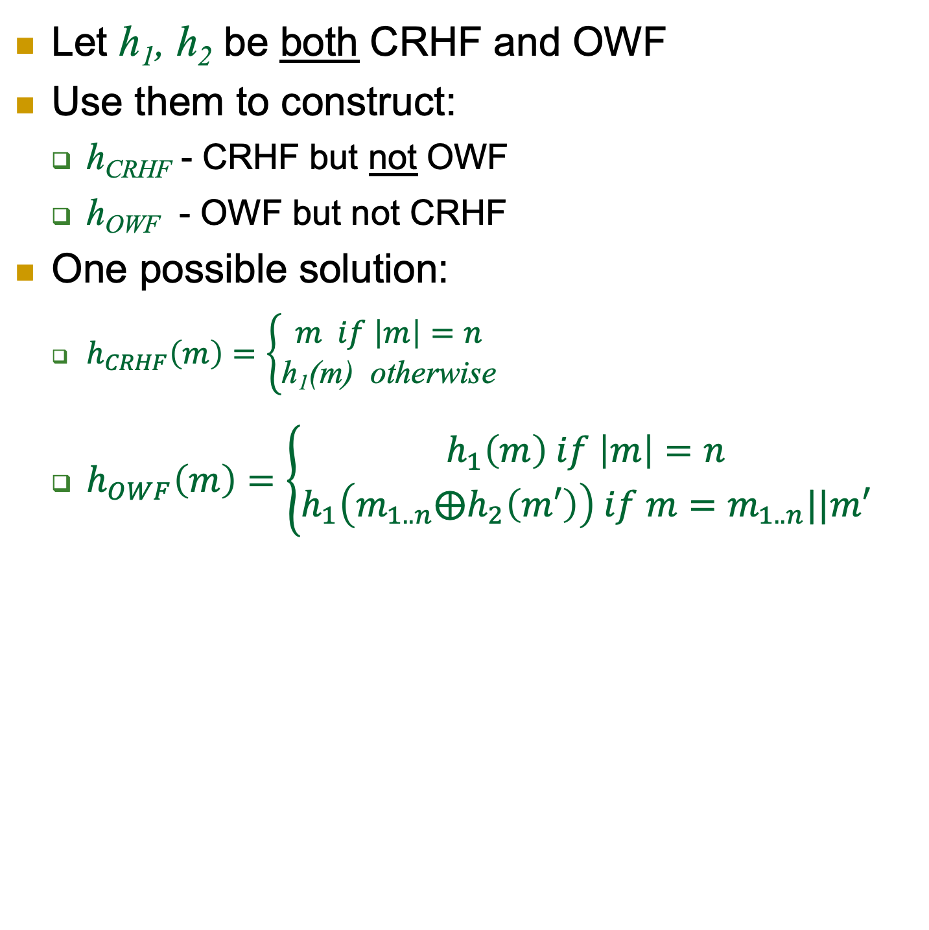
Exercise
Let h₁, h₂ be both CRHF and OWF
Use them to construct:
  h_{CRHF} - CRHF but not OWF
  h_{OWF} - OWF but not CRHF
One possible solution:
  $h_{CRHF}\left(m\right)=\left\{\begin{aligned}m if \left|m\right|=n \\ \text{h}\text{1}\text{(m) } \text{otherwise}\end{aligned}\right.$
  $h_{OWF}\left(m\right)=\left\{\begin{aligned}h_{1}\left(m\right) if \left|m\right|=n \\ h_{1}\left({m_{1..n}⨁h}_{2}\left(m′\right)\right) if m=m_{1..n}||m′\end{aligned}\right.$

Slide 32
What does all of that tell you about …
… the relation between CRHF, TCR, SPR, and OWF?
  CRHF vs. TCR?
  CRHF vs. SPR?
  TCR vs. SPR?
  CRHF vs. OWF?
  SPR vs. OWF?

Slide 33
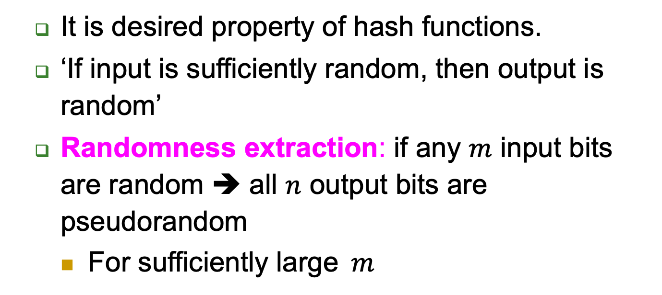
Randomness Extraction
  It is desired property of hash functions.
  ‘If input is sufficiently random, then output is random’
  Randomness extraction: if any $m$ input bits are random ➔ all $n$ output bits are pseudorandom
    For sufficiently large$m$
Notes:
33
(c) Amir Herzberg, http://AmirHerzberg.com, Bar Ilan University
04/07/06

Slide 34
Covered Material From the Textbook
Chapter 3
  Section 3.1,
  Section 3.2,
  Section 3.3, (except 3.3.6, and from 3.3.5 only what we covered in class)
  Section 3.4 (except 3.4.2),
  Section 3.5 (only its introduction, i.e., text before 3.5.1),

Slide 35

Thank You!

