Slide 1
CSE 3400/CSE 5850 - Introduction to Cryptography and Cybersecurity / Introduction to Cybersecurity
Lecture 3
Encryption – Part II
(and Pseudo-randomness)
Ghada Almashaqbeh
UConn
Adapted from the textbook slides

Slide 2
Outline
One time pad (OTP) encryption.
Pseudorandom number generators (PRGs).
Pseudorandom number functions (PRFs).
Encryption schemes from PRGs and PRFs.
2

Slide 3
We can apply generic, exhaustive attacks to every cryptosystem. So, is breaking just a question of resources?
Can encryption be secure unconditionally – even against attacker with unbounded time and storage?
Yes it can!

Slide 4
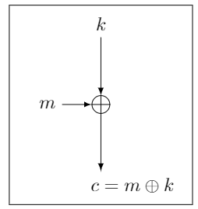
One-Time-Pad (OTP)
To encrypt message m, compute the bitwise XOR of the key k with the message m:
  E_{k}(m)=c where c[i] = k[i] ⊕ m[i]
To decrypt ciphertext c, compute the bitwise XOR of the key with the ciphertext:
  D_{k}(c)=m where m[i] = k[i] ⊕ c[i]
1 2 3 4 5 6 7 8
... | 1 | 1 | 1 | 0 | 0 | 0 | 1 | 0
Key k (pad)
Plaintext m
+
Ciphertext c
1 2 3 4 5 6 7 8
1 2 3 4 5 6 7 8
... | 0 | 0 | 0 | 1 | 0 | 0 | 1 | 1
 |  |  |  | 1 | 0 | 0 | 0 | 1

Slide 5
One-Time-Pad: Example, Properties
k = 11001
m = 10011
c = 01010
k = 11001
c = 01010
m = 10011
Correctness: k ⊕ c = k ⊕ (k ⊕ m) = (k ⊕ k) ⊕ m = 0 ⊕ m = m
Very simple, and efficient… but:
  Stateful encryption (must remember the keys, or a counter of the key bits, used so far to avoid using them again)
  Size of key must be (at least) equal to the message size.
  Key cannot be reused for several encryptions (one time!).
Shannon [1949; simplified]: OTP is unconditionally secure, and for every unconditionally-secure cipher, |k|≥|m|
  Proofs of these claims? See cryptography course / books ☺
To go around the above limitations: we assume attackers are computationally limited

Slide 6
Recall: Unconditional vs. Computational Security
Unconditional security
  No matter how much computing power is available, the cipher cannot be broken
Computational security
  The cost of breaking the cipher exceeds the value of the encrypted information
  The time required to break the cipher exceeds the useful lifetime of the information
  So it deals with Probabilistic Polynomial Time (PPT) attackers.
Notes:
Unconditional security would be nice, but the only known such cipher is the one-time pad (later). For all reasonable encryption algorithms, have to assume computational security where it either takes too long, or is too expensive, to bother breaking the cipher.

Slide 7
Looking ahead: Stream Ciphers vs. Block Ciphers
Stream cipher
  Encrypts a message bit by bit (stream of bits).
  Inherently stateful; needs to keep track of the location of last encrypted bit.
Block cipher
  Encrypts a block (string) of bits all at once.
  Can be stateless or stateful
Notes:
Unconditional security would be nice, but the only known such cipher is the one-time pad (later). For all reasonable encryption algorithms, have to assume computational security where it either takes too long, or is too expensive, to bother breaking the cipher.

Slide 8
Can we do computationally-secure variant of OTP, with ‘short key’ (|k|<<|m| ) ?
Yes, using pseudorandom number generators (PRGs)!

Slide 9
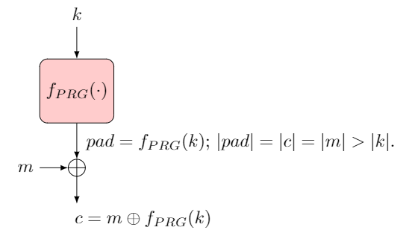
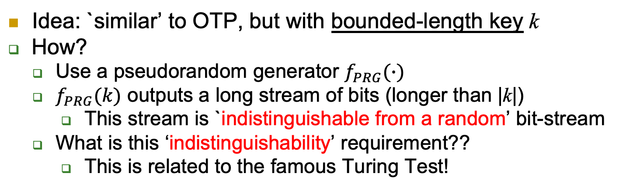
PRG Stream Cipher
Idea: `similar’ to OTP, but with bounded-length key k
How?
  Use a pseudorandom generator $f_{PRG}(∙)$
  $f_{PRG}(k)$ outputs a long stream of bits (longer than |k|)
    This stream is `indistinguishable from a random’ bit-stream
  What is this ‘indistinguishability’ requirement??
    This is related to the famous Turing Test!

Slide 10
PRG Stream Cipher - Example
Seed s
(as key)
PRG
1 2 3 4 5 6 7 8
... | 1 | 1 | 1 | 0 | 0 | 0 | 1 | 0
Bit i of PRG(s)
Plaintext m
Bit i of m
Bit i of c
Ciphertext c
+
1 2 3 4 5 6 7 8
1 2 3 4 5 6 7 8
... | 0 | 0 | 0 | 1 | 0 | 0 | 1 | 1
 |  |  |  | 1 | 0 | 0 | 0 | 1

Slide 11


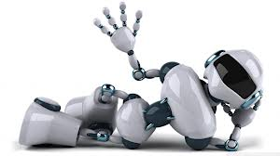
The Turing Test [1950]
Defined by Alan Turing
Machine M is intelligent if an evaluator cannot distinguish between M and a human
  Only textual communication, to avoid `technicalities’
If M is ‘intelligent’, then the judge will only be able to make a random guess
  I.e., probability of distinguishing would be (at most) ½

Slide 12
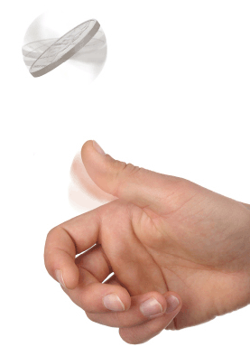
The PRG Indistinguishabity Test
Consider function f that maps n-bits to z-bits (z>n)
Let seed and rand be random strings such that |seed|=n, |rand|=l
f is a PRG if no efficient distinguisher D can tell which is which.
  i.e., cannot output 1 given f(seed) and 0 given rand with non-negligible advantage.
seed
(n-bits)
f( )
z-bits
rand
f(seed)
?
z-bits
1 if input is f(seed),
0 if input is rand

Slide 13
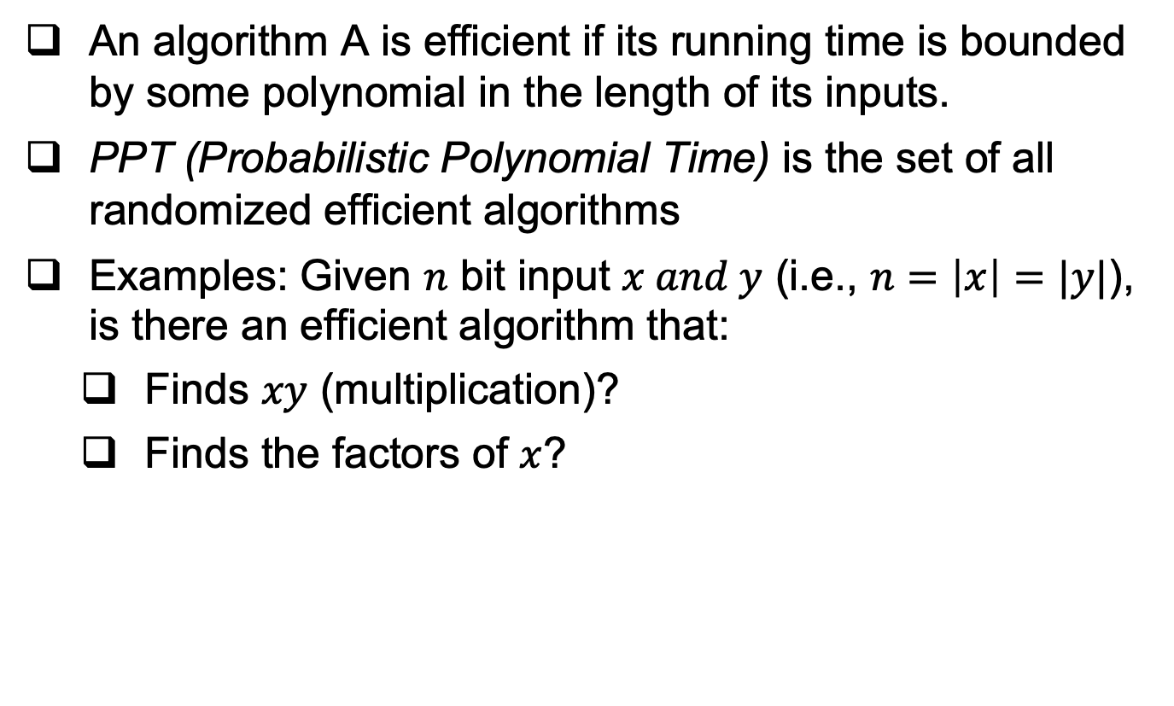
Recall: An Efficient (PPT) Algorithm
An algorithm A is efficient if its running time is bounded by some polynomial in the length of its inputs.
PPT (Probabilistic Polynomial Time) is the set of all randomized efficient algorithms
Examples: Given $n$ bit input $x and y$ (i.e., $n=\left|x\right|=|y|$), is there an efficient algorithm that:
  Finds $xy$ (multiplication)?
  Finds the factors of $x$?

Slide 14
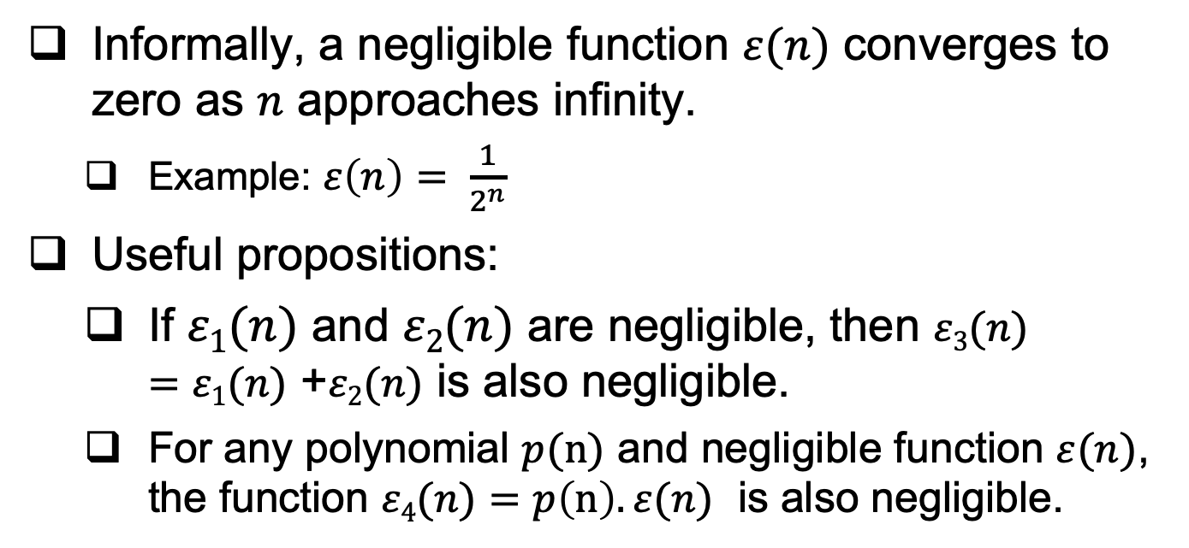
Recall: Negligible Functions
Informally, a negligible function $ε(n)$ converges to zero as $n$ approaches infinity.
  Example: $ε\left(n\right)= \frac{1}{2^{n}}$
Useful propositions:
  If $ε1(n)$ and $ε2(n)$ are negligible, then $ε3(n)$ $=ε1(n)$ +$ε2(n)$ is also negligible.
  For any polynomial $p(n)$ and negligible function $ε(n)$, the function $ε4(n)$ $=p\left(n\right).ε(n)$ is also negligible.

Slide 15
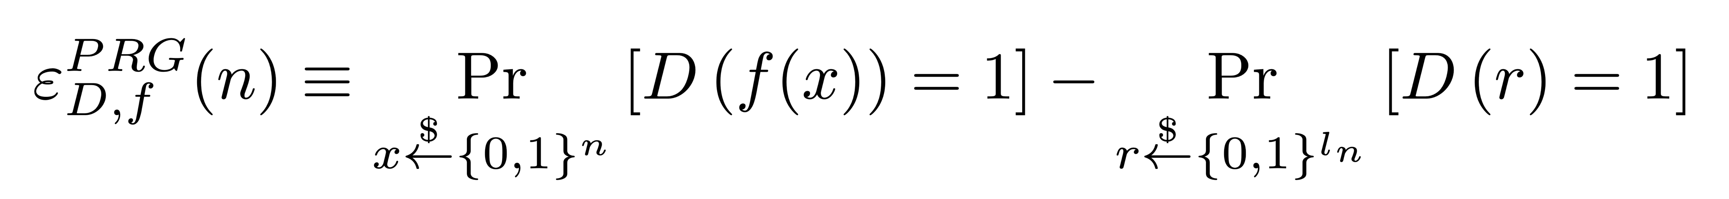
The PRG Advantage
A random guess is correct half of the time
A distinguisher in the PRG game will have an advantage:
l
Seed x
(n-bits)
f( )
l-bits
rand
f(x)
?
l-bits
1 if input is f(x),
0 if input is rand

Slide 16


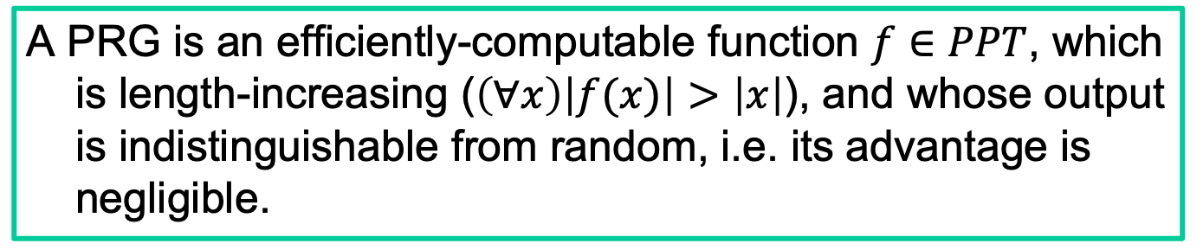


Pseudo-Random Generator: Definition
A PRG is an efficiently-computable function $f∈PPT$, which is length-increasing ($\left(∀x\right)\left|f(x)\right|>\left|x\right|$), and whose output is indistinguishable from random, i.e. its advantage is negligible.
$$f(x)$$
$$w$$
$$r$$
$$x$$
(n-bits)
f(.)
rand
Is w = r or w = f(x)?!!
Output 1 if w = f(x),
0 if input is w = r

Slide 17
Exercise
Let s be the seed and f(s) be a PRG, are the following PRGs?
  g(s) = 1||f(s)
  q(s) = (parity of s)||f(s)
  w(s) = ~f(s)
    ~ is the bitwise complement or negation

Slide 18
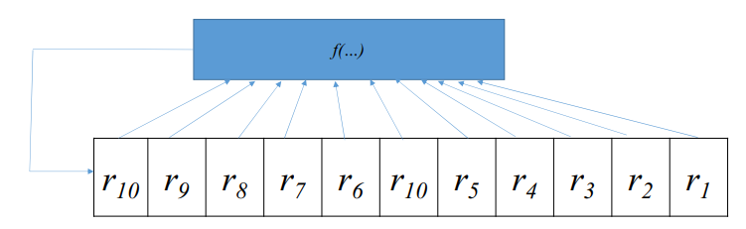
Many PRG proposals I
Often based on Feedback Shift Registers
  Easy construction for efficient hardware implementations.
  Linear feedback (LFSR), or non-linear feedback function (f(…) in the figure, e.g., XOR all previous bits to produce the next one).
    LFSR is easily predictable (not a secure PRG)

Slide 19
Many PRG proposals II
  In practice, attacks on PRGs (or constructions that use PRGs) are often caused by an incorrect use of a PRG.
    Example: a PRG-based OTP encryption scheme with a fixed PRG seed.
      What is wrong with this construction?

Slide 20
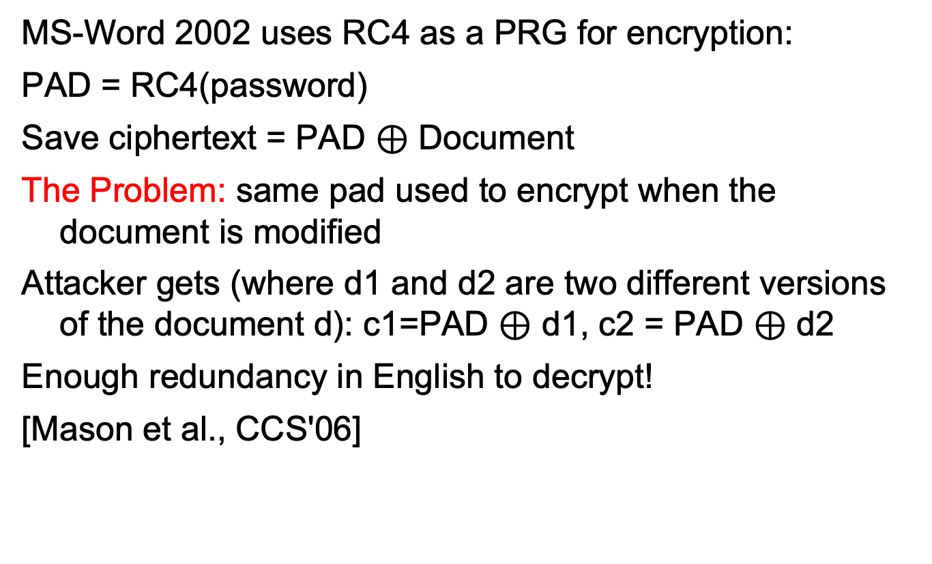
Example: Misusing Stream-Cipher
MS-Word 2002 uses RC4 as a PRG for encryption:
PAD = RC4(password)
Save ciphertext = PAD $⊕$ Document
The Problem: same pad used to encrypt when the document is modified
Attacker gets (where d1 and d2 are two different versions of the document d): c1=PAD $⊕$ d1, c2 = PAD $⊕$ d2
Enough redundancy in English to decrypt!
[Mason et al., CCS'06]
Cryptography is bypassed more often than broken!!

Slide 21
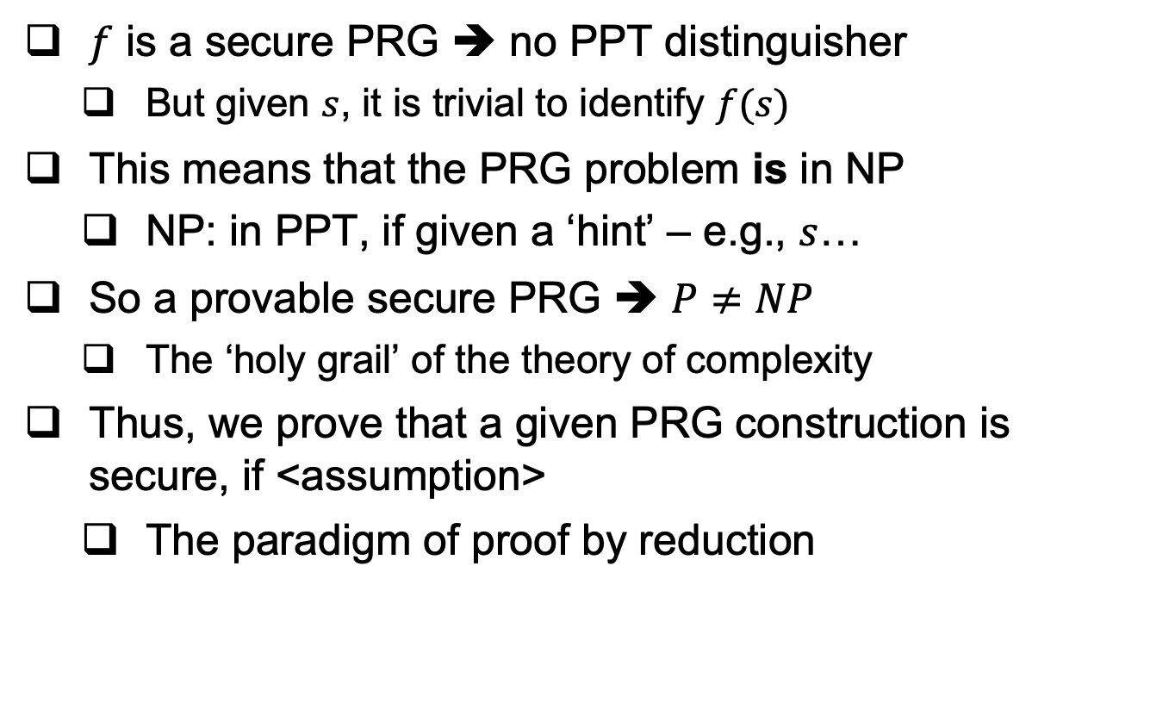
Provably-Secure PRG?
$f$ is a secure PRG ➔ no PPT distinguisher
  But given $s$, it is trivial to identify $f(s)$
This means that the PRG problem is in NP
  NP: in PPT, if given a ‘hint’ – e.g., $s$…
So a provable secure PRG ➔ $P≠NP$
  The ‘holy grail’ of the theory of complexity
Thus, we prove that a given PRG construction is secure, if <assumption>
  The paradigm of proof by reduction

Slide 22
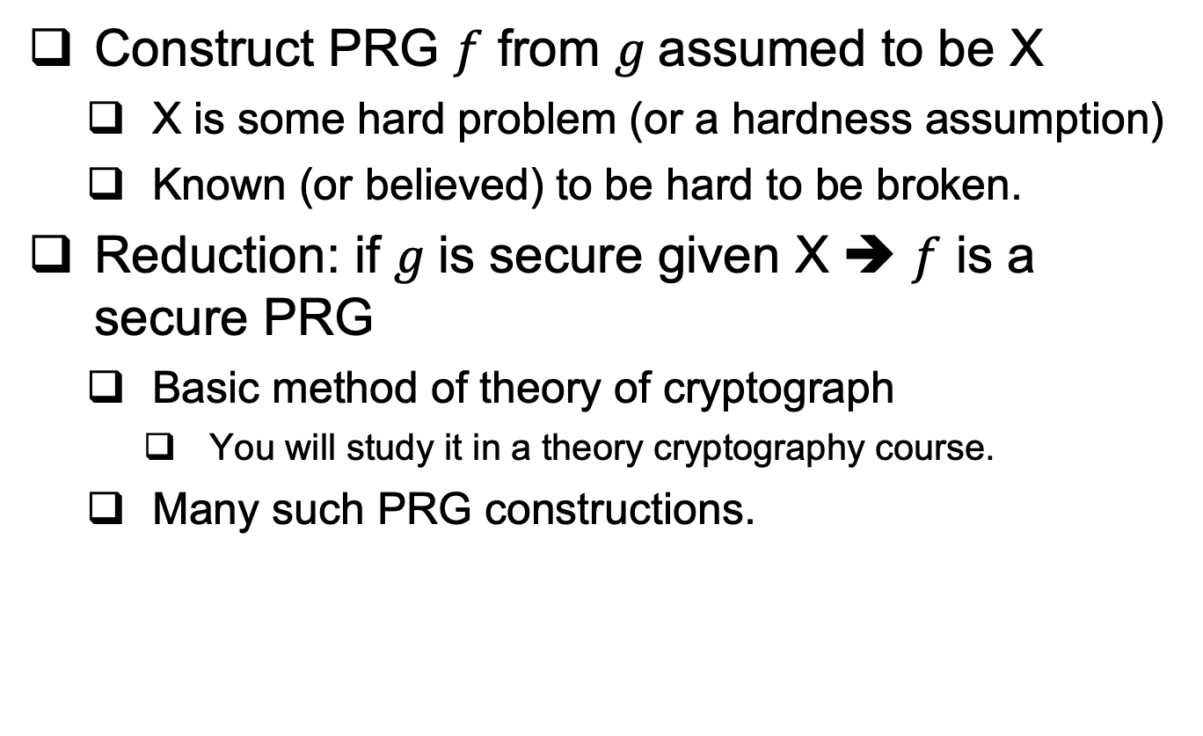
Provably-Secure PRG : by reduction
Construct PRG $f$ from $g$assumed to be X
  X is some hard problem (or a hardness assumption)
  Known (or believed) to be hard to be broken.
Reduction: if $g$is secure given X ➔ $f$ is a secure PRG
  Basic method of theory of cryptograph
    You will study it in a theory cryptography course.
  Many such PRG constructions.

Slide 23
PRG by reduction (informal) – An Example
Let f : {0, 1}^{n} → {0, 1}^{n+1} be a secure PRG. Is f′ : {0, 1}^{n+1} → {0, 1}^{n+2}, defined as f′(b || x) = b || f(x) where b ∈ {0, 1} is a random bit, also a secure PRG?
Hints:
intuitively, is f’ a secure PRG? Why?
How does security of f’ rely on the security of f?

Slide 24
Stream-Cipher Like but Stateless Encrypt?
PRG-based stream ciphers are stateful.
  Need to remember how many bits (or bytes) were already encrypted, and and how many bits (or bytes) of PRG output have been used so far.
Can secure encryption be stateless?
Yes it can!
In three steps (or versions):
Use less state
Use no state with a random function
Use no state, but with pseudo-random function

Slide 25

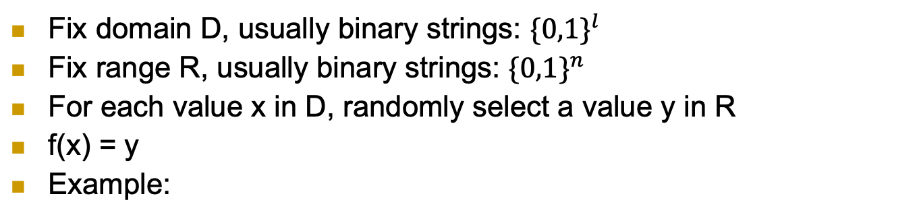

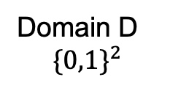
First, what’s a (‘truly’) random function f?
Fix domain D, usually binary strings: ${\{0,1\}}^{l}$
Fix range R, usually binary strings: ${\{0,1\}}^{n}$
For each value x in D, randomly select a value y in R
f(x) = y
Example:
 | f( )
00
01
10
11
Range R ${\{0,1\}}^{5}$
Domain D
$${\{0,1\}}^{2}$$

Slide 26
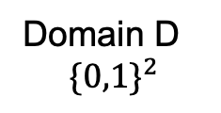

What’s a (‘truly’) random function?
Fix domain D, usually binary strings: ${\{0,1\}}^{l}$
Fix range R, usually binary strings: ${\{0,1\}}^{n}$
For each value x in D, randomly select a value y in R
f(x) = y
Example:
 | f( )
00 | 01101
01 | 11010
10 | 01101
11 | 11101
Range R ${\{0,1\}}^{5}$
Domain D
$${\{0,1\}}^{2}$$

Slide 27
What’s a (‘truly’) random function?
Another example:
Domain D: integers
Range R: bits {0,1}
For each integer i, randomly select a bit f(i)
Example:
i | f(i)
1
2
3
4
5
6
… | …
Range: bits {0,1}
Domain:
integers

Slide 28
What’s a (‘truly’) random function?
Another example:
Domain D: integers
Range R: bits {0,1}
For each integer i, randomly select a bit f(i)
Example:
i | f(i)
1 | 0
2 | 1
3 | 1
4 | 0
5 | 0
6 | 1
… | …
Range: bits {0,1}
Domain:
integers

Slide 29
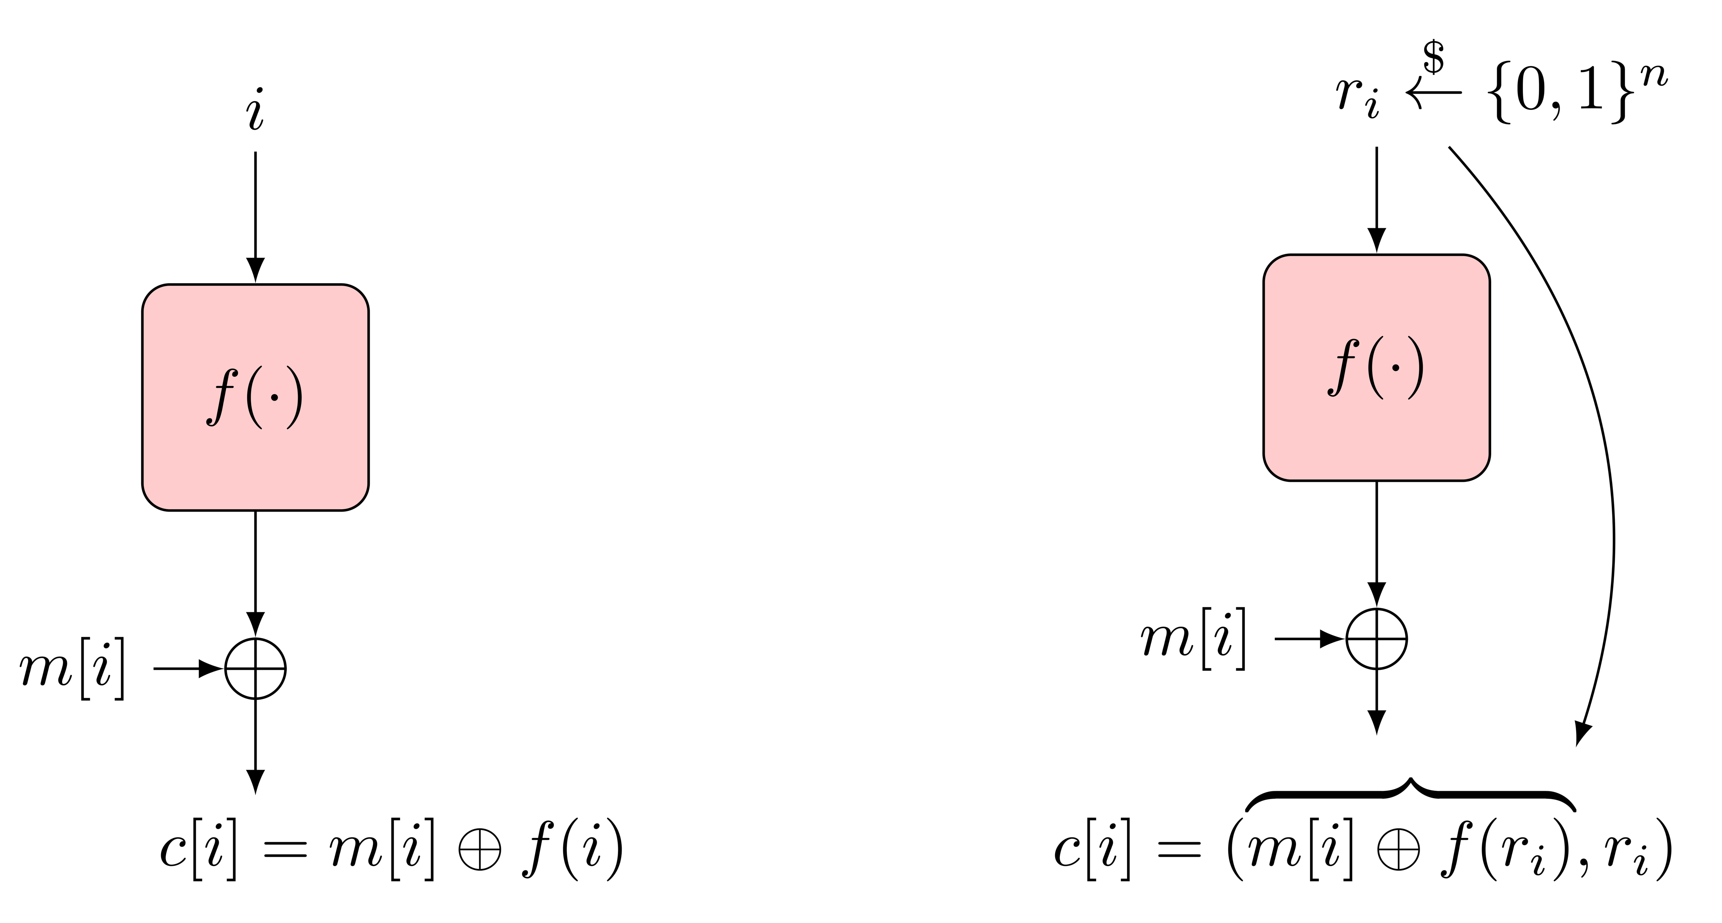
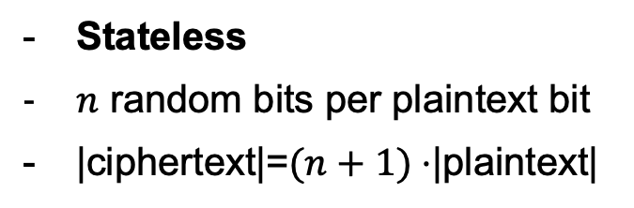
Random Function-Based Encryption (stream cipher)
Stateful (counter-based) Design
Stateless Design
Stateful
No extra random bits required
|ciphertext|=|plaintext|
Stateless
$n$ random bits per plaintext bit
|ciphertext|=$(n+1)⋅$|plaintext|

Slide 30
Random Function-Based Encryption (stream cipher)
Stateful (counter-based) Design
Stateless Design
Drawbacks:
Require (true) random function (impractical)
One random function invocation per bit (computational overhead)

Slide 31
Reduce Overhead: Blockciphers
Optimization: operate in blocks (say of n bits)
  f be random function that produce n-bits random strings
  m_{i} be i-th block of n-bits of plaintext
  c_{i} be i-th block of n-bits of ciphertext
Challenge: sharing such random function f (both sender and recipient must have it)!!
  Size of table? 2^{n} entries of n bits each…
Idea: use pseudo-random function (PRF) instead!
Stateful (counter-based) Design
Stateless Design

Slide 32
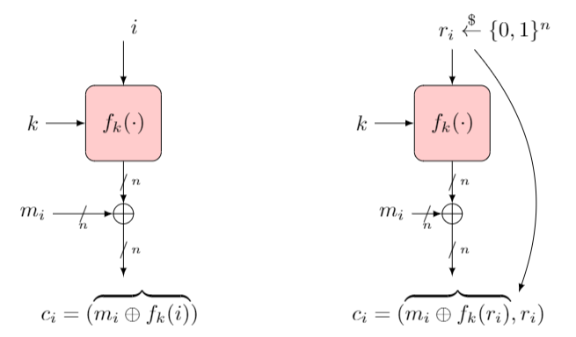

Encryption with PRF
Operate in blocks (say of n bits)
Use Pseudo-Random Function (PRF) $f_{k}\left(⋅\right)$ that outputs n bits
  Efficient , compact
  Keyed with a secret key k.
But what is a PRF ?

Slide 33
The PRF Indistinguishabity Test
F is a PRF from domain D to range R, if no distinguisher A:
  Outputs 1 (signaling PRF) given oracle access to F_{k}(.) (for random n-bits key k ), and
  Outputs 0 (signaling random) given oracle access to f(.), a random function (from D to R)
n-bit key k
k
x₁,x₂,…,x_{i}
x₁,x₂,…,x_{i}
F_{k}(.)
?
f(.)
…, F_{k}(x_{i})
…, f(x_{i})
Box 1: PRF
Box 0: random function
A
1 if oracle is F_{k}(.),
0 if oracle is f(.)

Slide 34
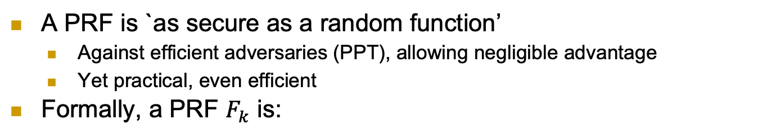
PRF Definition
A PRF is `as secure as a random function’
  Against efficient adversaries (PPT), allowing negligible advantage
  Yet practical, even efficient
Formally, a PRF $F_{k}$ is:

Slide 35
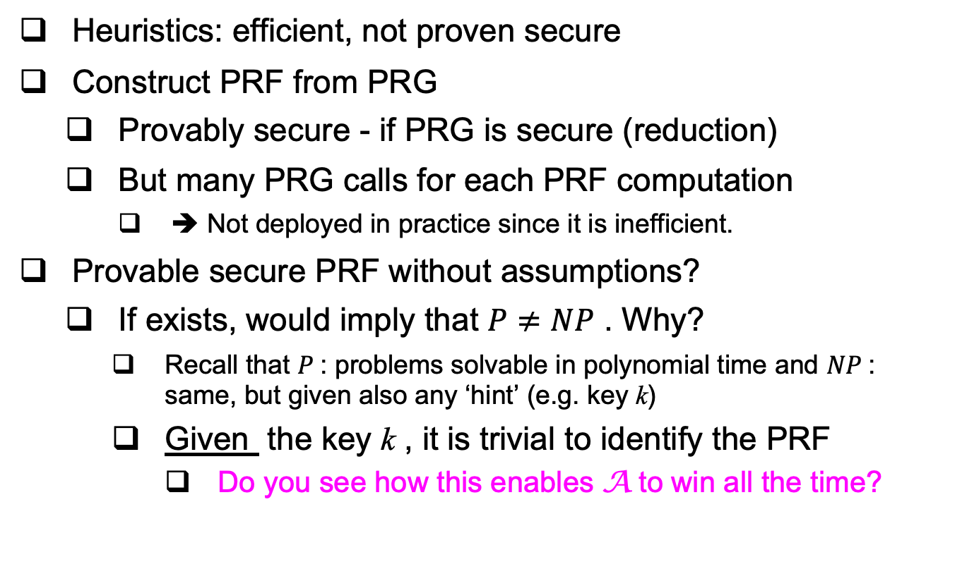
Constructing a PRF
Heuristics: efficient, not proven secure
Construct PRF from PRG
  Provably secure - if PRG is secure (reduction)
  But many PRG calls for each PRF computation
    ➔ Not deployed in practice since it is inefficient.
Provable secure PRF without assumptions?
  If exists, would imply that $P≠NP$ . Why?
    Recall that $P$: problems solvable in polynomial time and $NP$: same, but given also any ‘hint’ (e.g. key k)
    Given the key k , it is trivial to identify the PRF
      Do you see how this enables A to win all the time?

Slide 36
PRF Applications
PRFs have many more applications:
  Encryption, authentication, key management, …
Example: derive independent key for each day d
  Easy, with PRF and single shared key k
  Key for day d is k_{d} = F_{k}(d)
  Exposure of keys of Monday and Wednesday does not expose key for Tuesday
  Similarly: separate keys for different goals, e.g., encryption and authentication
d
Key k
PRF F_{k}
F_{k}(d)

Slide 37
Examples
Let F_{k} be a secure PRF, are the following functions secure PRFs and why?
  F’_{k}(x) = F₁^{n}(x) || F_{k}(x)
  F’’_{k}(x) = F_{k}(x) || lsb(F_{k}(x))
    lsb is the least significant bit

Slide 38
Covered Material From the Textbook
Chapter 2:
  Section 2.5
  Section 2.6
  Section 2.7

Slide 39

Thank You!

