Slide 1
CSE 3400 - Introduction to Computer & Network Security (aka: Introduction to Cybersecurity) Lecture 4 Encryption – Part III (and Pseudo-randomness)
Ghada Almashaqbeh
UConn
From Textbook Slides by Prof. Amir Herzberg
UConn

Slide 2
Outline
Block ciphers.
Pseudorandom permutations (PRPs).
Defining security of encryption.
Encryption modes.
Concluding remarks.
2

Slide 3
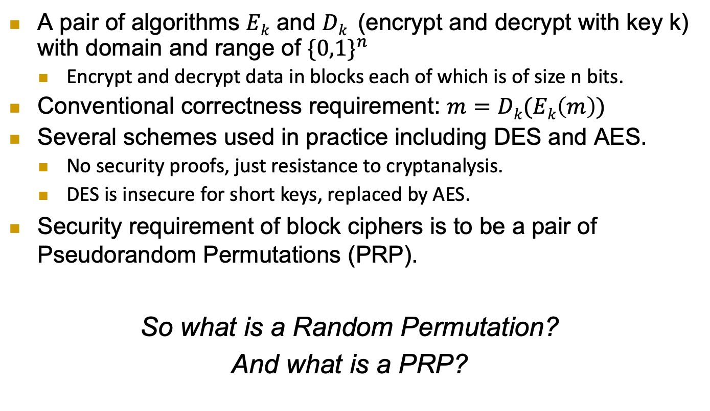
Block Ciphers
A pair of algorithms $Ek$ and $Dk$ (encrypt and decrypt with key k) with domain and range of ${\{0,1\}}^{n}$
Encrypt and decrypt data in blocks each of which is of size n bits.
Conventional correctness requirement: $m=Dk(Ek\left(m\right))$
Several schemes used in practice including DES and AES.
No security proofs, just resistance to cryptanalysis.
DES is insecure for short keys, replaced by AES.
Security requirement of block ciphers is to be a pair of Pseudorandom Permutations (PRP).
So what is a Random Permutation?
And what is a PRP?
3

Slide 4
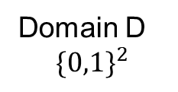
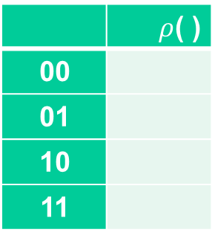
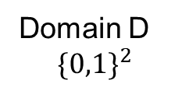
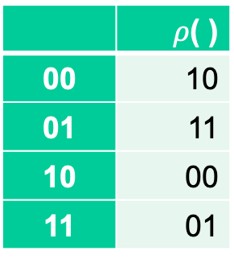
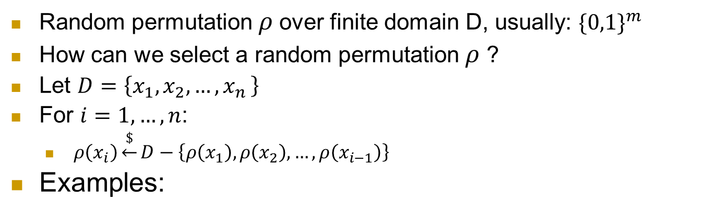
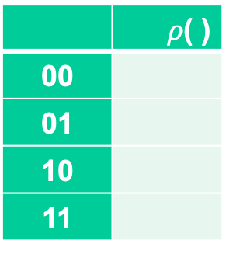

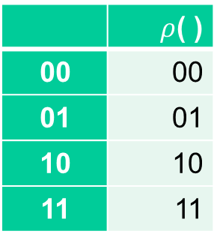
What is a random permutation $ρ$ ?
Random permutation $ρ$over finite domain D, usually: ${\{0,1\}}^{m}$
How can we select a random permutation $ρ$ ?
Let $D=\left\{x_{1},x_{2},…,x_{n }\right\}$
For $i=1,…, n$:
$ρ\left(x_{i}\right)\underset{←}{\$}D−\left\{ρ\left(x_{1}\right),ρ\left(x_{2}\right),…,ρ\left(x_{i−1}\right)\right\}$
Examples:
 | $ρ$( )
00
01
10
11
 | $ρ$( )
00 | 10
01 | 11
10 | 00
11 | 01
 | $ρ$( )
00
01
10
11
 | $ρ$( )
00 | 00
01 | 01
10 | 10
11 | 11
Domain D
$${\{0,1\}}^{2}$$
Domain D
$${\{0,1\}}^{2}$$
4

Slide 5
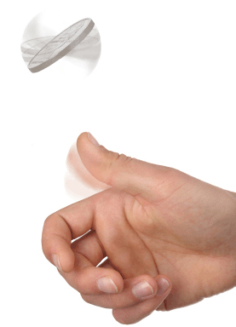


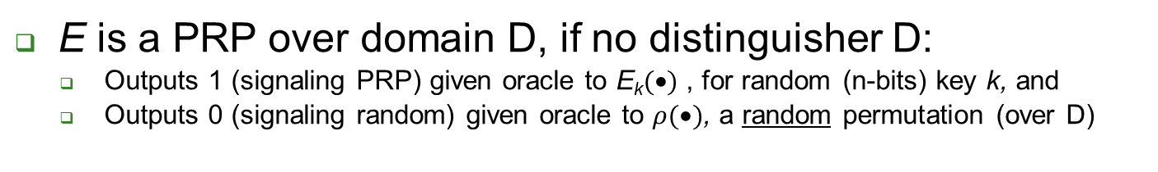
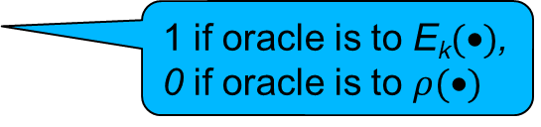


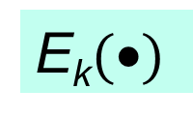
Pseudo-Random Permutation (PRP) and their Indistinguishabity Test
E is a PRP over domain D, if no distinguisher D:
Outputs 1 (signaling PRP) given oracle to E_{k}$(•)$ , for random (n-bits) key k, and
Outputs 0 (signaling random) given oracle to $ρ(•)$, a random permutation (over D)
n-bit Key k
k
x₁,x₂,…,x_{i}
x₁,x₂,…,x_{i}
E_{k}$(•)$
?
$$ρ(•)$$
…, E_{k}(x_{i})
…, $ρ$(x_{i})
Box 1: E_{k}$(•)$
Box 0: random permutation
1 if oracle is to E_{k}$(•)$,
0 if oracle is to $ρ(•)$
5

Slide 6
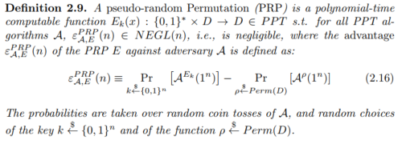
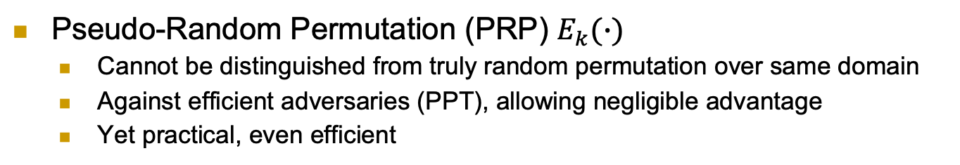
Pseudo-Random Permutation (PRP)
Pseudo-Random Permutation (PRP) $E_{k}(∙)$
Cannot be distinguished from truly random permutation over same domain
Against efficient adversaries (PPT), allowing negligible advantage
Yet practical, even efficient
6

Slide 7
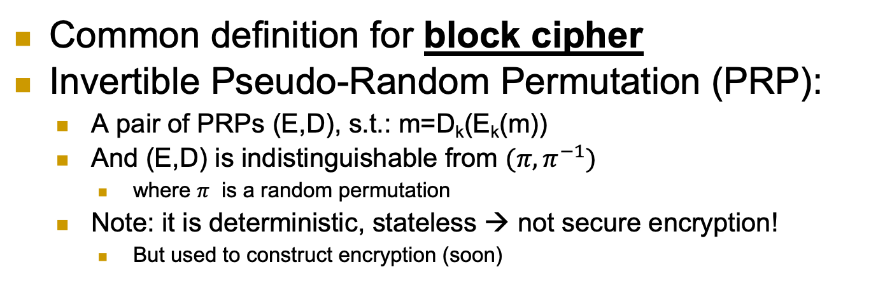
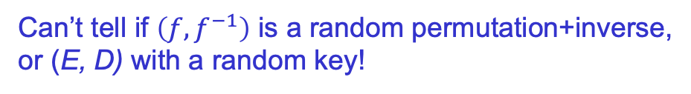
Block Cipher: Invertible PRP (E, D)
Common definition for block cipher
Invertible Pseudo-Random Permutation (PRP):
A pair of PRPs (E,D), s.t.: m=D_{k}(E_{k}(m))
And (E,D) is indistinguishable from $(π, π^{−1})$
where $π$ is a random permutation
Note: it is deterministic, stateless → not secure encryption!
But used to construct encryption (soon)
f← E_{k}(.) or D_{k}(.) [for random k]
or f← random n-bit permutation or its inverse
x
f(x)
Can’t tell if $\left(f,f^{−1}\right)$ is a random permutation+inverse, or (E, D) with a random key!
7

Slide 8
Example of a Block Cipher Security and Correctness
On the whiteboard.
8

Slide 9
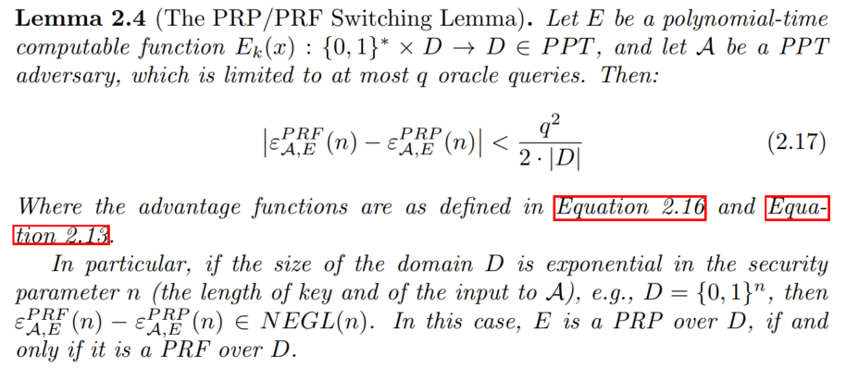


Constructing block-cipher, PRP
Focus: constructions from a PRF $f_{k}(∙)$
PRFs seem easier to design (less restrictions)
First: ‘plain’ PRP $E_{k}(∙)$ (not a block cipher)
What is the simplest construction to try?$E_{k}(x)$=______
$$f_{k}(x)$$
9

Slide 10
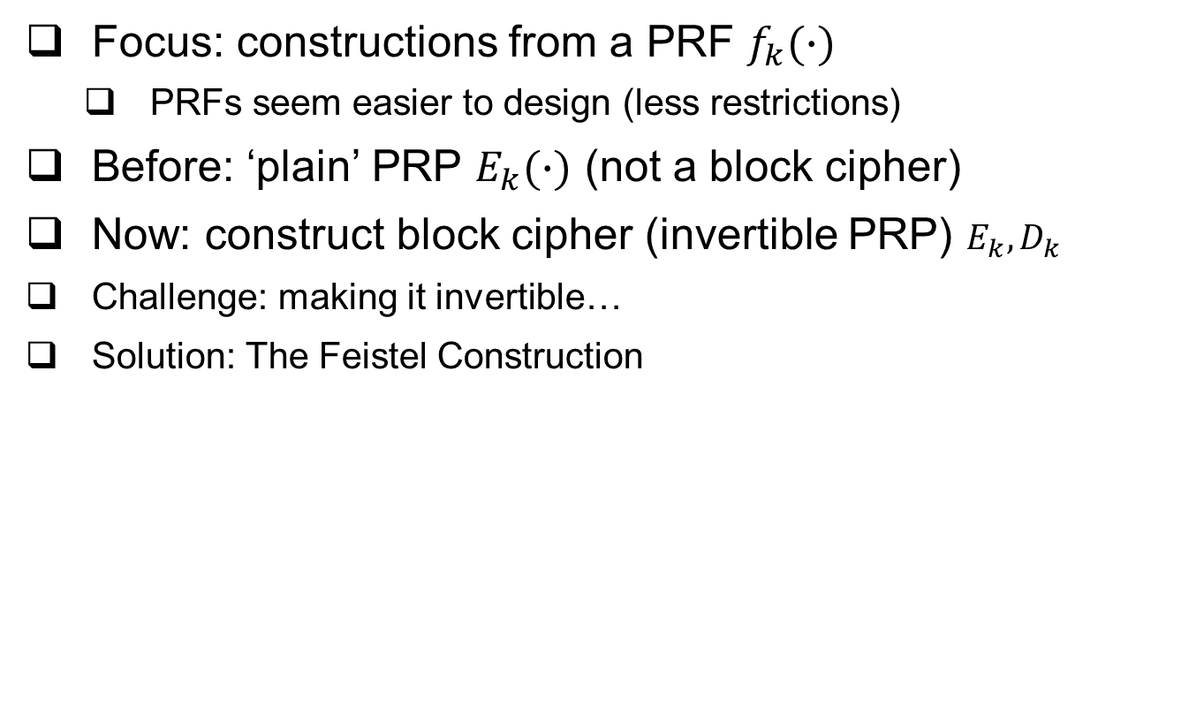
Constructing block-cipher, PRP
Focus: constructions from a PRF $f_{k}(∙)$
PRFs seem easier to design (less restrictions)
Before: ‘plain’ PRP $E_{k}(∙)$ (not a block cipher)
Now: construct block cipher (invertible PRP) $E_{k}, D_{k}$
Challenge: making it invertible…
Solution: The Feistel Construction
10

Slide 11






The Feistel Block-cipher Construction
Turn PRF F_{k} into a block cipher
Three ‘rounds’ suffice [LR88]
Used in DES (but not in AES)
With 16 ‘rounds’
$$m_{0,…,n−1}$$
$$m_{n,…,2n−1}$$
+
F_{k}()
$$L_{k}\left(m\right)$$
F_{k}()
+
F_{k}()
$$R_{k}\left(m\right)$$
+
$$g_{k}\left(m\right)$$
11

Slide 12

Crypto Building-Blocks Principle
Design and focus cryptanalysis efforts on few basic functions: simple, easy to test, replaceable
Construct schemes from basic functions
Provably secure constructions: attack on scheme ➔ attack on function
Allows replacing broken/suspect functions
Allows upgrading to more secure/efficient function
E.g., encryption from block cipher (or PRG/PRF/PRP)
Block-cipher, PRG,PRF,PRP: deterministic, stateless, FIL (Fixed-Input-Length)
Encryption: randomized/stateful, VIL (Variable-Input-Length)
12
Notes:
Another advantage is that robust combiner for function usually gives robust combiner for scheme (and usually, it is simpler than direct combiner for scheme)

Slide 13
Why standardize block ciphers, and not encryption?
Crypto building blocks principle, rephrased: design, cryptanalyze simple function, use function to construct more complex scheme
Design, cryptanalyze PRF; use it to build block cipher; and block cipher to construct cryptosystem
Attack on cryptosystem ➔ attack on block cipher, PRF
Design (FIL, deterministic, stateless) PRF, construct (VIL, randomized/stateful) cryptosystem
Easier to design and to combine:
Given two PRFs F, F’, let F’’_{k,k’}(x)=F_{k}(x)⊕F’_{k’}(x)
If either F or F’ is a secure PRF ➔ F’’ is secure PRF
This is a robust combiner for PRFs (block ciphers: also not hard)
Next: Feistel construction of Block-cipher from PRF!
13

Slide 14
We defined security for PRG, PRF and PRP. Block cipher too (informally). But… what about security of encryption??
A bit tricky, in fact.
14

Slide 15
Defining Secure Encryption
Attacker capabilities:
Computational limitations? ➔ PPT
Ciphertext only (CTO), Known / chosen plaintext attack (KPA/CPA), Chosen ciphertext (CCA)?
What’s a successful attack?
Key recovery ?
May be impossible yet weak cipher…
(Full) Message recovery?
What of partial exposure, e.g., m∈{“Advance”, “Retreat”}
Prudent: attacker ‘wins’ for any info on plaintext
15

Slide 16
Conservative Design Principle
When designing, evaluating a cryptosystem…
Consider most powerful attacker (CTO< KPA< CPA)
Be as general as possible – cover many applications
And `easiest’ attacker-success criteria
Not message/key recovery!
Make it easy to use securely, hard to use insecurely!
When designing, evaluating a system
Which use some cryptosystem
Restrict attacker’s capabilities (e.g., avoid known/chosen plaintext)
16

Slide 17
Cryptanalysis Success Criteria
Key recovery ? -- meaningless
(Full) Message recovery? – may be an overkill. E.g., when m∈{“Advance”, “Retreat”}
Can’t learn anything at all about plaintext – how to define? Can we achieve it ?
Well-defined notion: ‘semantic security’ [crypto course]
Indistinguishability: Eve ‘wins’ if she distinguishes between encryptions of (any) two messages
We focus on indistinguishability:
In crypto course: equivalent to semantic security
17

Slide 18
Defining Secure Encryption
Attacker’s capabilities:
Computational limitations? ➔ PPT
Ciphertext only (CTO), Known / chosen plaintext attack (KPA/CPA), Chosen ciphertext (CCA)?
Attacker’s goal: distinguish btw encryptions of two messages
Which messages? Let adversary choose!
Intuition: encryption is like ‘perfect disguise’
18

Slide 19





The Disguise Indistinguishability Test/Party
J (Judge/Jacob): choses actress, see disguised
Many times, actresses…………….. : Rachel, Lea, Natalie, …
J picks two of them… say: Rachel, Lea
J sees one of them (disguised)
Who is it?
Rachel, please!
J
Change
room
Choice: Rachel and Lea
It’s _______!
19
Notes:
Lea Thompson, Rachel Green (character from Friends, played by ), Natalie Portman

Slide 20
The Disguise Indistinguishability Test/Party
Basic rules:
Actresses change custom each time
All are roughly same size
Can’t ask a giant to disguise as a dwarf !
Rachel, please!
J
Change
room
Choice: Rachel and Lea
It’s _______!
20
Notes:
Lea Thompson, Rachel Green (character from Friends, played by ), Natalie Portman

Slide 21






IND-CPA-Encryption Test (1st try)
Flip coins to select random bit b and key k
A (adversary) gives message m, receives E_{k}(m)
Repeat if desired (with different messages m)
Chosen Plaintext Attack
A gives two messages (m₀,m₁), receives c*=E_{k}(m_{b})
A output b* , and ‘wins’ if b*=b
$$n,b$$
$$m$$
$
A
k
$${\left\{0,1\right\}}^{n}$$
$$Ek(m )$$
E_{k}(.)
$$m0 , m1$$
$$c∗=Ek(mb )$$
A wins if b*=b
b*
21

Slide 22






IND-CPA-Encryption Test (1st try): too easy!!
This test is too easy!! The adversary can easily win!!
How?????????
Hint: messages can be arbitrary binary strings
Namely, m, m₀ , m₁ ∈ {0,1}^*
Solution: let m₀=0 , m₁=1111111111111111111111111111
If c*=E_{k}(m_{b}) is `short’, output b*=0; if ‘long’, output b*=1
$$n,b$$
$$m$$
$
A
k
$${\left\{0,1\right\}}^{n}$$
$$Ek(m )$$
E_{k}(.)
$$m0 , m1$$
$$c∗=Ek(mb )$$
A wins if b*=b
b*

Slide 23






IND-CPA-Encryption Test (fixed)
Flip coins to select random bit b and key k
A (adversary) gives message m, receives E_{k}(m)
Repeat if desired (with another message)
Chosen Plaintext Attack
A gives messages (m₀,m₁) s.t. |m₀|=|m₁| , receives E_{k}(m_{b})
A output b* , and ‘wins’ if b*=b
$$n,b$$
$$m$$
$
A
k
$${\left\{0,1\right\}}^{n}$$
$$Ek(m )$$
E_{k}(.)
$m0 , m1$s.t. $|m0|=|m1|$
$$c∗=Ek(mb )$$
A wins if b*=b
b*

Slide 24
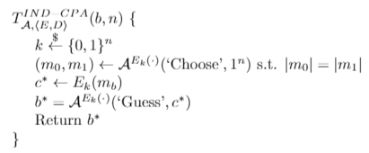






IND-CPA-Encryption Test (fixed)
Or, as pseudo-code:
Oracle notation
$$n,b$$
$$m$$
$
A
k
$${\left\{0,1\right\}}^{n}$$
$$Ek(m )$$
E_{k}(.)
$m0 , m1$s.t. $|m0|=|m1|$
$$c∗=Ek(mb )$$
A wins if b*=b
b*

Slide 25
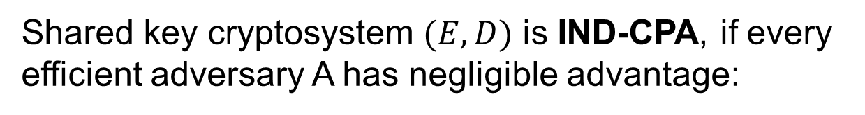
Definition: IND-CPA Encryption
Shared key cryptosystem $(E,D)$ is IND-CPA, if every efficient adversary A has negligible advantage:

Slide 26






IND-CPA : distinguish monoalph. sub.!
Students split to pairs: adversary and `tester’
Tester selects (or receives) `random’ (k, b)
k is monoalphabetic substitution table: E_{k}(abc)=k(a)||k(b)||k(c)
Adversary gives message(s) m, receives E_{k}(m)
Then adversary gives m₀ , m₁ … receives E_{k}(m_{b})
Adversary finds b !! How?
$$n,b$$
$$m$$
$
A
k
$${\left\{0,1\right\}}^{n}$$
$$Ek(m )$$
E_{k}(.)
$m0 , m1$s.t. $|m0|=|m1|$
$$c∗=Ek(mb )$$
A wins if b*=b
b*
Monoalphabetic substitution
is not IND-CPAistinguishable!

Slide 27
Can IND-CPA encryption be deterministic?
No!! But why? Suppose E_{k}(x) is deterministic…
Assume messages are words (arbitrary length).
A gives m=_________ , receives c=E_{k}(m)
A gives m₀=_________ , m₁=________, receives c*=E_{k}(m_{b})
A outputs 1 if _________ , 0 otherwise - and wins!!
Conclusion: IND-CPA Encryption must be randomized
$$n,b$$
$$m$$
$
A
k
$${\left\{0,1\right\}}^{n}$$
$$Ek(m )$$
E_{k}(.)
$m0 , m1$s.t. $|m0|=|m1|$
$$c∗=Ek(mb )$$
A wins if b*=b
b*

Slide 28
What’s next? Present a secure cryptosystem? … provably secure w/o assumptions ? Unlikely: Proof of security ➔ P ≠ NP (similar argument to PRF) Instead, let’s build secure encryption from PRF ! (I.e.: PRF is secure ➔ encryption is IND-CPA) Actually, we’ll use block cipher (and build it)
28

Slide 29
PRP→Encryption: Modes of Operation
`Modes of operation’: use block cipher (PRP), to...
Encrypt long (Variable Input Length, VIL) messages
Randomize/add state for security
Often: use random/stateful Initialization Vector (IV)
Use longer or shorter keys
Longer key (e.g., Triple-DES): better security (at least against exhaustive search)
Shorter key: intentionally-weakened version, e.g. to meet export regulations
Other tasks (e.g., message authentication)

Slide 30
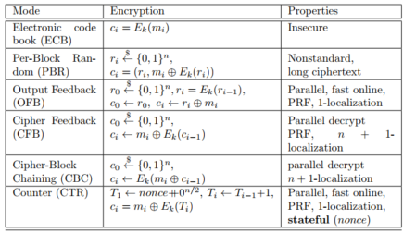
Encryption Modes of Operation
30

Slide 31



Block Cipher Modes of Operation
For encryption
Later: modes for message authentication
Assume plaintext is in blocks: m₀||m₁||…
Electronic Code Book mode (ECB): encryption c_{i}=E_{k}(m_{i}), decryption m_{i}=D_{k}(c_{i})
`Encrypt` E_{k}
`Decrypt` D_{k}
m_{i}
c_{i}
m_{i}
Which of these is ECB encryption? Why?

Slide 32
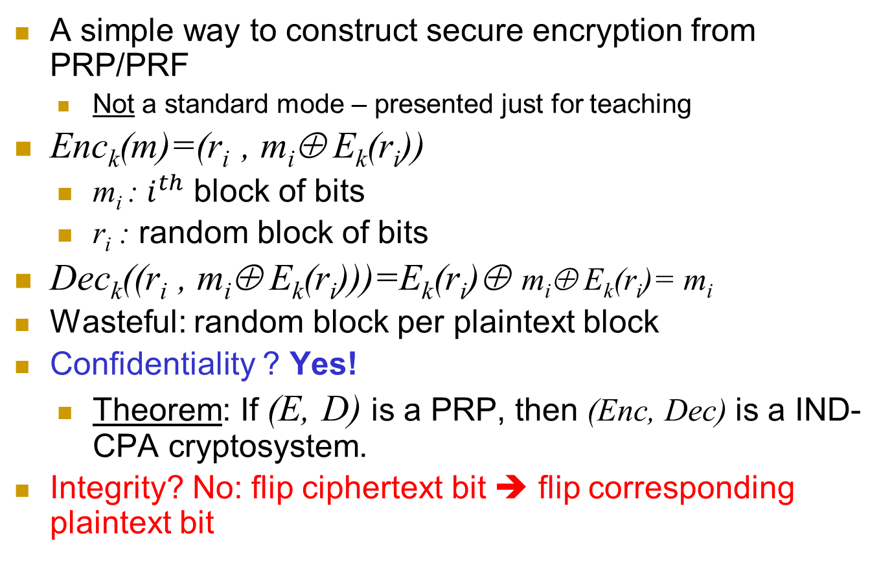
Per-Block Random (PBR) mode
A simple way to construct secure encryption from PRP/PRF
Not a standard mode – presented just for teaching
Enc_{k}(m)=(r_{i} , m_{i}⊕ E_{k}(r_{i}))
m_{i} : $i^{th}$ block of bits
r_{i} : random block of bits
Dec_{k}((r_{i} , m_{i}⊕ E_{k}(r_{i})))=E_{k}(r_{i})⊕ m_{i}⊕ E_{k}(r_{i})= m_{i}
Wasteful: random block per plaintext block
Confidentiality ? Yes!
Theorem: If (E, D) is a PRP, then (Enc, Dec) is a IND-CPA cryptosystem.
Integrity? No: flip ciphertext bit ➔ flip corresponding plaintext bit
32

Slide 33
Encryption Modes of Operation
We saw two...
ECB (insecure!): c_{i}=E_{k}(m_{i})
Per-Block Random (PBR): r_{i}←$, c_{i} = (r_{i} , m_{i}⊕ E_{k}(r_{i}))
We’ll see three more…
Output Feedback (OFB)
Cipher Feedback (CFB)
Cipher-block-chaining (CBC)
Others exist (for encryption – and other tasks)
All operate on blocks (e.g., 128 bits = 16 bytes)

Slide 34
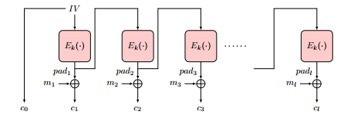
Output-Feedback (OFB) Mode
Goal: encrypt long (multi-block) messages, with less random bits
Generate and send less random bits – cf. to per-block random
How? Use random bits only for first block (`initialization vector’)
To encrypt next blocks of message, use output of previous block
Namely, a block-by-block stream cipher
Encryption: pad₀←IV, pad_{i} ← E_{k}(pad_{i-1} ), c₀ ← pad_{0,} c_{i} ← pad_{i}⊕ m_{i}
Decryption: ?
34

Slide 35
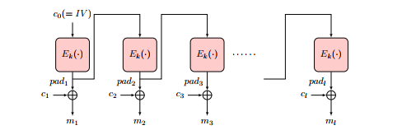
Output-Feedback (OFB) Mode
Goal: encrypt long (multi-block) messages, with less random bits
Generate and send less random bits – cf. to per-block random
How? Use random bits only for first block (`initialization vector’)
To encrypt next blocks of message, use output of previous block
Namely, a block-by-block stream cipher
Encryption: pad₀←IV, pad_{i} ← E_{k}(pad_{i-1} ), c₀ ← pad_{0,} c_{i} ← pad_{i}⊕ m_{i}
Decryption: pad₀ ← c_{0,} pad_{i} ← E_{k}(p_{i-1} ), m_{i} ← pad_{i}⊕ c_{i}
35

Slide 36
Output-Feedback (OFB) Mode
Encryption: pad₀←IV, pad_{i} ← E_{k}(pad_{i-1} ), c₀ ← pad_{0,} c_{i} ← pad_{i}⊕ m_{i}
Decryption: pad₀ ← c_{0,} pad_{i} ← E_{k}(p_{i-1} ), m_{i} ← pad_{i}⊕ c_{i}
Offline pad computation: compute pad in advance
Online computation: only (parallelizable) XOR !
Bit errors are bitwise localized (corrupt only one bit)
No integrity: Flip ciphertext bit ➔ flip corresponding decrypted plaintext bit
Can we protect integrity?
36

Slide 37
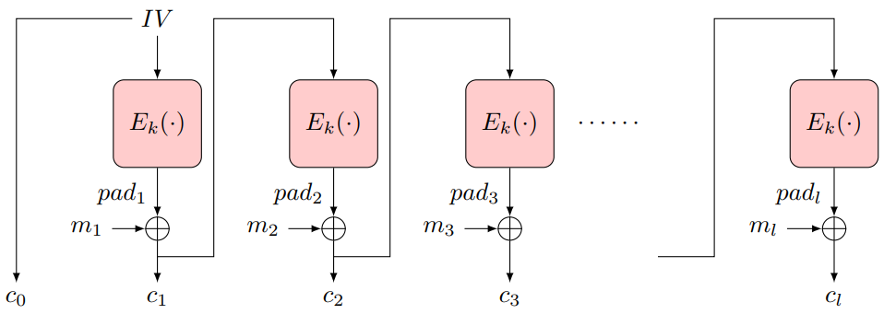
Cipher-Feedback Block (CFB) Encryption
Random first block c₀ (`initialization vector’, IV)
XOR ‘pad’ E_{k}(c₀) with plaintext to obtain: c₁ = m₁⊕ E_{k}(c₀)
Repeat: c_{i} = m_{i}⊕ E_{k}(c_{i-1})
37

Slide 38
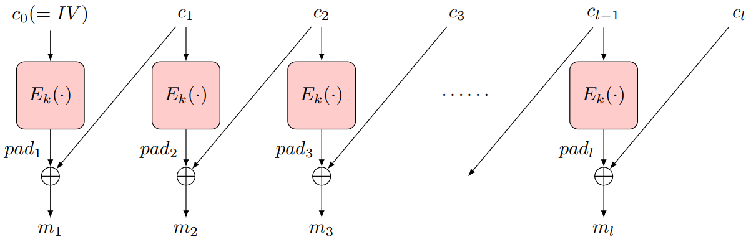
Cipher-Feedback Block (CFB) Encryption
Random first block c₀ (`initialization vector’, IV)
XOR ‘pad’ E_{k}(c₀) with plaintext to obtain: c₁ = m₁⊕ E_{k}(c₀)
Repeat: c_{i} = m_{i}⊕ E_{k}(c_{i-1})
CFB Encryption
CFB Decryption
38

Slide 39
Cipher-Feedback Block (CFB) Encryption
Random first block c₀ (`initialization vector’, IV)
XOR ‘pad’ E_{k}(c₀) with plaintext to obtain: c₁ = m₁⊕ E_{k}(c₀)
Repeat: c_{i} = m_{i}⊕ E_{k}(c_{i-1})
Ciphertext: c₀, c₁ = m₁⊕ E_{k}(c₀), … , c_{i} = m_{i}⊕ E_{k}(c_{i-1})
Can’t pre-compute `pad’ offline ☹
Decryption: c_{i}⊕ E_{k}(c_{i-1})= m_{i}⊕ E_{k}(c_{i-1}) ⊕ E_{k}(c_{i-1})= m_{i}
Parallelizable
Bit/block errors are 2-block localized (corrupt only 2 blocks)
Integrity? A bit…
Flip ciphertext bit ➔ flip corresponding decrypted plaintext bit
But also corrupt next plaintext block
Except for last block: no `next block’
Can we protect integrity (even) better?
39

Slide 40
Cipher Block Chaining (CBC) Mode
Random first block c₀ (`initialization vector’, IV)
i>0: c_{i} = E_{k}(c_{i-1} ⊕ m_{i})
Parallel decryption
But no offline precomputing
Integrity: flip bit in c[i] ➔ flip bit in m[i+1] … But also corrupt m[i]
May suffice to ensure integrity for many applications
But not all!
Split plaintext m to l bit blocks m[1],…
m[1] | m[2] | … | m[n]
IV
E
E
E
k
c[0] | c[1] | … | c[n]
Ciphertext c[0],c[1]…
Notes:
40
10/30/11

Slide 41
Security of CBC mode (2)
Thm: If block-cipher E is a (strong) pseudo-random permutation ➔CBC#E is IND-CPA-secure encryption
Proof: omitted (crypto course ☺ )
Observation: CBC is Not IND-CCA-Secure
CCA (Chosen ciphertext attack), intuitively: attacker can choose ciphertext and get its decryption, except for the `challenge ciphertext’
Definition, details: crypto course
Exercise: show CBC is Not IND-CCA-Secure
Feedback-CCA: practical variant of CCA
Just returns <ERROR, OK> for any ciphertext
Error – for incorrectly padded decryption (next)

Slide 42
Encryption: Final Words
Basic goal of cryptography
Focus: computationally-limited adversaries
Principles:
Kerckhoff’s: Known Design
Sufficient Key Space
Crypto Building Block: build schemes from simple, standard functions
Constructions & reductions: PRG→PRF→PRP→Enc
Secure system design: easy to use securely, hard to use incorrectly!

Slide 43
Encryption: Final Words...
Many variants…
One important example is Homomorphic encryption: E(m₁+m₂)=EncAdd(E(m₁),E(m₂))
Where EncAdd is an efficient algorithm
Fully-homomorphic : also E(m1*m2)=EncMult(E(m1), E(m2))
Very inefficient designs, huge keys… but lots of research!

Slide 44
Covered Material From the Textbook
Will be updated later.

Slide 45

Thank You!

