Slide 1
CSE 3400 / CSE 5850 Introduction to Cryptography and Cybersecurity / Introduction to Cybersecurity Lecture 4 Encryption – Part III (and Pseudo-randomness)
Ghada Almashaqbeh
UConn
Adapted from the textbook slides

Slide 2
Outline
Block ciphers.
Pseudorandom permutations (PRPs).
Defining security of encryption.
Encryption modes.
2

Slide 3
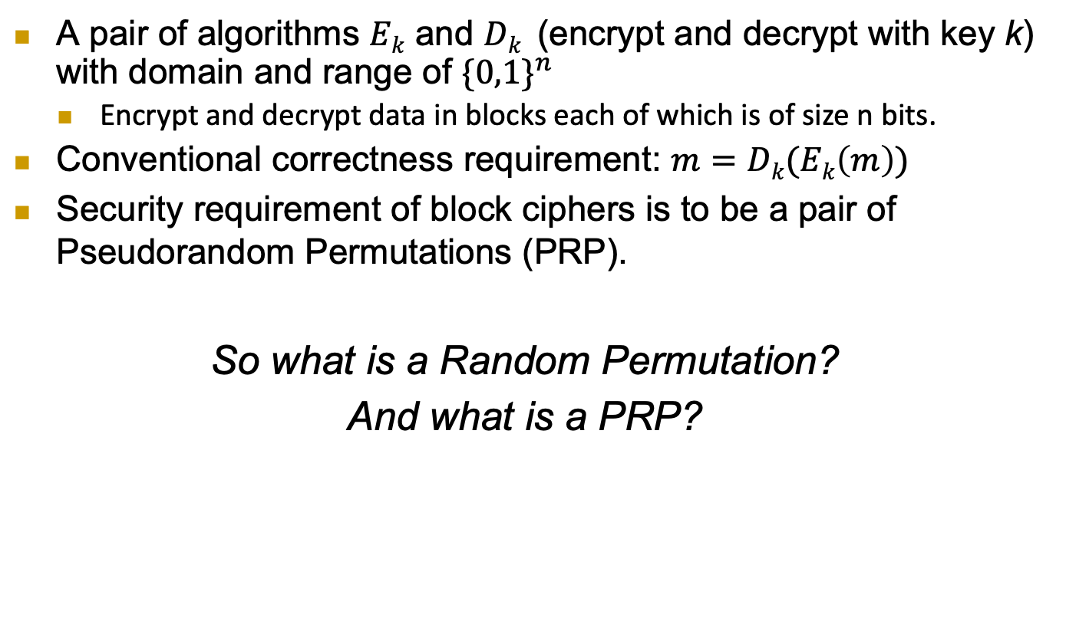
Block Ciphers
A pair of algorithms $Ek$ and $Dk$ (encrypt and decrypt with key k) with domain and range of ${\{0,1\}}^{n}$
Encrypt and decrypt data in blocks each of which is of size n bits.
Conventional correctness requirement: $m=Dk(Ek\left(m\right))$
Security requirement of block ciphers is to be a pair of Pseudorandom Permutations (PRP).
So what is a Random Permutation?
And what is a PRP?
3

Slide 4
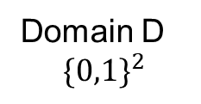
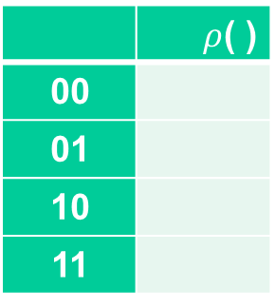
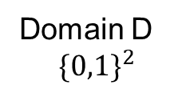
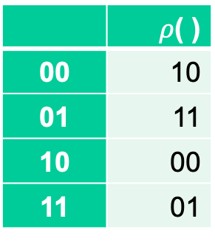
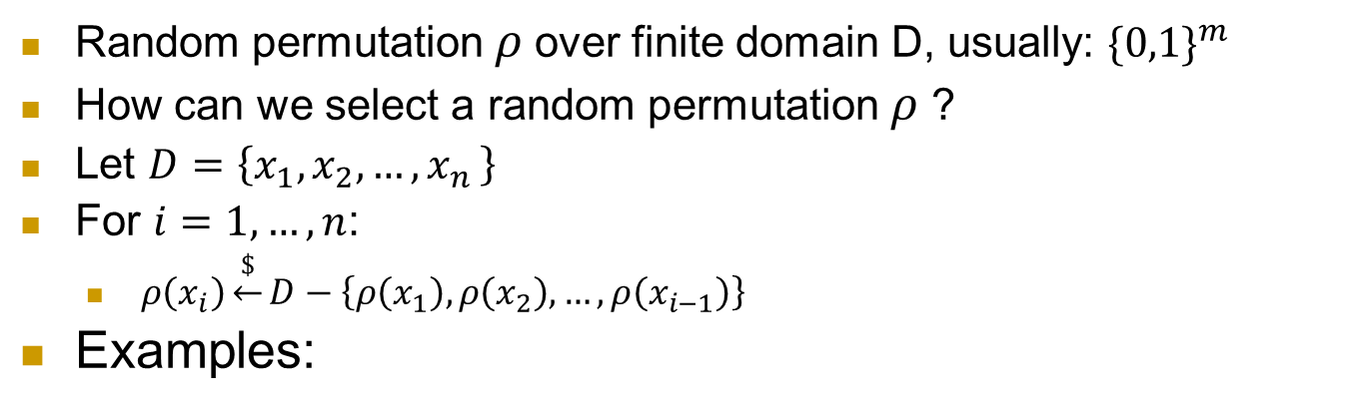
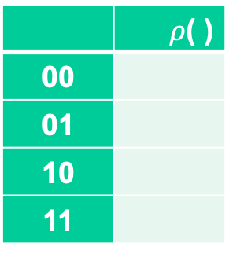

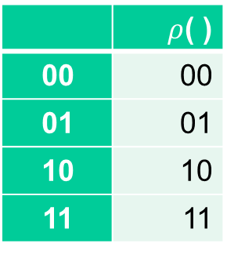
What is a random permutation $ρ$ ?
Random permutation $ρ$over finite domain D, usually: ${\{0,1\}}^{m}$
How can we select a random permutation $ρ$ ?
Let $D=\left\{x_{1},x_{2},…,x_{n }\right\}$
For $i=1,…, n$:
$ρ\left(x_{i}\right)\underset{←}{\$}D−\left\{ρ\left(x_{1}\right),ρ\left(x_{2}\right),…,ρ\left(x_{i−1}\right)\right\}$
Examples:
 | $ρ$( )
00
01
10
11
 | $ρ$( )
00 | 10
01 | 11
10 | 00
11 | 01
 | $ρ$( )
00
01
10
11
 | $ρ$( )
00 | 00
01 | 01
10 | 10
11 | 11
Domain D
$${\{0,1\}}^{2}$$
Domain D
$${\{0,1\}}^{2}$$
4

Slide 5


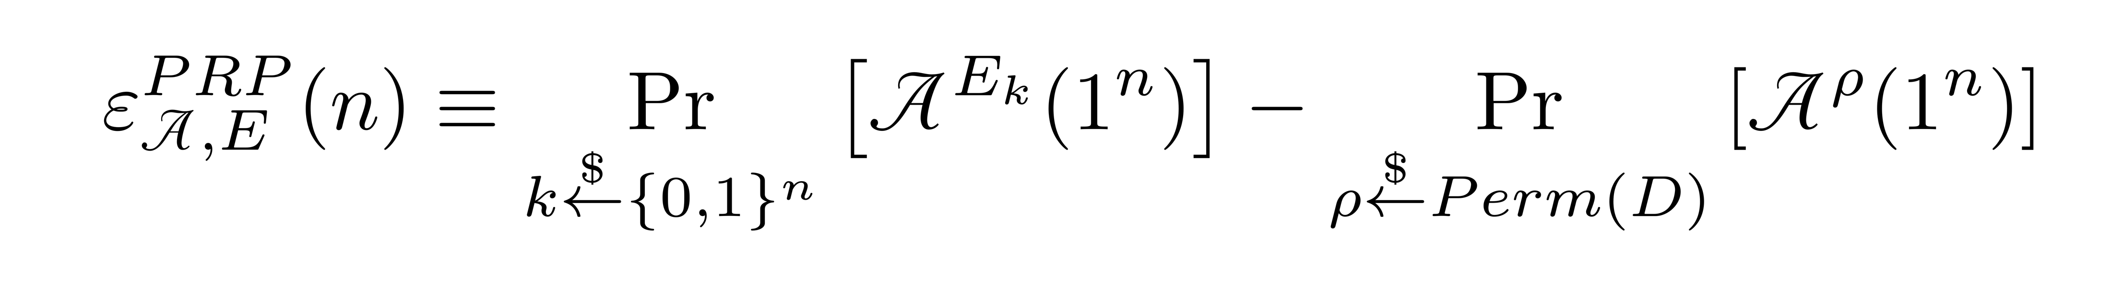
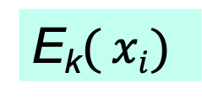
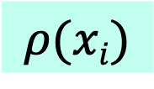
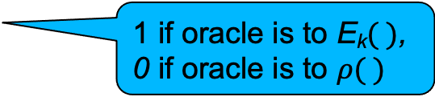


Pseudorandom Permutation (PRP) and their Indistinguishability Test
E is a PRP over domain D, if no distinguisher or attacker A can distinguish E from a random permutation with non-negligible probability.
So A’s advantage is negligible.
n-bit Key k
k
x₁,x₂,…,x_{i}
x₁,x₂,…,x_{i}
E_{k}$( xi)$
?
$$ρ(xi)$$
…, E_{k}(x_{i})
…, $ρ$(x_{i})
E_{k}$( )$
random permutation
1 if oracle is to E_{k}$( )$,
0 if oracle is to $ρ( )$
5

Slide 6
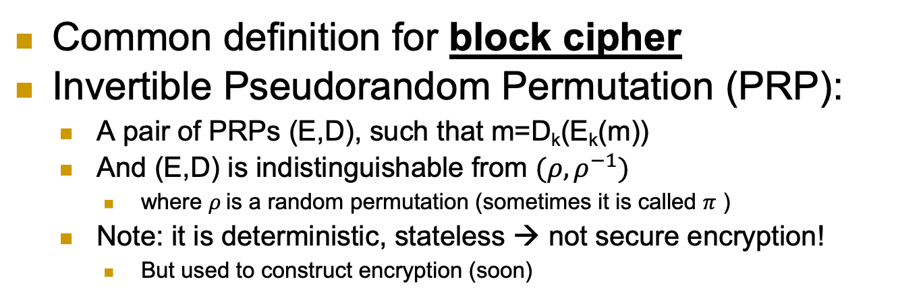

Block Cipher: Invertible PRP (E, D)
Common definition for block cipher
Invertible Pseudorandom Permutation (PRP):
A pair of PRPs (E,D), such that m=D_{k}(E_{k}(m))
And (E,D) is indistinguishable from $(ρ, ρ^{−1})$
where $ρ$is a random permutation (sometimes it is called $π$ )
Note: it is deterministic, stateless → not secure encryption!
But used to construct encryption (soon)
f← E_{k}( ) or D_{k}( ) [for random k]
or f← random n-bit permutation or its inverse
x
f(x)
Can’t tell if $\left(f,f^{−1}\right)$ is a random permutation + inverse, or it is (E, D) with a random key!
6

Slide 7
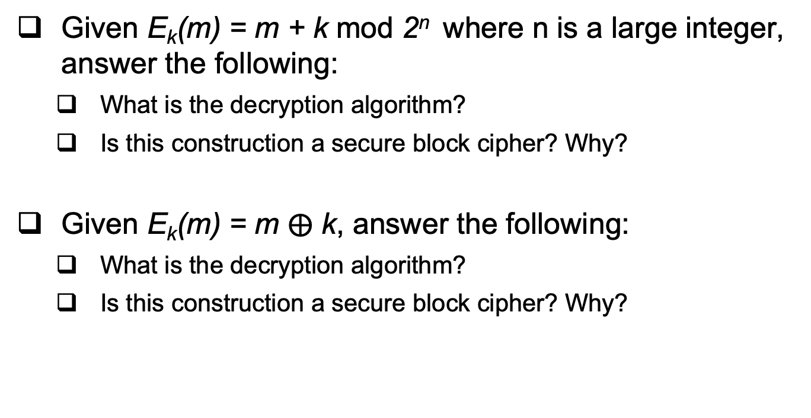
Examples
Given E_{k}(m) = m + k mod 2^{n} where n is a large integer, answer the following:
What is the decryption algorithm?
Is this construction a secure block cipher? Why?
Given E_{k}(m) = m $⨁$ k, answer the following:
What is the decryption algorithm?
Is this construction a secure block cipher? Why?
7

Slide 8
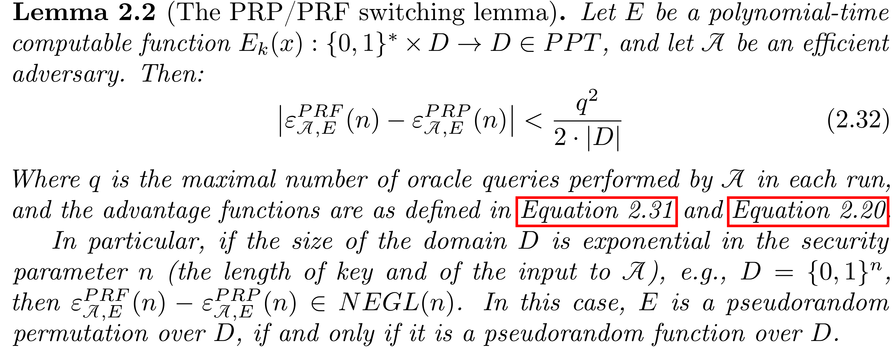


Constructing block-cipher, PRP
Focus: constructions from a PRF $f_{k}( )$
PRFs seem easier to design (less restrictions)
First: ‘plain’ PRP $E_{k}( )$ (not a block cipher)
What is the simplest construction to try?$E_{k}(x)$=______
$$f_{k}(x)$$
8

Slide 9
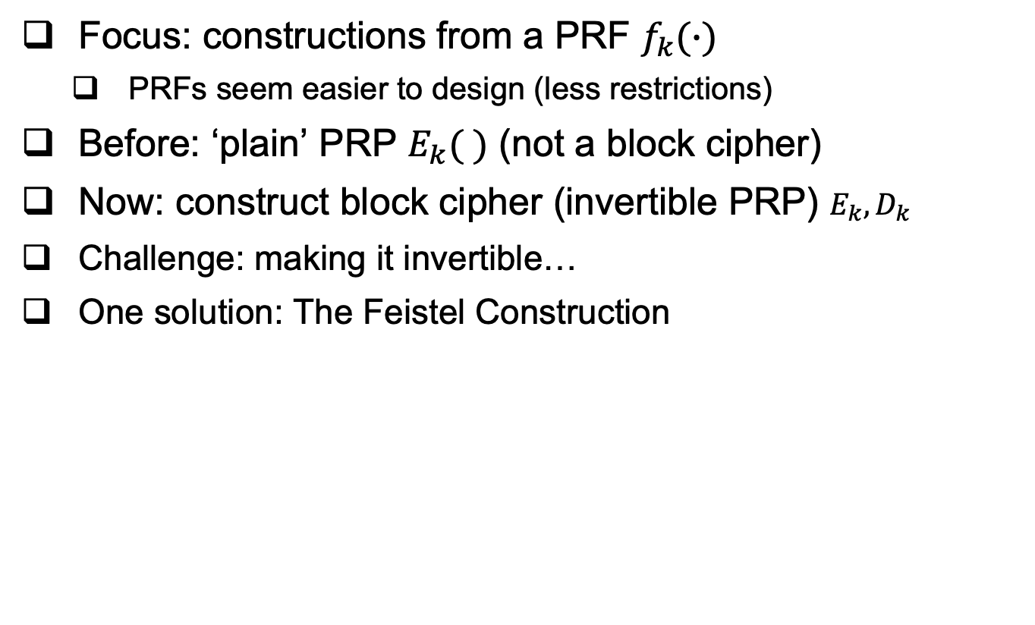
Constructing block cipher, PRP
Focus: constructions from a PRF $f_{k}(∙)$
PRFs seem easier to design (less restrictions)
Before: ‘plain’ PRP $E_{k}( )$ (not a block cipher)
Now: construct block cipher (invertible PRP) $E_{k}, D_{k}$
Challenge: making it invertible…
One solution: The Feistel Construction
9

Slide 10
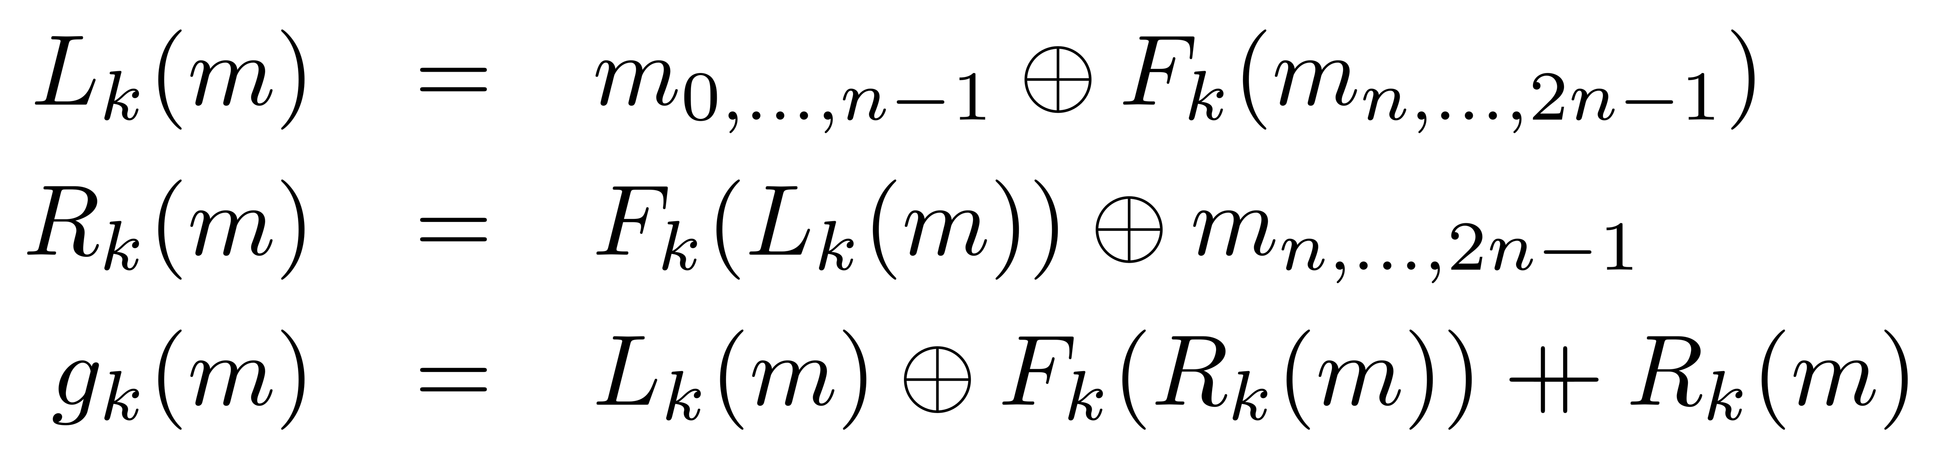





The Feistel Block-cipher Construction
Turn PRF F_{k} into a block cipher
Three ‘rounds’ suffice for security [LR88]
Used in DES (but not in AES)
With 16 ‘rounds’
(DES and AES are some encryption schemes used in practice, AES replaced DES. They do not have security proofs)
$$m_{0,…,n−1}$$
$$m_{n,…,2n−1}$$
+
F_{k}()
$$L_{k}\left(m\right)$$
F_{k}()
+
F_{k}()
$$R_{k}\left(m\right)$$
+
$$g_{k}\left(m\right)$$
10

Slide 11

Crypto Building Blocks Principle
Design and focus cryptanalysis efforts on few basic functions: simple, easy to test, replaceable
Construct schemes from basic functions
Provably secure constructions: attack on scheme ➔ attack on function
Allows replacing broken functions
Allows upgrading to more secure/efficient functions
E.g., encryption from block cipher (or PRG/PRF/PRP)
Block-cipher, PRG,PRF,PRP: deterministic, stateless, FIL (Fixed-Input-Length)
Encryption: randomized/stateful, VIL (Variable-Input-Length)
11
Notes:
Another advantage is that robust combiner for function usually gives robust combiner for scheme (and usually, it is simpler than direct combiner for scheme)

Slide 12
We defined security for PRG, PRF and PRP (Block cipher) too (informally). But… how about security of encryption??
A bit tricky, in fact.
12

Slide 13
Defining Secure Encryption
Attacker capabilities:
Computational limitations ➔ PPT
Ciphertext only (COA), Known / chosen plaintext attack (KPA/CPA), Chosen ciphertext (CCA)?
What’s a successful attack?
Key recovery ?
May be impossible yet weak cipher…
(Full) Message recovery?
What of partial exposure, e.g., m∈{“Advance”, “Retreat”}
Prudent: attacker ‘wins’ for any info on plaintext
13

Slide 14
Conservative Design Principle
When designing, evaluating a cryptosystem…
Consider most powerful attacker (COA< KPA< CPA < CCA)
Be as general as possible – cover many applications
And `easiest’ attacker-success criteria
Not full message/key recovery!
Make it easy to use securely, hard to use insecurely!
When designing, deploying a system (that uses some cryptographic primitives)
Restrict attacker’s capabilities (e.g., avoid known/chosen plaintext)
14

Slide 15
Cryptanalysis Success Criteria for Encryption
Learn anything at all about plaintext – how to define? Can we achieve it ?
Well-defined notion: ‘semantic security’ [crypto course]
So an encryption scheme is secure if the attacker cannot learn anything about the plaintext that he did not know in advance.
Indistinguishability: Eve ‘wins’ if she can distinguish between encryptions of (any) two messages
The attacker chooses these two messages.
We focus on indistinguishability for CPA attacker. In crypto course: equivalent to semantic security
15

Slide 16






IND-CPA-Encryption Test (1st try)
Flip coins to select random bit b and key k
A (adversary) gives message m, receives E_{k}(m)
Can ask for a polynomial number of encryptions (i.e., can make a polynomial number of encryption oracle queries over any message it wishes)
Chosen Plaintext Attack (CPA)
A gives two messages (m₀,m₁), receives c*=E_{k}(m_{b})
A output b* , and ‘wins’ if b*=b
$$n,b$$
$$m$$
$
A
k
$${\left\{0,1\right\}}^{n}$$
$$Ek(m )$$
E_{k}(.)
$$m0 , m1$$
c$∗ =Ek(mb)$
A wins if b*=b
b*
16

Slide 17






IND-CPA-Encryption Test (1st try): too easy
This test is too easy!! The adversary can easily win!!
How?
Hint: messages can be arbitrary binary strings
Namely, m, m₀ , m₁ ∈ {0,1}*
Solution: let m₀=0 , m₁=111111111111111111
If c*=E_{k}(m_{b}) is `short’, output b*=0; if ‘long’, output b*=1
$$n,b$$
$$m$$
$
A
k
$${\left\{0,1\right\}}^{n}$$
$$Ek(m )$$
E_{k}(.)
$$m0 , m1$$
c$∗ =Ek(mb)$
A wins if b*=b
b*

Slide 18






IND-CPA-Encryption Test (fixed)
Flip coins to select random bit b and key k
A (adversary) gives message m, receives E_{k}(m)
Chosen Plaintext Attack
A gives messages (m₀,m₁) s.t. |m₀|=|m₁| , receives E_{k}(m_{b})
A output b* , and ‘wins’ if b*=b
$$n,b$$
$$m$$
$
A
k
$${\left\{0,1\right\}}^{n}$$
$$Ek(m )$$
E_{k}(.)
$m0 , m1$s.t. $|m0|=|m1|$
c$∗ =Ek(mb)$
A wins if b*=b
b*

Slide 19
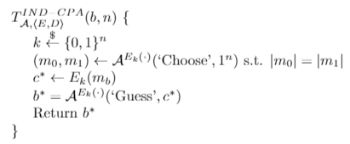
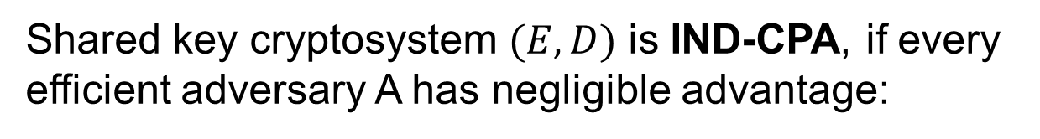
Definition: IND-CPA Encryption
Shared key cryptosystem $(E,D)$ is IND-CPA, if every efficient adversary A has negligible advantage:

Slide 20






Can IND-CPA encryption be deterministic?
No!! But why? Suppose E_{k}(m) is deterministic…
A can ask E_{k} to encrypt m₀ and m₁ and then check which one is equal to the challenge ciphertext → always wins!
Conclusion: IND-CPA Encryption must be randomized
Even if you encrypt the same m over and over again, a new ciphertext will be produced.
$$n,b$$
$$m$$
$
A
k
$${\left\{0,1\right\}}^{n}$$
$$Ek(m )$$
E_{k}(.)
$m0 , m1$s.t. $|m0|=|m1|$
c$∗ =Ek(mb)$
A wins if b*=b
b*

Slide 21
What’s next? Present a secure cryptosystem? … provably secure without assumptions ? Unlikely: Proof of security ➔ P ≠ NP (similar argument to PRF) Instead, let’s build secure encryption from PRFs ! (I.e.: PRF is secure ➔ encryption is IND-CPA) Actually, we’ll use block cipher (recall the PRF/PRP switching lemma) to build encryption schemes under what is called “Modes of operation.”
21

Slide 22
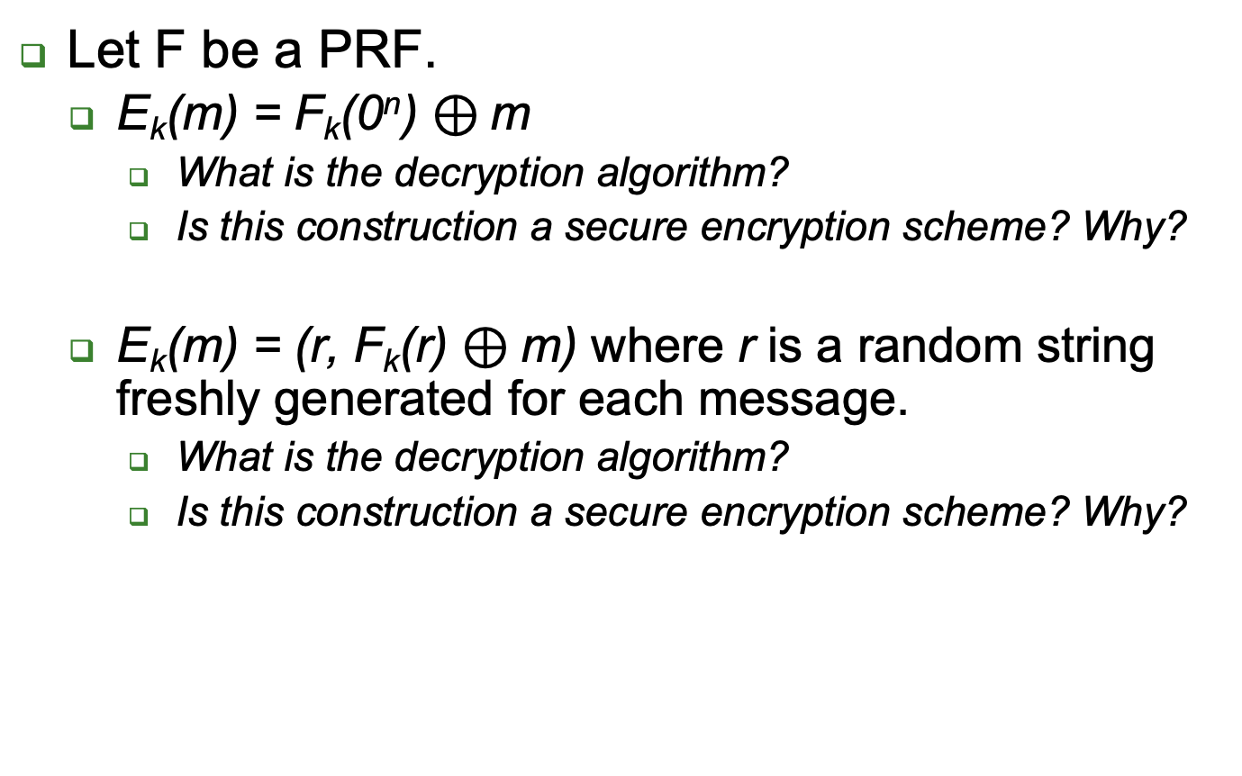
Examples
Let F be a PRF.
E_{k}(m) = F_{k}(0^{n}) $⊕$m
What is the decryption algorithm?
Is this construction a secure encryption scheme? Why?
E_{k}(m) = (r, F_{k}(r) $⊕$m) where r is a random string freshly generated for each message.
What is the decryption algorithm?
Is this construction a secure encryption scheme? Why?
22

Slide 23
Encryption: Modes of Operation
`Modes of operation’: use block cipher (PRP), to encrypt long (Variable Input Length, VIL) messages
Randomize/add state for security
Often: use random or stateful Initialization Vector (IV)
Use long keys
Better security (at least against exhaustive search)
Assume plaintext message is in blocks: m₀||m₁||…
An integer number of blocks, each block is n bits.

Slide 24
Encryption Modes of Operation
24

Slide 25
Electronic Code Book mode (ECB) I
Encryption c_{i}=E_{k}(m_{i}), decryption m_{i}=D_{k}(c_{i})
Each message m is composed of l blocks, m₁ … m_{l}, and each m_{i} is n bit block , and same for c and c_{i}

Slide 26



Electronic Code Book mode (ECB) II
Encryption c_{i}=E_{k}(m_{i}), decryption m_{i}=D_{k}(c_{i})
Insecure!! (do not use it!) Which of these is ECB encryption? Why?

Slide 27
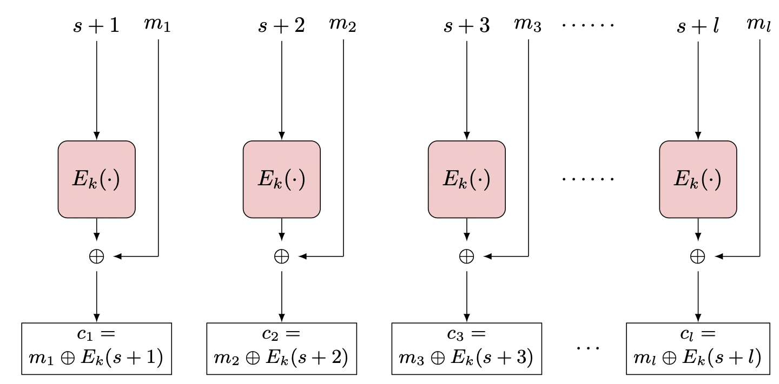
Counter (CTR) Mode
Random counter (or `initialization vector’, IV, or s)
i>0: c_{i} = E_{k}(s+ i) ⊕ m_{i}
m_{i} = E_{k}(s + i) ⊕ c_{i}
Parallel encryption and decryption with offline precomputing
How to decrypt?
If a PRF is used as the PRP (or E_{k}), then it is CPA (provably secure).
Error propagation:
flip bit in c_{i} ➔ flip bit in m_{i}
Notes:
27
10/30/11

Slide 28
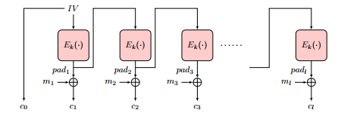
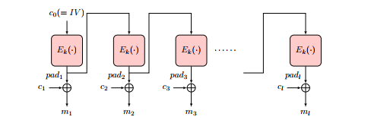
Output-Feedback (OFB) Mode
Goal: encrypt long (multi-block) messages, with less random bits
How? Use random bits only for first block (`initialization vector’)
To encrypt next blocks of message, use output of previous block
Namely, a block-by-block stream cipher
Encryption: pad₀←IV, pad_{i} ← E_{k}(pad_{i-1} ), c₀ ← pad_{0,} c_{i} ← pad_{i}⊕ m_{i}
Decryption: pad₀ ← c_{0,} pad_{i} ← E_{k}(p_{i-1} ), m_{i} ← pad_{i}⊕ c_{i}
28

Slide 29
Output-Feedback (OFB) Mode
Offline pad computation: compute pad in advance
Online computation: only (parallelizable) XOR !
Bit errors are bitwise localized
Corrupting a one bit in the ciphertext corrupts only one bit in the plaintext.
29

Slide 30
Cipher Block Chaining (CBC) Mode
Random first block c₀ (`initialization vector’, IV)
i>0: c_{i} = E_{k}(c_{i-1} ⊕ m_{i}), m_{i} = c_{i-1} ⊕ D_{k}(c_{i})
Parallel decryption
But no offline precomputing
How about encryption? Sequential (it is a chain!)
Error propagation:
flip bit in c_{i} ➔ flip bit in m_{i+1} and corrupt m_{i}
Notes:
30
10/30/11

Slide 31
Security of CBC mode
Theorem: If block-cipher E is a (strong) pseudo-random permutation ➔CBC is IND-CPA-secure encryption
Proof: omitted (crypto course ☺ )
Observation: CBC is Not IND-CCA-Secure
CCA (Chosen ciphertext attack), intuitively: attacker can choose ciphertext and get its decryption, except for the `challenge ciphertext’
Definition, details: crypto course
Exercise: show CBC is Not IND-CCA-Secure
Other variants of CBC exists that are CCA secure.

Slide 32
Covered Material From the Textbook
Sections 2.8, 2.9, and 2.10 excluding:
2.9.6
2.10.4
2.10.7
2.10.8
2.10.10
CCA security

Slide 33

Thank You!

