Slide 1
CSE 3400 - Introduction to Computer & Network Security (aka: Introduction to Cybersecurity) Lecture 5 Message Authentication Codes
Ghada Almashaqbeh
UConn
From Textbook Slides by Prof. Amir Herzberg
UConn

Slide 2
Outline
Motivation.
Message authentication codes (MACs) definition.
MAC security definition.
MAC constructions.
Combining message authentication and encryption.
2

Slide 3



Encryption Ensures Confidentiality
k
k
m=“Hello”
E
D
m
c=E_{k}(m)
c
Man-in-the-Middle attacker ‘learns nothing’ about message
Notes:
3
10/30/11

Slide 4
Integrity and Authentication?
k
k
m=“Hello”
E
D
c=E_{k}(m)
c'
m‘=D_{k}(c’)
m’=“Bye”
How can the recipient know that the message was not tampered with and it is the original one sent by the sender?
Notes:
4
10/30/11

Slide 5
Does Encryption Prevent Forgery?
Cannot be guaranteed.
Several secure encryption schemes are malleable (an attacker might be able to alter the ciphertext, and hence, the decrypted plaintext will be different).
Clearly not for bitwise stream ciphers (& OTP).
Given c=m⊕k, attacker can send c⊕mask, to invert any bit in decrypted message.
Example, send “Pay Bob $100” encrypted using OTP.
Eve can change it to “Pay Eve $100” (note that this is a KPA attacker). How?
Take the ciphertext of the letter “B” above, denote it as c[4].
Note that c[4] = k[4] ⊕ “B” (note that we do know the key!)
Compute a mask that does the following: c[4] ⊕ mask = k[4] ⊕ “E” (this boils down to computing “B” ⊕ mask = “E” )
Repeat that for the rest of the letters.

Slide 6
Message Authentication Codes (MACs)
A MAC allows a recipient to validate that a message was not tampered with and that it was sent by a key holder
Valid MAC ➔ Only Sponge and I know k. So he sent m.
It is a symmetric key setup!
m=“Hi”, MAC_{k}(m)
Key k
Key k
Notes:
6
(c) Amir Herzberg, http://AmirHerzberg.com, Bar Ilan University
11/13/11

Slide 7
Message Authentication Codes (MACs)
Use shared key k to authenticate messages
Pair (tag , m) is valid iff tag=MAC_{k}(m)
Very efficient
Does not support non-repudiation!
Sponge may say that the key k has
been stolen, and so someone else sent
the message.
k = ??
MAC
(
) = ??
k
“Bye”
“Hi”
“Bye”
+
+
MAC
(“Hi”)
tag ??
k
Alice
Key
k
Key
k
Notes:
7
(c) Amir Herzberg, http://AmirHerzberg.com, Bar Ilan University
11/13/11
Message sent together with Tag=MAC_{k}(m)
Received message, tag are valid iff Tag=MAC_{k}(m)
Efficient (often even more than shared-key encryption)
But: Alice can later deny having sent m to Bob (why?)

Slide 8
Defining MAC Security
Following the `conservative design principle’:
Consider most powerful attacker
Let attacker receive tag for any message it wants (so it has an oracle access to MAC_{k}).
And `easiest’ attacker-success criteria
Attacker wins if it can produce a valid tag for any message
Except for these that the attacker asked to authenticate
Notes:
8
(c) Amir Herzberg, http://AmirHerzberg.com, Bar Ilan University
11/13/11
Message sent together with Tag=MAC_{k}(m)
Received message, tag are valid iff Tag=MAC_{k}(m)
Efficient (often even more than shared-key encryption)
But: Alice can later deny having sent m to Bob (why?)

Slide 9
MAC Security Definition
Notes:
9
(c) Amir Herzberg, http://AmirHerzberg.com, Bar Ilan University
11/13/11
Message sent together with Tag=MAC_{k}(m)
Received message, tag are valid iff Tag=MAC_{k}(m)
Efficient (often even more than shared-key encryption)
But: Alice can later deny having sent m to Bob (why?)

Slide 10

On the Use of MACs
MAC_{k}(m) may expose information about m!
Example: Let MAC be any secure MAC. Define MAC’_{k}(m)=MAC_{k}(m)||Lsb(m), where Lsb is least significant bit.
MAC shows a key-holder computed it
Could be any key holder (even recipient)…
Replay attacks: an old message (and its tag) is being resent.
Need to Ensure freshness (more about this later).
Cat, Sponge (or I) sent m.
m=“Hi”, MAC_{k}(m)
Key k
Key k
Key k
Notes:
10
(c) Amir Herzberg, http://AmirHerzberg.com, Bar Ilan University
11/13/11

Slide 11
Constructing MAC: Three Approaches
Design `from scratch`, validate security by failure to cryptanalyze
Huge effort, risk → do only for few `building blocks`
Maybe from EDC (Error Detection Code), but it is not secure for every EDC.
Robust combiner of (two) MAC candidates:
MAC_{k,k’}(m)=f_{k}(m)||f’_{k’}(m), MAC_{k,k’}(m)=f_{k}(m)⊕f’_{k’}(m) are secure MAC, if either f or f’ is a secure MAC.
Provable-secure constructions from:
PRF/PRP/Block ciphers (next)
First: PRF/PRP → Fixed-Input-Length (FIL) MAC
Hash functions (later) – even more efficient.
Notes:
11
(c) Amir Herzberg, http://AmirHerzberg.com, Bar Ilan University
11/13/11

Slide 12
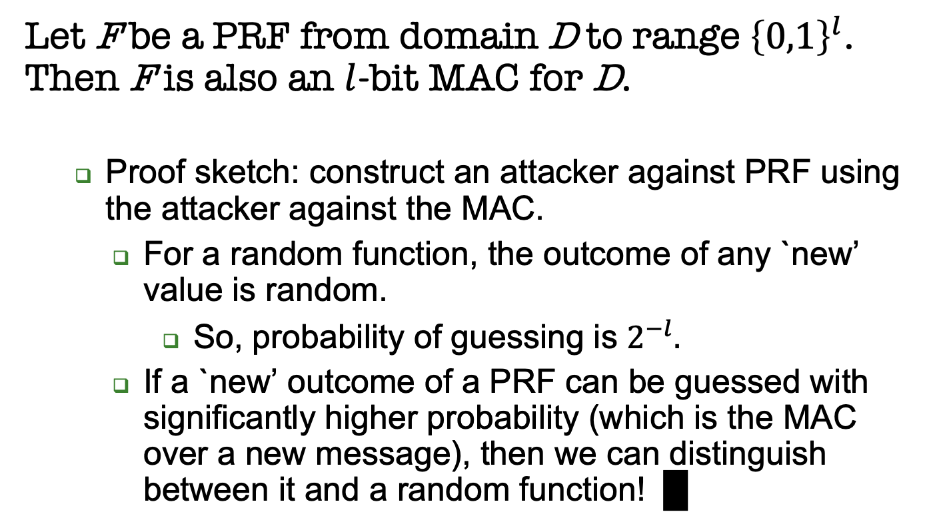
Theorem: every PRF is also a MAC
Let F be a PRF from domain D to range ${\left\{0,1\right\}}^{l}$. Then F is also an $l$-bit MAC for D.
Proof sketch: construct an attacker against PRF using the attacker against the MAC.
For a random function, the outcome of any `new’ value is random.
So, probability of guessing is $2^{−l}.$
If a `new’ outcome of a PRF can be guessed with significantly higher probability (which is the MAC over a new message), then we can distinguish between it and a random function! █
Notes:
12
(c) Amir Herzberg, http://AmirHerzberg.com, Bar Ilan University
11/13/11

Slide 13
Every PRF is also a MAC
A PRF is a MAC for l-bit messages.
(l.n)-bit FIL MAC from n-bit PRP (block cipher): use CBC-MAC – a variant of CBC
What standard crypto function can we use as a PRF?
A block cipher ? But …
Notes:
13
(c) Amir Herzberg, http://AmirHerzberg.com, Bar Ilan University
11/13/11

Slide 14
Using a Block Cipher for MAC
Problem 1: block cipher is PRP, not PRF
Solution: the switching lemma says that a PRP is also a PRF !
Note: PRP→PRF reduction involves loss in concrete security (larger advantage):
Some other constructions reduce this loss but we will not discuss them
Notes:
14
(c) Amir Herzberg, http://AmirHerzberg.com, Bar Ilan University
11/13/11

Slide 15
Using a Block Cipher for MAC
Problem 2: block ciphers are defined only for (short) fixed input length (FIL)
Ideally a MAC should work for any input string (Variable Input Length – VIL)
We already had a similar problem… where?
Block ciphers.
We solved by using various encryption modes of operation.
A solution for MACs: the CBC-MAC mode of operation!
Notes:
15
(c) Amir Herzberg, http://AmirHerzberg.com, Bar Ilan University
11/13/11

Slide 16
Cipher Block Chaining MAC: CBC-MAC
Split plaintext m into blocks
Fixed, known (zero)
Initialization Vector (IV)
The tag is the cipher of the last block
CBC-MACE_{k}(m₁||m₂||..||m_{l} ) = E_{k}(m_{l}⊕E_{k}(…E_{k}(m₁))))
Recall: MACs are deterministic functions
Notes:
16
(c) Amir Herzberg, http://AmirHerzberg.com, Bar Ilan University
11/13/11
Parallel mode – see [BR02]

Slide 17
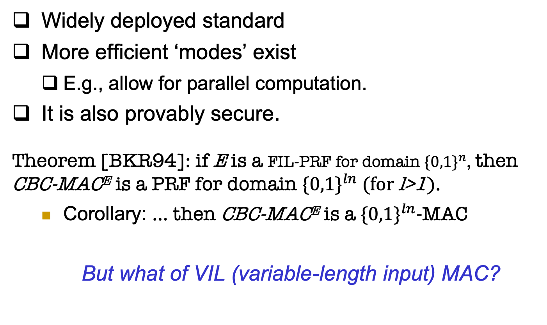
CBC-MAC
Widely deployed standard
More efficient ‘modes’ exist
E.g., allow for parallel computation.
It is also provably secure.
Theorem [BKR94]: if E is a FIL-PRF for domain ${\{0,1\}}^{n}$, then CBC-MACE is a PRF for domain ${\{0,1\}}^{ln} (for \text{l}\text{>1}$).
Corollary: … then CBC-MACE is a ${\{0,1\}}^{ln}$-MAC
But what of VIL (variable-length input) MAC?
Notes:
17
(c) Amir Herzberg, http://AmirHerzberg.com, Bar Ilan University
11/13/11
Corollary follows from `FIL-PRF is FIL-MAC` theorem

Slide 18
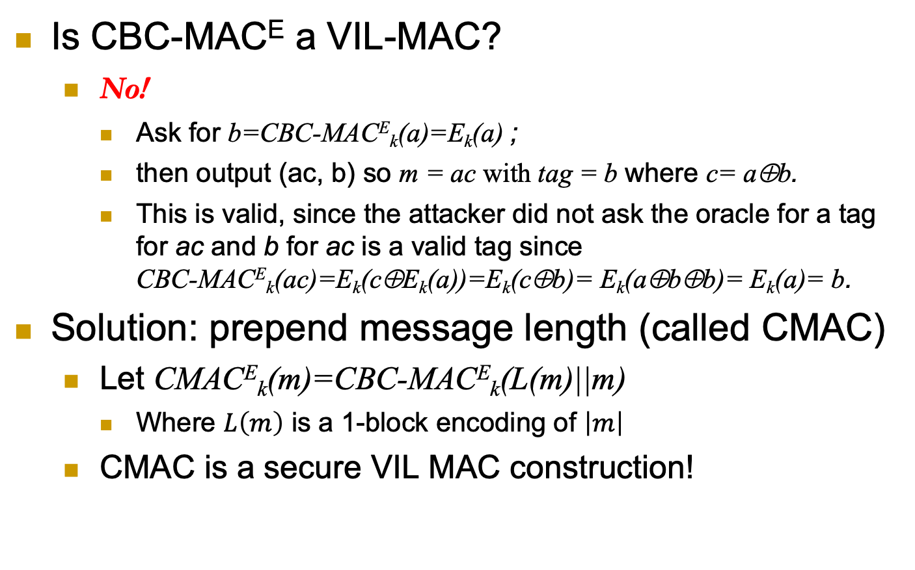
CBC-MAC-based VIL-MAC
Is CBC-MACE a VIL-MAC?
No!
Ask for b=CBC-MACE_{k}(a)=E_{k}(a) ;
then output (ac, b) so m = ac with tag = b where c= a⊕b.
This is valid, since the attacker did not ask the oracle for a tag for ac and b for ac is a valid tag since CBC-MACE_{k}(ac)=E_{k}(c⊕E_{k}(a))=E_{k}(c⊕b)= E_{k}(a⊕b⊕b)= E_{k}(a)= b.
Solution: prepend message length (called CMAC)
Let CMACE_{k}(m)=CBC-MACE_{k}(L(m)||m)
Where $L\left(m\right)$ is a 1-block encoding of $\left|m\right|$
CMAC is a secure VIL MAC construction!
Notes:
18
(c) Amir Herzberg, http://AmirHerzberg.com, Bar Ilan University
11/13/11
KR

Slide 19
Examples of MAC Constructions
Are the following constructions a secure MAC:
Let E_{k} be a block cipher that takes input of length n bits. For a message m of length 2n bits, compute the tag as:
MAC_{k}(m) = E_{k}(m_{L}) xor E_{k}(m_{R})
Let G be a secure PRG. For a message m of length n bits, compute the tag as:
MAC_{k}(m) = k xor PRG(m)

Slide 21
Combining Authentication and Encryption
For confidentiality, use encryption
For authentication, use MAC
For both confidentiality and authentication?
Option 1: Combine MAC and encryption
Possible pitfalls (vulnerabilities)
Option 2: authenticated-encryption schemes (or modes)
Easier to deploy (securely)
Generic combination of MAC and Encryption schemes
Or direct combined constructions (can be more efficient)
Might be ad-hoc or rely on complex or less-tested security assumptions.
Notes:
21
(c) Amir Herzberg, http://AmirHerzberg.com, Bar Ilan University
11/13/11

Slide 22
Generic MAC and Encryption Combinations
Three standards, three ways…
Authenticate and encrypt (A&E):
c = Enc(m), tag = MAC(m), send (c, tag)
Authenticate then encrypt (AtE):
tag = MAC(m), c = Enc(m, tag), send c
Encrypt then authenticate (EtA):
c = Enc(m), tag = MAC(c), send (c, tag)
Some of these may be vulnerable even when combining some secure encryption and MAC schemes!
Notes:
22
(c) Amir Herzberg, http://AmirHerzberg.com, Bar Ilan University
11/13/11

Slide 23
Security of Generic MAC/Enc Combinations
A&E may be vulnerable!
Example:
Let MAC be any secure MAC scheme
Let MAC’_{k’}(m)=MAC_{k’}(m)|| lsb(m)
MAC’ is a secure MAC.
But A&E(m) leaks least significant bit of m (even if the encryption scheme is secure!!!).
Recall that the security guarantee of a MAC is about integrity (or preventing forgery)!
It has nothing to do with confidentiality!
What about AtE, EtA ?
AtE: also may be vulnerable (not IND-CPA)!
Notes:
23
(c) Amir Herzberg, http://AmirHerzberg.com, Bar Ilan University
11/13/11

Slide 24
Security of Generic MAC/Enc Combinations
How about EtA ? Provably CCA-Secure [CK01]!
➔ Secure encryption; otherwise attack Enc(m) by appending MAC
➔ Secure authentication, since any change in (c, MAC(c)) is detected
Also: reject fake messages w/o decryption ➔ efficiency and foil Denial of Service (DoS), CCA attacks
Note: using separate keys for Enc and MAC; what if we use same key?
Notes:
24
(c) Amir Herzberg, http://AmirHerzberg.com, Bar Ilan University
11/13/11

Slide 25
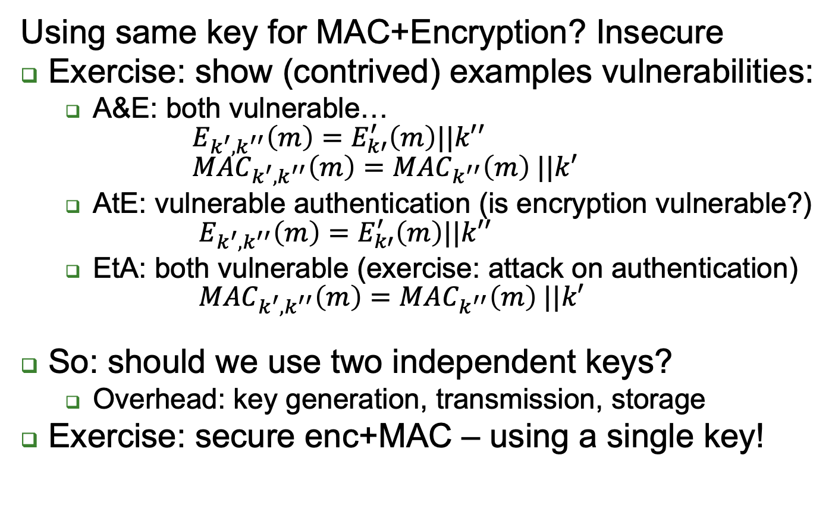
Keys for MAC and Encryption?
Using same key for MAC+Encryption? Insecure
Exercise: show (contrived) examples vulnerabilities:
A&E: both vulnerable… $E_{k^{′},k^{′′}}\left(m\right)=E_{k′}^{′}\left(m\right)||k′′$ ${MAC}_{k^{′},k^{′′}}\left(m\right)={MAC}_{k^{′′}}\left(m\right) ||k′$
AtE: vulnerable authentication (is encryption vulnerable?) $E_{k^{′},k^{′′}}\left(m\right)=E_{k′}^{′}\left(m\right)||k′′$
EtA: both vulnerable (exercise: attack on authentication) ${MAC}_{k^{′},k^{′′}}\left(m\right)={MAC}_{k^{′′}}\left(m\right) ||k′$
So: should we use two independent keys?
Overhead: key generation, transmission, storage
Exercise: secure enc+MAC – using a single key!
Solution: k_{mac}:= PRF_{k}(`MAC’), k_{enc}:= PRF_{k}(‘Encrypt’)
Notes:
25
(c) Amir Herzberg, http://AmirHerzberg.com, Bar Ilan University
11/13/11
Attack on auth using EtA, works also for different keys: Forge: Let E’_{k}(m)=E_{k}(m)||MAC_{k}(m+1)

Slide 26
Covered Material From the Textbook
Chapter 4
Sections 4.1 – 4.6 except sections 4.6.1, 4.6.3.
For section 4.7: only the topics that we covered in class.

Slide 27

Thank You!

