Slide 1
CSE 3400/CSE 5850 - Introduction to Cryptography and Cybersecurity/ Introduction to Cybersecurity Lecture 2 Encryption – Part I
Ghada Almashaqbeh
UConn
Adapted from the textbook slides

Slide 2
Outline
Introduction and motivation.
Ancient ciphers.
Kerckhoffs' Principle.
Encryption attacker models.

Slide 3



Encryption
Prevention of exposure of secret information
Earliest and `basic’ tool of cryptology
Related terms:
Cryptography: `secret writing’
Cryptanalysis: `breaking’ encryption
Encryption scheme = Cryptosystem = Cipher
Encrypt
Decrypt

Slide 4
The Encryption World: basic terms
Goal: encrypt plaintext into ciphertext
Only legit-recipient can decrypt ciphertext to plaintext
Adversary cannot learn anything from ciphertext
Variants of encryption schemes:
Keyed or unkeyed?
Shared key (symmetric) or public/private keys (asymmetric)?
Stateful / stateless ? Randomized ? Input size ?
key
key
plaintext
ciphertext
plaintext
Encrypt
Decrypt
Notes:
4
10/30/11
Asymmetric = public key

Slide 5
Symmetric Encryption Scheme
Key k
Plaintext
m
Encrypt E
Ciphertext c=E_{k}(m)
This is a stateless encryption, stateful will additionally have state as input and updated state as output.
Key k
Ciphertext c
Decrypt D
Plaintext m=D_{k}(c)
Key k
Key k
Plaintext
m
Encrypt E
Ciphertext c=E_{k}(m)
Decrypt D
Plaintext D_{k}(c)
Correctness: m=D_{k}(E_{k}(m))

Slide 6
Ancient, Keyless Ciphers
Ancient ciphers were simple, naive
No key: secrecy is in the algorithm
Monoalphabetic ciphers: encrypt/decrypt one character at a time
Plaintext, ciphertext are both single letters
A set {<E,D>} of permutation + inverse: m=D(E(m))

Slide 7
Az-By Cipher
Az-By Cipher
Substitute the first letter of alphabet by the last… and so on:
Mathematically: Let A be 0, B be 1, …, Z be 25. Let m denote plaintext and c denote ciphertext.
c = Enc(m) = 25 – m
m = Dec(c) = 25 - c
Plaintext:
A | B | C | . | . | . | . | X | Y | Z
Ciphertext:
Z | Y | X | . | . | . | . | C | B | A

Slide 8
(Unkeyed) Caesar Cipher
Used by Julius Caesar
Rotate the 26 letters of the alphabet by 3:
A B C D E F G H I J K L M N O P Q …
A B C D E F G H I J K L M N O P Q …
As formula:
c = E(m) = m+3 (mod 26)
m = D(c) = c-3 (mod 26)
Ceasar and AzBy are trivial to cryptanalyze
No key – algorithm itself is `secret`
‘Security by obscurity’
+3

Slide 9
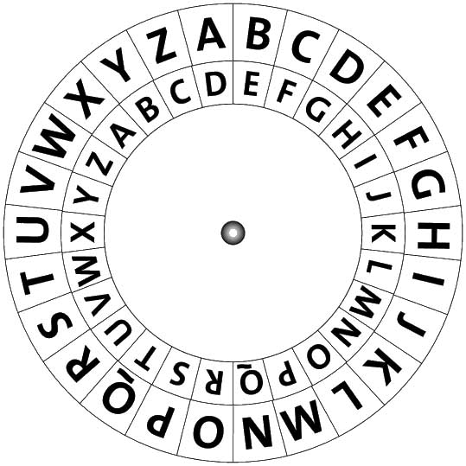
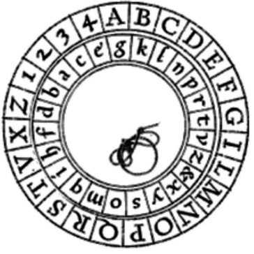
Monoalphabetic Substitution Ciphers
Generalize Caesar and Az-By:
Other permutations of letters
To letters or to other symbols (no real difference)
Keyed: Given key k, cipher E_{k} is a permutation
Or: the ‘key’ is simply the permutation (table)
Classical, `elementary school’ cryptosystem
Examples:
Vulnerable to letter-frequency cryptanalysis

Slide 10
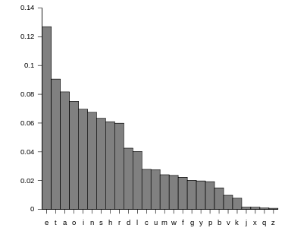
Letter frequencies (in English)
Other useful statistic:
Bigrams, Trigrams…
First/Last letter in words, sentences
Etc…

Slide 11
Example: Frequency Cryptanalysis
Given ciphertext:
UZQSOVUOHXMOPVGPOZPEVSGZWSZOPFPESXUDBMETSXAIZ
VUEPHZHMDZSHZOWSFPAPPDTSVPQUZWYMXUZUHSX
EPYEPOPDZSZUFPOMBZWPFUPZHMDJUDTMOHMQ
Count relative letter frequencies:
A | B | C | D | E | F | G | H | I | J | K | L | M
2 | 2 | 0 | 6 | 6 | 4 | 2 | 7 | 1 | 1 | 0 | 0 | 8
N | O | P | Q | R | S | T | U | V | W | X | Y | Z
0 | 9 | 16 | 3 | 0 | 10 | 3 | 10 | 5 | 4 | 5 | 2 | 14

Slide 12
Example: Frequency Cryptanalysis
Given ciphertext:
UZQSOVUOHXMOPVGPOZPEVSGZWSZOPFPESXUDBMETSXAIZ
VUEPHZHMDZSHZOWSFPAPPDTSVPQUZWYMXUZUHSX
EPYEPOPDZSZUFPOMBZWPFUPZHMDJUDTMOHMQ
Sorted:
P | Z | S | U | O | M | H | D | E | V | X | F | W
16 | 14 | 10 | 10 | 9 | 8 | 7 | 6 | 6 | 5 | 5 | 4 | 4
e | t
Q | T | A | B | G | Y | I | J | C | K | L | N | R
3 | 3 | 2 | 2 | 2 | 2 | 1 | 1 | 0 | 0 | 0 | 0 | 0
Most frequent letter is e, so: P=E(e)
Second frequent is t, so: Z=E(t) … let’s replace…

Slide 13
Example: Frequency Cryptanalysis
Given ciphertext:
UtQSOVUOHXMOeVGeOteEVSGtWStOeFeESXUDBMETSXAIt
VUEeHtHMDtSHtOWSFeAeeDTSVeQUtWYMXUtUHSX
EeYEeOeDtStUFeOMBtWeFUetHMDJUDTMOHMQ
Sorted:
P | Z | S | U | O | M | H | D | E | V | X | F | W
16 | 14 | 10 | 10 | 9 | 8 | 7 | 6 | 6 | 5 | 5 | 4 | 4
e | t
Q | T | A | B | G | Y | I | J | C | K | L | N | R
3 | 3 | 2 | 2 | 2 | 2 | 1 | 1 | 0 | 0 | 0 | 0 | 0
In English texts, `t` is often followed by `h`. Count chars following Z (t):
Twice: W, H, U and O; once: Q, V, D & S.
Pick W, since this gives `the’…

Slide 14
Example: Frequency Cryptanalysis
Given ciphertext:
UtQSOVUOHXMOeVGeOteEVSGthStOeFeESXUDBMETSXAIt
VUEeHtHMDtSHtOhSFeAeeDTSVeQUthYMXUtUHSX
EeYEeOeDtStUFeOMBtheFUetHMDJUDTMOHMQ
Sorted:
P | Z | S | U | O | M | H | D | E | V | X | F | W
16 | 14 | 10 | 10 | 9 | 8 | 7 | 6 | 6 | 5 | 5 | 4 | 4
e | t | a |  |  |  |  |  |  |  |  |  | h
Q | T | A | B | G | Y | I | J | C | K | L | N | R
3 | 3 | 2 | 2 | 2 | 2 | 1 | 1 | 0 | 0 | 0 | 0 | 0
We have thSt with S being third-most common. After e and t, most common letters are: aoinshr (in this order). Only `a` fits, so…

Slide 15
Example: Frequency Cryptanalysis
Given ciphertext:
UtQaOVUOHXMOeVGeOteEVaGthatOeFeEaXUDBMETaXAIt
VUEeHtHMDtaHtOhaFeAeeDTaVeQUthYMXUtUHaX
EeYEeOeDtatUFeOMBtheFUetHMDJUDTMOHMQ
Sorted:
P | Z | S | U | O | M | H | D | E | V | X | F | W
16 | 14 | 10 | 10 | 9 | 8 | 7 | 6 | 6 | 5 | 5 | 4 | 4
e | t | a |  |  |  |  |  |  |  |  |  | h
Q | T | A | B | G | Y | I | J | C | K | L | N | R
3 | 3 | 2 | 2 | 2 | 2 | 1 | 1 | 0 | 0 | 0 | 0 | 0
Next common in ciphertext is U and in English are oinshr (in this order). Few, rare words begin with `ot’ (and not `oth’), but `it` is common, so: U=E(i) !

Slide 16
Example: Frequency Cryptanalysis
Given ciphertext:
itQaOViOHXMOeVGeOteEVaGthatOeFeEaXiDBMETaXAIt
ViEeHtHMDtaHtOhaFeAeeDTaVeQithYMXitiHaX
EeYEeOeDtatiFeOMBtheFietHMDJiDTMOHMQ
Sorted:
P | Z | S | U | O | M | H | D | E | V | X | F | W
16 | 14 | 10 | 10 | 9 | 8 | 7 | 6 | 6 | 5 | 5 | 4 | 4
e | t | a | i |  |  |  |  |  |  |  |  | h
Q | T | A | B | G | Y | I | J | C | K | L | N | R
3 | 3 | 2 | 2 | 2 | 2 | 1 | 1 | 0 | 0 | 0 | 0 | 0
Next common in ciphertext are OMH and in English are onsr (in this order). ‘O’=E(‘o’) is unlikely since it gives `that oeFeEa…` ➔ try ‘M’=E(‘o’)…

Slide 17
Example: Frequency Cryptanalysis
Given ciphertext:
itQaOViOHXoOeVGeOteEVaGthatOeFeEaXiDBoETaXAIt
ViEeHtHoDtaHtOhaFeAeeDTaVeQithYoXitiHaX
EeYEeOeDtatiFeOoBtheFietHoDJiDToOHoQ
Sorted:
P | Z | S | U | O | M | H | D | E | V | X | F | W
16 | 14 | 10 | 10 | 9 | 8 | 7 | 6 | 6 | 5 | 5 | 4 | 4
e | t | a | i |  | o |  |  |  |  |  |  | h
Q | T | A | B | G | Y | I | J | C | K | L | N | R
3 | 3 | 2 | 2 | 2 | 2 | 1 | 1 | 0 | 0 | 0 | 0 | 0
Next common in ciphertext is O and in English is s… go for it: O=E(s)!

Slide 18
Example: Frequency Cryptanalysis
Given ciphertext:
itQasVisHXoseVGesteEVaG that seFeEaXiDBoETaXAIt
ViEeHtHoDtaHtshaFeAeeDTaVeQithYoXitiHaX
EeYEeseDtatiFesoBtheFietHoDJiDTosHoQ
Sorted:
P | Z | S | U | O | M | H | D | E | V | X | F | W
16 | 14 | 10 | 10 | 9 | 8 | 7 | 6 | 6 | 5 | 5 | 4 | 4
e | t | a | i | s | o |  |  |  |  |  |  | h
Q | T | A | B | G | Y | I | J | C | K | L | N | R
3 | 3 | 2 | 2 | 2 | 2 | 1 | 1 | 0 | 0 | 0 | 0 | 0
`that’ is mostly one word. Most common last-letter not assigned yet is `y`, which is not a common word, so: G=E(y)…

Slide 19
Example: Frequency Cryptanalysis
Given ciphertext:
itQasVisHXoseVyesteEVay that seFeEaXiDBoETaXAIt
ViEeHtHoDtaHtshaFeAeeDTaVeQithYoXitiHaX
EeYEeseDtatiFesoBtheFietHoDJiDTosHoQ
Sorted:
P | Z | S | U | O | M | H | D | E | V | X | F | W
16 | 14 | 10 | 10 | 9 | 8 | 7 | 6 | 6 | 5 | 5 | 4 | 4
e | t | a | i | s | o |  |  |  |  |  |  | h
Q | T | A | B | G | Y | I | J | C | K | L | N | R
3 | 3 | 2 | 2 | 2 | 2 | 1 | 1 | 0 | 0 | 0 | 0 | 0
 |  |  |  | y
We now simply recognize the (quite common) word `yesterday’, so:
E=E(r), V=E(d)…

Slide 20
Example: Frequency Cryptanalysis
Given ciphertext:
itQasdisHXosed yesterday that seFeraXiDBorTaXAIt
direHtHoDtaHtshaFeAeeDTadeQithYoXitiHaX
reYreseDtatiFesoBtheFietHoDJiDTosHoQ
Sorted:
P | Z | S | U | O | M | H | D | E | V | X | F | W
16 | 14 | 10 | 10 | 9 | 8 | 7 | 6 | 6 | 5 | 5 | 4 | 4
e | t | a | i | s | o |  |  | r | d |  |  | h
Q | T | A | B | G | Y | I | J | C | K | L | N | R
3 | 3 | 2 | 2 | 2 | 2 | 1 | 1 | 0 | 0 | 0 | 0 | 0
 |  |  |  | y
Next unused common letter is n (by far). But H doesn’t seem to fit… so D=E(n)…

Slide 21
Example: Frequency Cryptanalysis
Given ciphertext:
itQasdisHXosed yesterday that seFeraXinBorTaXAIt
direHtHontaHtshaFeAeenTadeQithYoXitiHaX
reYresentatiFesoBtheFietHonJinTosHoQ
Sorted:
P | Z | S | U | O | M | H | D | E | V | X | F | W
16 | 14 | 10 | 10 | 9 | 8 | 7 | 6 | 6 | 5 | 5 | 4 | 4
e | t | a | i | s | o |  | n | r | d |  |  | h
Q | T | A | B | G | Y | I | J | C | K | L | N | R
3 | 3 | 2 | 2 | 2 | 2 | 1 | 1 | 0 | 0 | 0 | 0 | 0
 |  |  |  | y
Long string with only one cipher-letter, H… only c fits so: H=E(c)…

Slide 22
Example: Frequency Cryptanalysis
Given ciphertext:
itQasdiscXosed yesterday that seFeraXinBorTaXAIt
direct contacts haFeAeenTadeQithYoXiticaX
reYresentatiFesoBtheFietconJinToscoQ
Sorted:
P | Z | S | U | O | M | H | D | E | V | X | F | W
16 | 14 | 10 | 10 | 9 | 8 | 7 | 6 | 6 | 5 | 5 | 4 | 4
e | t | a | i | s | o | c | n | r | d |  |  | h
Q | T | A | B | G | Y | I | J | C | K | L | N | R
3 | 3 | 2 | 2 | 2 | 2 | 1 | 1 | 0 | 0 | 0 | 0 | 0
 |  |  |  | y
Next common cipher-letter is X and plain-letter is l, and it indeed fits: X=E(l) !

Slide 23
Example: Frequency Cryptanalysis
Given ciphertext:
itQas disclosed yesterday that seFeralinBorTalAIt
direct contacts haFeAeenTadeQithYolitical
reYresentatiFesoBtheFietconJinToscoQ
Sorted:
P | Z | S | U | O | M | H | D | E | V | X | F | W
16 | 14 | 10 | 10 | 9 | 8 | 7 | 6 | 6 | 5 | 5 | 4 | 4
e | t | a | i | s | o | c | n | r | d | l |  | h
Q | T | A | B | G | Y | I | J | C | K | L | N | R
3 | 3 | 2 | 2 | 2 | 2 | 1 | 1 | 0 | 0 | 0 | 0 | 0
 |  |  |  | y
Next identify text begins with `it was’ and also two quite common words so : Q=E(w), Y=E(p), F=E(v) !

Slide 24
Example: Frequency Cryptanalysis
Given ciphertext:
it was disclosed yesterday that several inBorTalAIt
direct contacts have AeenTade with political
representatives oBthevietconJinToscow
Sorted:
P | Z | S | U | O | M | H | D | E | V | X | F | W
16 | 14 | 10 | 10 | 9 | 8 | 7 | 6 | 6 | 5 | 5 | 4 | 4
e | t | a | i | s | o | c | n | r | d | l | v | h
Q | T | A | B | G | Y | I | J | C | K | L | N | R
3 | 3 | 2 | 2 | 2 | 2 | 1 | 1 | 0 | 0 | 0 | 0 | 0
w |  |  |  | y | p
Next: `oB’->`of’, ‘Aeen’->been, `Tade’->made, `vietconJ’->Vietcong, ..

Slide 25
Example: Frequency Cryptanalysis
Given ciphertext:
it was disclosed yesterday that several informal bIt
direct contacts have been made with political
representatives of the vietcong in moscow
Sorted:
P | Z | S | U | O | M | H | D | E | V | X | F | W
16 | 14 | 10 | 10 | 9 | 8 | 7 | 6 | 6 | 5 | 5 | 4 | 4
e | t | a | i | s | o | c | n | r | d | l | v | h
Q | T | A | B | G | Y | I | J | C | K | L | N | R
3 | 3 | 2 | 2 | 2 | 2 | 1 | 1 | 0 | 0 | 0 | 0 | 0
w | m | b | f | y | p |  | g
(finally: I=E(u) )

Slide 26
Security-by-Obscurity Ciphers
Previous ciphers’ security relied on obscurity
I.e., hope attacker does not know cipher
Used extensively until 1883
Usually cryptanalyzed especially after encryption devices were captured
What happened in 1883??
A conceptual leap in cryptography and security

Slide 27
Kerckhoffs’ Known Design Principle [1883]
Assume adversary knows the design – everything except the secret keys
No `security by obscurity’
Although attacking obscure design is harder
Why assume/use public design?
No need to replace system once design is exposed
Usually stronger
Establish standards for multiple applications:
Efficiency of production and of test attacks / cryptanalysis
Secrecy is based only on secrecy of key
a
Notes:
27
10/30/11

Slide 28
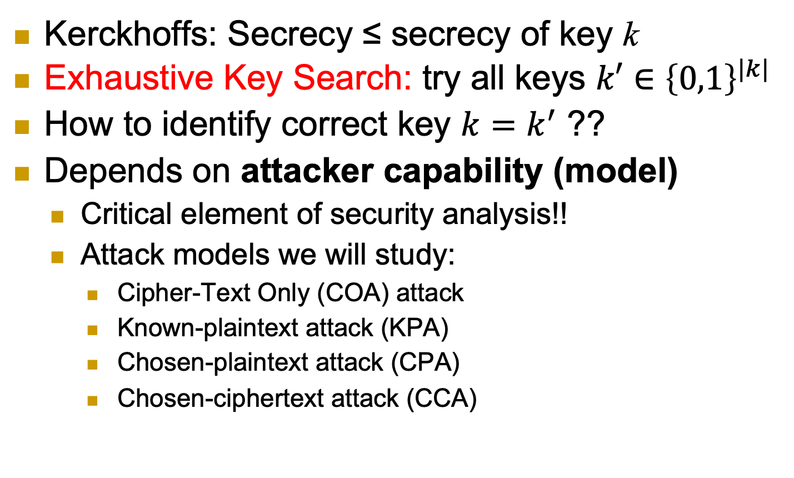
Exhaustive Key Search
Kerckhoffs: Secrecy ≤ secrecy of key k
Exhaustive Key Search: try all keys $k′∈{\left\{0,1\right\}}^{|k|}$
How to identify correct key $k=k^{′}$ ??
Depends on attacker capability (model)
Critical element of security analysis!!
Attack models we will study:
Cipher-Text Only (COA) attack
Known-plaintext attack (KPA)
Chosen-plaintext attack (CPA)
Chosen-ciphertext attack (CCA)
Notes:
28
10/30/11

Slide 29



Cipher-Text Only (COA) attack
Adversary have previous knowledge about all possible plaintexts, like their distribution.
Attacker’s goal is to infer info about the challenge plaintext m* beyond the initial info it has.
This is given only ciphertexts and the plaintext distribution
E_{k}
D_{k}
m*
c₁=E_{k}(m₁), c₂=E_{k}(m₂), … , c*=E_{k}(m*)
m1, m2,…
m_{1,} m_{2,}…
m*
Info about m* (beyond distribution)
a
Notes:
29
10/30/11

Slide 30
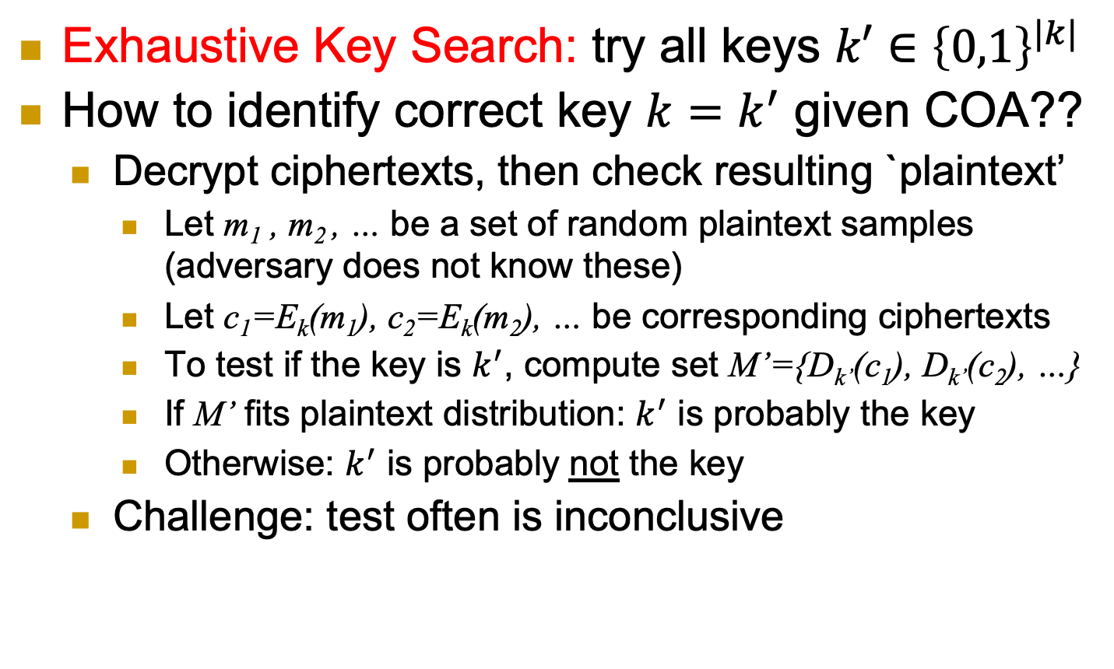
Exhaustive Key Search and COA
Exhaustive Key Search: try all keys $k′∈{\left\{0,1\right\}}^{|k|}$
How to identify correct key $k=k^{′}$ given COA??
Decrypt ciphertexts, then check resulting `plaintext’
Let m₁ , m₂ , … be a set of random plaintext samples (adversary does not know these)
Let c₁=E_{k}(m₁), c₂=E_{k}(m₂), … be corresponding ciphertexts
To test if the key is $k^{′}$, compute set M’={D_{k’}(c₁), D_{k’}(c₂), …}
If M’ fits plaintext distribution: $k^{′}$ is probably the key
Otherwise: $k^{′}$ is probably not the key
Challenge: test often is inconclusive
Notes:
30
10/30/11

Slide 31
Known Plaintext Attack (KPA)
Sample messages M={m₁, m₂,…} from a given distribution.
Give M and ciphertexts c₁=E_{k}(m₁), c₂ =E_{k}(m₂), … to the attacker who is trying to infer more info about the challenge.
E_{k}
D_{k}
m_{1,} m_{2,}…
c₁=E_{k}(m₁), c₂=E_{k}(m₂), … , c*=E_{k}(m*)
m*
Info about m* (beyond distribution)
a
Notes:
31
10/30/11

Slide 32
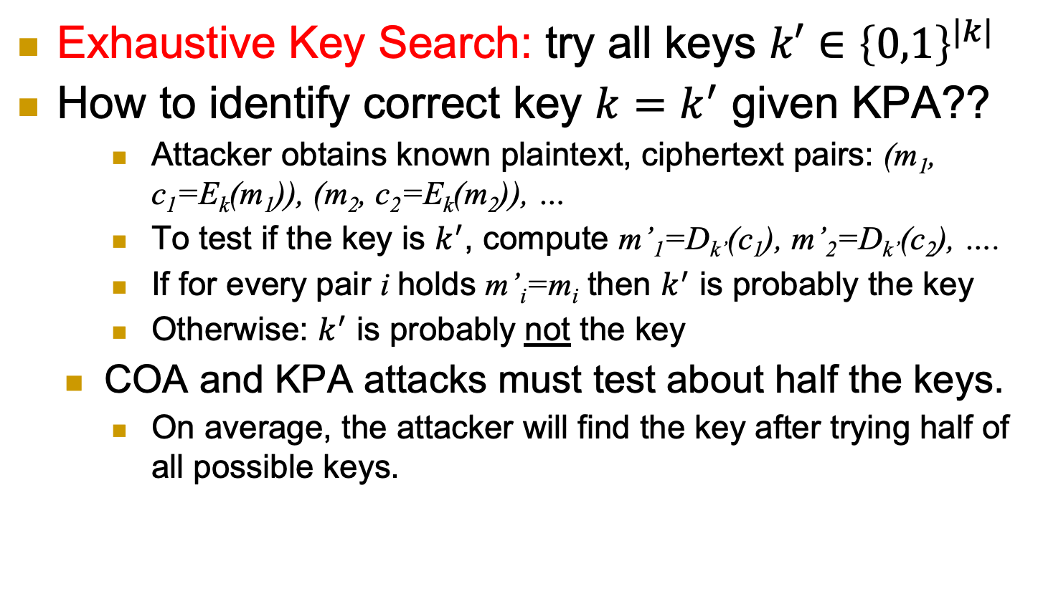
Exhaustive Key Search and KPA
Exhaustive Key Search: try all keys $k′∈{\left\{0,1\right\}}^{|k|}$
How to identify correct key $k=k^{′}$ given KPA??
Attacker obtains known plaintext, ciphertext pairs: (m₁, c₁=E_{k}(m₁)), (m₂, c₂=E_{k}(m₂)), …
To test if the key is $k^{′}$, compute m’₁=D_{k’}(c₁), m’₂=D_{k’}(c₂), ….
If for every pair i holds m’_{i}=m_{i} then $k^{′}$ is probably the key
Otherwise: $k^{′}$ is probably not the key
COA and KPA attacks must test about half the keys.
On average, the attacker will find the key after trying half of all possible keys.
a
Notes:
32
10/30/11

Slide 33
Chosen Plaintext Attack (CPA)
Beside the plaintext distribution/initial info, attacker can choose messages m₁, m₂,…
Give ciphertexts of these plaintext messages to the attacker who is trying to obtain more info about the challenge.
E_{k}
D_{k}
m_{1,} m_{2,}…
c₁=E_{k}(m₁), c₂=E_{k}(m₂), … , c*=E_{k}(m*)
m*
Info about m* (beyond distribution)
a
Notes:
33
10/30/11

Slide 34
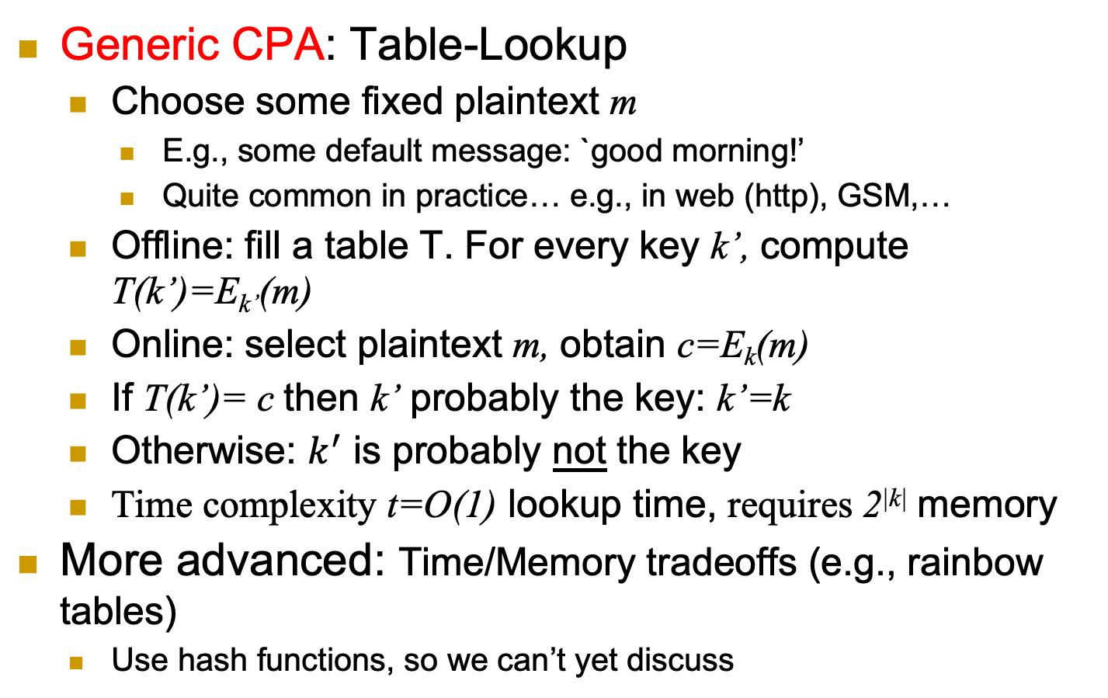
Exhaustive Key Search and CPA
Generic CPA: Table-Lookup
Choose some fixed plaintext m
E.g., some default message: `good morning!’
Quite common in practice… e.g., in web (http), GSM,…
Offline: fill a table T. For every key k’, compute T(k’)=E_{k’}(m)
Online: select plaintext m, obtain c=E_{k}(m)
If T(k’)= c then k’ probably the key: k’=k
Otherwise: $k^{′}$ is probably not the key
Time complexity t=O(1) lookup time, requires 2^{|k|} memory
More advanced: Time/Memory tradeoffs (e.g., rainbow tables)
Use hash functions, so we can’t yet discuss
a
As described here, this works only for deterministic encryption schemes!!
Notes:
34
10/30/11

Slide 35
Chosen Ciphertext Attack (CCA)
Beside being able to choose plaintexts and obtain their encryptions, attacker can select ciphertexts c₁, c₂,…, and receive decryptions (but not the challenge).
Again, attacker tries to infer more info about the challenge.
E_{k}
D_{k}
m*
c*=E_{k}(m*)
c₁, c₂ ,…
m₁=D_{k}(c₁), m₂=D_{k}(c₂), …
Info about m* (beyond distribution)
a
Notes:
35
10/30/11

Slide 36
The Attack Models Championship
We discussed several attack models:
COA, KPA, CPA, CCA
Model A is stronger than model B, if a cipher secure against A is also secure against B
Notation: A > B
Example: KPA > COA [why?]
KPA vs. CPA ?
KPA vs. CCA?
CPA vs. CCA ?

Slide 37
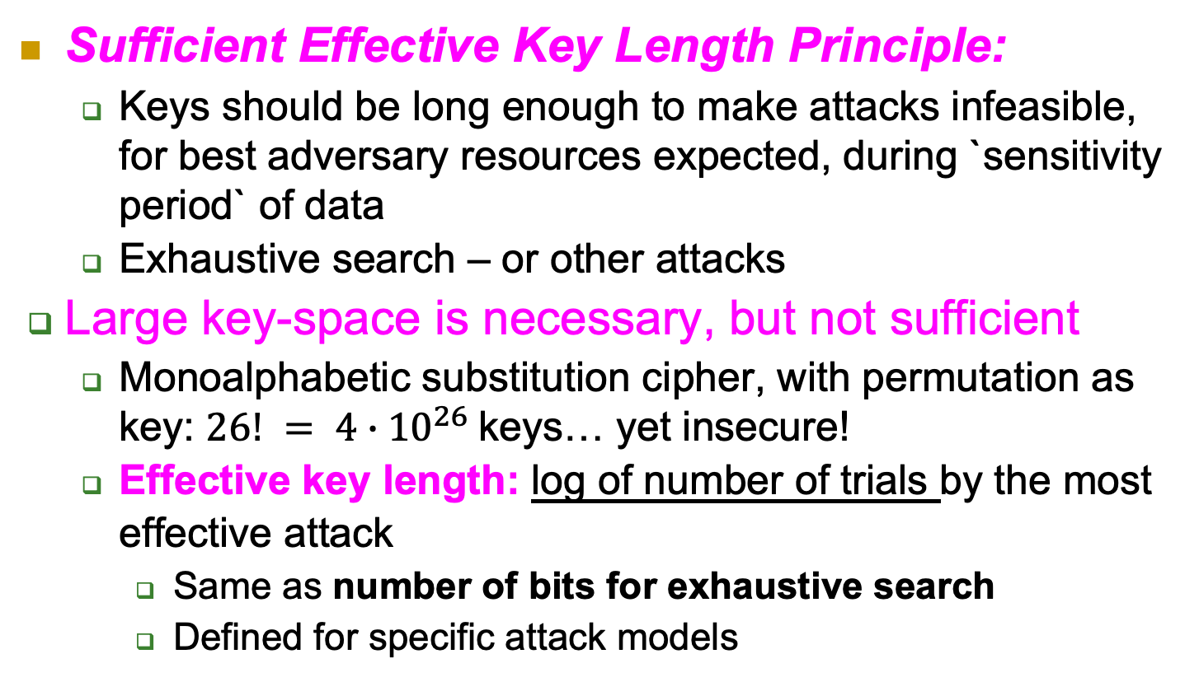
Sufficient Effective Key Length
Sufficient Effective Key Length Principle:
Keys should be long enough to make attacks infeasible, for best adversary resources expected, during `sensitivity period` of data
Exhaustive search – or other attacks
Large key-space is necessary, but not sufficient
Monoalphabetic substitution cipher, with permutation as key: $26! = 4∙{10}^{26}$keys… yet insecure!
Effective key length: log of number of trials by the most effective attack
Same as number of bits for exhaustive search
Defined for specific attack models

Slide 38
Covered Material From the Textbook
Chapter 2:
From the chapter beginning until the end of section 2.4 except:
Section 2.1.3,
Section 2.2.5,
Section 2.4.2,
Any ancient ciphers from 2.2.1 that we did not study in class,

Slide 39

Thank You!

